Slide 1
Contribution to the LHCb VELO
R. Dumps

Slide 2
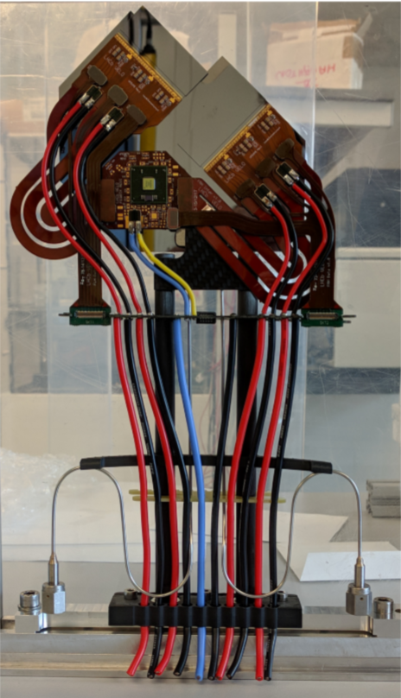
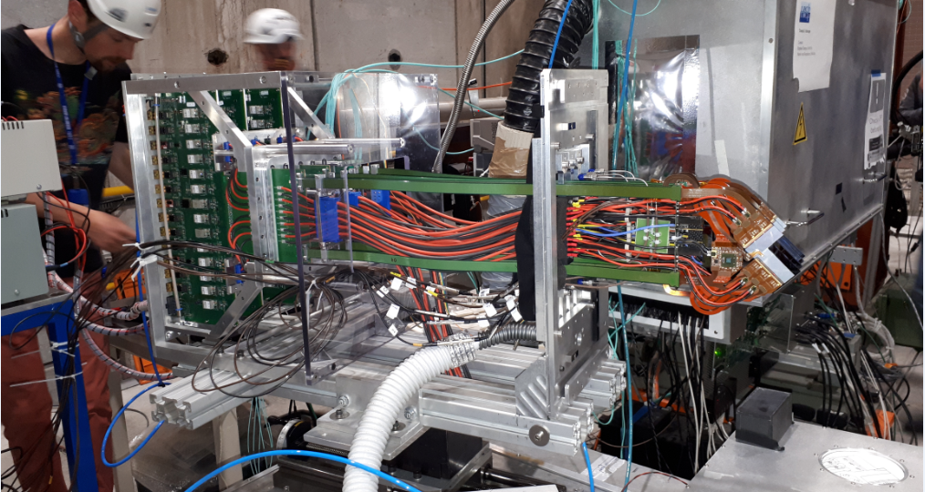


LHCb VELO 2018 achievements
Tiles
GBTx
Hybrids
Successful testbeam with three modules
Data cables
Low voltage cables
$CO_{2}$ output
Custom
connector
$CO_{2}$ input

Slide 3
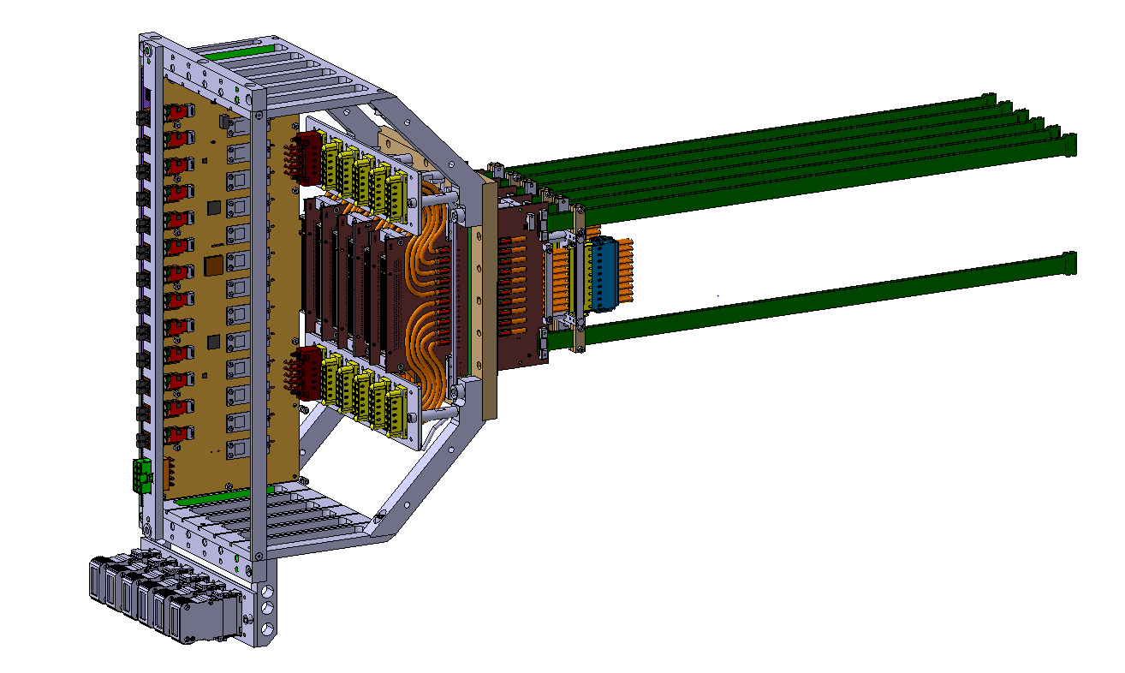
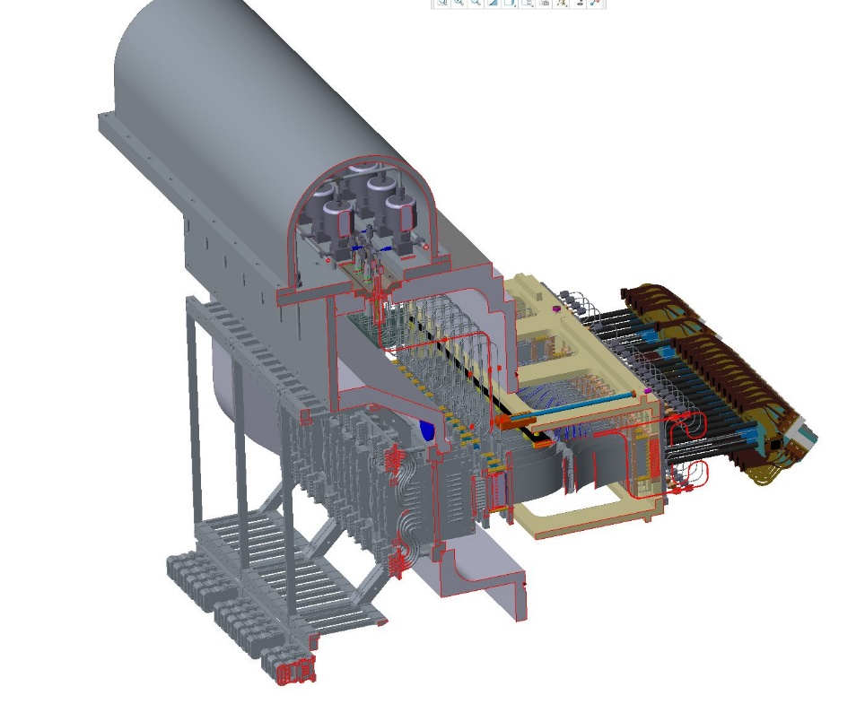
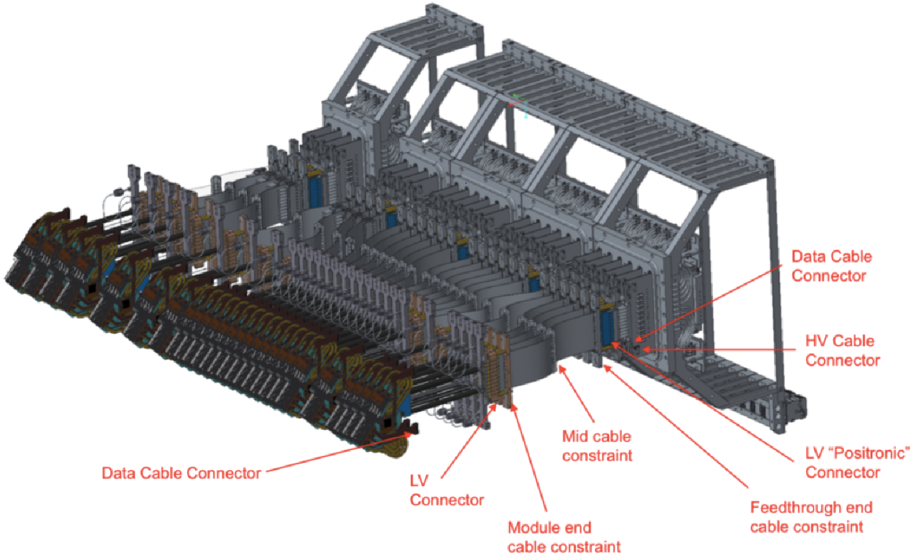
VELO Vacuum feedthroughs
They consist of different complex assembly parts in a tight area that will allow the powering and the readout system to go out of the secondary vacuum volume of the VELO detector
Design/ assembly and all mechanical parts are produced by EP/DT
Isolation vacuum
CO2 Safety system
Beam line
26 modules per side

Slide 4
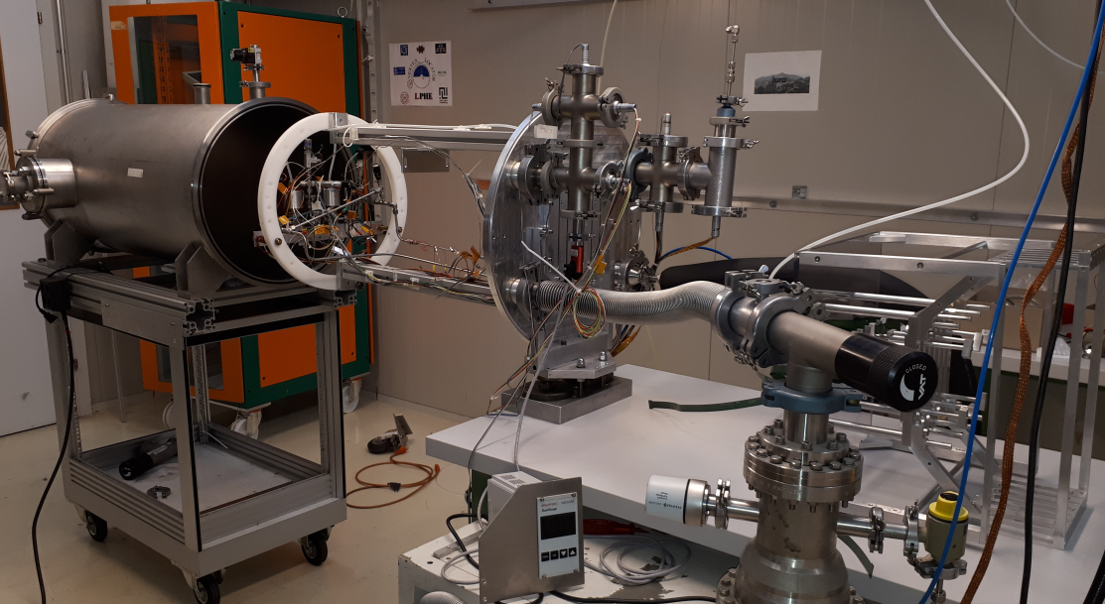
New mini VELO stand under construction (max. 2 modules in parallel)
- testing the full chain readout characterization using radioactive source (high speed rate) under vacuum at -25C.
- vacuum feedthrough quality control stand (electrical test , leak test)
- testing the well behaviour of the CO2 safety system.

Slide 5
Task for the coming 2 years on the VELO
Technical and engineering support to the VELO upgrade project.
continued technical advice for planning the 2020 VELO Upgrade installation and de-installation procedures. (mostly in the cavern)
helping students/fellows on hardware of the cooling system and the safety system, including the soldering of the connector to the micro channel substrates (production ongoing at CERN)
Participation and advice to the LHCb designer team for service integration: cables, vacuum, cooling pipes, detectors installation, etc.
launch the mass production in situ of the Vacuum feedthrough board including required test (3-4 months)
completed the new Mini VELO testing readout chain stand (1month)
Resources: 0.85 FTE of Raphael Dumps

Slide 6
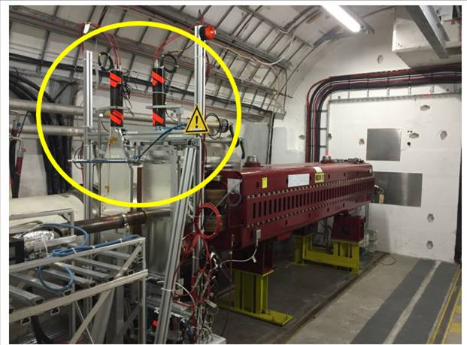
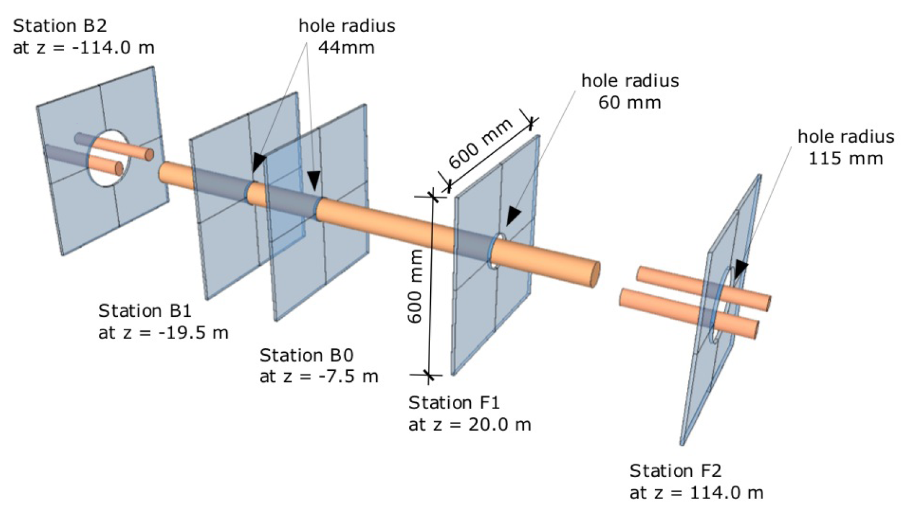
Project: LHCb HERSHEL
- partial dismantlement of 5 stations (magnet survey) (1week)
- rebuilt 20 scintillators for LS2 under discussion ? (1-2month)
- reintallation of the 5 stations including the test required ( 1month)
IP8

Slide 7
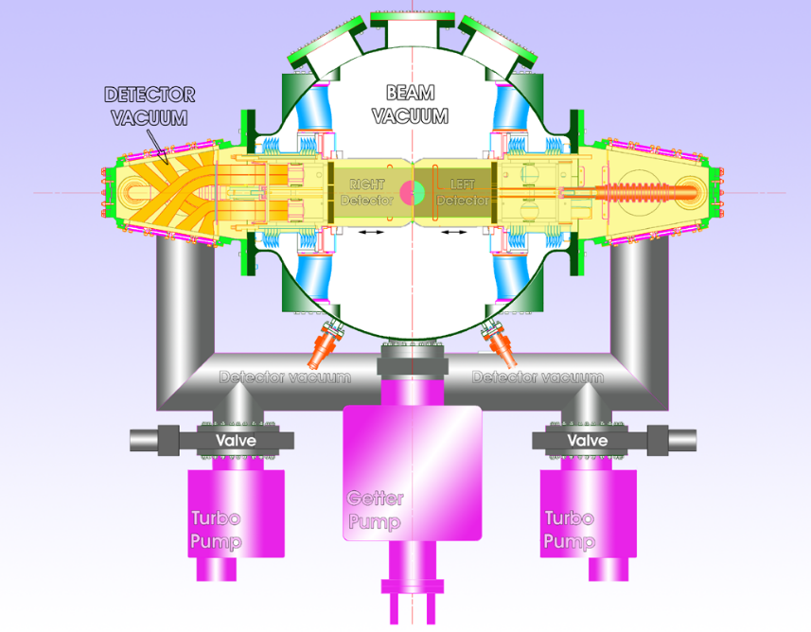
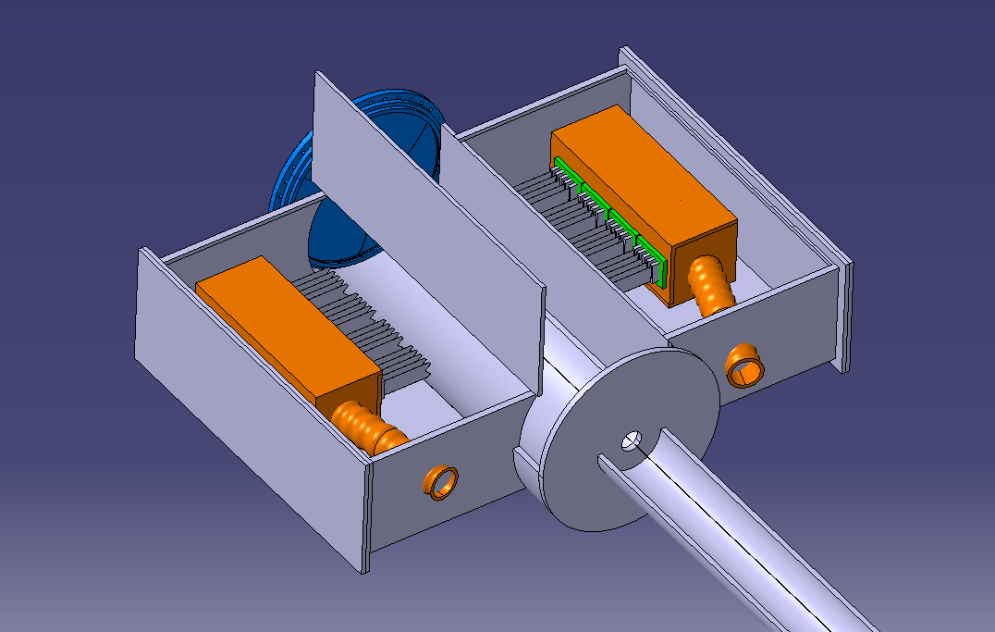
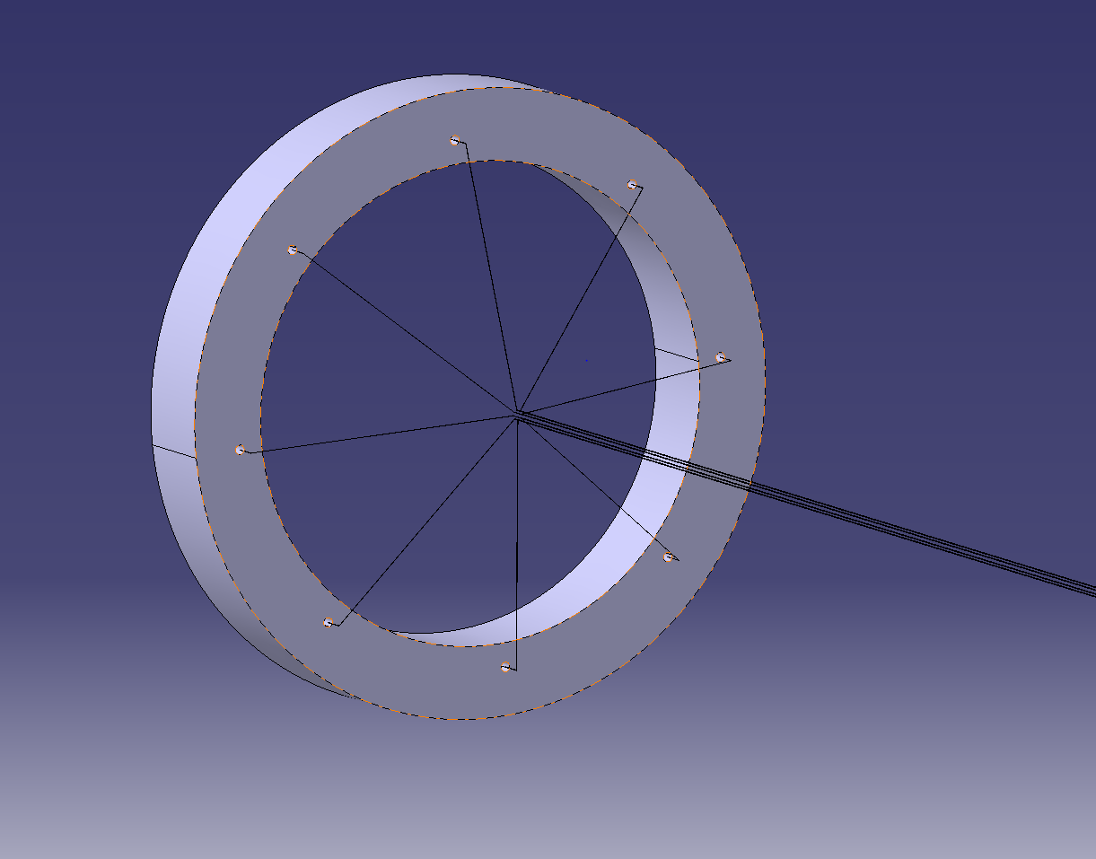
Project: LHCb VELO 2030 run5
.
Very high radiation level
Easy replaceable detector
Remove the foil
Wires instead of RF-foil ?
The wires should move out during beams injection !

