Slide 1
Overview of DT – LHCb RICH (and TORCH) activities
EP/DT Coordination Meeting
CERN
28th November 2018
Thierry Gys
CERN EP/DT-TP

Slide 2
Main activities
Current LHCb-RICH maintenance and operation
  Follow-up of HPD reprocessing
    Last HPD reprocessing campaign completed in November 2017
  Replacement of vacuum-degraded HPDs
    Last maintenance performed in February 2018
  Punctual interventions (eg HV, L0, LV, cooling)
  (E)YETS activities
Support for and follow-up of forthcoming (partial) dismantling of RICHes
  In particular HPD planes and related aspects

Slide 3
Main activities (cont’d 1)
LHCb-RICH upgrade
  Support for and follow-up of laboratory activities, MaPMT system tests and development
    Including related laboratory space renovation and management
  Support of beam test activities
    Last beam test campaign successfully completed in October 2018
  Support for and follow-up of commissioning and installation activities
    Including commissioning, storage and installation of MaPMT columns

Slide 4
Main activities (cont’d 2)
TORCH
  Support for and follow-up of laboratory activities
  Organization, management and support of beam test activities
    Last two beam test campaigns successfully completed in June (mini-TORCH) & October/November (proto-TORCH) 2018
  Organization and management of regular TORCH internal meetings

Slide 5
DT personnel and infrastructure involved
DT personnel
  1 senior applied physicist (TG)
  1 technician (DP)
DT infrastructure
  Laboratory space:
    B 16
    B 17
    B 153
    B 169
  Workshop
    B 162

Slide 6
LHCb-RICH upgrade Nov. ‘18 beam tests – Cherenkov ring from a radiator lens detected with MaPMTs
https://indico.cern.ch/event/774892/contributions/3220418/attachments/1756990/2848983/RICHupgradeTB18.pdf

Slide 7
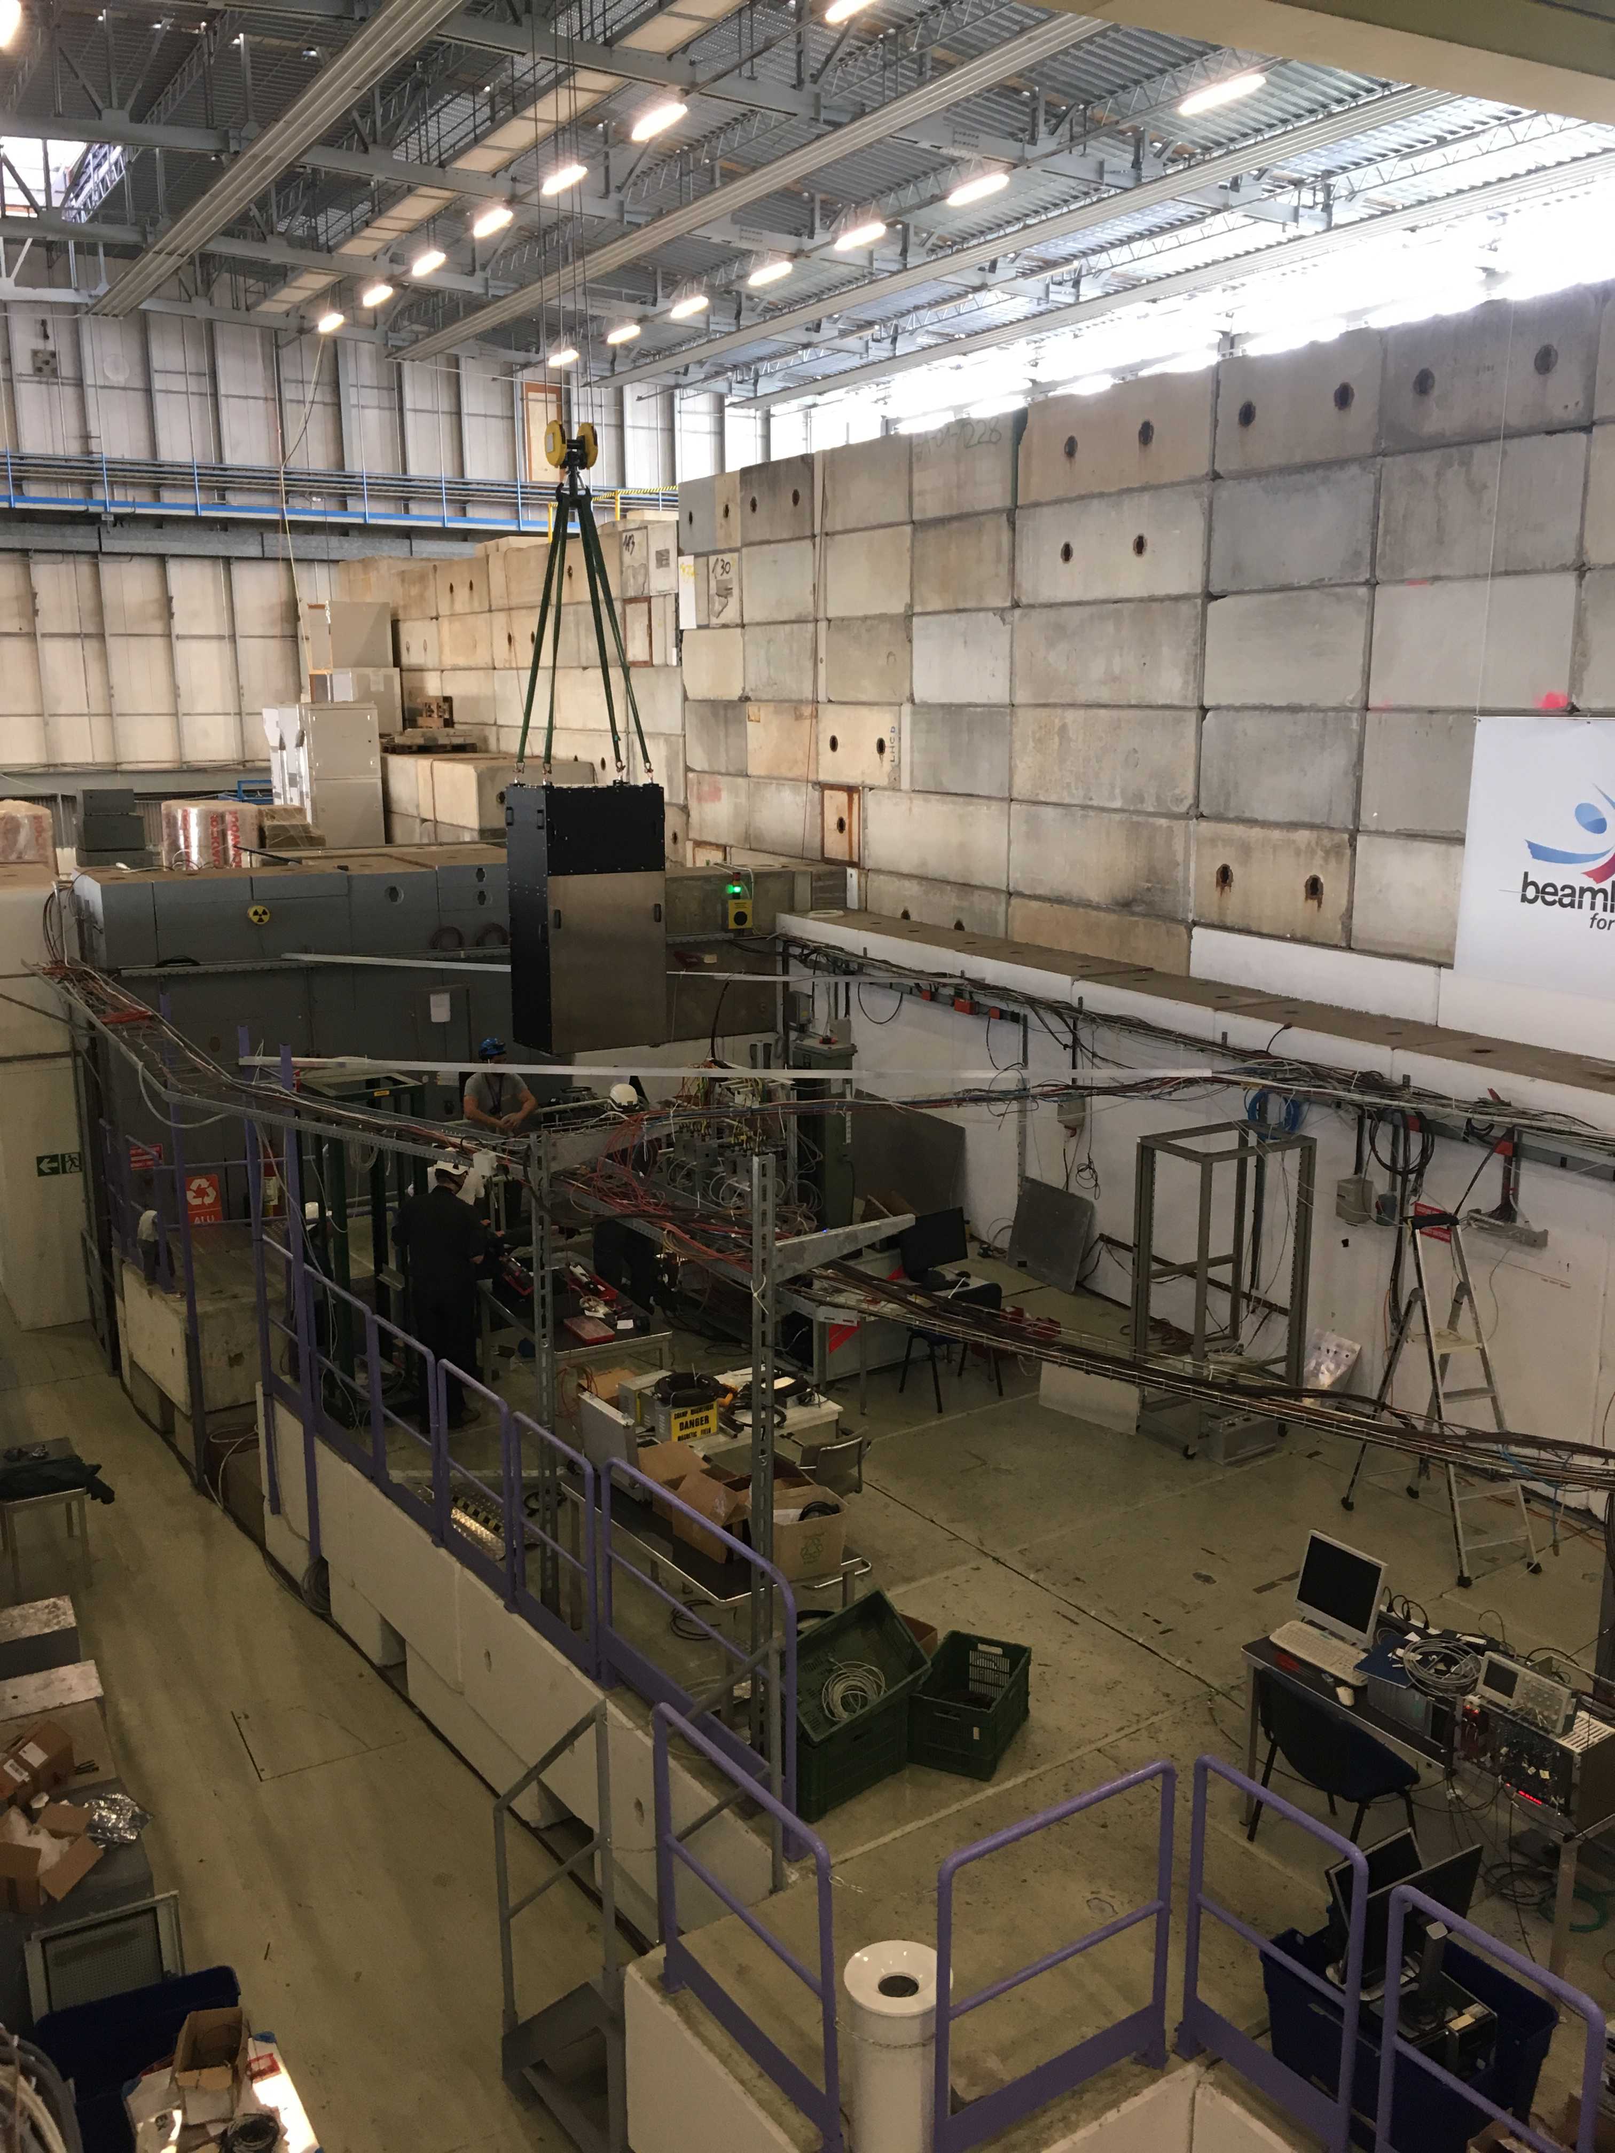
TORCH beam tests – (new) infrastructure and TORCH patterns
Installation of proto-TORCH (full-scale radiator module) in PS/T9
TORCH patterns from full module detected with 2 MCP-PMTs
https://indico.cern.ch/event/714247/contributions/2934857/subcontributions/251790/attachments/1749167/2833409/Testbeam_summary_081118.pdf

