Slide 1
TFG works for LHCb RICH1 upgrade
Double sided AR coating on 6 big exit Quartz windows: Preparation of coater /test coating/QC of windows and witness samples (Nov/Dec 2018). 12 coatings foreseen mid January to mid March.
Enhanced reflective coating of 4 Composite Substrates: Preparation of coater with modified mechanics (mid March to mid April). Test coatings and real coatings (1 per week) following ( mid April to end June)
Enhanced reflective coating on 20 Glass substrates: Test coatings starting end of August. End of coating campaign end November 2019
Workpackage summarizing the task and deliverables to be finalized (URGENT!)
Resources: 12 to 15 FTE months of TFG lab are foreseen in 2019 for the above tasks.
Workload equally shared between Th. Schneider, M. van Stenis and J. Noel

Slide 2
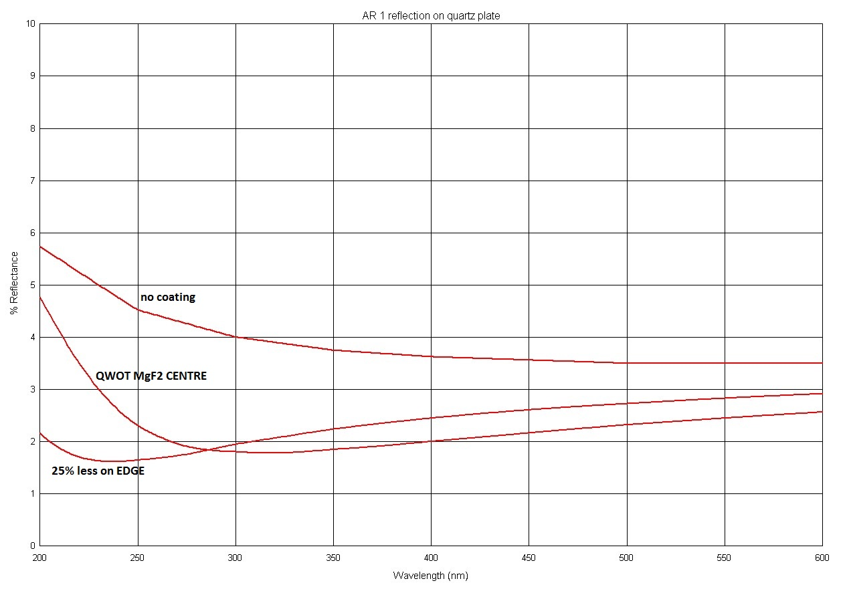
AR coating of 6 Quartz windows
Simulation for a QWOT coating with MgF2 on quartz shows about 2% gain @300nm ( 1% @500nm) per interface.
Test coating of MgF2 coating on quartz witness samples foreseen for December. Transmission scan with spectrometer needed to confirm simulation.
Mechanical fixation frame for quartz windows on top of the coater will be provided by Oxford. Foreseen delivery January 2019
QC of quartz witness samples planned in the TFG lab in collaboration with Ahmed of the CERN metrology service. (Transmission, 60/40 Dig scratch and Rrms of 2-4nm)
Big window delivery foreseen End November. Quality acceptance checks will be performed by the RICH1 collaboration in the TFG lab (Microscope).
Handling and tooling boxes (old RICH2) will be modification by TFG staff.

Slide 3
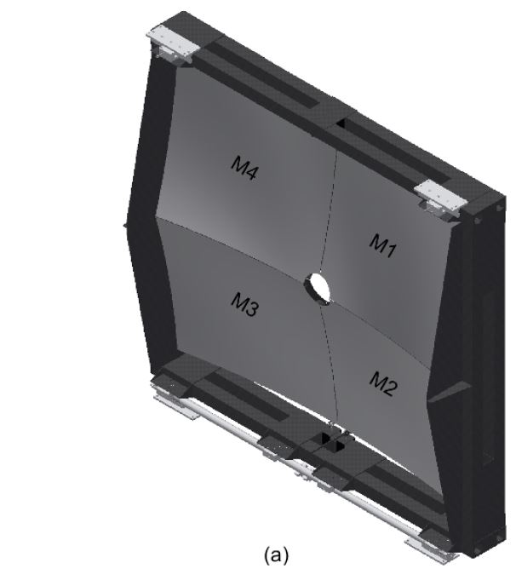
Witness samples have arrived in the TFG lab. First surface quality test TFG staff in collaboration of metrology service gave promising results: Rrms 1.8nm
Diagonal of composite substrates (envelope for rotation 993mm) exceeds the limit of our today coating mechanics. Design of a new adopted mechanics is on the way and has to be produces early 2019 (TFG responsibility)
Once we receive the big composite substrates a final pumping cycle reaching 10-7 mbar has to be performed. Outgassing of the structure might lead to long pumping time (days?)
Delivery of composite substrates is foreseen for January 2019.
LHCb RICH1 collaboration will take care for the delivery acceptance quality checks.
For the coating campaign (April –June) no spare has been foreseen. In case of coating failure the company will recover the concerned substrate (1 month lead time)
Reflective coating of 4 composite substrates

Slide 4
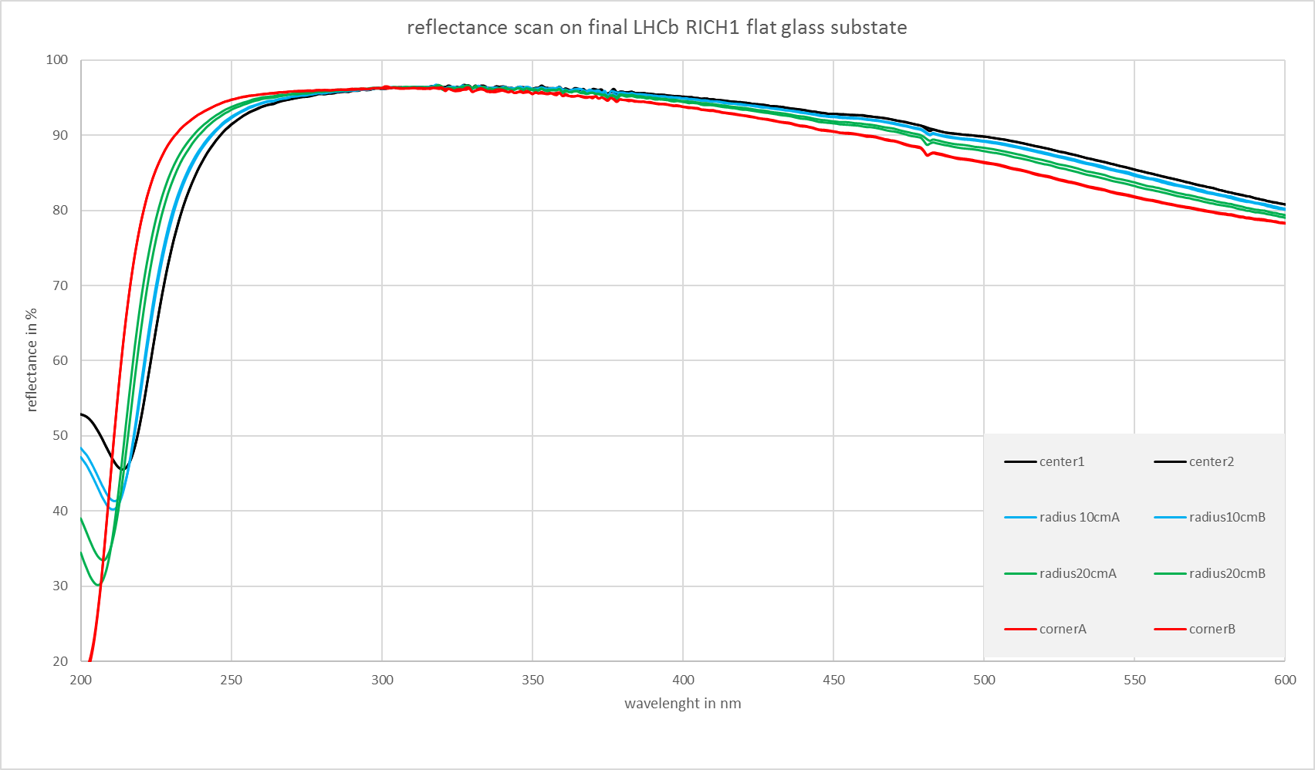
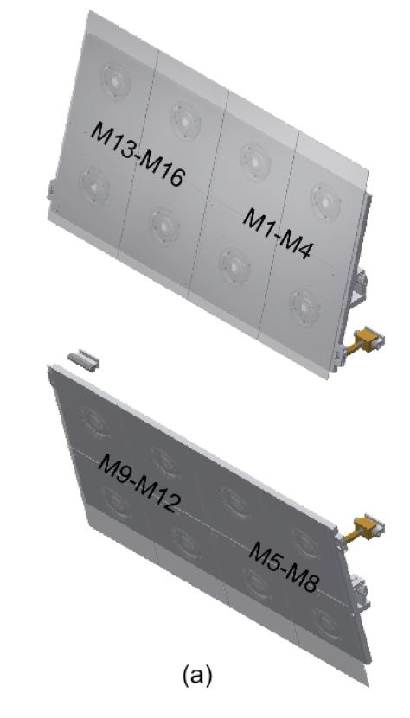
Reflective coating of flat glass substrates
TFG lab has developed an enhanced reflective coating recipe for the flat and spherical mirrors in 2016/17:
Adherence layer: Chrome
Reflective layer: Aluminium
(Flash evaporation with thermal source)
Dielectric layers couple: SiO2 and HfO2 using electron gun
(enhancement and protective layer)
LHCb RICH1 requirements of reflectivity >90% in the range of 250 to 450nm has been demonstrated.
Delivery of 20 flat mirrors (4 spare) is scheduled for end August 2019 (to be confirmed by the chosen company)

