Slide 1
DT Contribution to the
Muon System upgrade
Burkhard Schmidt
November 28, 2018

Slide 2
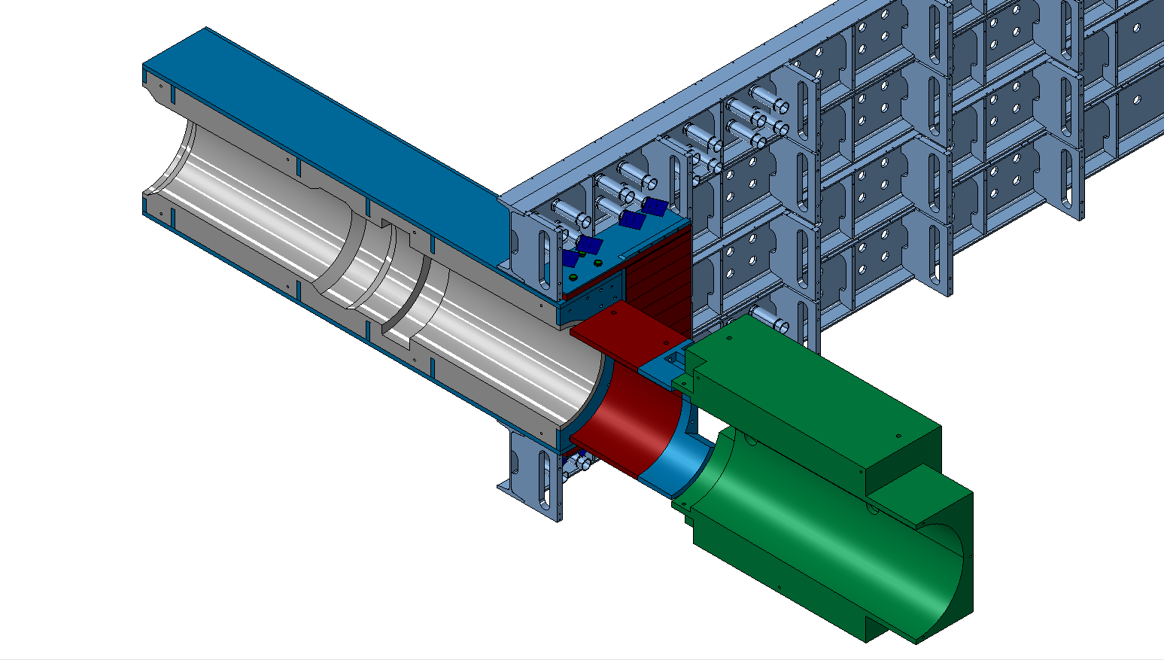
Improved shielding behind HCAL
Goal: Improve the shielding in front of M2 to reduce the expected rate in the hottest M2 region by about 50%.
This shielding consists of three parts:
  A new HCAL beam-plug made of lead in a steal carcass; this plug will have a similar design with respect to the present one, but with a smaller clearance (1cm) to the beam pipe in the part facing M2.
  An additional shielding made of tungsten in the position of the PMTs of the innermost HCAL cells .
  An improved M2 plug, of identical dimensions with respect to the present one, but partially made of lead
Additional shielding
behind HCAL
New HCAL beam-plug
New M2 beam plug

Slide 3
Additional shielding: Next steps
old design
The ECR for the HCAL beam-plug has been completed
The price enquiry for the all the additional shielding has been completed
The orders for the lead parts will be placed in November; the tungsten part in December.
Delivery expected 8 weeks after the order is placed.
Installation in LHCb is scheduled for early 2020 in the overall installation schedule.
3.
2cm
1cm
new design
Resources: 0.2 FTE (M. Galka and B. Schmidt in 2019)
0.1 FTE in total during LS2

