Slide 1


Magnet Control System
EP-DT-DI CONTRIBUTION

Slide 2
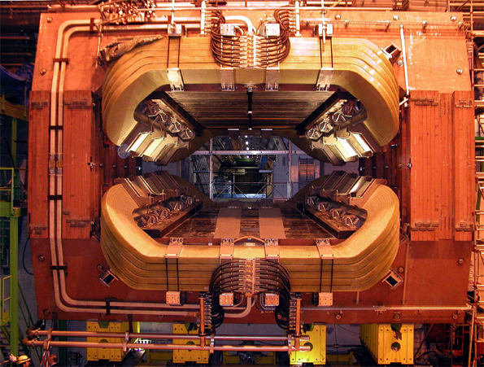
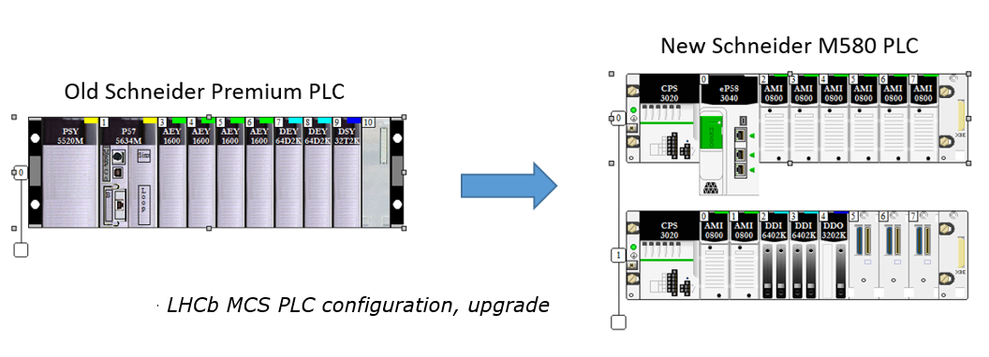
Magnet Control System
WP: https://edms.cern.ch/document/1561470/2
EP-DT-DI: Nicolas Bourgeois,
In addition to the regular preventive maintenance actions performed by the DT-DI experts in the framework of the workpackage, including the ‘PIQUET’ service for the magnet and Detector Safety System (DSS).
A major update will be implemented in the Magnet Control System by replacing the old Schneider Premium PLC, declared obsolete by the manufacturer by the new Schneider M580 PLC. The cost of this upgrade has been evaluated up to 16 kCHF
This implies the adaptation of the hardware signals to the new PLC as well the software upgrade and at the end full recommissioning.
LHCb MAGNET

Slide 3
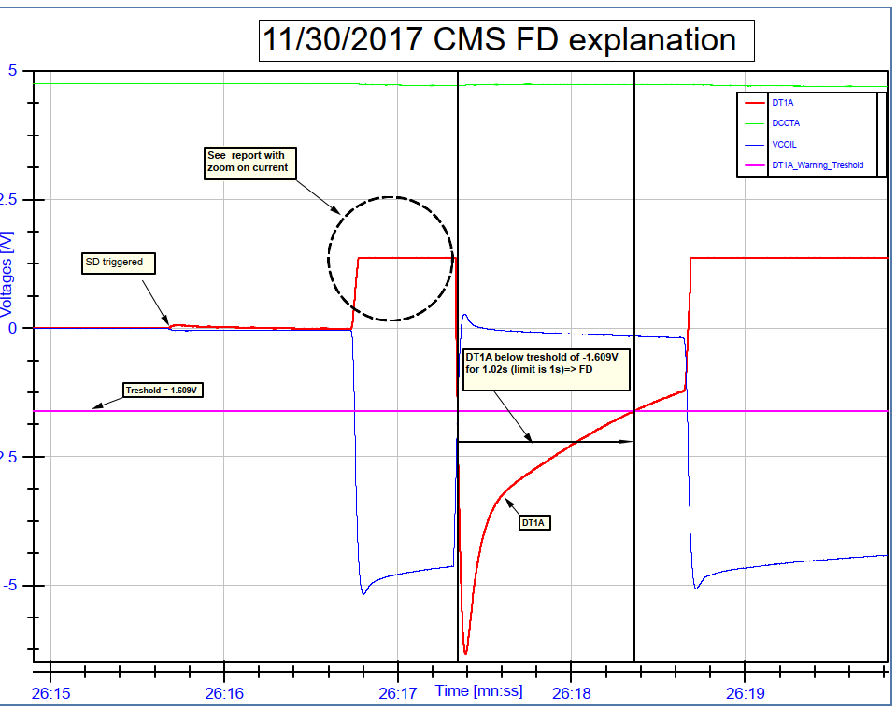
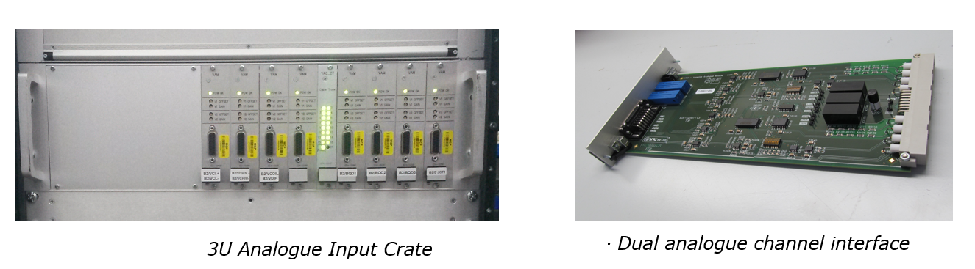
Triggered by an unclear BEAM_DUMP/Failure generated by the power converter of the LHCb magnet during the last run.
The LHCb and DT-DI magnet expert requested the possibility of a Magnet Safety System (MSS) modification including analogue signal readings from the magnet into the fast acquisition diagnostics. The cost of the modification is evaluated to 8.5 kCHF.
LHCb is still evaluating whether to do this upgrade.
This implies the installation of a MSS analogue crate with Analogue Input Module, software reprogramming and full recommissioning of the System
CMS MSS fastacq logfile
MSS

