Slide 1



Welcome
OMA Advanced School on
Medical Accelerators and Particle Therapy
Samantha J. Colosimo
University of Liverpool / Cockcroft Institute

Slide 2
Optimisation of Medical Accelerators
Funding from the European Union’s Horizon 2020.
15 Marie Curie Fellows
4 years; started in Feb 2016
Gives industry an important role in training the next generation of scientists.
Allows for organizing a number of events.
Recognized importance of R&D at interface between physics and life sciences at European level.

Slide 3



Research Overview
Develop beyond state-of-the-art detector and imaging systems for particle therapy; improve patient treatment and facility performance
Work Packages:
Facility Design and Optimisation
Beam Imaging and Diagnostics
Treatment Optimisation
Notes:
Develop beyond state-of-the-art detector and imaging systems for particle therapy; improve patient treatment and facility performance using these 3 main work packages, including : Facilty design optimisation, beam imaging and diagnostics and treatment optimisation. Each Fellow works with research focusing on one of these major areas.

Slide 4













Beneficiaries
Notes:
The network consists of an international consortium of more than 35 partner organisations; universities, research centres and private companies, including main beneficiaries and adjunct partners.

Slide 5
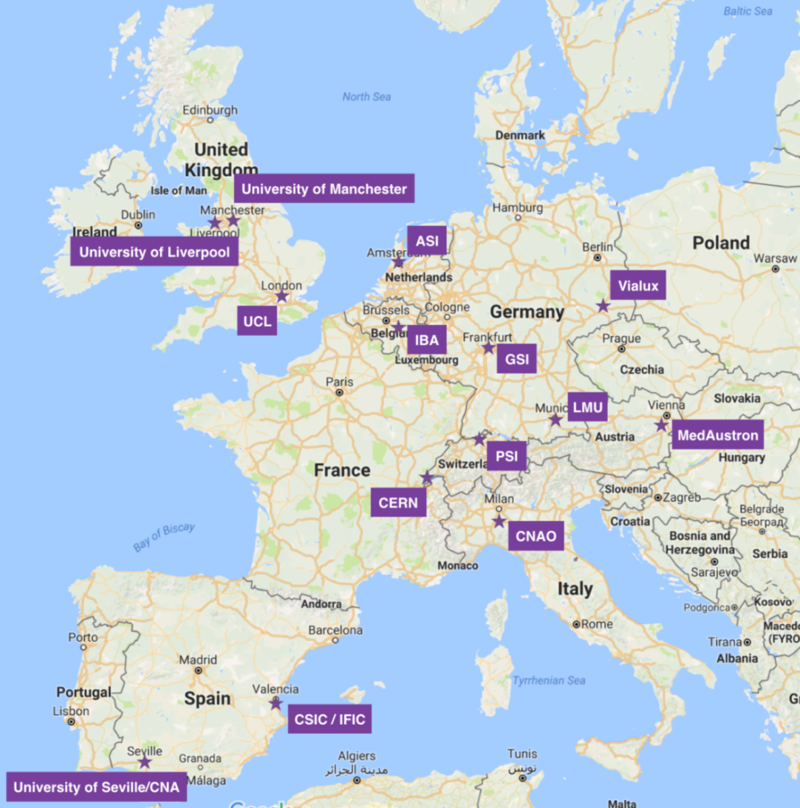
Overview
Notes:
The network is based across Europe at all institutions in 8 countries

Slide 6
Notes:
There are also additional Adjunct Partner Organisation which allows for collaboration and the opportunity for secondments for OMA Fellows.

Slide 7


Slide 8
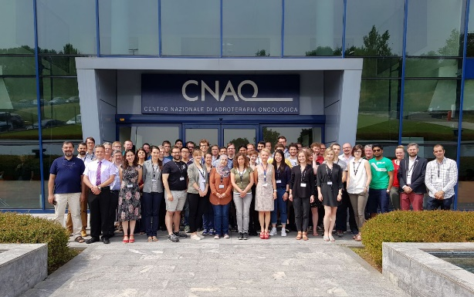
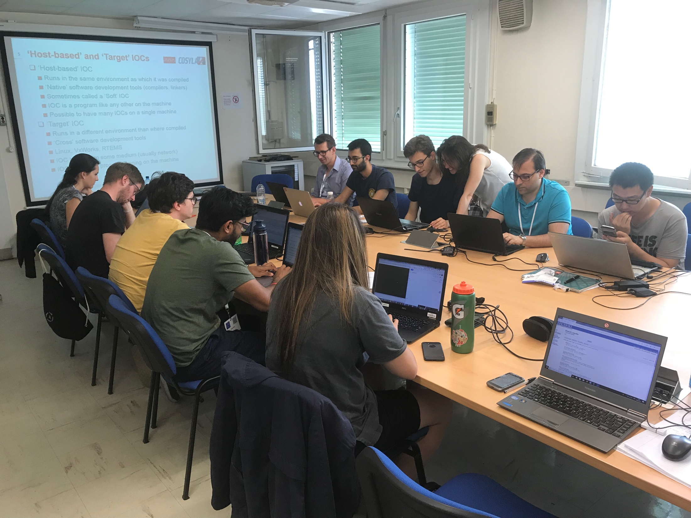
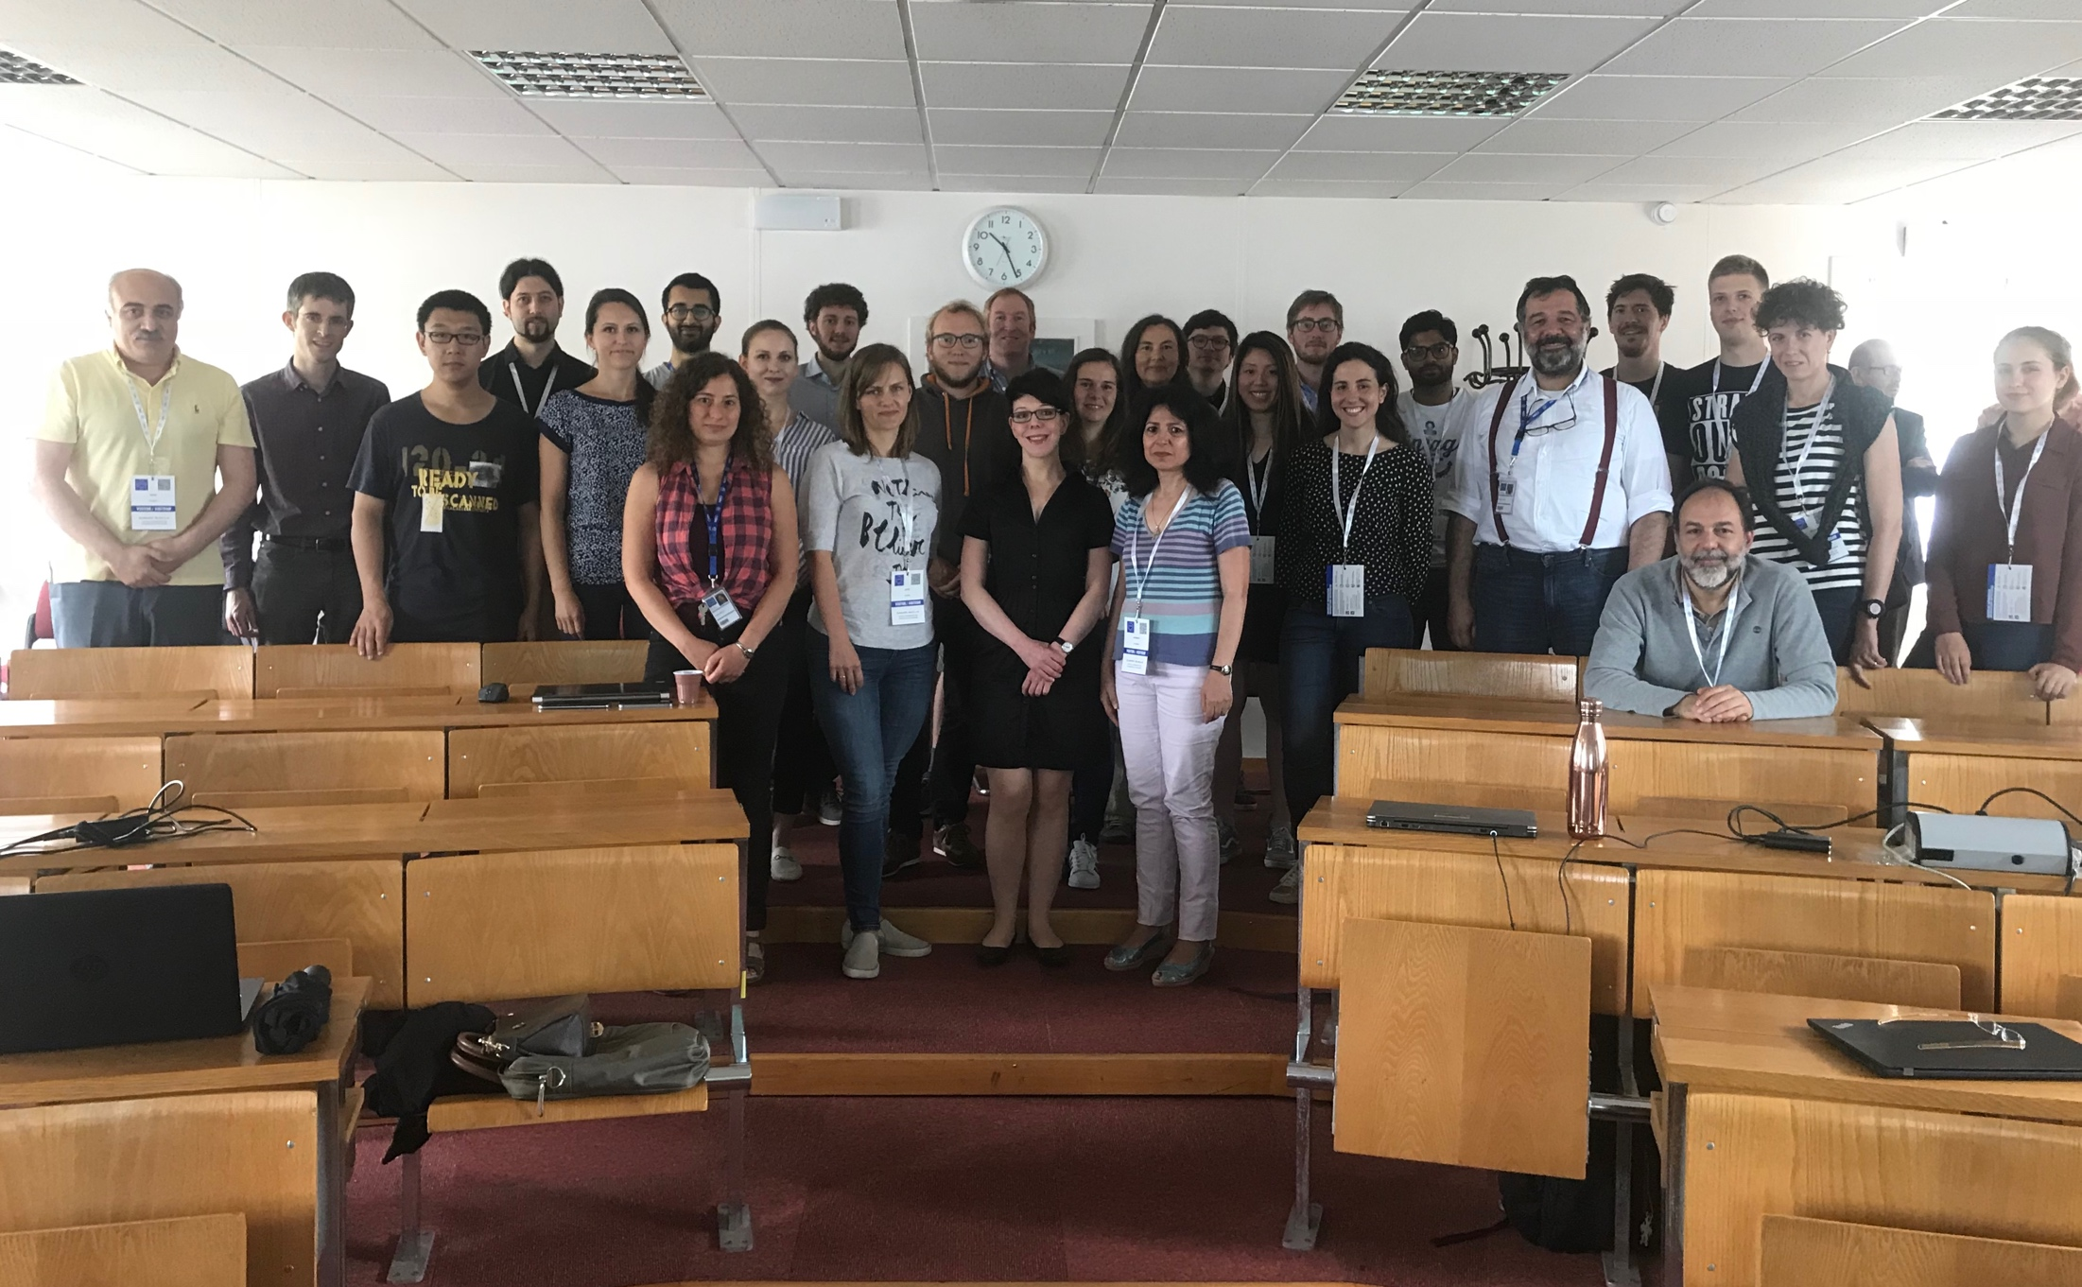
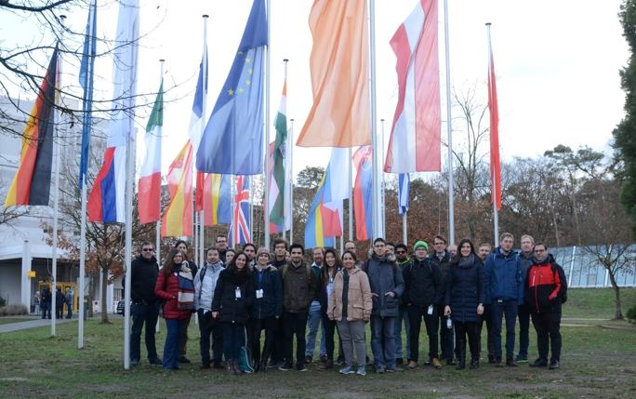
OMA Events
International Schools on research skills, medical accelerators and Monte Carlo simulations;
Topical Workshops on focused research work packages;
Symposium and Conference to present project results.
Notes:
The OMA network organises a large number of events including International Schools, Topical Workshops which combine work packages, and a final conference and symposium

Slide 9
Upcoming OMA Events
Advanced Researcher Skills Workshop
  Program will develop career skills for academia and industry
  University of Liverpool, Liverpool, 24-27th June 2019
Accelerators for Science and Society Symposium
  Outreach to 300 high school students
  Liverpool, 28th June 2019
International Conference on Medical Accelerators and Particle Therapy
  US/CNA, Seville, 4th-6th September 2019

Slide 10
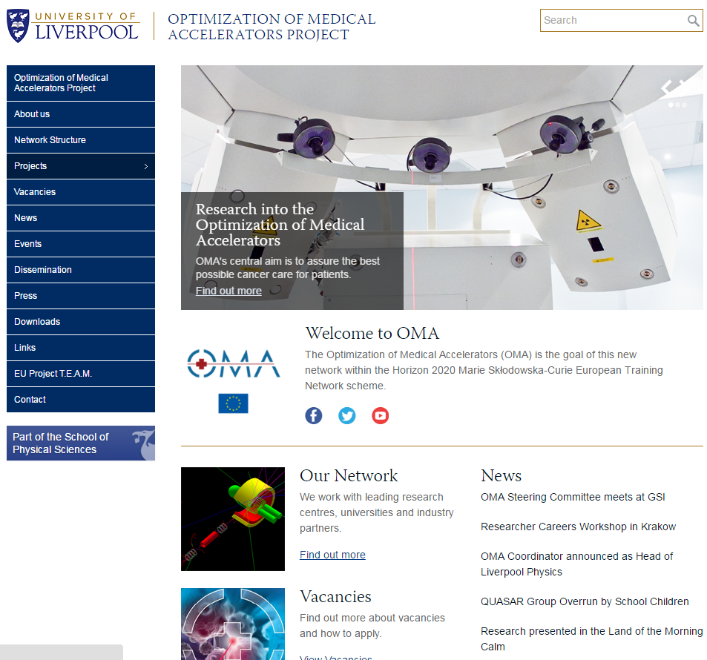

Project Website
(http://www.) oma-project.eu

Slide 11
Welcome
OMA Advanced School on
Medical Accelerators and Particle Therapy
Samantha J. Colosimo
University of Liverpool / Cockcroft Institute

Slide 12
Advanced School on
Medical Accelerators and Particle Therapy
Lecture Topics
 | Wednesday
 | Relative Biological Effectiveness comparison and impact analysis
Monday | Treatment planning I : How to identify best dose distribution,
State of the art medical treatment modalities, challenges and future trends | Treatment planning II: How to Deliver Specific Dose
Diagnostics for medical accelerators | Real-time In-Vivo Dosimetry and Range Verification
Radiobiology in a research or lab environment
Radiobiology for real patients | Thursday
 | MR-guided p-therapy
Tuesday | 4D motion manage
Dosimetry and related detector R&D | Treatment Planning via NTCP Models
Monte Carlo simulations into cell physics | Seminar: Novel Accelerators
Ion beam imaging (Proton CT)
Machine QA | Friday
Medical imaging techniques | Improving range accuracy in particle therapy
 | Strategies for patient specific QA pre-treatment
 | Treatment workflow - hospital expert perspective
Notes:
TW on ‘Accelerator Design & Diagnostics’ will look into the efficient integration of the devices developed in WP2 into the facilities, beam lines and gantries from WP4.

Slide 13
Practical information
Monday 01/04/2019, TU Vienna | Tuesday 02/04/2019, TU Vienna | Wednesday 03/04/2019, TFZ | Thursday 04/04/2019, TU Vienna | Friday 05/04/2019, TU Vienna
9:30 - School 10:30 – Coffee 11:00 – School 13:00 – Lunch 14:30 – School 16:30 – Coffee 18:00 – Finish | 8:30 - School 10:30 – Coffee 11:00 – School 13:00 – Lunch 14:30 – School 16:30 – Finish 19:00 - Public Talk | 7:30 – Bus Transfer 8:30 - School 10:30 – Coffee 11:00 – School 13:00 – Lunch 14:30 – Tour 17:15 – Bus Transfer | 8:30 - School 10:30 – Coffee 11:00 – School 13:00 – Lunch 14:30 – School 16:30 – Coffee 18:00 – Finish 20:30 – Formal Dinner | 8:30 - School 10:30 – Coffee 11:00 – School 13:00 - Finish

Slide 14
Practical information
Tuesday 2nd April: Public Lecture
19:00, Audimax TU Wien

Slide 15
Practical information
Wednesday 3rd April: Visit to MedAustron
TFZ Wiener Neustadt
Viktor Kaplan Strasse 2,
2700 Wiener Neustadt, Austria
7:30 Bus Transfer from Parking Bay Karlsplatz (Friedrichstrasse 12, 1010 Vienna) to TFZ Wiener Neustadt
9:00 - 15:00 School
Coffee and Lunch at Café Bistro Laborie
15:00: Radiation Protection Instruction by Lukas Jägerhofer at TFZ
15:15 – 17:00 Participants divided into groups of 20 for guided tour of MedAustron
17:00 Bus Transfer to Vienna

Slide 16
Practical information
Thursday 3rd April: Formal Dinner
20:30
Hotel Stefanie
Taborstraße 12, 1020 Wien
** Dress code smart

Slide 17
Practical information
Lunch: TU Wien Mensa
  Obtain voucher from registration.
  Each day: soup, main and side, drink.
Thursday 3rd April: Poster Session
  14:30 – 16:30, First Floor Foyer
Local support:
  Samantha Colosimo: s.colosimo@liverpool.ac.uk, +44 7791941666
  Andrea De Franco: +43 664 80878868

