Slide 1
MedAustron: From Concept to the Future…
Claus Schmitzer
Notes:
#

Slide 2
WHO
we are
  A centre for ion therapy for cancer treatment and for research.
  Our facility is unique in Austria and worldwide, there are only a few comparable centres.

Slide 3
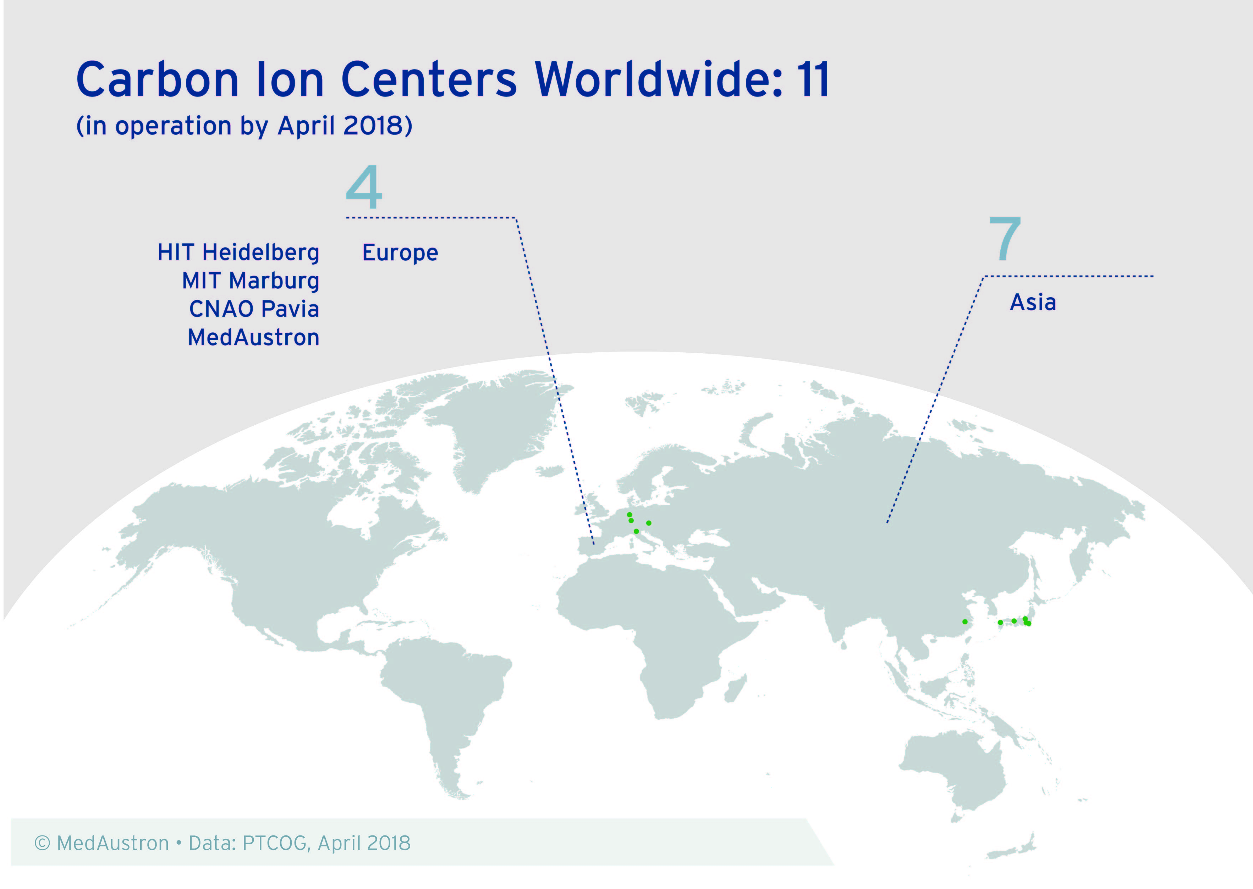
Notes:
11 centers world wide
6 using protons and carbon ions

Slide 4
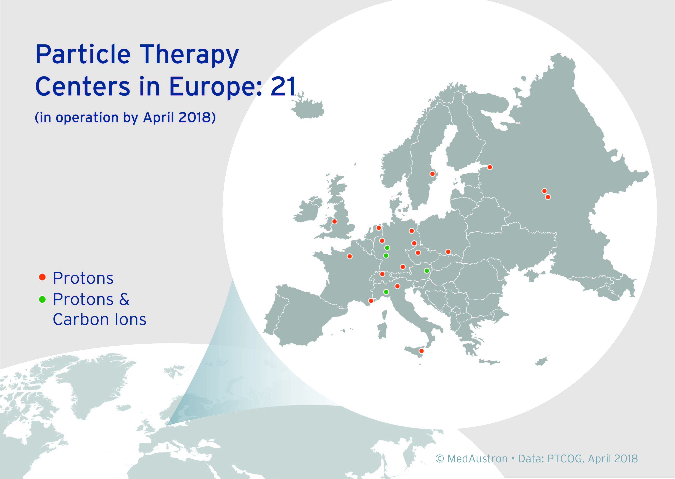

Slide 5
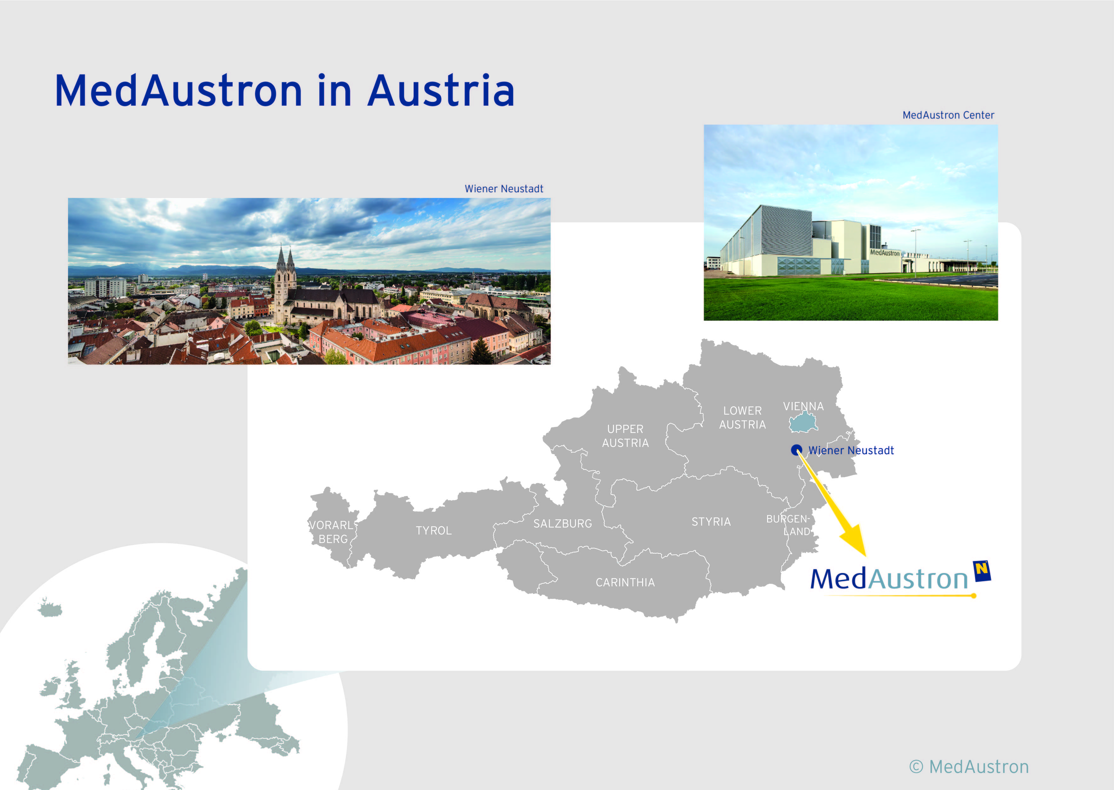

Slide 6

OWNERSHIP STRUCTURE
  Federal State of
  Lower Austria
  100 %
  Holding structure
  EBG MedAustron GmbH

Slide 7
OWNERSHIP STRUCTURE
  Our main task is the operation of the facility as an outpatient clinic.
  Treatment of up to 1000 patients/year in full operation from Austria and foreign countries.
  We focus on the further development of this treatment method and the technology behind.
  Our facility is used for basic and translational research.
  »EBG« stands for construction and operating company.
  Federal State of
  Lower Austria
  100 %
  Holding structure
  EBG MedAustron GmbH

Slide 8
FINANCING STRUCTURE
  Investment: 200 MEUR
  Financing:
  State of Austria:
    41 MEUR (for research part)
  Federal state of Lower Austria:
    32 MEUR of equity capital
    3.7 MEUR (for research part)
    220 MEUR of liabilities
  City of Wiener Neustadt:
    1.9 MEUR (for research part)
    3.2 ha estate
  Reimbursement contract with health insurance system in Austria:
    List of indications (sarcoma, adenoid-cystic carcinoma, pediatric tumors, meningeoma,…)
  Pricing for domestic patients (depending on tumor type): 36.000 € to 50.000 € (VAT incl.)

Slide 9






From concept to clinical operation
  From first initiatives to first patient treatment - almost 30 years of history
  Reorientation towards an ion therapy center
  -> MedAustron
  Company
  foundation
  First patient treatment
  1989 – 1994
  1989
  1995
  2005
  2012
  2007
  2016
  „AUSTRON“ feasibility study (research facility for neutron spallation source)
  Signing of basic agreement on realisation:
  Rep. of Austria,
  Fed. State of Lower Austria,
  City of Wr. Neustadt
  Completion of building

Slide 10


From concept to clinical operation
  Reorientation towards an ion therapy center
  -> MedAustron
  Company foundation
  „MedAustron“ feasibility study
  „MedAustron“ design study
  1989 – 1994
  1996 - 2000
  1999 – 2004
  1989
  1995
  1998
  2005
  04/2007
  „AUSTRON“ feasibility study (research facility for neutron spallation)
  Proton-Ion Medical Machine Study
  (CERN, MedAustron, TERA Foundation)
  Signing of basic agreement on realisation:
  Rep. of Austria,
  Fed. State of Lower Austria,
  City of Wr. Neustadt

Slide 11


From concept to clinical operation
- Building branch
  Filing for Environmental Impact Assessment (EIA)
  Company
  foundation
  Ground breaking
  05/2008
  10/2009
  12/2010
  03/2011
  04/2007
  08/2012
  Contracting of general architect
  Positive EIA decision
  Completion of building

Slide 12
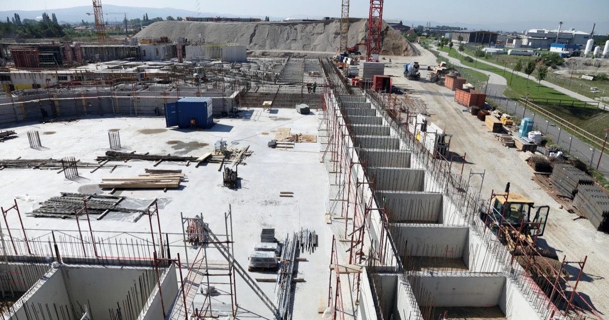
Building construction (09/2011)
  “Sandwich” construction technology for building.

Slide 13
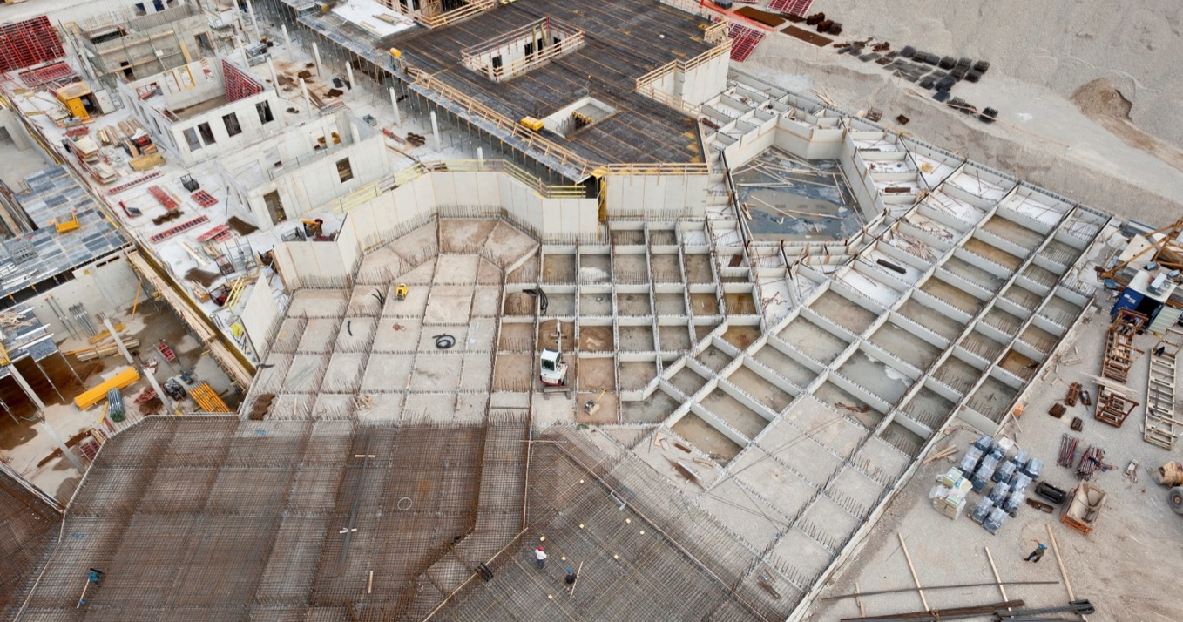
Building construction (09/2011)

Slide 14
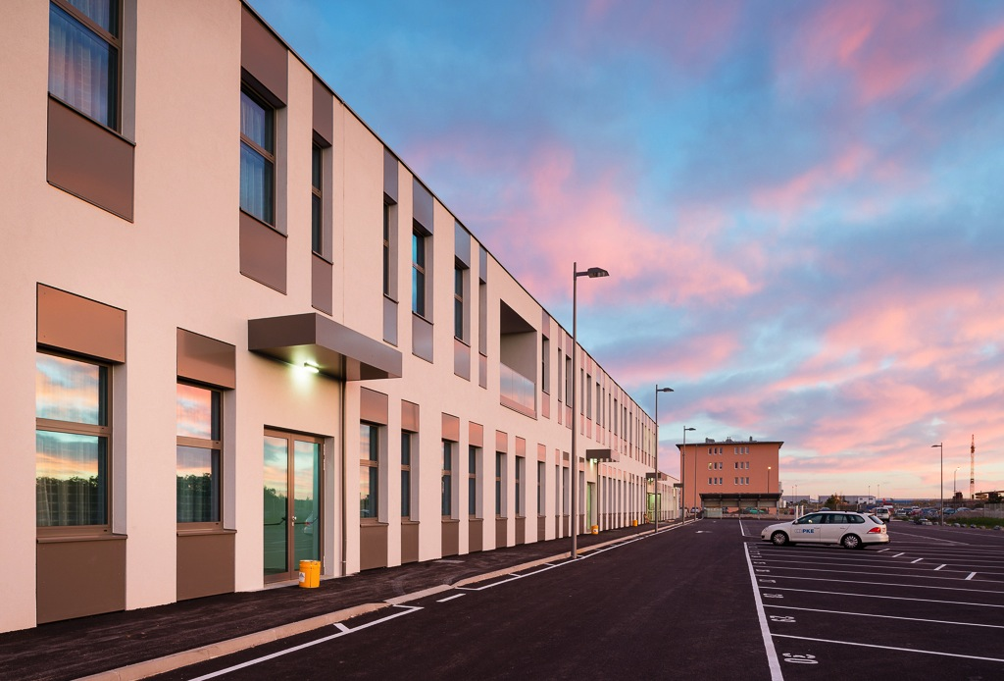
Oct 2012: Moving in
Completion of building (08/2012)

Slide 15
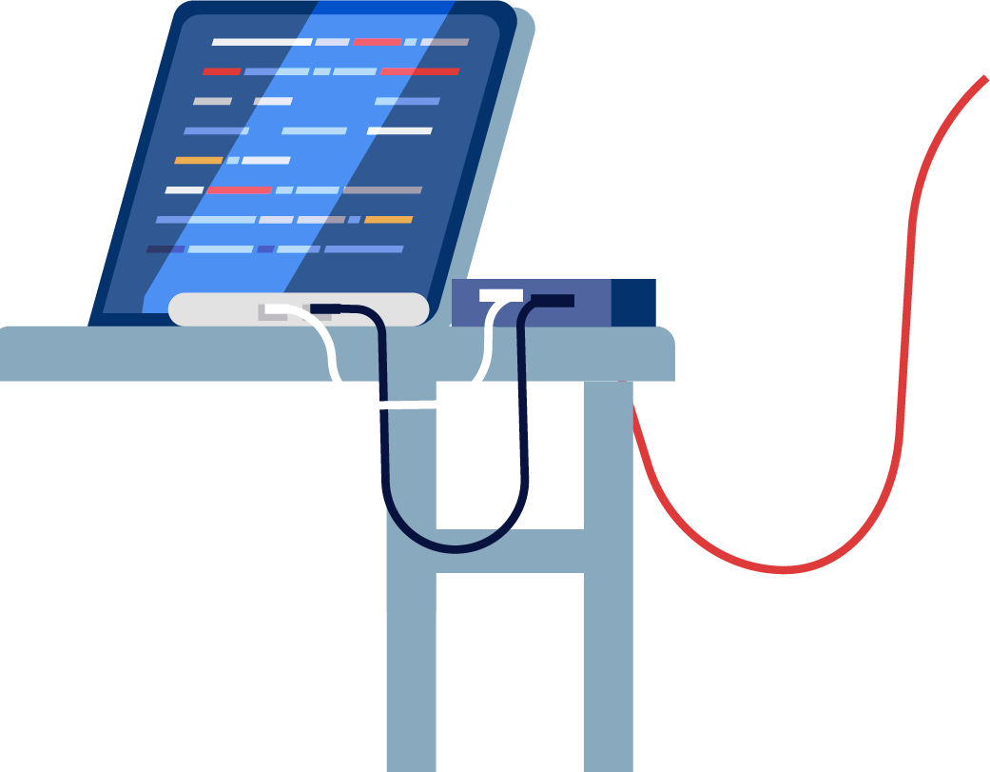


From concept to clinical operation
- High technology branch
  Cooperation with CNAO and INFN (Know-how on accelerator component technology)
  First beam at Injector Test Stand at CERN
  Company
  foundation
  04/2007
  2008 - 2012
  08/2012
  11/2007
  07/2008
  03/2012
  Completion of building
  Designing, tendering and manufacturing of accelerator components
  Cooperation with CERN (Know-how on accelerator technology)

Slide 16
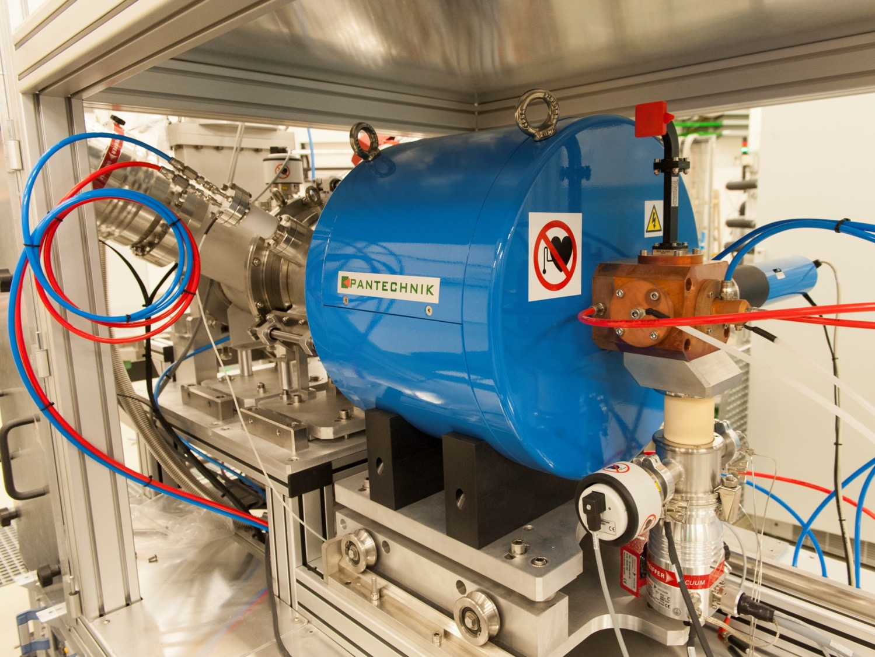
ION SOURCES
Origin of the particle beam

Slide 17
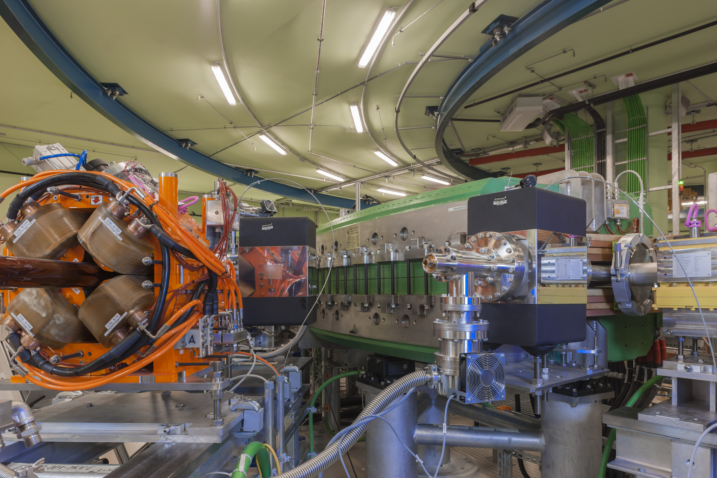
Guiding and focusing of particle beam
Dipole and Quadrupole Magnets

Slide 18
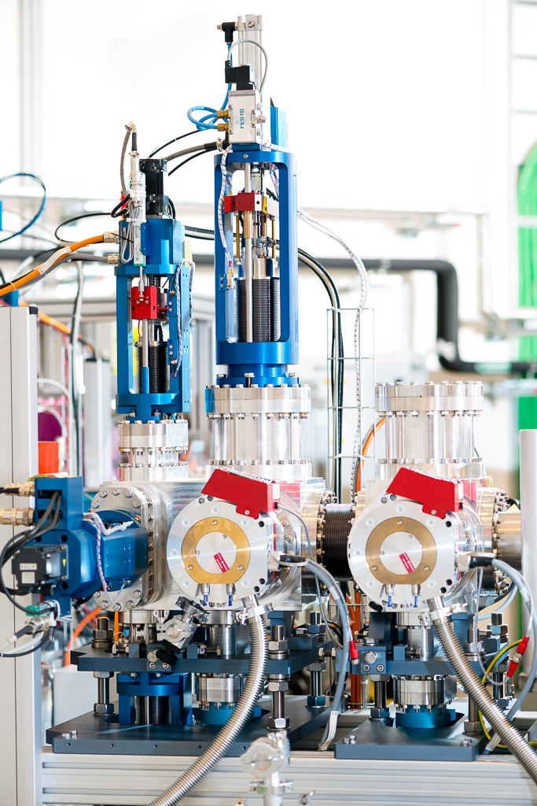
Eyes of the physicist
Beam Diagnostic Devices

Slide 19
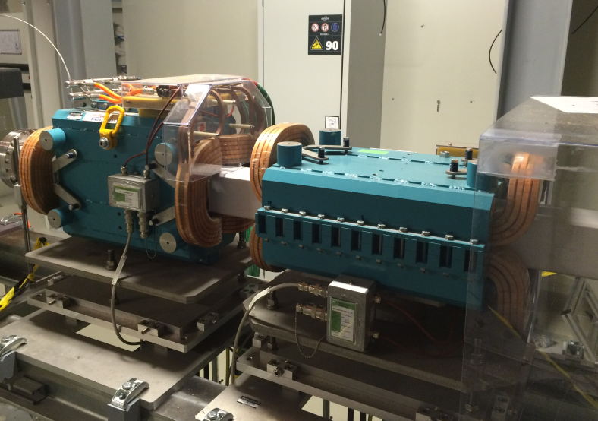
SCANNING MAGNETS
ION SOURCES
Distributing particle beam over tumor cross section

Slide 20
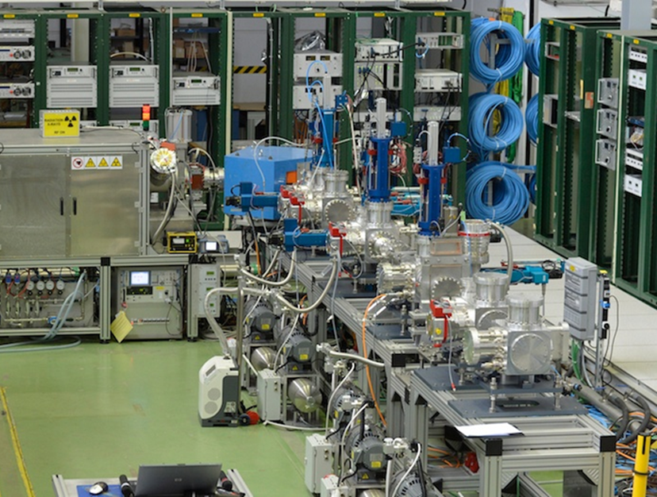
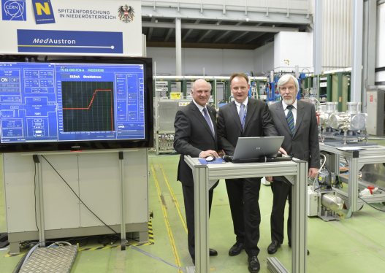
INJECTOR TEST STAND @ CERN
Proof of principle for the injector

Slide 21



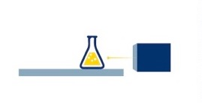
From concept to clinical operation
  Start of accelerator installation
  First beam in treatment room
  Successful CE certification,
  Start of patient treatments
  08/2012
  01/2013
  03/2014
  11/2014
  12/2015
  08/2016
  12/2016
  Completion of building
  Start of synchrotron commissioning
  Fully established treatment system workflow
  Start of research program

Slide 22
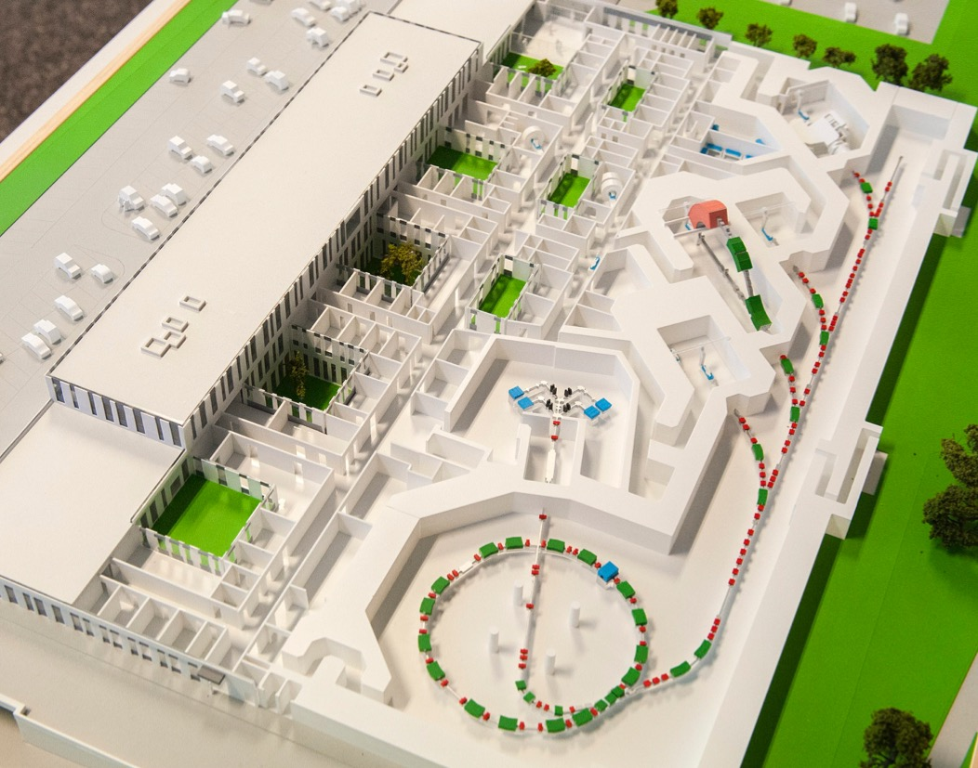
OUR FACILITY
  Irradiation Rooms
  Three rooms for patient treatment
  Research
  Separate irradiation room only for scientific use
  Ion Sources
  and linear accelerator
  Synchrotron
  Circular accelerator

Slide 23
The
TECHNOLOGY
  To generate protons AND carbon ions, a specific accelerator is necessary.
  To guarantee highest precision and safety for patient treatment, state-of-the-art medical technology is used at MedAustron.

Slide 24


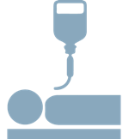
TUMOR THERAPY
  3D-
  Radio-
  therapy
  IMRT
  Surgery
  Gamma Knife
  ION THERAPY
  IONEN-THERAPIE
  Intra-operative Radio-therapy
  Brachy-therapy
  Radiation Therapy
  Chemotherapy

Slide 25
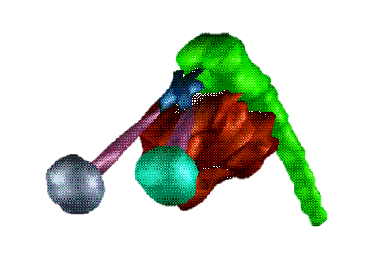
RADIATION THERAPY
Prevents
the tumor cells from proliferation
  Organ at risk:
  brain stem
  Organ at risk:
  optic nerve
High dose
delivery is necessary in the tumor cells
  Tumor
Organs at risk
Dose tolerance is considerably lower, e.g. optic nerve, parotid gland, inner ear, …

Slide 26
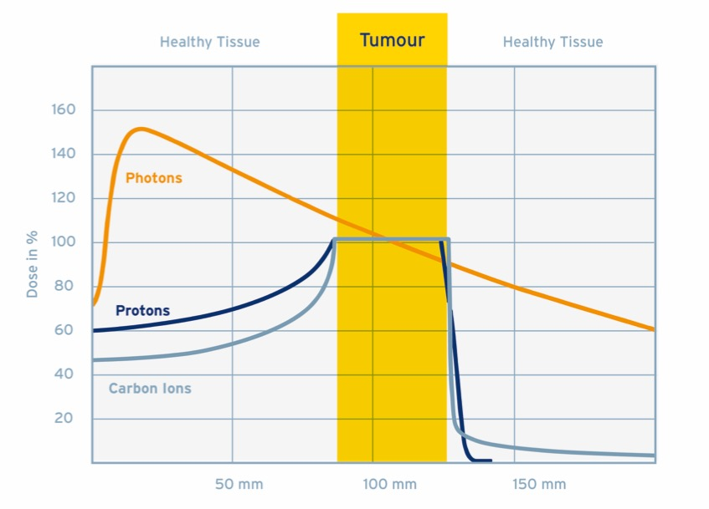
ION BEAM THERAPY
  Lower exposure
  to radiation of healthy tissue
  Reduction
  of side effects and long-term damages
  Photons:
  „Conventional“ Radiation Therapy
  Protons,
  Carbon Ions:
  Ion Beam Therapy

Slide 27
CARBON IONS
Carbon Ions:
Higher biological effectiveness
p
C
Carbon Ions =
heavier particles

Slide 28
Carbon ions – differences compared to protons
  PROS:
  Higher and energy dependent LET
  Higher and energy dependent RBE
  Less scattering
  Lower dependency on the cell cycle
  Increased effectiveness in case of radiation resistant tumor (hypoxic tumors)
  Improved dose conformity
  Potentially lower fractionation scheme
  CONS:
  Increased fragmentation tail
  Less experience compared to protons (~ factor 10)
  Lower acceptance in the community

Slide 29
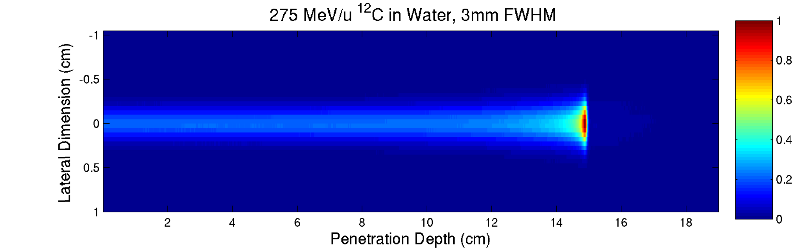
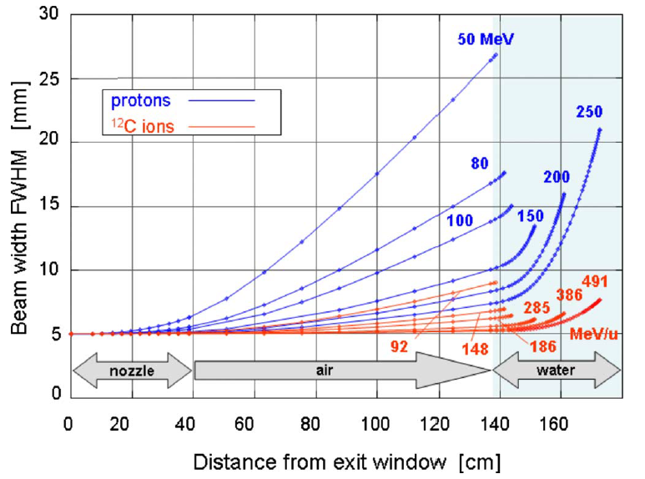
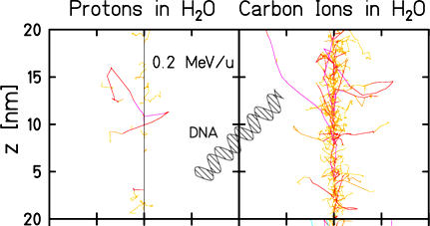
Rational for carbon ions
entrance channel:
low physical dose
low rel. biol. effiency
tumour:
high physical dose
high rel. biol. effiency
Notes:
29

Slide 30
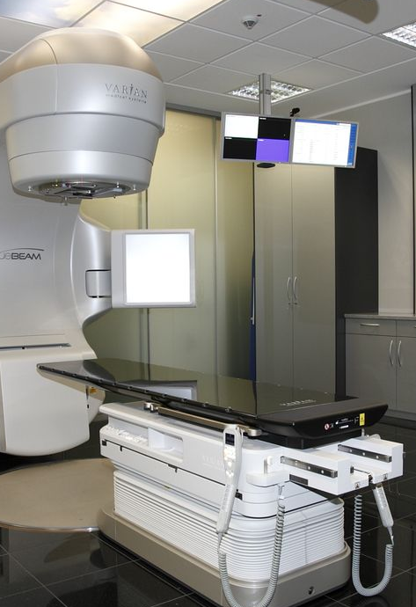
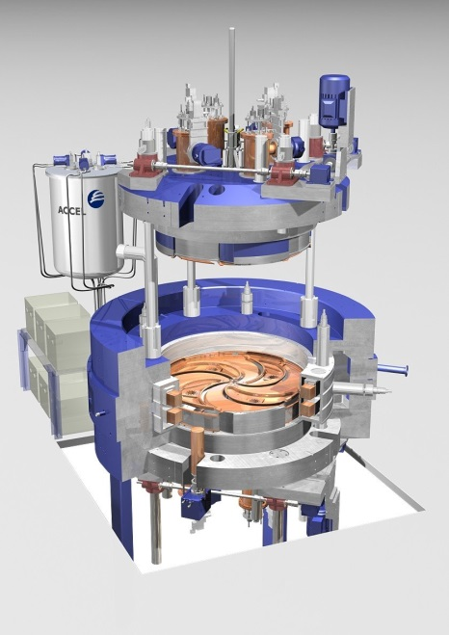
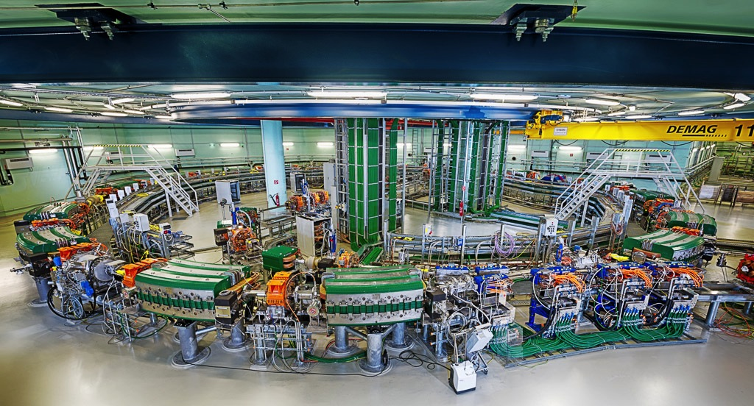
Radiotherapy
 | Conventional Radiotherapy | Proton Therapy | Ion Therapy
Accelerator type | Electron Linac | Cyclotron | Synchrotron
Particle type | Electrons, photons | Protons | Ions (protons, carbon ions)
# Austria | > 40 | 0 | 1 (2016)
# World | x000 | ~ 60 | 6 (incl. MedAustron)
Courtesy of Varian
Courtesy of Varian

Slide 31
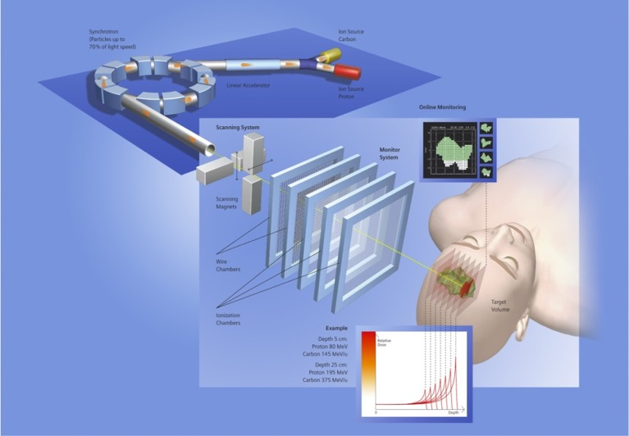
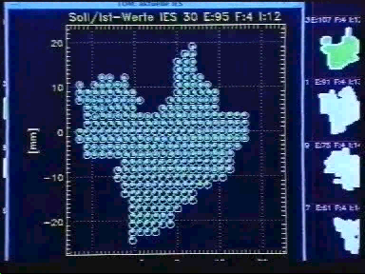

Irradiation concept
  active energy selection
  -> penetration depth
  transverse pencil beam scanning
  online beam monitoring
  no patient specific passive devices!
Courtesy of GSI

Slide 32
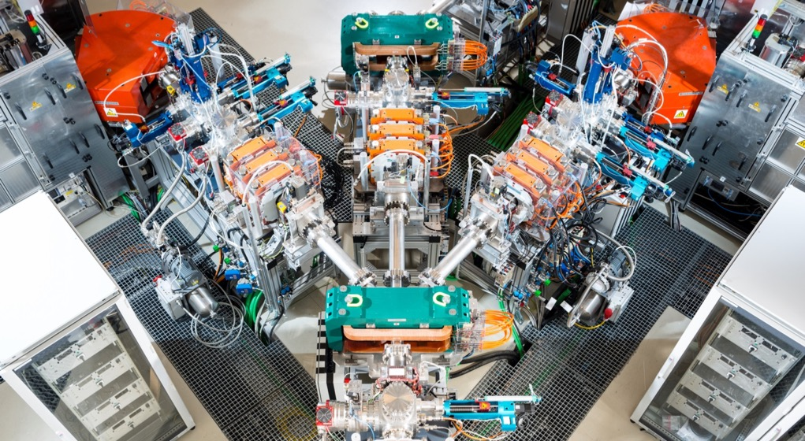
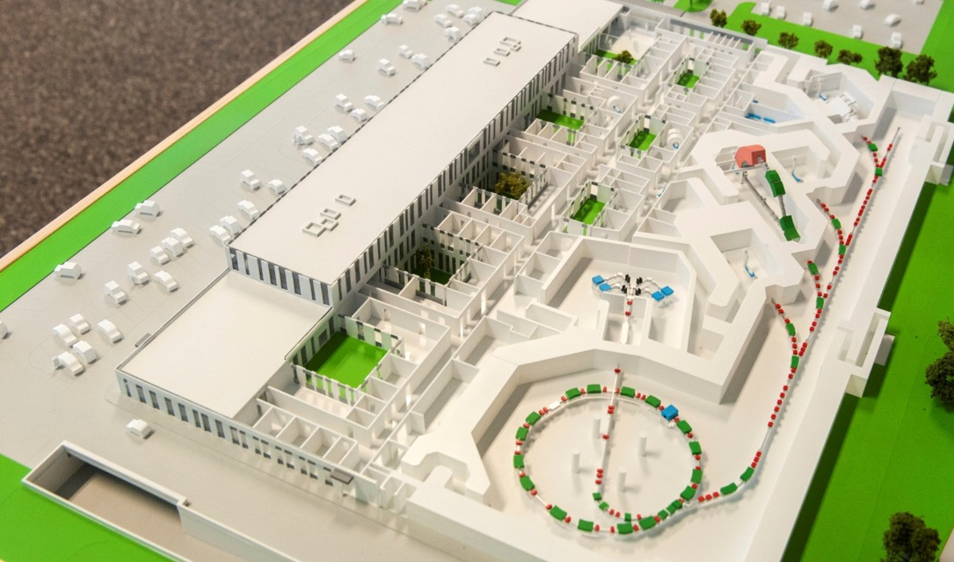
Source room
Generation of protons and carbon ions

Slide 33
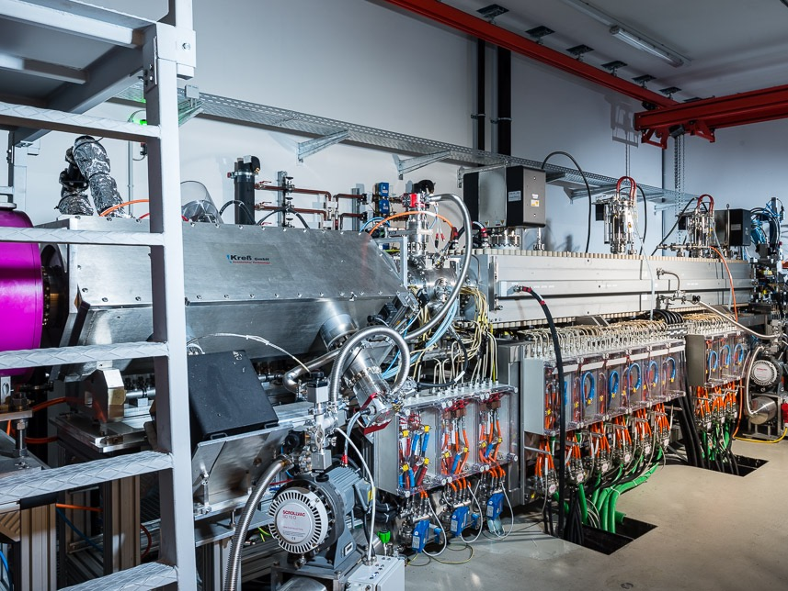
LINEAR ACCELERATOR
First step of acceleration

Slide 34
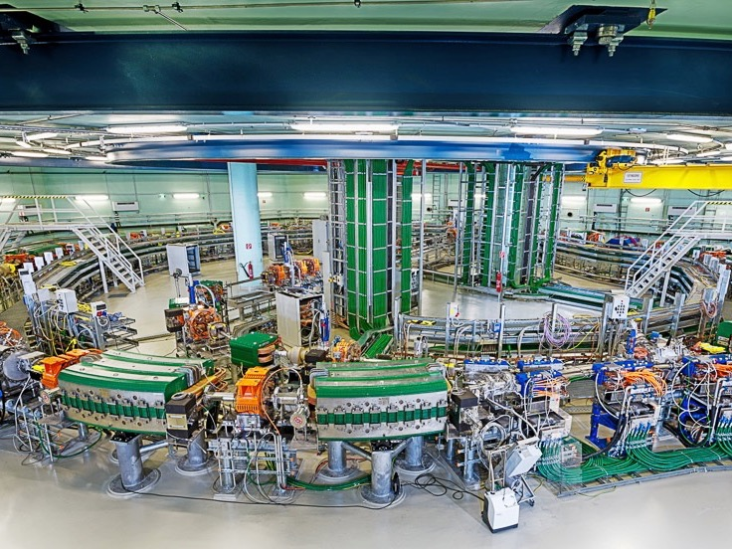
SYNCHROTRON
Acceleration up to 200,000 km/s

Slide 35
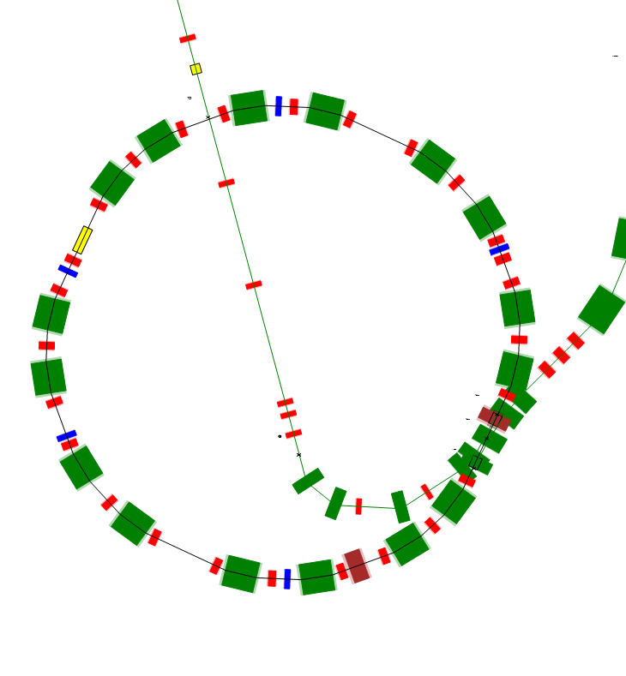
Synchrotron
Beam from Injector (7 MeV/u)
  Acceleration of beams to desired extraction energy
  Active energy selection:
    255 selectable energy steps (steps of 1 – 2 mm)
    p: 60 – 250 MeV (NCR: 800 MeV)
    C: 120 – 400 MeV/u
  Ramp speed: 0.5 s to highest energy
  Extraction time: 1 – 10 s
Beam to Patient
approx. 25m

Slide 36
Synchrotron
Typical cycle for a synchrotron for medical use with slow extraction.
Magnetic field
B_{max}
B₁
B₂
Injection
Extraction
energy 1
Extraction
energy 2
Injection
Time
Acceleration
∼2 s
Acceleration
∼4 s
Intensity
Energy 1
Intensity 1
Energy 2
Intensity 2
Time
Beam structure: pulsed, energy and intensity variable

Slide 37
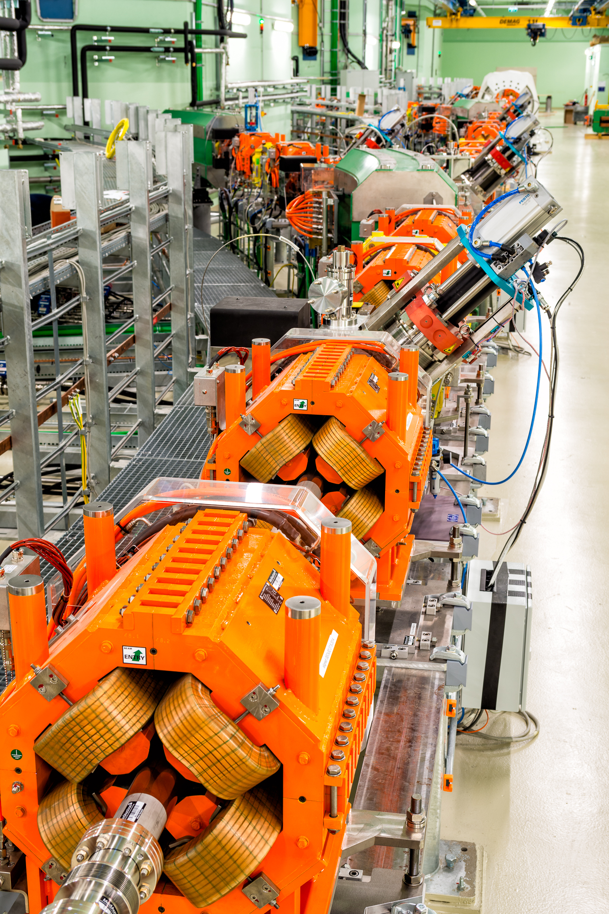
Transfer lines
Guiding the particles to the irradiation rooms

Slide 38
Scanning system
    Transverse pencil beam scanning: beam size: mm range (FWHM in vacuum)
  Fast magnetic deflection: scanning speed > 20 m/s
  One iso-energy slice irradiated with approx. one extracted beam pulse (spill of 1 – 10 s)
horizontal
deflection
vertical
deflection

Slide 39
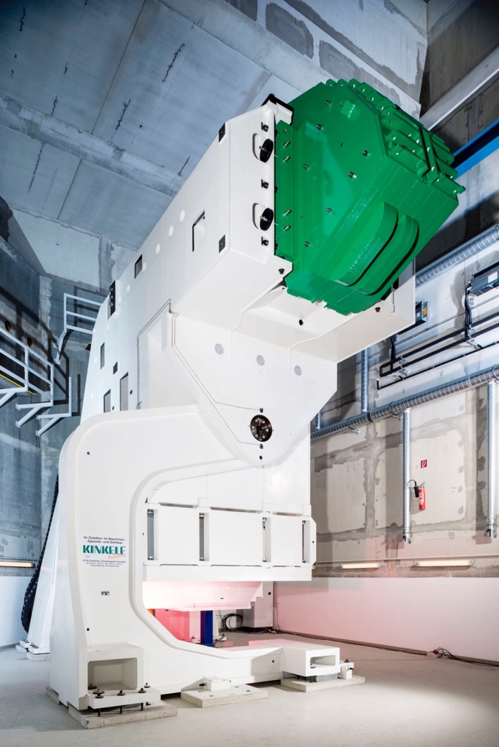
Proton Gantry
Offering beam irradiation angles of larger 180 degrees

Slide 40
Particle accelerator
Key figures
  developed in close cooperation with CERN (European Organisation for Nuclear Research)
  more than 1.000 large components
  220 manufacturers from 23 countries
  diameter of the synchrotron: 25 m
  more than 100 km of cables
  power consumption: 5 MW (approx. 10.000
  households)

Slide 41
Beam parameters
  Particles
  protons, carbon ions
  Energy
  Clinical energies: p: 60-250 MeV; C6+: 120-400 MeV/u -> 3-37 (p)/ 27 (C) cm penetration depth in water
  IR1: clinical energies + up to 800 MeV for protons
  Intensity
  Per spill: 1 * 10¹⁰ (p) / 4 * 10⁸ (C)
  4 different intensity levels
  Size
  4 sizes: 4, 6, 8, 10 mm FWHM [in vacuum]
  Scanning field : 20x20 cm² (IR1-3), 12x20 cm² (IR4)
  Beam delivery precision
  < 0.5 mm
Notes:
+/- 0.5 mm position, 70 m/s scanning

Slide 42
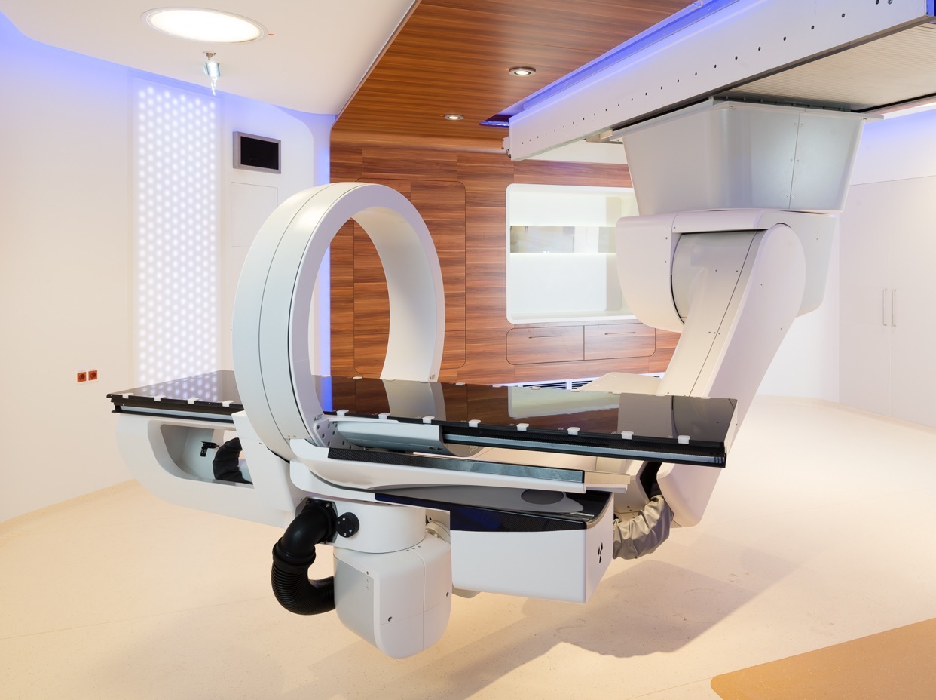
PATIENT POSITIONING
in the millimeter domain

Slide 43
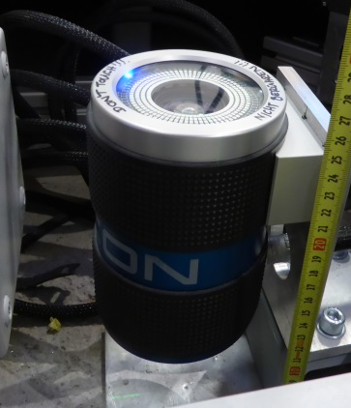
Patient positioning system
7DOF ceiling mounted robot positioner
High resolution tracking for feedback loop based positioning and surveillance

Slide 44
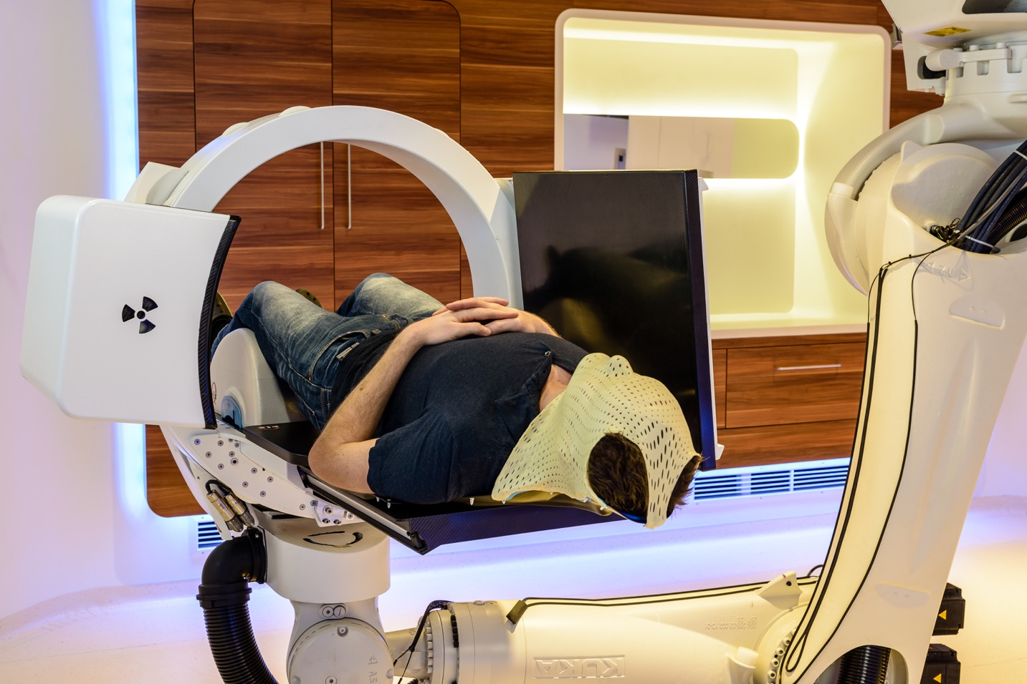
Patient position verification
  Flat panel and X-ray tube rotatable around the ring, couchmounted
  fast flat panel detector (30 Hz framerate)
  single source dual energy X-ray (60, 120 kV)
  large clearance (78 cm ring)
  2D, 3D imaging
  cone beam CT
Notes:
→ Hinweis: Erklärung vor Ort
Robotisches Patienten-Positionierungssystem
Hängende Montage
Optisches Tracking zur Überwachung der Position der Liege
Präzision: < 0,3 mm

Slide 45
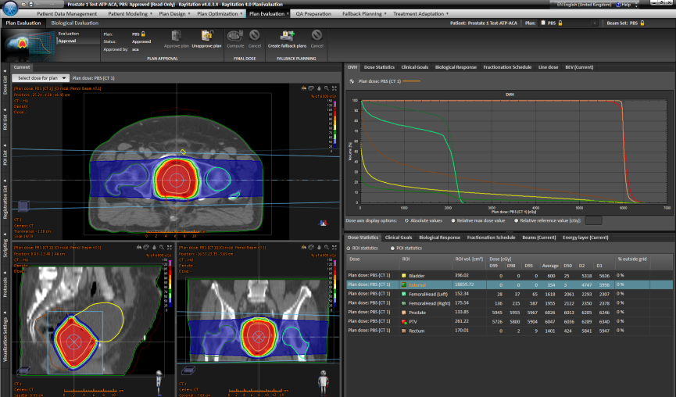
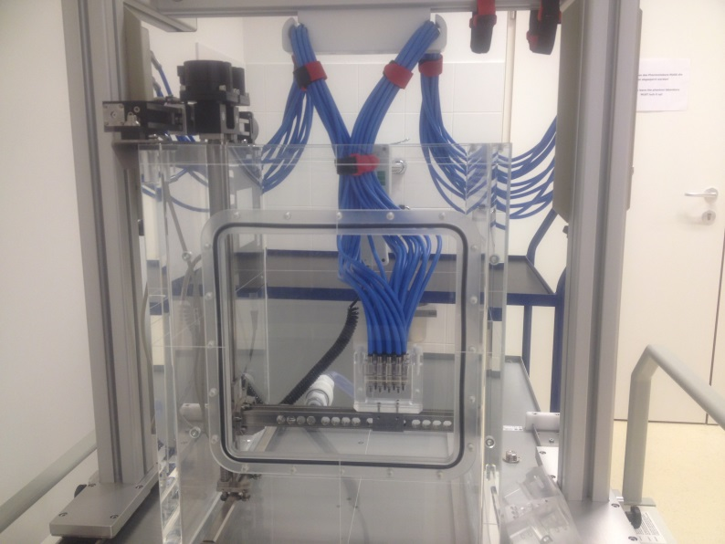
Patient workflow
Happening once:
Introductory talk
Diagnostic: CT/MR
Immobilization aids (patient specific!)
CT/MR for treatment planning (in treatment position)
Therapy planning
Plan verification

Slide 46
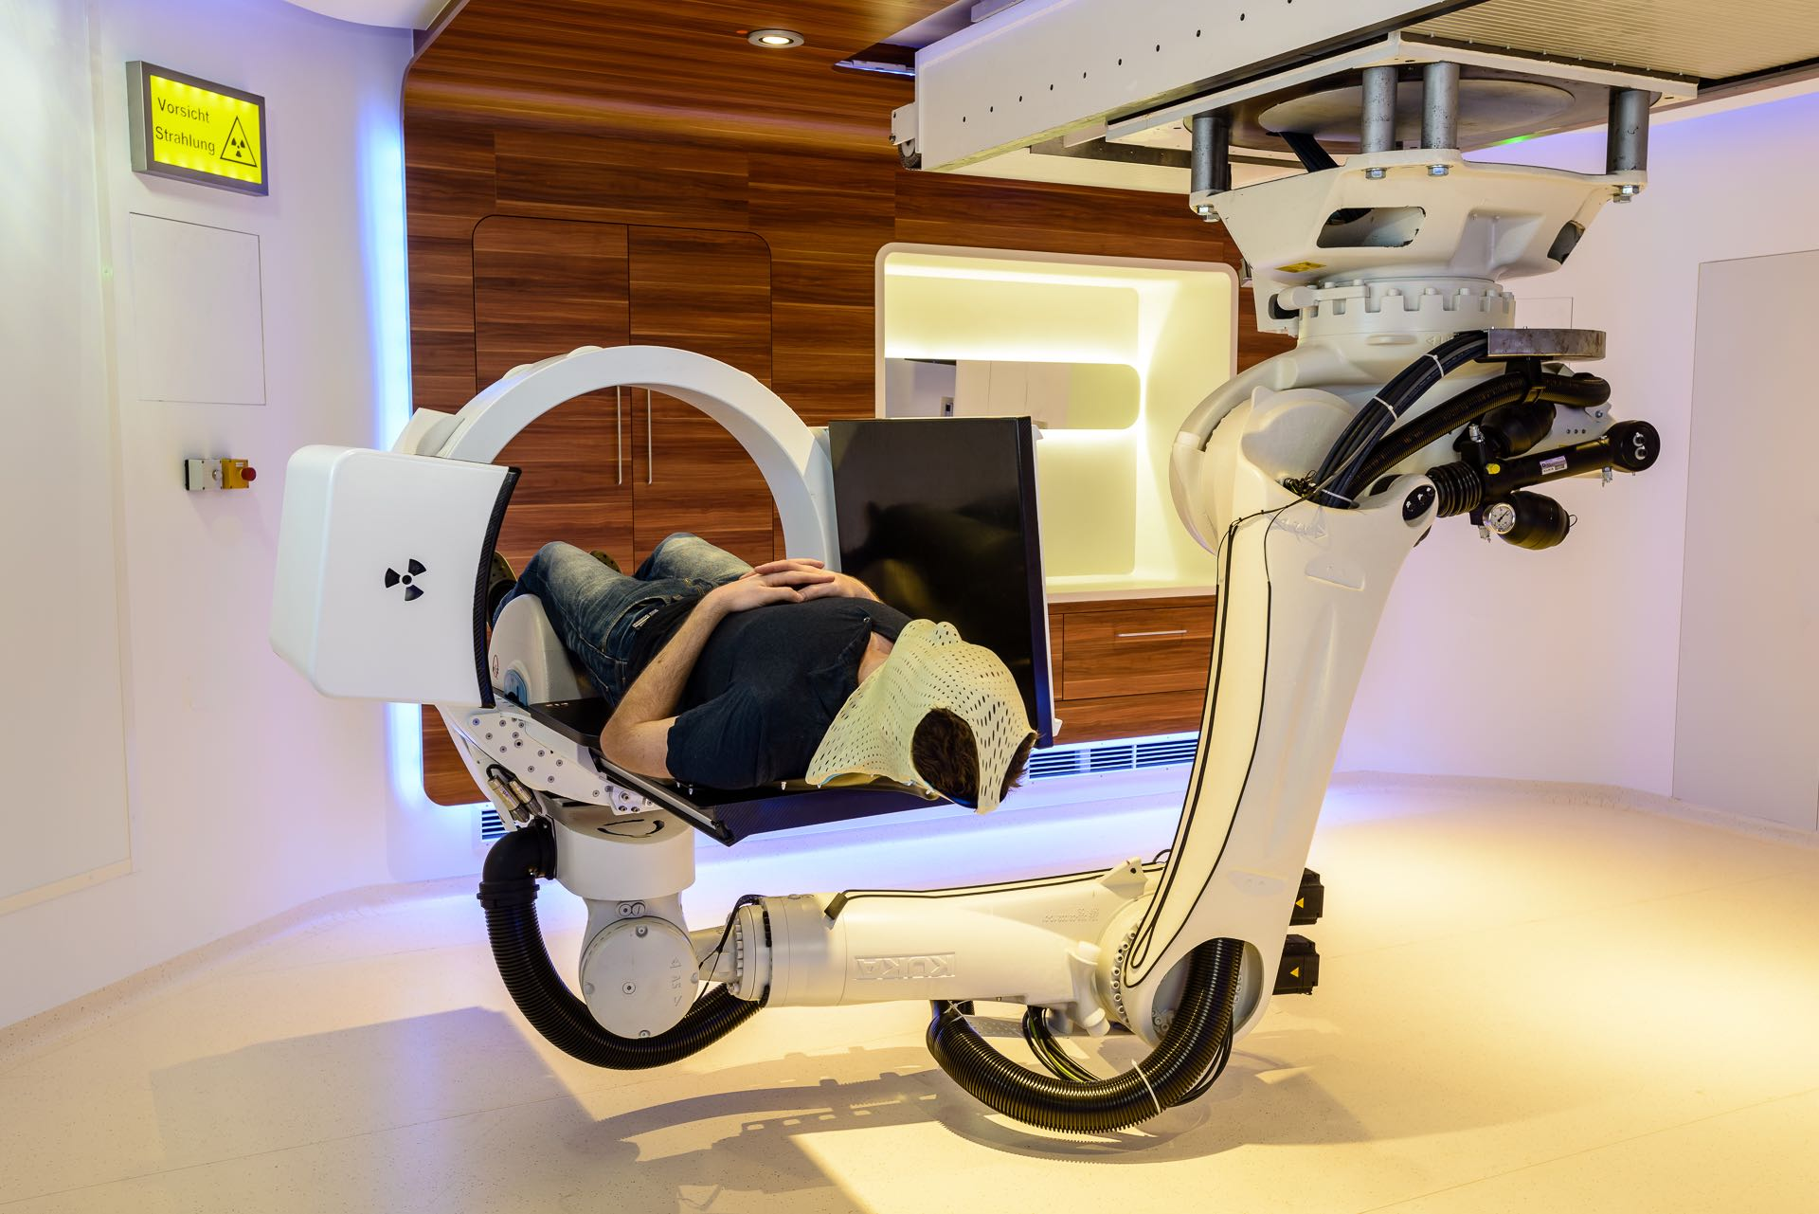
Daily Patient workflow
Daily irradiations (fractions: 20 – 40 tumor dependent):
Patient positioning
Position verification (2D/3D or 3D/3D)
Irradiation
Ev. adaptive Therapy planning

Slide 47
Daily Patient workflow – in room time
Example: CNS or base of skull tumor
Step | Dur. (min)
Preparation, Positioning and Verification | 11
Irradiation (2 portals including robot movement) | 16
End of treatment (release of patient, move robot to step off position, patient exit) | 5
Sum | 32

Slide 48
A typical clinical day @ medaustron
Patient treatment: Mo – Fr from 8am – 6pm, presently: 27 patients
4:30 am: Start of accelerator QA
6 am: Handover to medical physics
6 – 8 am: QA by medical physics (3 beam lines, protons only)
8 am - 6 pm: patient treatment
6 – 10 pm: patient specific QA, machine development, etc..
10 pm – 4:30 am: commissioning, development
Weekends:
Commissioning, development, research, service slots

Slide 49
Present status
Presently 27 patients/day (from 8am – 6pm)
2 rooms in operation (H/V) with protons only

Slide 50
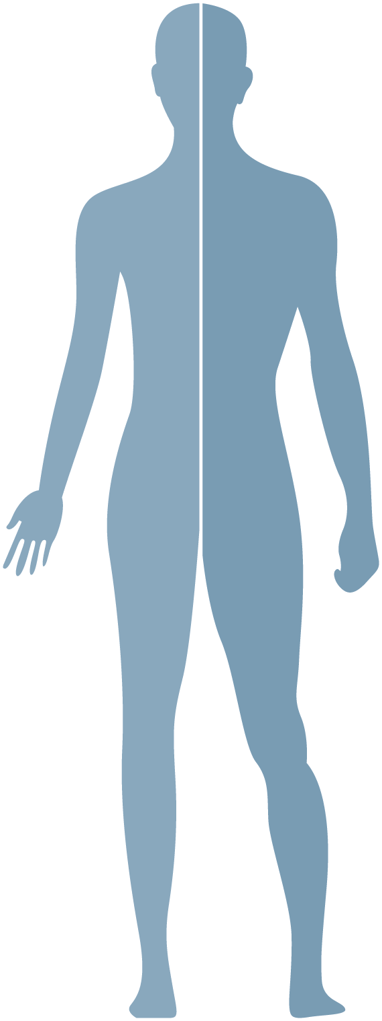
Treated Indications
Gastrointestinal (upper)
1%
Meningeoma
44%
Prostate
3%
ENT Tumors
16%
Chordoma & Chondrosarcoma
of the Skull Base
11%
Sarcoma
4%
Pediatric Tumors
10%
Re-Irradiation
11%
December 2016 – May 2018
Mainly „established“ indications, suitable for horizontal beam line

Slide 51

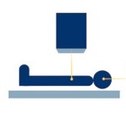
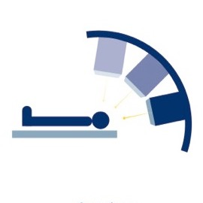
Status and Outlook
  Commissioning of further modalities (beam lines, ion species) in parallel to clinial operation.
  Full operation by end of 2021.
  Start of pediatric patient treatments
  Vertical beamline for patient treatments
  2nd room with
  carbon ions,
  horizontal beam line
  Patient treatments with carbon ions
C
C
  07/2017
  02/2020
  12/2021
  12/2016
  06/2018
  05/2019
  12/2020
C
C
  2nd room for patient treatments
  Carbon-ions
  for research
  Carbon ions,
  vertical beamline
  Patient treatments
  with Gantry

Slide 52






RESEARCH @ medaustron
  Close connection to the medical and technical universities of Vienna
  3 professorships
  Medical Radiation Physics
  Medical University
  of Vienna
  Radiation Biology
  Medical University
  of Vienna
  Radiation Physics
  Technical University
  of Vienna

Slide 53
RESEARCH @ medaustron
  Focus on translational research:
  Intrafraction Adaptive Radiation Therapy:
    CBCT implementation, dual energy for 3D/3D image registration and adaptive treatment planning
  Interfraction Adaptive Radiation Therapy:
    Moving targets (breath hold techniques, surface scanner,…)
    Tracking of tumor target

Slide 54
RESEARCH @ medaustron
  Focus on translational research:
  Imaging with Ion Beams (proton CT):
    Use same particle for imaging, planning and treatment
    Direct measurement of stopping power, no conversion in HUs
  Energy Transfer Mechanisms and Applications in Biology and Physics
    cell and tissue culture studies

Slide 55
RESEARCH @ medaustron
  Focus on translational research:
  MR-Guided Proton Therapy
  Pre-Clinical Animal Research
  Presently only 5 shifts (40h) for research per month.
  At maximum 14 shifts/month.

Slide 56
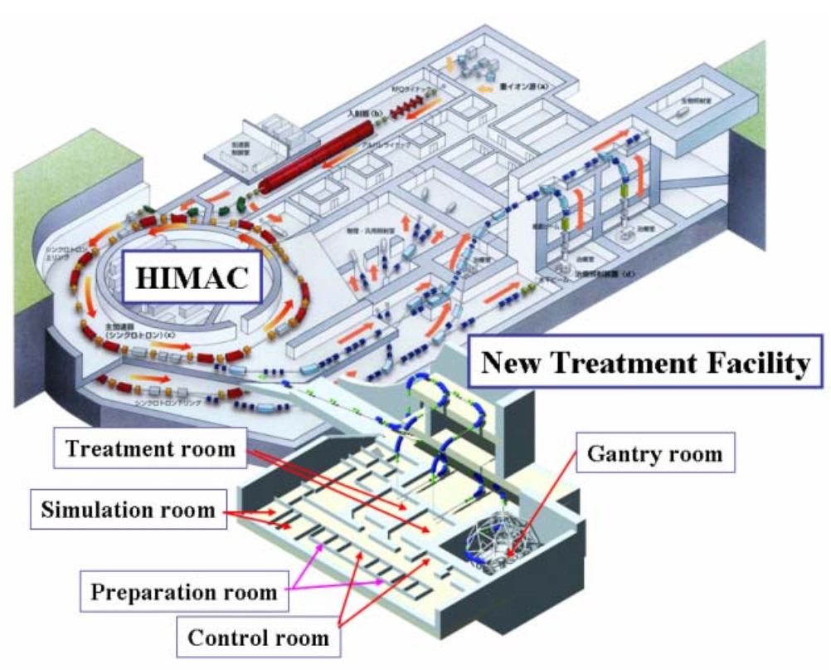
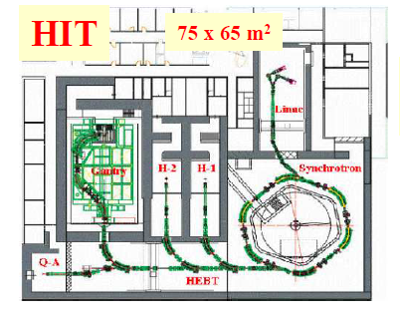
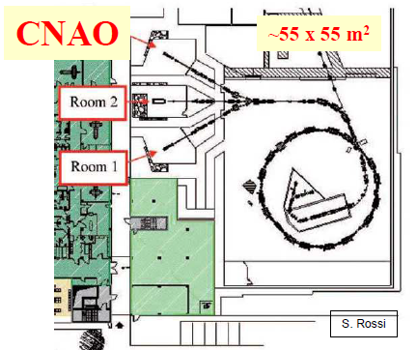
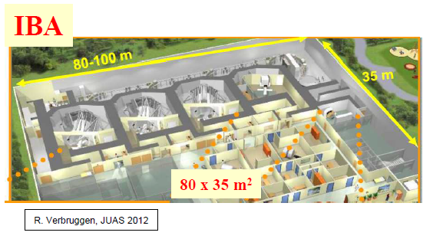
Treatment Facilities
A.Peters
K.Noda

Slide 57
THE State of the Art facility
Multiple ion species (p, He, C)
Synchrotron Cycle time optimized
  Cycle compression
  Dynamic spill time
Gating
Field regulation
Multi Energy Extraction
Dynamic Intensity Control
3D dose online tracking
  Prompt Gamma Imaging
  C11 beams – online PET

Slide 58
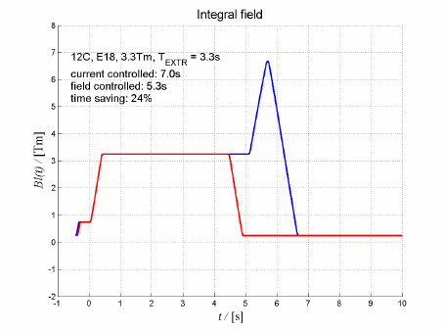
THE State of the Art facility
Multiple ion species (p, He, C)
Synchrotron Cycle time optimized
  Cycle compression
  Dynamic spill time
Gating
Field regulation
Multi Energy Extraction
Dynamic Intensity Control
3D dose online tracking
  Prompt Gamma Imaging
  C11 beams – online PET
E.Feldmaier

Slide 59
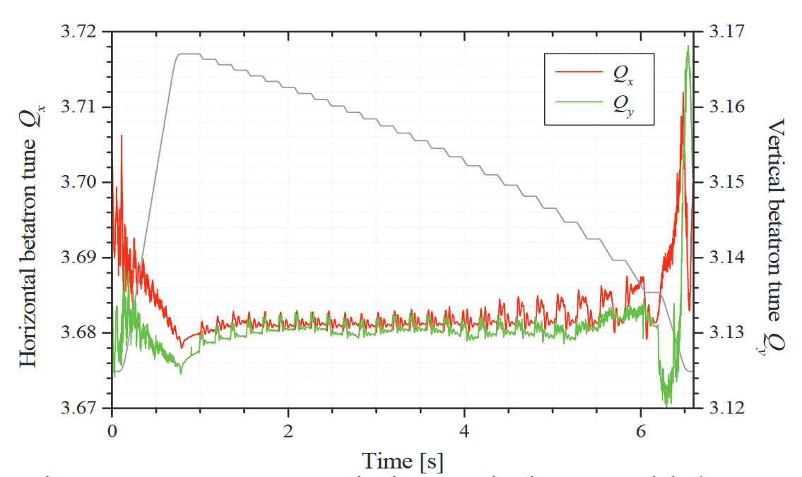
THE State of the Art facility
Multiple ion species (p, He, C)
Synchrotron Cycle time optimized
  Cycle compression
  Dynamic spill time
Gating
Field regulation
Multi Energy Extraction
Dynamic Intensity Control
3D dose online tracking
  Prompt Gamma Imaging
  C11 beams – online PET
K.Noda

Slide 60
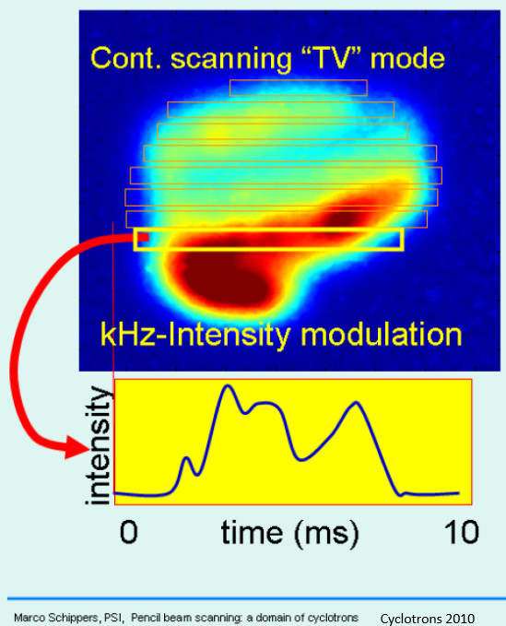
THE State of the Art facility
Multiple ion species (p, He, C)
Synchrotron Cycle time optimized
  Cycle compression
  Dynamic spill time
Gating
Field regulation
Multi Energy Extraction
Dynamic Intensity Control
3D dose online tracking
  Prompt Gamma Imaging
  C11 beams – online PET

Slide 61
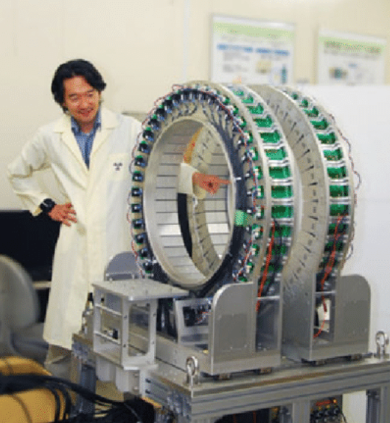
THE State of the Art facility
Multiple ion species (p, He, C)
Synchrotron Cycle time optimized
  Cycle compression
  Dynamic spill time
Gating
Field regulation
Multi Energy Extraction
Dynamic Intensity Control
3D dose online tracking
  Prompt Gamma Imaging
  C11 beams – online PET

Slide 62



THE State of the Art facility
Multiple ion species (p, He, C)
Synchrotron Cycle time optimized
  Cycle compression
  Dynamic spill time
Gating
Field regulation
Multi Energy Extraction
Dynamic Intensity Control
3D dose online tracking
  Prompt Gamma Imaging
  C11 beams – online PET

Slide 63
conclusions
  MedAustron is a synchrotron based centre for ion therapy for cancer treatment and research, one out of four centres in Europe.
  About 10 years from company foundation to treatment of first patient.
  Presently commissioning and development of further treatment modalities in parallel to clinical operation and research activities.
  Manufacturer of a CE labelled medical accelerator and technology provider of particle therapy systems
  Provider of training for radiation oncologists and medical physicists.

Slide 64
Thank you
for your attention!
www.medaustron.at

