Slide 1

Radiobiology I
Research and Lab Environment
Sylvia Gruber, PhD
Medical University of Vienna
Advanced School of Medical Accelerators and Particle Therapy

Slide 2
Contents
Basics of Radiobiology
  DNA damage
  DNA damage repair
  Cellular survial influencing factors
Ion Beam Radiobiology at MedAustron
  Ion beam therapy motivation – a biologist´s point of view
  Focus of radiobiological research at MedAustron
    Relative Biological Effectiveness of Particles and its Dependencies
    Synergistic IBT effects and combinations
    Advanced cell culture and in vivo models

Slide 3
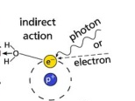
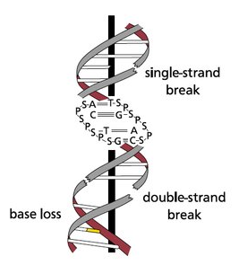
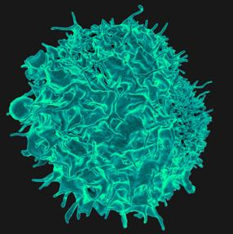
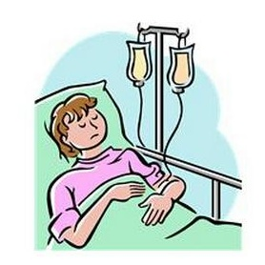
Chronology of Radiation Effects
10 ⁻¹⁵
Energy deposition /
Excitation and Ionization
physical phase
10 ⁻¹²
10 ⁻⁹
Formation of free radicals /
chemical reactions
10 ⁻⁶
chemical phase
10 ⁻³
DNA damage
1 ms
10 ⁰
10 ³
Repair
biological phase
1 s
10 ⁶
Cell death / mutations
10 ⁹
1 year
Promotion
Teratogenesis / Cancer inductions
medical effects
100 years

Slide 4
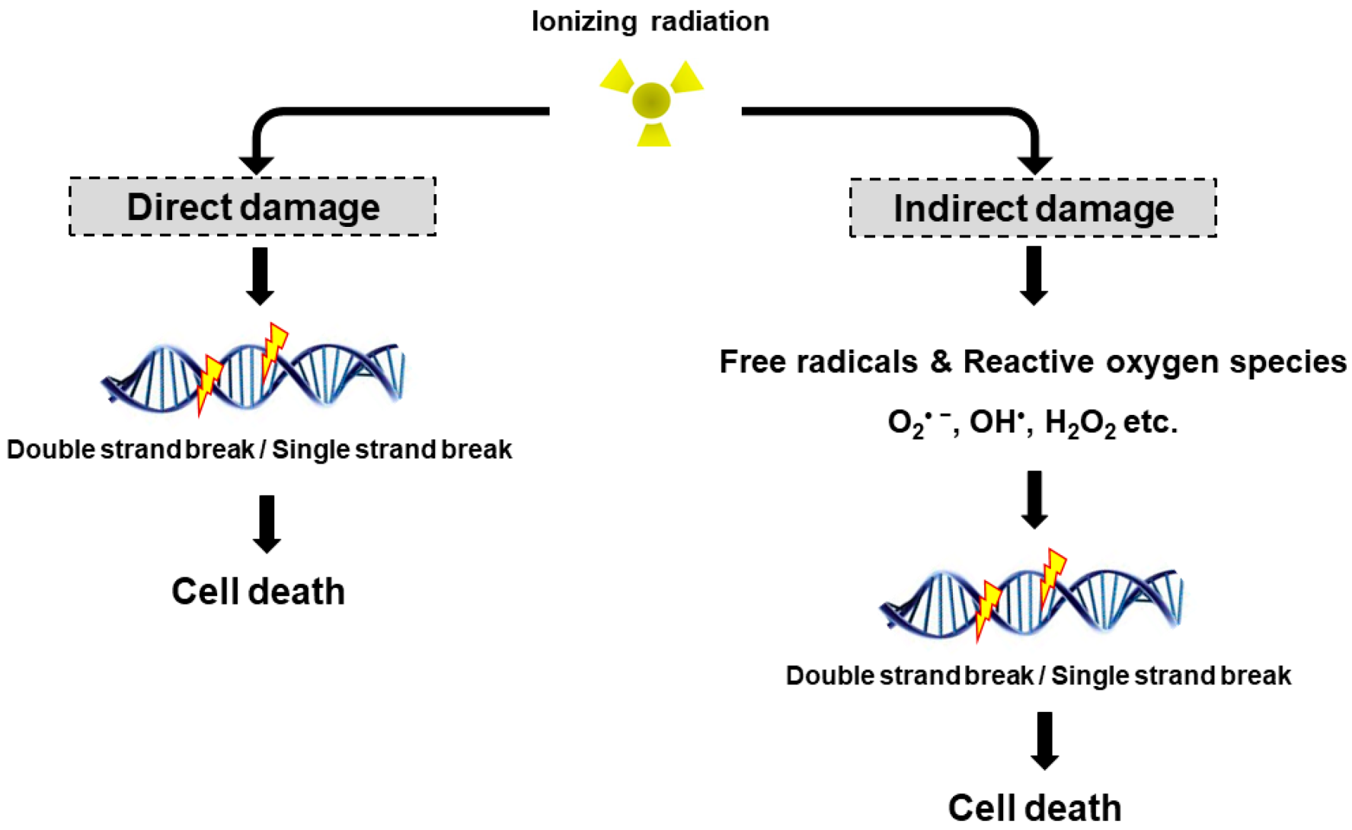
DNA damage
Direct vs. indirect
High-LET IR
Low-LET IR

Slide 5
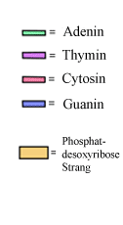
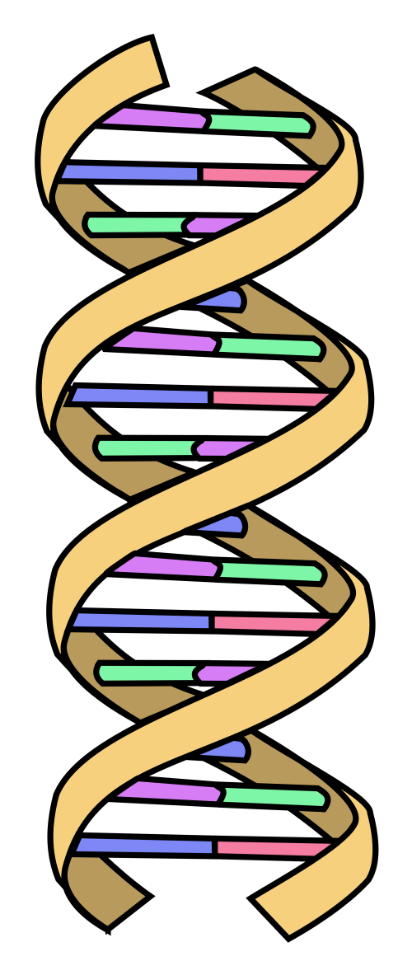
DNA damage – 1 Gy
base damage
4000-5000 incidents
DNA-protein crosslinks
Histon
150 crosslinks
sugar changes
800 – 1500 changes
single strand breaks
1000 SSB
double strand breaks
30- 60 DSB

Slide 6
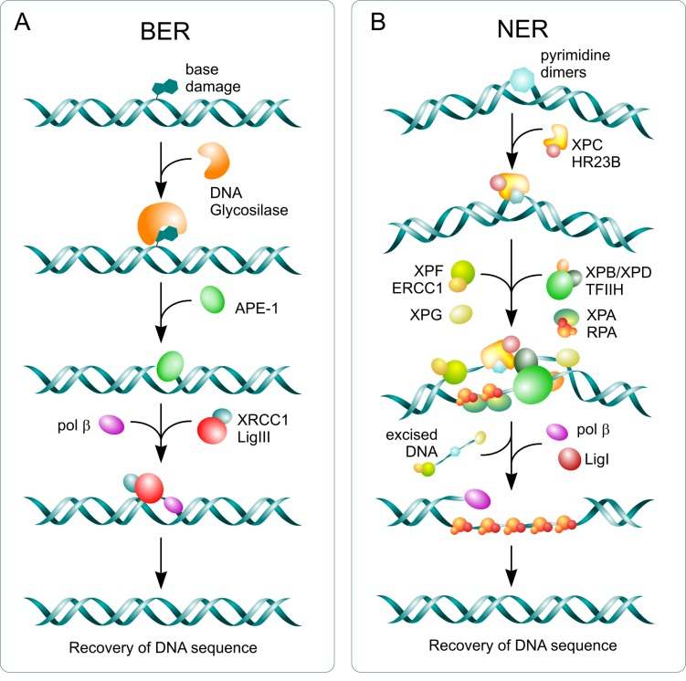
DNA damage repair – Single Strand Breaks
Baseexcision repair
base damage
induction of SSB
synthesis of missing bases
annealing
Nucleotideexcision repair
bulky lesions
induction of SSB
excision of 20-30 BP
synthesis of missing bases
annealing
The Journal of Biological Chemistry, 285, 9762-9769, March 26, 2010

Slide 7
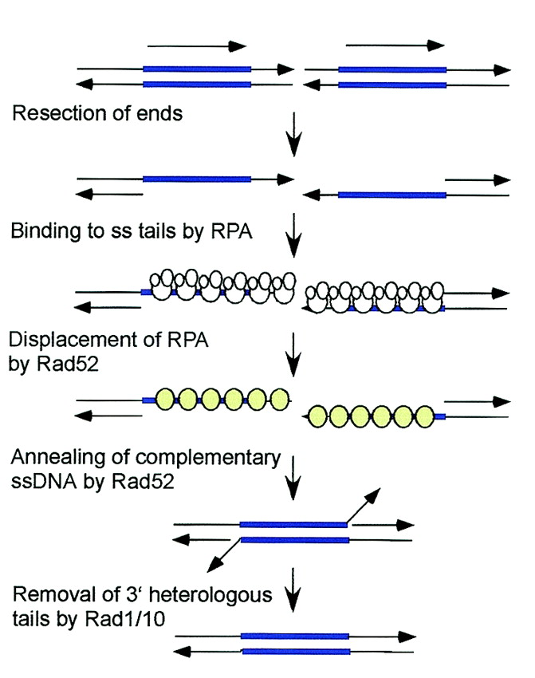
DNA damage repair – Double Strand Breaks
Single Strand Annealing
only if DSB occurs between 2 repetetive sequences
generation of ESB
annealing of complementary sequences
romoval of tails
error prone
Microbiol. Mol. Biol. Rev. 2002;66:630-670

Slide 8
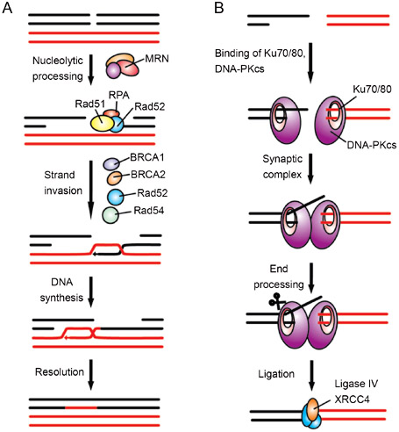
DNA damage repair – Double Strand Breaks
Nonhomologous endjoining
Homologous recombination
>80 % of DSB
G0 and G1 cell cycle phase
< 20% of DSB
S and G2 cell cycle phase
error prone
error free

Slide 9
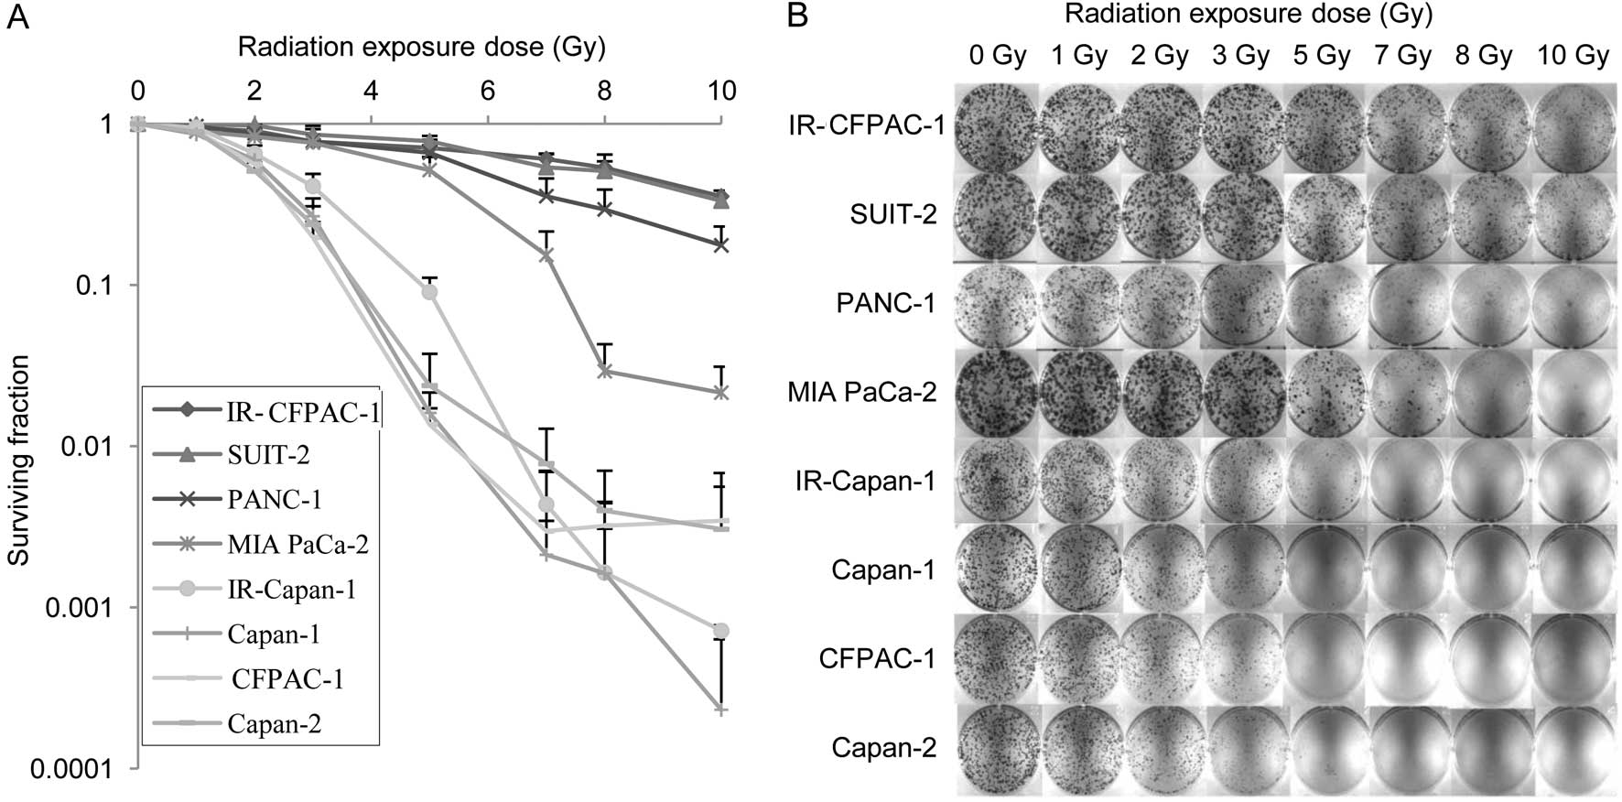
Survival influencing factors
Intrinsic Radiosensitivity
Kozono et al, Oncol. Rep. 2013 Oct;30(4):1601-8.

Slide 10
Survival influencing factors
Repair and Recovery
Repair = function of macromolecule is restored
Recovery = refers to increase in survival when TIME is increased
  recovery from sublethal damage
fractionation effect
Increase in
dose
Surviving rate
survival
gain
Dose

Slide 11
Survival influencing factors
Repopulation
Proliferation between fractions – increase in cell numbers
Increased radiation tolerance with increasing treatment time
Increase in
dose
Surviving fraction
Survival
gain
Dose

Slide 12
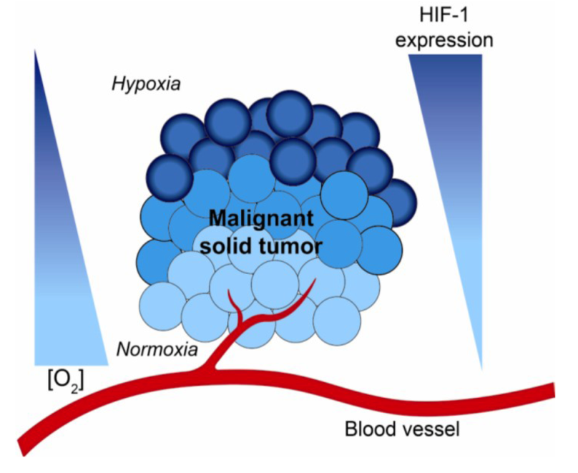
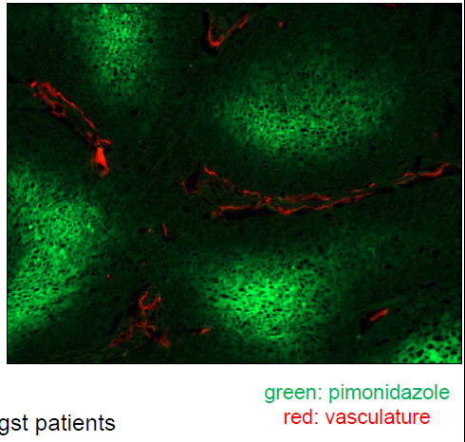
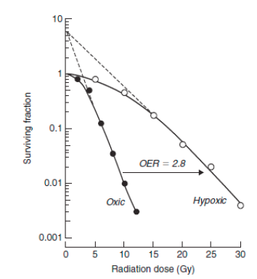
Survival influencing factors
Hypoxia/Reoxygenation
low LET irradiation

Slide 13
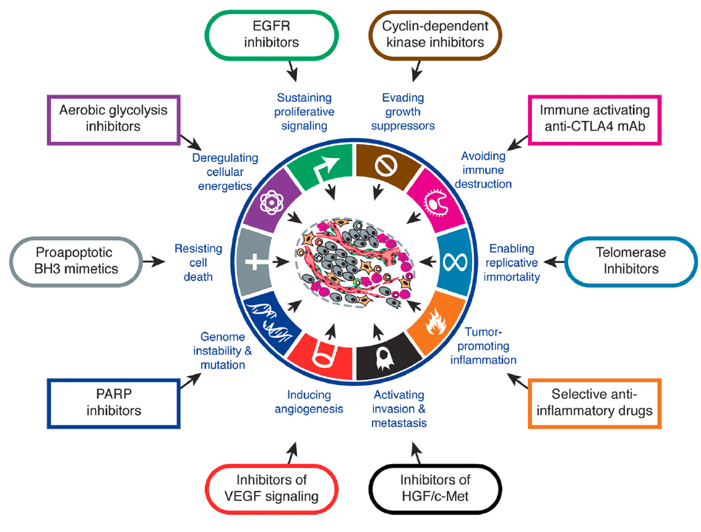
Survival influencing factors
molecular Radiopathology

Slide 14
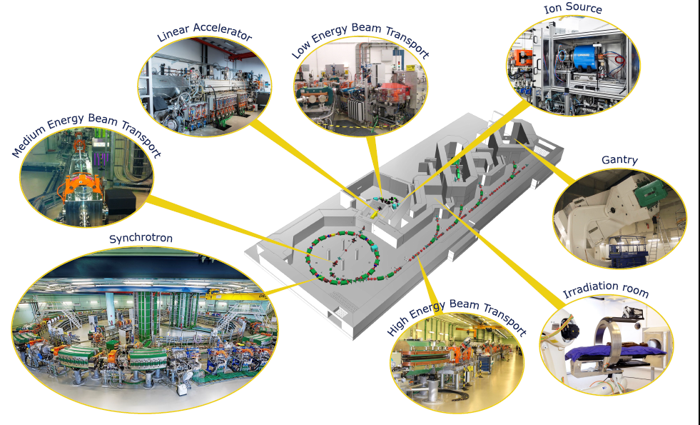
Ion Beam Radiobiology

Slide 15
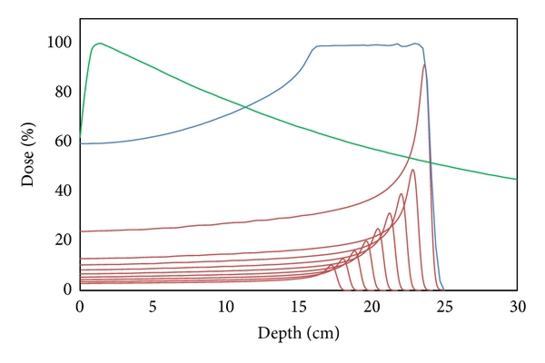
Biologist´s point of view: Physical Motivation
Superior dose distribution
photons
SOBP
  inverted depth dose profile
    highest dose to the tumour
  defined penetration depth and reduction of integral dose
    effective sparing of NT
  reduced lateral scatter
    high conformity
Tumour
NT
pristine peaks
NT
reduced dose in
organs at risk

Slide 16
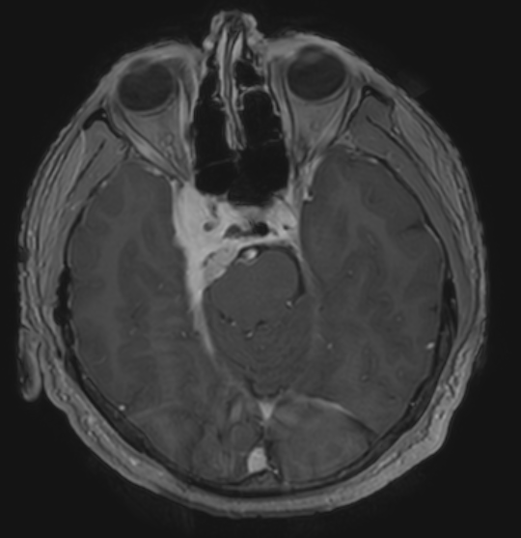
Biologist´s point of view: Medical Motivation
Image: Dr. Markus Stock, MedAustron

Slide 17
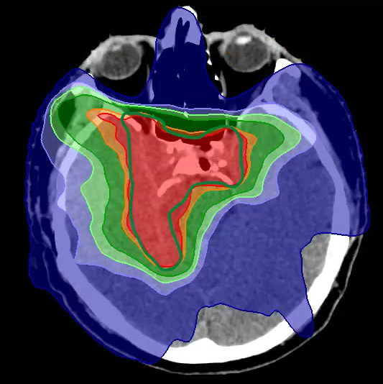
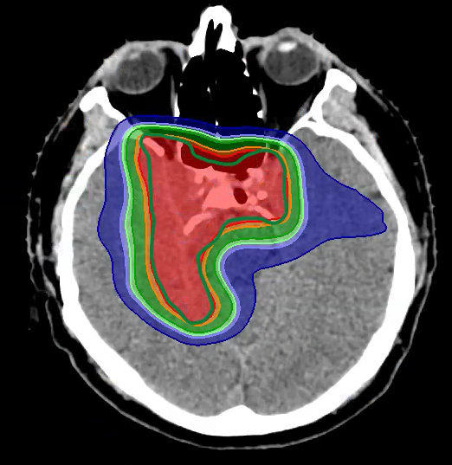

Ion Beam Therpay: Medical Motivation
Photons vs. protons
Image: Dr. Markus Stock, MedAustron

Slide 18
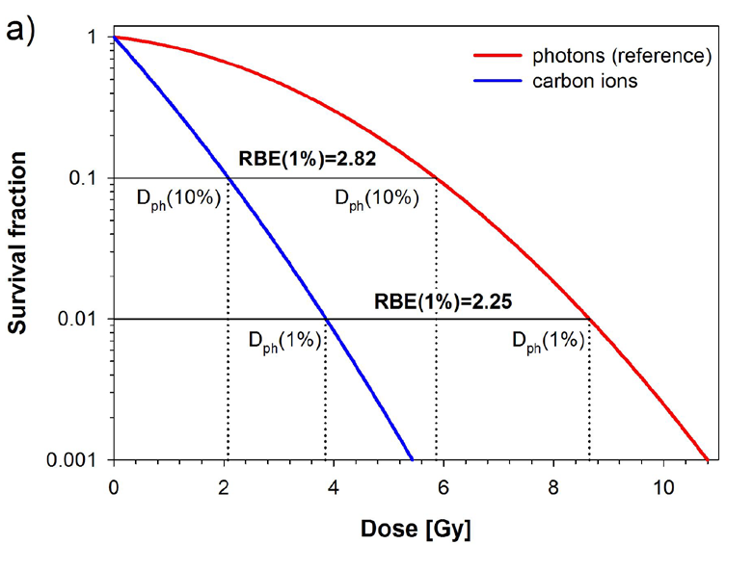

Ion Beam Therapy: Biological Motivation
Increased Effectiveness
Increased relative biological effectiveness (RBE)
  Proton RBE (generic): 1.1 → clinically used
  Carbon RBE: values >3 reported
sparsly vs. densly ionizing irradiation
same physical dose results in increasingly complex DNA damage pattern
Karger and Peschke 2018 Phys. Med. Biol. 63

Slide 19
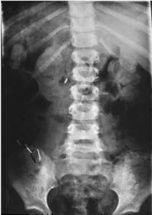
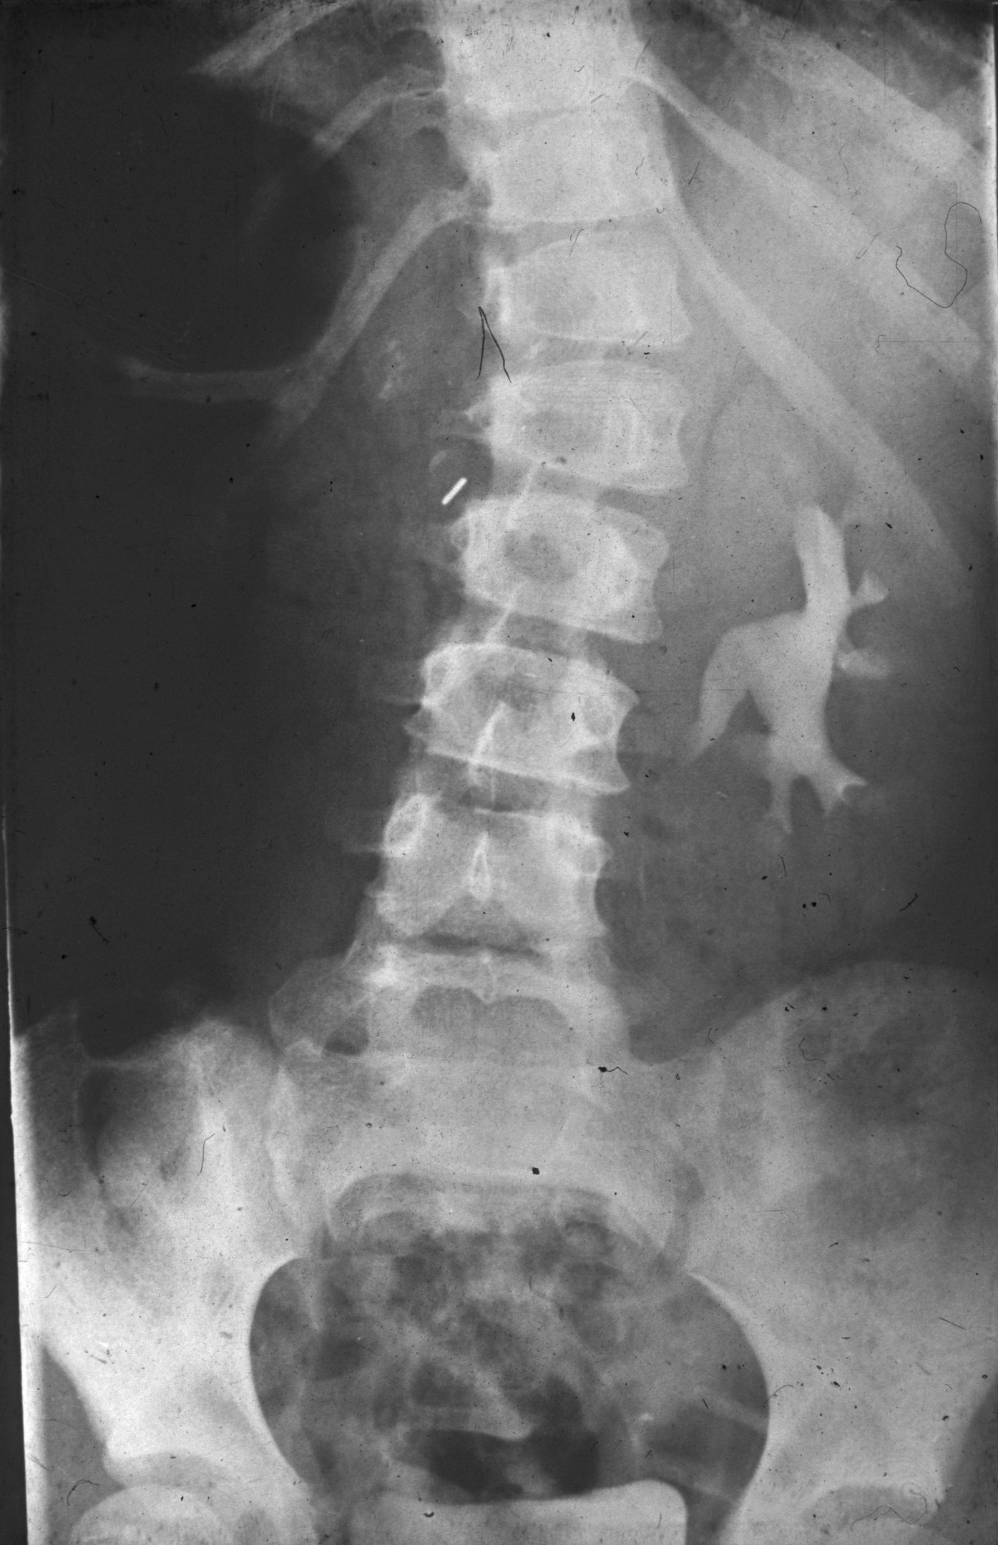
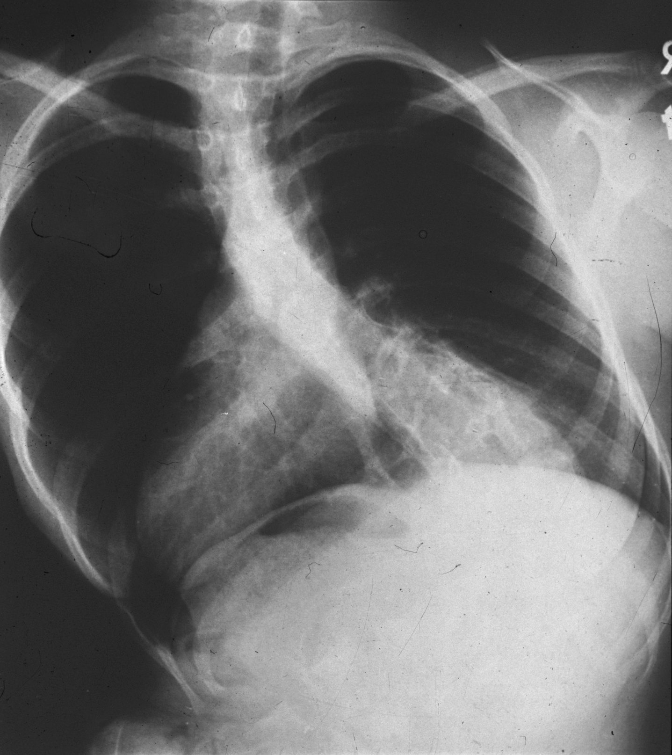
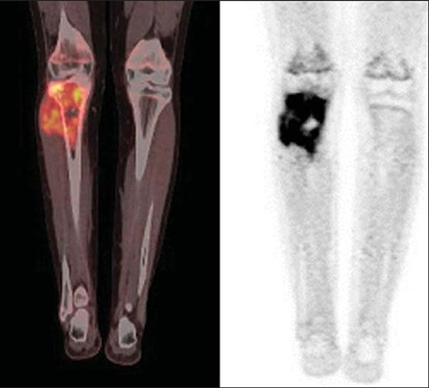
Ion Beam Therapy: Indications
Tumours close to critical organs at risk
Pediatric tumours
  reduced risk of secondary tumours
  reduced developmental impairment
Reirradiations
  occult irreversible radiation injury
Resistent tumours – increased relative biological effetiveness (RBE)
growing bone
depth dose profile
increased RBE
Osteosarcoma

Slide 20
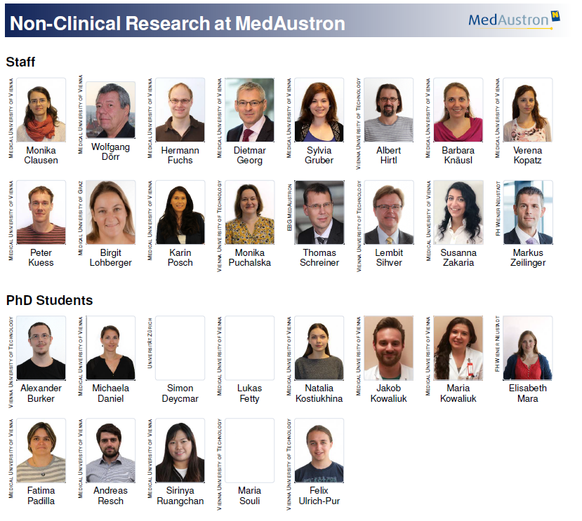


Slide 21
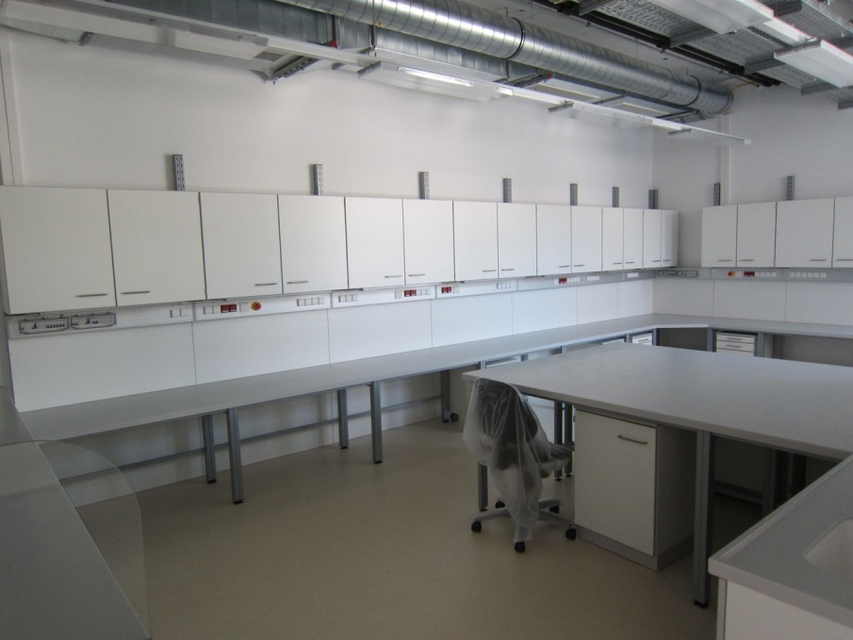
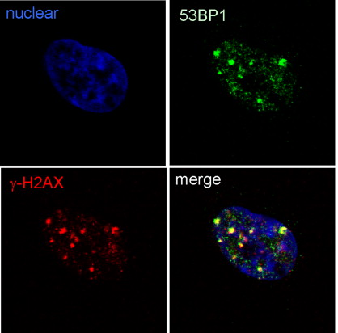
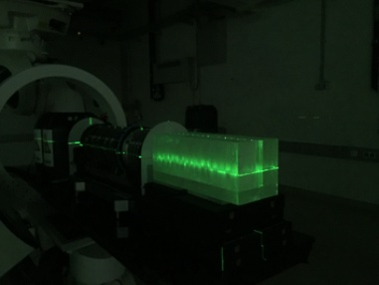
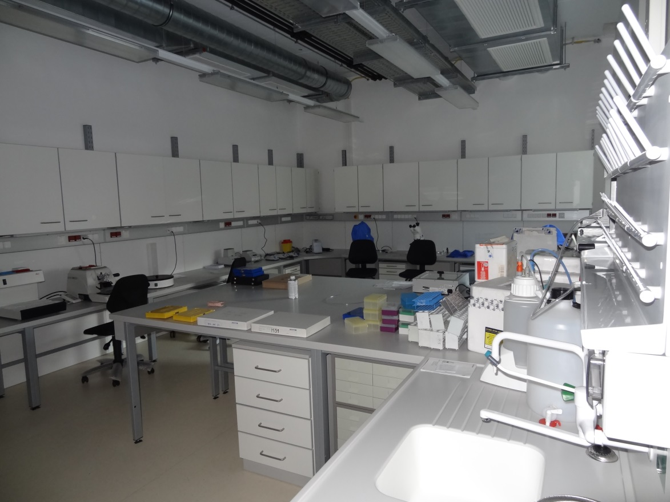
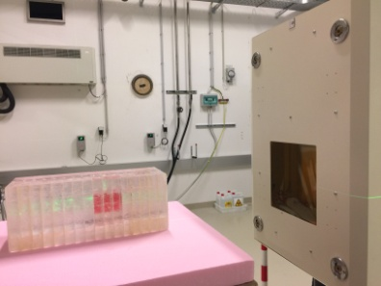
Timeline of Radiobiology Research at MedAustron
2015
2016
2017
2018
equip the labs
10/16: proton beam in IR1
04/17: first cell irradiations in IR1 → RBE dependencies
commissioning of infrastructure
implementation of methods and techniques
3D models
53BP1

Slide 22
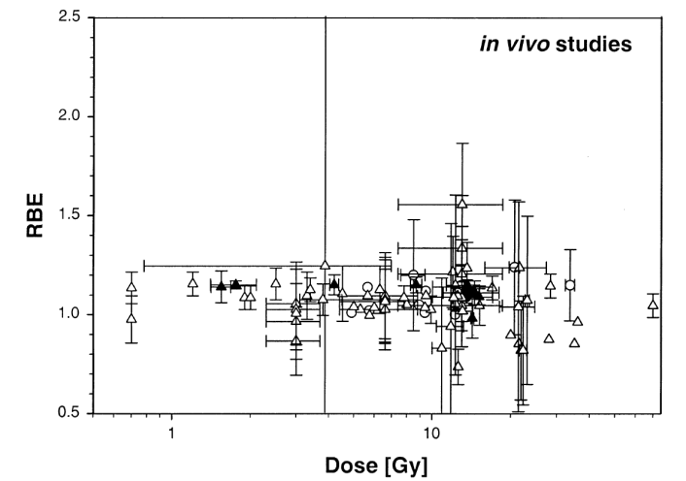
Focus of Radiobiological Research at MedAustron I
Challenging the RBE
Generic RBE for PBT: 1.1
Influencing factors
  Tissue Chracteristics
  Linear Energy Transfer (LET)
RBE of protons relative to CO⁶⁰
Mice data: crypt regeneration, lung tolerance, skin reaction, fibrosarcoma
Paganetti et al, Int J Radiat Oncol Biol Phys. 2002 ;53(2)

Slide 23
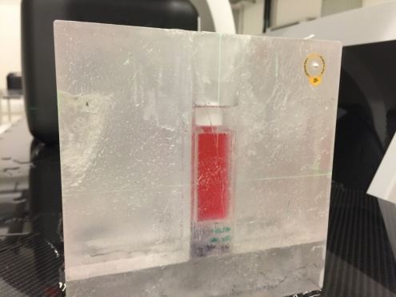
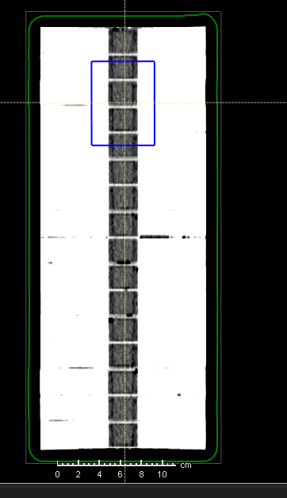
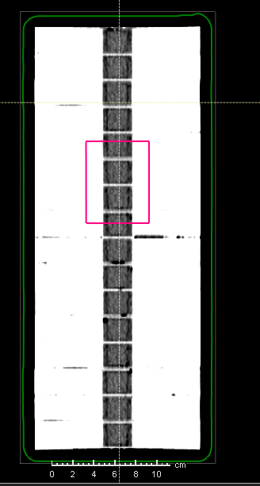
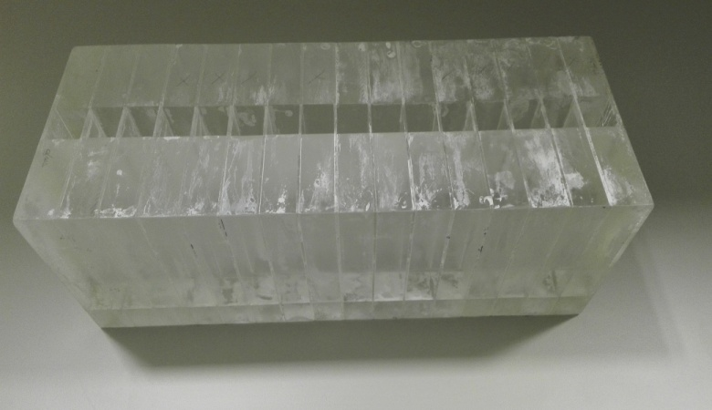
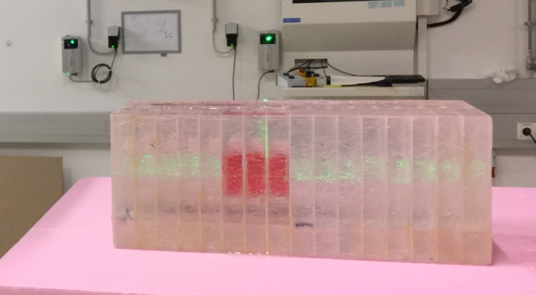
RBE Dependencies: LET
Development and implementation of a dedicated irradiation setup in cooperation with Medical Radiation Physics
Key requirement 1:
  Simultaneous irradiation of multiple samples
    investigation of end-of-range effects (LET)
Key Requirement 2:
  Variation of target depth
    investigation of target coverage energy effects
66.5 – 135.6 MeV
137.2 – 180.1 MeV

Slide 24
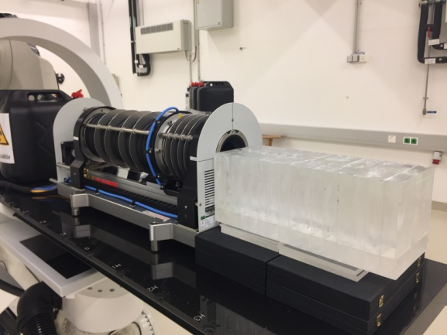
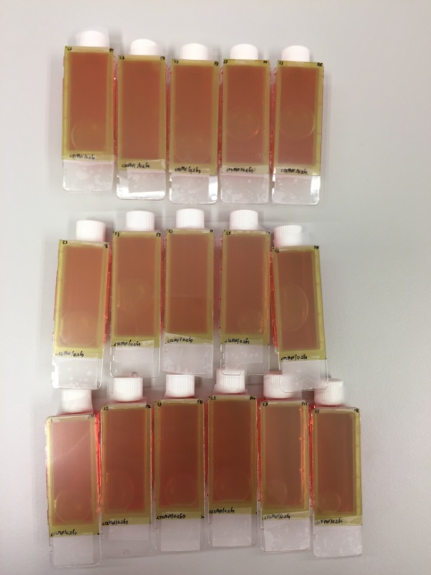
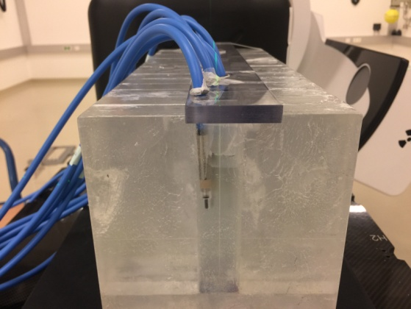
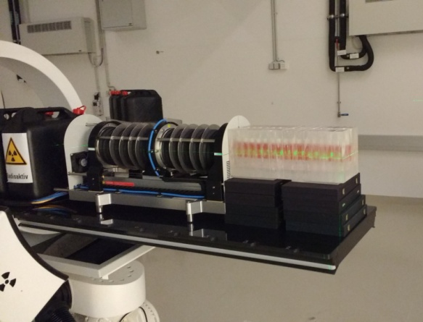
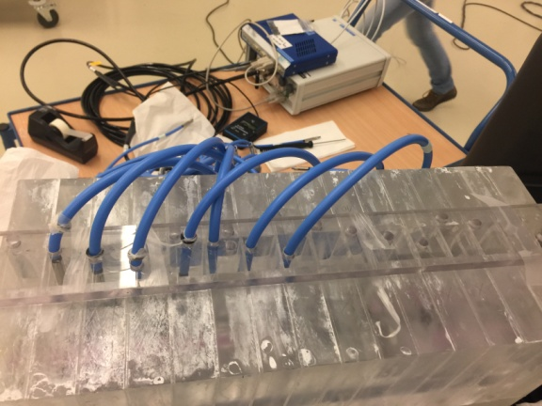
Dosimetry Aspects
Dosimetry: films
Dosimetry: Ionisation chambers
Range measurements

Slide 25
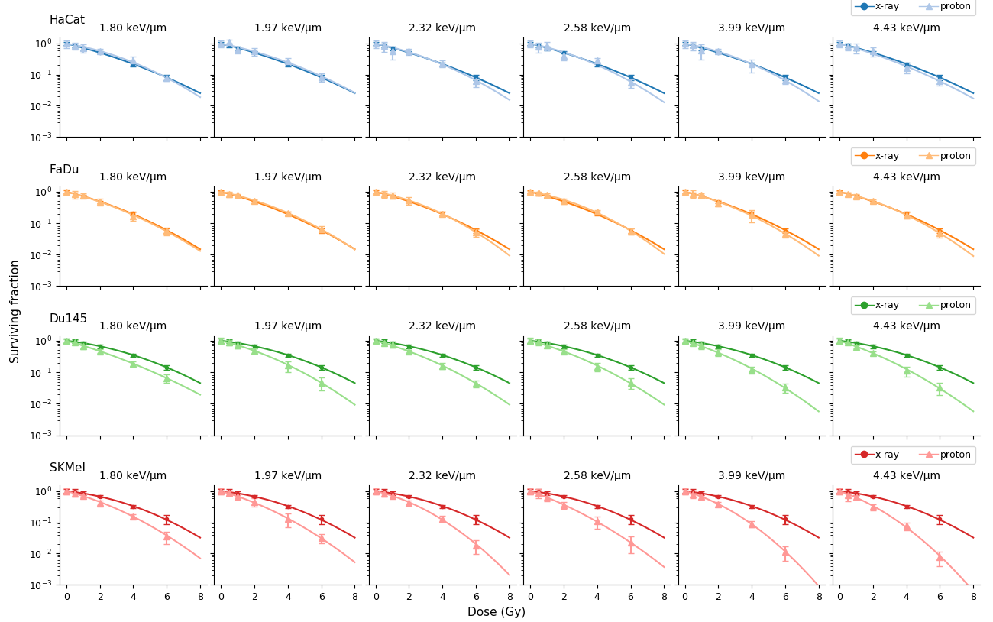
The RBE of protons: an α/β – LET relationship

Slide 26
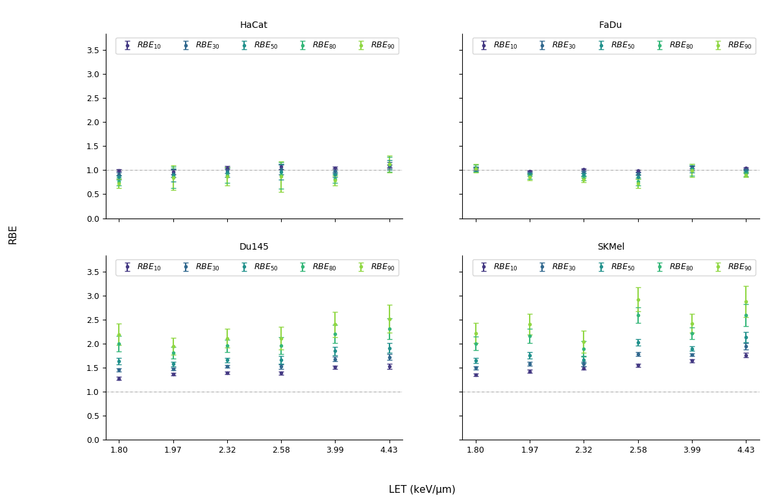
The RBE of protons: an α/β – LET relationship

Slide 27
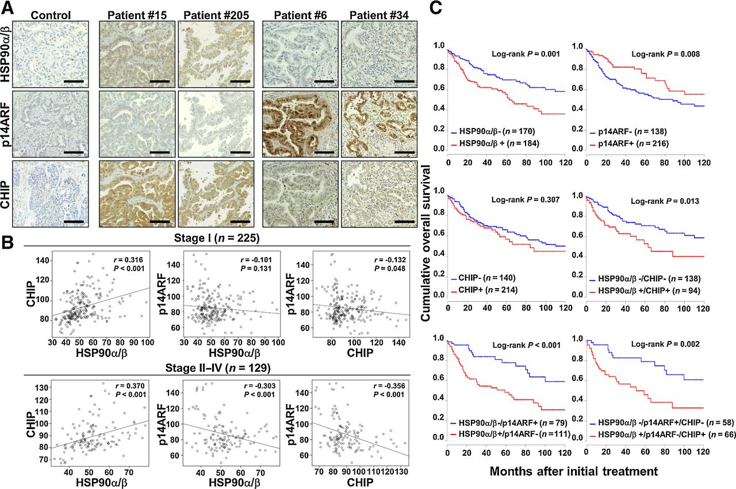
Focus of Radiobiological Research at MedAustron II
Identification of synergistic therapy mechanisms
Targeting of HSP90 in HNSCC and NSCLC

Slide 28
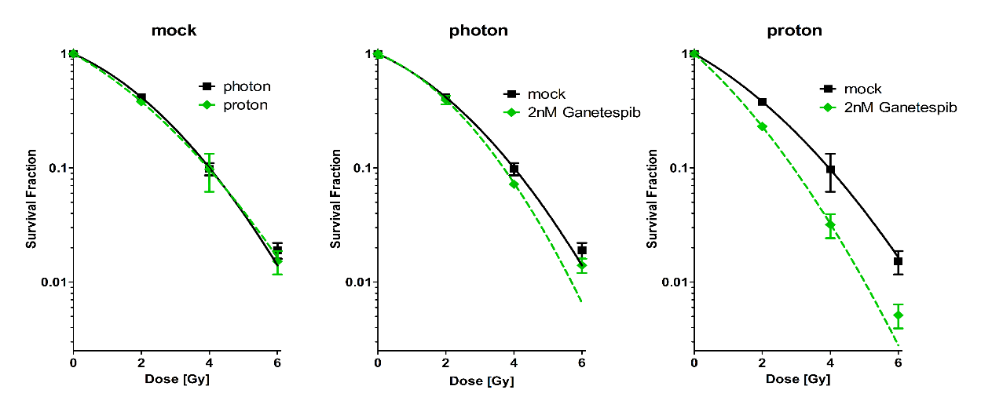
Synergistic effect of HSP90 inhibition in NSCLC

Slide 29
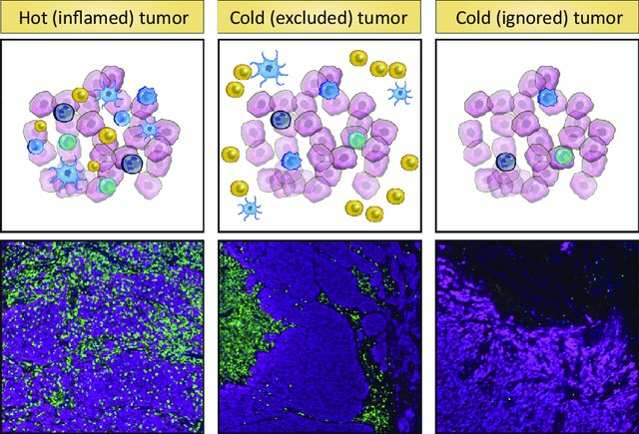
Synergistic effects of IBT: enhanced immune recognition
Hot vs. cold tumors
Hot
Cold
Excluded
immune cells
tumor
Non Small Cell Lung Cancer
Squamous Cell Carcinoma
Chondrosarcoma
Osteosarcoma
Pancreatic Cancer
Van der Woude, Trends Cancer. 2017

Slide 30
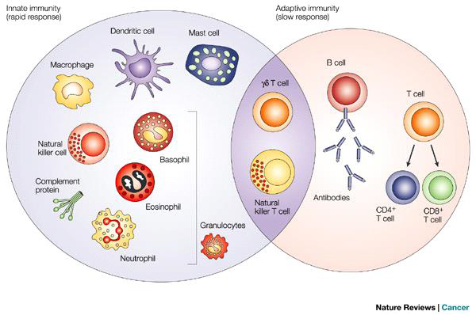
Immune System Function and Response
Innate Immunity
Adaptive Immunity
Identify and destroy non-self antigen presenting cells
Macmillan , Nature Reviews Cancer,2004

Slide 31
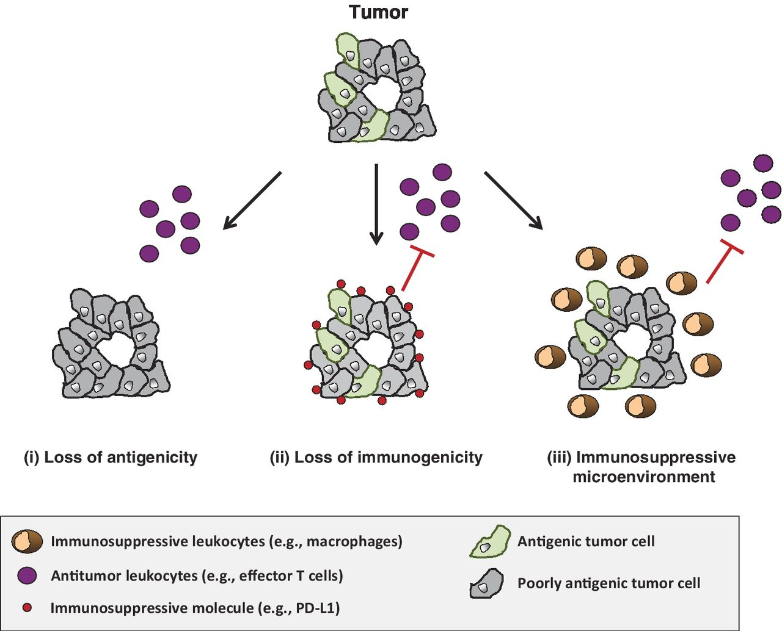
Mechanisms of Immune Escape
immune privilege =
no immune cells within or close to the tumor
Loss of antigens = loss of immune recoginition
Upregulation of immuneinhibitory antigens=
immune escape
Baetty and Gladney,
Clin Cancer Res 2015; 21(4); 687–92.

Slide 32
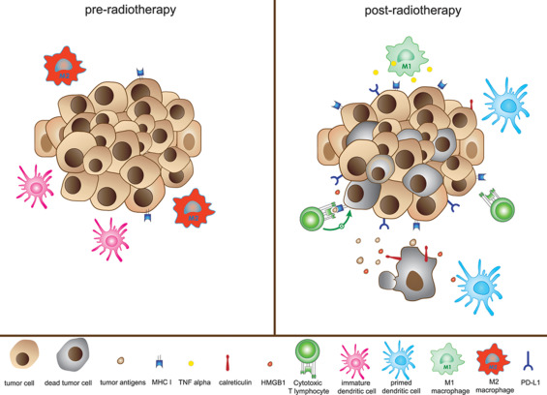
Stimulation of immune recoginition with radiotherapy
in situ vaccine
Daly et al, J.Thor.Oncol 2015; 10(12); 1685-93.

Slide 33

Stimulation of immune recoginition with radiotherapy
enhanced effect of particle radiotherapy?
Rodrigez-Ruiz et al, Cancer Res 2016; 76(20)

Slide 34


A 3D World
Baker and Chen, J Cell Sci 2012 125: 3015-3024

Slide 35
Focus of Radiobiological Research at MedAustron III
Advanced Cell Culture models
Squamous cell carcinoma cells 2D
SCC 3D
SCC 3D + ECM mimetic
SCC 3D + ECM mimetic
+ fibroblasts
head-and-neck squamous cell carcinoma
prostate carcinoma
pancreatic ductal adenocarcinoma
osteosarcoma
chondrosarcoma

Slide 36



Advances Cell Culture Models:
Multicellular Tumor Spheroids
biological function
Low
High
gradients of
oxygen
nutrients
metabolites
drugs
proliferating region
quiescent zone
hypoxic/necrotic core

Slide 37




Focus of Radiobiological Research at MedAustron IV
Effect of particle beams on the tumor microenvironment/stroma
Pancreatic ductal adenocarcinoma (PDAC)
Osteosarcoma (OS)
Tumor-stroma interactions affect:
Tumor growth, hypoxia, aggressiveness, immune phenotype
→ Therapy resistance and relapse
normal pancreatic duct PDAC
normal bone tissue osteosarcoma
Christine A Iacobuzio-Donahue; Gut (2011)
Yale Histology (2018)
Klein, Siegal; AJCP (2006)
Malignant osteoid

Slide 38

In vivo studies
Heterogeneous tumor
Biological targeting
Dose painting
MRC cancer unit (2018)
Beneficial effect of particle beam therapy?

Slide 39



Xenograft model (nude mice)
Heterogeneous cell suspension or
spheroid injection
Alginate transplantation
OMA / April 1st 2019 / Sylvia Gruber

Slide 40


Colleagues and Advisors
Radiobiology Team MedAustron
  Elisabeth Mara: RBE dependencies /3D Pancreatic cancer model
  Simon Deycmar: synergistic mechanisms
  Jakob Kowaliuk / Susanna Zakaria: in vivo studies
Prof. Dietmar Georg – Head of Medical Physics and Oncotechnology
Medical Physics and Oncotechnology Team
Dr. Thomas Schreiner – Coordinator Non Clinical Research MedAustron
Prof. Eugen Hug – Medical Director MedAustron

