Slide 1
Dosimetry of light-ion beams
Hugo Palmans
MedAustron, Wiener Neustadt, Austria
and National Physical Laboratory, Teddington, UK

Slide 2
Overview
  Dosimetry defined
  Why absorbed dose to water
  Mechanisms for dosimetry
  Detectors for dosimetry of light-ion beams:
  calorimeters, ionization chambers, solid state detectors, chemical dosimeters, microdosimeters, nanodosimeters

Slide 3
Dosimetry defined
Measurement of dose (in radiation measurement dose = absorbed dose)
Measurement of dosimetric quantities
  energy imparted (absorbed dose)
  kinetic energy released (kerma)
  number of particles (fluence)
  a function of number and energy (e.g. product of dose and a quality factor)

Slide 4
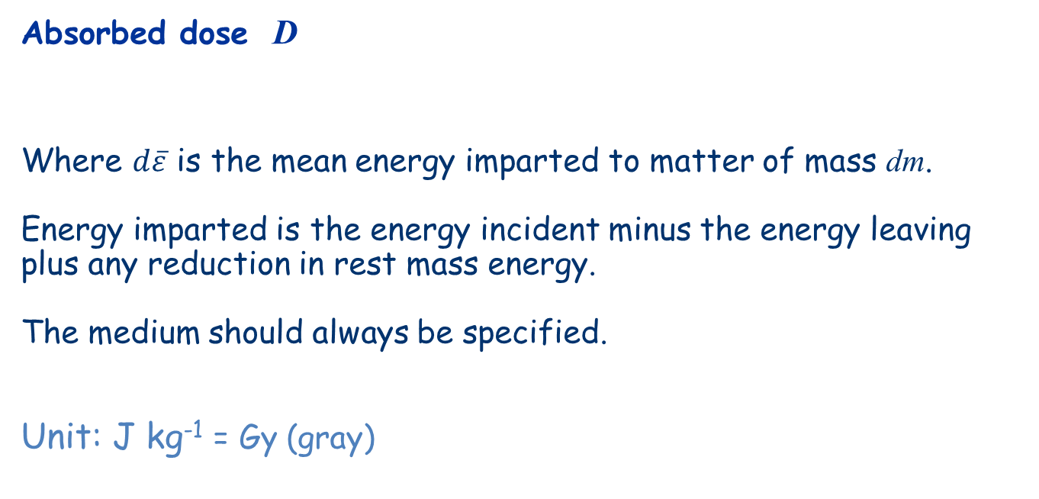
Absorbed Dose
Absorbed dose D
Where $d\overline{ε}$ is the mean energy imparted to matter of mass dm.
Energy imparted is the energy incident minus the energy leaving plus any reduction in rest mass energy.
The medium should always be specified.
Unit: J kg⁻¹ = Gy (gray)

Slide 5
Why absorbed dose to water?
  Tradition, for high-energy photon and electron beams:
  biological effect ~ f(n_{ionizations} ) ~ absorbed dose
  Water is close to tissue + ionizations mainly in water
  -> RT prescription is generally in terms of D_{w}
  Easy and reproducible material

Slide 6
Ionising radiation mechanisms for dosimetry
Ionisation
Energy cascade
Free radicals creation resulting in a chemical reaction chain
Physical effects

Slide 7
Calorimetry

Slide 8

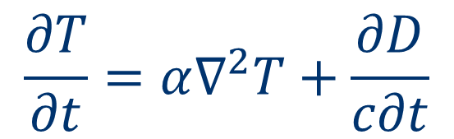
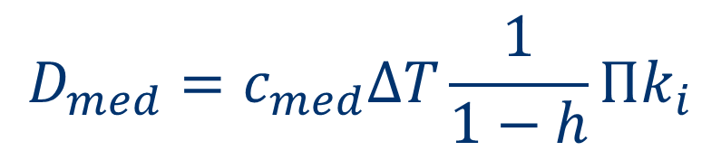
Calorimetry: principle
$$D_{med}=c_{med}∆T\frac{1}{1−h}Πk_{i}$$
$$\frac{∂T}{∂t}=α∇^{2}T+\frac{∂D}{c∂t}$$
$$D_{med}=c_{med}∆T$$
 | C (J.kg⁻¹.K⁻¹) | ΔT/D (mK.Gy⁻¹) | α (m².s⁻¹)
water | 4182 | 0.24 | 1.44x10⁻⁷
graphite | 704 | 1.42 | 0.80x10⁻⁴

Slide 9
Water calorimeter
Cooling fluid
Beam
Air
4ºC

Slide 10
Water calorimeter – chemical heat defect
H₂O⁺ e⁻ H₂O*
(10⁻¹² s)
H₃O⁺ e⁻_{aq} H• OH•
+ (10⁻⁷s)
H₂ H₂O₂ OH⁻

Slide 11
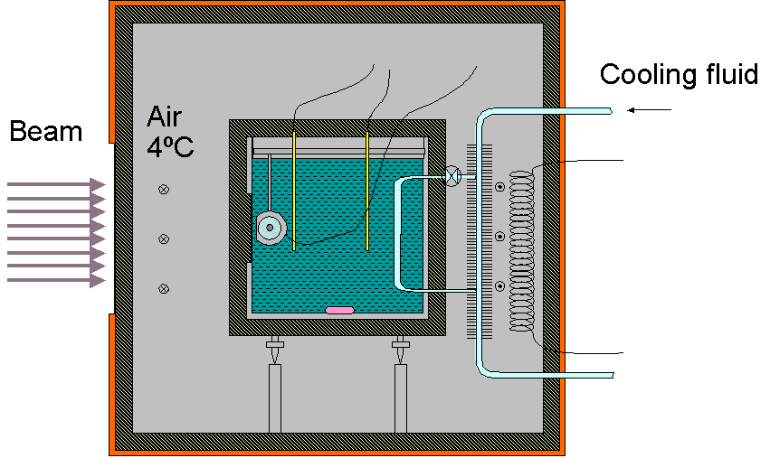
Water calorimetry / chemical heat defect protons
⁶⁰Co
(100 MeV)
protons
(1MeV)
3,0
OH•
H⁺
2,0
e¯_{aq}
G (100 eV⁻¹)
OH¯
1,0
H₂
H₂O₂
H•
0,0
HO₂
10⁻¹
10⁰
10¹
10²
LET (keV.μm⁻¹)
4,00
(-) H₂O
3,00
H⁺
G (100eV⁻¹)
OH•
2,00
e⁻_{aq}
1,00
OH⁻
H₂O₂
H₂
H•
0,00
0,0
0,2
0,4
0,6
0,8
1,0
t (s)

Slide 12
Water calorimetry / chemical heat defect ions
Brede et al. 2006 Phys. Med. Biol. 51:3667-82

Slide 13
Graphite calorimetry
Beam
D_{w}
D_{C}

Slide 14
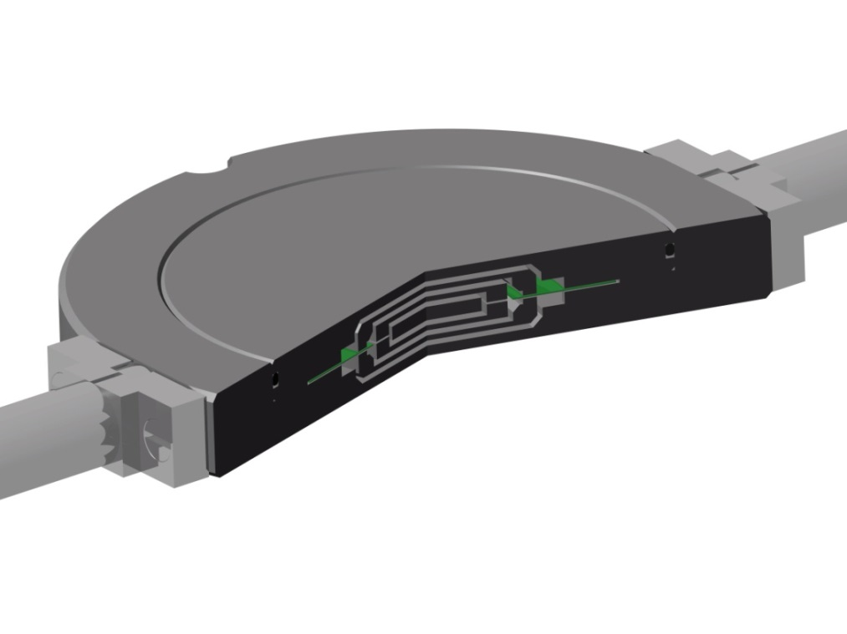
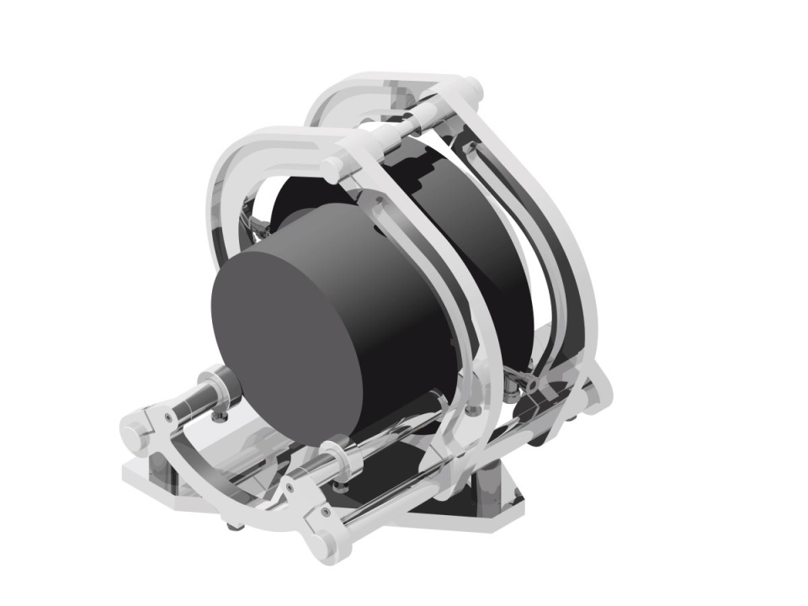
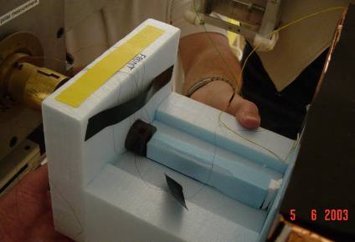
Graphite calorimetry
NPL primary standard level proton calorimeter under development:
Palmans et al (2004)
Phys Med Biol 49:3737
Core
Inner jacket
Outer jacket
Annular PCB
Graphite vacuum body
Notes:
With graphite calorimetry the thermal diffusivity is such that any temperature distribution in a small single block is levelled out within less than a second. For this reason a sample (core) is normally separated by one or more vacuum gaps from the graphite phantom as is illustrated here in a new calorimeter dedicated for proton dosimetry which is under development at NPL. The main concern with graphite calorimetry is, however, the conversion from dose to graphite to dose to water, the quantity of interest.

Slide 15
Dose conversion graphite calorimetry
k_{fl}
?

Slide 16
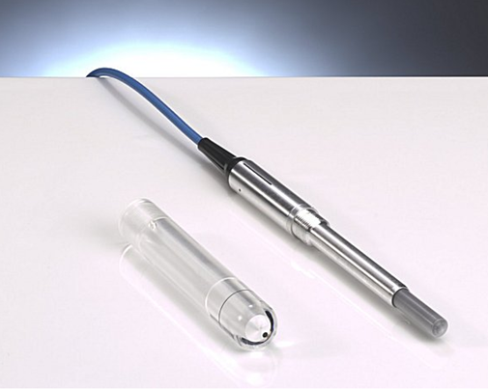
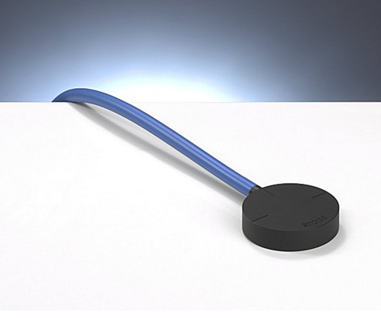
Ionization chambers

Slide 17
Dose determination with ion chamber
D
=
D
⋅
s
⋅
p
w
air
w,
air
Q
Q
D
=
⋅
W_{air}
=
⋅
W_{air}
air
m
ρ
⋅
V
air
air
Q: charge produced in the air of the chamber
W: mean energy required to produce an ion-pair in air
Unfortunately, for commercially available chambers, the volume V is not known with the necessary accuracy (would otherwise be a primary standard!).
We have to rely on methods other than “first principles”, which involve the use of ion chamber calibration factors

Slide 18

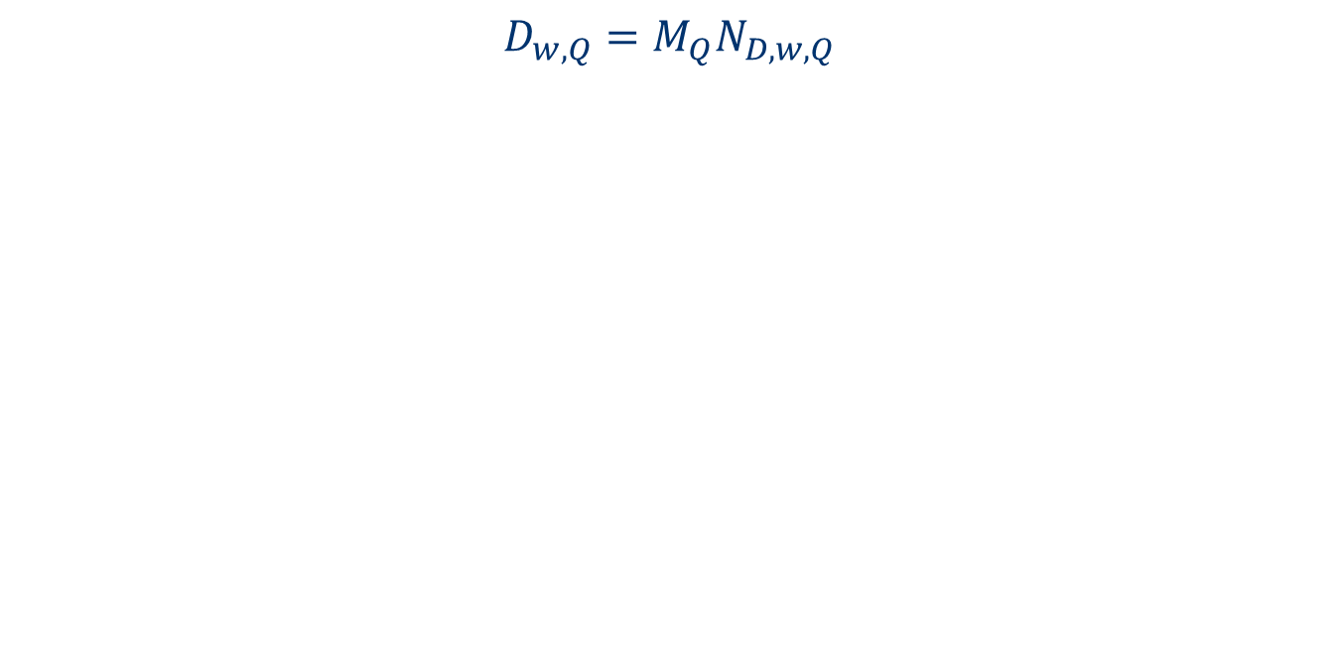
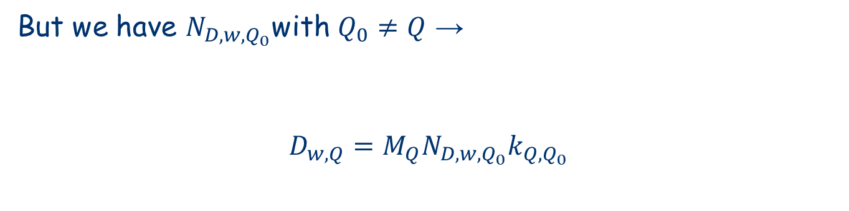

Simple absorbed dose protocol
$$D_{w,Q}=M_{Q}N_{D,w,Q}$$
But we have $N_{D,w,Q_{0}}$with $Q_{0}≠Q$ →
$$D_{w,Q}=M_{Q}N_{D,w,Q_{0}}k_{Q,Q_{0}}$$
This is formalism of IAEA TRS-398 and ICRU Report 78

Slide 19
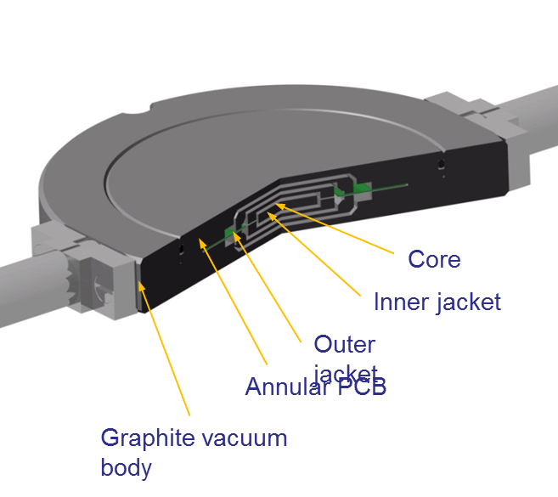


Experimental determination of $k_{Q,Q_{0}}$
$$k_{Q,Q_{0}}=\frac{N_{D,w,Q}}{N_{D,w,Q_{0}}}=\frac{{D_{w,Q}}/{M_{Q}}}{{D_{w,Q_{0}}}/{M_{Q_{0}}}}$$
$D_{w,Q_{(0)}}$ from calorimetry:

Slide 20


Calculation of $k_{Q,Q_{0}}$
$$k_{Q,Q_{0}}=\frac{{\left(W_{air}\right)}_{Q}}{{\left(W_{air}\right)}_{Q_{0}}}\frac{{\left(s_{w,air}\right)}_{Q}}{{\left(s_{w,air}\right)}_{Q_{0}}}\frac{p_{Q}}{p_{Q_{0}}}$$

Slide 21
(W_{air})_{p}
37,0
36,0
ECHED
w_{air} (J/C)
35,0
ICRU 59
AAPM-16
34,0
IAEA TRS398
33,0
0
100
200
300
400
E (MeV)

Slide 22
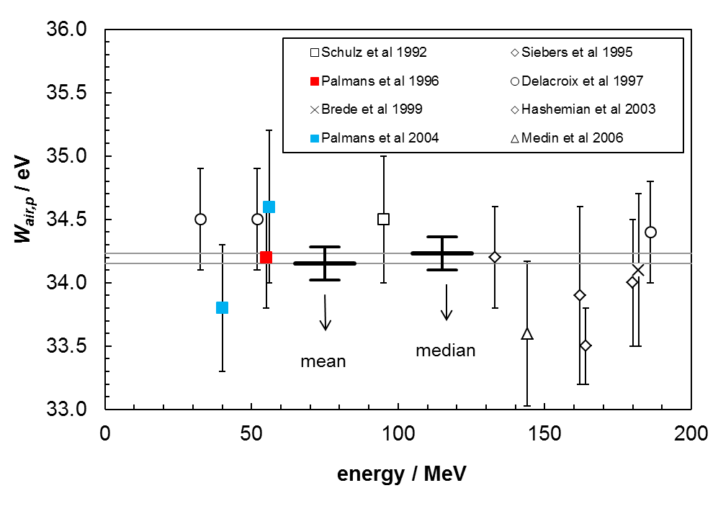
(W_{air})_{p}
Jones 2006 RPC 75:541
37,0
36,0
ECHED
w_{air} (J/C)
35,0
ICRU 59
AAPM-16
34,0
IAEA TRS398
33,0
0
100
200
300
400
E (MeV)

Slide 23
Water/air stopping power ratio
r
o,p
= 1mm
r
o,e
= 1mm
ICRU 49
ICRU 37
10³
1.30
-1
)
1.20
g
10²
2
(MeV cm
s
1.10
w,air
ρ
/
10¹
proton water
coll
protons air
S
electrons water
1.00
electrons air
sw,air protons
sw,air electrons
10⁰
0.90
10⁻⁶
10⁻⁴
10⁻²
10⁰
10²
τ
= E
k
/E
rest

Slide 24
Perturbation correction factors
p
x
R_{sleeve}
water
R_{wall}
sleeve
R_{cav}
wall
air
R_{cel}
c.e.
z
Proton
z₀
(Gy)
70.0
2
60.0
50.0
40.0
per proton per cm
30.0
20.0
air
10.0
D
0.0
5.0
reconstruction
Difference pdd and
0.0
0.0
10.0
20.0
30.0
-5.0
Depth (mm)
Palmans 2011 Proc IDOS
IAEA-CN182-230
Palmans 2006 Phys Med Biol 51:3483

Slide 25
Initial recombination
E

Slide 26
Volume recombination

Slide 27
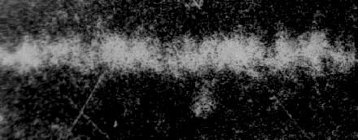

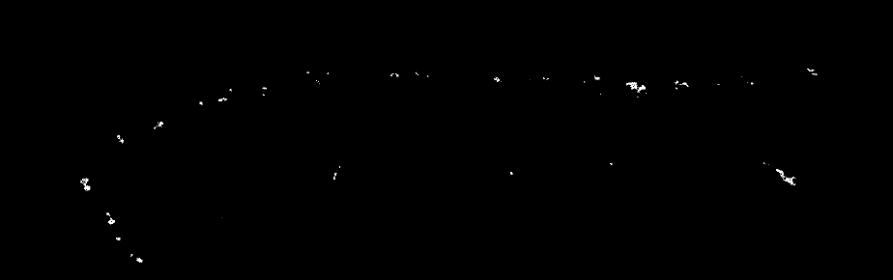
Track structure
Electron:
Alpha:
Heavy ion:

Slide 28
Initial recombination
E

Slide 29
Initial recombination
E

Slide 30
Quenching in chemical and solid dosimeters
Ionisation density
Radical formation
Termination reactions
Transport phenomena

Slide 31
Protons
-1
20.0
1
g
total
H
2
> 2 eV/nm
15.0
< 2 eV/nm
energy loss per unit depth / MeV cm
10.0
1
primary
H
> 6 eV/nm
5.0
> 10
1
1
eV/nm
secondary
H
secondary
H <10 eV/nm
> 20
eV/nm
0.0
0
5
10
15
20
25
30
-2
depth in water / g cm
Kempe et al. (2007) Med. Phys. 34:183-92

Slide 32
Carbon ions
300
-1
g
250
2
12
total
C
200
primary
12
C
energy loss per unit depth / MeV cm
150
> 60 eV/nm
100
> 40 eV/nm
> 20 eV/nm
50
1
10+11
H
4
He
C
10+11
B
0
0
5
10
15
20
25
30
35
40
-2
depth in water / g cm
Kempe et al. (2007) Med. Phys. 34:183-92

Slide 33
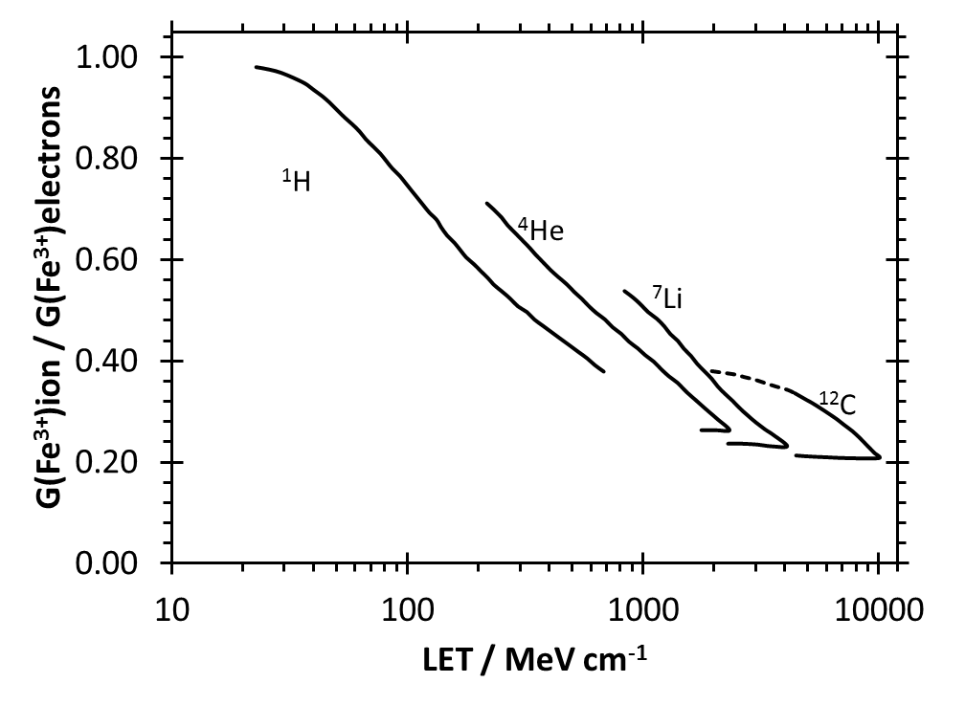

Ferrous sulphate dosimeter
${Fe}^{2+}+HO_{2}→{Fe}^{3+}+HO_{2}^{−}$
${Fe}^{2+}+H_{2}O_{2}→{Fe}^{3+}+{}_{}^{•}{OH}+OH^{−}$
${Fe}^{2+}+{}_{}^{•}{OH}→{Fe}^{3+}+OH^{−}$

Slide 34
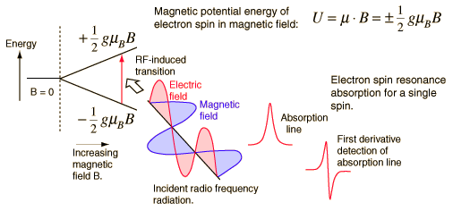
EPR or ESR - Alanine

Slide 35

Alanine/EPR
4.0
ion chamber measmnt
D_{w,γ}(alanine)
3.0
$${\overline{η}}_{aln}=\frac{\sum_{i=1}^{n_{proj}}{\sum_{j=1}^{n_{bin}}{φ\left(E_{j},Z_{i}\right)×{\left(\frac{S_{el}}{ρ}\right)}_{aln}\left(E_{j},Z_{i}\right)× η_{aln}\left(E_{j},Z_{i}\right)}}}{\sum_{i=1}^{n_{proj}}{\sum_{j=1}^{n_{bin}}{φ\left(E_{j},Z_{i}\right)×{\left(\frac{S_{el}}{ρ}\right)}_{aln}\left(E_{j},Z_{i}\right)}}}$$
dose per m.u. (Gy)
2.0
1.0
Palmans 2006
NPL report DQL-RD003
0.0
0.0
0.5
1.0
1.5
2.0
2.5
3.0
depth in alanine (cm)

Slide 36
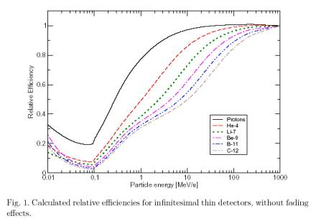
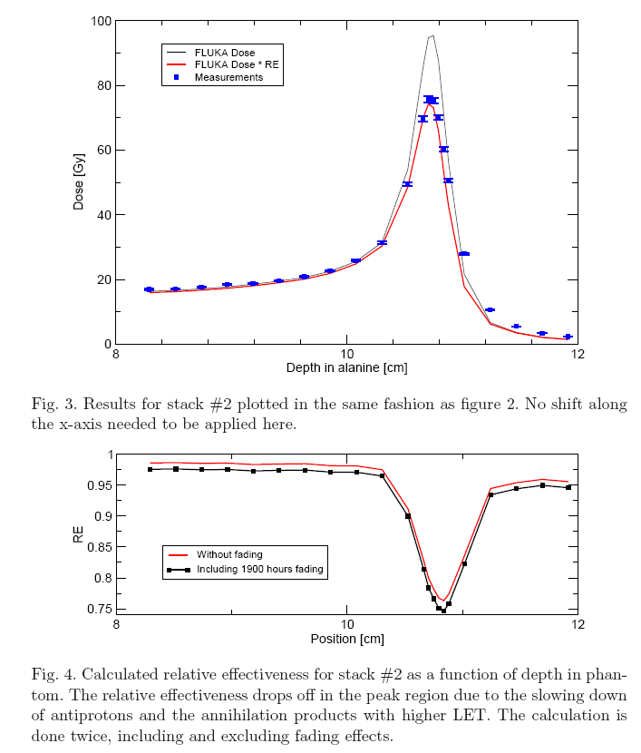
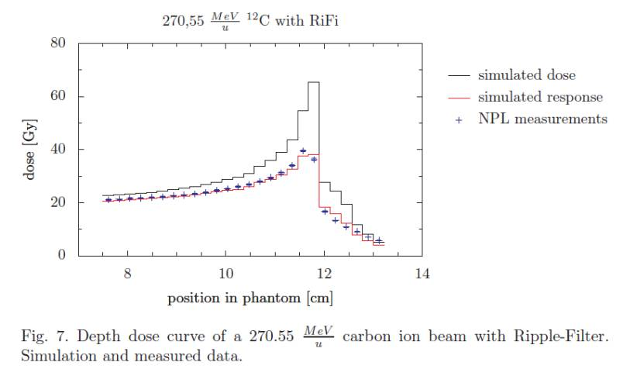
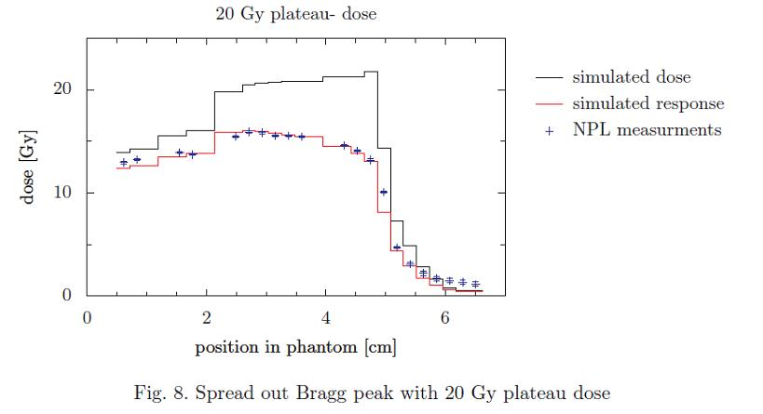
Alanine/EPR dosimetry
Bassler et al, NIMB 266 929-936, 2008
CERN anti-proton beam
Birmingham 15 MeV beam
Herrmann et al 2011 Med Phys 38:1859
GSI ¹²C ion beam

Slide 37
Radiochromic film
Protons
Vatnitsky 1997 Appl Rad Isot 48:643
Carbon ions
Martisikova 2010 PMB 55:5557

Slide 38
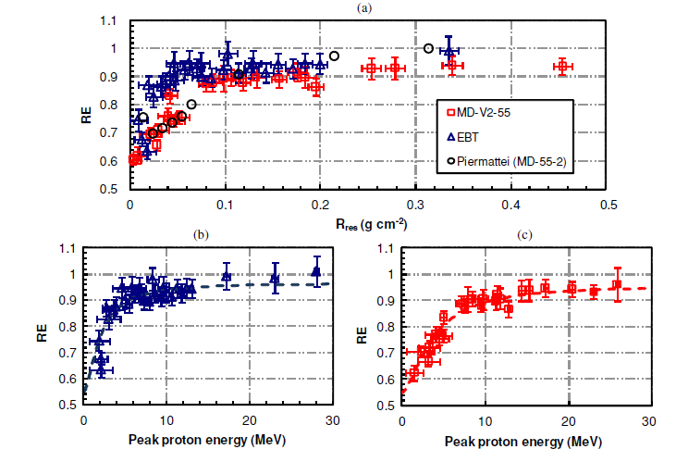
Radiochromic film – energy dependence
Kirby et al. 2010 Phys Med Biol 55:417

Slide 39
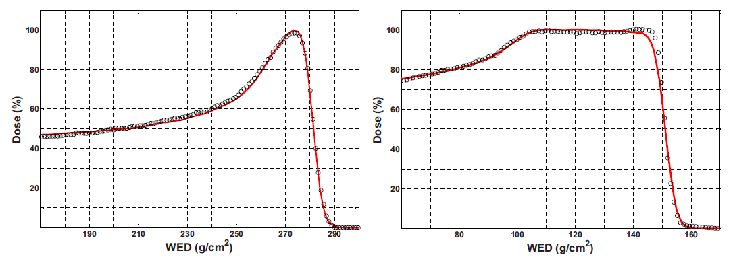
Polymer gel dosimetry
BANG:
BANG3-Pro2:
Heufelder et al. 2003.
Zeidan et al. 2010 Med Phys 37:2145

Slide 40
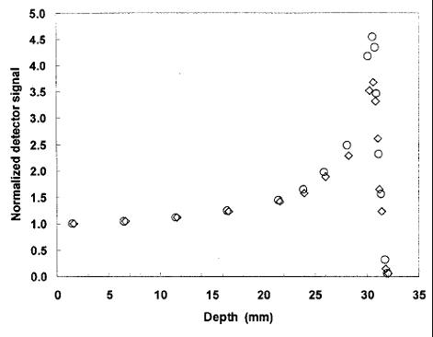
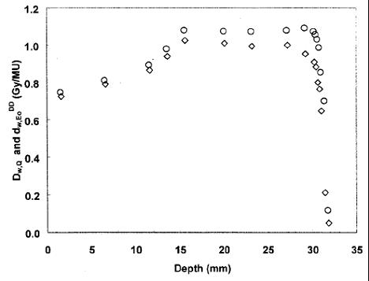
Natural diamond detector
Fidanzio et al 2002 Med Phys 29:669

Slide 41
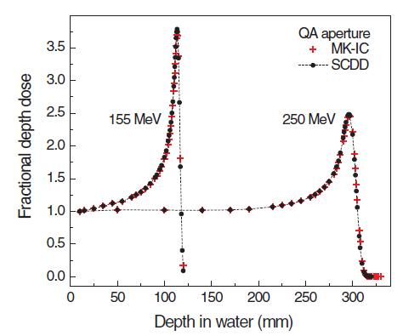
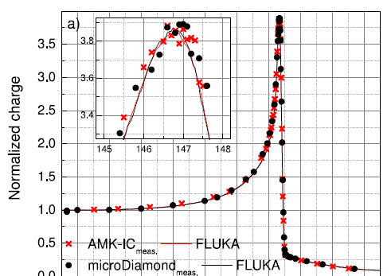

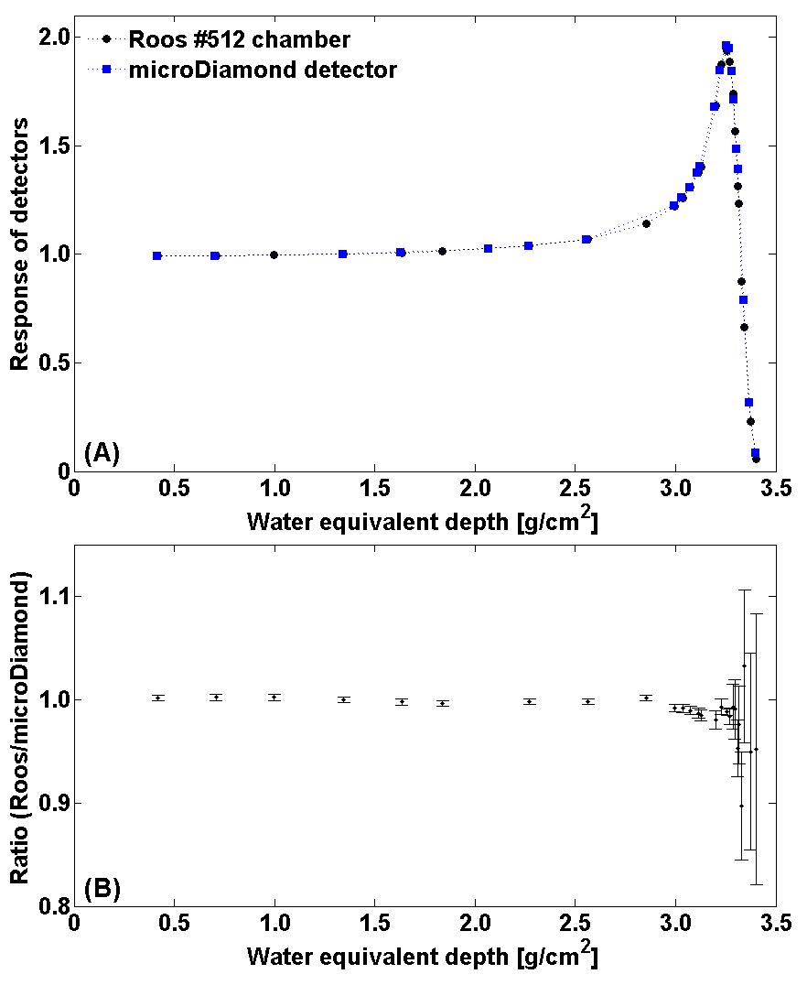
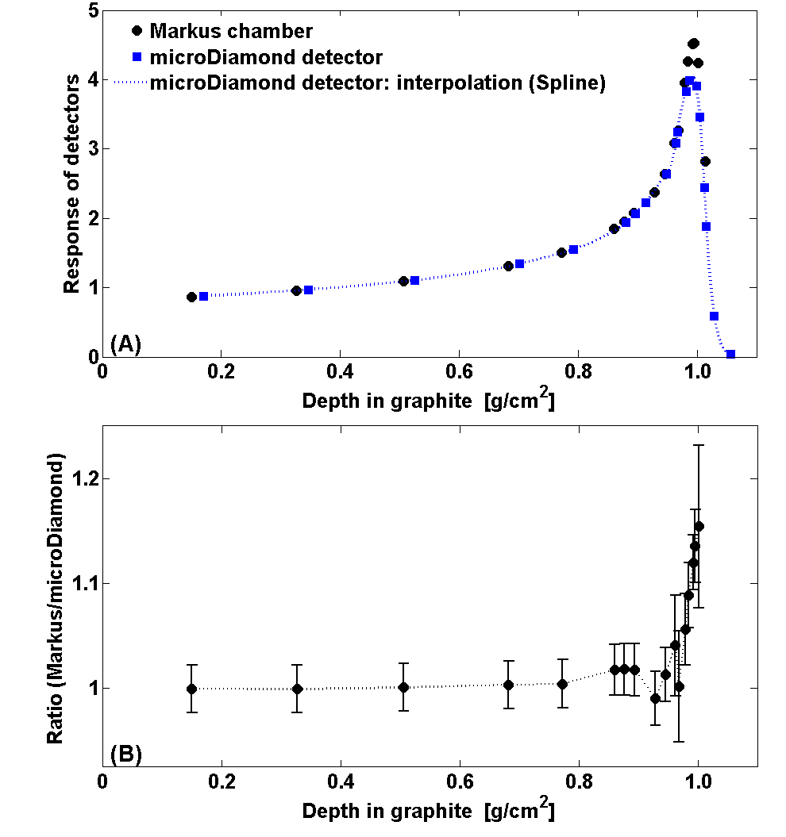
CVD diamond
HE protons: Mandapaka, Med Phys 40:121702
HE carbon ions: Marinelli, Med Phys 42:2085
LE protons: Rossomme et al. (BHPA 2016)
LE carbon ions: Rossomme et al. (BHPA 2016)
/ submitted Med Phys

Slide 42
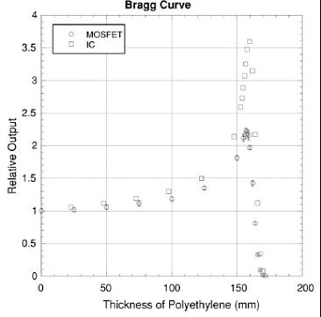
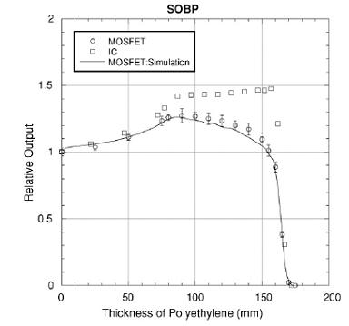
Silicon-based detectors
Kohno et al 2006 Phys Med Biol 51:6077

Slide 43
TLD - protons
Besserer 2001 Phys Med Biol 46:473

Slide 44
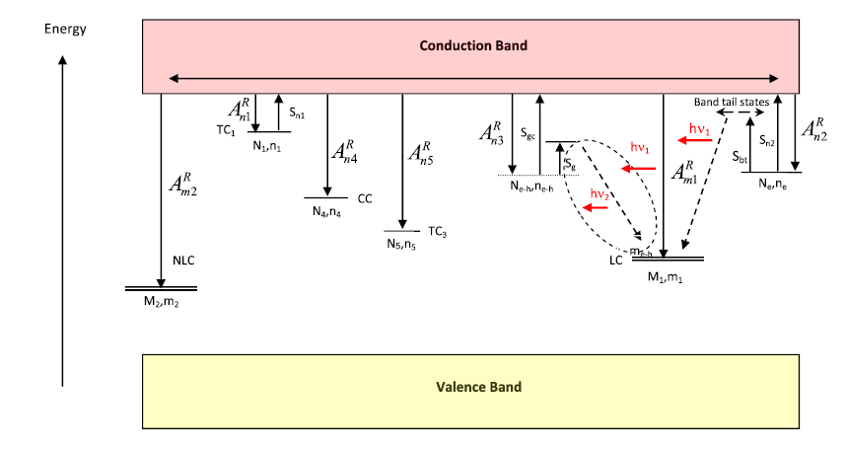
TLD - protons
Eliyahu 2014 Radiat Meas 71:226

Slide 45
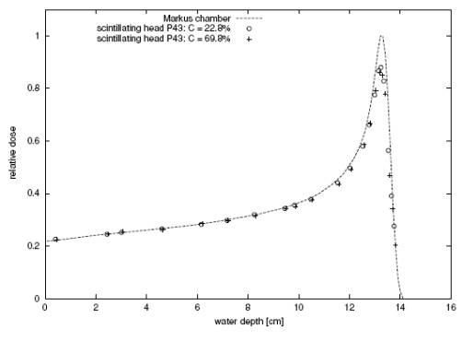
Scintillators
Safai et al. 2004 Phys. Med. Biol. 49:4637

Slide 46
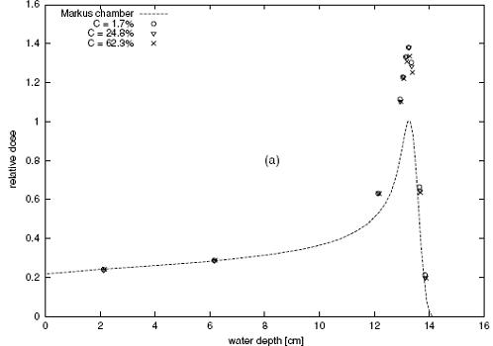
Scintillators
Safai et al. 2004 Phys. Med. Biol. 49:4637

Slide 47
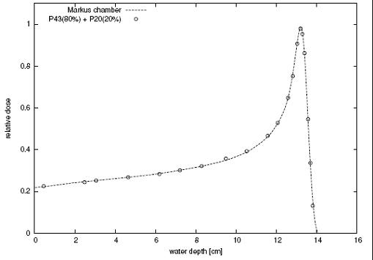
Scintillators
Safai et al. 2004 Phys. Med. Biol. 49:4637

Slide 48

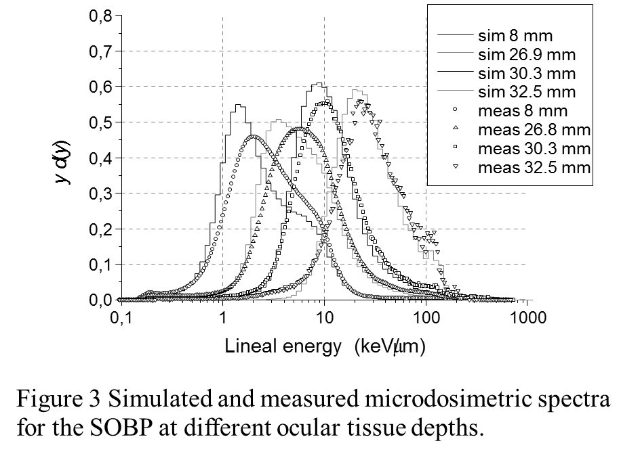
Microdosimetry…
Cathode (A-150 plastic)
Gas In
Gas Out
Aluminium
Rexolite®
Sensitive Volume: 0.9x0.9 mm²
Andrea Pola, Politecnico di Milano
Rollet et al 2010, Rad Prot Dosim 143:445

Slide 49
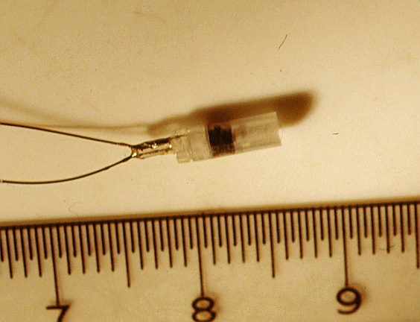
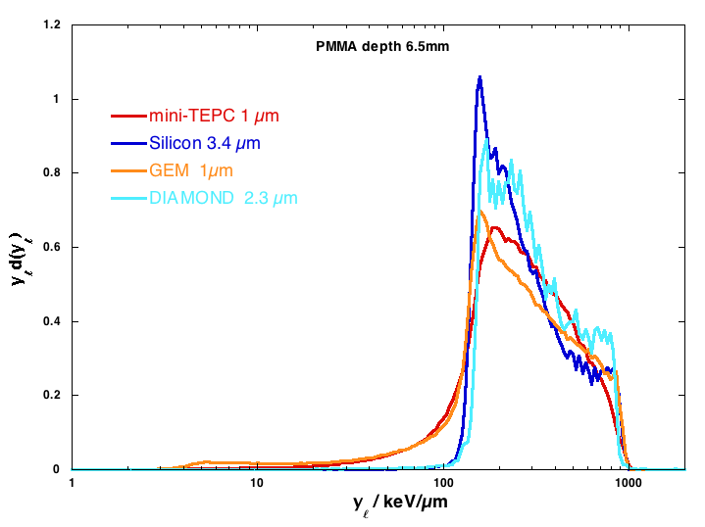
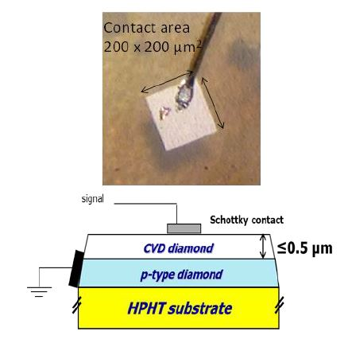
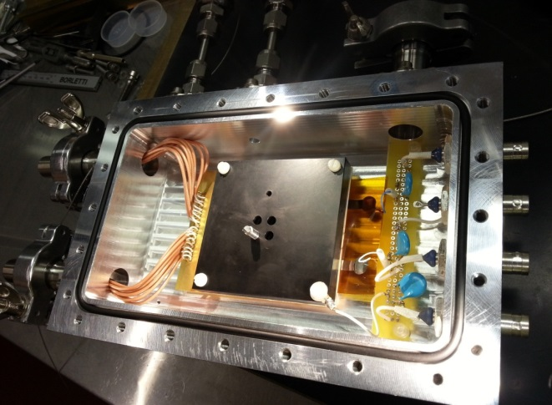
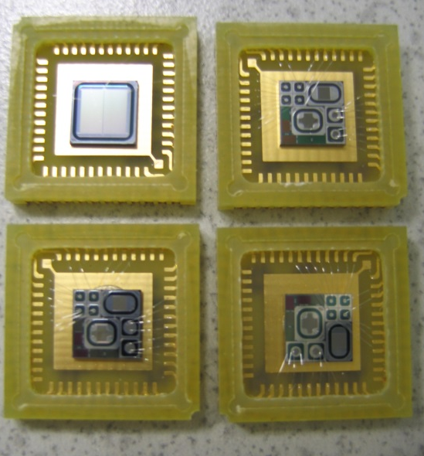
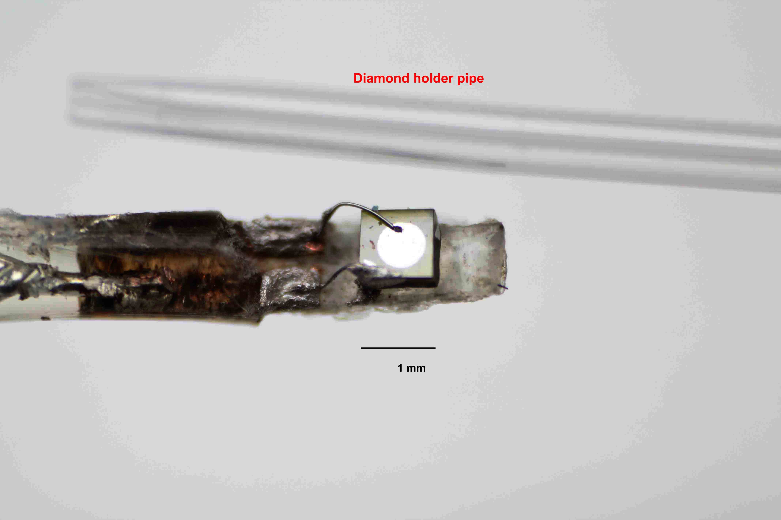
Microdosimetry
Colautti et al 2017 ESTRO Physics workshop Glasgow

Slide 50
Nanodosimetry…
Ion counter / PTB Startrack / INFN

Slide 51
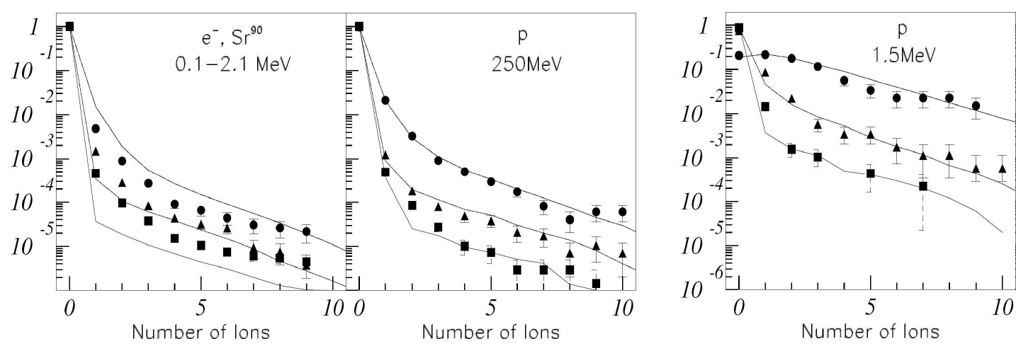
Schulte et al 2011 AIP Conf Proc 1345:249

Slide 52
Conclusions
No ideal detectors for proton and carbon ions
Calorimeters can serve as primary standards
Ionization chambers remain workhorse for light-ion reference dosimetry
Most chemical and solid state dosimeters exhibit signal quenching in the Bragg peak
Micro- and nano-dosimetry

Slide 53
Reading
H. Palmans, A. Kacperek and O. Jäkel, “Hadron dosimetry” In: Clinical Dosimetry Measurements in Radiotherapy (AAPM 2009 Summer School), Ed. D. W. O. Rogers and J. Cygler, (Medical Physics Publishing), 2009
C. P. Karger, O. Jäkel, H. Palmans and T. Kanai, “Dosimetry for Ion Beam Radiotherapy,” Phys. Med. Biol. 55(21) R193-R234, 2010
Proton Therapy Physics, Ed. H. Paganetti (Taylor & Francis), 2011, second edition 2018
M. F. Moyers and S. Vatnitsky, Practical Implementation of Light Ion Beam Treatments, (Medical Physics Publishing), 2012
Principles and practice of proton beam therapy (AAPM 2015 Summer School), Ed. I. J. Das and H. Paganetti, (Medical Physics Publishing), 2015
H. Palmans, “Light-ion beam dosimetry” In: Clinical 3D Dosimetry in Modern Radiation Therapy, Ed. B. Mijnheer, (Taylor & Francis), 2017

