Slide 1
Treatment Planning NTCP Models
Sarah Gulliford
2nd April 2019
UCLH

Slide 2
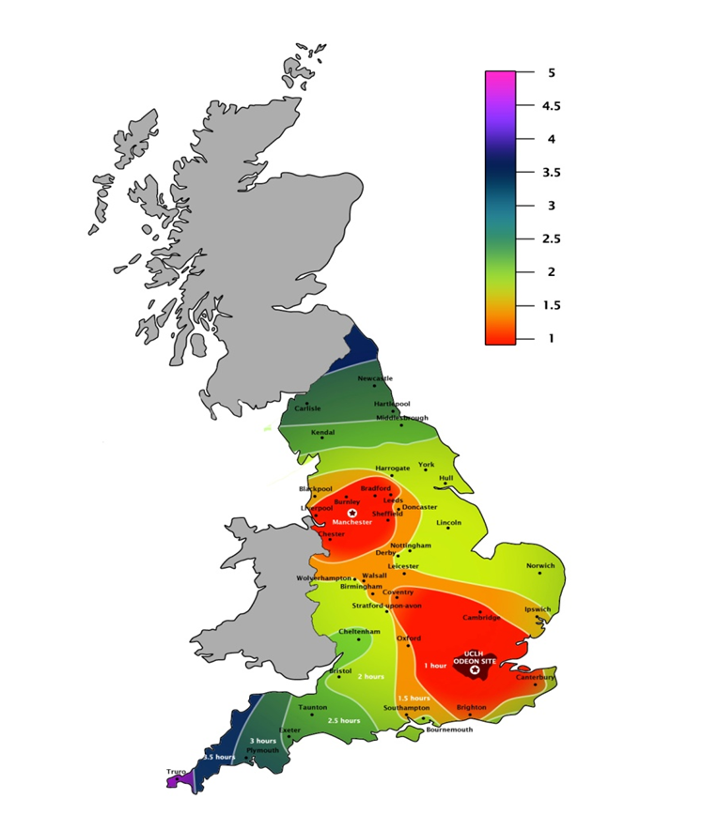


In 2012 NHS England confirmed the two National PBT centres would be the Christie Hospital in Manchester and UCLH in London

Slide 3
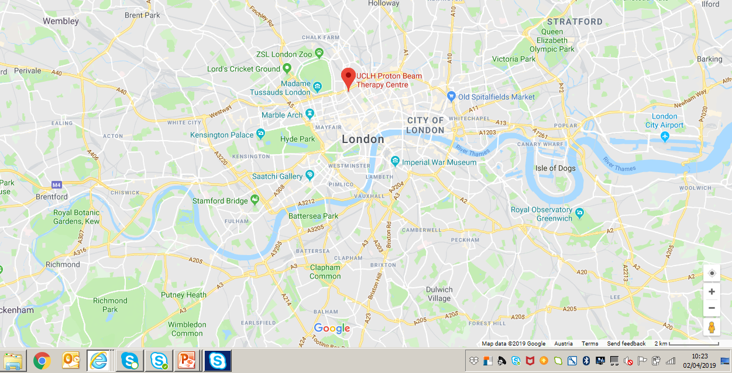
UCLH Proton Beam Therapy Centre

Slide 4
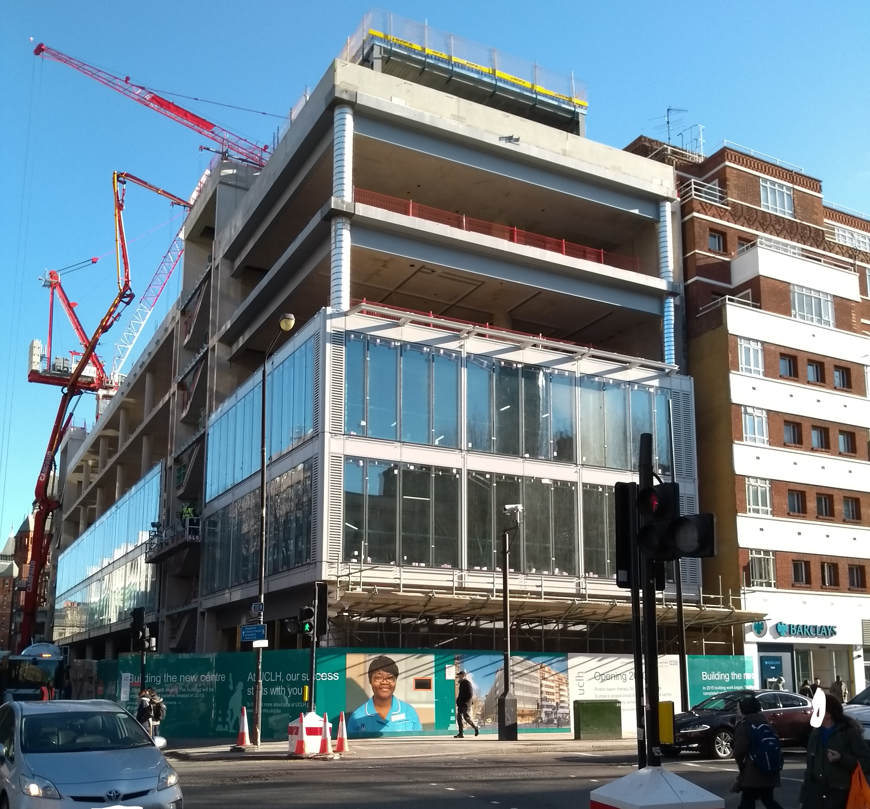
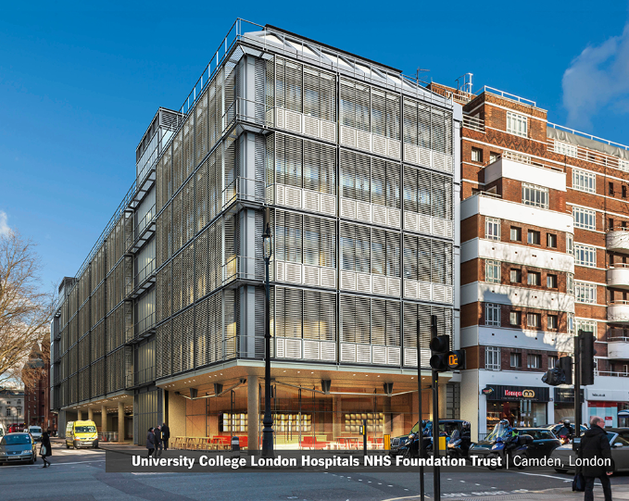

Slide 5
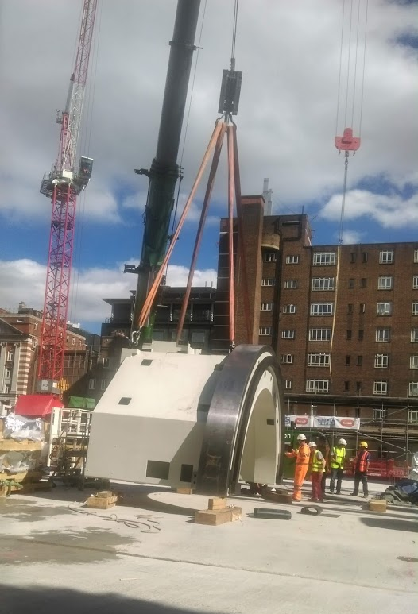
Section of Gantry 4 being lowered

Slide 6
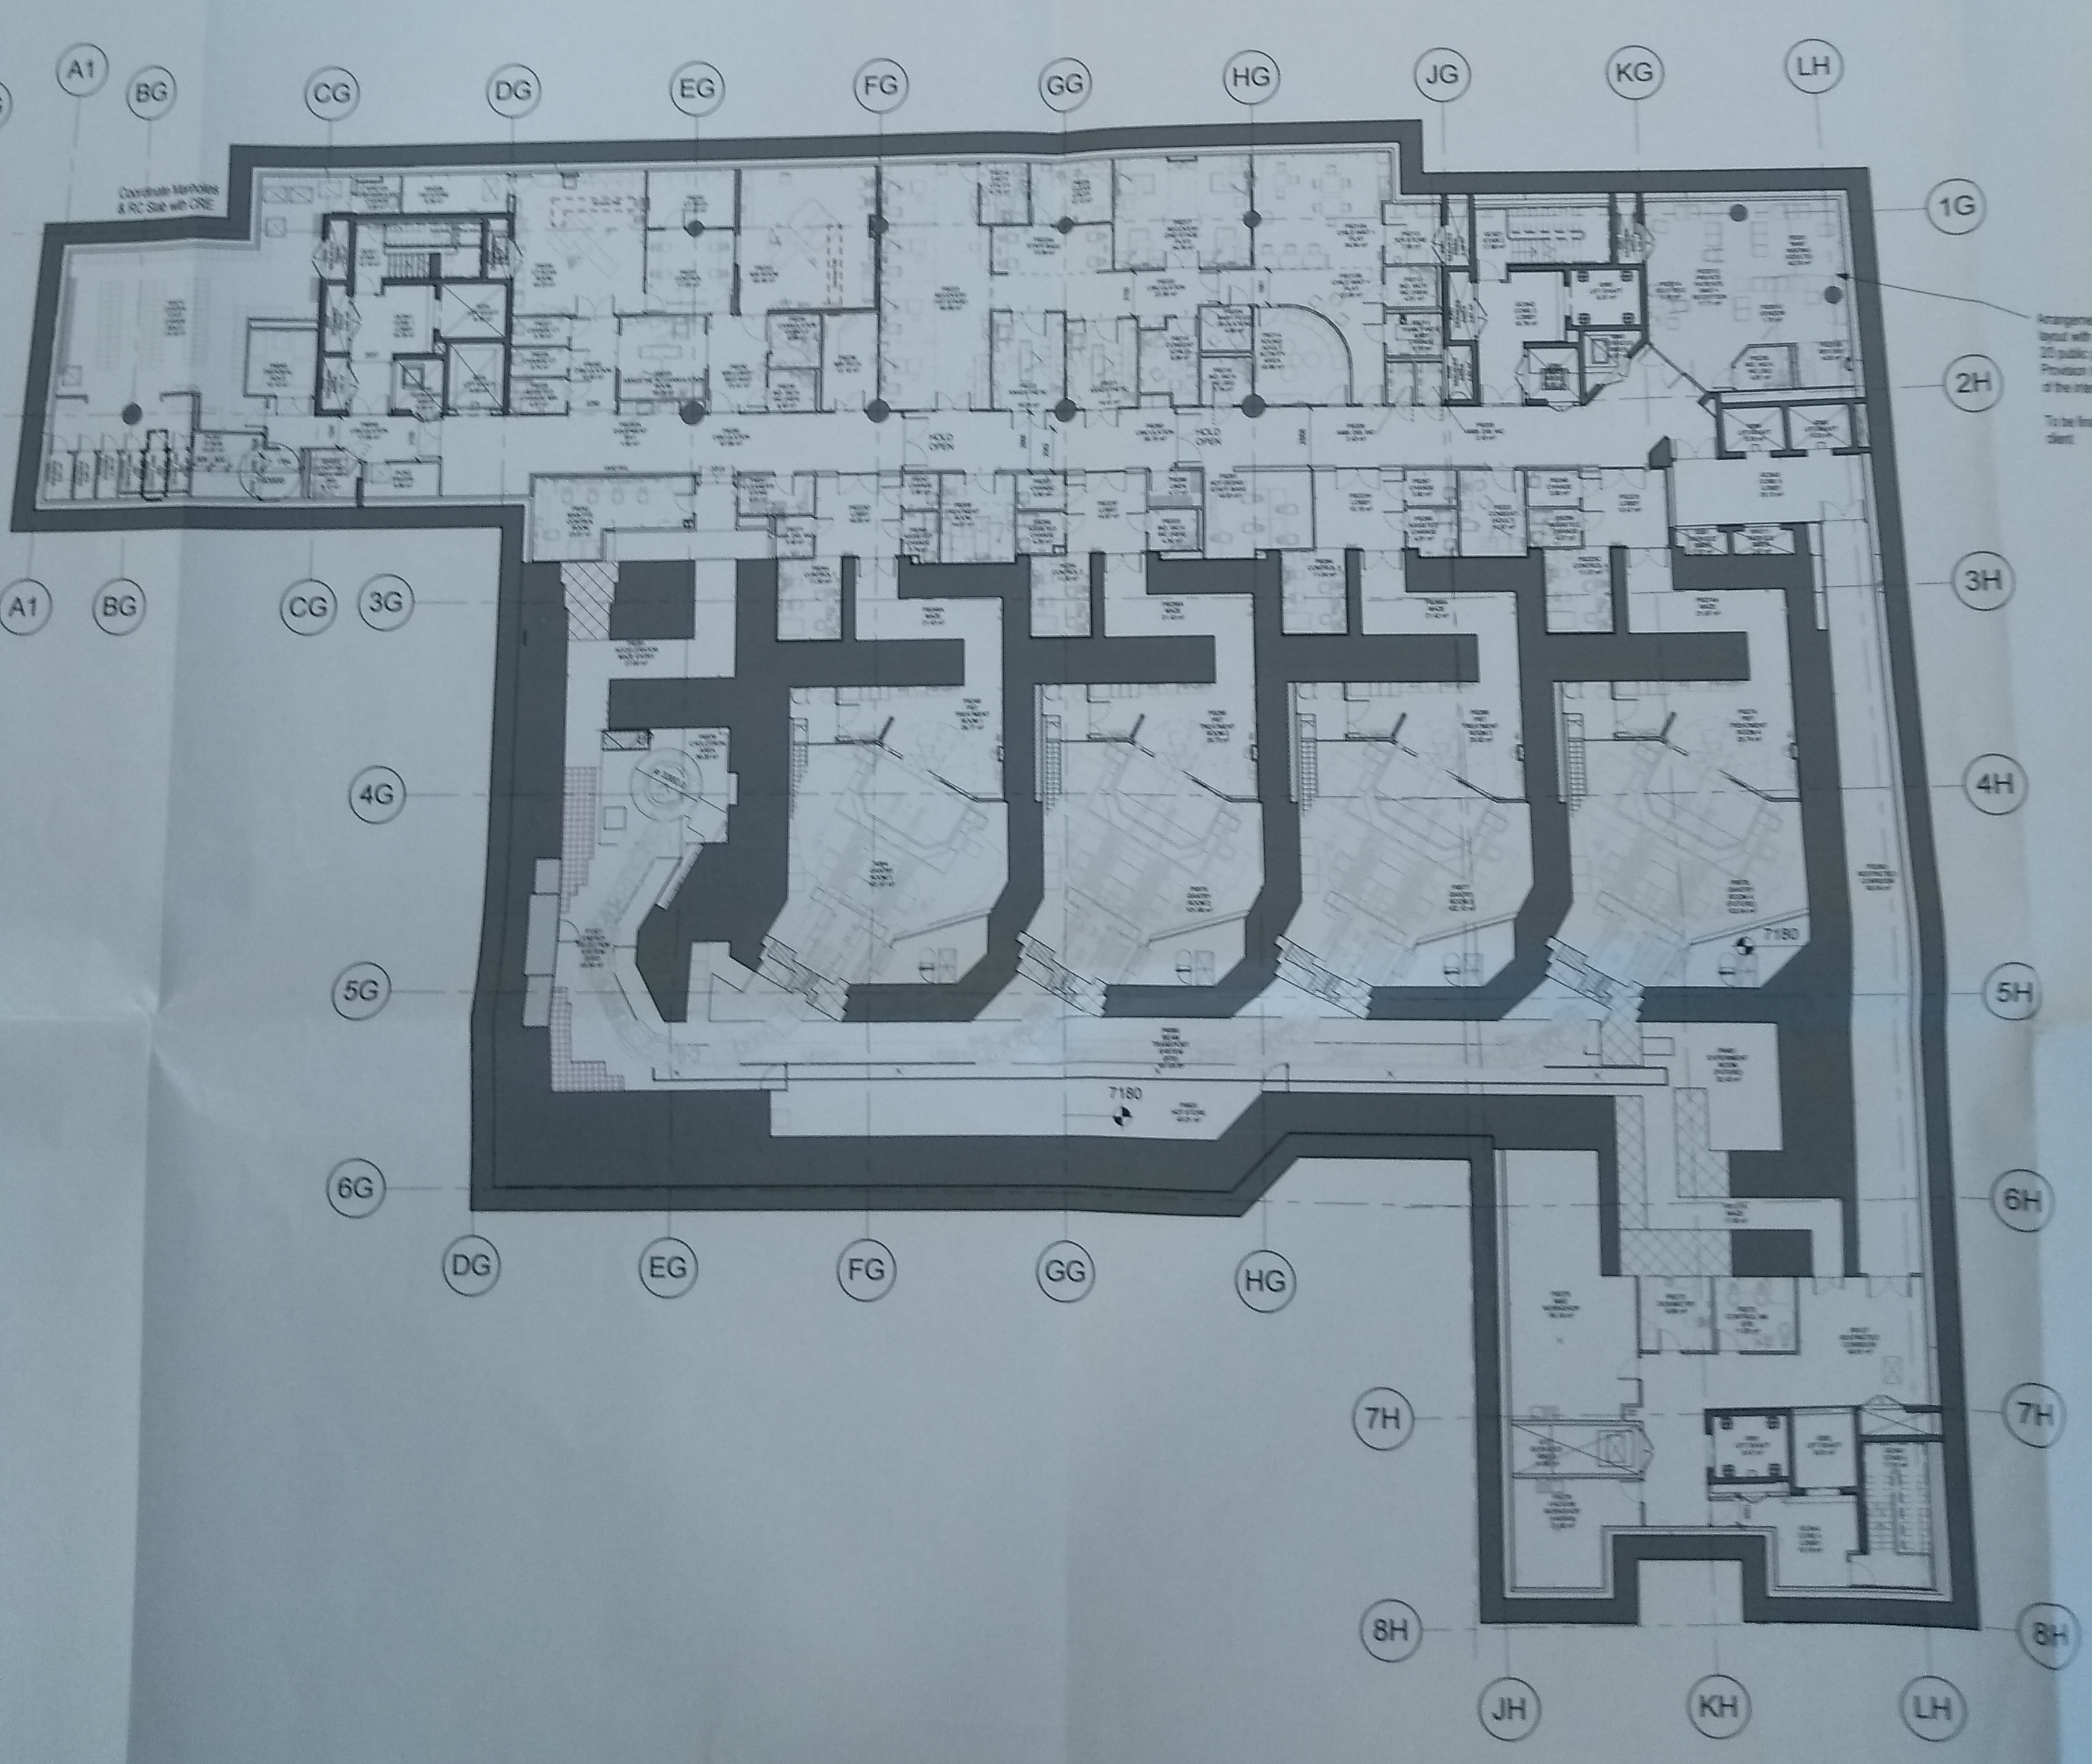
CT
MR
ANAESTHETICS
MOD
CYC
G1
G2
G3
G4
ESS
BEAMLINE

Slide 7
Where do we start?
We want to characterise the response of normal tissues so that we can design treatments that minimise the risk of toxicity and maximise the probability of “cure”

Slide 8
Inhomogeneity of dose distribution

Slide 9
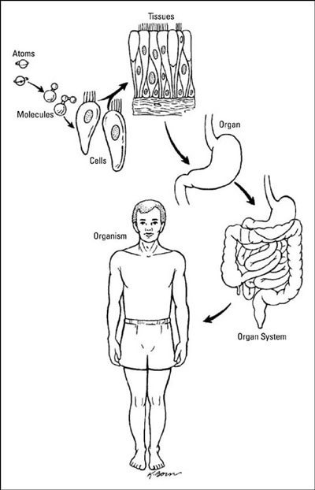
Normal tissue toxicity
  Cells
  Tissues
  Organs
http://www.dummies.com/how-to/content/building-the-body-from-atoms-to-organs.html
Notes:
What’s the difference between tissues and organs?

Slide 10
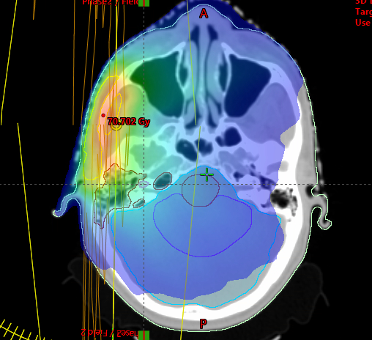
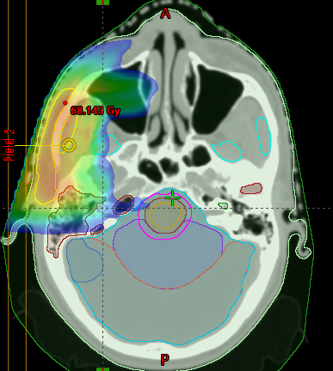
Plan Comparison

Slide 11
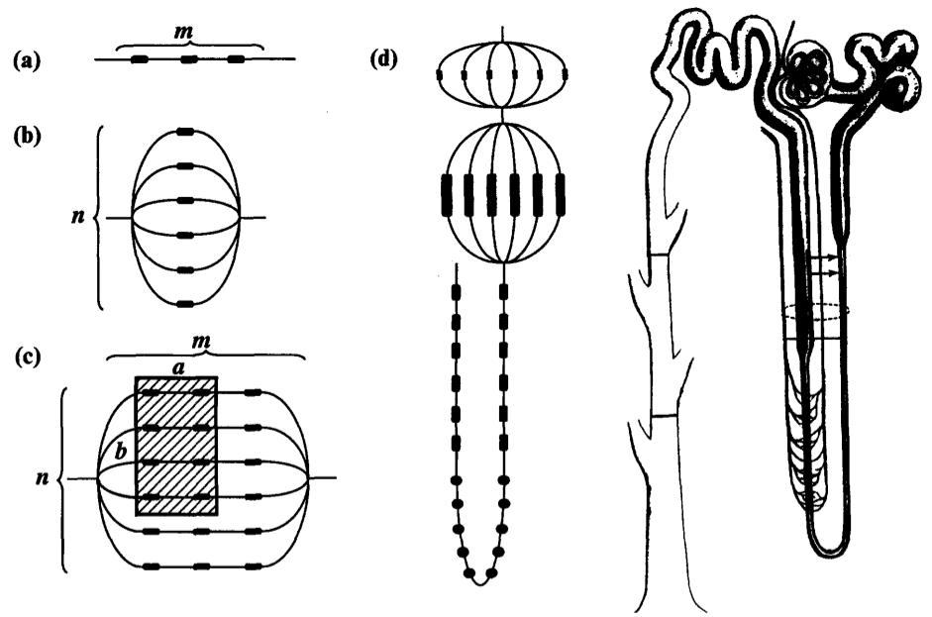
Organ architecture
Each organ different in terms of FSU interaction
Parallel type response like a rope: it can perform its function even if some strands break.
  Large volume effect
Serial type response like a chain: function is lost if any one link breaks.
  Small volume effect
Källman, P.; Ågren, A. & Brahme, A. Tumour and normal tissue responses to fractionated non-uniform dose delivery.
Int J Radiat Biol, 1992, 62, 249-262

Slide 12
Organ architecture
In some tissues FSU are anatomically defined structures
“An example of the
parallel-serial model applied to a functional subunit of kidney, a nephron, is shown in d). The first parallel structure is the capillary system inside the glomerular capsule, followed by the capsule itself and the limbs and Henle's loop.
In other tissues there is no anatomical demarcation of the FSU
Skin
Mucosa
Spinal cord
Källman, P.; Ågren, A. & Brahme, A. Tumour and normal tissue responses to fractionated non-uniform dose delivery.
Int J Radiat Biol, 1992, 62, 249-262

Slide 13
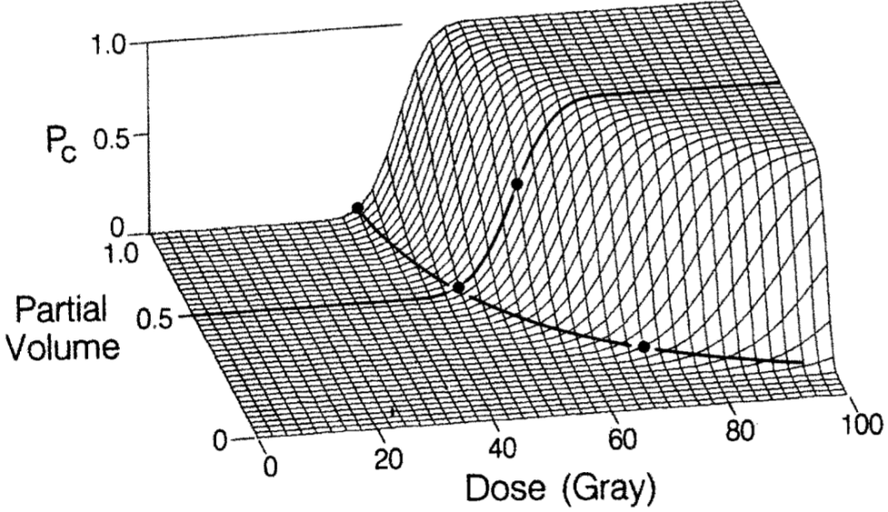
Volume effect
Sigmoid dose-response for partial (uniform) organ irradiation:
The volume effect depends on:
Functional reserve
Migration of cells
Stochastic tissue damage
Inflammatory response?
Nb volume effect ≠ FSU in planning terms
Lyman, J. T. Complication probability as assessed from dose-volume histograms. Radiat Res Suppl, 1985, 8, S13-S19
Notes:
Firstly, the dose-volume response of an organ strongly depends onits functional reserve. If the functional reserve is large the com-plication probability is associated with the overall tissue damage,whilst if it is small even small volumes of tissue damage causemorbidity. Alber and N ̈sslin called this the volume effect of theufirst kind [30]. Secondly, for anatomical/structural damage, tissuerepair often relies on migration of viable cells into the damagedvolume, and in this case there is a saturation of damage whendistances within the damaged volume exceed the distance overwhich a cell can migrate. It is therefore not surprising that the6critical irradiated volume seems to be independent of the size ofthe individual [26]. Thirdly, the stochastic nature of radiationdamage can cause a volume effect in some tissues [1, 29] (called thevolume effect of the second kind by Alber and N ̈sslin [30]). Thisuwould be the case if a complication were triggered by a certainamount of contiguous tissue damage, since, if a larger volume isirradiated the likelihood increases that, somewhere in the organ, acritical contiguous volume is damaged. Finally, it is also possiblethat the radiosensitivity of a tissue could increase with increasingirradiated volume [29], perhaps due to secondary injury caused byoxygen radicals produced by inflammatory cytokines (which canalso cause ‘out of field’ effects) [21]. If more cells are irradiatedthe amount of cytokines in the irradiated volume could increase,leading to the additional tissue damage, and also a certain level ofdamage outside the irradiated volume [21].

Slide 14
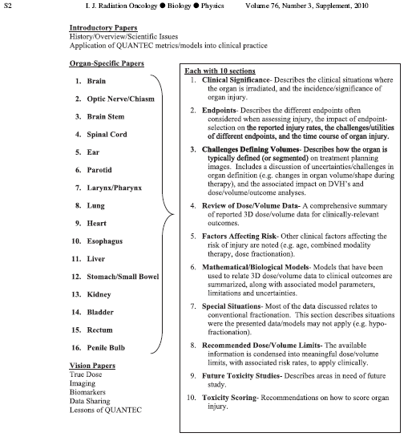
Quantec
Quantitative Analysis of Normal Tissue Effects in the Clinic (QUANTEC).
IJROBP 76 (3) Supplement 2010

Slide 15
Common dose parameters
Lots of data on normal tissue response have been collected over the last 20 years.
Different dose parameters correlate with toxicity
  Maximum dose
  Mean dose
  V_{x} (the volume receiving at least x Gy)
The relevant dose depends on the organ architecture, the size of the functional reserve.
No reserve: maximum dose?
Large reserve: V_{x} or mean dose?

Slide 16
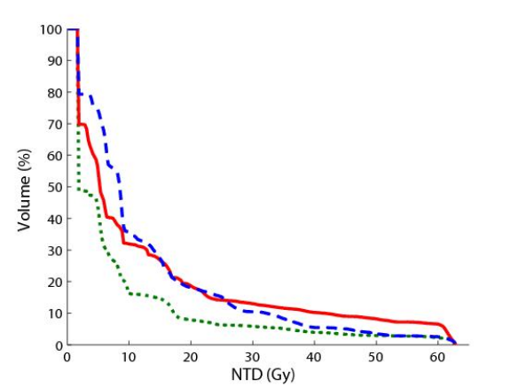
Dose volume histogram (DVH)
(Cumulative) dose volume histograms (DVHs) are often used to evaluate treatment plans.
Useful for comparing alternative plans
If two DVHs overlap it is not clear which is better.
DVH needs to be reduced to a single parameter.

Slide 17

Regression-based NTCP models
NTCP=$\frac{1}{1+e^{−(β_{0}+x_{1}β_{1}……..)}}$
Model with a continuous output between 0 & 1.
Coefficients fitted with multivariate logistic regression

Slide 18
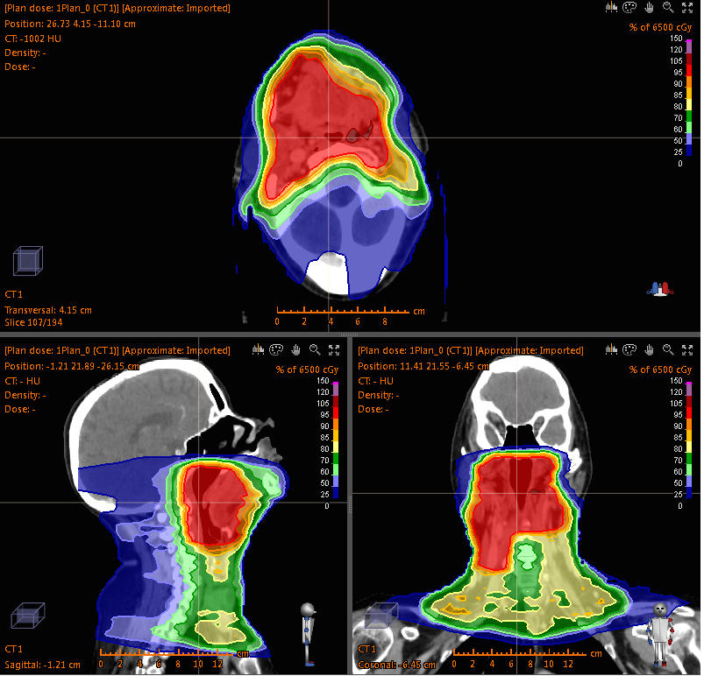
Radiotherapy planning
  Parotid gland
  Parotid gland
  Spinal cord
  Primary planning target volume
  Brain stem
  Nodal planning target volume
  Oral cavity
Notes:
Personalized dose distributions produced for each patient based on anatomy
Mention dose constraints and optimization

Slide 19
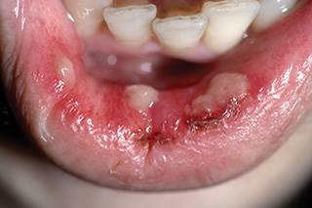
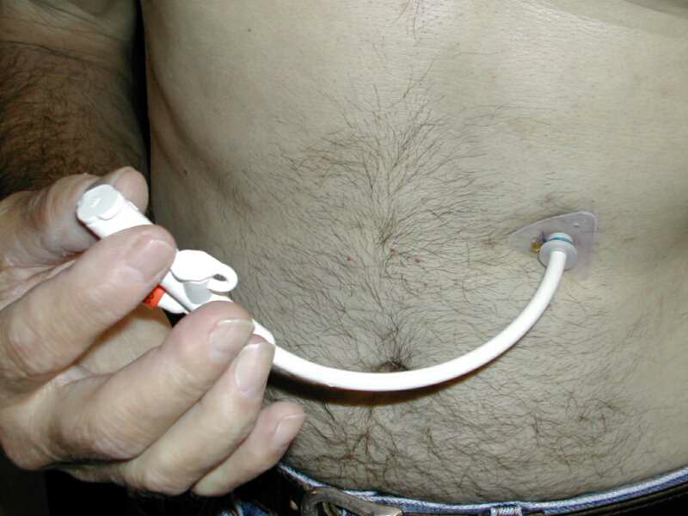
Clinical problem
    Oral mucositis
    Dysphagia
    Severe impact on quality of life
    Acute and often transient
    Consequential late effects
  Limits dose-escalation and accelerated fractionation
Notes:
High suicide rate
Want to increase dose as failure rates quite disappointing
Without compromising other aspects of the plans
Test these in clinical trial

Slide 20
Patients
Trial | Number available | Primary disease site | Radiotherapy technique | Concurrent chemotherapy
PARSPORT | 71 | Oropharynx, hypopharynx | Bilateral; Conventional, IMRT | No
COSTAR | 78 | Parotid gland | Unilateral; Conventional, IMRT | No
Dose Escalation | 30 | Hypopharynx, larynx | Bilateral; IMRT | Yes
Midline | 117 | Oropharynx | Bilateral; IMRT | Yes
Nasopharynx | 36 | Nasopharynx | Bilateral; IMRT | Yes
Unknown Primary | 19 | Unknown primary | Bilateral; IMRT | Yes
Notes:
Not all patients had concurrent chemotherapy

Slide 21
Toxicity scoring
CTCAE toxicity | Grade 1 | Grade 2 | Grade 3 | Grade 4
Clinical oral mucositis | Erythema of the mucosa | Patchy ulcerations | Confluent ulcerations | Tissue necrosis; significant spontaneous bleeding
Dysphagia | Symptomatic, able to eat regular diet | Symptomatic and altered eating/swallowing; IV fluids indicated < 24 hours | IV fluids, tube feedings, or TPN indicated >= 24 hours | Life threatening consequences
  Prospectively measured at baseline, weekly during and 1, 2, 3, 4 and 8 weeks post-radiotherapy
  Patients with missing data excluded
  Peak grade < 3 vs >= 3

Slide 22
Clinical data
  Age
  Sex
  Primary disease site
  Definitive radiotherapy vs postoperative radiotherapy
  Concomitant treatments
  - Induction chemotherapy
  - Concurrent chemotherapy regime
  No smoking, alcohol or genetic data

Slide 23
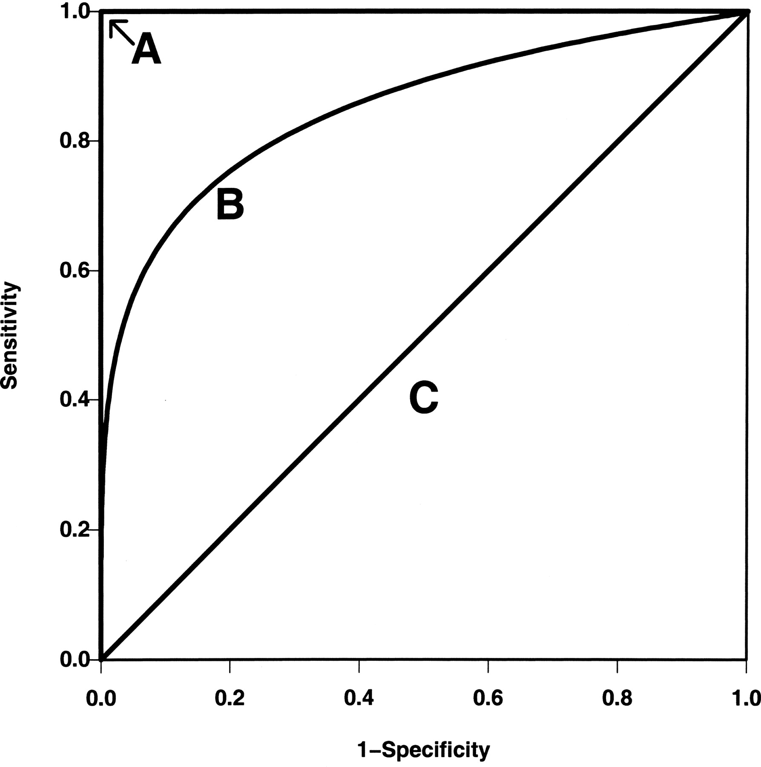
Predictive modeling pipeline
  Remove data for external validation
  Penalized logistic regression
  Support vector classification
  Random forest classification
  Preprocessing
  Train and tune model
  Internal validation
  External validation
Notes:
Novel to compare multiple models most studies just use standard logistic regression with poor variable selection strategies
Few studies perform validation

Slide 24
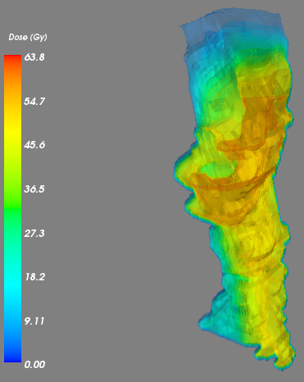
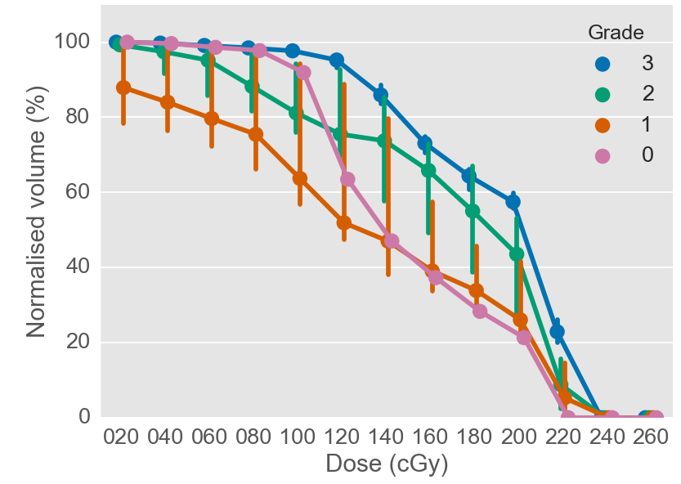
Dysphagia modelling
  Feeding tube dependence
  Pharyngeal mucosa
        - Dose-volume
        Training data – 172 patients
        Independent external validation with University of Washington cohort – 24 patients

Slide 25
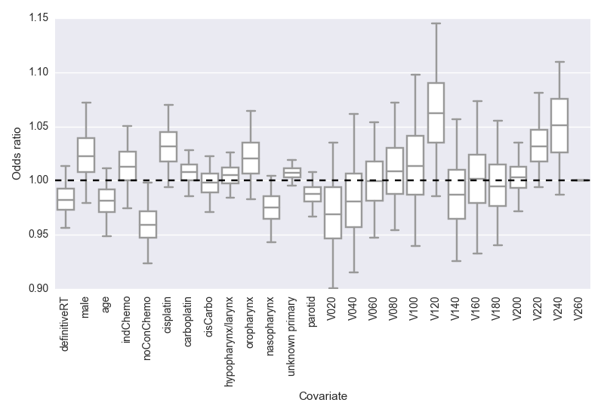
Dysphagia
 | Standard | Spatial
Model chosen | Logistic regression | Logistic regression
Internal validation AUC (mean (s.d.)) | 0.77 (0.08)* | 0.76 (0.08)
External validation AUC | 0.82
*selected

Slide 26
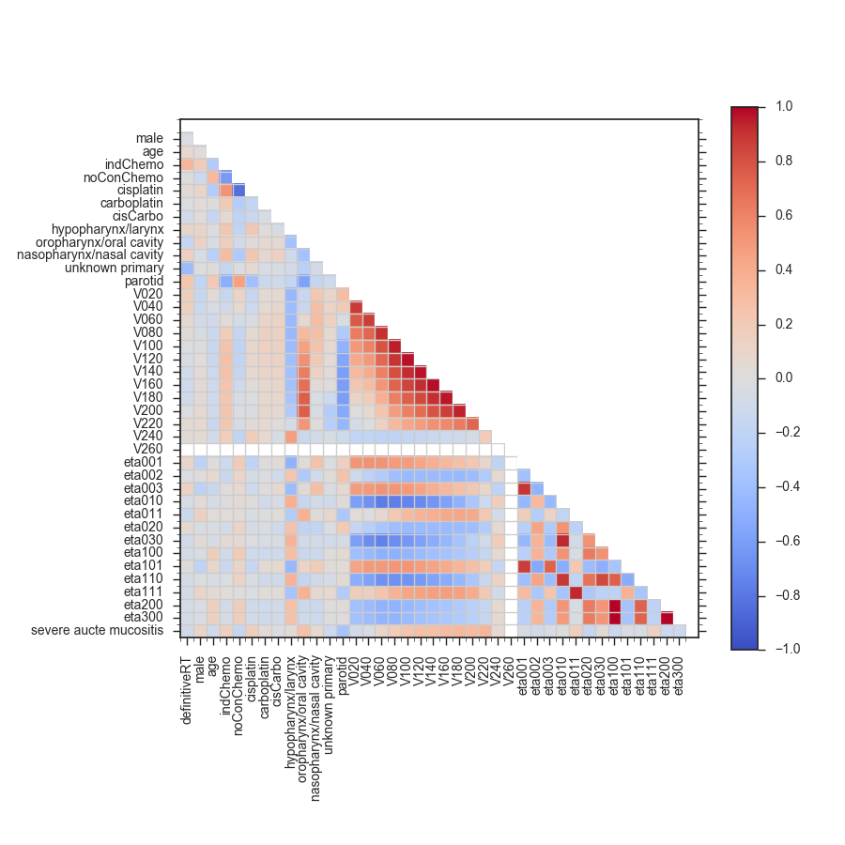
Correlated Variables
Dean et al Rad Onc 120 (2016) 21–27
Notes:
This plot of the spearman’s correlation coefficients of the data included in the model clearly highlights the issue with DVH data

Slide 27
Conclusions
  Trained and validated predictive model of swallowing dysfunction
  High performance model for severe dysphagia
  - No concurrent chemotherapy has highest absolute regression coefficient
  - V70 has highest regression coefficient out of dose-volume features

Slide 28
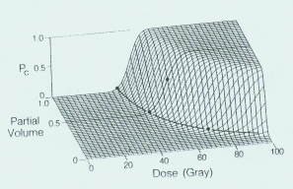
Lyman Model 1985
D maximum dose to the structure
TD50(1) tolerance dose for 50% incidence of complication
m slope of TD50(1)
n indicates serial/parallel nature of the structure
v effective volume if the structure was irradiated uniformly to D
Lyman,J.T. Complication probability as assessed from dose-volume histograms.
Radiat. Res. Suppl 8, S13-S19 (1985).

Slide 29
Dose Volume Histogram Reduction
Kutcher,G.J.et al, Histogram reduction method for calculating complication probabilities for three-dimensional treatment planning evaluations. Int. J. Radiat. Oncol. Biol. Phys. 21, 137-146 (1991).

Slide 30
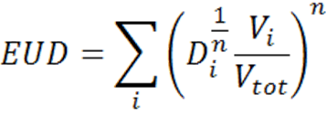
Equivalent uniform dose
Parameter ‘n’ is organ (endpoint) specific
Low (≈ 0): small volume effect, EUD ≈ max dose
High (= 1): large volume effect, EUD = mean dose

Slide 31
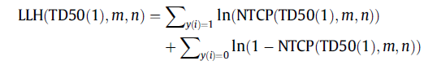
Maximum Likelihood Estimation
. y(i) known outcome
Bootstrapping
Sample available data (with replacement) to create different populations
Test generalisability of fit.
Results shown for 1000 Bootstrapped cohorts

Slide 32
Fitting NTCP models :an example
RT01 Prostate Radiotherapy Trial
Patients randomised to 64 Gy vs 74 Gy
Accrual from Jan 1998 to Dec 2001
Patients randomised from 23 centres throughout the UK, 1 in NZ, 1 in Victoria

Slide 33
Fitting NTCP models :an example
Rectal Bleeding -RMH
Proctitis-RTOG
Stool Frequency- Lent Som
Loose Stools -UCLA QoL
Rectal Urgency -UCLA QoL
0=none 1=mild 2=moderate/severe toxicity
1000 Bootstrapped cohorts fitted using maximum likelihood estimation.

Slide 34
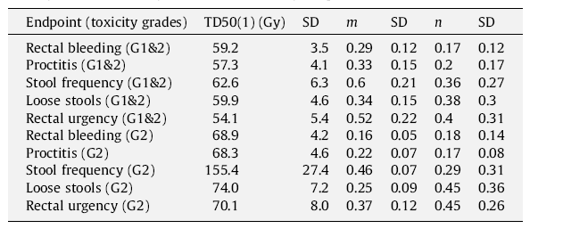
Bootstrap Approach

Slide 35
Bootstrap Approach
Quantec Values Grade 2 Toxicity
TD50 76.9Gy n=0.09 m=0.13

Slide 36
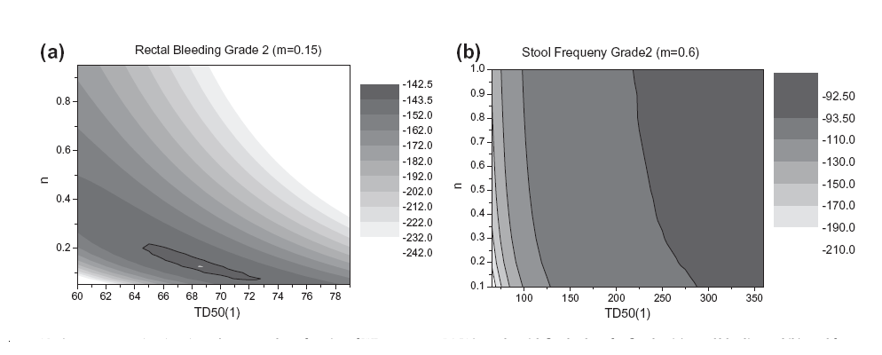
Maximum Likelihood Estimation
Log-likelihood values

Slide 37
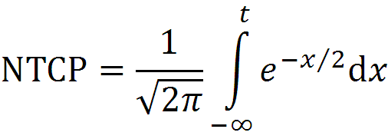

Taking empirical models further
Accounting for confounding factors
  Confounding factors include any non-dosimetric factors (X) influencing the outcome, as these are not modelled.
  Health status, chemo/surgery, radiosensitivity etc.
  Sharper slope, greater certainty

Slide 38
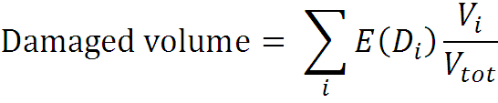



The Critical Volume
In the Critical Volume model the summary measure is a damaged volume, calculated using a local dose-effect function E(D_{i}).
D_{i} = total dose to bin i
V_{i} = absolute volume in bin i
V_{tot} = total organ volume
D₅₀ = dose causing 50% local effect
k = parameter for slope of curve
Function 1:
2 parameters
Function 2:
1 parameter
Function 3:
1 parameter

Slide 39

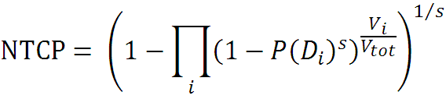
The Relative Seriality model
The Relative Seriality model first calculates a probability of local damage for each dose bin in the DVH:
D_{i} = total dose to bin i
D₅₀ = Dose causing 50% probability
γ = slope of the curve
Then NTCP is estimated using the relative seriality parameter ‘s’.
Serial organs: s = 1, high doses to small volume important
Parallel organs: s ≈ 0, large irradiated volume important
V_{i} = absolute volume in bin i
V_{tot} = total organ volume
s = relative seriatlity parameter

Slide 40
Fractionation
Linear Quadratic (LQ) Model
S~exp(-αD –βD²)
Acute responding tissues α/β~10 late responding tissues α/β~3 (classically)
Illustration from Hall E & Giaccia A. Radiobiology for the Radiologist (Lippincott-Williams Wilkins 2012).

Slide 41
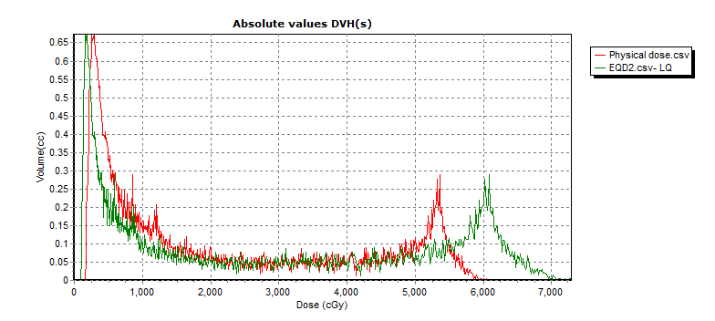
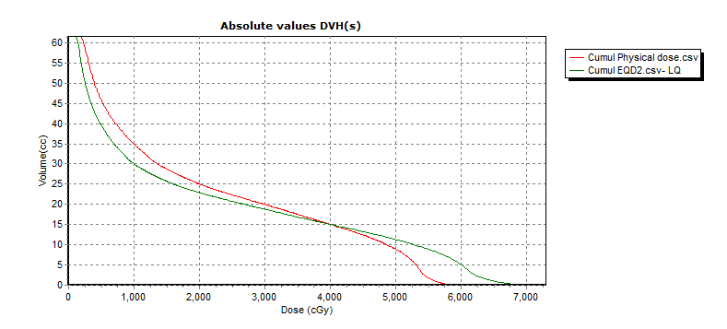
Fractionation correction!
Each bin in the DVH receives a different dose per fraction.
Convert each dose-bin to 2Gy fraction equivalence (reference conditions).

Slide 42
Example
DVHs for 2 lung cancer patients
Total lung – GTV
Fractionation correction (α/β = 3 Gy)
NTCP estimated using 3 different models
Parameter values from Seppenwoolde et al. 2003
 | Patient 1 | Patient 2
LKB | 9.2% | 5.4%
Critical Volume | 9.9% | 6.9%
Relative Seriality | 8.5% | 4.4%

Slide 43
When can I use NTCP?
ICRU report 83: level 3 dose reporting
Ranking treatment plans
Evaluation of treatment data from clinical studies; derive parameter values locally
  Better to used locally derived parameter values than published values
Develop new potential techniques
Dose prescription
Radiobiological plan optimisation

Slide 44
Which model should I use?
Preferably several
The LKB model is the most commonly used model and has parameter values published for many organs/endpoints (e.g. QUANTEC).
All the above models are empirical.
  Statistical fits to clinical data
  Biological interpretation of DVH reduction method should not be relied on blindly.
The more parameters the more clinical data needed for parameter fitting. Up to 3 parameters often appropriate.
Datasets often in the order of 100-300 patients. The more ‘events’, the more information to model on.

Slide 45
Important considerations
The model is only as good as the data used for parameter fitting.
  Well-designed study (unbiased, representative)?
  Sample size, number of events
  Uncertainties in dose distributions (incl. outlining, organ motion, organ definition)

Slide 46
Important considerations
The model is only reliable for plans reasonably similar to the plans included in the study (also applies to patient specific factors).
When a model is used without knowledge of these factors, or for a different technique/patient group, the same limitations apply as to empirical ‘tolerance doses’.
NTCP is continuous but the patient outcome is binary

Slide 47

Model-based selection

Slide 48
Patient Selection
Step 1 NTCP Models
    Data from optimal photon treatment
Step 2 In silico planning studies
    Photon vs Proton
Step 3 Estimation of clinical benefit

Slide 49
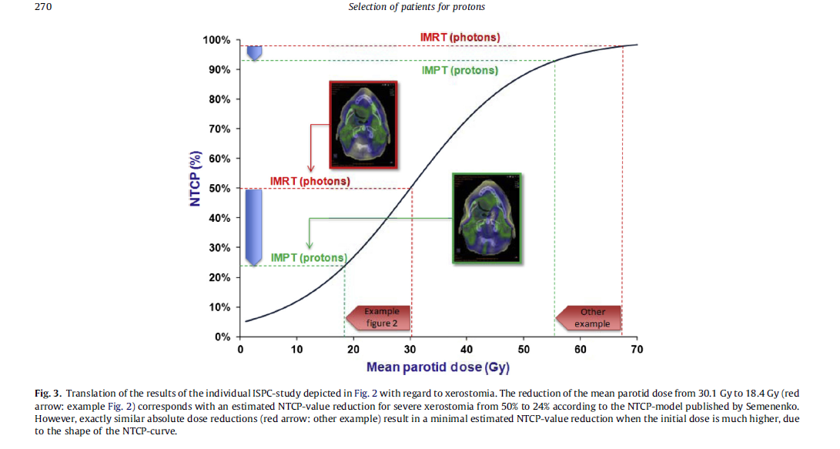
Step 3 Estimation of clinical benefit

Slide 50
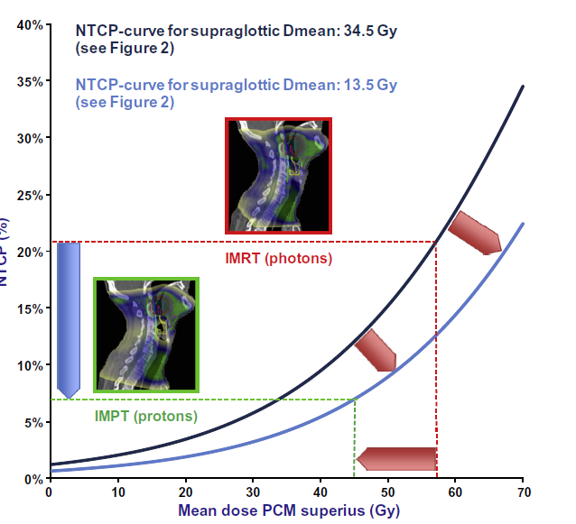
Estimation of clinical benefit

Slide 51
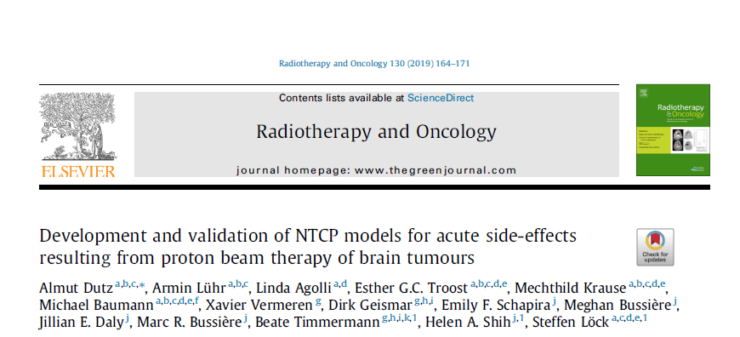
NTCP data derived from proton therapy

Slide 52
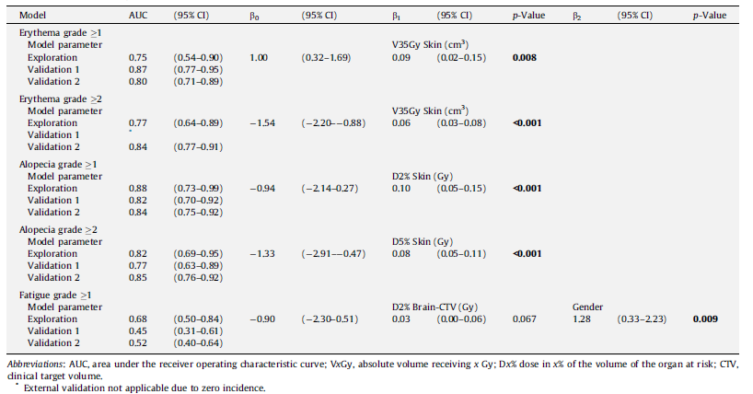

Slide 53
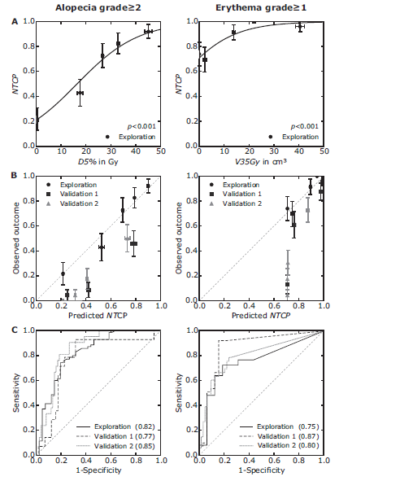

Slide 54
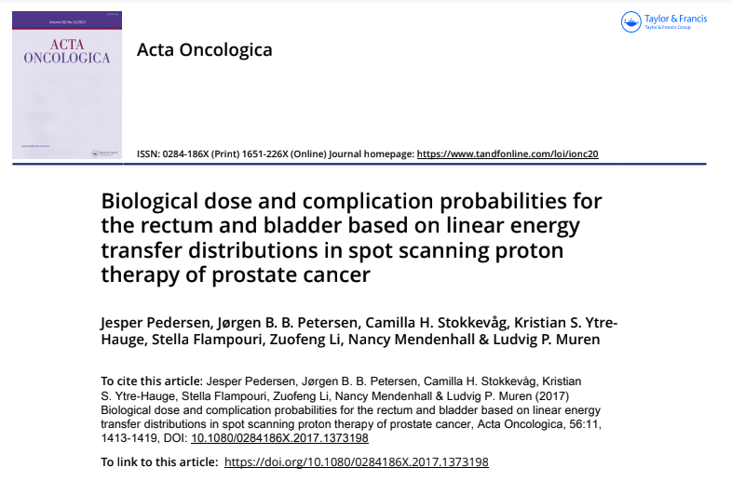
Using NTCP models to quantify variation in RBE

Slide 55
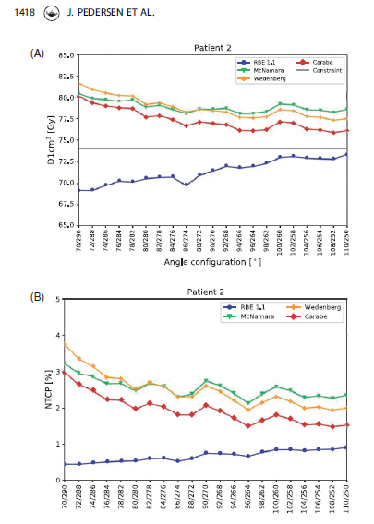
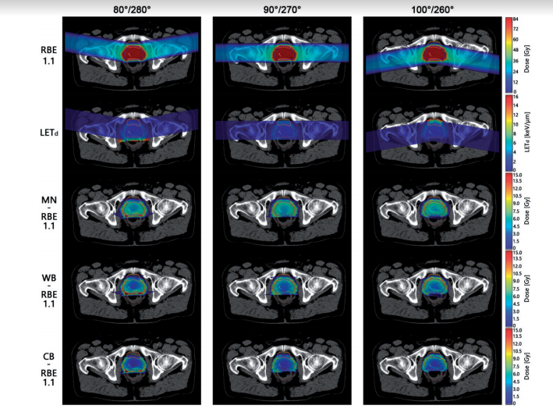

Slide 56


Slide 57

The curse of dimensions
Data stored as a jpeg
3 dimensional array
2816x2112x3
Notes:
Discrete cosine transform r g b

Slide 58
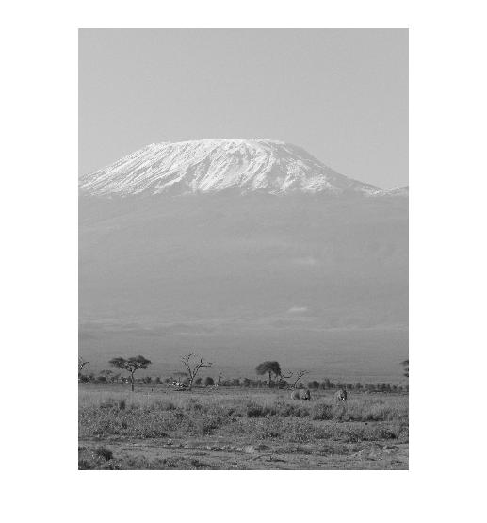
The curse of dimensions

Slide 59
The curse of dimensions
Data stored as 2D matrix 2816 by 2112

Slide 60
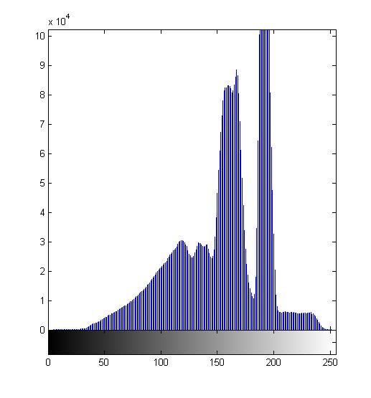
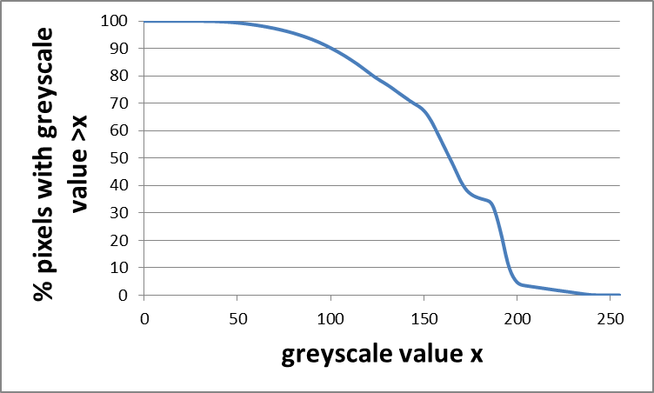
The curse of dimensions

Slide 61
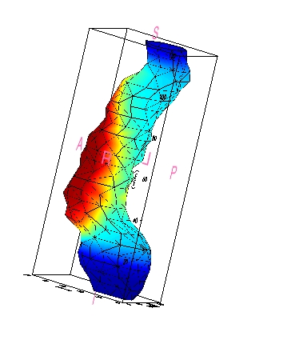
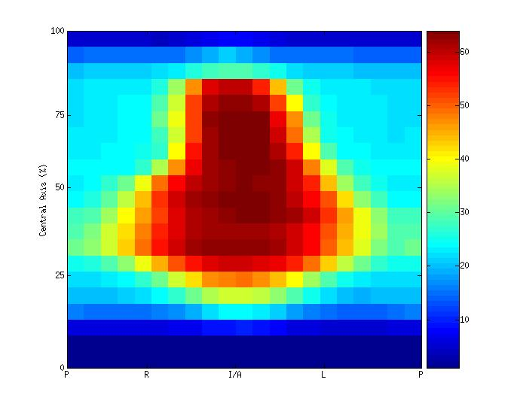
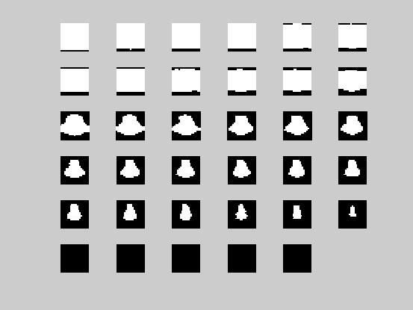
Rectum unfolding and feature extraction
Extract a limited set of interpretable features
Unfold rectum and project dose on 2D map
Consider binary maps for feature extraction
Binary maps corresponding to 35 dose levels between 5 Gy and 73 Gy
3D dose distribution
Primary DSM
F. Buettner, S.L. Gulliford, M. Partridge, M.R. Sydes, D.P. Dearnaley and S. Webb
Notes:
The dose surface maps were generated using Guiness which is the inhouse predecessor to Vodca. Once the dose to the rectal wall has been unwrapped and normalised a serious of thresholded dose maps were generated at 2Gy intervals over the dose range 5 to 73Gy. White pixels have a value greater than the threshold dose and black pixels have a value less than the threshold dose.

Slide 62
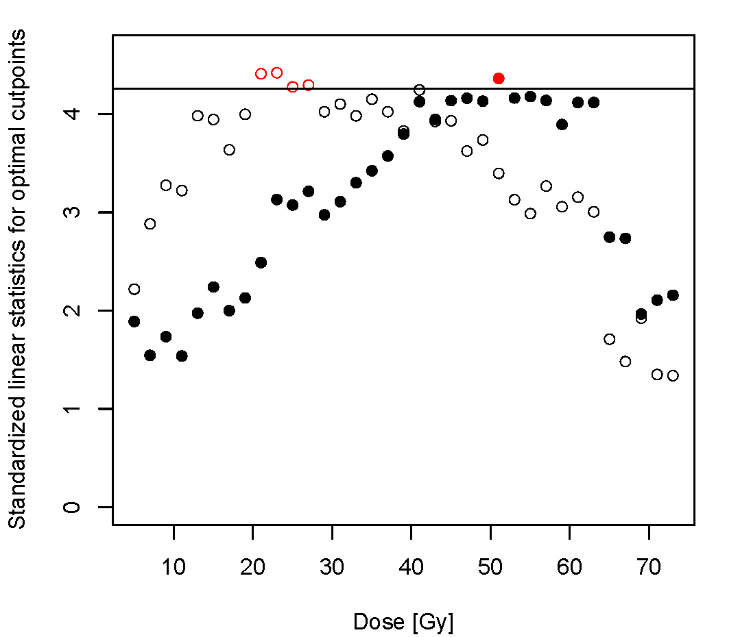
Results
Maximally selected standardized T for the 35 bins of the DSH

Slide 63
Results cont.
Rectal Bleeding
Loose stools

Slide 64
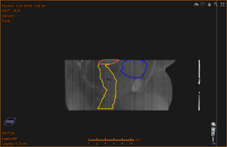
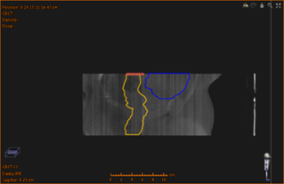
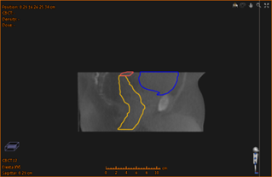

















Cone Beam Series
CHHIP 20# Prostate
Notes:
Explain contourig

Slide 65
Final Comments
Need to be cautious when applying constraints or predictive model derived from one technique to patients treated with a different technique.
Know the limitations of the model and accept that data doesn’t always fit the model
Consider the definition of toxicity used to derive the model and what is relevant to the clinic.
All constraints and models should be independently validated.

Slide 66

Acknowledgements
Prof David Dearnaley
Dr Julia Murray
Dr Florian Buettner
Dr Jamie Dean
Prof Chris Nutting
Mr Andy Poynter

