Slide 1
Treatment workflow – hospital expert perspective
Harald Hentschel
EBG MedAustron

Slide 2
topics
Introduction
  Historical overview of MedAustron
  Medical staff groups
Patient referral
Comparison of photon and ion beam radiotherapy
  Beamgeneration and -application
  Immobilization/simulation and imaging
  Treatment planning
  Irradiation
Challenges in (ion beam) radiotherapy
Ramp-up and improvements
Further development

Slide 3
1. introduction
a. Historical overview of MedAustron
History
End of 1980s
1st drafts and proposals – exclusively designed for research
2005
Decision to realize the project with a modified objective: “therapy & research”
2012
Building completion
2013
Start of the accelerator installation
November 2014
The 1st proton beam is measured in a treatment room
December 2016
Start of patient treatment in 1 room
August 2017
Start of the 2nd room (horizontal only)
June 2018
Activation of vertical beam line in the 2nd room
1980s
Design
2012
2013
2005
June 2018 until now
Dez. 2016
Nov. 2014

Slide 4
1. introduction
b. Medical staff groups at MedAustron
Radiation Oncologist
Case preparation, evaluation of eligibility for ion beam radiotherapy, evaluation and considerations of prior treatments
Patient education
Definition of target volumes
Evaluation of treatment plan and approval
Physical examinations during therapy and follow-up
Contact person for referring physicians
Patient administration (Reception, Intake)
Administration of patient data, creation of medical record, import and export of imaging data
Point of contact for patients during their treatment session
Communication of appointments
Communication and exchange of data between MedAustron and referring institutions

Slide 5
1. introduction
b. Medical staff groups at MedAustron
Clinical Studies
Every patient (who agrees) is included in a study protocol
Initial Check to acquire baseline data for comparison + interviews during and at end of therapy
Creation of valuable data for the assessment of ion beam treatment outcome
Patient care – Nurses
Patient education about skin care, nutritional support
Treatment of therapy related side effects
Blood sampling
Drug administration (e.g. anxiolytics)
Coordination of external anesthesia team
Patient care - Patient Care Coordinator
- Supports patients prior to and during therapy (accommodation, transport, recreational activities, general counseling)

Slide 6
1. introduction
b. Medical staff groups at MedAustron
Radiotherapy Technologists (radiographer, radiology technologist, ...)
Patient education
Creation of immobilization using positioning devices
Imaging (CT, MR, PET-CT)
Registration/Fusion of imaging data
Organ at risk delineation
Treatment planning together with MPE
Preparation of treatment sequence (Treatment Operation)
DryRuns in the treatment room together with MPE
Scheduling
Patient-positioning and radiological positioning-verification
Patient and treatment surveillance during treatment
Support of the patient

Slide 7
1. introduction
b. Medical staff groups at MedAustron
Medical staff professions | No. of employees
Radiation Oncologists (incl. Medical- and Clinical Directors) | 9
Radiologist | 1
Medical Physicists | 22
Medical Technicians | 3
Radiotherapy Technologists | 17
Patient Care | 3
Clinical Studies | 4
Patient Administration | 7
Sum | 66

Slide 8
2. Referral procedure
Catalog with indications that are accepted by the main association of Austrian social insurances
Costs are covered if a Tumorboard recommendationis available (Tumorboard = committee of oncological specialists of the referring hospital)
If a case is not included in the catalog – Insurance may cover the costs
Administrative workflow of filing the case at the insurance is done by MedAustron
Contracts with some international health insurances are in place
Alternatively, patients may cover the treatment costs by themselves

Slide 9
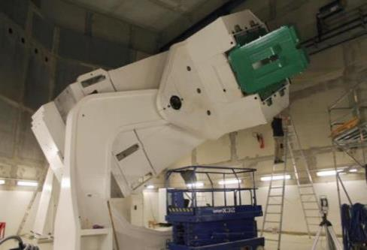
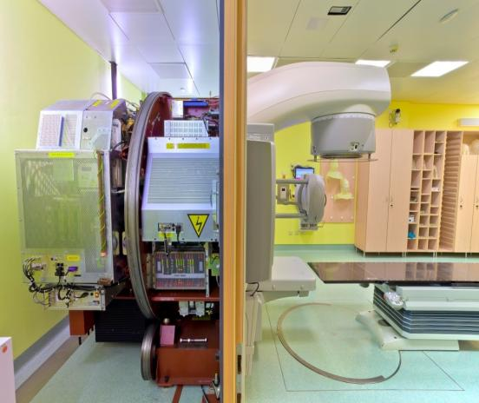
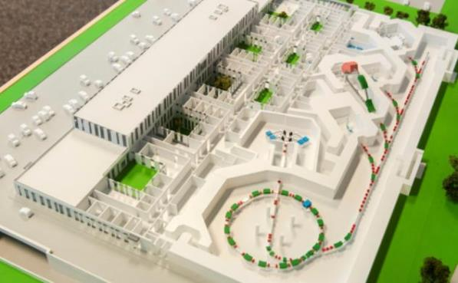
3. Comparison photon and ion beam radiotherapy
a. Beamgeneration and -application
Electron/photon-LINAC vs. p, C Synchrotron
50t
7.5 m
2.5 m
100 m

Slide 10

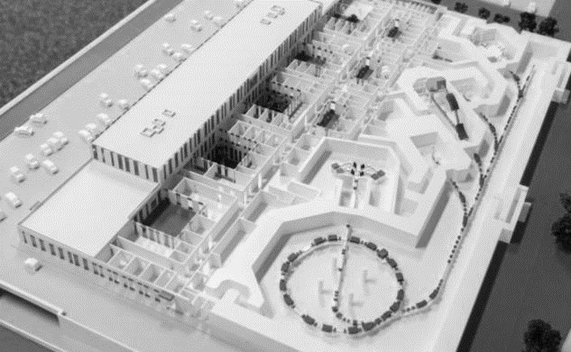
3. Comparison photon and ion beam radiotherapy
a. Beamgeneration and -application
Electron / photon-LINAC vs. p, C Synchrotron
Simultaneous operation of
all available devices
Treatment rooms share the beam
Simultaneous beam delivery is
not possible
Sequential and overlapping operation

Slide 11
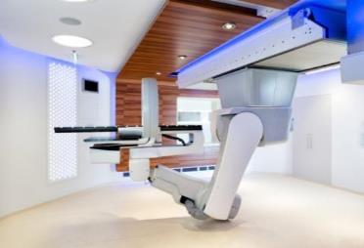
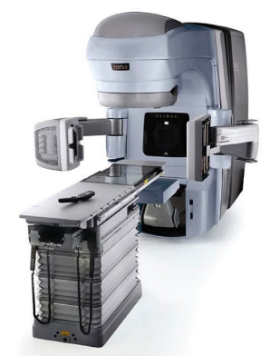
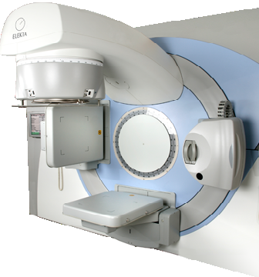
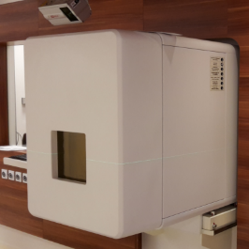
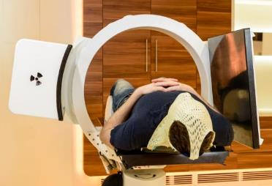
3. Comparison photon and ion beam radiotherapy
a. Beamgeneration and -application
Unit consisting of
- Positioning device/couch
- X-ray imaging
- Radiation source
→ Designed for isocentric
treatment
Very short couch movement
during treatment
Patientpositioning and –verification system (Imaging Ring)
Beam outlet (nozzle)
Designed for non-isocentric treatment
Several time consuming couch movements during treatment
Image courtesy: Varian Medical Systems, Elekta Instrument AB

Slide 12
3. Comparison photon and ion beam radiotherapy
a. Beamgeneration and -application
Ideal case
Pat. 1
Pat. 3
IR 2
Pos+Img
Init
Beam
Exit
Pos+Img
Init
Beam
Exit
Beam
IR 3
Pos+Img
Init
Beam
Exit
Pos+Img
Init
Pat. 2
Pat. 4
Pos+Img
Patient-Enter, Positioning, X-Ray Imaging (planar or ConeBeamCT), Verification/Image Registratin
Includes several Robot- und ImagingRing Movements : 9 – 14 min
Init
Beam-release room1, beam-occupation room2, initialization of the accelerator: 2 -3 min
Beam
Mainly 2 beams from different directions. Includes robot movements between the beams and initialization of the accelerator : 12 – 15min, pure beam-on time 10 – 13 min (range of 5-50minutes)
Exit
Optional exit-imaging for the assessment of intrafractional patient- or organ motion. Robotmovement to the step on/off position. Release, mobilize the patient. Patient leaves the room.

Slide 13


3. Comparison photon and ion beam radiotherapy
a. Beamgeneration and -application
Technical problems during beam application affect ALL rooms
IR 2
(Plan)
Pos+Img
Init
Beam
Exit
Pos+Img
Init
Beam
Exit
Pos+Img
Pos
IR 2
(Real)
Pos+Img
Init
Beam
Exit
Beam
Init
Beam
Exit
Beam
IR 3
Pos+Img
Init
Exit
Problems during patient setup, patient movement, etc.: waiting time in the other room(s)
Beam
IR 2
Pos+Img ..........
Init
Beam
Exit
Pos+Img
Init
IR 3
Pos+Img
Init
Beam
Exit
Pos+Img
Init
Beam
Exit

Slide 14

3. Comparison photon and ion beam radiotherapy
a. Beamgeneration and -application
Downtime of one treatment room, e.g ImagingRing or Robot:
→ Inefficient beam utilization
IR 2
out of order
Pos+Img
Init
Beam
Exit
Pos+Img
Init
Beam
Exit
Beam
IR 3
Pos+Img
Init
Beam
Exit
Pos+Img
Init
Beam
Exit
Pos+Img
Init
Long beam-time at big target volumes: waiting time in other room(s)
IR 2
Beam
Pos+Img
Init
Beam ...........
Exit
Pos+Img
Init
IR 3
Pos+Img
Init
Beam
Exit
Pos+Img
Init
Beam
Exit

Slide 15
3. Comparison of photon and ion beam radiotherapy
b. Immobilization/Simulation and Imaging
  Basic requirements are the same for photons and ions
  - reproducible
  - minimize patient motion
  - reduce organ motion
  - comfortable
  - stable
  - unobstructed beam path
  Consideration of
  - treatment duration (25-60min)
  - No material in the beam entrance region unless it cannot be avoided (mask) or on purpose (bolus, flab)
  Immob.systems which allow for a minimal Air-Gap
  - Majority of the systems are standard (photon devices)
  - some specialized, ion-specific products
  Exclusively indexed positioning

Slide 16
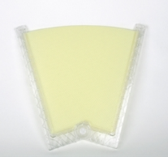

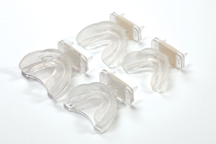
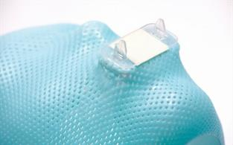
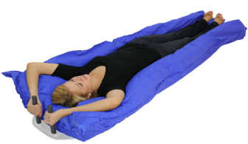
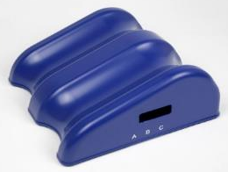
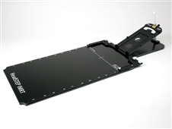
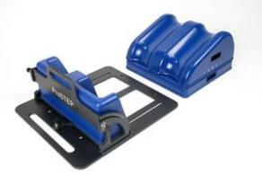
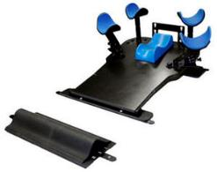
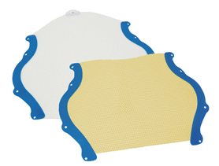
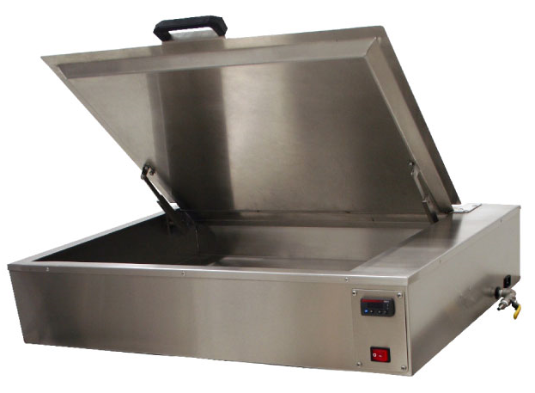
3. Comparison of photon and ion beam radiotherapy
b. Immobilization/Simulation and Imaging
  Immobilization devices

Slide 17
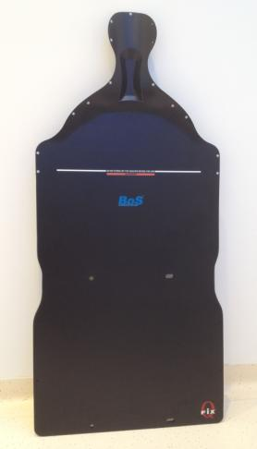
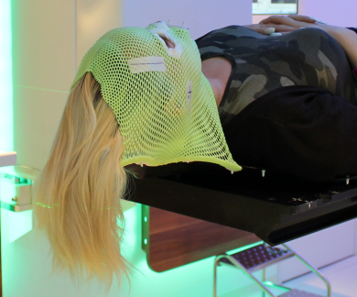
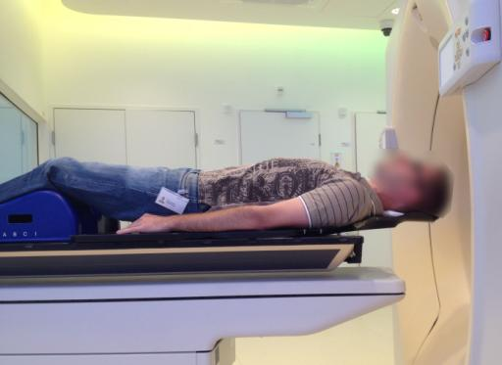
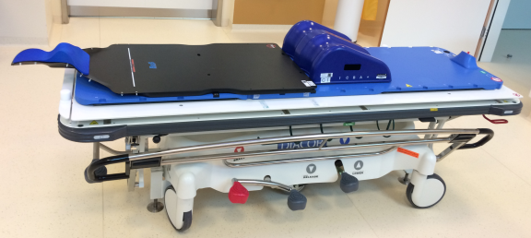
3. Comparison of photon and ion beam radiotherapy
b. Immobilization/Simulation and Imaging
  BoS (Base of Skull Overlay)
  - Treatment in the head & neck region
  - Minimal distance (=air gap)
  between patient and nozzle
  → Improvement of beam geometry

Slide 18
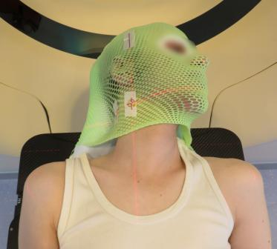
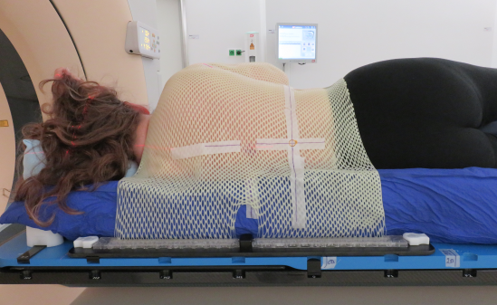
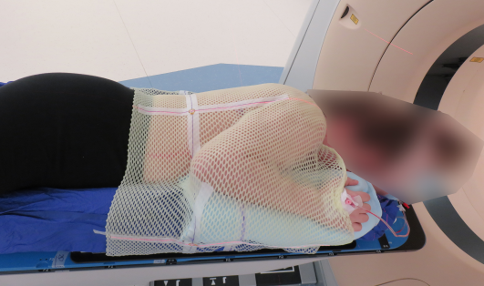
3. Comparison of photon and ion beam radiotherapy
b. Immobilization/Simulation and Imaging
  „Alternative“ positions to compensate for limited beam entrance angles
  Tilting and rotation of the head
  Decubitus position
  - Problematic, but can be done with training and experience
  - requires creativity
  - dependant on patient´s disease and physical condition
  - no standards available; have to be established

Slide 19
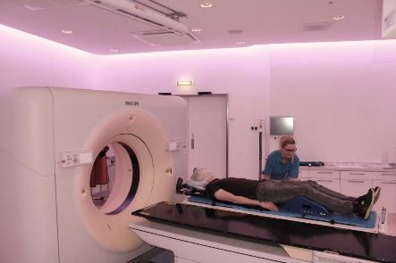
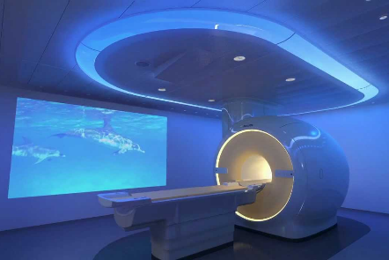
3. Comparison of photon and ion beam radiotherapy
b. Immobilization/Simulation and Imaging
  Planning-CT with predefined protocols
  (X-ray and geometric parameters)
  MR in immobilized position (if possible)
  - incl. positioning devices
  CT mostly w/o contrast. MR always with contrast, unless there is a contraindication
  (renal function, known allergy or intolerance)
  Immobilization and imaging are pre-discussed with medical physicist and the radiation oncologist.

Slide 20
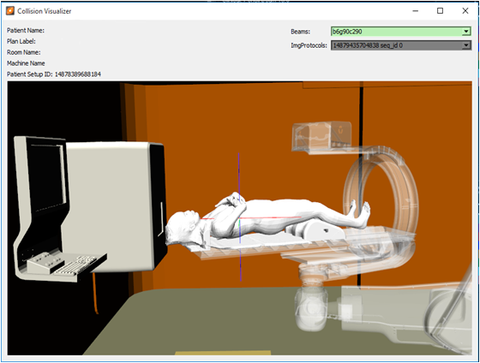
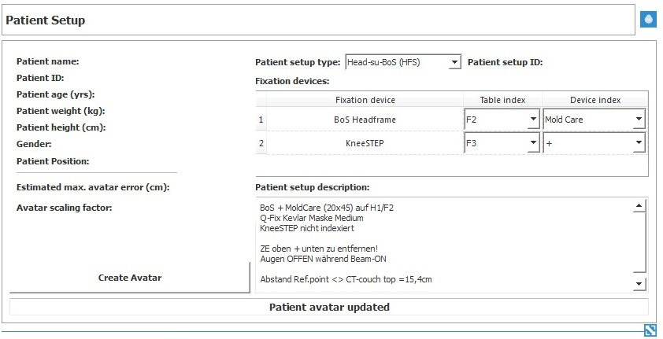
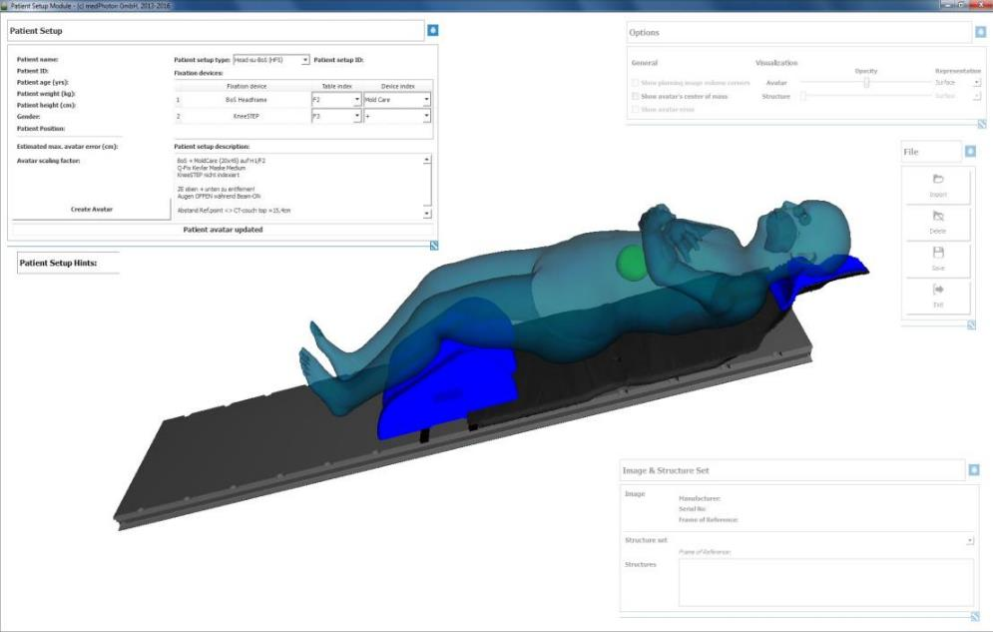
3. Comparison of photon and ion beam radiotherapy
b. Immobilization/Simulation and Imaging
  Definition and 3D simulation of the patientensetup
  → Collision avoidance

Slide 21
3. Comparison of photon and ion beam radiotherapy
c. Treatment planning
  Involved staff: Medical physicists, RTTs and Radiation Oncologists
  Import of Planning-CT and MR imaging to the treatment planning system
  Import of external images
  Registration/Fusion of images
  Contouring/segmentation of OARs
  Dose-prescription and contouring of the target volumes by the radiation oncologist
  Planning

Slide 22
3. Comparison of photon and ion beam radiotherapy
c. Treatment planning
  Preparation of QA plans
  Plan approval by the responsible RO and the board of ROs
  Creation of the Treatment Operation (= predefined sequence of actions)
  Physical plan verification by MP
  Dry run (w/o patient) in the treatment room
  Final plan approval

Slide 23
3. Comparison of photon and ion beam radiotherapy
d. Irradiation
 | Conventional Linac | MedAustron - fixed beam Particle therapy
Positioning and verification | Imaging in treatment position | Imaging in defined positions to avoid interference with dose monitors
Different beam angles | Gantry rotation | Positioning robot, fixed beam angles
Treatment time | 7-10min | 25 – 60min
Beam-On time (avg.) | Independant of treatment volume 1min – 5min | Depending on treatment volume 5 – 45min
Fieldsize | Up to 40x40 cm | 20x20 / 17x14 cm

Slide 24
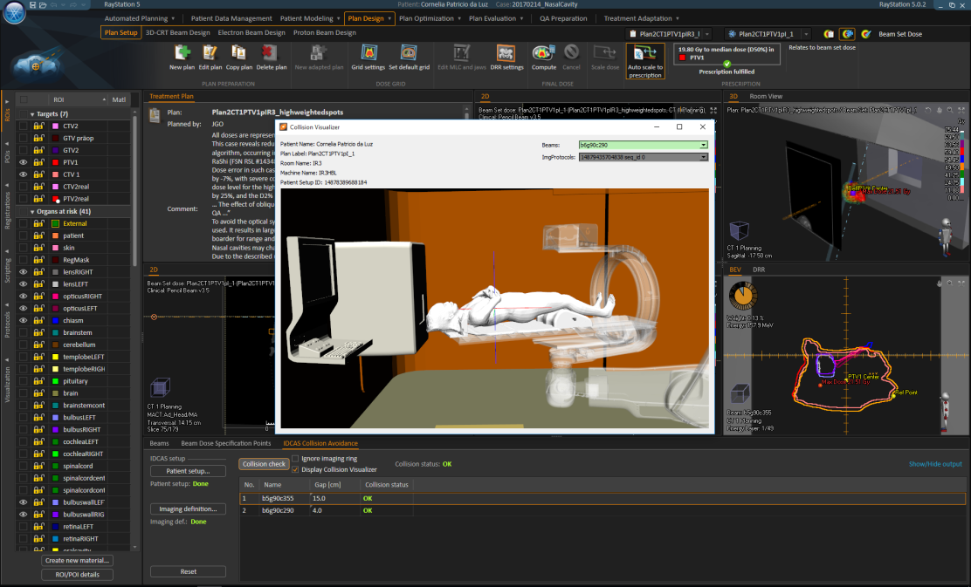
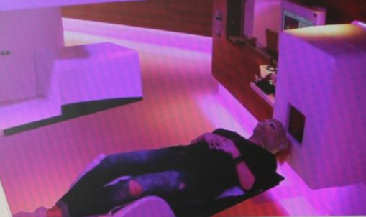
3. Comparison of photon and ion beam radiotherapy
d. Irradiation
  - Workflow is supported by a TPS based modelling of: Room-, robot- and patient geometry
17

Slide 25
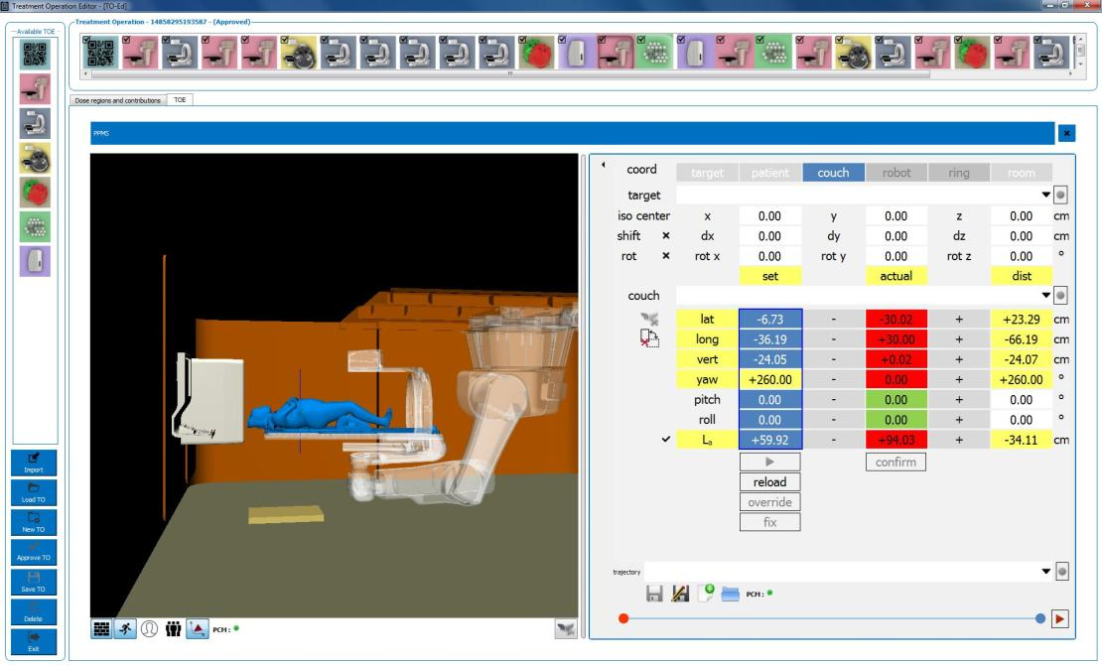
3. Comparison of photon and ion beam radiotherapy
d. Irradiation
Softwarebased
No manual control of the positioning table (exception: emergency)
Pre-definition of:
- Robot movements
- Imaging geometry and - parameters
- Registrationparameters
- Sequence of the beams / portals

Slide 26
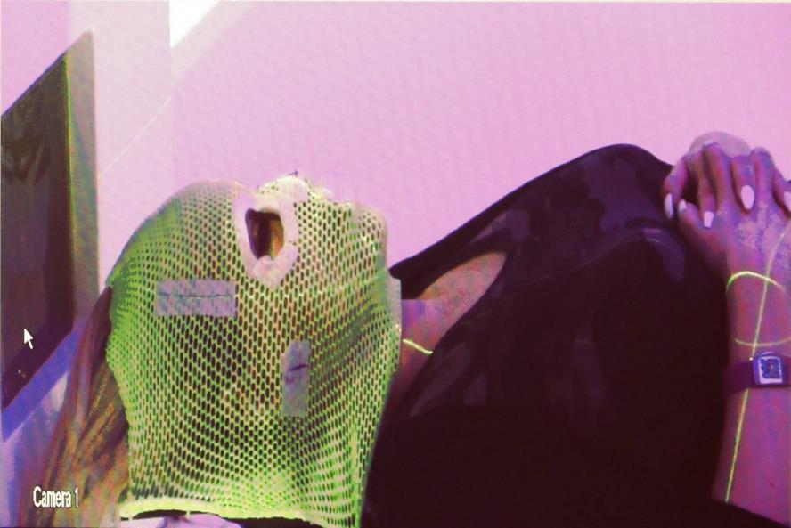
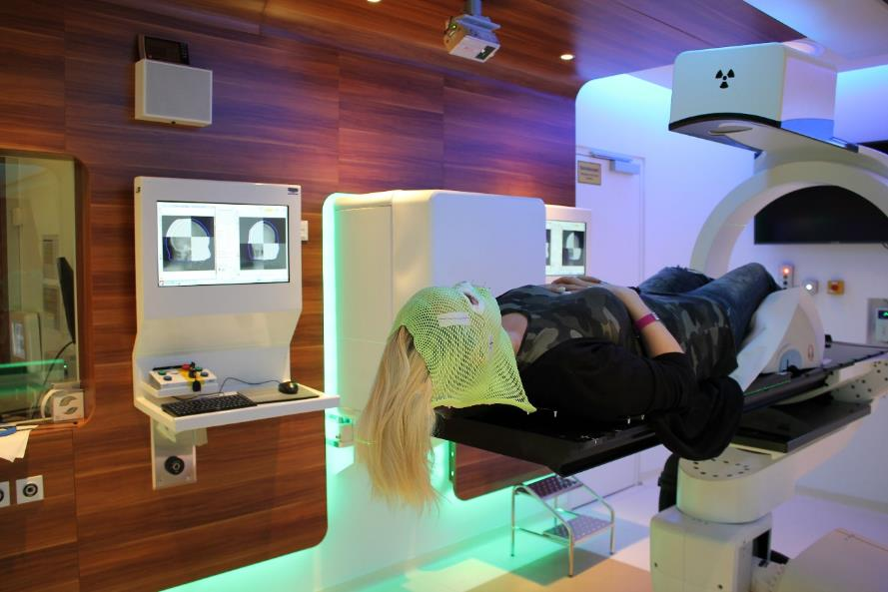
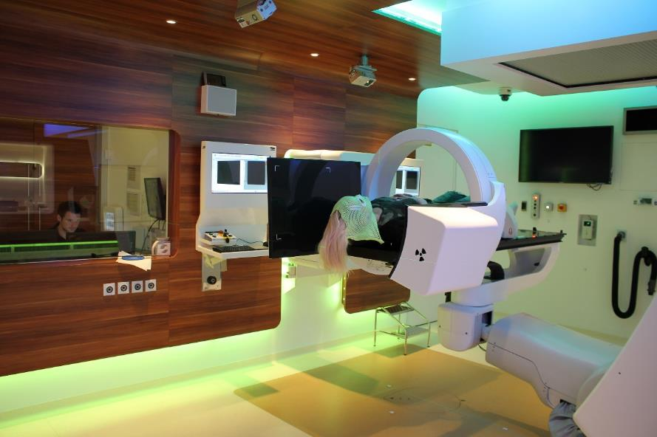
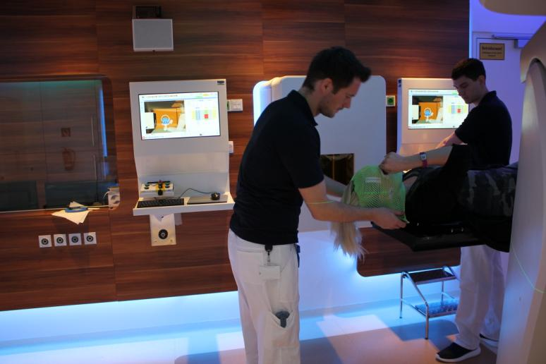
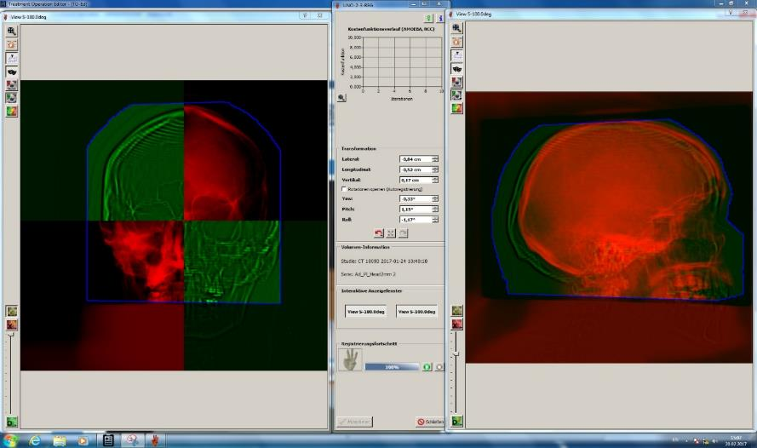
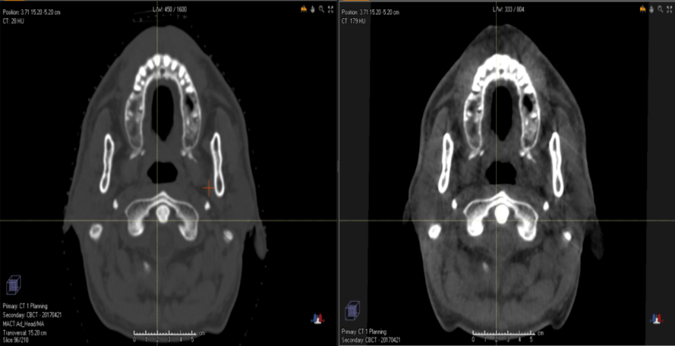
3. Comparison of photon and ion beam radiotherapy
d. Irradiation
Movement to treatment position
Irradiation
Image registration: current vs. planned position
Patient identification, step-on and positioning
X-ray image acquisition

Slide 27
3. Comparison of photon and ion beam radiotherapy
d. Irradiation
27

Slide 28
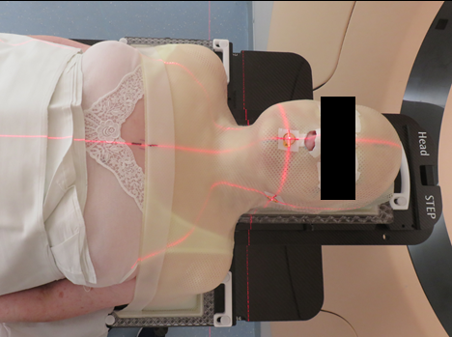
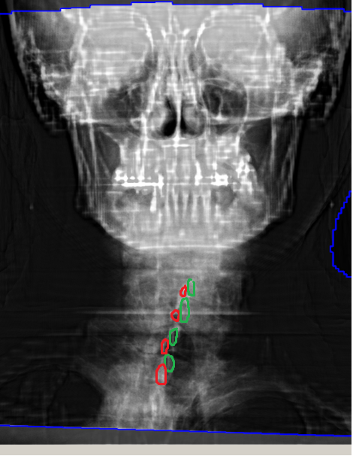
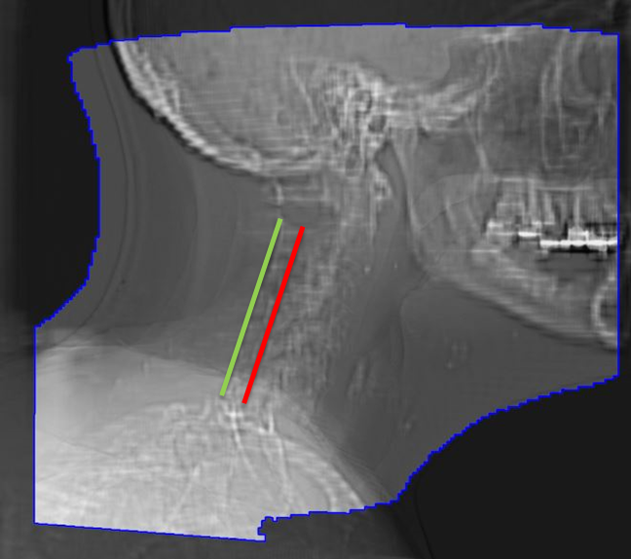
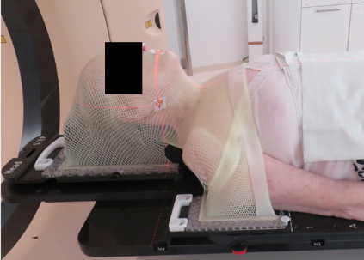
4. Challenges in (IB)RT
  Reproducibility of positioning
  The accuracy of the positioning is crucial to ensure correct dose delivery.
  ... which can be challenging ...

Slide 29
4. Challenges in (IB)RT
  Claustrophobia
  MR imaging
  Although the oncology MRI has a relatively wide opening („big-bore“) it is still a narrow tube
  Irradiation
  Patients are immobilized with tight and rigid masks which restrict any movement of the region of interest
  Long treatment time
  Depending on the size of the treatment volume, the procedure takes between 25-60 minutes
  - discomfort
  - pain due to position, pressure marks (gets worse over time !!!)
  - Coughing and sneazing causes interruptions and repetition of workflow steps → further increase of treatment time

Slide 30
4. Challenges in (IB)RT
  Interruptions
  Due to the complexity of the accelerator and the MedAustron specific use of prototype medical devices (Robot, ImagingRing, Software) downtimes are usually longer than in conventional RT.
  Increased complexity in the anesthesia workflow for pediatric patients
  → patients must not eat and drink prior to sedation
  → duration of sedation is limited
  Difficult timing of patient-specific routines
  - drinking protocoll for defined bladder filling
  - enema for emptying the rectum
  - medication
  Competing patient appointments
  - concomitant external therapy, rehab, examinations

Slide 31
5. Ramp up and improvements
  Number of patients per day

Slide 32
5. Ramp up and improvements
  Increase of efficiency
  In-room time: Patient-enter to Patient-exit

Slide 33
5. Ramp up and improvements
  Increase of efficiency
  Positioning and verification: Patient-enter to start 1st beam

Slide 34
5. Ramp up and improvements
  Increase of efficiency
  Reduce number of beams per treatment (split treatment plan into „beamsets“ which are treated in an alternating sequence
  Increase of robot speed
  Reduce robot travel distances by definition of optimized step-on and imaging positions
  Reduction of beam-time by stepwise implementation of accelerator performance increase projects
  RTT workflow improvements
  More effective and quicker troubleshooting

Slide 35
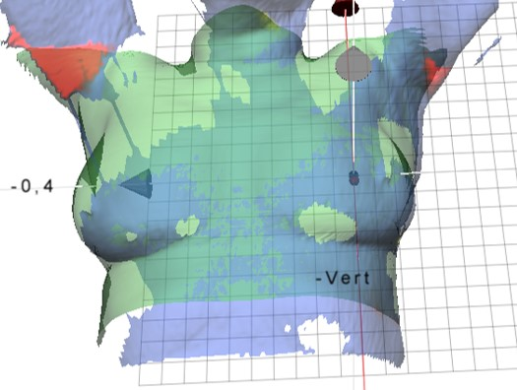
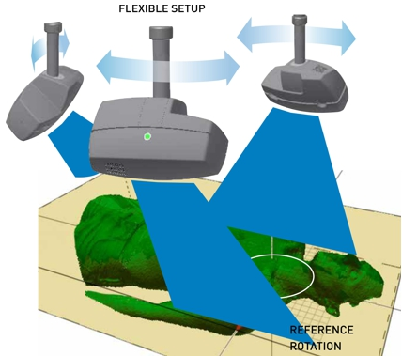
6. Further development
  Surface scanner installation: C-RAD Catalyst / Sentinel
  Patient setup
  Surveilance (intrafraction motion)
  4D CT
  Gating
Image courtesy: C-RAD

Slide 36
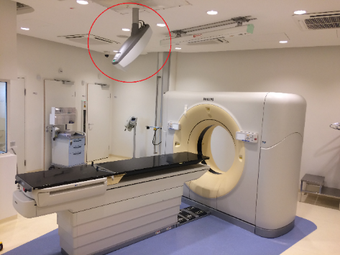
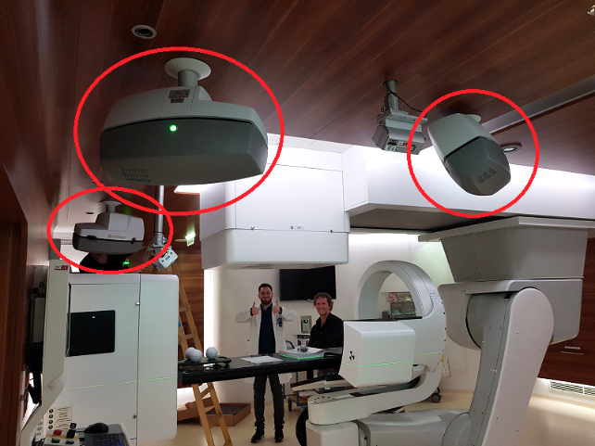
6. Further development
  Surface scanner installation: C-RAD Catalyst / Sentinel
  Hardware installation is finished
  Next steps:
  → Gradual installation of SW packages
  → Acceptance
  → Training (MP, RTT, MedTec)
  → 4D CT - clinical use
  → Assisted setup - clinical use
  → Intrafraction motion surveillance
  → Future goal = gated irradiation

Slide 37

6. Further development
Carbon ions 07/2019
Proton-Gantry 12/2021
Numbers of treated patients
2018: ~200 patients (avg. 26/d)
Goal for 2019: 270 patients (avg. 30/d)
Treatment times
Mo-Fr, including holidays
Currently → 8:10 – 18:00 (in fact until treatments are finished)
07/2019 → 8:10 – 19:00

Slide 38

Closing remark
Interdisciplinary cooperation of teams is the precondition for
- treatment optimization
- cost-efficiency
- effectiveness
- safety

Slide 39
Thank you
Questions ?
<DokKlasse: AAnnn><Inhaltskennz.: xxxxx><DokNo: xxxxxxxxxxxxxxxxx><Datum: JJJJ-MM-DD><Version: n.n><Schutzklasse: nur intern><Vertraulichkeit: offen><Eigner: AA>
39

