Slide 1

VSC LS2 Overviews of activities
LHC Experimental Areas
26th of November 2018
Josef Sestak On behalf of TE-VSC-BVO

Slide 2
Long Shutdown 2 in the experiments
General activities
ATLAS experiment
  New small wheel
  Liquid argon calorimeter upgrade
ALICE
  Major upgrade of the detector (ITS, TPC, MFT…)
CMS
  Hadron Barrel upgrade
  Refurbishment of the pixel
LHCb
  Major upgrade of the detector (VELO, RICH, …)

Slide 3
Long Shutdown 2 in the experiments
Vacuum related activities
All experiments – dismounting the vacuum layouts
ATLAS experiment
  Exchange of the VC1AX chamber; VT supports;
ALICE
  New central vacuum chamber; RB24 layout
CMS
  New central vacuum chamber;
  New forward layout;
LHCb
  New VELO upstream sector;
  VELO vacuum control system upgrade;

Slide 4
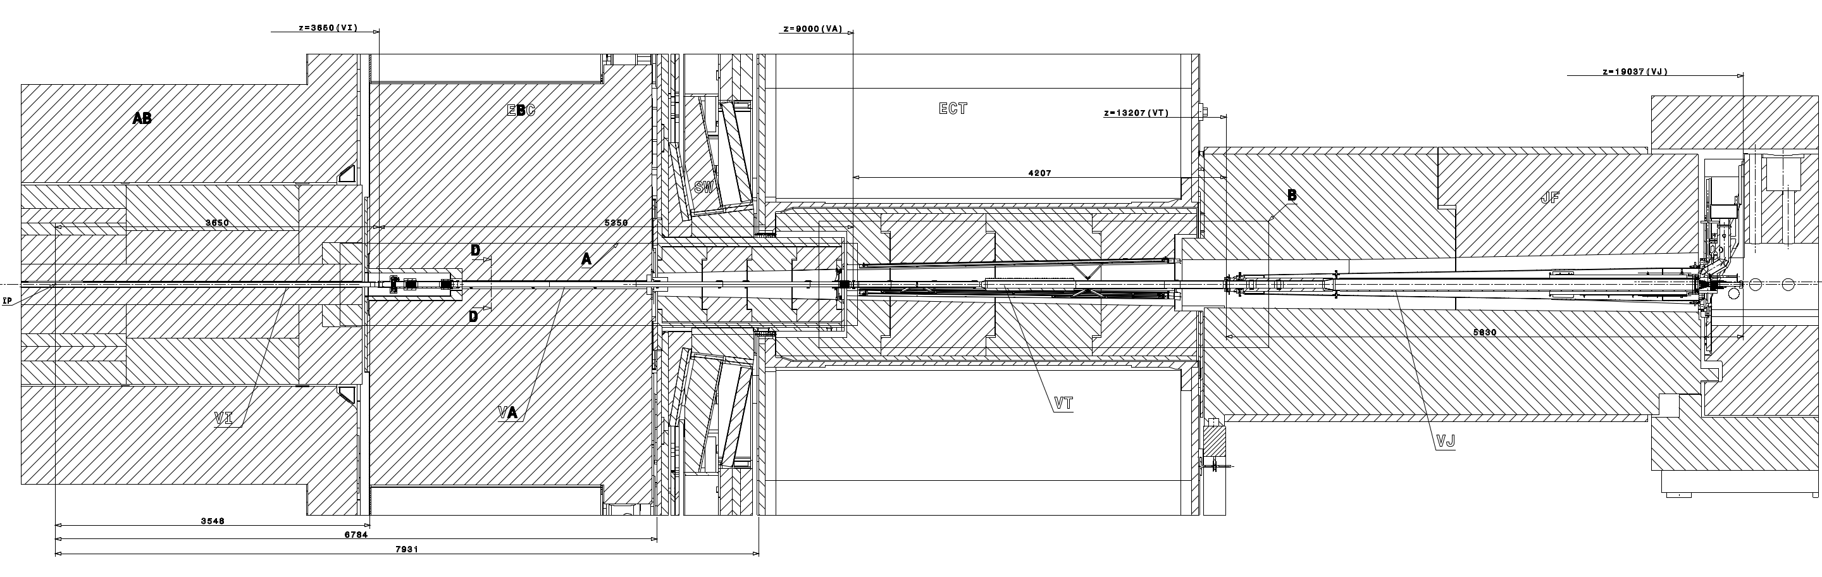
LHC experiments in LS2 - ATLAS
Exchange of the VC1AX - C chamber (damaged bellow);
Upgrade of the VT supporting system (both sides);
IP1
TAS
C-side of the ATLAS experiment
10 chambers dismounted

Slide 5
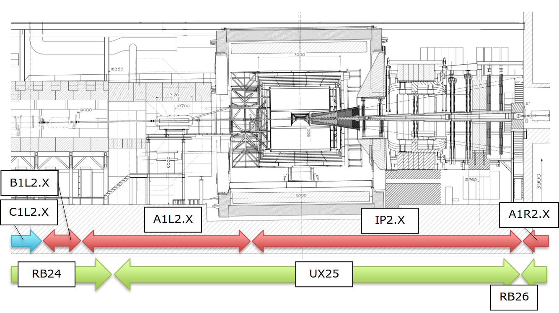
LHC experiments in LS2 - ALICE
Upgrade of the central chamber and RB24 & 26 layouts
6 chambers dismounted

Slide 6
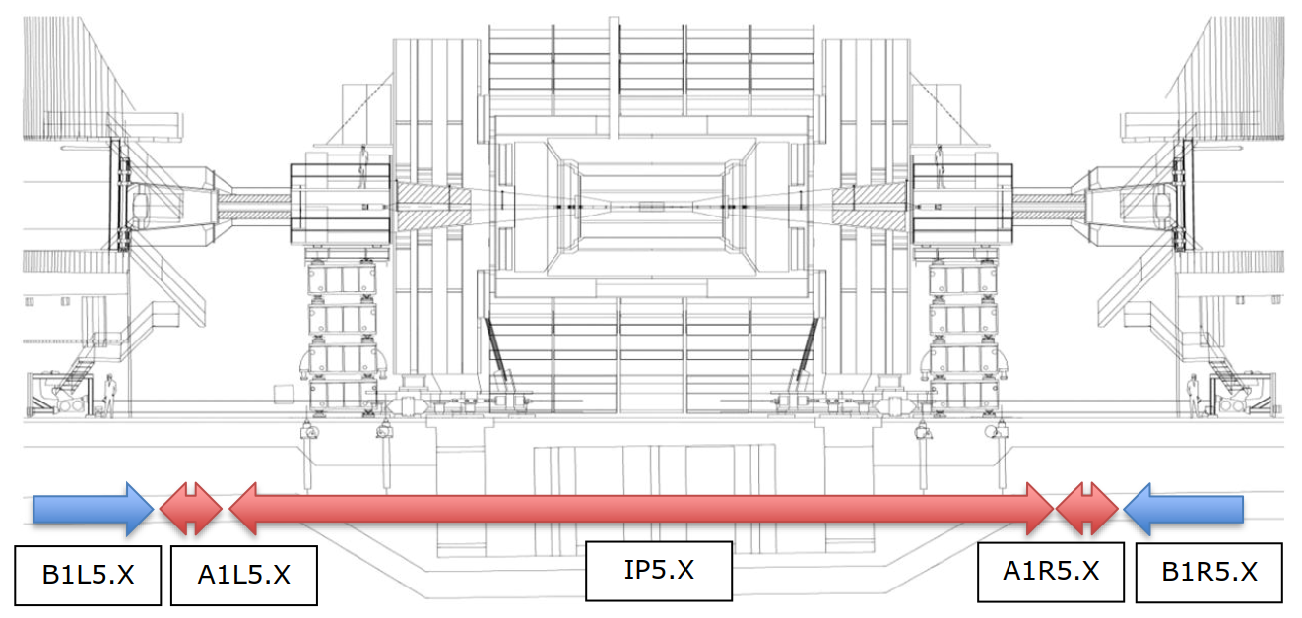
LHC experiments in LS2 - CMS
Upgrade of the vacuum layout up to ±18 m.
9 chambers dismounted

Slide 7
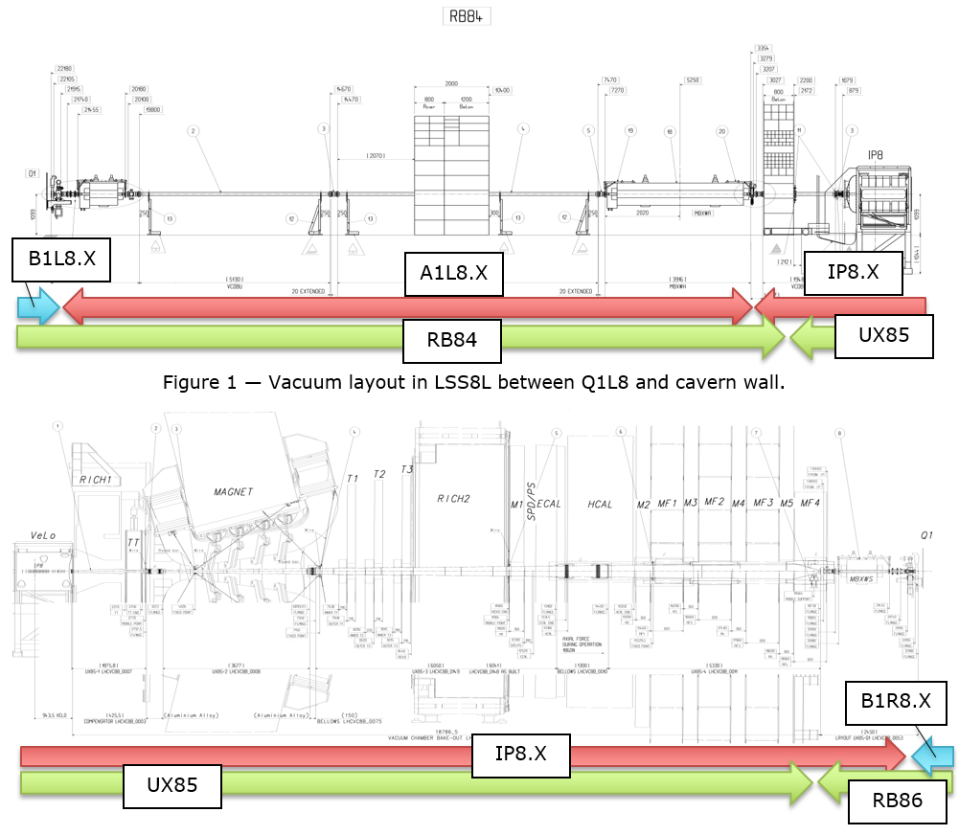
LHC experiments in LS2 - LHCb
5 chambers dismounted

Slide 8
LHC experiments in LS2 - LHCb
Upgrade of the VELO upstream sector

Slide 9
Planning as in EDMS 2010266

Slide 10
Procedures for dismounting
ATLAS
  EDMS 2010405 – Removal of the vacuum layout
  EDMS 2045933 – VT supporting system
ALICE
  EDMS 2010245 - Removal of RB24 vacuum layout
  EDMS 2010253 - Removal of the central chamber
CMS
  EDMS 2010258 - Removal of the vacuum layout
LHCb
  EDMS 1887809 - Removal of the vacuum layout

