Slide 1
BVO Activities during 2018
LS2 Preparation in the LHC

Slide 2
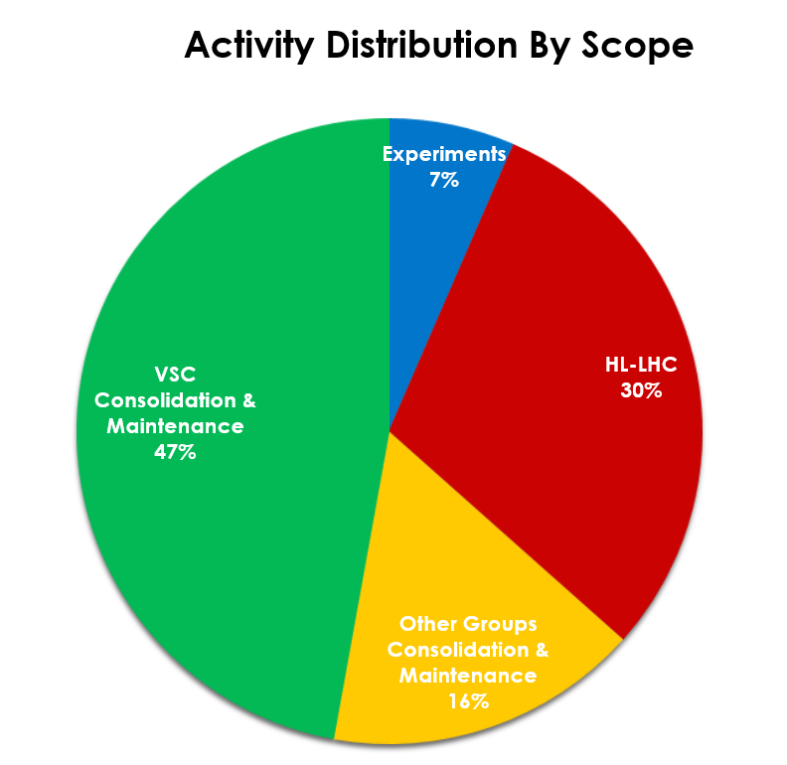
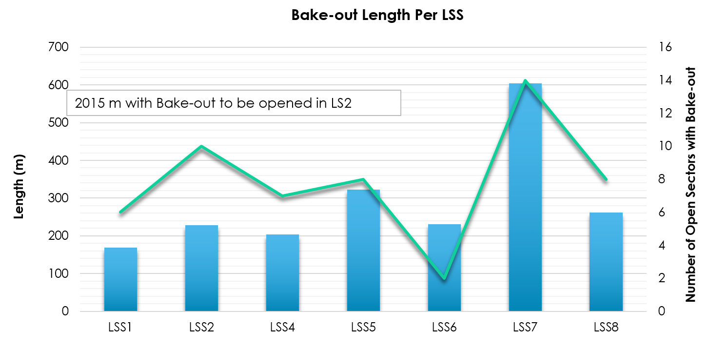
The LS2 in the LHC Tunnel at a Glance
Most of the ECRs are approved and final versions are published.
Layout documents are completed, final control ongoing.
Installation documents to be produced and procedures are being updated.
New components have been ordered and foreseen to arrive well within time.

Slide 3
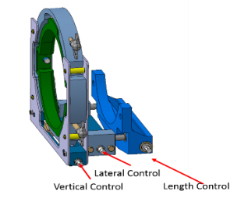
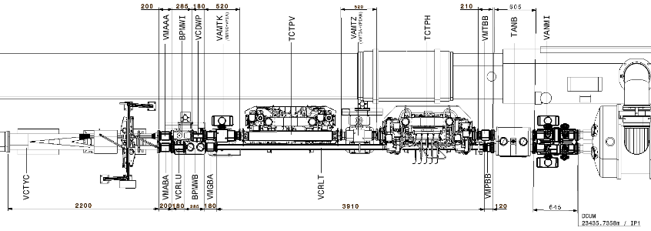
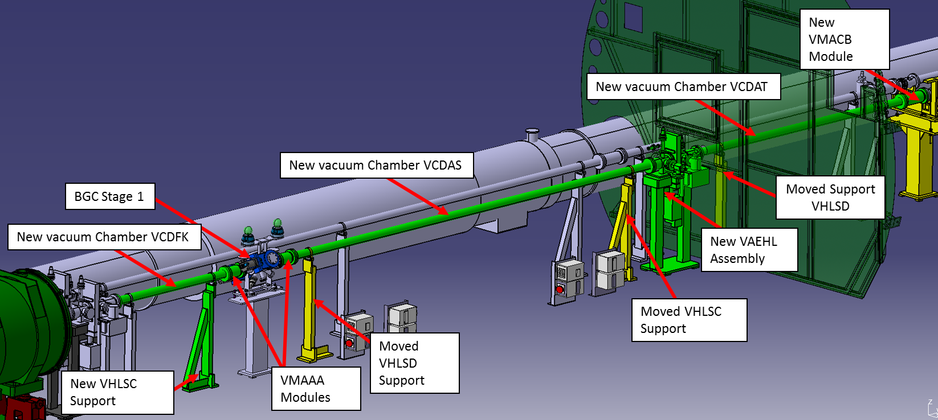
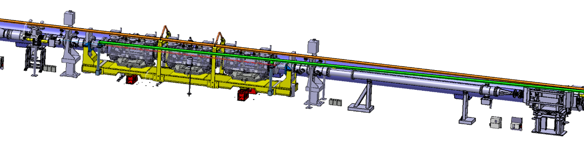
HL-LHC Activities
Selected Activities
WP5 | TCLD Installation Bellow control mechanism developed with EN-MME and EN-STI for TCLD installation. Compact Sector valve design. Vacuum acceptance tests, tunnel installation, bake-out and sector commissioning. New pumping ports in the extremities of each of these arcs. | ARCS 1-2, 2-3, 6-7 & 7-8
 | 12 Low Impedance Collimators Installation 4 Primary Collimators 8 Secondary Collimators | LSS7
WP8 | TANB Installation Significant modification of the vacuum layout in the affected sectors. New vacuum supports design for the installation. New layout installation, bake-out and sector commissioning. | C4R8 & C4L8
WP13 | Beam Gas Curtain Installation New layout installation, bake-out and sector commissioning. Studies are ongoing to define the BGC Stage 2 vacuum system with BE-BI. | C5L4
WP14 | TDIS Installation Vacuum Performance Simulations: Bake-out at surface and vacuum acceptance tests for all sub-assemblies. Development of Mechanism to compress sector valve assembly modules. Tunnel installation support and commissioning of the adjacent sectors. | C4R2 & C4R8
TCLD Collimator
Differential Layout of C4R8
TANB
BGC Stage 1 Layout
(ST1028569_01)
The New TDIS in P2

Slide 4
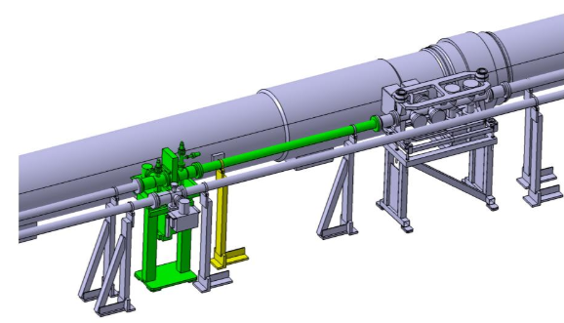
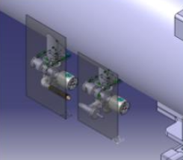
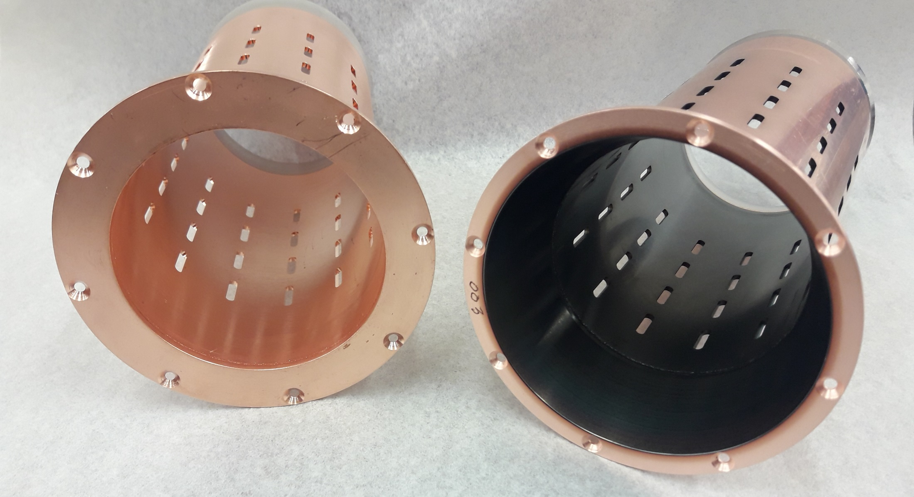
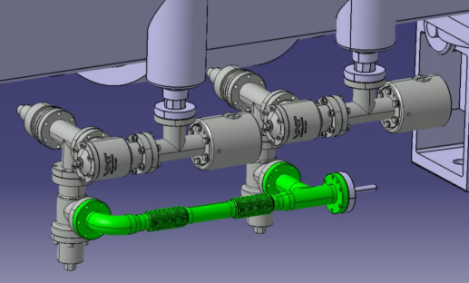
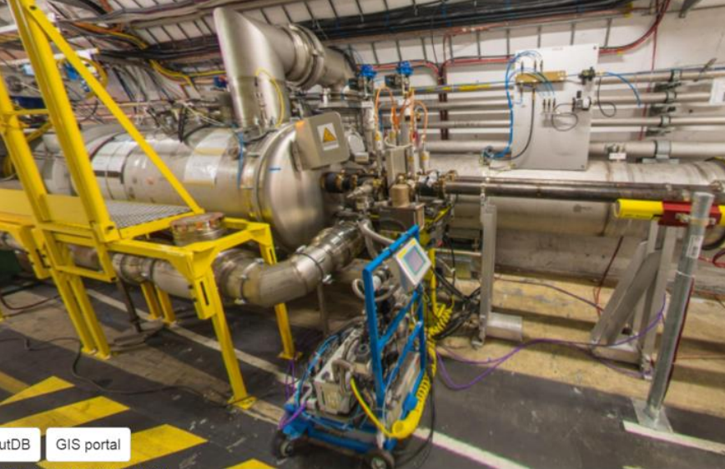
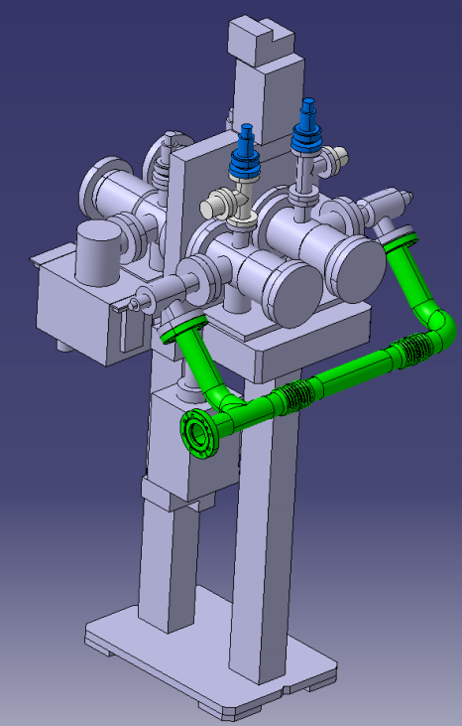
VSC Consolidation Activities in LHC
Most Significant Activities
LSS | Sectorization of the BWS
 | Removal of Solenoids and Installation of a-C Coated inserts at IP1, IP2, IP5 and IP8 Endoscopy of the Inner Triplets
 | Pumping Port Relocation in SAM’s and New Pumping Port Connections
 | Consolidation of Non-Conform Gauges and RF Fingers Consolidation of Bake-Out Equipment
ARC | Pumping port upgrades and installation of protections Consolidation of non-conform gauges Helium base signal RGA Analysis of 16L2 Leak detection of RDs Endoscopy in C15R8 (ULO)
Dump Lines | Consolidation of pumping groups, gauges and ion pumps Leak Detection
New Sectorization in the BWS’s
New a-C Coated RF Inserts
Pumping Port Upgrade and Protection in the Arcs
Pumping Port Upgrade In SAM

Slide 5
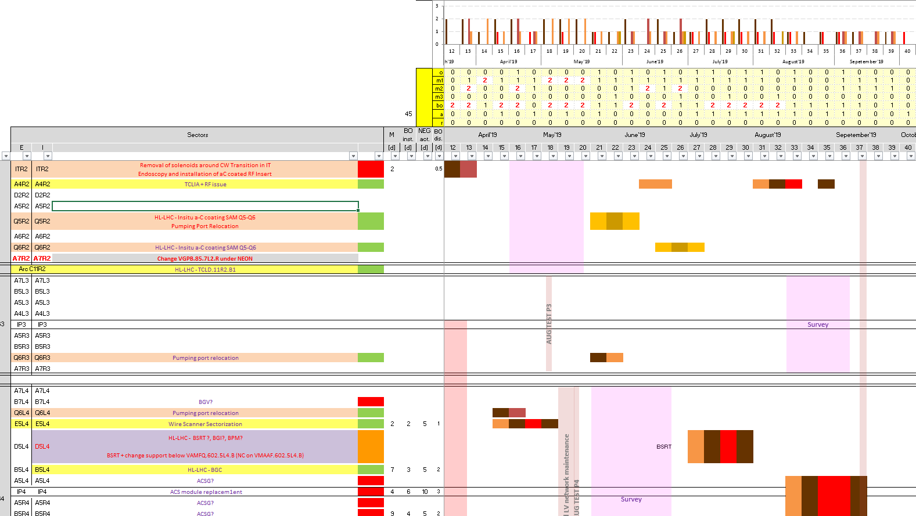
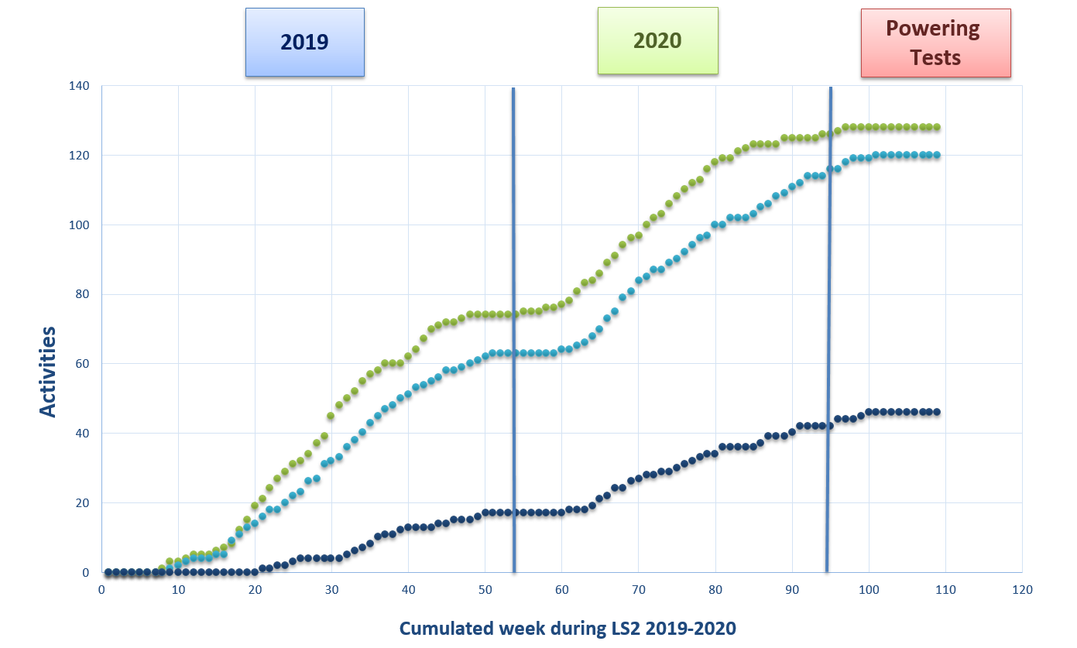
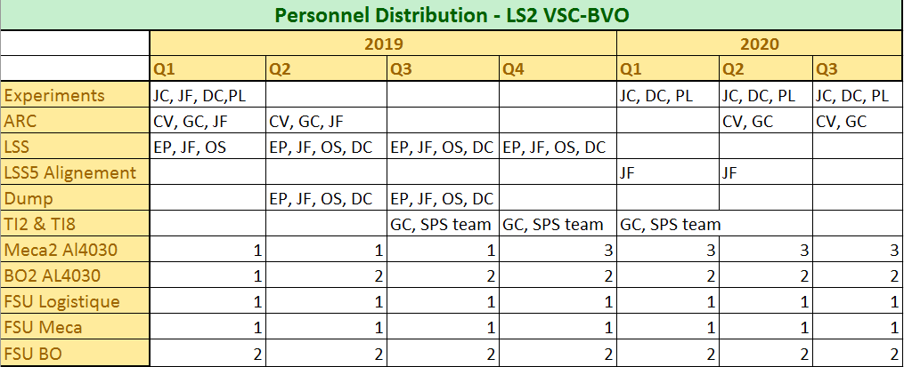
Follow up of activities during LS2

Slide 6
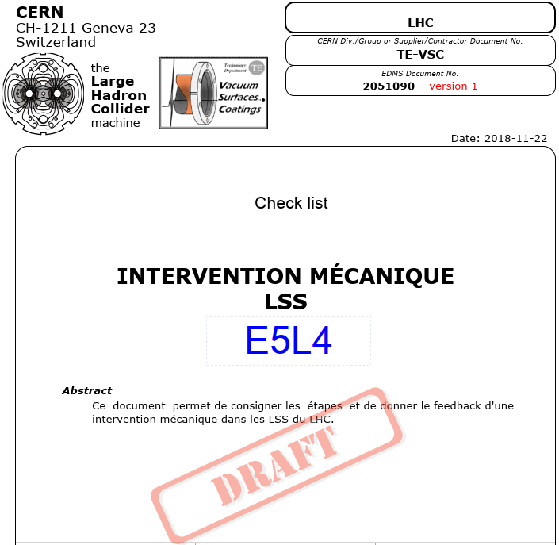
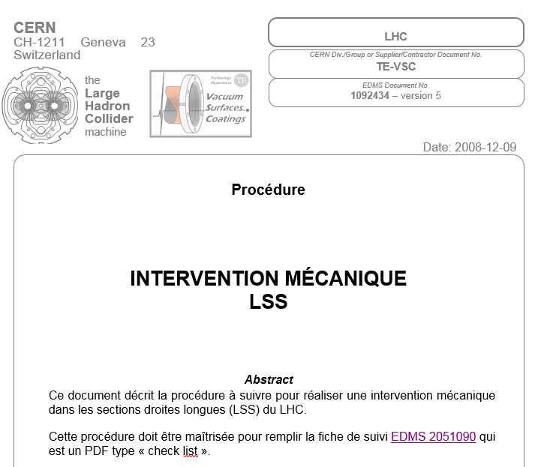
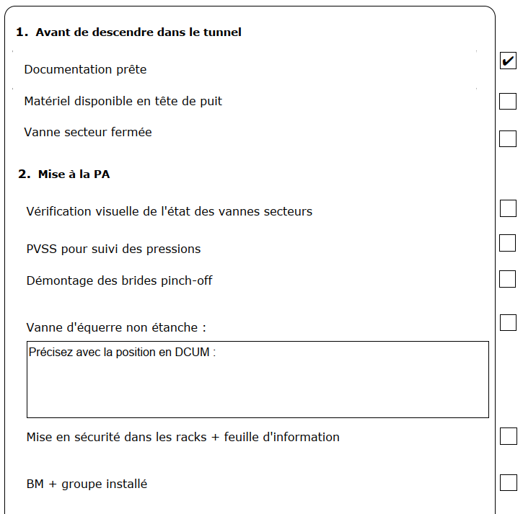
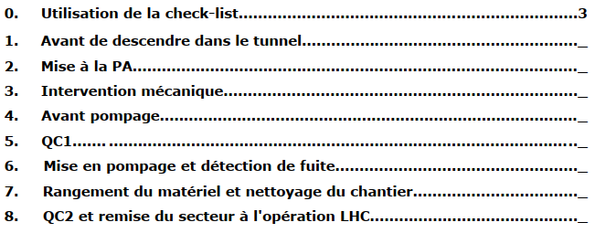
Intervention file, BWS sectorization 1/2
The procedure is the general guide-line for the LSS
The check-list is the working document in the tunnel: the template is modified for each vacuum sector and used on-line through BVO sharepoint site

Slide 7
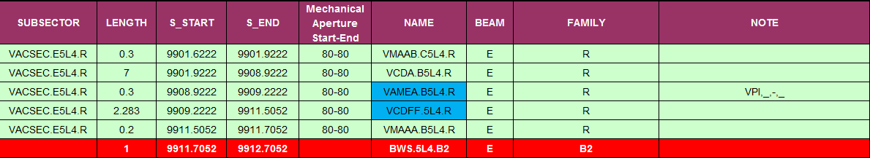
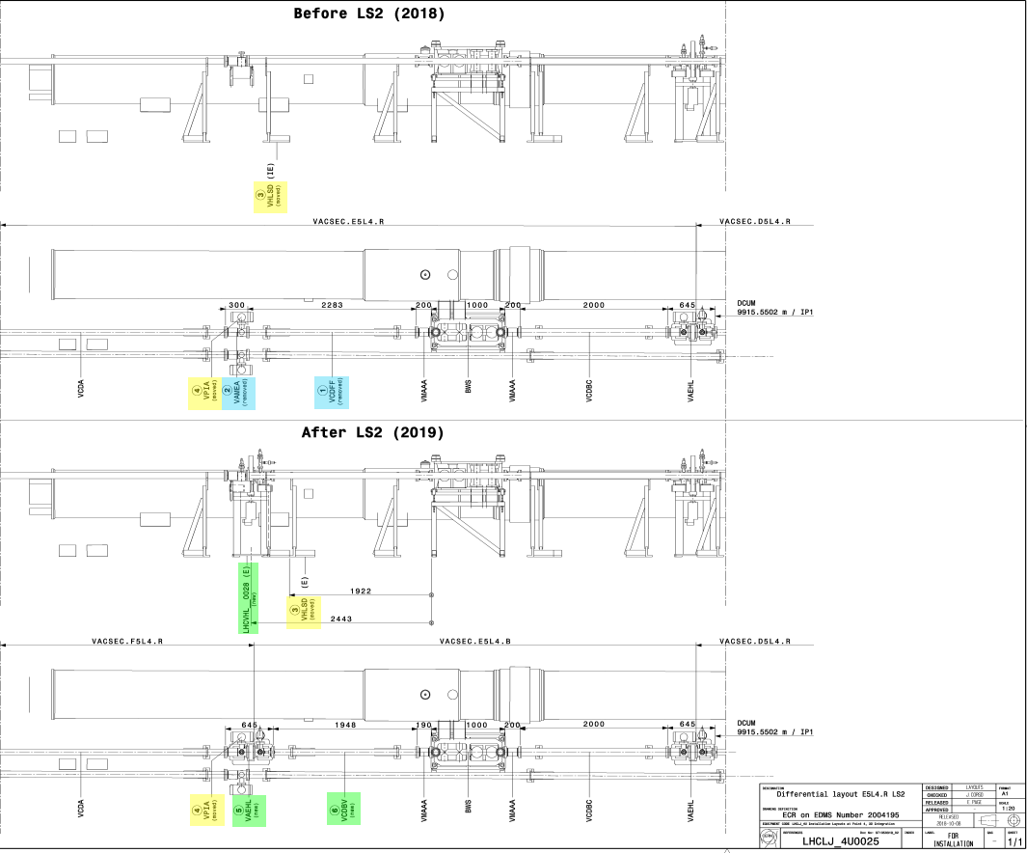
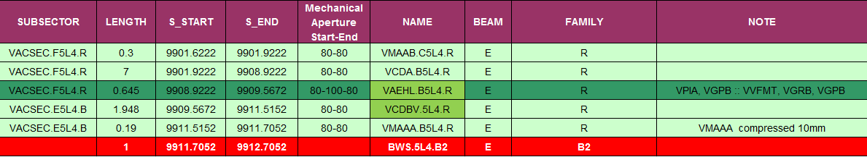
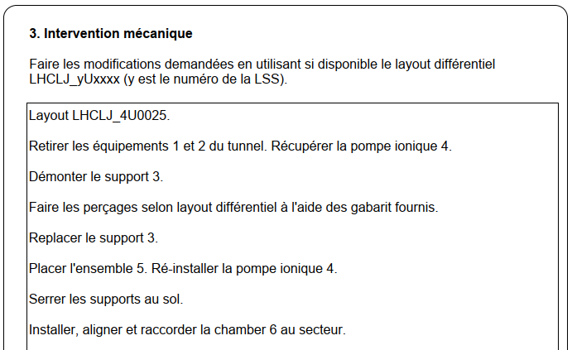
Intervention file, BWS sectorization 2/2
Differential Layout coupled to the TE-VSC vacuum documentation and/or to the ECR
 | Vacuum Component
 | Sector Valve Assembly
 | Optical Component
 | New Component
 | Moved Component
 | Removed Component

