Slide 1

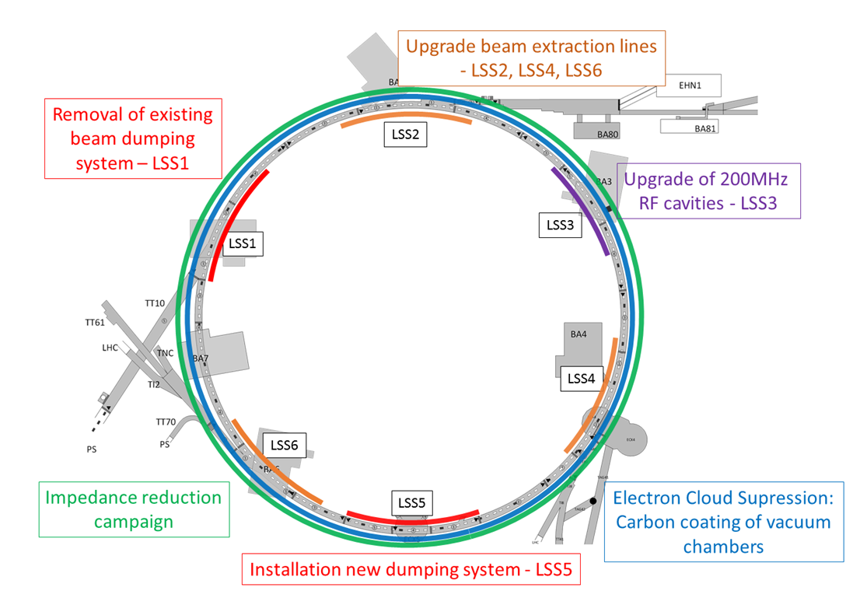

SPS – LS2
Full SPS-ring activities
Magnet exchange (~15x)
aC coating
Impedance reduction
General maintenance
  Components purchased
  Non-conformities
    Ion pumps
    Gauges
    Vacuum chamber supports
QD aperture restriction
QD aperture restriction upgrade

Slide 2
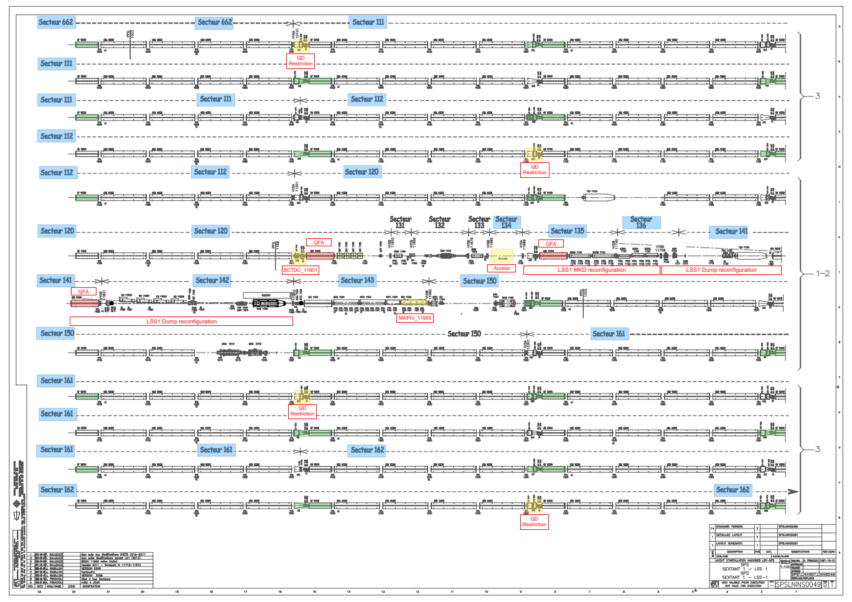
SPS LS2 – BA1
Enlarged quadrupole reconfiguration
LSS1 reconfiguration
  Component purchasing
  Design – fixed
  Pump consolidation
  Chamber production
BCTDC removal

Slide 3
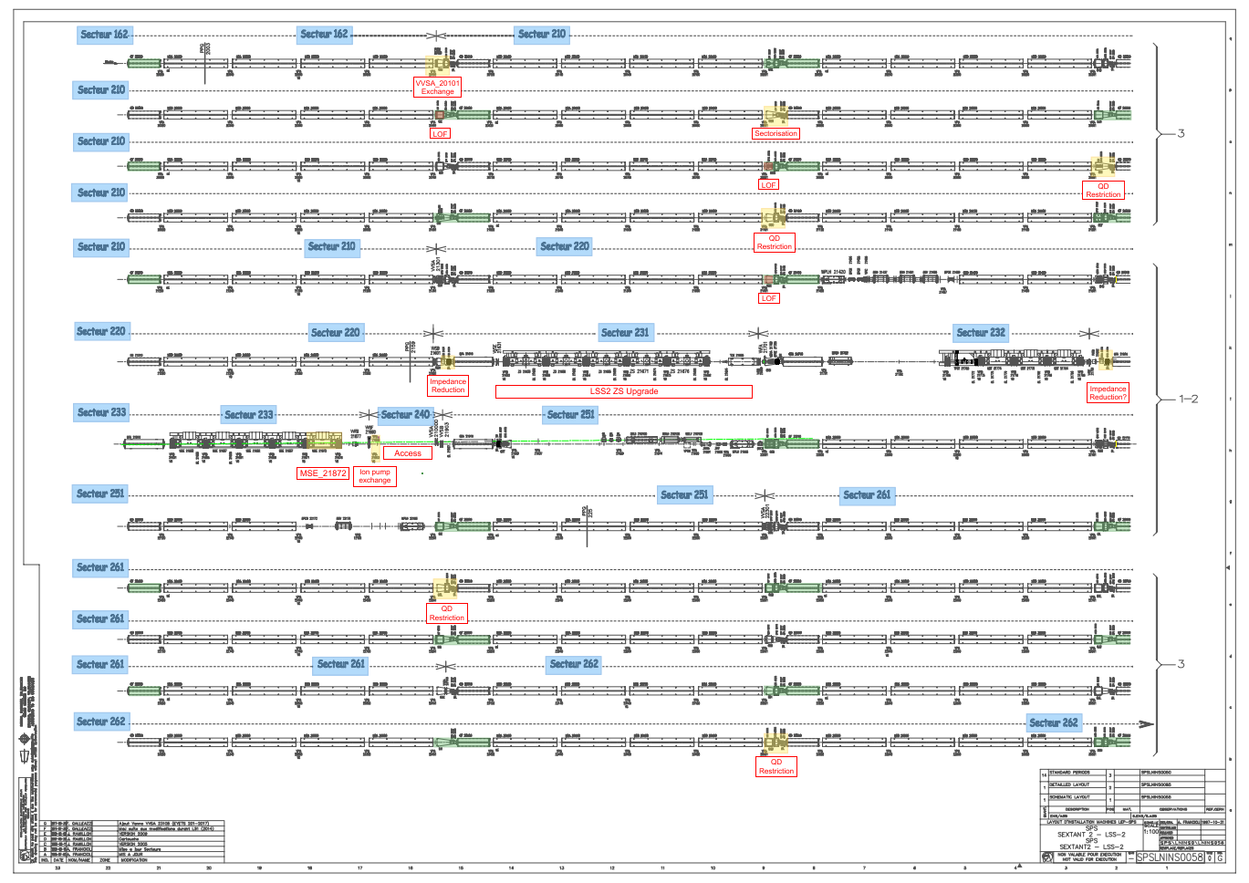
SPS LS2 – BA2
Sectorisation (BA2-)
LOF symmetry
MSE exchange
ZS upgrade
  Component purchasing
  ZS testing
  Interconnect testing
Impedance optimisation

Slide 4
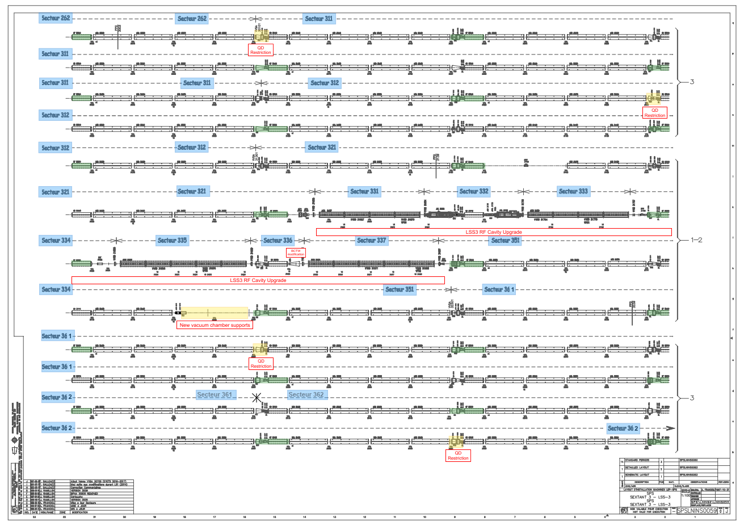
SPS LS2 – BA3
RF cavity refurbishment
  Design - fixed
  Component purchasing
  Ion pump consolidation
  Chamber production
Chamber support consolidation
Wall-Current Transformer (BCTW)

Slide 5
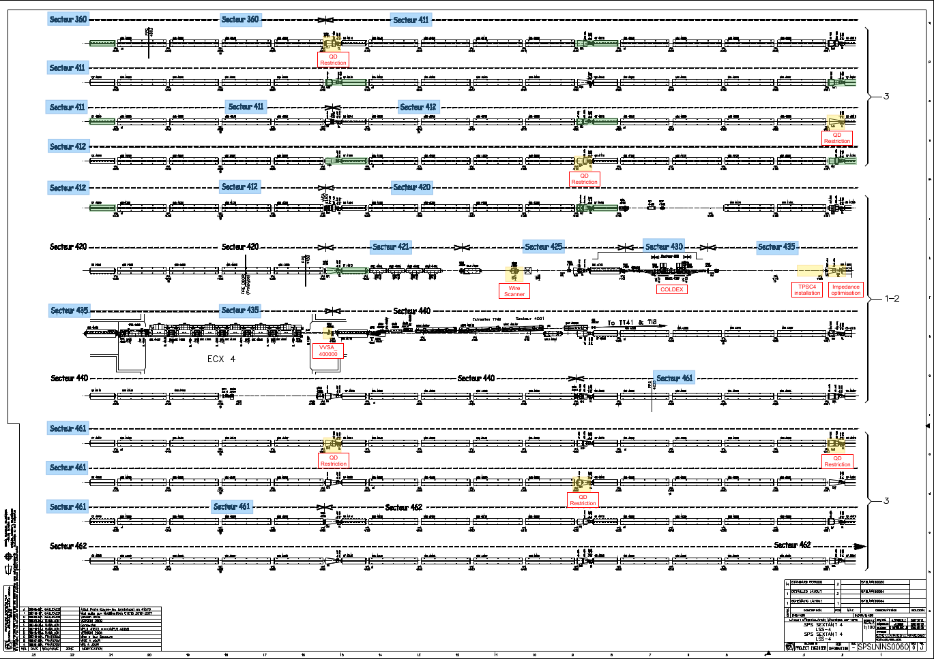
SPS LS2 – BA4
Sector valve exchange
Impedance optimisation
TPSC4 installation
Wire scanner installations

Slide 6
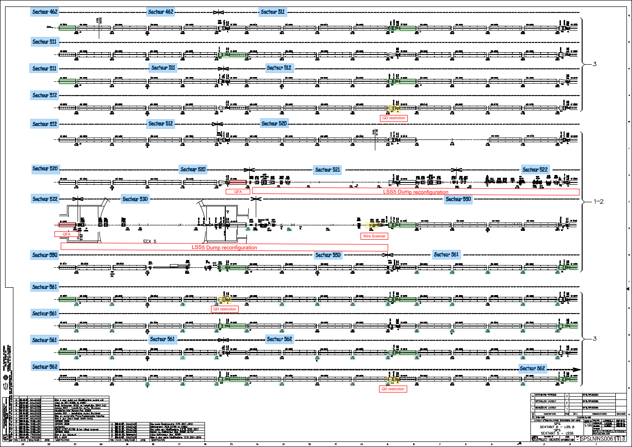
SPS LS2 – BA5
Enlarged quadrupole
Ion pump consolidation
(LSS & arc+)
Wire scanner installations
LSS5 reconfiguration
  Component purchasing
  TIDVG design review
  Layout design – fixed
  Vacuum chamber production

Slide 7
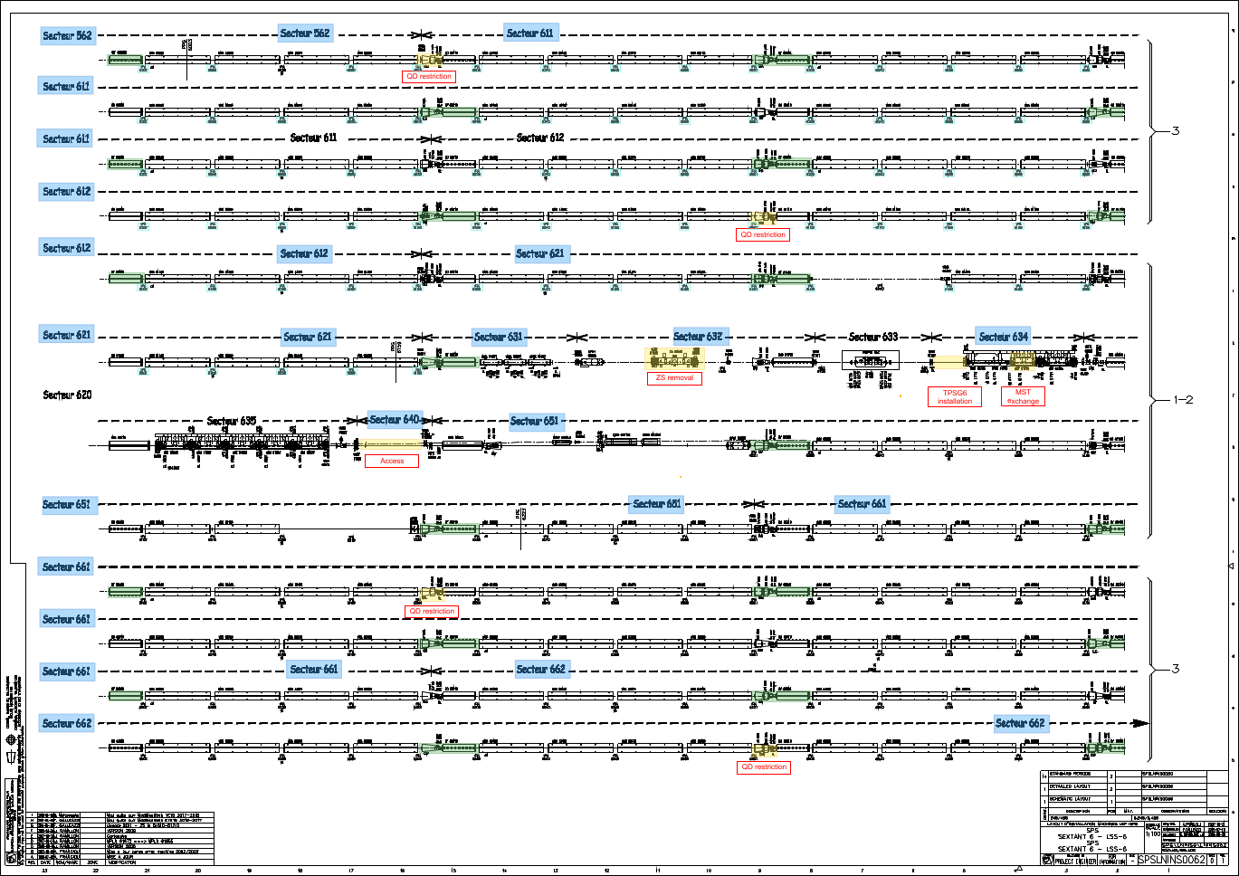
SPS LS2 – BA6
TPSG6 installation
MST exchange
Ion pump consolidation (arc-)
Impedance optimisation
ZS removal

Slide 8
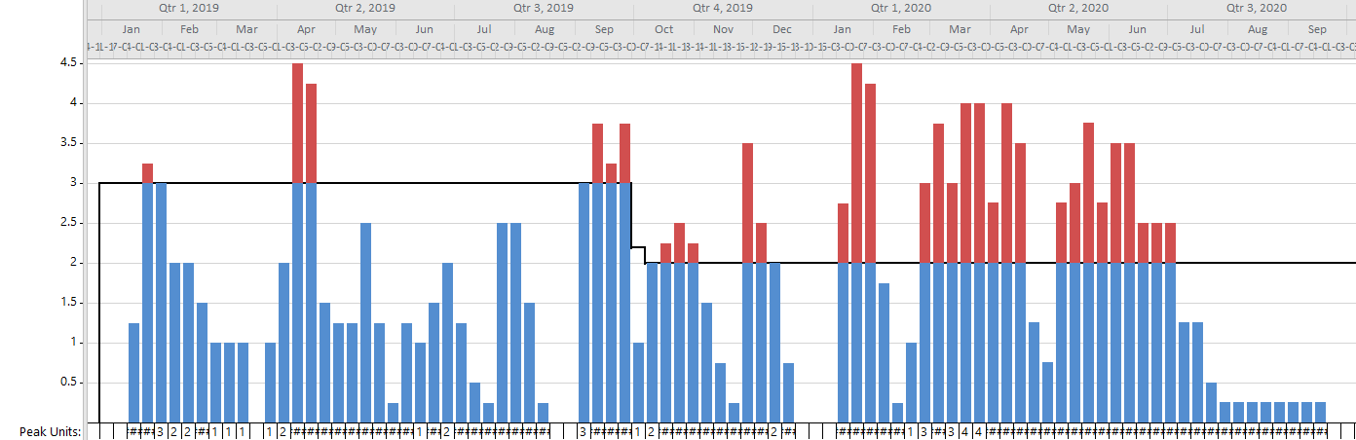
SPS LS2 – Planning
Current planning has smoothed Q1 2019 peak but remains Q1/2 2020 peak
Man power limited to be updated from last meeting

Slide 9
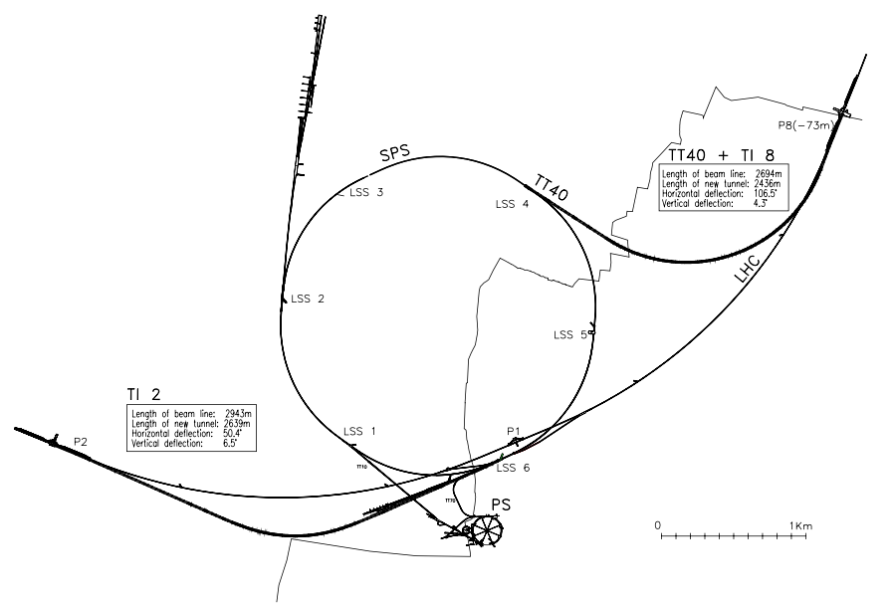
SPS LS2 – Ti2/Ti8
New layout
  Layout design – fixed
  Component procurement
  6x new TCDIL
  Sectorisation of TED
General maintenance
  Non-conformities – planned
  Sector valve pressure switch
  Components purchased

