Slide 2
SPS LS2 2019-2020
- aC coating campaign
- flange impedance reduction
What are we going to coat
Where are we coating
When => planning
Some Slides from: P. Cruikshank LIU & TE/VSC activities, 23/6/2016

Slide 3
What are we going to coat:
- QF
- SSS QF
- LSS Drifts tubes
NO MBB and QD

Slide 4
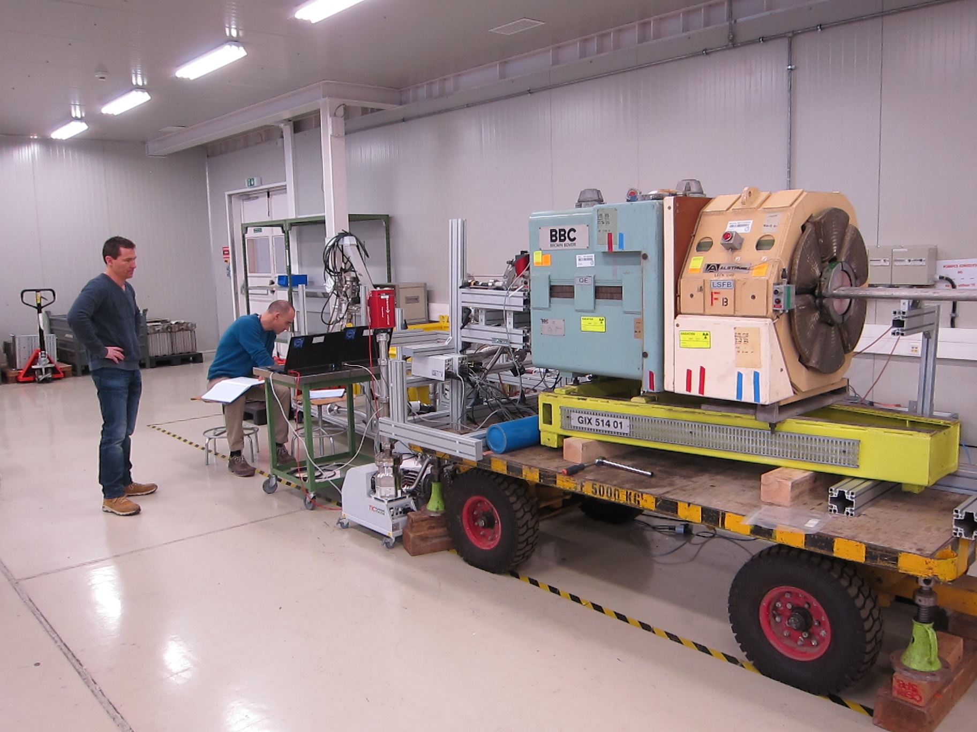
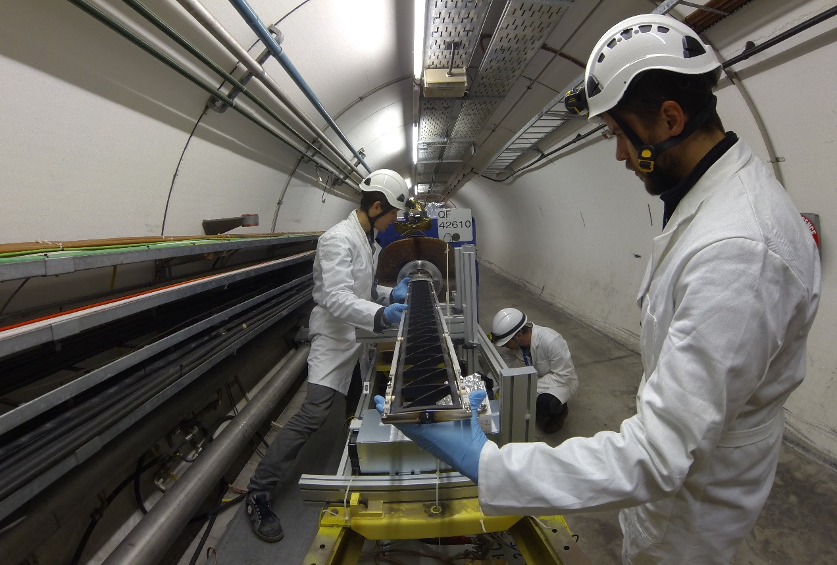
What are we going to coat
1 cell = 63.995 m
MBA
SSS
QF
MBA
MBA
MBB
MBB
SSS
QD
MBB
MBB
MBA
MBA
SSS
QF
Coating lab in surface building
+ drifts to 181

Slide 5
What are we going to coat
Prevessin site
(magnet lift)
(LS2)
BA3
(LS2)
Mandate QF and SSS QF aC coated:
EYETS/YETS – up to 1 ARC
(magnet lift)
RF
LS2 – complete 6 arcs
BA2
BA4
TT20 ext
TT40 ext
9 QF (EYETS 2016)
SPS
(LS2)
Injection
& Dump
Future
dump
BA1
BA5
TT60 ext
ECX5
BHA5
BA6
(LS2)
(LS2)
Meyrin, P1 LHC
(magnet lift)
QF activity includes QF & SSS QF treatment (aC & IR) LS2: 87 QF to be coated in SPS !
87 SSS QF to be coated in 867

Slide 6
What are we going to coat:
ECR: SPS amorphous carbon coating in LS2 2019-2020
WPA: Amorphous carbon coating and vacuum flange impedance reduction in SPS during the long shutdown 2
WDP: 1429 in work
Impact (once WDP finished)

Slide 7
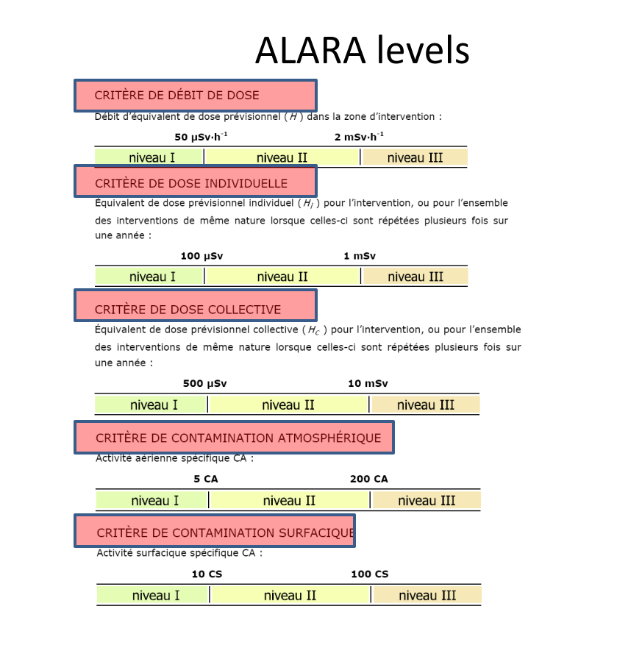
Dose Analysis based on EYETS “Real doses”
From analysis:
With some assumptions for higher dose
0.43 mSv
4.7 mSv

Slide 8
Planning
Planning sequence for aC coating and flange impedance reduction during LS2
Treatment zone | Transport via | 2019 |  |  |  | 2020
 |  | Q1 | Q2 | Q3 | Q4 | Q1 | Q2
arc 5- | BA3 | X
arc 4- | BA3 | X
arc 3+ | BA3 |  | X
arc 3- | BA3 |  | X
arc 2+ | BA3 |  |  | X
arc 5+ | BA6 |  |  | X
arc 6- | BA6 |  |  |  | X
arc 6+ | BA6 |  |  |  | X
arc 1- | BA6 |  |  |  |  | X
arc 1+ | BA6 |  |  |  |  | X
arc 2- | BA6 |  |  |  |  | X
closure | -
Acces BA6 !!

Slide 9
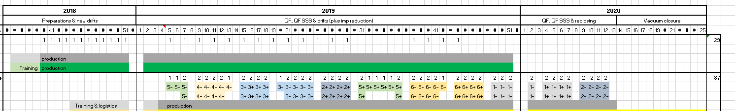
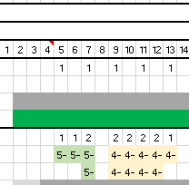
Planning
Access SPS 21 January => 14 January = week 3
Week 3-4: dismounting 5- + transport to 867 + equipment to TNL
01/11/2018

Slide 10
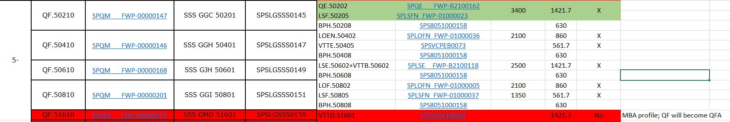
5- coating activities
SSS QF elements
name
weight
length
QF’s to be coated in tunnel
SSS QF’s to be:
Dismounted
Transported to 867
Coated in 867 or 181
Reinstalled in SPS
2 magnets on girder
magnets stand alone
magnets + QF drift
QF drift stand alone
EDMS link: Detailed list of LS2 aC coating

Slide 11
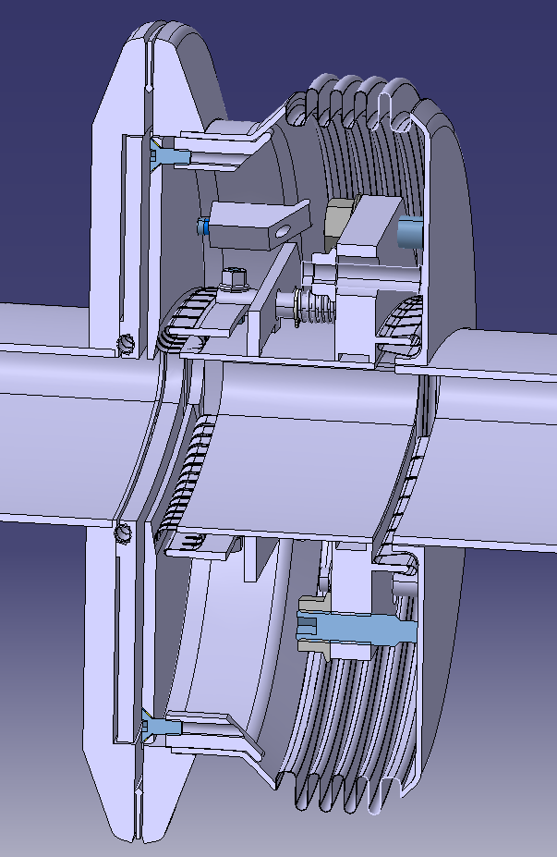
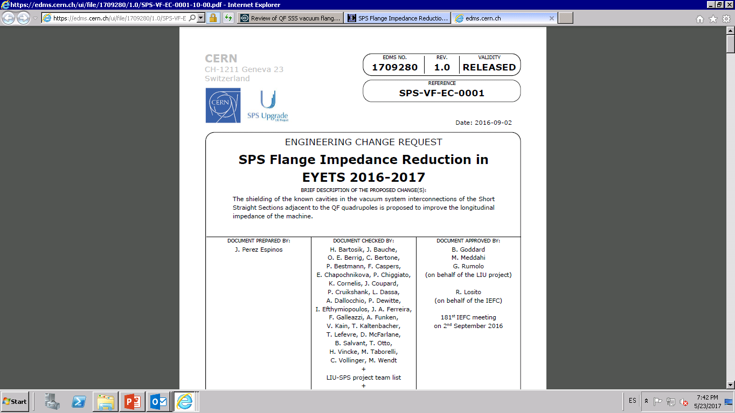
EYETS 2016-2017
  In parallel with a-C coating:
  Impedance reduction (I.R.) campaign for QF-SSS
INCLUDED IN LS2
project

Slide 12
Planning
Access SPS 21 January => 14 January = week 3
Week 3-4: dismounting 5-
181 and 867; Coating + I.R.
SPS; Coatings + I.R. at the end
Week 8: re-mounting 5- and dismounting 4-

Slide 13
Coating process
867; 2 coating systems:
Basis sequence: 1 coating/ week/system (in EYETS: 1.5 /week/system)
Now: 5 coating runs in 3 weeks
SPS; 2 coating systems
Basic seq: 1 coating/week/system (in EYETS: 1.5 /week/system)
Now: 4 coating runs in 3 weeks
Mounting and coating procedure is under progress
Training sessions in the next few week, already started => end of year
Both for SSS QF (867 set-up) and QF (Tunnel set-up)
Database for project: under construction ( Ole)
SEY measurements: Danilo …..

Slide 14
Who
Location | Man power for coating activities
181 | Process engineer + 1 FSU
SPS | Process engineer + 1 technicien + 1 FSU
867 | Process engineer + 1 technicien + 1 FSU
Dismounting / re-installation: Tony Mongelluzzo + 1 person
SEY measurements: Danilo Zanin …….

Slide 15
MERCI
Question?
Remarks ?

Slide 16
Who
Mechanics
Spyros Fiotakis
Paul Garritty
Ludovic Mourier
Giovanni Marinaro
Tony Mongelluzzo (reduced act.)
New TTE (03/04 2019, as G.M. => LHC)
Ole Gunnar Sveen *
Location | Man power
181 | P.E. + 1 FSU
SPS | P.E. + 1 mech. + 1 FSU
867 | P.E. + 1 mech. + 1 FSU
Process engineer (during first period *)
FSU
Jerome Gremion
Charles Erik Moreillon
3rd FSU
Location | Man power
181 | Antonios Sapountzis
SPS | Wil / Harold
867 | Wil / Harold
Joker *
Pedro
Alban
*: more people trained during starting phase

Slide 17
SPS LS2 2019-2020
- aC coating campaign
- flange impedance reduction
What are we going to coat
Where are we coating
When => planning
Who => planning
How => Training
Safety and Access issues

Slide 18
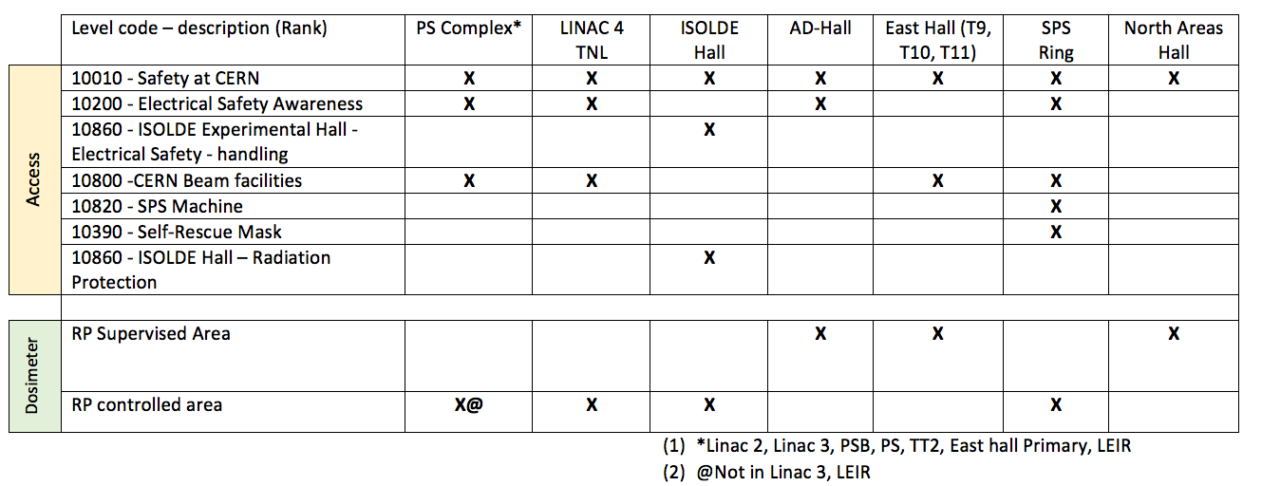
General Access Injectors
Acknowledgements: T.Otto, M.Tavlet
*
* See next slide
Please CHECK in ADaMS !!!
01/11/2018

Slide 19
Safety electrical safety requirements
Additional requirement according to WPA:
Habilitation Electric-Person making Test in Labs or on Test Bench- Initial (10250) ¹ OR
Habilitation Electric Electrician low Voltage ¹
Habilitation Electric for non Electrician ²
¹: for persons cabling power supply to cathode assembly and start coating process.
²: for persons making mechanical assembly of coating set-up.
01/11/2018

Slide 20
General safety/ RP remarks:
Several other equipment in environment where we are working:
  We don’t touch equipment that we don’t know
In SPS: red/white band + flash light around magnet + coating set-up
Info attached to system who is responsible for the coating + tel. nr.
- In 867: stay in our “zone” + info above
Lots of co-activity:
  Keep working place clean *
  Keep an eye on other activities: can they have an impact on our work?
  Please react if co-activities don’t go together !
* Cleaning working place:
When dismounting gaskets that have seen the beam: radioactive waste !
collect together in one bag => TREC
All other waste: select / separate and take away => No TREC.
  BE SURE NOT TO MIX UP !!!!!
01/11/2018

Slide 21
Access rights and safety equipment
EVERYONE who enters the SPS MUST have the following:
Completed the correct courses. See previous slides
The correct access authorisation (via EDH). CHECK YOUR ACCESS RIGHTS HAVE NOT EXPIRED!!!!
  Zone Code “SPS” for access into the SPS
  Zone Code “SPS-KN-000” for “Autorisation conduite RTL”
  Zone Code “SPS-KN-001” for “SPS Shutdown Padlock” (only used during Long Shutdowns)
  P.P.E.
Safety shoes.
Biocell. (next slide)
Electronic dosimetre.
Passive dosimetre. (All contractors must have an additional company passive dosimetre!!)
Helmet plus Light.
A valid approved IMPACT. (with their name included on this IMPACT)
They must know the number of this IMPACT.
Please note that personnel are not allowed to work in the tunnel alone!!
RTL training not longer required for staff, for driving without lorry
01/11/2018

Slide 22
Access rights and safety equipment
EVERYONE who enters Building 867 MUST have the following:
Completed the correct courses: electrical courses / radiation protection course
The correct access authorisation (via EDH). CHECK YOUR ACCESS RIGHTS HAVE NOT EXPIRED!!!!
  0867
  0867-R ALL
  0867-R-W25
  P.P.E.
Safety shoes.
Electronic dosimetre.
Passive dosimetre. (All contractors must have an additional company passive dosimetre!!)
A valid approved IMPACT. (with their name included on this IMPACT)
They must know the number of this IMPACT.
Please note that personnel are not allowed to work in building 867 alone!:
For aC coating process: process regulation/ check during day-time: OK
mounting / dismounting: always be two
Weekend: no Access !! (in case of “urgent issues”: two people to come during W,E.)

Slide 23
Not possible without….
TE-MSC
  SSS & QD electrical & hydraulic disconnection/reconnection
  SSS dismantling and reinstallation
EN-HE
  SSS dismantling, tunnel & surface transport, reinstallation
BE-BI
  Instrumentation cabling disconnection/reconnection
EN-ACE
  Planning framework and advice
  Realignment of displaced magnets & BPH/BPV
HSE
  Guidance & preparation of the safety file
  Radiation surveys & Work & Dose Planning advice

