Slide 1
LS2 in PS complex
Jose A. Ferreira Somoza

Slide 2
Summary
Outlook of the work
Preparation
Teams / Resources
Budget
Critical activities and main risks

Slide 3
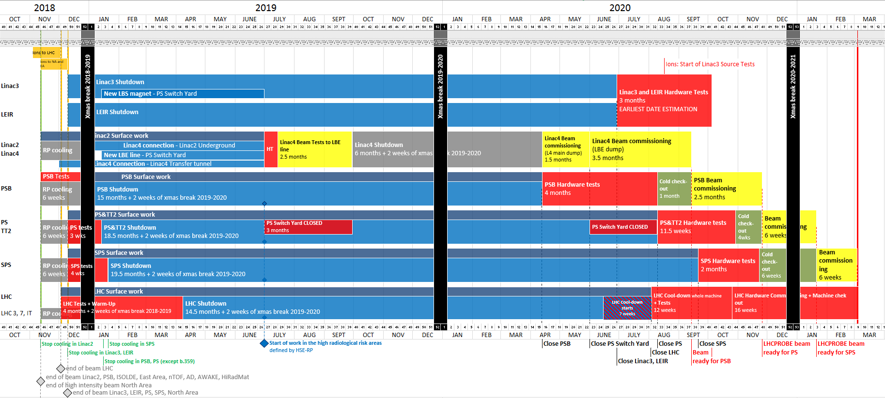
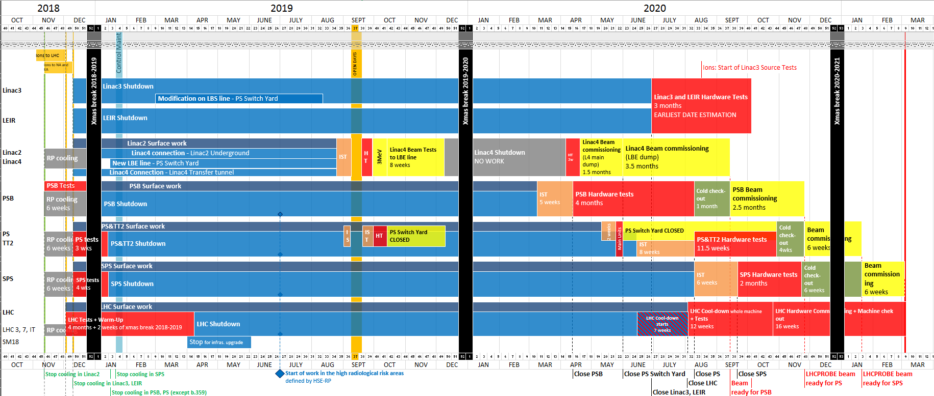
Master schedule

Slide 4
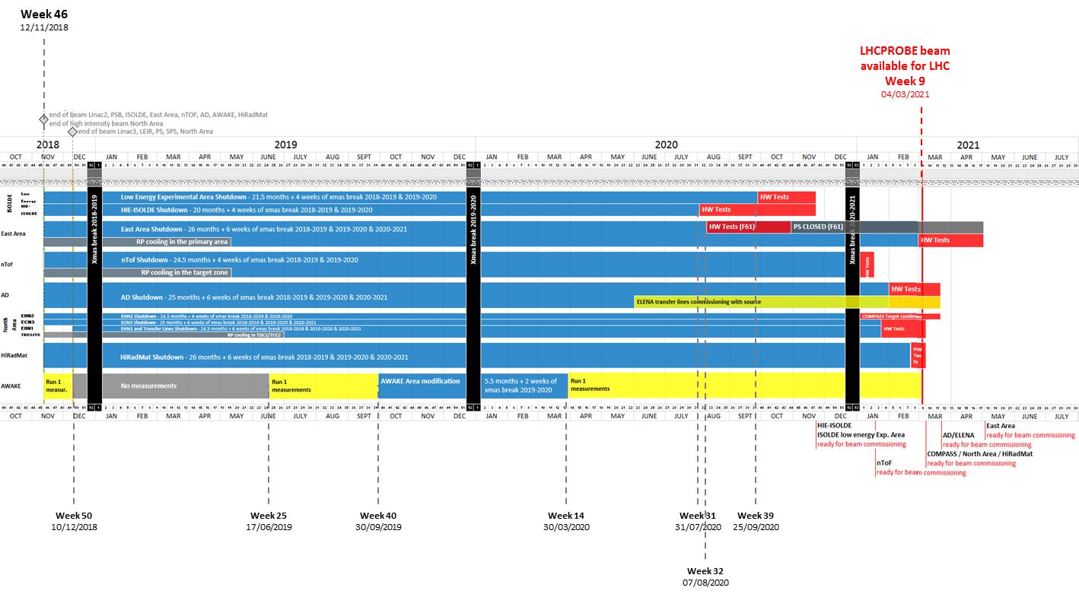
Master schedule
Some operation with stable beam or RF tests to be defined

Slide 5
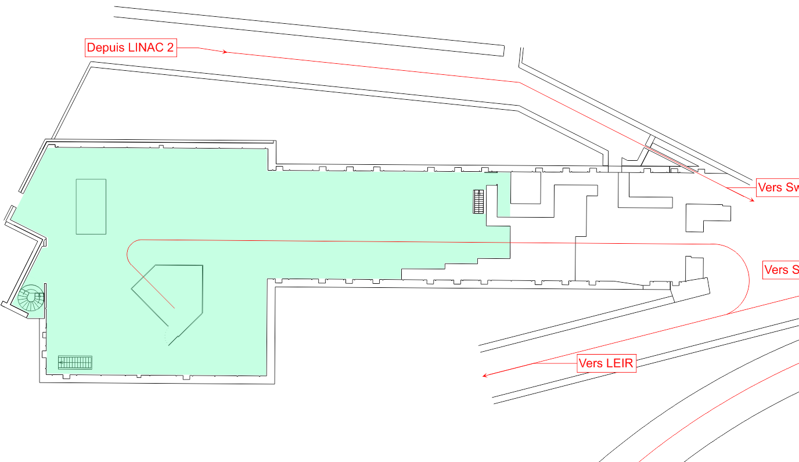
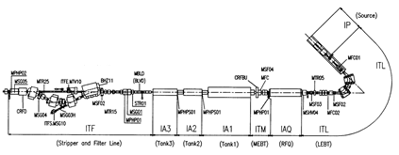
LINAC3&LEIR
Linac3 IH drift tubes - PLAN
Maintenance turbopumps and primary pumps
L3 NO ACCESS asbestos removal: May-June 2019
  Equipment off
  Racks off
  Equipment protected from dust
Linac3 source moveable extraction electrode
No planning

Slide 6
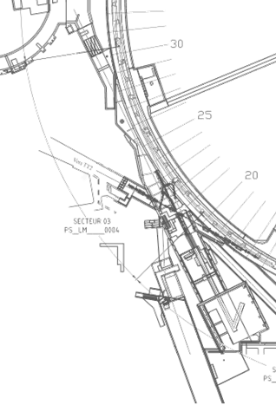
LINAC4 connection
New emittance measurement line LBE
Removal of the beam stoppers
LBS Magnet exchange and removal of kicker
Replacement of magnets in LT, LTB and BI lines
Remove LTB.STP10
Connection of the Linac4 transfer line
Partial dismantling of the Linac2

Slide 7
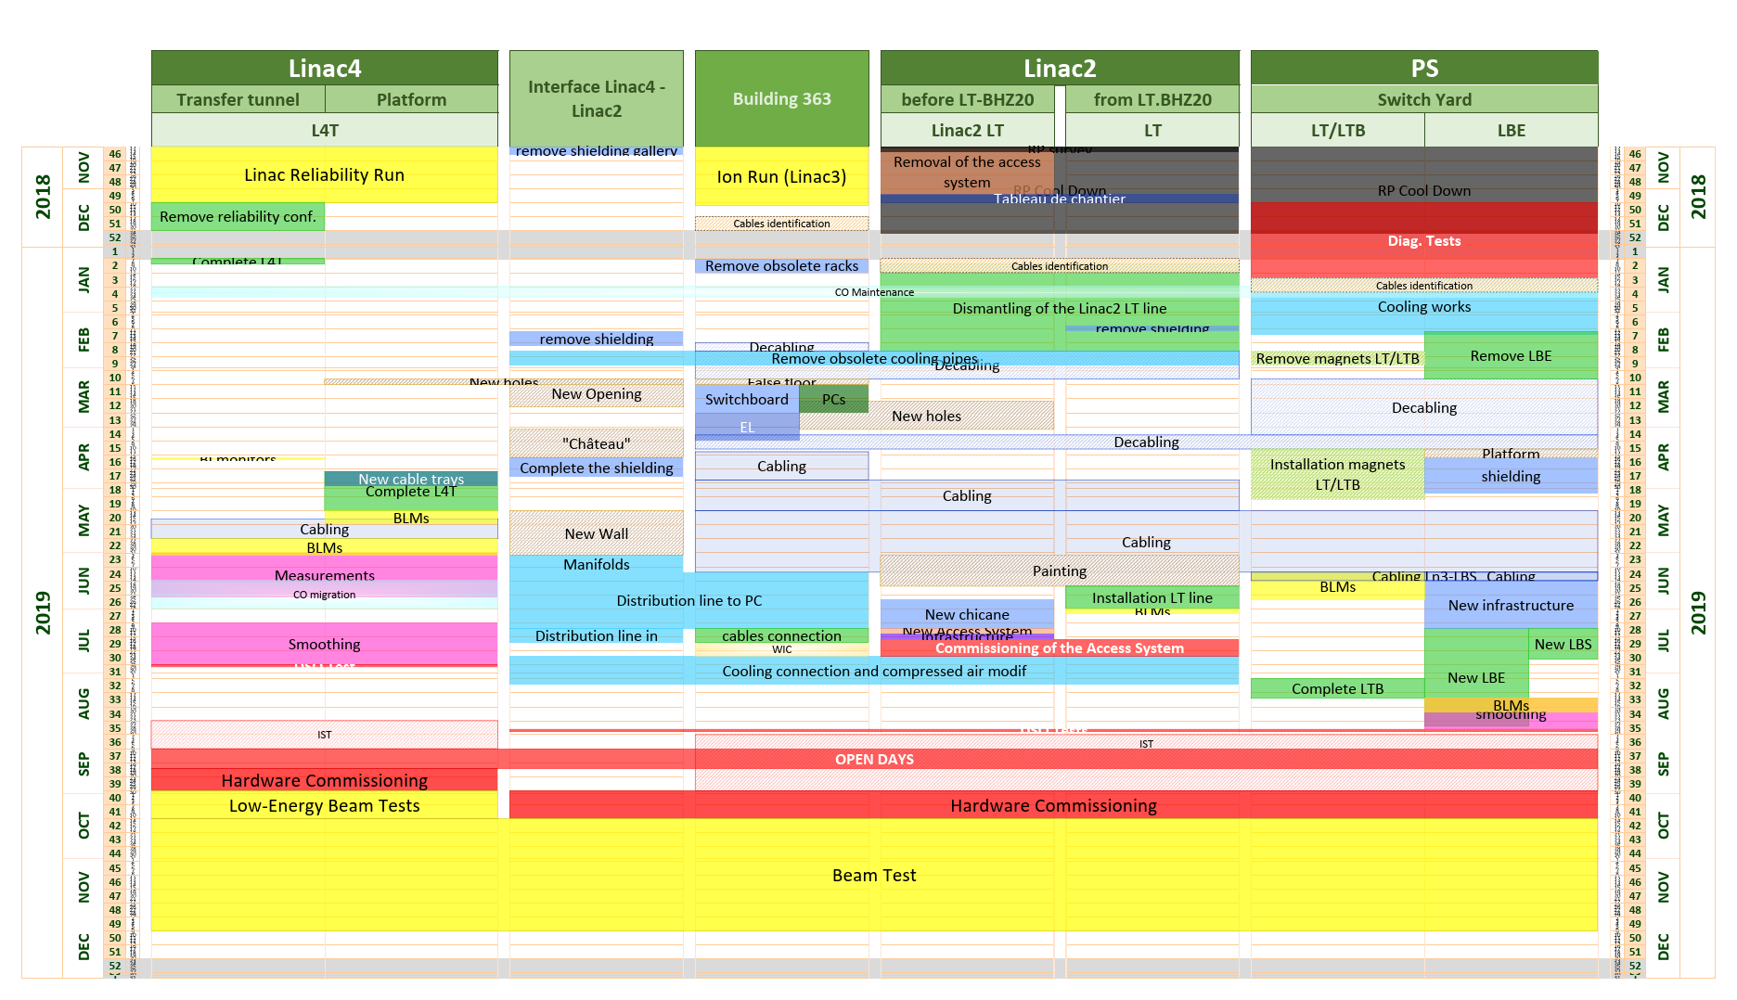

Slide 8
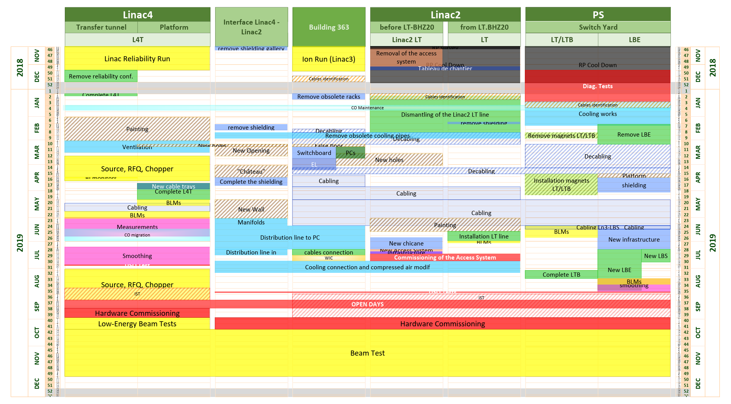
Not yet finished!!

Slide 9
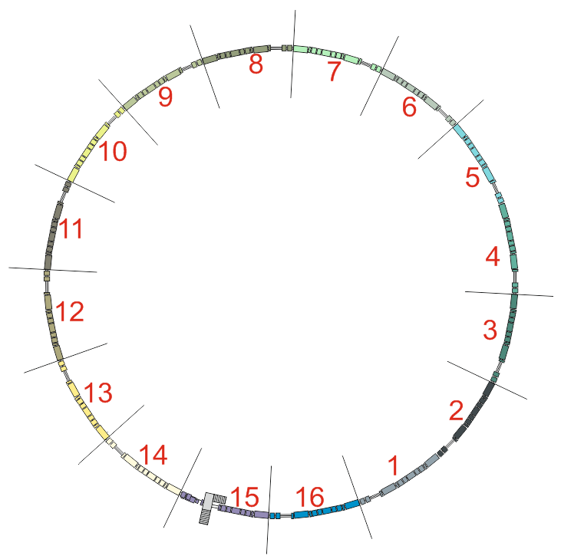
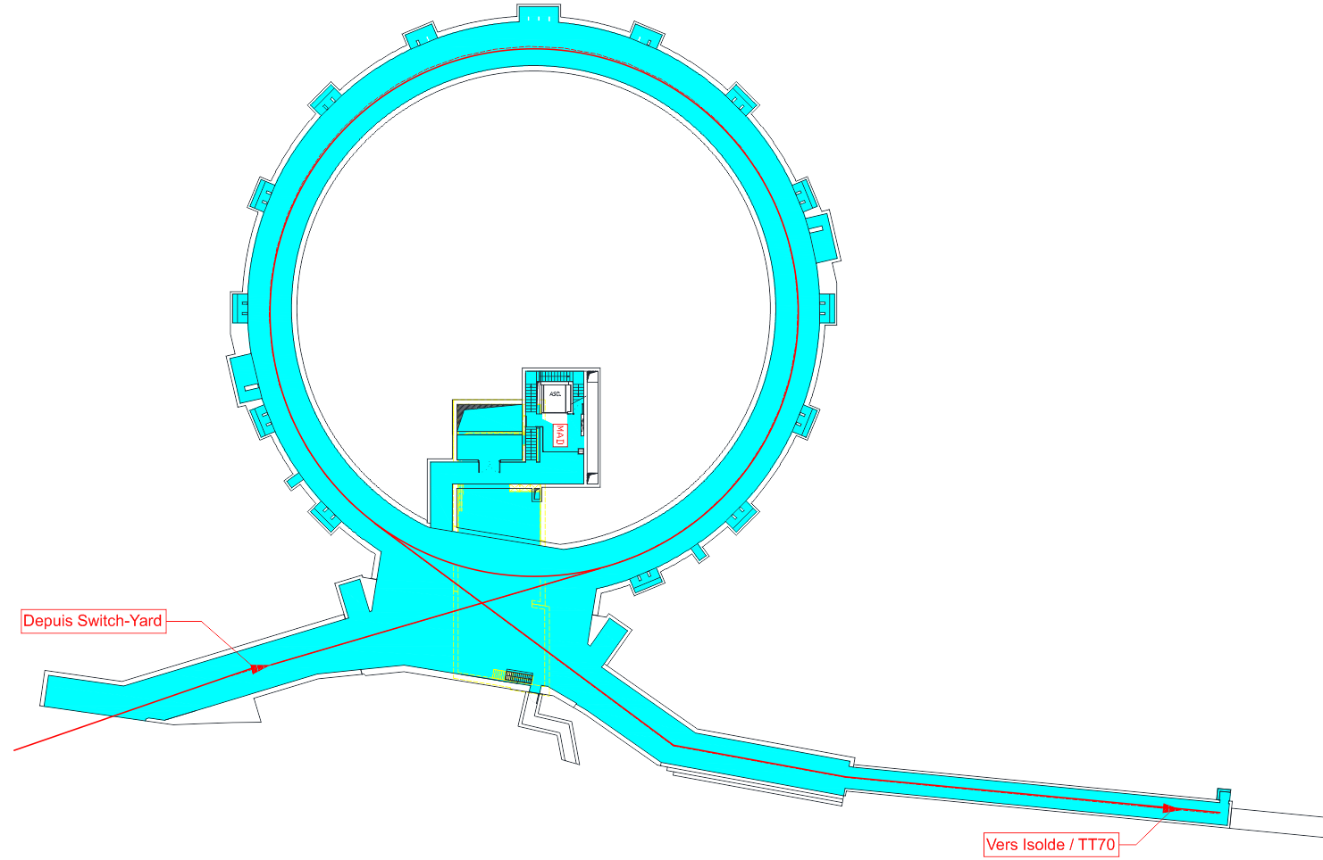
PSB
LIU Project
HL-LHC Project
Fire Safety Project
New PPS Project
New Absorber/Scraper
(8L4)
Consolidations
Maintenance
Upgrade
Remove RF cavities (BR1.C02 10L1 & BR3.C02 10L1)
Remove prototype Finemet cavities (BR4.ACWF 6L1)
New Wire Scanner x4 (11L1)
Replacement of ion pumps and pumping groups
Replace RF cavities with new finemet cavities (BRr.C16 5L1, BR2.C02 7L1 & BR4.C02 7L1, BRr.C04 13L1)
Replace extraction kicker
(BEr.KFA14L1)
New Wire Scanner x3 (4L1)
Replace kicker magnets (16L4, 2L1)
New PSB Injection Region
Remove the current sector (1L1)
New H- charge exchange injection systems
Replace bending magnets (INJ BHZ162, EXT BHZ151)
Remove BHZ152 and BHZ161)
Injection line BI:
New Injection bending (BHZ INJ)
New Distributor (BI.DIS10)
New Septa (BI.SMV10)
Relocate beam instrumentation (BI.BTV30)
Change of the magnets (BVTs, correctors)
New BPMs
New beam loss monitors
New RF bypasses
Extraction line BT:
New extraction bending (BHZ EXT)
New septum (BT.SMV10 and BT.SMV20)
Relocate beam instrumentations (BT.BTV10)
New kicker (BT.KFA10, BT.KFA20)
Change the magnets (BT.BVT10, BT.BVT20, BT.DVT10, quadrupoles)
Significant preparation
  BHZ151, BHZ162 and BHZ11 ( min 2 weeks of work/magnet)
  Preparation of quads in BI and BT line: cut, weld and leak detection
Change the bending magnets (BT.BHZ10, BTM.BHZ10)
New vacuum window on BTM line before the PSB Dump
Change the beam stopper (BTP.STP10)
Upgrade magnets (quadrupoles) and add new corrector magnets
Vers PS

Slide 10
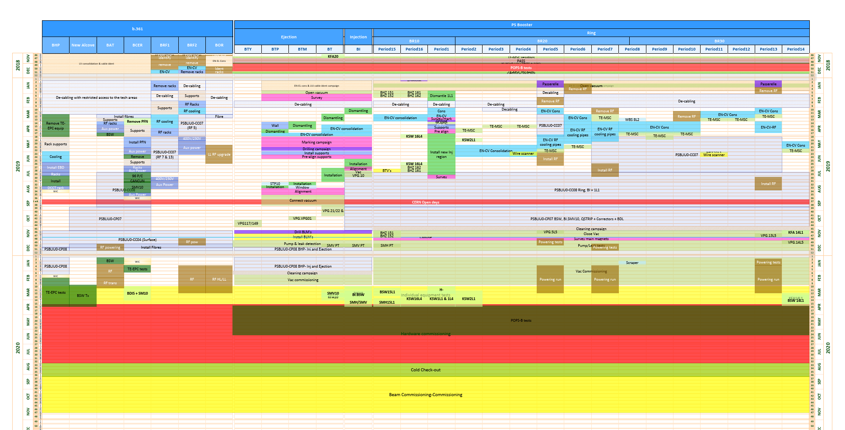
Heavy EN-EL activities
Access to TE-VSC racks (January – April 2019)
Power on racks and tunnel
For commissioning of vacuum control system also Technical network
Commissioning beginning 2020 → users shall check vacuum alarms!

Slide 11
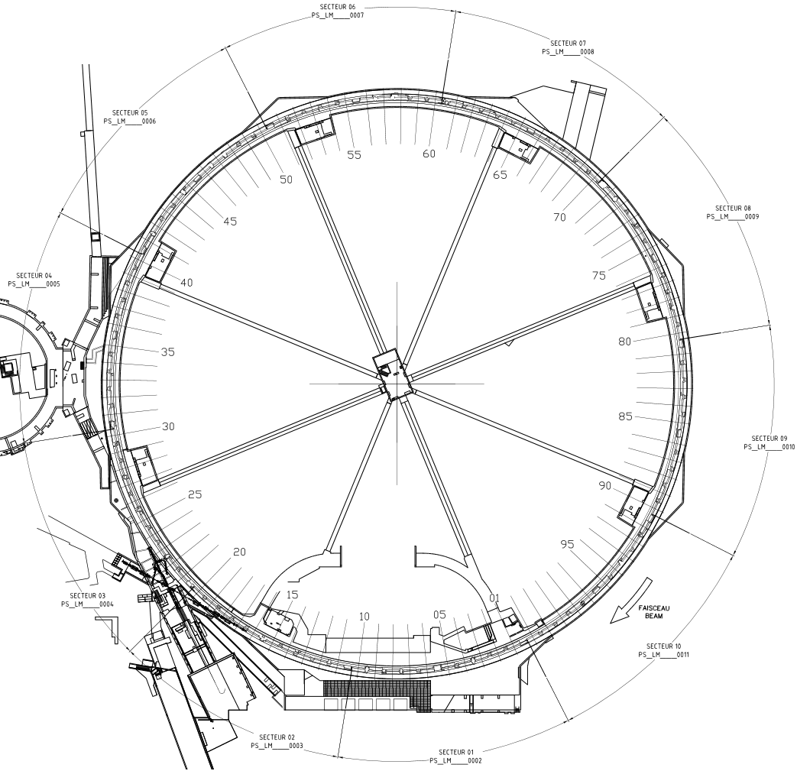
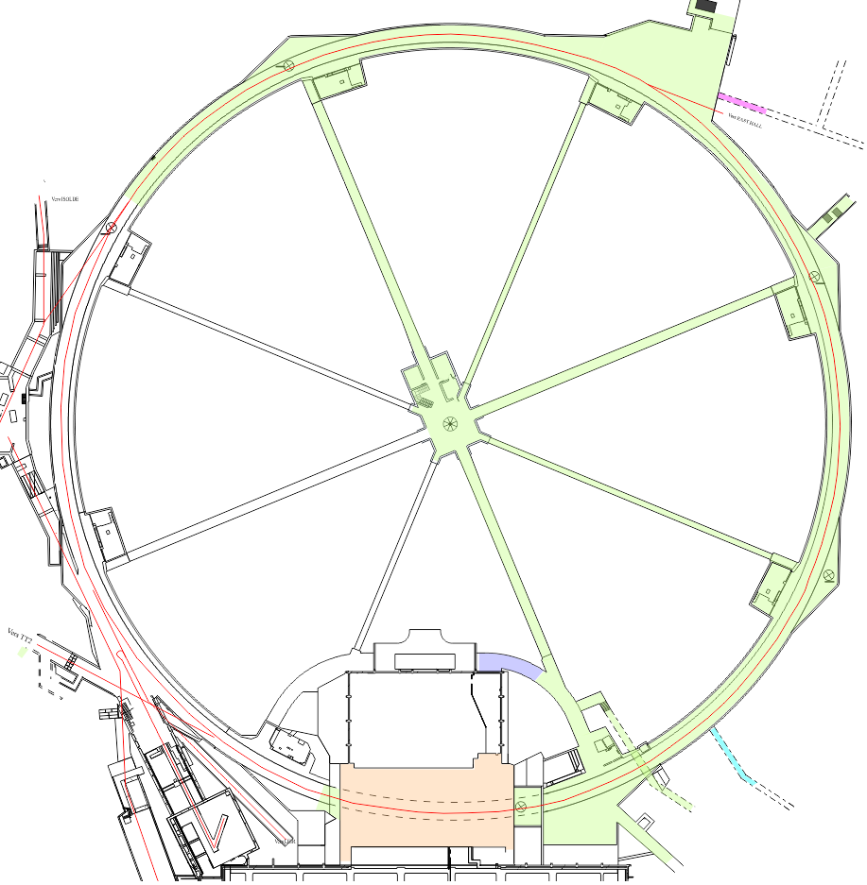
LIU Project
PS
New internal beam dumps
(SS47 and SS48)
Consolidations
Maintenance
Upgrade
Replacement of F61.QFO01
New injection septum + bumper SMH42:
New SEMGrid (MU42)
New bumper (SS42)
New beam wire scanners
(SS64, SS65, SS68, SS85)
Replace injection extra kicker (KFA45)
New BTP transfer line
New injection bumpers
(40, 41, 43, 44)
Remove the obsolete beam current transformers BCT
Remove SEH31 and BFA21
New vertical beam gas ionization profile monitor
(SS84)
Consolidation of the magnets
Replace SMH16, SEH23 and SMH57
New 80 MHz fast tuner
(SS88 and SS89)
Consolidation of the beam stoppers
(F16.STP512, F16.STP176)
Remove dummy septum
Open passage SS01?
New ralentisseur
(SS12)
Replace 2 magnets in extraction line to SPS (TT2)

Slide 12
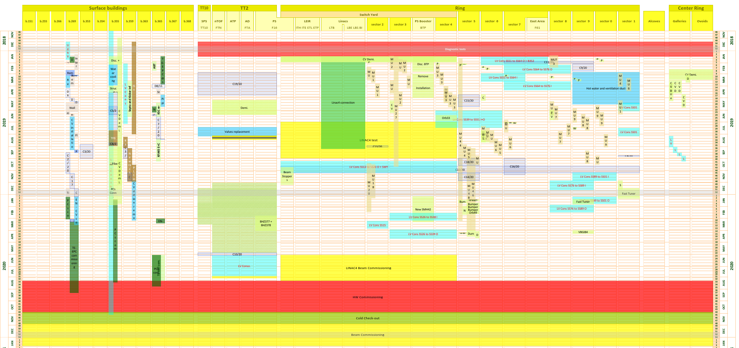
2019
2020
Surface Buildings
TT2
Switch Yard
Ring
galleries
Linac4 beam to LBE
Linac4 beam to LBE
Waiting new planning
Planning dominated by magnet consolidation campaign

Slide 13
TE-VSC works to be included in the planning
Septum pressurization
  PSB
    BE.SMH
    BI.SMV, BT.SMV10 and BT.SMV20
  PS
    SMH26, SMH16, SMH42 and SMH57
  Bake-outs: BE.SMH, BT.SMV10, BT.SMV20, SMH16, SMH26, SMH42 and SMH57

Slide 14
TE-VSC consolidation
Fix pumping groups (one week/group)
  PSB: 10 pumping groups
  PS: 16 pumping groups
Ion pumps
  PS ring (synergy with main magnet consolidation)
  TLs (synergy with LIU)

Slide 15
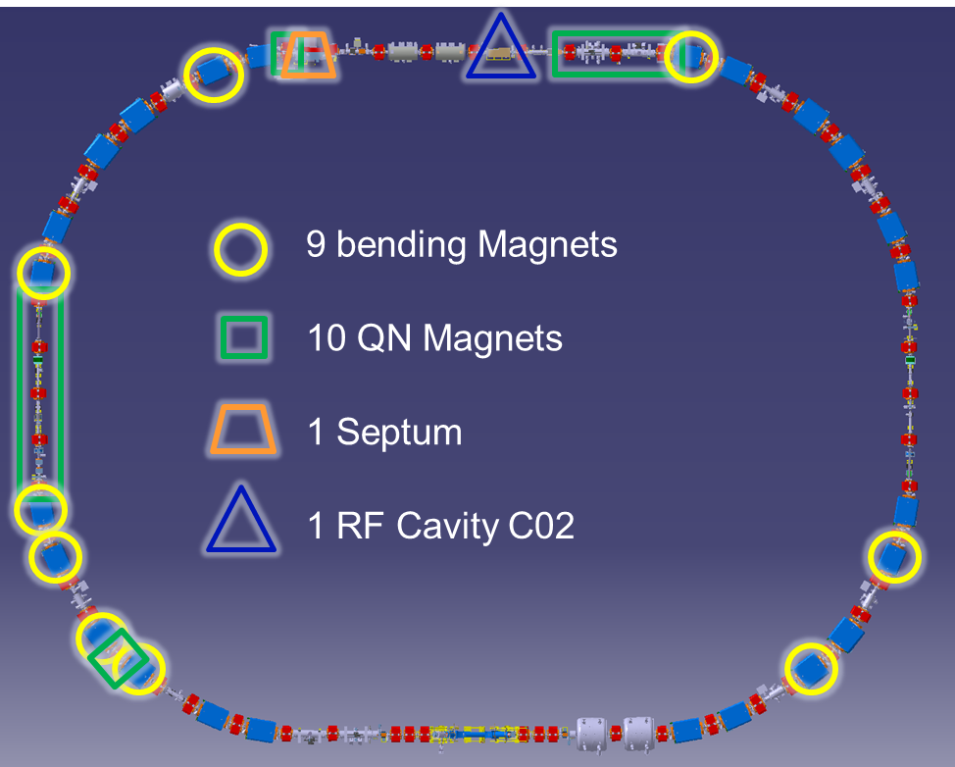
AD/ELENA
Line 6000: Removal of 2 slits and beam stopper
e-cooler: Installation of new collector
Disassembly of target area
New ELENA transfer lines
Repair Stripline in ELENA ring
Commissioning with beam May 2020

Slide 16
ISOLDE/REX/HIE-ISOLDE
Support repair CM4 in clean room
New HRS and GPS frontends
New tape station
3 new D-boxes in REX
Oil exchange
Maintenance of turbopumps + consolidation
Replacement of full range gauges in experiments (remove profibus gauges)
NO PLANNING YET → Delay activities to May-June 2020 if possible
MEDICIS: Operation during LS2, request of upgrade

Slide 17
nTOF
Consolidation of 4 magnets in FTN line
Disconnection for target exchange
New sweeping magnet
New movable collimator

Slide 18
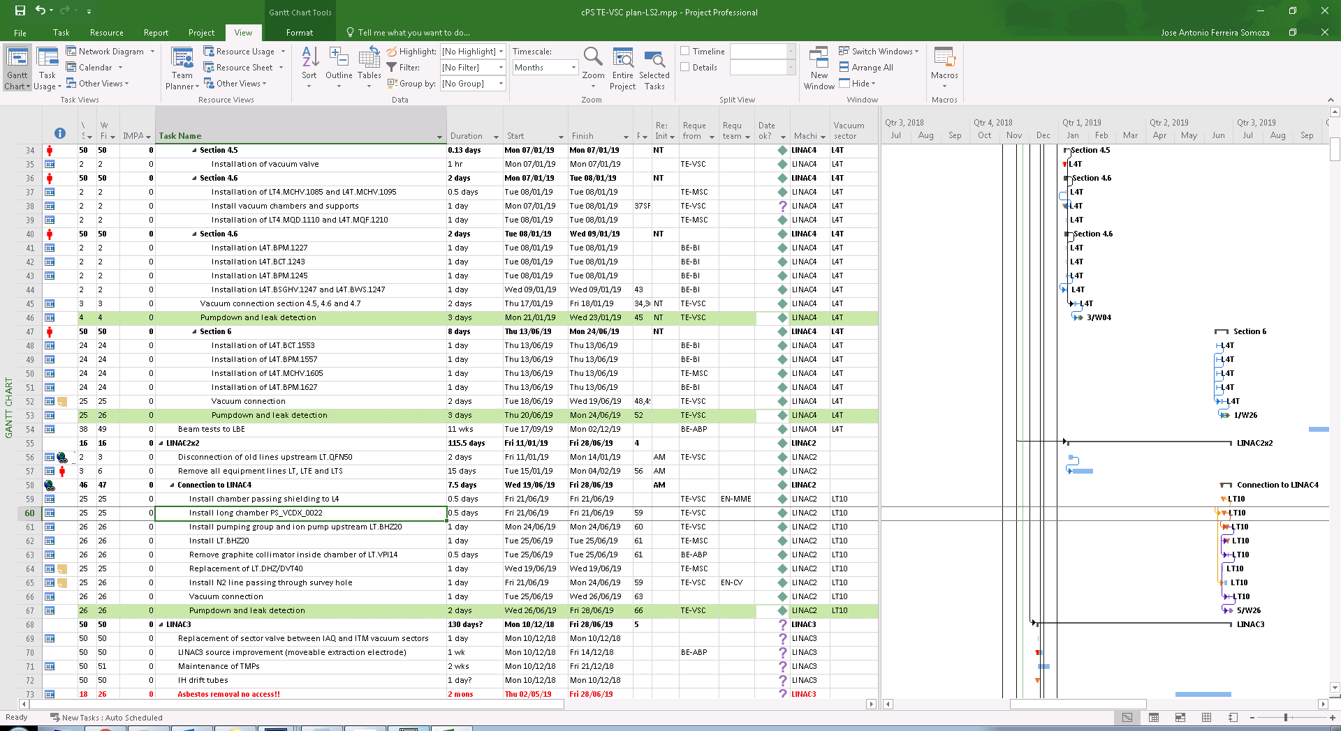
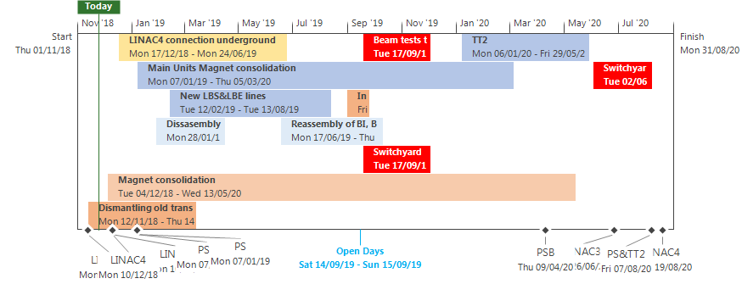
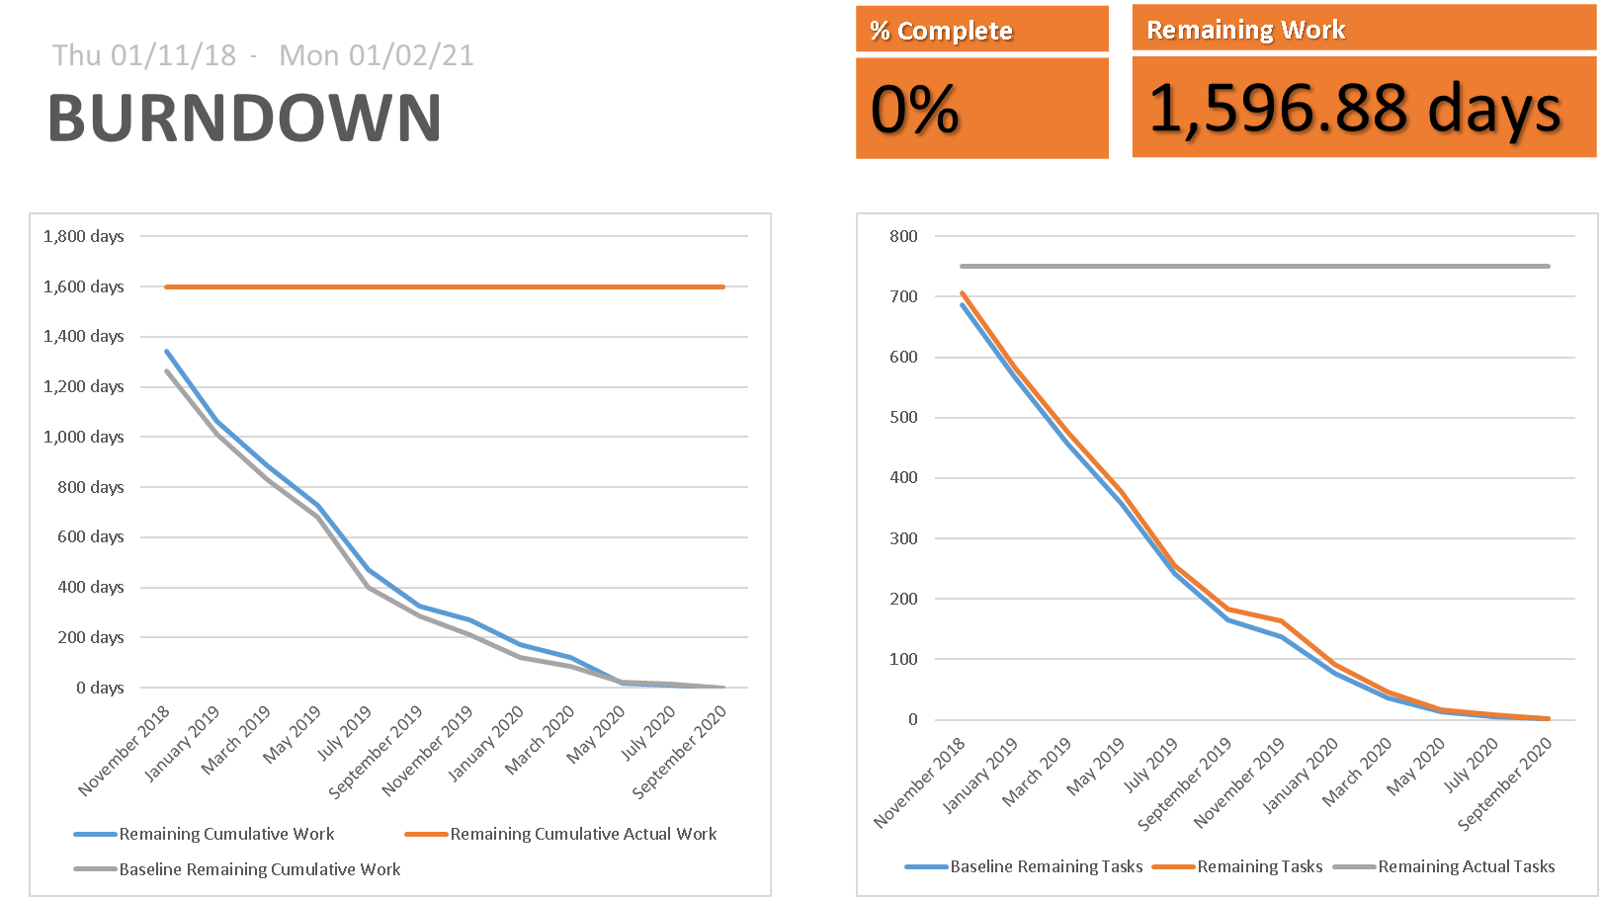
Preparation
Planning available here

Slide 19
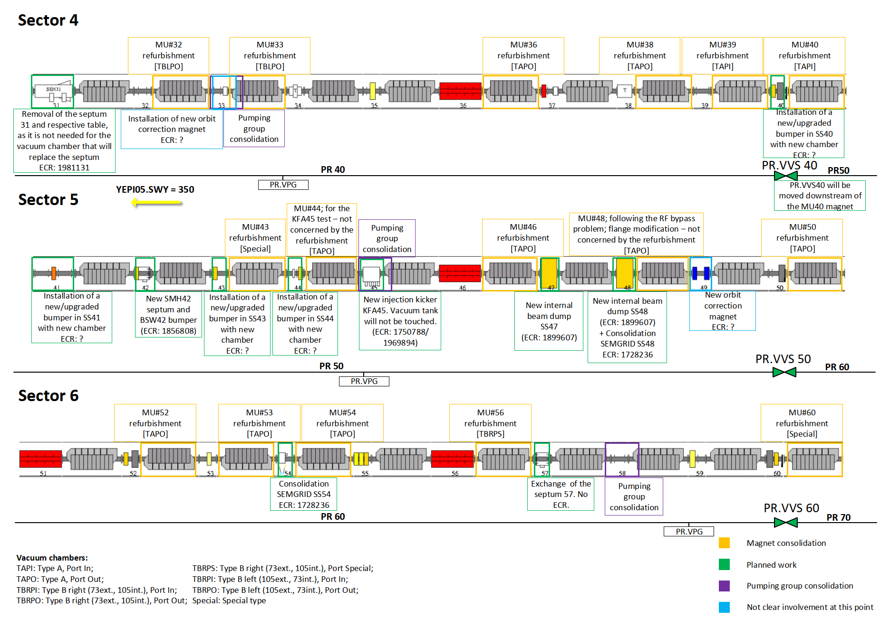
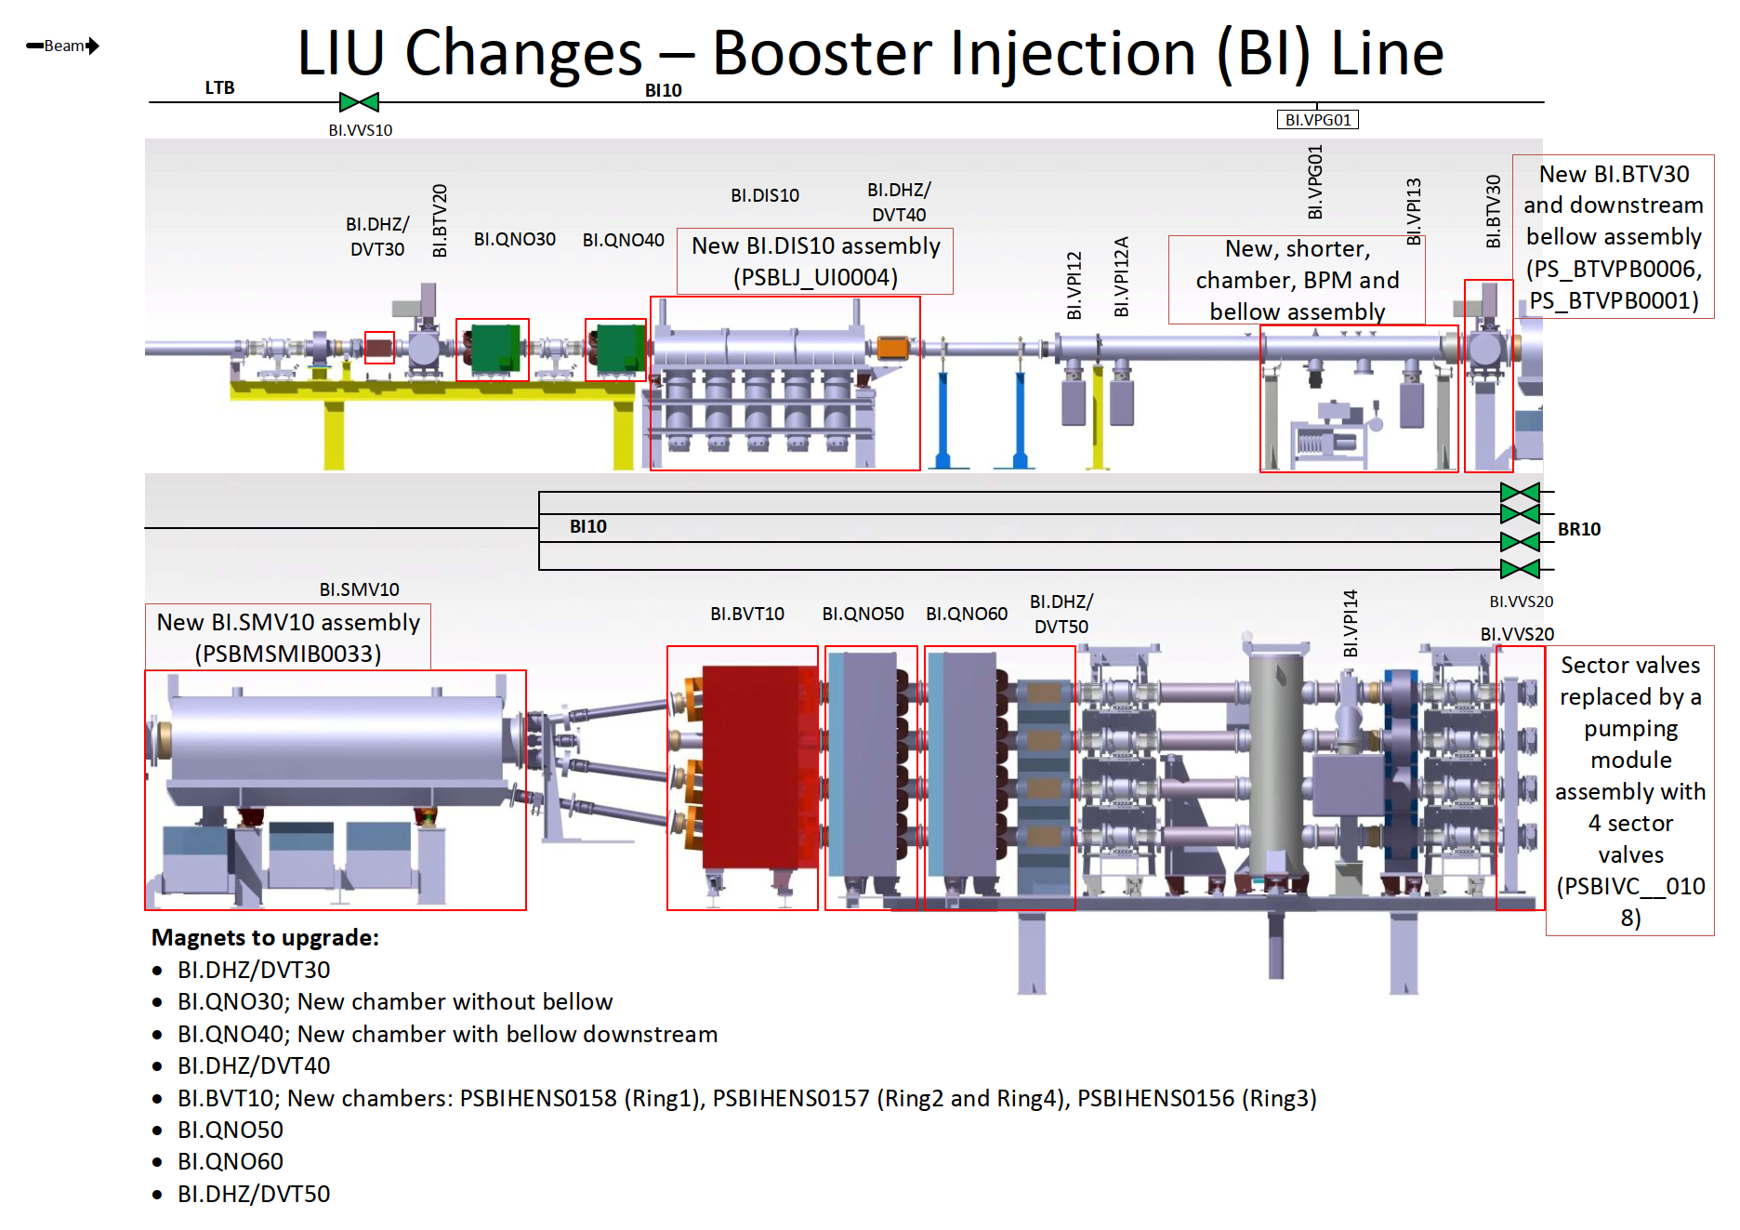
Preparation
Planning available here
Synoptic detailing all modifications in EDMS

Slide 20
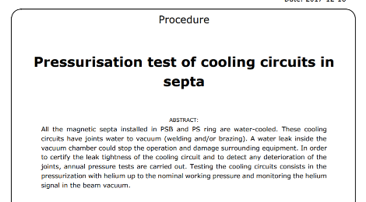
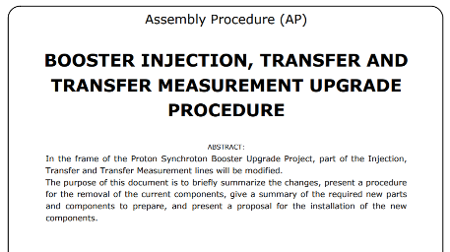
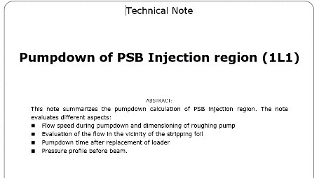
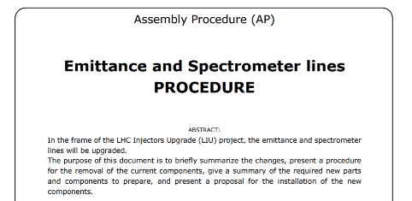
Preparation
Planning available here
Synoptic detailing all modifications in EDMS
Procedures

Slide 21
TE-VSC resources
1 team LINAC2/3/4 and acceptance tests
1 team PSB/PS with coordination of:
  1 Russian team for LIU works (new team every 2 months)
  1 team 40/30 for support magnet consolidation (>100 magnets)
1 team AD/ELENA
½ team ISOLDE, HIE-ISOLDE, nTOF
No too much margin for holidays, sick leaves, etc.

Slide 22
Budget 2019
LIU-PS: 80 kCHF
LIU-PSB: 477 kCHF
ISOLDE-cons: 60 kCHF
PS fixed pumping groups: 105 kCHF
PS magnet consolidation: 105 kCHF
Machine | Number | Cost (CHF) | Cost/magnet (CHF) | Job number
PS ring | 42 | 80671.50 | 1920.75 | J3049294
TT2 | 28 | 35911.06 | 1282.54 | J3048428
nTOF | 4 | 5130.15 | 1282.54 | Extrapolation from TT2
LT-LTB-BI | 17 | 21803.14 | 1282.54 | Extrapolation from TT2
TT10 | 6 | 7695.23 | 1282.54 | Extrapolation from TT2
AD-quads | 10 | 2047.50 | 204.75 | J3052729
AD-bending | 9 | 3276.00 | 364.00 | J3052736
TOTAL | 116 | 156534.6
TE-MSC consolidation work package doesn’t include all linked costs. EN-MME budget needs to be secured to start

Slide 23
Critical activities and main risks
Magnet consolidation: Number and cost
Injection area and transfer lines
Civil engineering works (dust production)
ELENA bakeout of transfer lines. Availability of resources (LHC priority)
Planning and leveling of resources LINACs/PSB/PS/AD/ELENA/LEIR/ISOLDE/HIE-ISOLDE/nTOF
ISOLDE activities, no planning, not enough resources → Advance as much as possible when resources available

Slide 24
Work before Xmas
Full power cut the 19th of December!
LINAC4 removal of reliability run configuration
AD transfer lines removal (ongoing)
AD removal of first 3 magnets
nTOF disconnection of FTN line
nTOF disconnection of sweeping magnet
Peak of activities during first weeks of January: Detailed planning under preparation

Slide 25


