Slide 1
Installation Infrastructure
Jim Stewart
January 25 2018

Slide 2
General Cavern infrastructure
North-South Bridge (Now DUNE Scope)
Bridge crane in cavern
Fixed stair tower near the North drift
Alimak lift on West end of the cavern
  Materials and People
Small machine shop and storage area on the cavern floor
Battery operated fork lift for work in the cavern
Pallet jacks and rigging equipment

Slide 3
Installation cleanroom
(Image needs revised after mirroring detector )
Cleanroom: 16m W 17m T 10m D
SAS/airlock: 13m W 17m T 10m D
Changing room 3m W 3m T 10m D
Roll up doors for material entry to the SAS and cleanroom
Roof access for the bridge crane

Slide 4
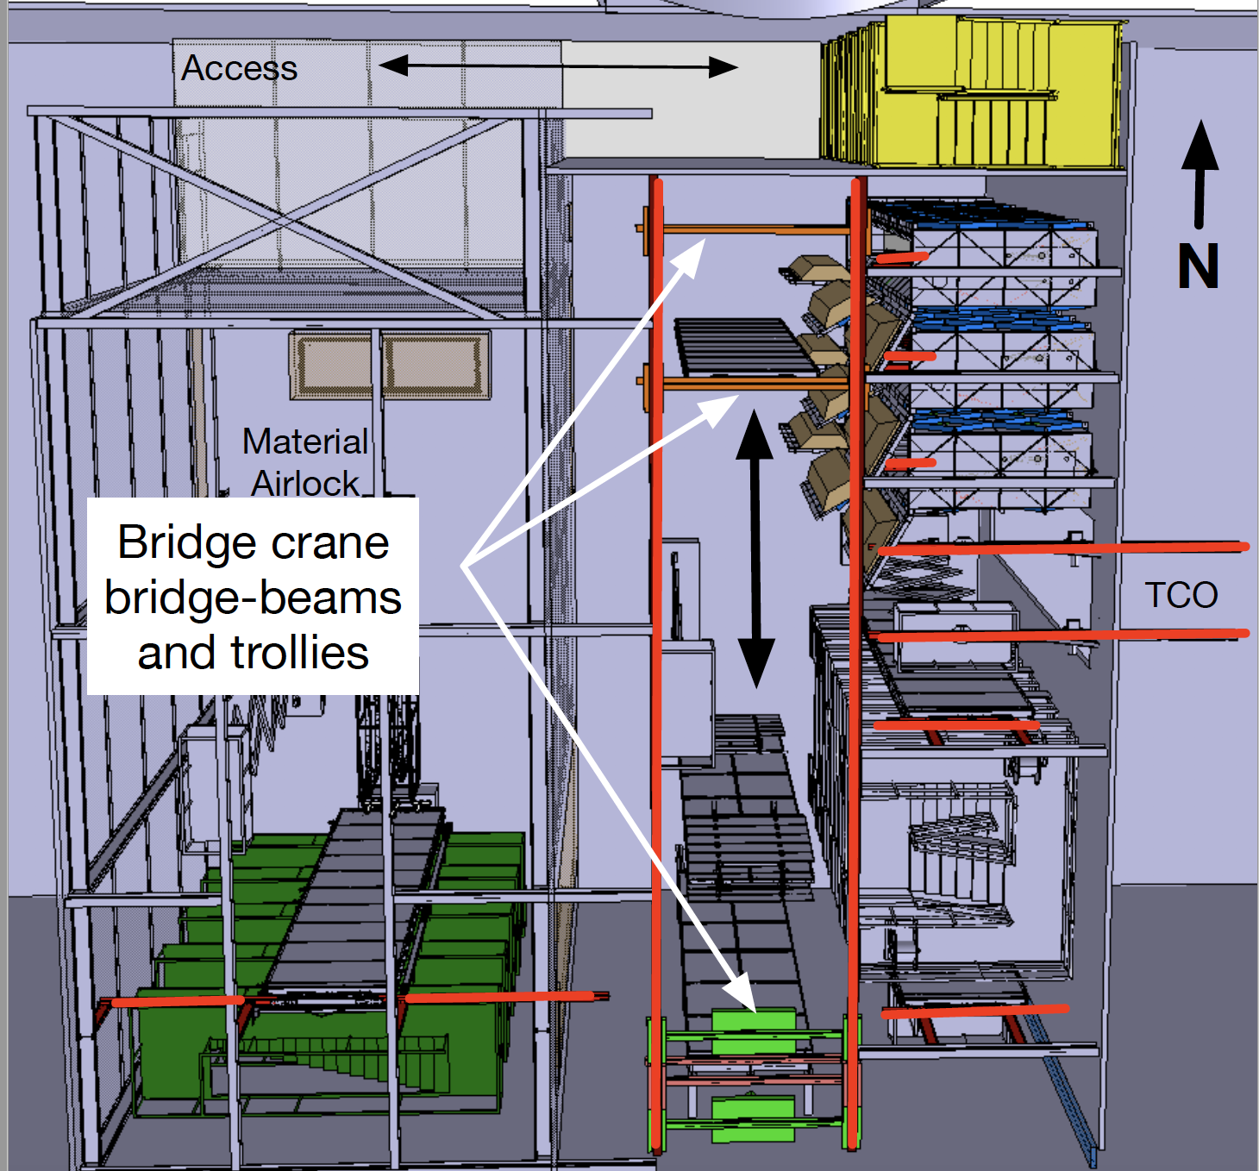
Installation Monorails
A bridge crane is needed under the bridge.
8 Fixed rails segments on the East side
  3 cold box
  2 TCO
  2 APA cabling
  1 Cable equipment
1 fixed rail to the APA assembly tower

Slide 5
APA Assembly Tower
Stair tower used to support the APA assembly fixture.
  APA assembly fixture provided by consortia
Good access is needed at the bottom, the mid plane where the linkage is attached and the top.
A commercial stationary scissor lift can be used is needed to access the top. This is too high for a mobile scissor lift.

Slide 6
APA cabling tower
Need to work on two APA at the same time.
  Time for cabling and testing is taken from ProtoDUNE (See Bill’s talk)
Experience at Ash River shows that someone must look at the mid-point between the APA as the cable is fed thru
A fixed lift is needed for full height.
  This may be be more stable in any event.

Slide 7
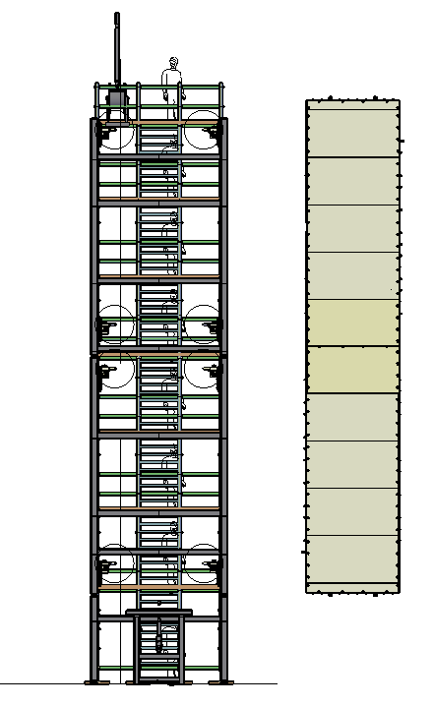
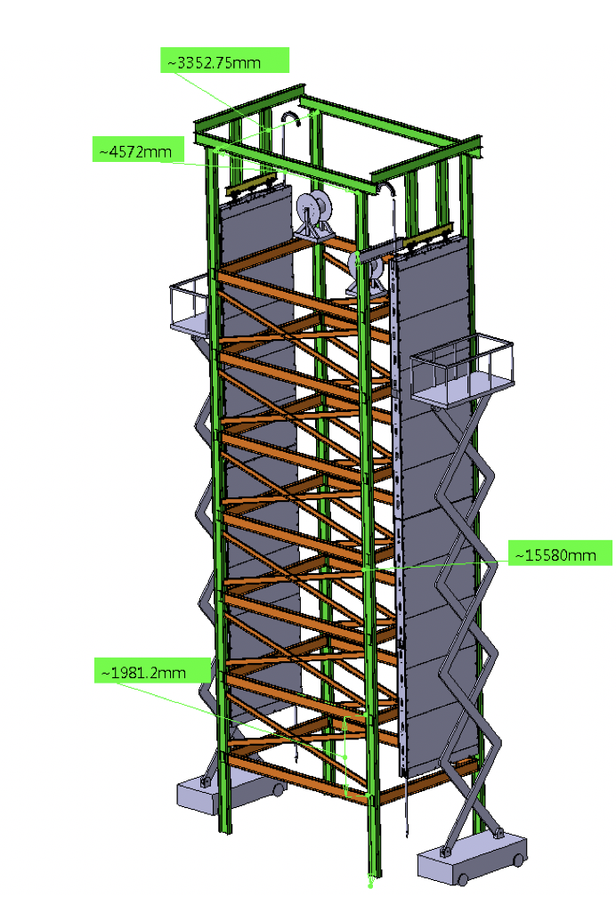
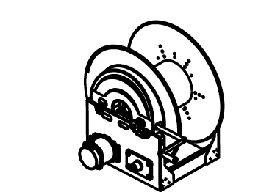
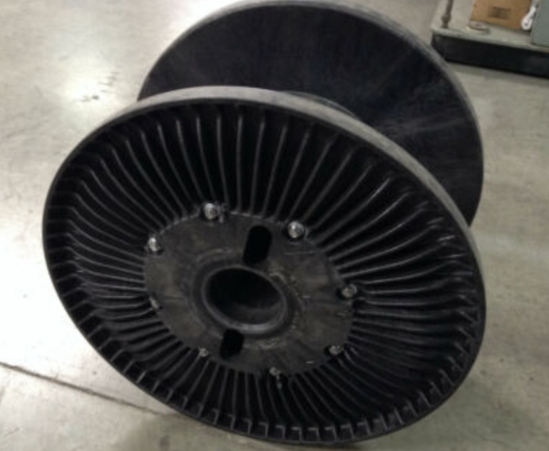
Ordering a motorized reel
Possible
Storage
Reel
30" Sonoco plastic reels

Slide 8
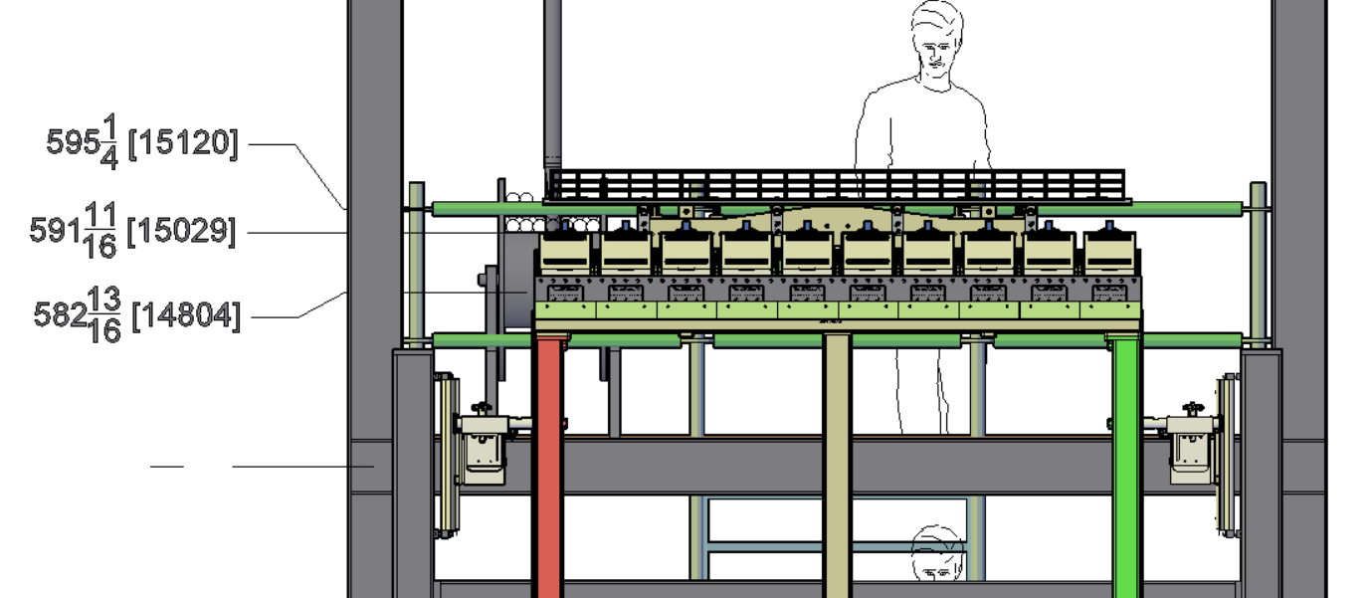
View of level 7
Level 7 deck at lowest level - 46’ 2-3/4”. Includes 1.5” pad and 4” jack. Top of APA head tube at 14804mm

Slide 9
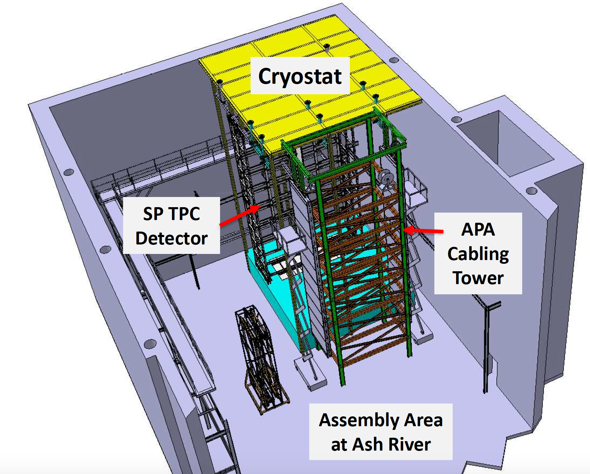
Ash River Test Frame
Design of a steel frame that holds the APA cabling and assembly fixtures is nearly complete.
Concept calls for a commercial scaffolding inside the frame for access.
Hope to have available for Spring test with APA frames.

Slide 10
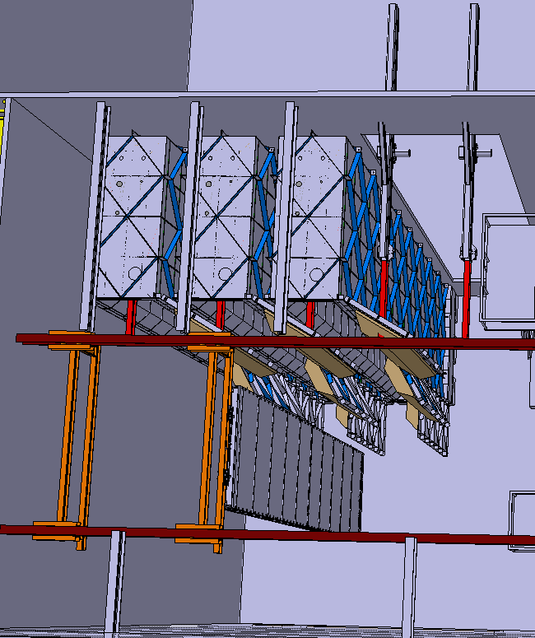
Cold Boxes
Construction similar to ProtoDUNE-SP cold box but twice as tall.
3 cold boxes are needed
Doors will be hinged so they can be easily opened
Doors are split in 3 panels
Space inside will allow for a fixed patch panel for the CE
Will seek to design the system so the WEC is above the cleanroom roof and accessible from a platform on the cryostat.
More information in Dimitar’s talk later today

Slide 11
Cryogenics System for the cold boxes
Will be presented by David later today.

Slide 12
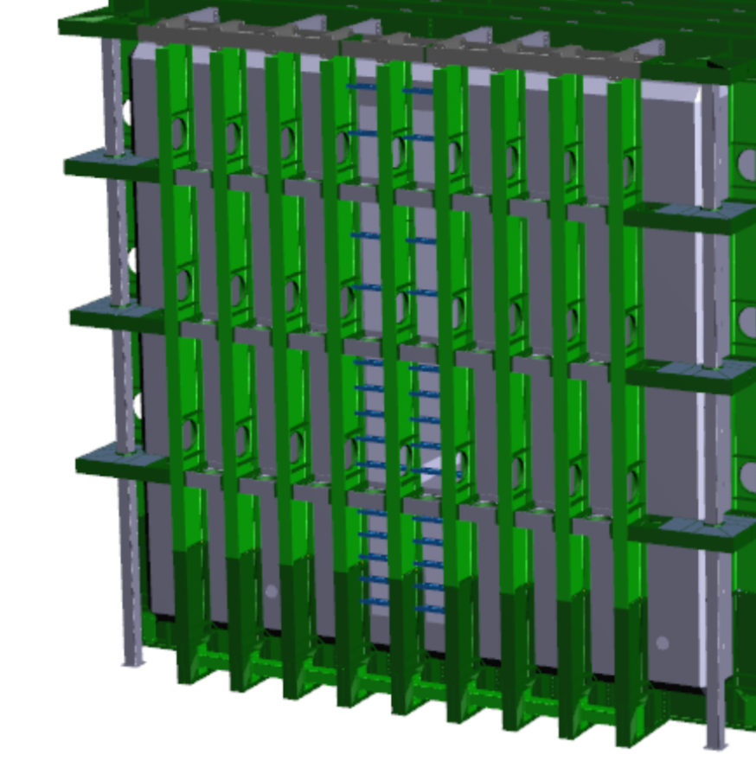
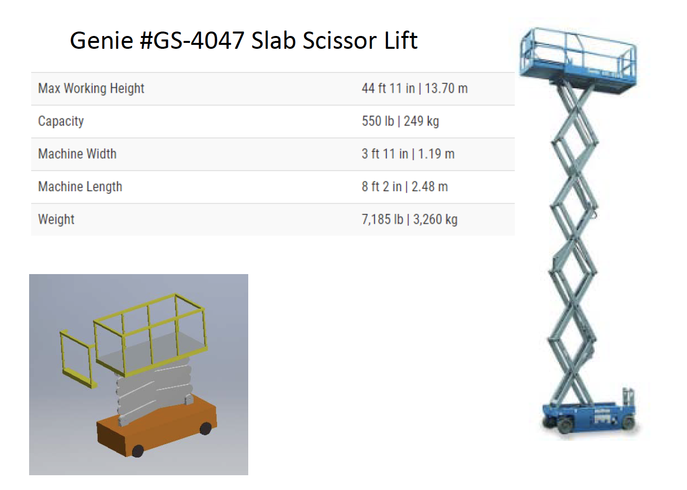
Cryostat scissor lifts
post
Several companies exist that make battery operated scissor lifts.
All have max height of around 13.7 m
Inserting the lifts into the cryostat will be a challenge as they are wider than the gap between the post and TCO wall.
  Even more difficult to remove at the end.

Slide 13
Cryostat internal infrastructure
Air handling units to purify air for the cryostat and cleanroom
Lighting inside the cryostat
False floor inside the cryostat
Internal cryogenic piping

Slide 14
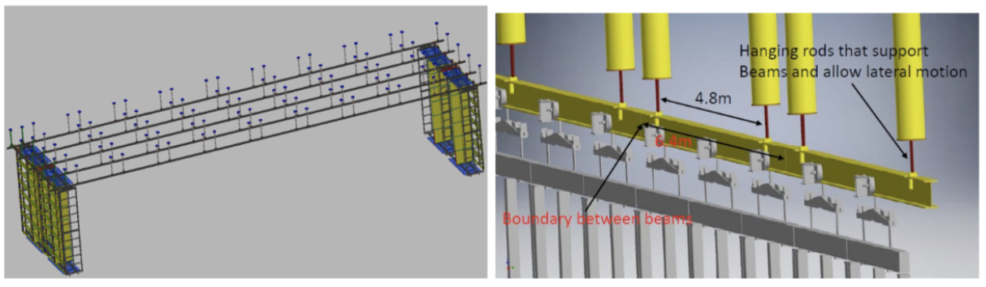
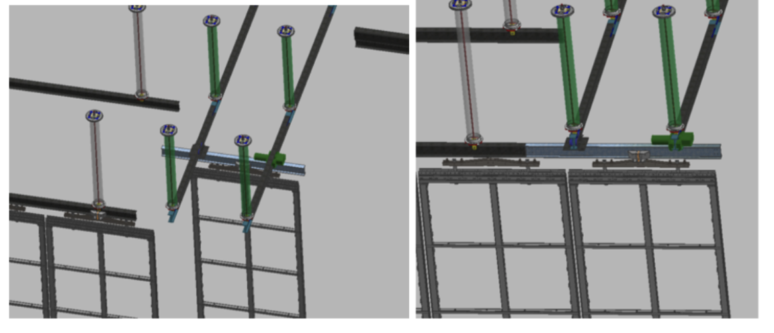
Detector Support System
Support rails for the detector.
Installation switchyard inside the cryostat.

Slide 15
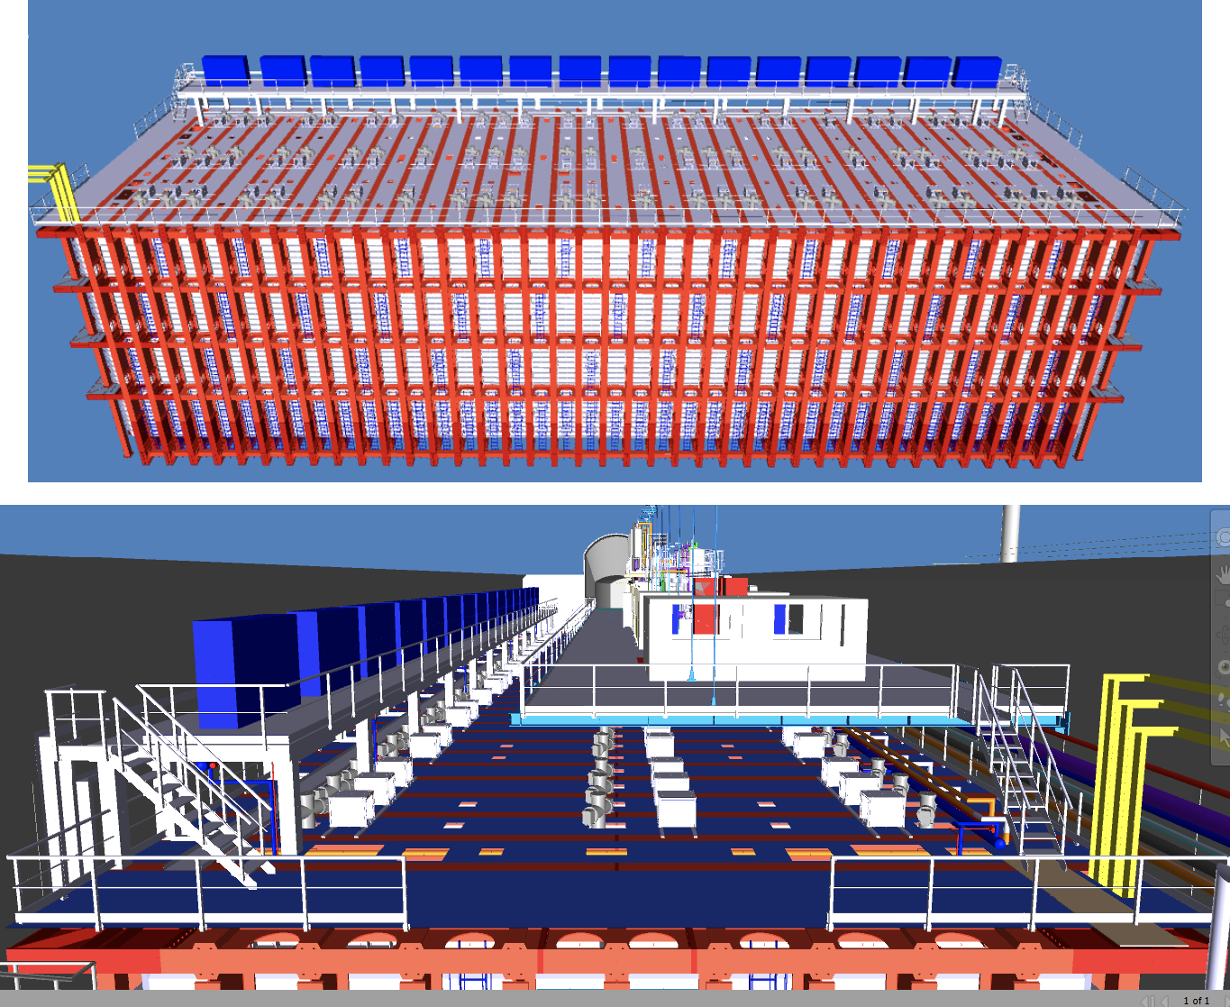
Mezzanine and Racks
16 groups of 4 racks
  25-CE 25-PD 14-CISC+Calib.
  Possible to add a few more
Mezzanine is on detector ground
Cable trays to CUC run under floor along West edge.
North-South cable trays run near I-beams under the floor.
Rack cooling is not designed

Slide 16
Cryostat Crossing tubes
Custom vacuum assembly. Welded to the cryostat roof and the thin cryostat membrane. Supported off the cryostat I-beams.
243 penetration in the SP cryostat roof
Must be assembled with care.

Slide 17
Additional Infrastructure items that will add up
Diagnostic equipment
Ground monitoring
Cable trays
Power distribution, lighting and ventilation
  We will clearly have to add and change things at the end.

Slide 18
What is Missing?

