Slide 1
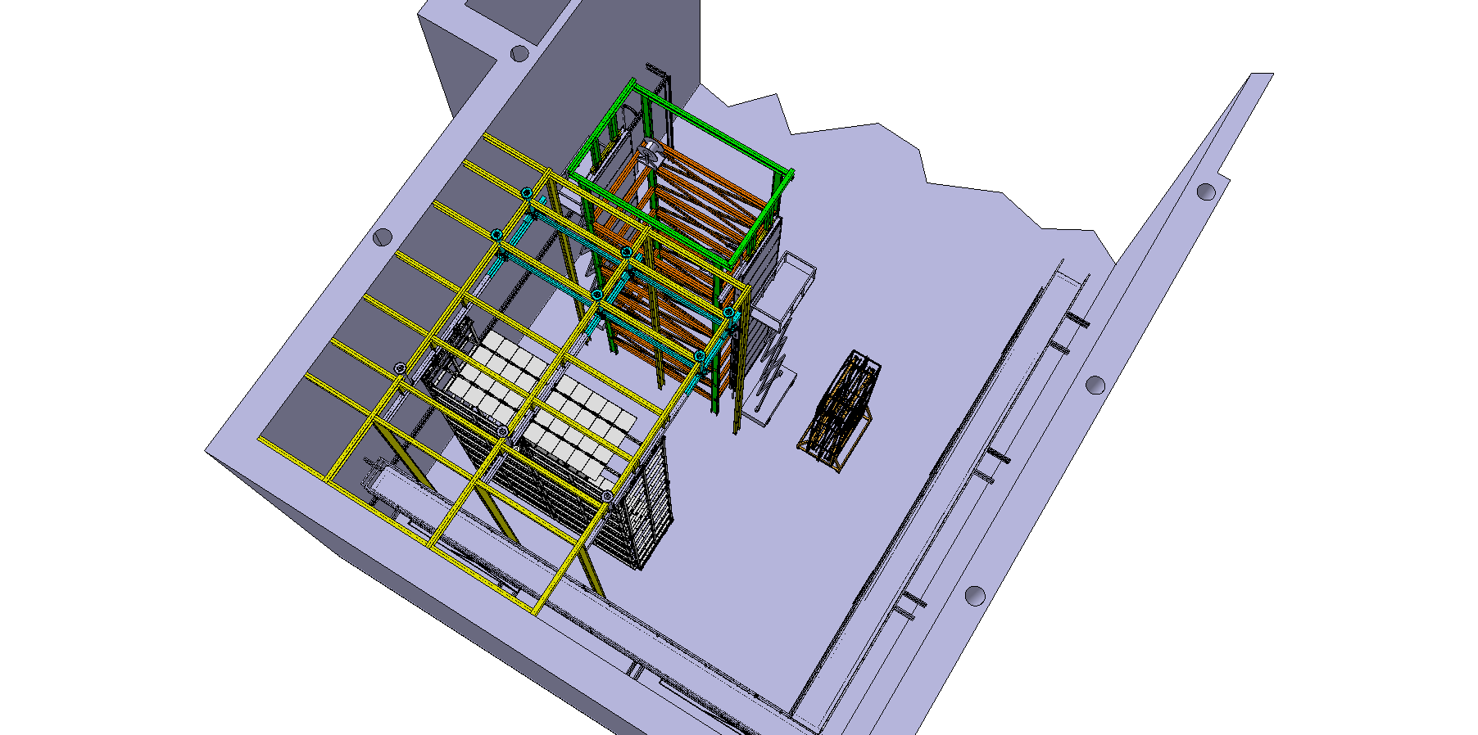
DUNE FD-Trial Assembly
Update at Ash River Scope
William Miller
25 January, 2019
Version 1

Slide 2
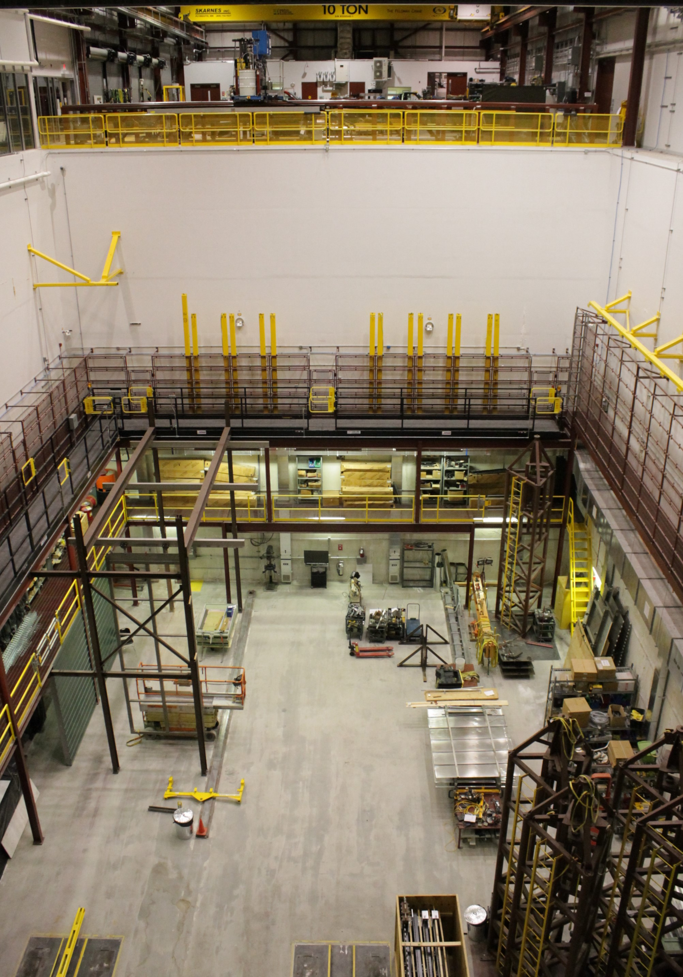
DUNE-Trial Assembly at Ash River
16.75m
The NOvA Far Detector Assembly hall is the right size for setting up the DUNE-Trial Assembly. With a loading dock area and two 10-ton overhead cranes, fork lifts, scissor lifts, work shop and experienced technicians we have the ability to adjust the Scope of work as needed
16m
DUNE – SP Detector Cryostat

Slide 3
Goals of DUNE-Trial Assembly at Ash River
Test all full scale TPC (Time Projection Chamber) components and installation equipment during assembly stages and inside the cryostat including
  APA Assembly including manipulation of APA shipping frames, joining an APA pair together, testing of PD (Photon Detector) components, CE (Cold Electronics) cabling, APA protection, movement on shuttle beam, cryostat cabling and final deployment in cryostat.
  DSS (Detector Support Structure) and shuttle beam system including final detector configuration
  Assembly of HV system including construction of an End Wall, CPA pairs, movement on shuttle beam and final deployment in cryostat
  Future Assembly of Dual Phase detector components
Write full set of Hazard analyses and assembly procedure documents including gathering all component documentation
Test access equipment (scaffold, scissor lifts, work platforms) and lifting fixtures
Assembly time and motion studies including labor estimates
Future-Training site for lead workers as DUNE begins setup, testing mechanical modifications

Slide 4
Summary-Trial Assembly Scope at Ash River
  FY19
Phase 0-Pre TDR
  HV Field Cage prototypes for ground plane support- Completed first phase
  Check vertical cable installation with two APA side tubes- In place now
    First set of tests week of December 17th
  Build APA Cabling Tower to test 2 APAs both connection and cabling & CPA assembly- March
  Use ProtoDUNE Trial Assembly frame to test DUNE FC deployment and top ground plane support- January-March
Phase 1
  Build DSS shuttle, 3 sections of DSS beam
  Test movement of CPA and APA from cleanroom to final destination, including cabling of APA along cryostat side wall
  Test APA, CPA, Endwall and FC deployment in one drift section
  Test assembly sequence of final section of TPC including removal of DSS shuttle beam runway rails, moving TPC components so TCO can be closed up
  Test APA Shipping frame
Phase 2
  Include the top of the cryostat (no warm structure) with feed-thru’s as needed to test complete installation system
  Test DSS installation
  Design feed-thru’s to support Dual Phase installation test
  FY20
  FY21

Slide 5
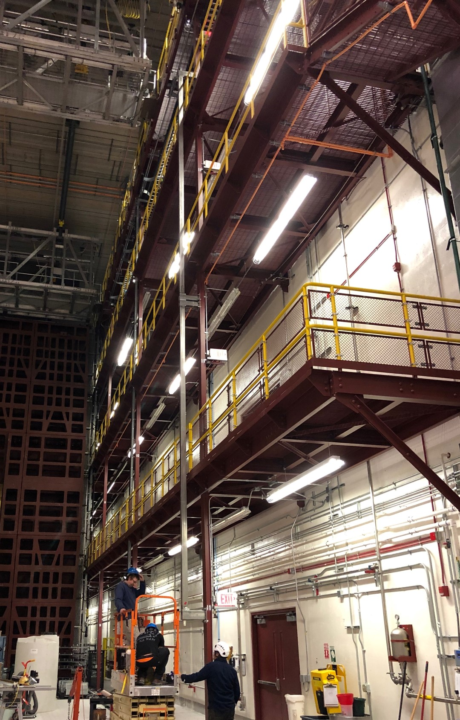
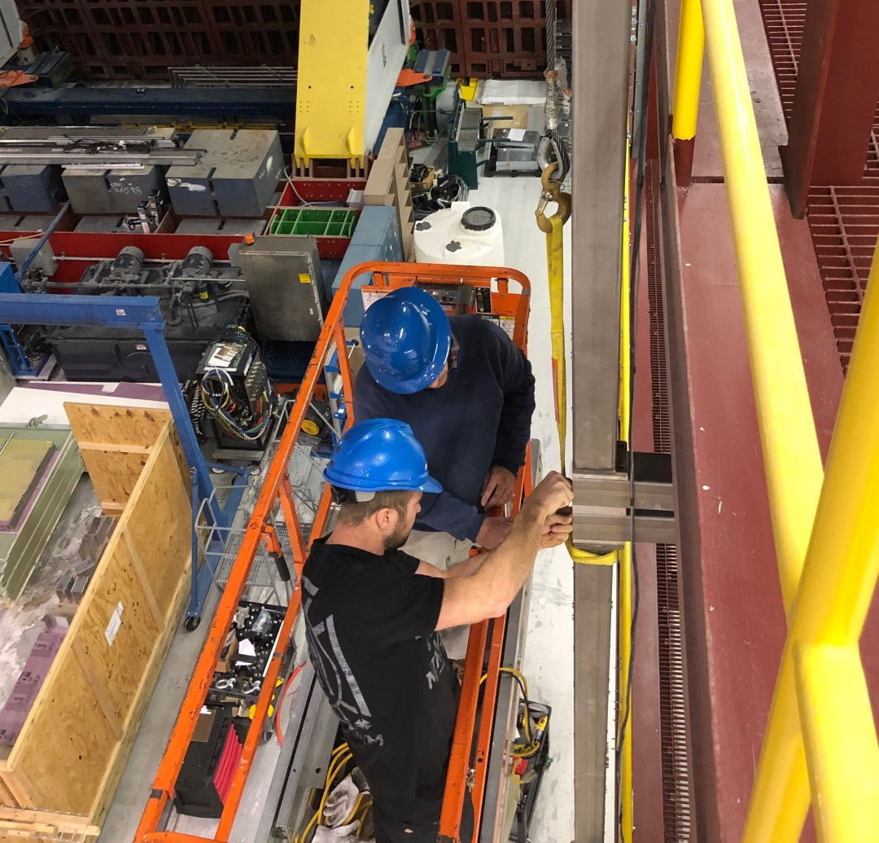
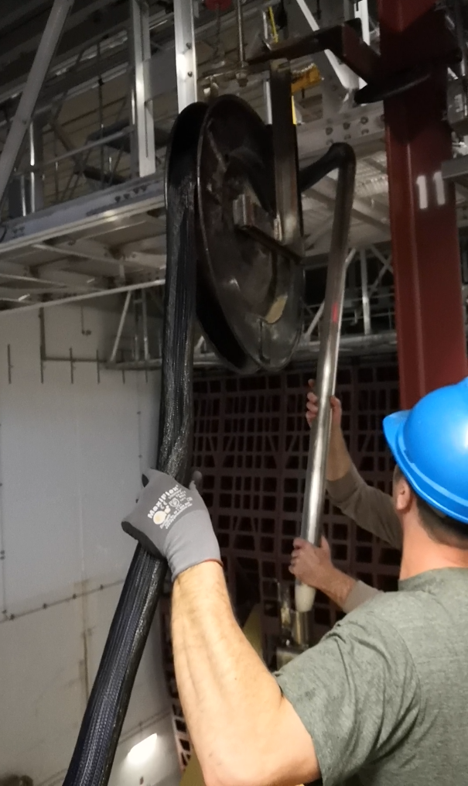
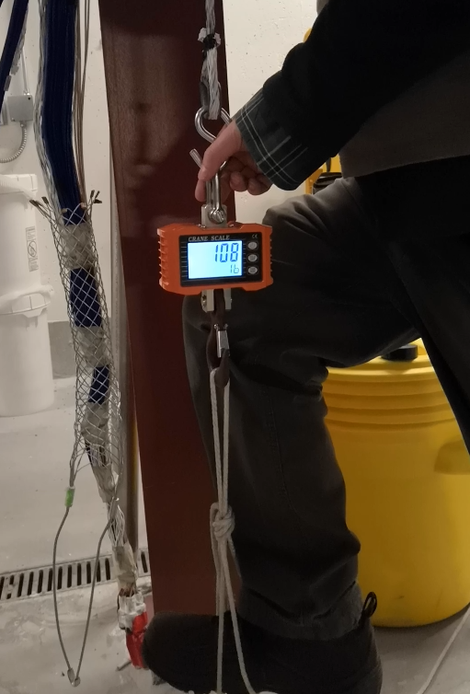
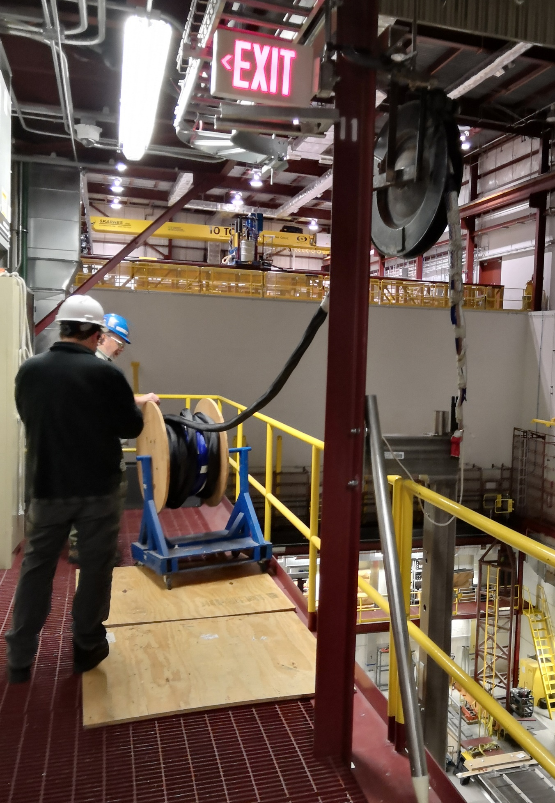
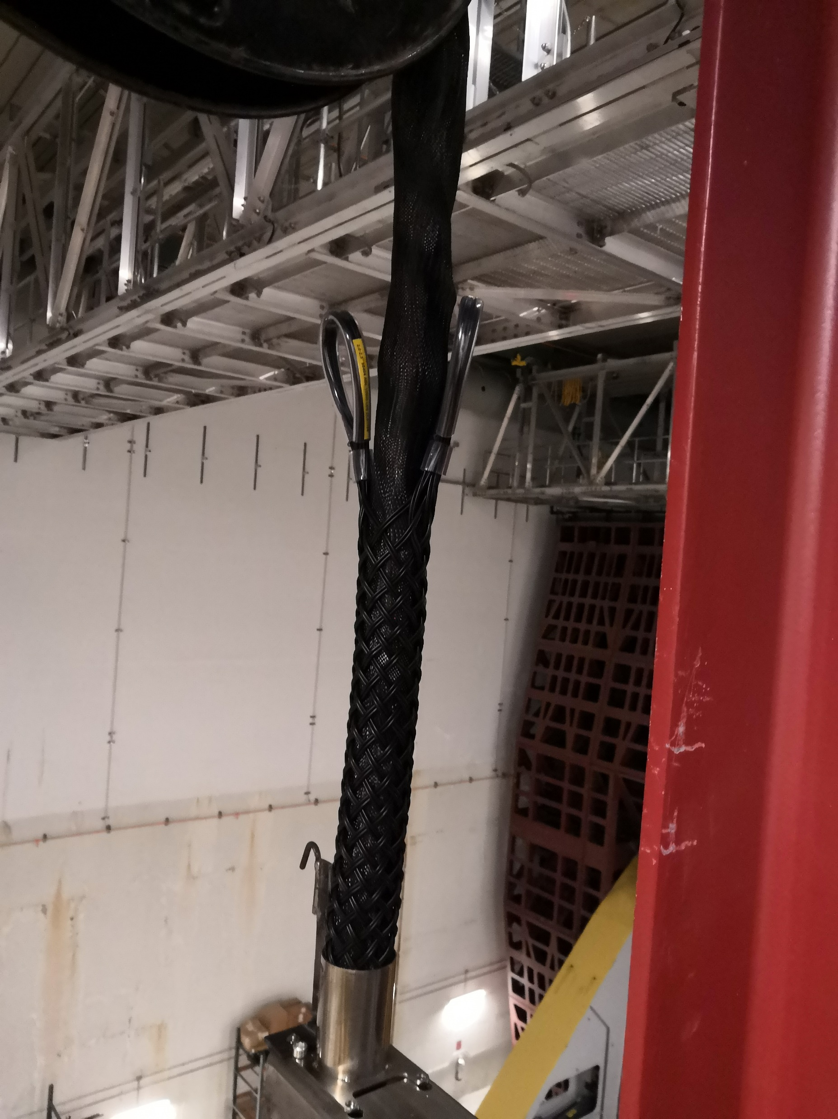
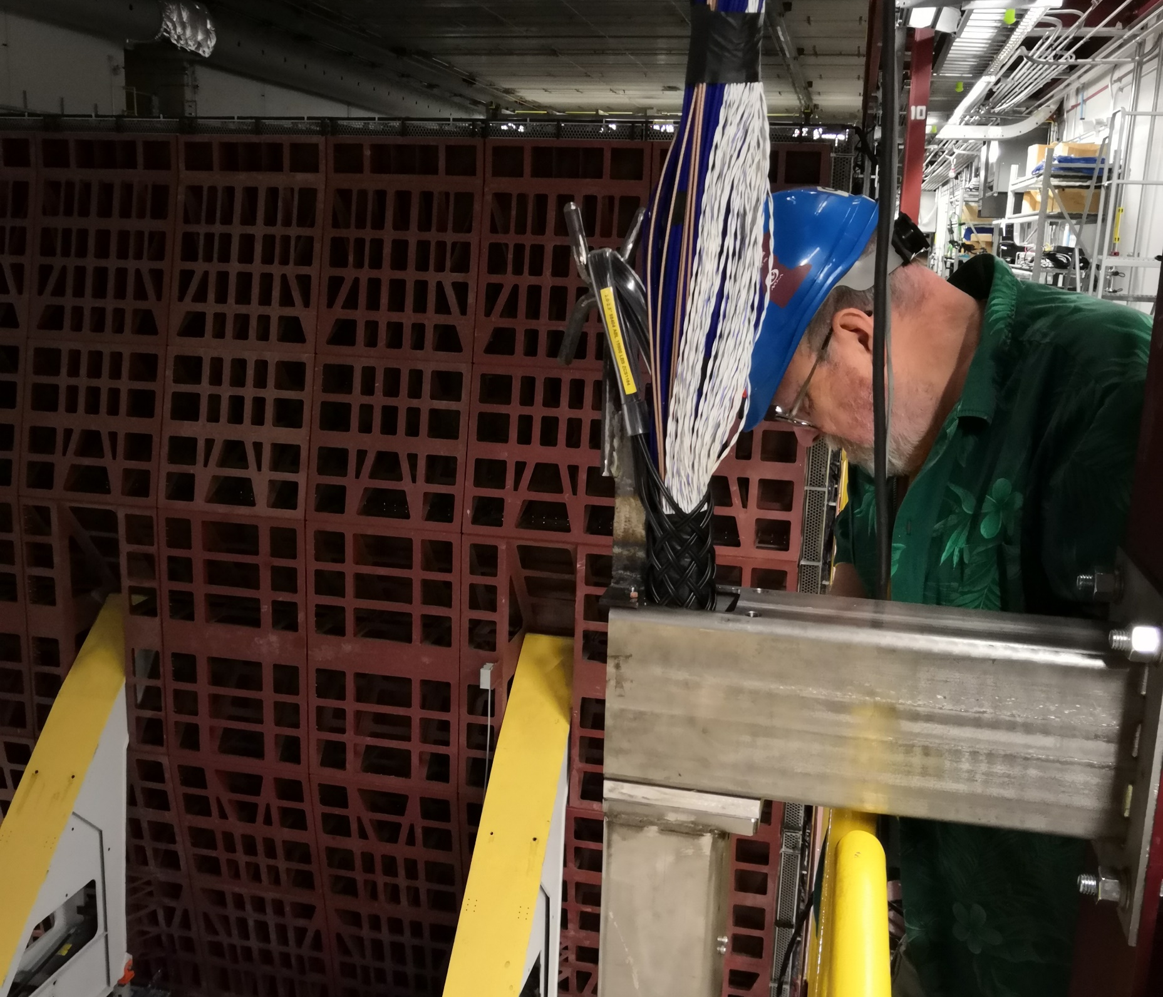
DUNE Cable Tests-Now
APA side tubes are mounted and in position
  Several tests with conduit and mesh completed
  Dec 17-18 we did a series of tests with different configurations of the cable bundle as well as some strain relief trials
  Some additional tests in January/February

Slide 6
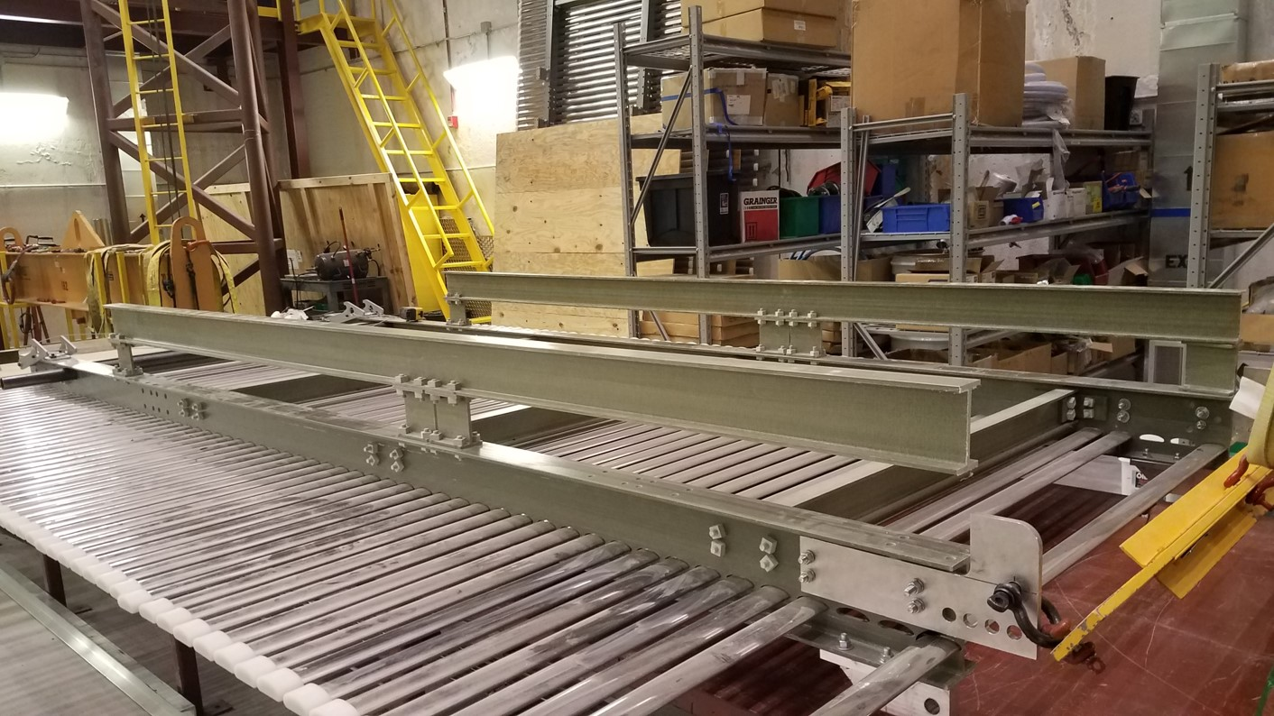
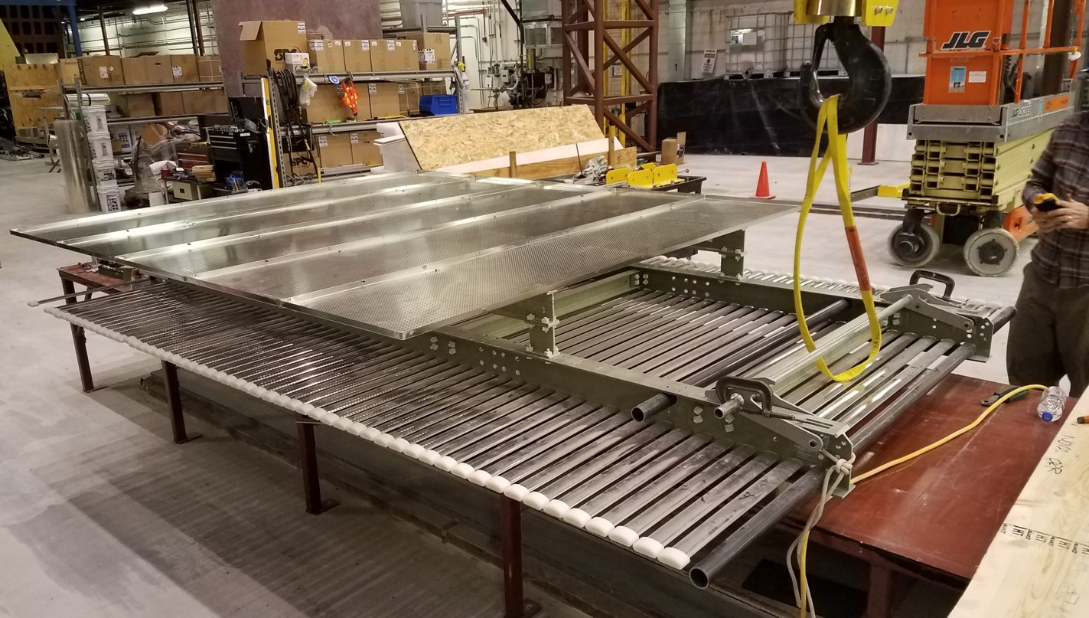
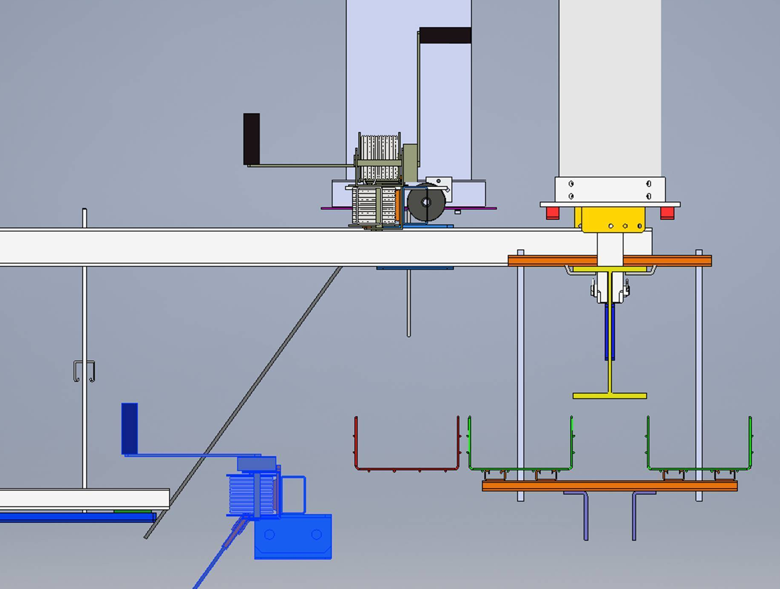
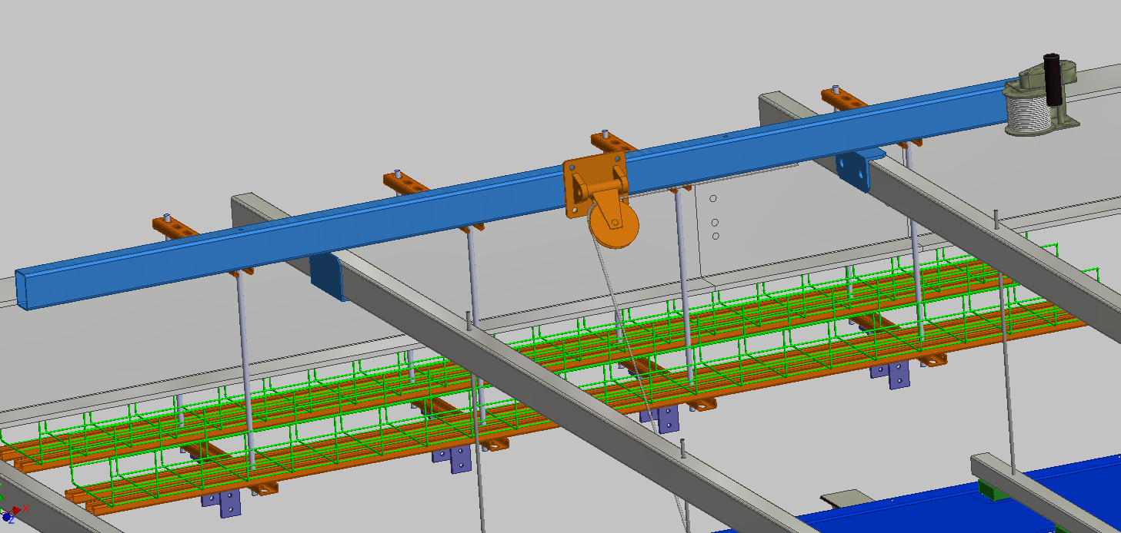
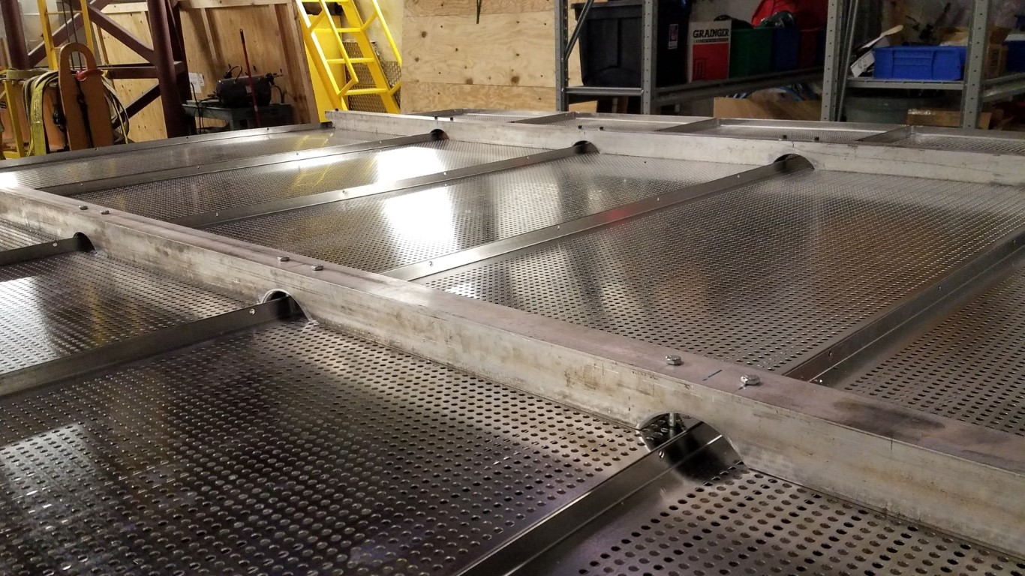
DUNE-HV Field Cage and Ground Plane
HV FC Ground plane
  Completed first test with increasing the distance of the ground plane from the extrusions using a 4” FR4 beam
  Completed second test (picture to the right) using an 2” Al square tube
January-Using existing ProtoDUNE trial assembly structure
  Test deployment of DUNE Field Cage Deployment
  Test possible Ground plane support
Late February remove ProtoDUNE structure
Ground Plane support Modifications
DUNE Field Cage Deployment concept

Slide 7
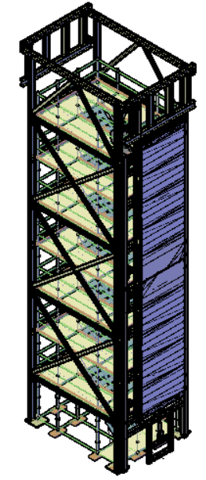
Phase 0 FY19 Trial Assembly APA Tower
Purchase/rent Scaffold for APA cabling tower-This information is needed to align the scaffold levels to the horizontal beams on the tower. Bid has been awarded to API (They built the NOvA Building)
Design of tower would allow us to do both the connection of the APA Pairs, cabling and protection tests. A CPA assembly station will be added as the design matures. The APA tower bid will go out as a design/build so we have properly stamped assembly drawings- Expect bids to go out in early February
The elevation on the work platform is the same as the cleanroom at DUNE based on the elevation of the Detector Support Structure.
NOvA crew will get all building permits required as well as write HA and procedure documents for approval by UMN ESH. Training and documentation will be developed as needed
APA Cabling Tower

Slide 8
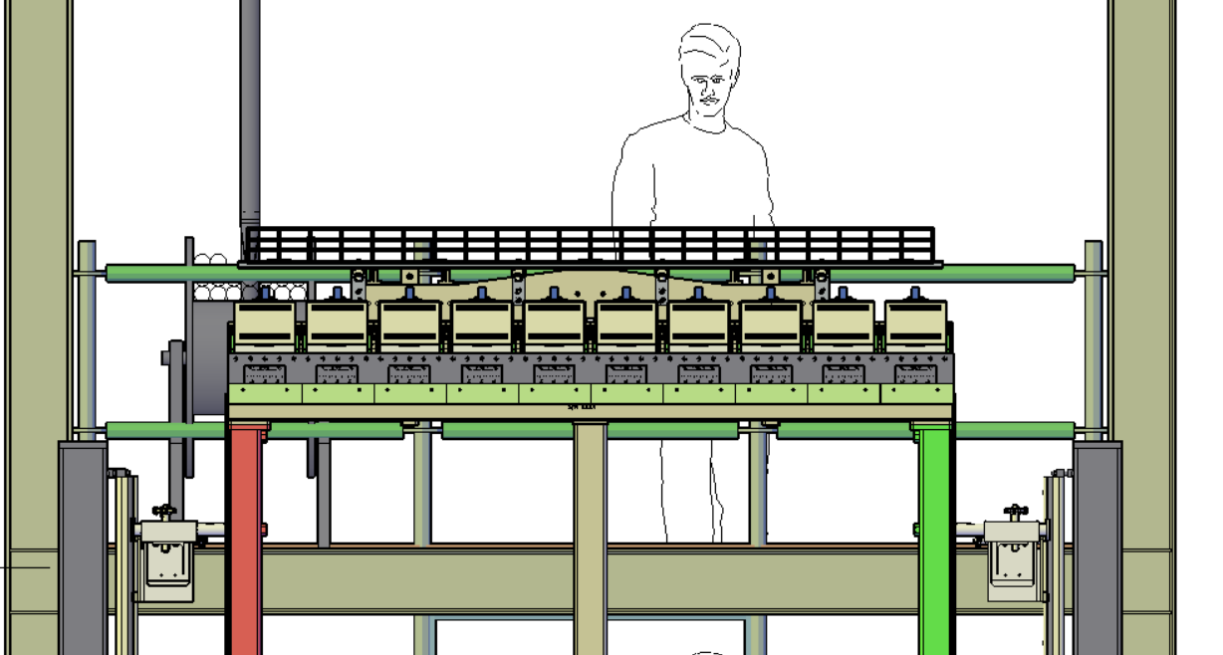
Access for the top of the APA Cabling Tower

Slide 9
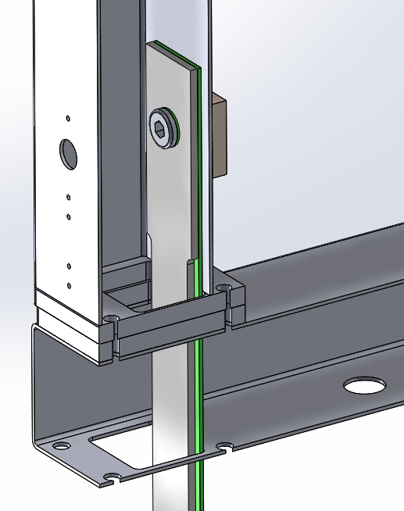
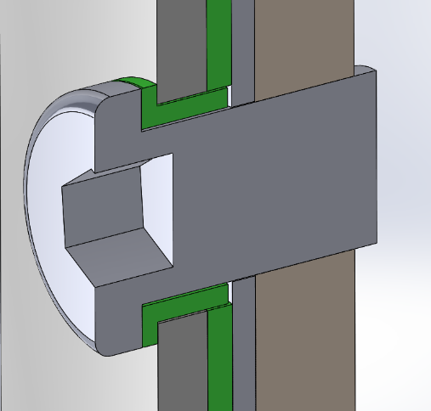
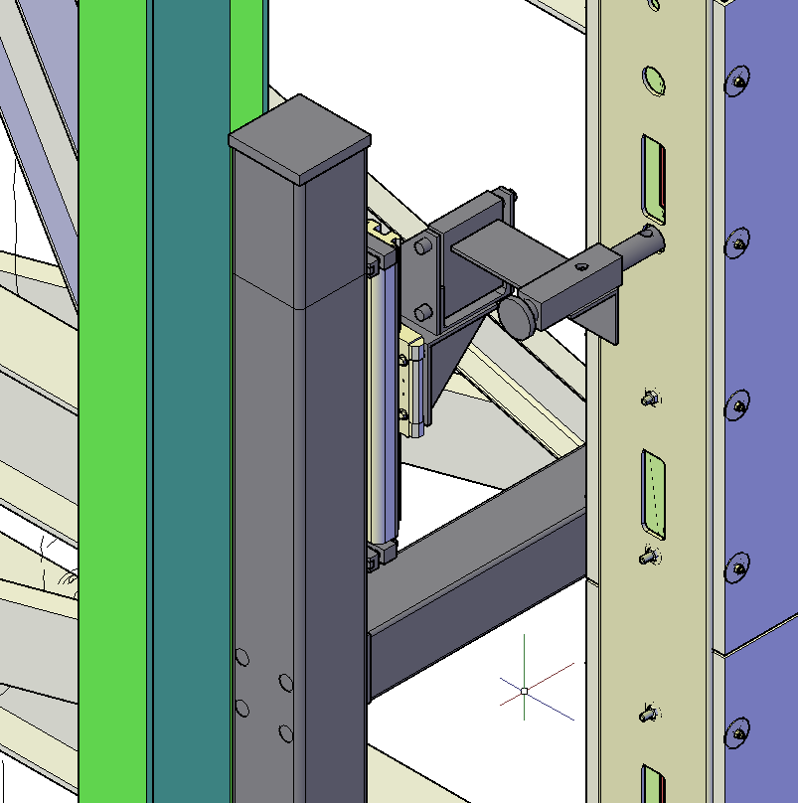
APA Cabling Tower Features
The steel tower is self supporting and give horizontal stability to the scaffolding stair tower.
The spacing on the horizontal beams on the ends maximizes access to allow removal of the protection panels after cabling is completed
The pair of APA frames will be supplied by PSL. They will have all the features of a real APA but no wires and include APA connection bars. We would have the ability to add APA protection. There would be several sets of rails for installing Photon Detectors
The APA Mounting Frame, stabilizing hardware and jack system will be designed and supplied by PSL and bolted to the APA Tower by the NOvA crew. They would include assembly drawings
APA connection hardware
Iso-view of the APA stabilizing hardware
APA Mounting frame
Pair
APA
Frames

Slide 10
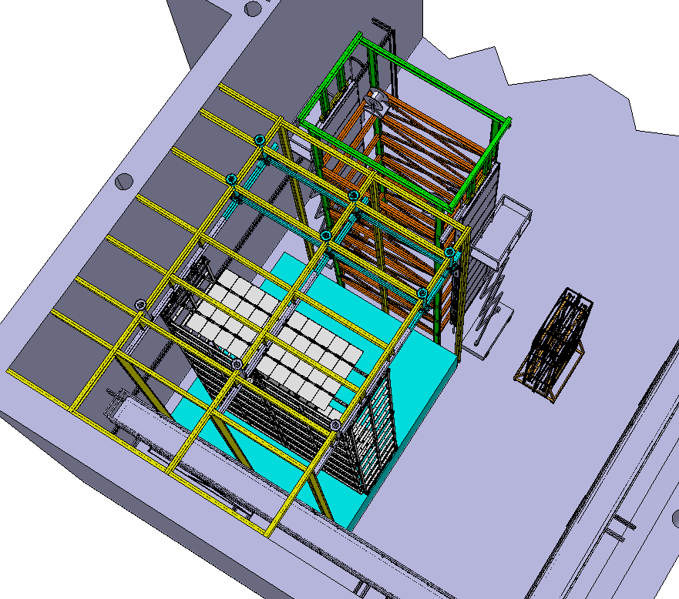
Phase 0-APA Cable Tower March 2019-Schedule
Design APA Cabling Tower and location so:
  Phase 1 DSS shuttle runway beam
  Phase 2 top of cryostat work
Can be added without modifications to tower
Ability to test access issues on back side of tower (same layout as DUNE cleanroom)
We expect the APA frames with yokes from PSL to arrive at Ash River in early March
We expect APA mounting frame and APA stabilizers in mid-March- PSL
Need to order 2-4 sets of cables, connectors, cable mesh and cable strain relief- BNL
PD cable with connectors and several sets of PD rails- Colorado State

Slide 11
Additional Equipment needed-Phase 0
Use all access equipment proposed for DUNE to confirm that it works:
  Mobile Scissor Lift-Only 40’ available in US, needed for center APA connection and for phase 1 work- Quotes in progress
  Static scissor lift capable of reaching ~50’. We are getting quotes from 2 different vendors.
Lifting fixture for both top and bottom APA- Design PSL purchase ?? Needed later in FY19
APA shipping frame- APA consortia Needed later in FY19
We have ordered sheave wheel, a motorized cable puller and cable spool to do additional tests on the APA side tube tester. These will be used on the APA cabling tower - UMN
Order cable trays and brackets for full cable tests- BNL and UMN
Additional slings and lifting equipment- UMN

Slide 12
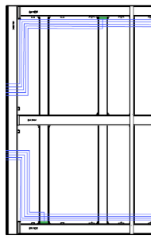
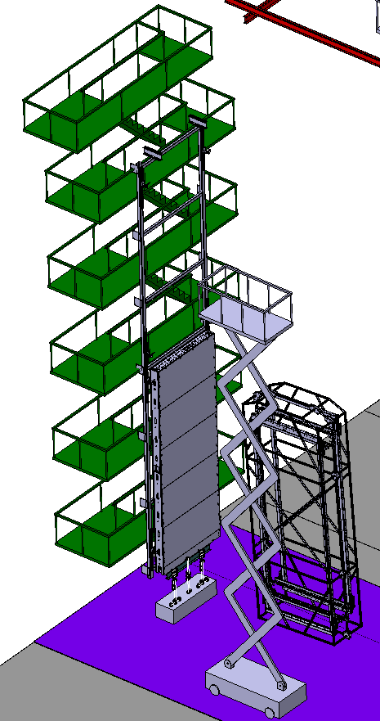
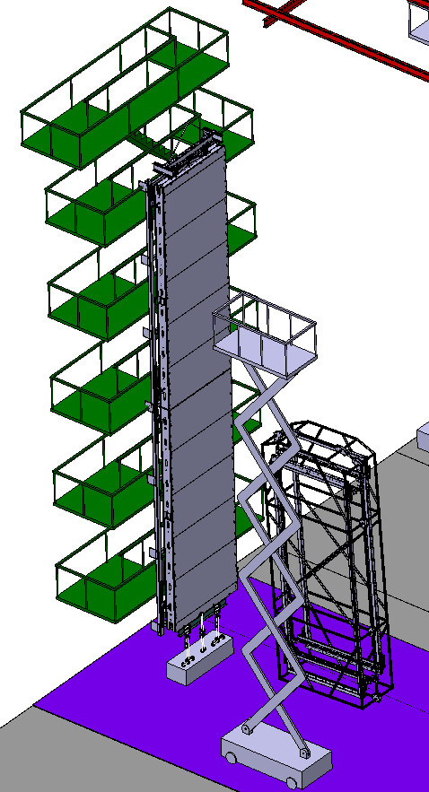
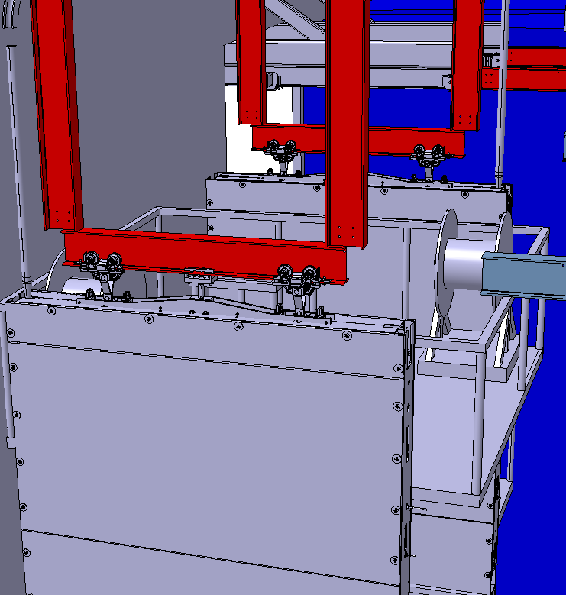
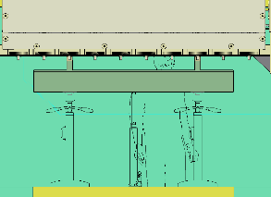
APA Assembly Procedures
We will not have the APA shipping frame or the final lifting fixtures for our first tests. Frames will be rigged using slings
Hydraulic jacks raise bottom APA up and connection is made
Lower APA will be placed on APA mounting frame. The load is supported by the bottom jacks
Top APA will be placed on APA mounting frame. The load is supported by APA Trolleys
Trolleys are mounted on 10” stainless steel I-Beam same as DSS. Access needed to both vertical APA side tubes
PD cables run inside the APA frames and must be connected in the middle

Slide 13
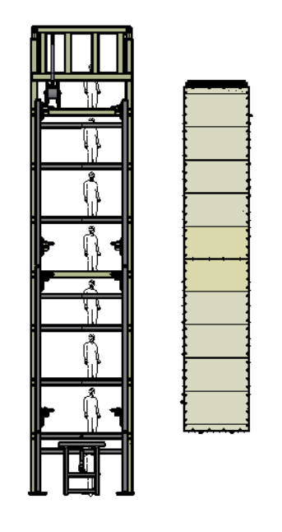
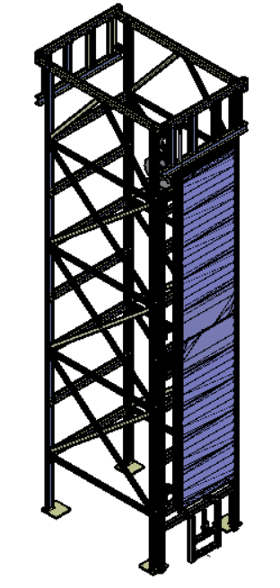
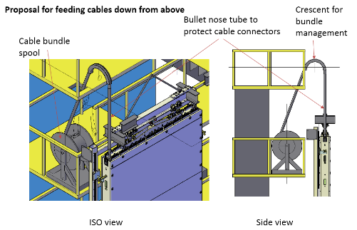
Phase 0-Testing Procedure
We are now ready to Install CE cables
Sheave wheel
Img. from Dan Wenman

Slide 14
Documentation for Phase 0
All documentation will be located in folders in EDMS at CERN. This will be a prototype for documentation for DUNE
Similar to what we did for CERN on ProtoDUNE but following Fermilab documentation guidelines
Hazard Analysis for each task including all PPE and Training requirements
Detailed step by step procedures
All lifting fixtures, trolleys will have completed documentation including calculations and load tests
List of documents-End Wall
Document | EDMS # | Status
End Wall analysis warm | 1816841 | Released
Transport Beam | 1853726 | Released
APA Trolley | 1834246 | Released
Spreader Bar, Swivel, 5/8” pin | 1876417 | Released
TCO Intermediate Beam | 1871905 | Released
Procedure for building End Wall-Cleanroom | Draft | Draft
Procedure mounting End Wall-Cryostat | Draft | Draft
All Ash River documentation will be reviewed UMD Safety Officer- Jean Cranston and Fermilab ESH

Slide 15
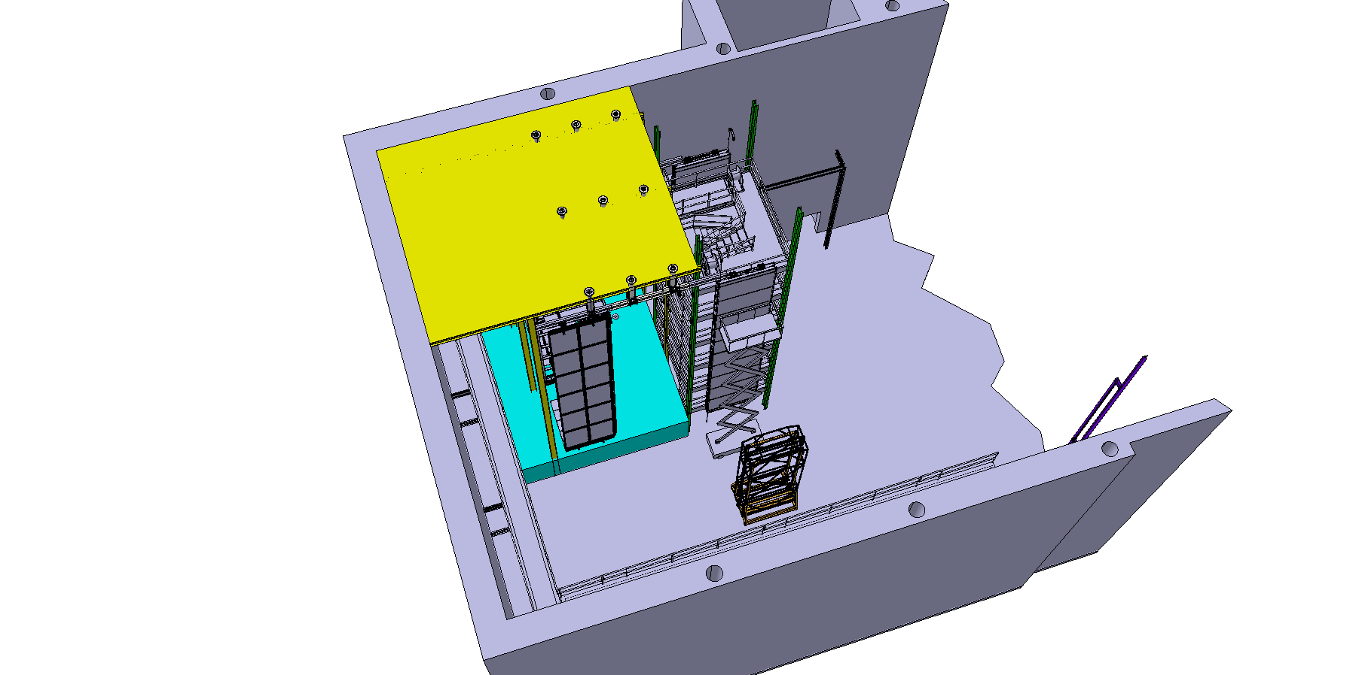
Phase 1 FY20-Cryostat Structure
Design/Build bid for mockup of the Cryostat Structure including the ability to add feed-thru tubes for grated decking if funding is available
Order DSS components and assembly DSS shuttle beam and 3 DSS rails consistent with the TCO opening and the first row of TPC components- Design by Vic Guarino at ANL
Decision needs to be made if full test of DSS Feed-Thru hanger should be done. This would change the layout of the beam support structure
Design should allow top of cryostat to line up with existing loading dock floor if possible
Elevation of the DSS and cryostat floor needs to be determined. Cost savings by making NOvA Assembly area floor cryostat floor

Slide 16
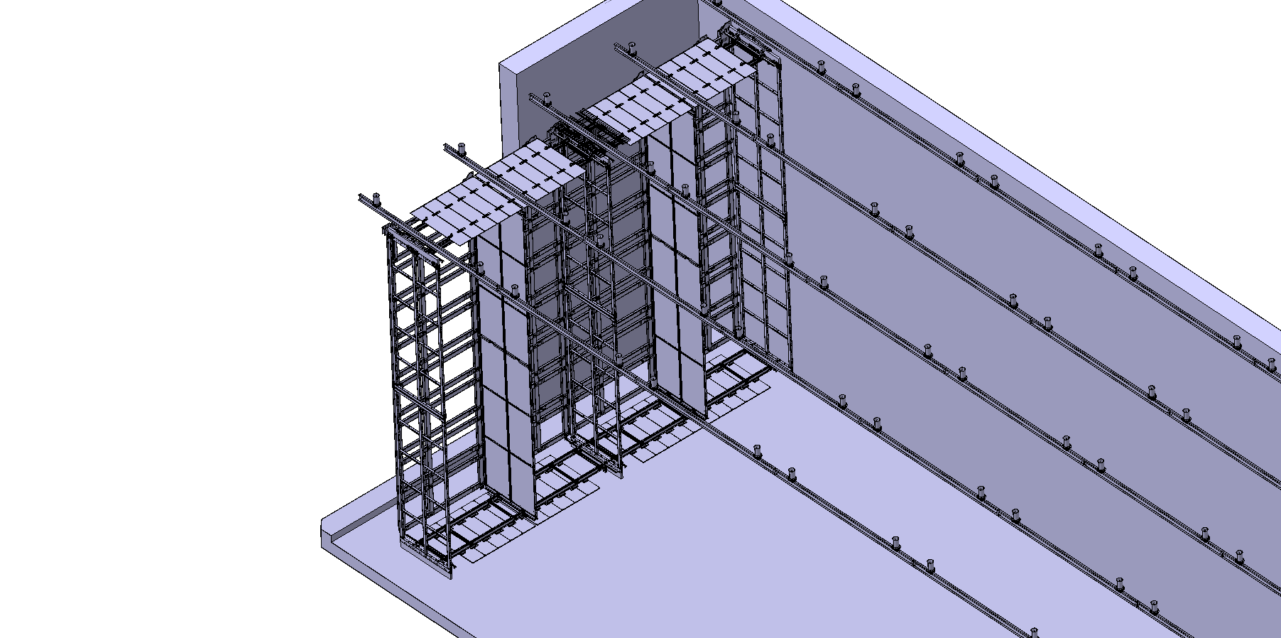
Two Completed TPC drift volumes with DSS Shuttle
1
2
APA Shipping Frame
1
2
DSS Shuttle Beam
CPA APA CPA APA
DUNE - Ash River Trial Assembly
DUNE – Single Phase Detector

Slide 17
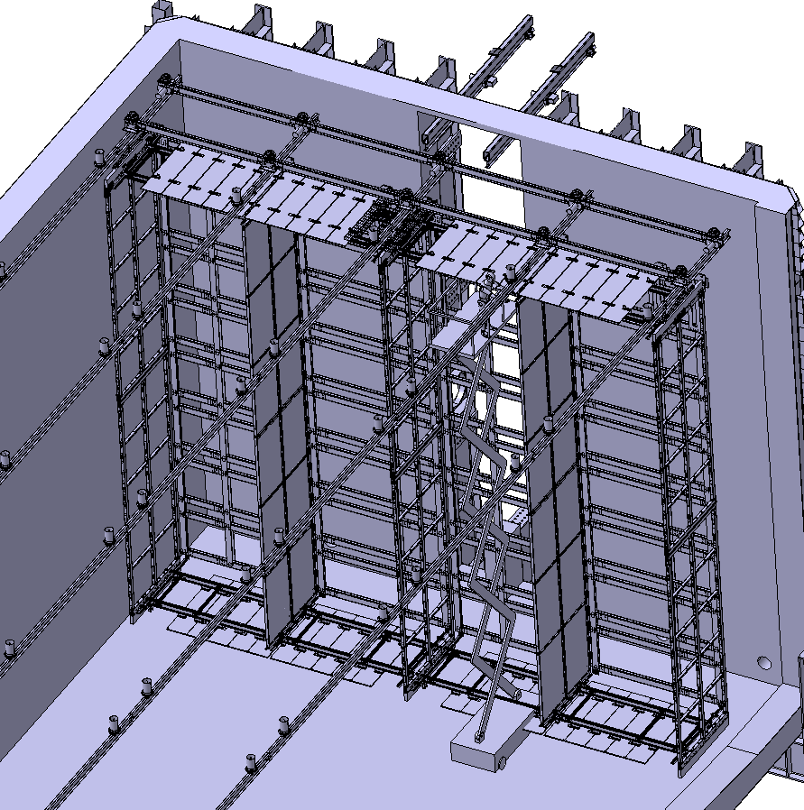
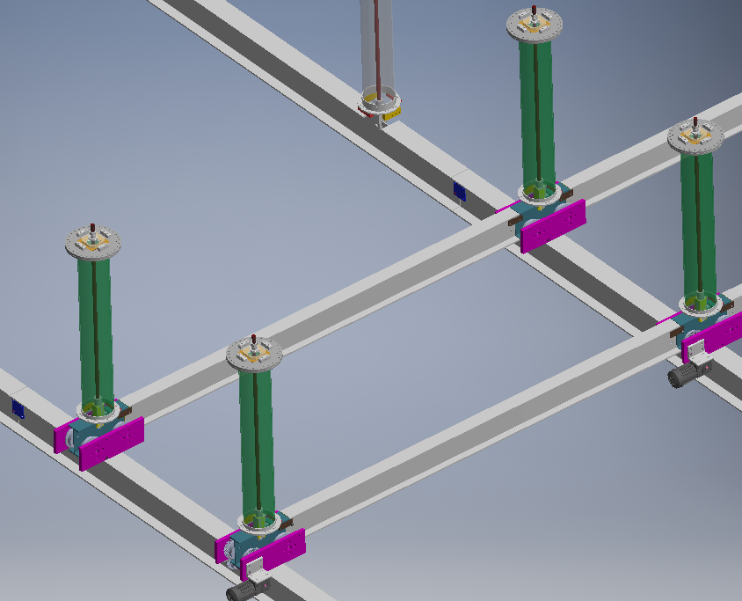
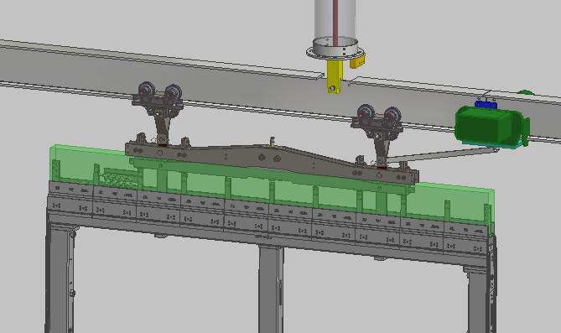
Phase 1-FY20 DSS Shuttle
Build DSS shuttle and DSS beams
  Test how it is powered for movement
  Test beam connections and access to them
  Do we want to test DSS installation procedures?
Test how APA pair and CPA components move
DSS Runway Beams
DSS Feed-thru

Slide 18
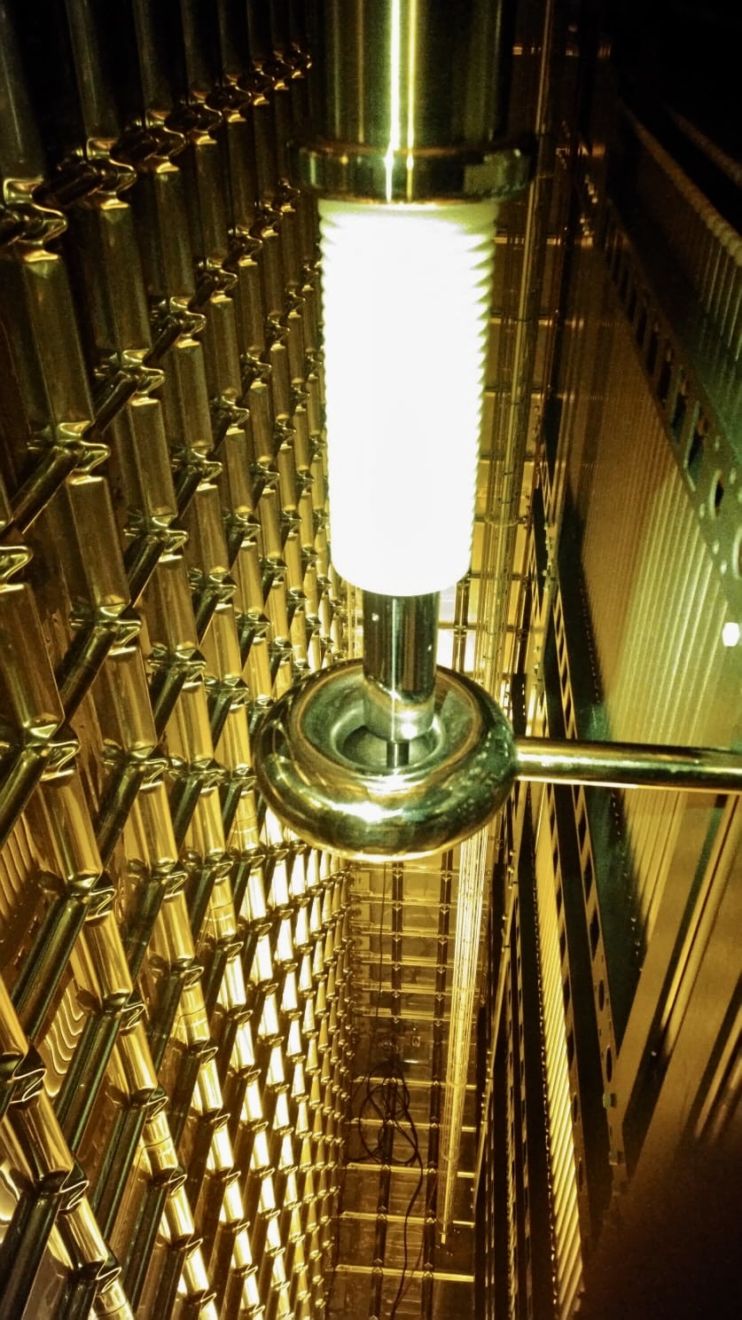
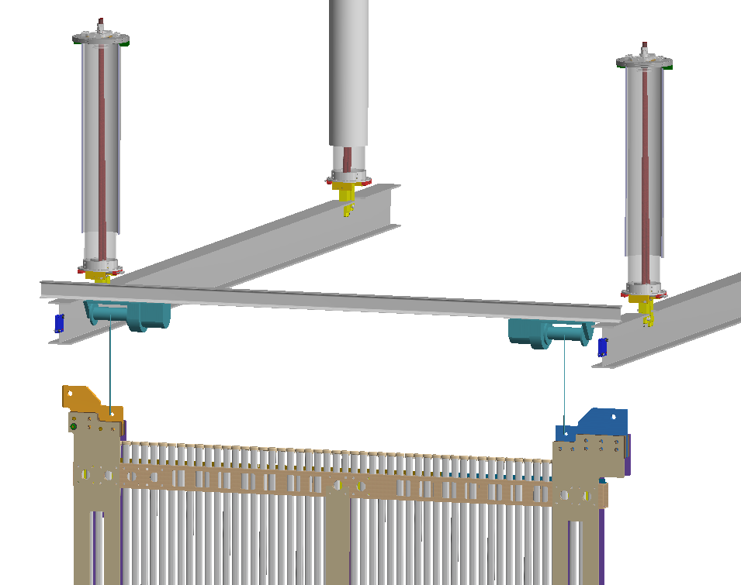
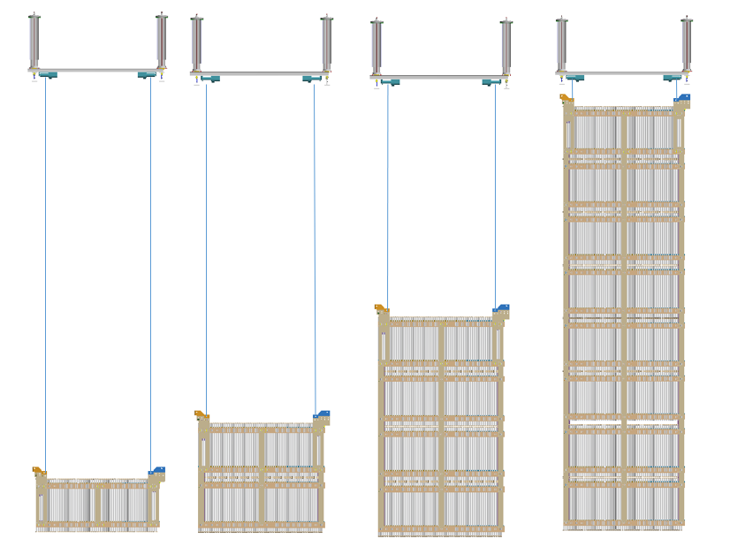
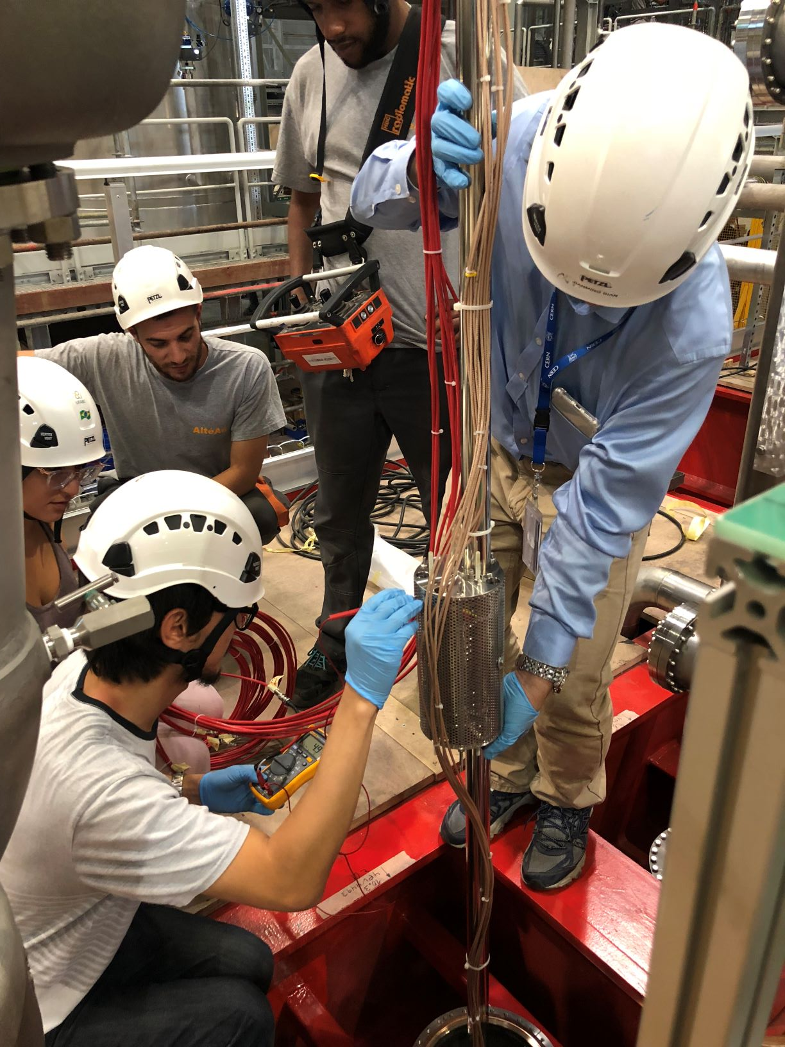
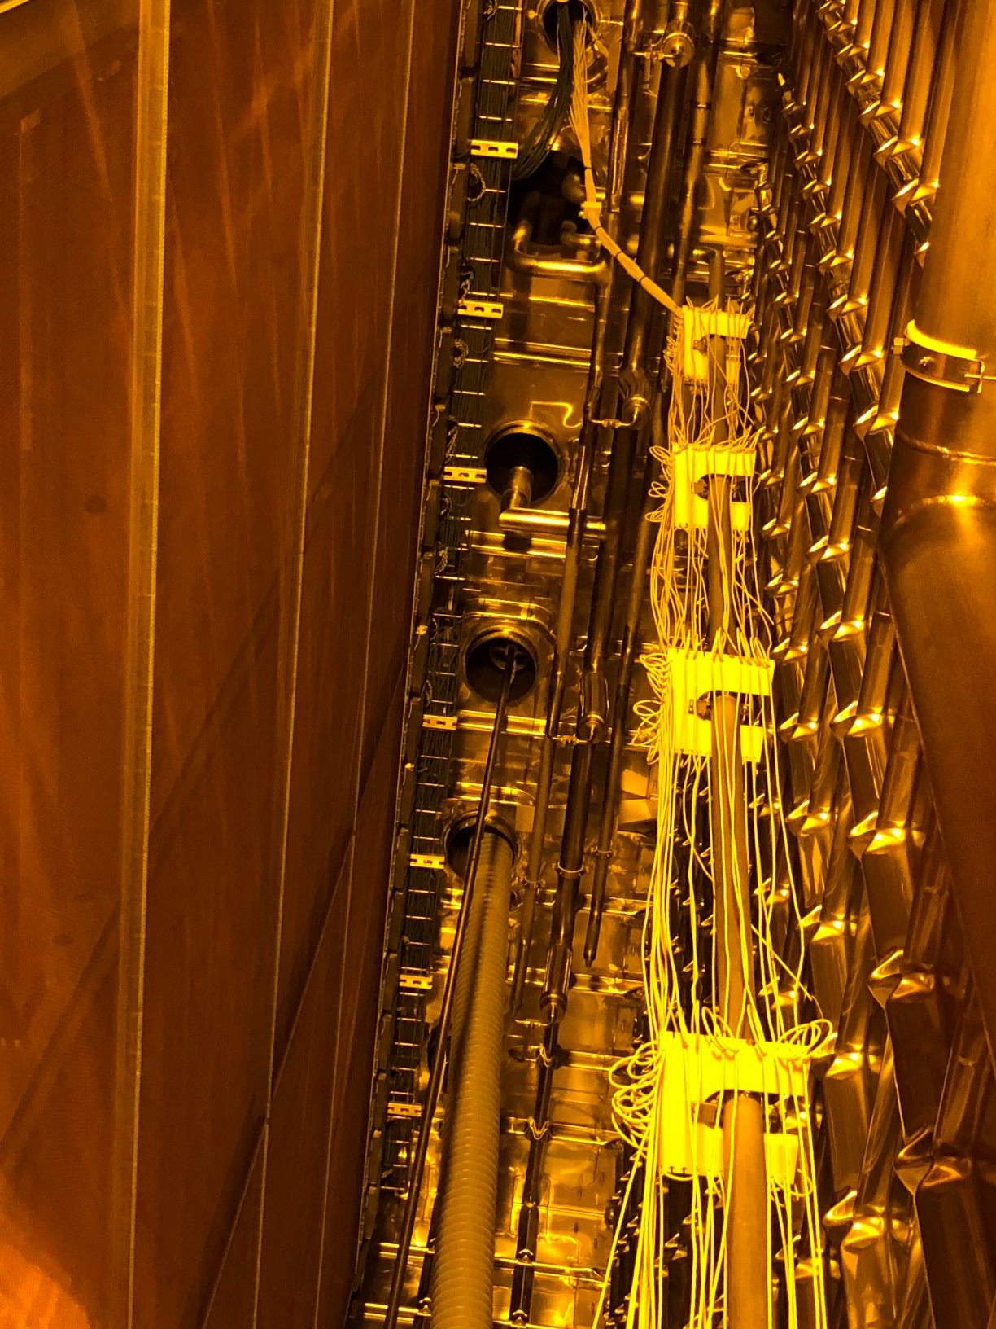
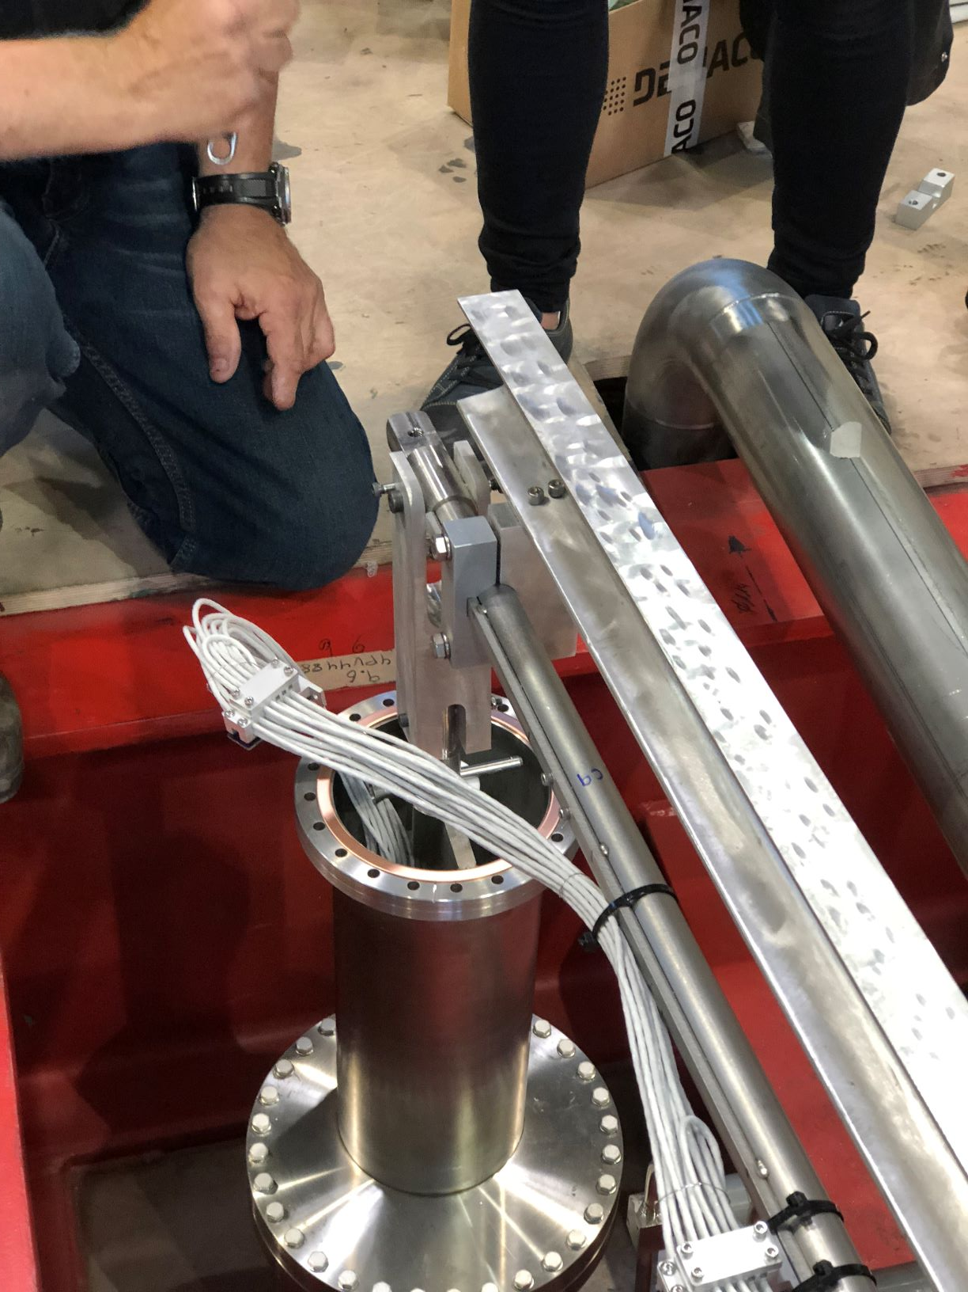
Phase 1 – FY20 TPC Assembly Procedures
Once the DSS has been installed and the subfloor is in place we are ready to start
No access equipment can reach once End Walls are in place
First the any instrumentation (purity monitors, temperature sensors, cameras) that are installed at the end of the cryostat must be installed first
HV connection is made to CPA
Then the 4 end wall sections are build just like in protoDUNE with the pieces connected at floor level and raised up
HV Connection
Purity Monitor Temp Sensors Gradient Temp Sen

Slide 19
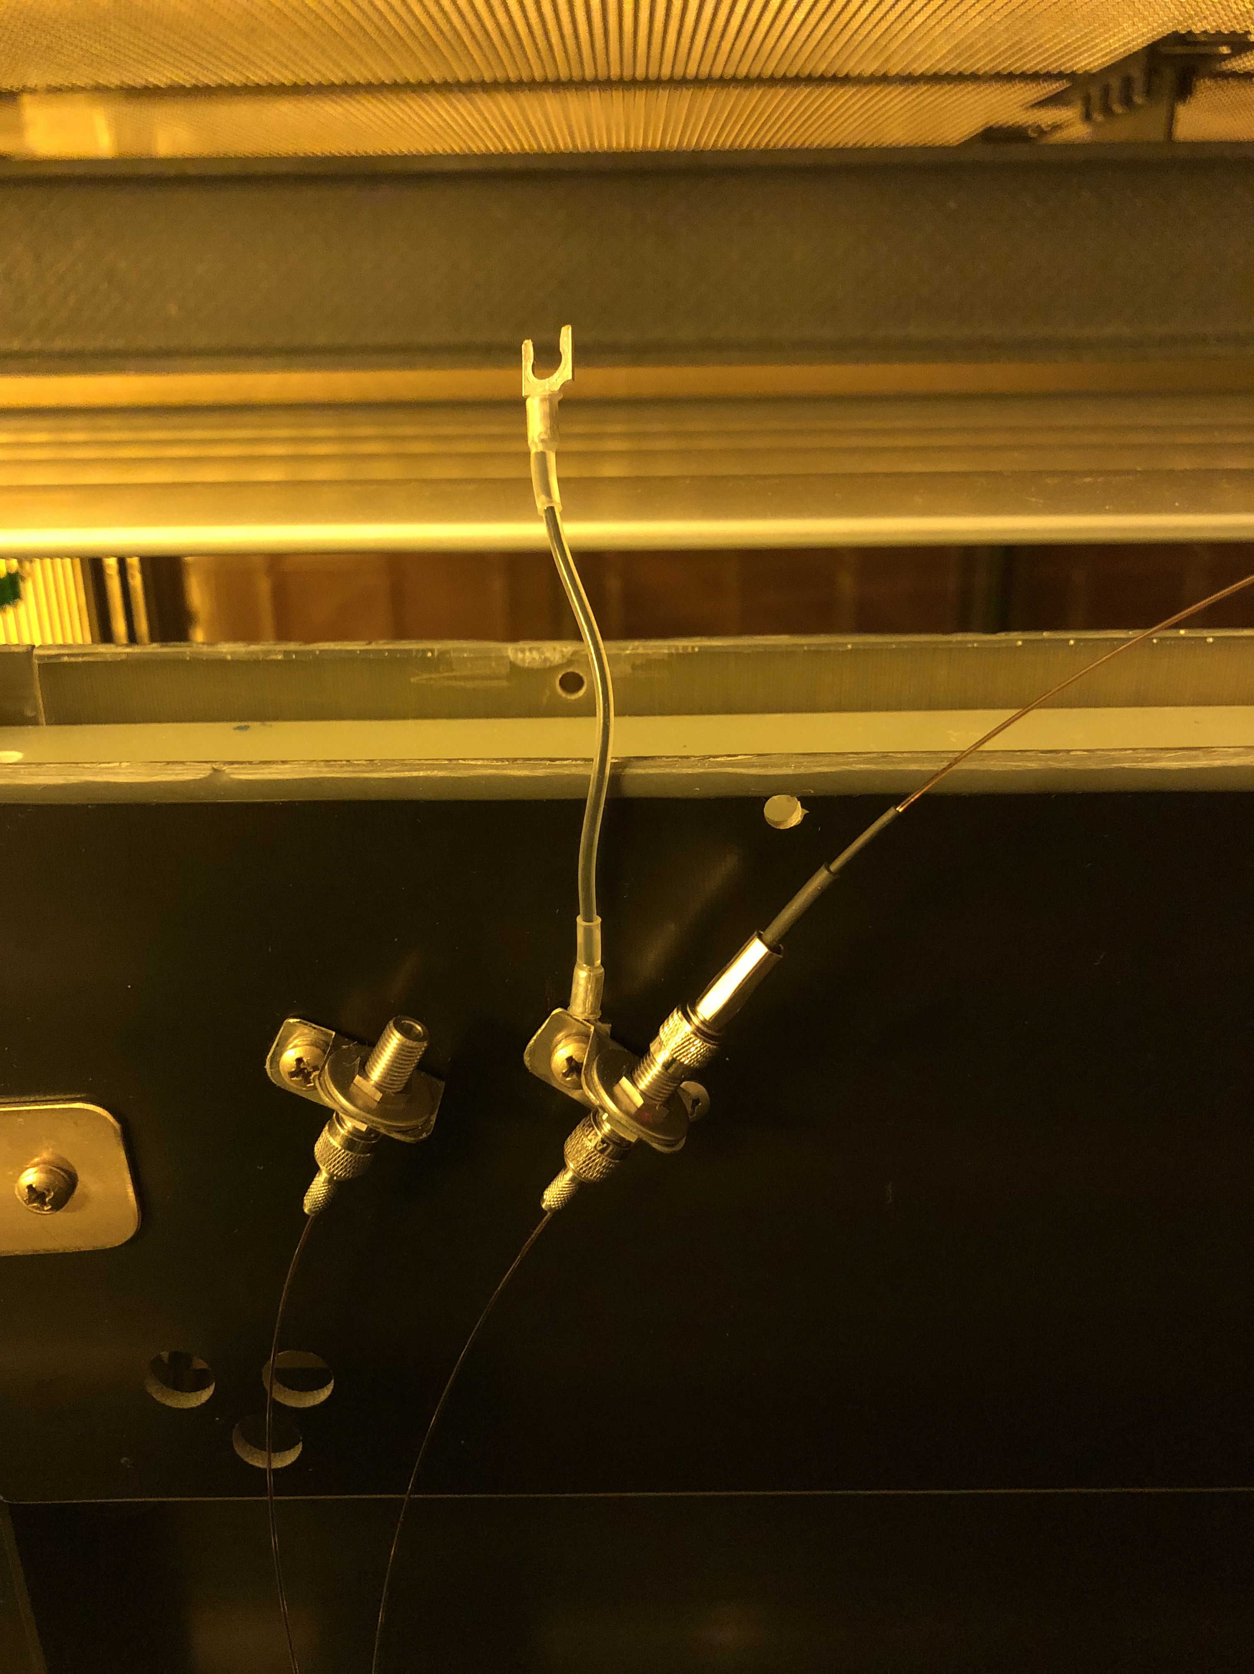
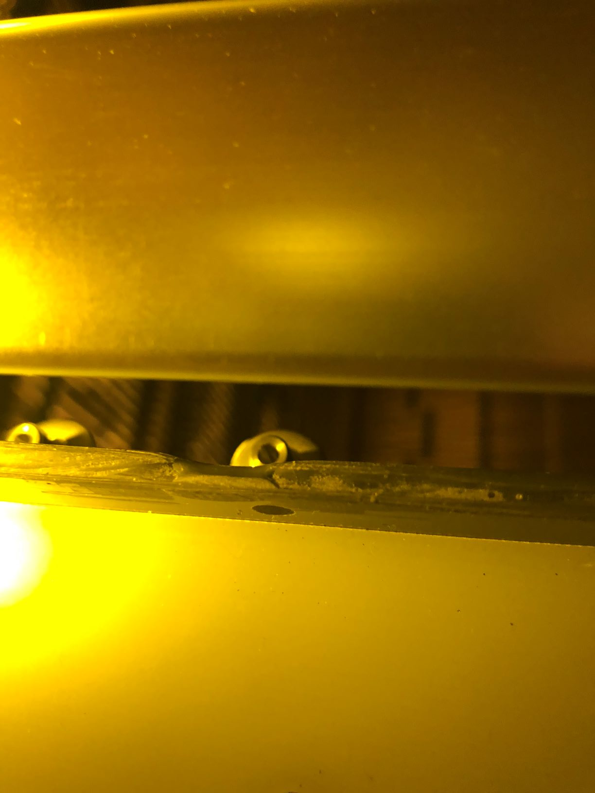
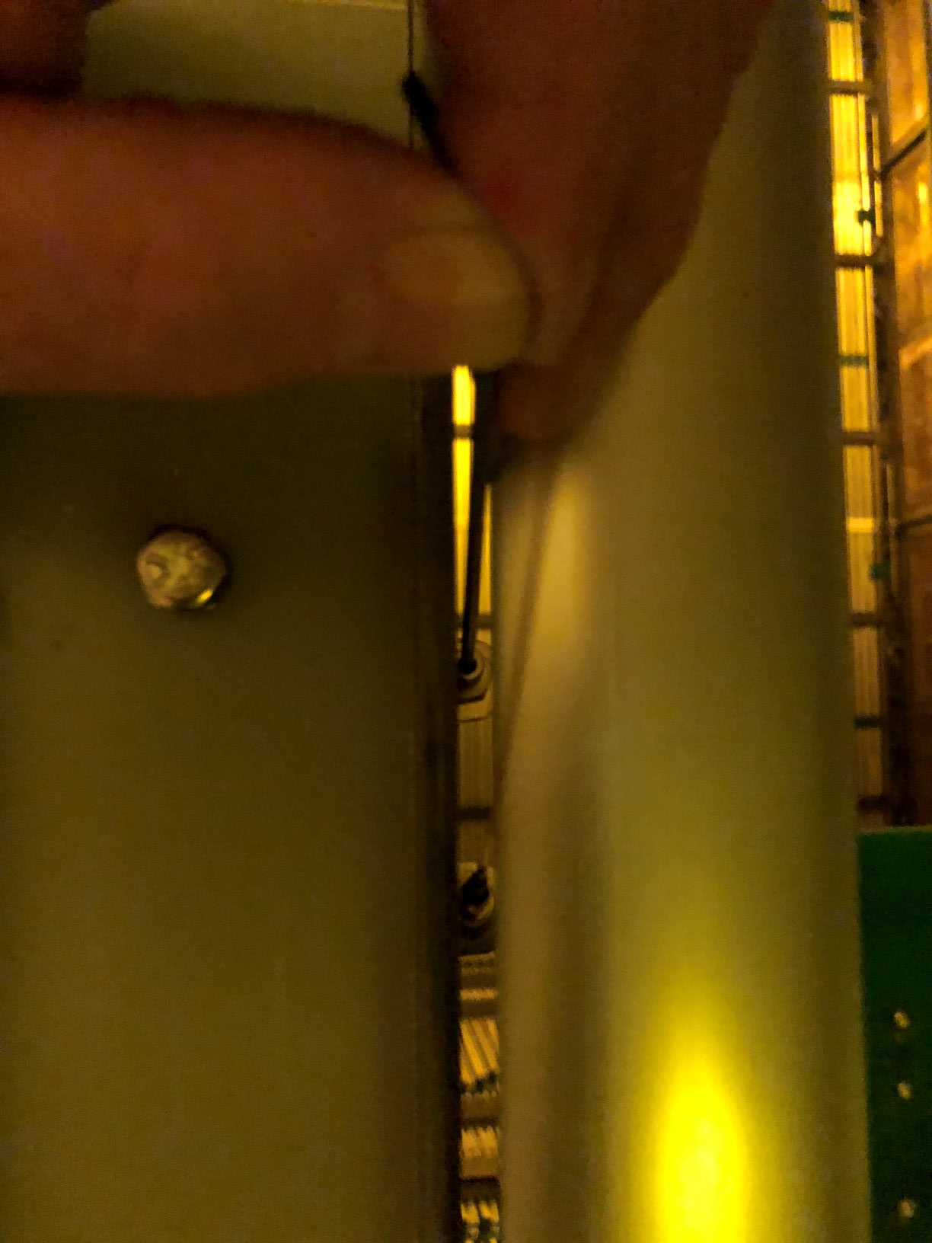
Phase 1-FY20 TPC Assembly Procedures
Lot’s of questions to answer:
Can we physically we access the cables on the back side of the APA?
Can we remove the APA trolley (not shown) ?
We do not have the light flasher/defuser system in the drawing, difficult to install on the CPA even more difficult to run the glass fibers up to the feed-thru.
Had to remove the profile and feed down thru crack on the back side
View of the top of the TPC
CPA, FC and Ground Plane

Slide 20
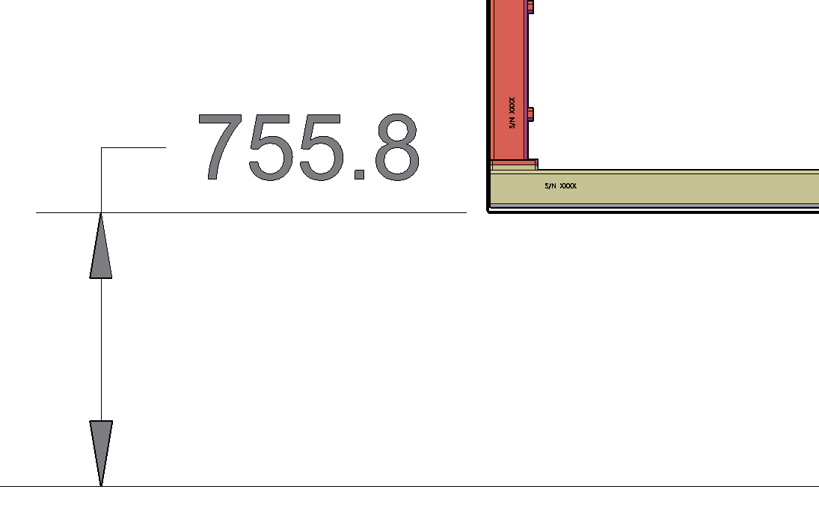
Phase 1-FY20 TPC Assembly Procedures
Write procedures for move APA and CPA components into the cryostat in into
Test clearances cabling and assembly of APA against wall top and bottom
  Adding cable tray support
  Removing trolleys
  Attaching APA and CPA hanging hardware
  Moving cables into feed-thru cable tray
Mock up position of cryostat walls
Deploy top and bottom field cage, access to latches, etc. –Very worried
It is even worse on the top
Dune has only 331mm clearance from the bottom of the APA to the face of the cryostat
ProtoDUNE had 756mm
17 inches less!
ProtoDUNE

Slide 21
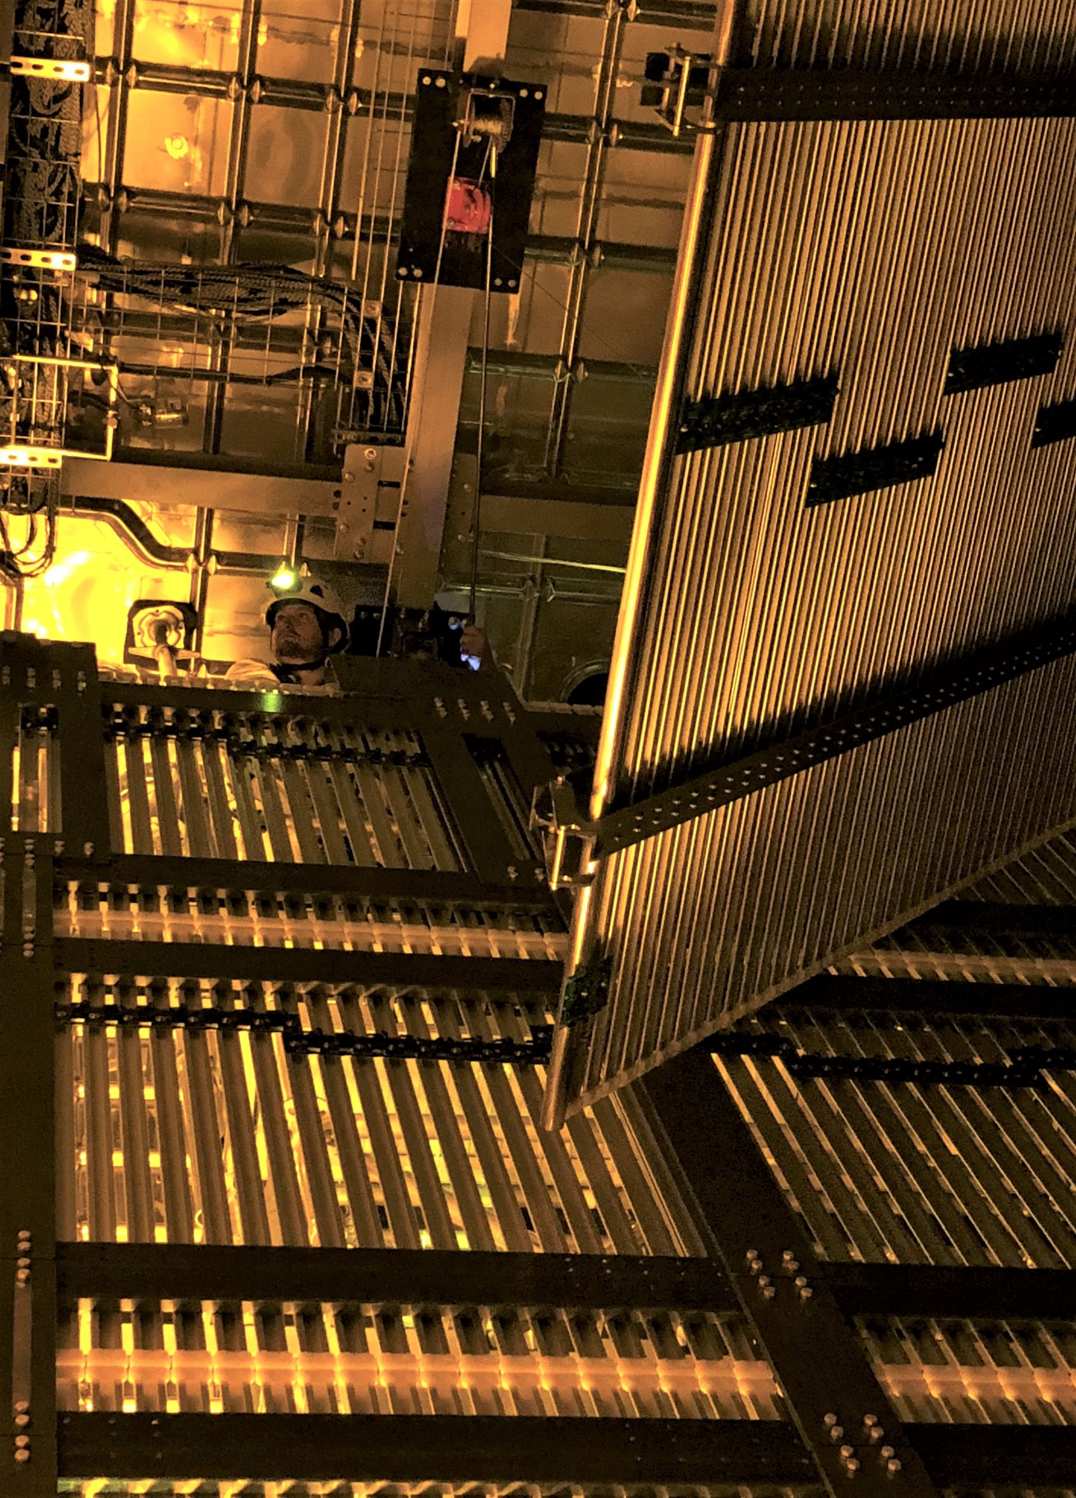
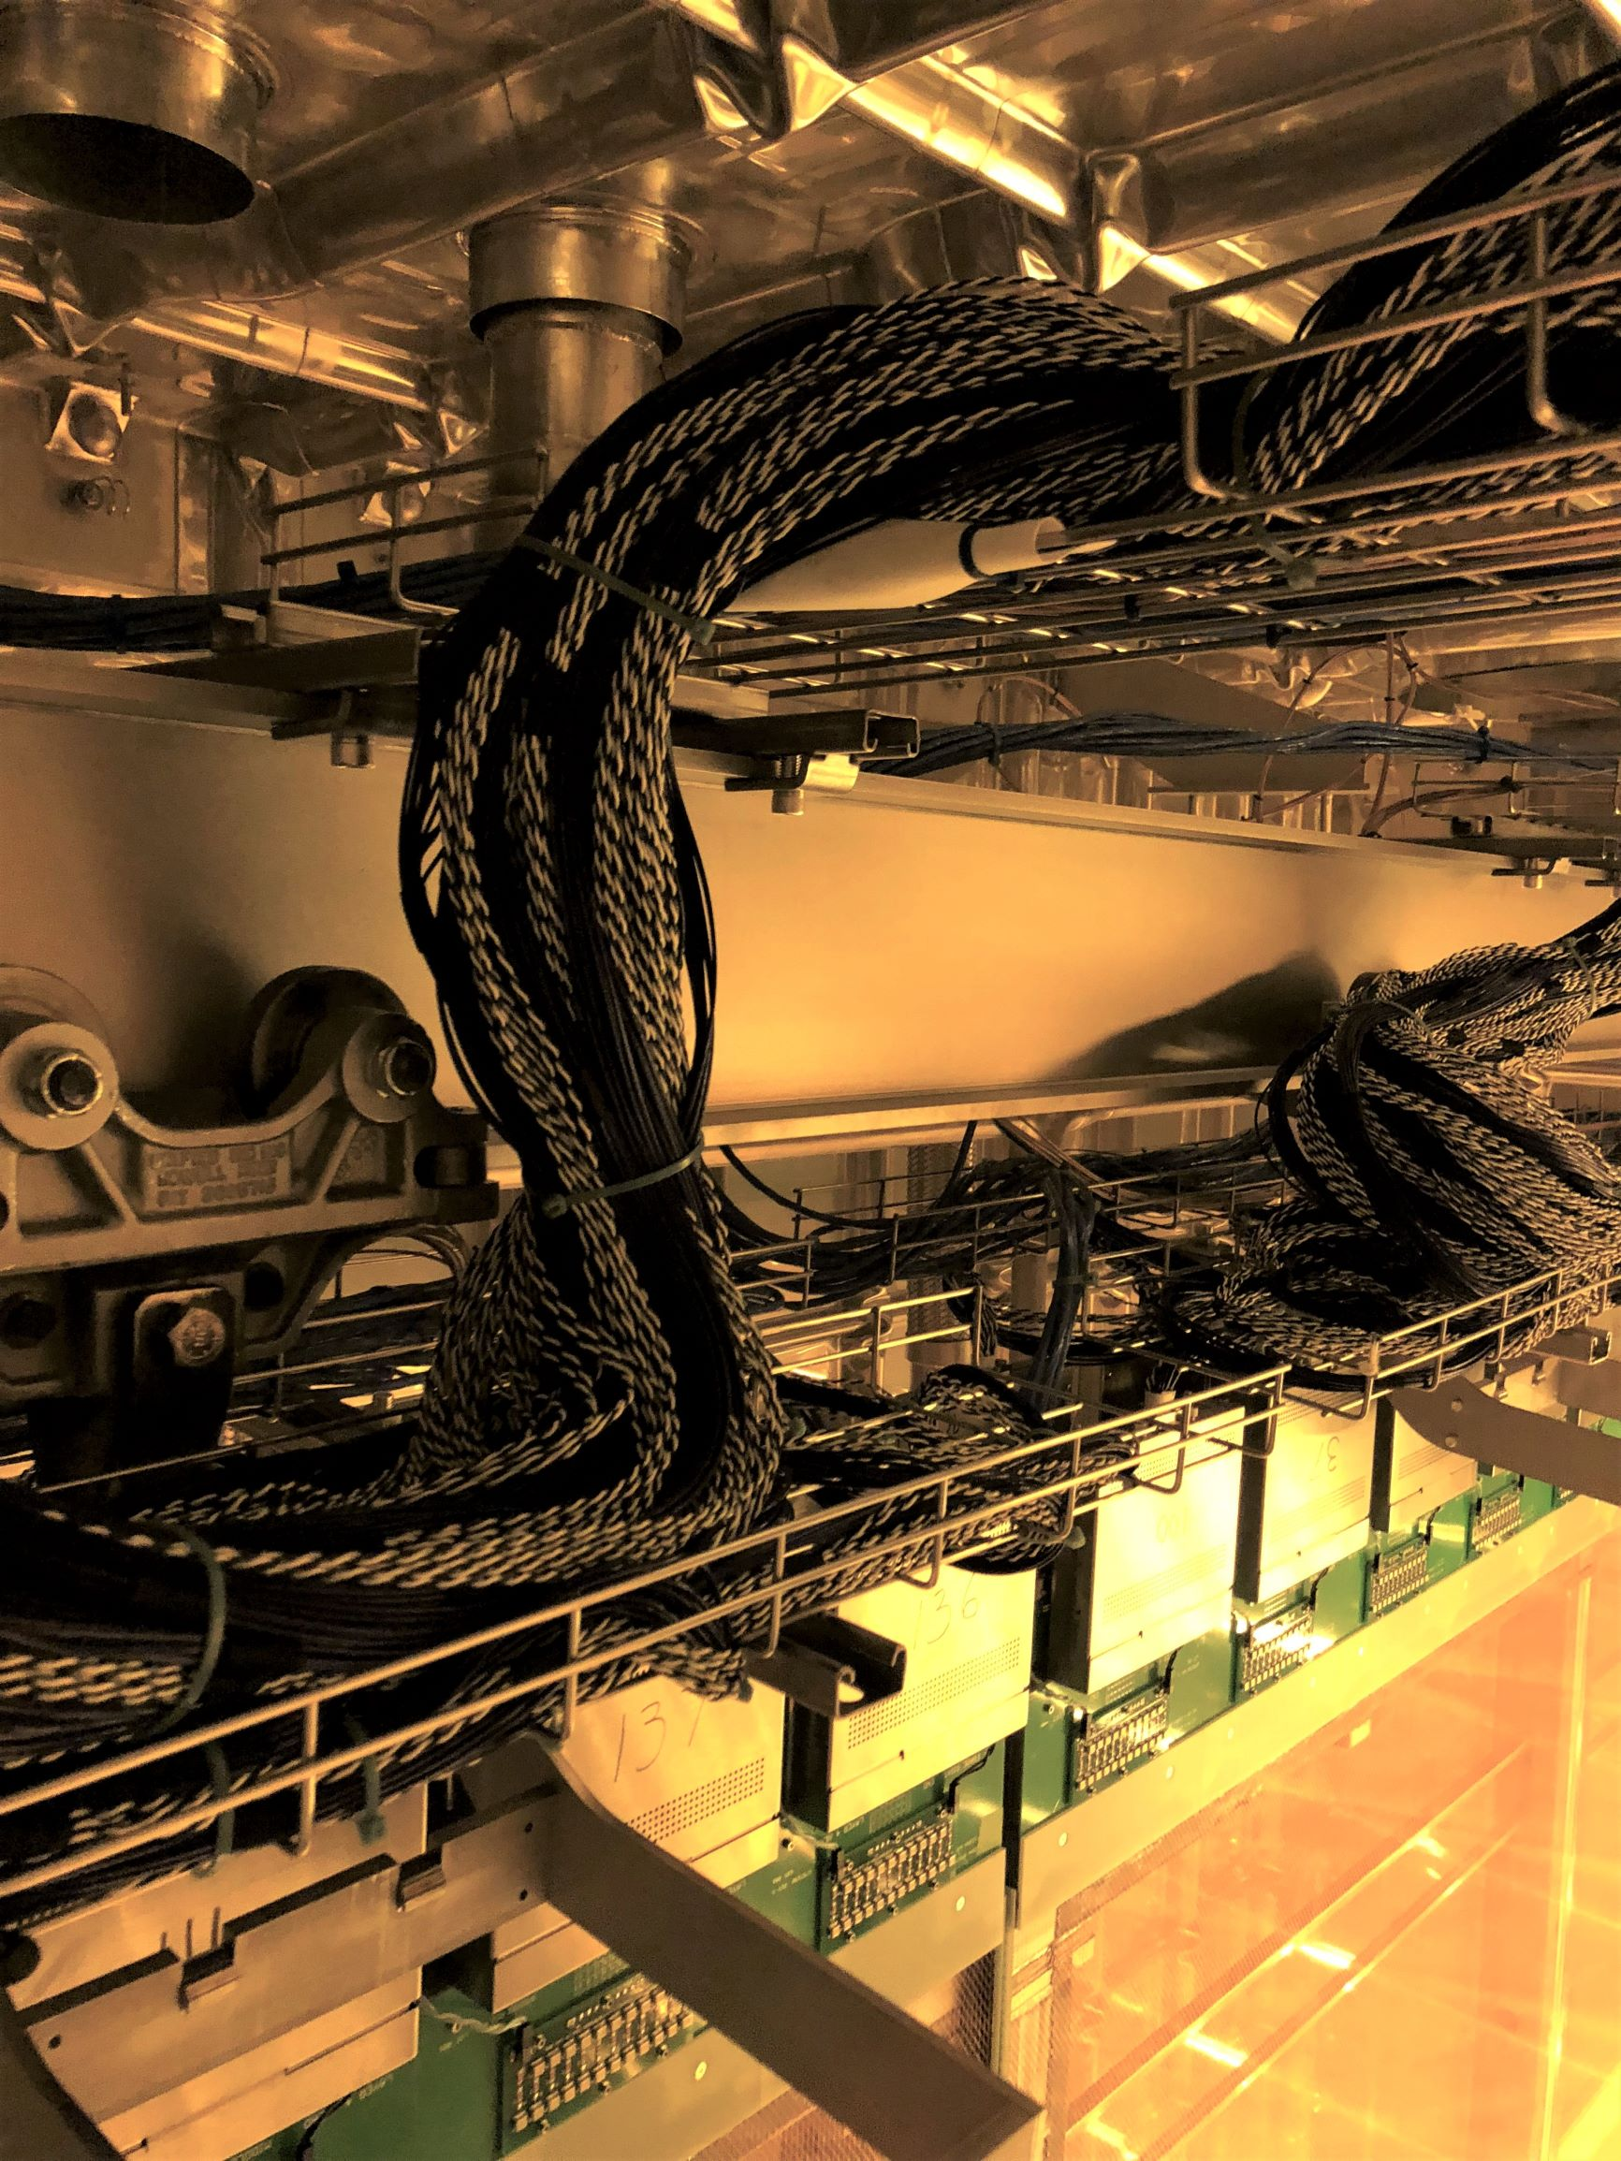
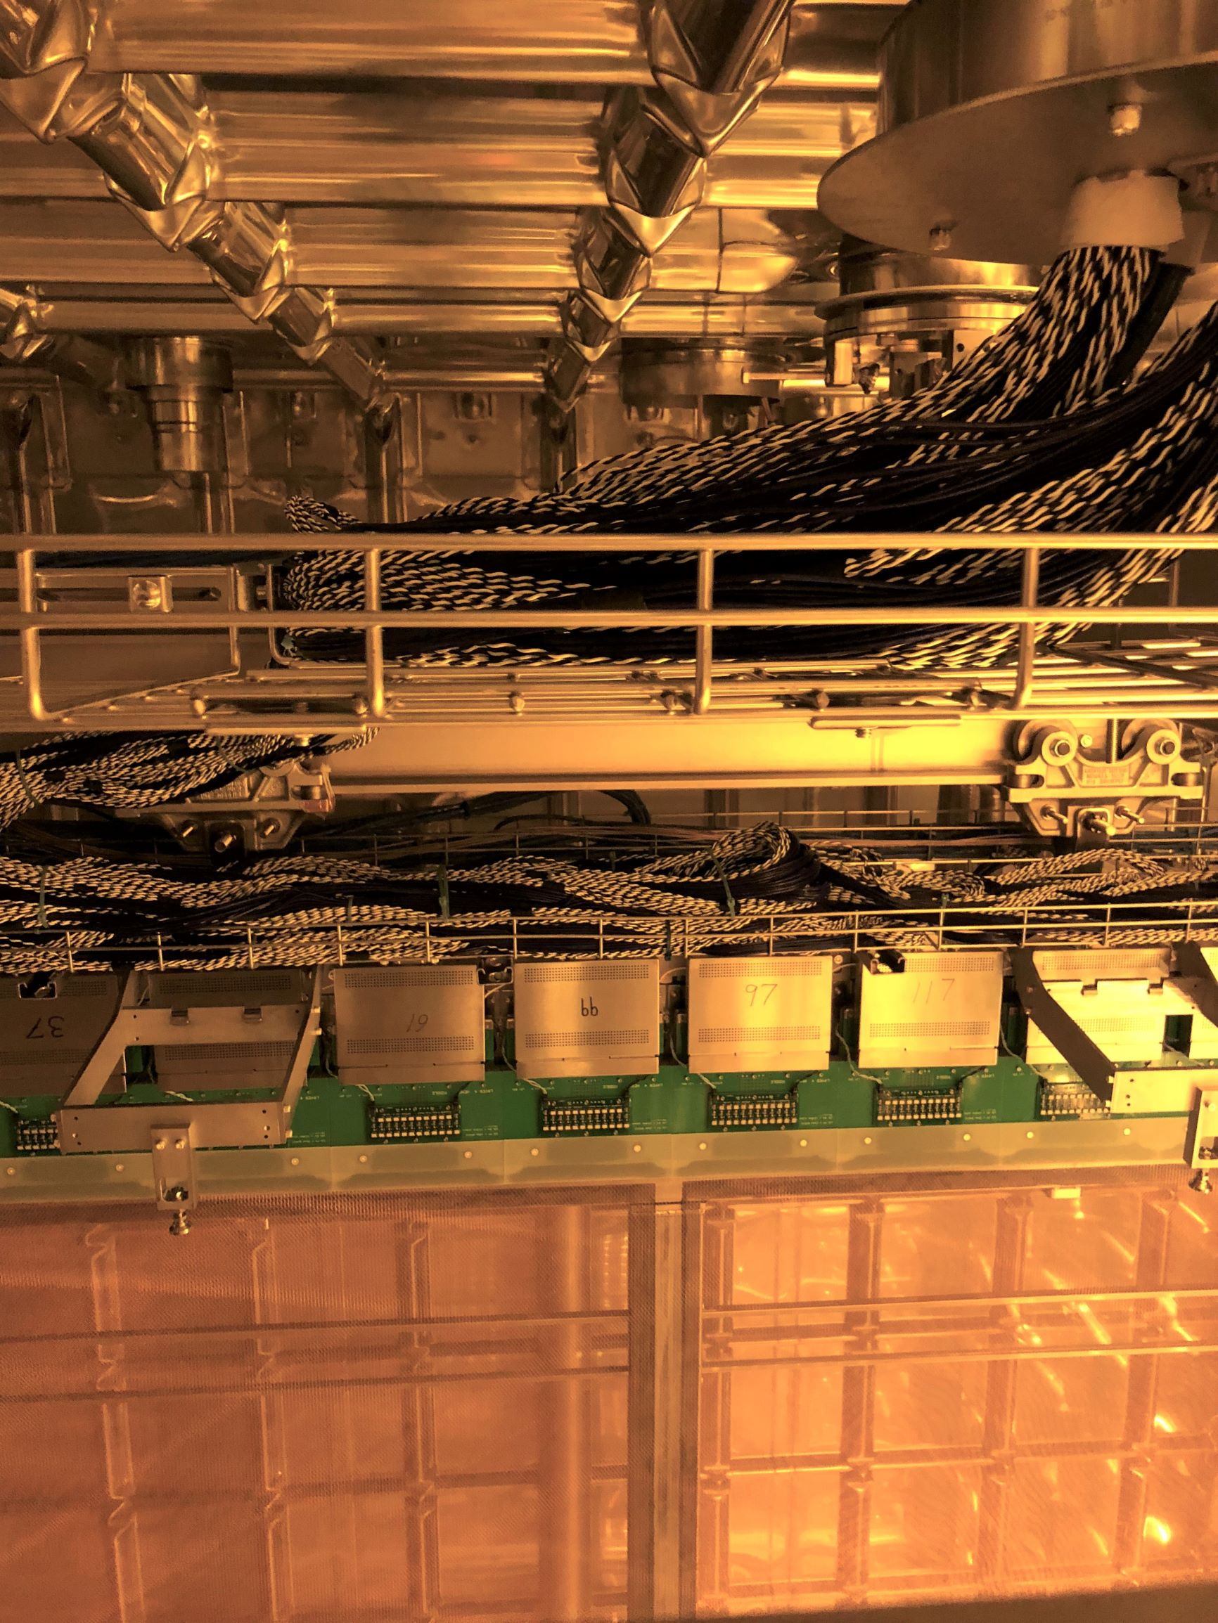
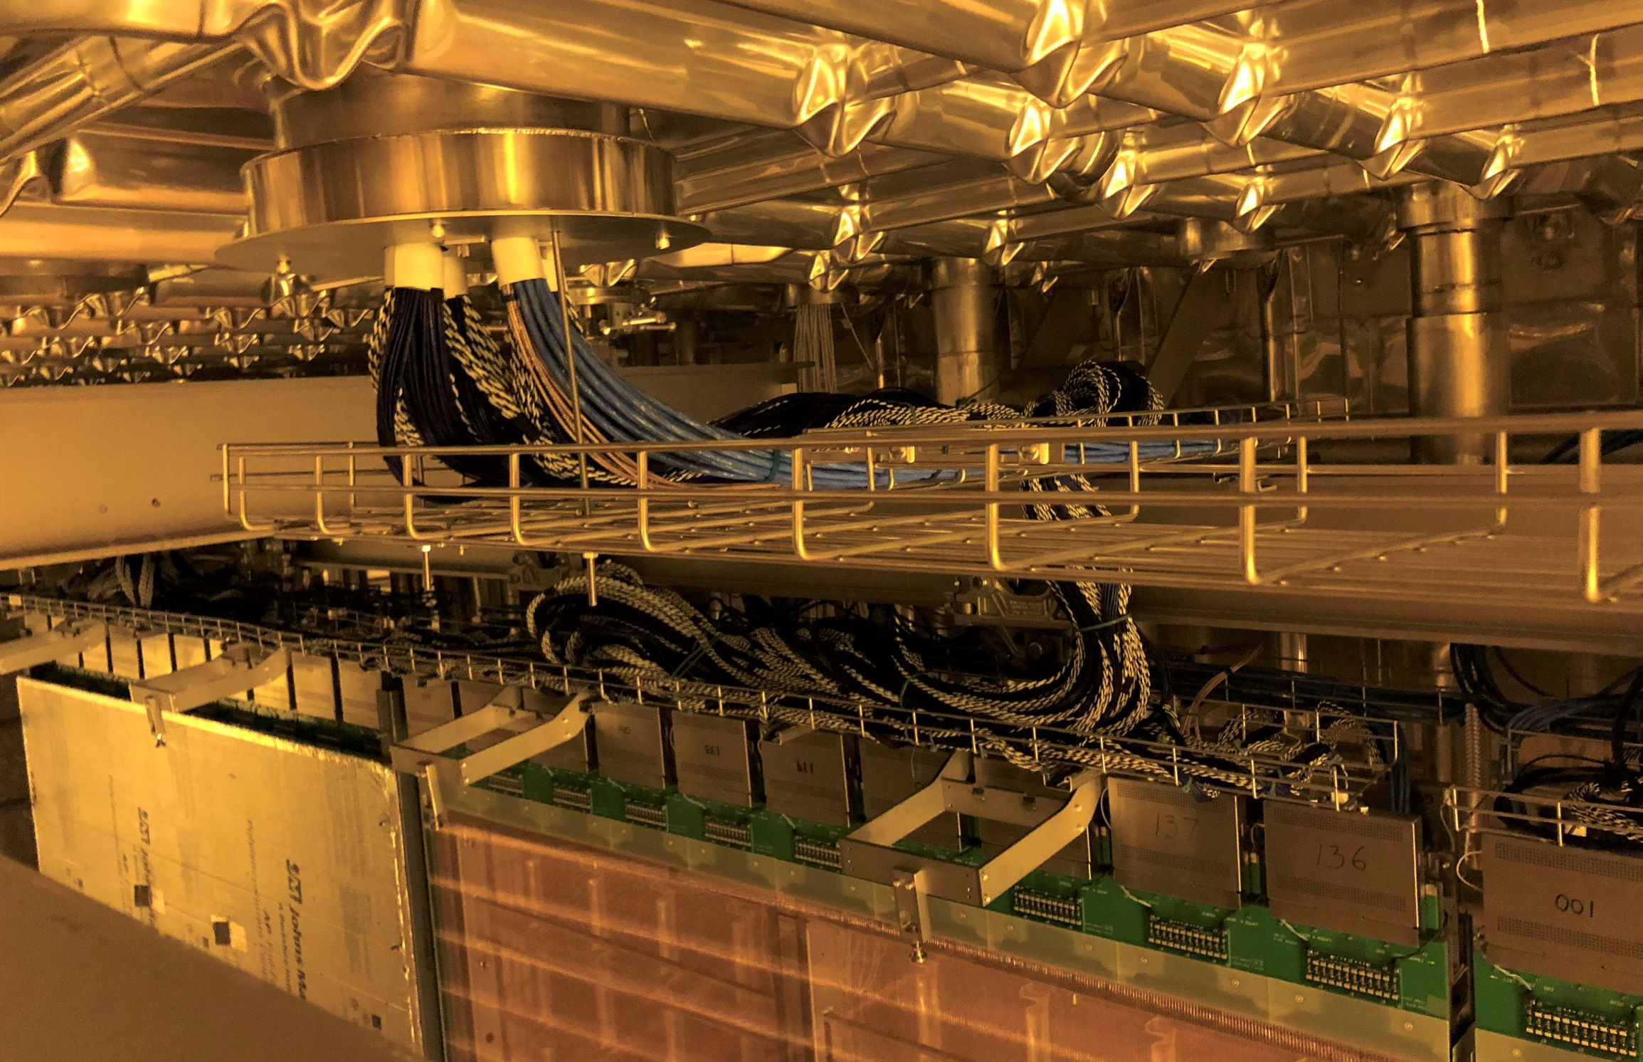
Phase 1-FY20 TPC Assembly Procedures
Now that APA pair panels are in place CE cables are run in the feed thru and tested
Then the Field Cages are deployed

Slide 22
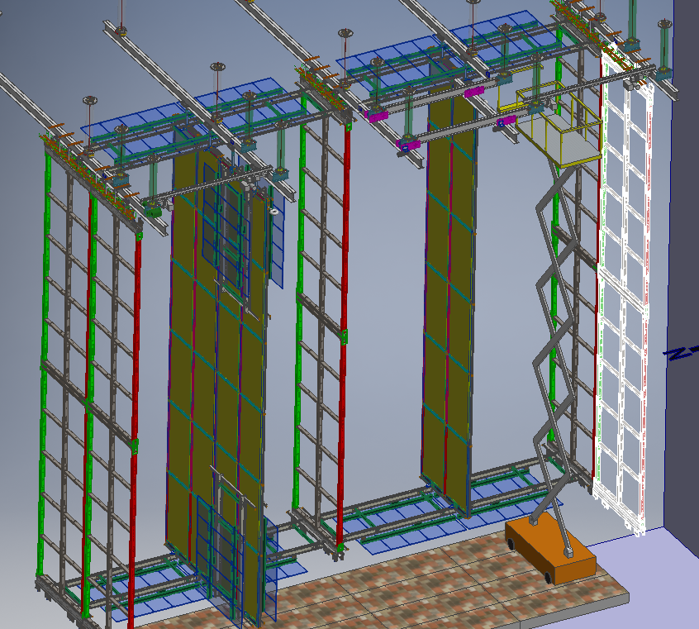
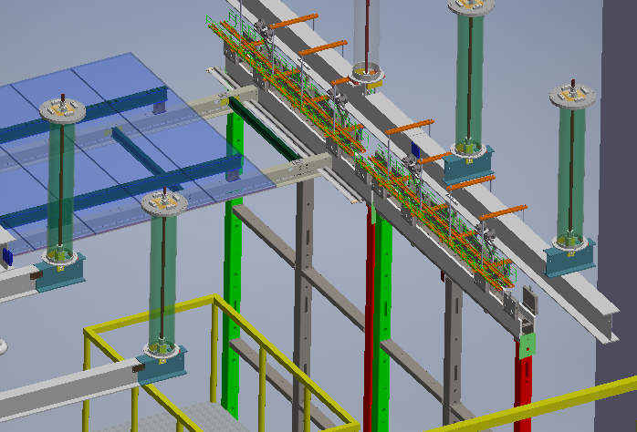
Phase 1-FY20 closing up the TCO
Placing the 25th row of TPC components and removing the runway beams while leaving enough room for closing the TCO (Temporary Construction Opening) will be difficult and needs to be tested
Shuttle Beam is then Permanently Mounted
Runway Beams are Removed

Slide 23
Phase 2- FY21 Cryostat Deck Summary
Support beams for Cryostat Deck roof should be flush with loading dock floor, decking should be open grating to eliminate a need for changes to the sprinkler system
Mock up feed-thru for both, DSS installation, APA cabling and DP trial assembly
Gives additional flexibility to do a full test of TPC assembly now possible including time and motion studies.

Slide 24
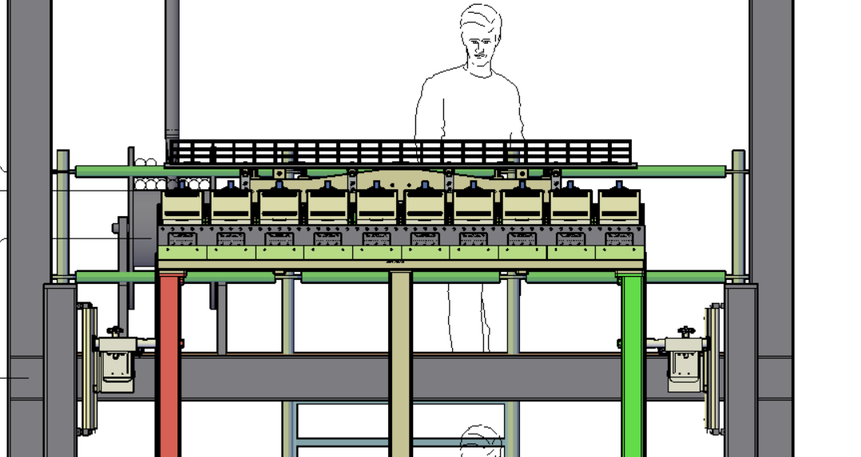
Remaining Trial Assembly Issues-Phase 0
Phase 0: Likely will not start tower construction until late March
Finish the tower design so it can go our for Design Build Bid: (~2 months behind)
Once we have Design/assembly drawings submit to code officials to get building permit approved (~1 month)
Write documentation for procedures for first steps of phase 0, get approved by Jean Cranston (University Safety) and FNAL Safety (Mike Andrews) this includes all components APA design and structural documentation
Need design for CPA assembly to add attachments to tower design- Can we design CPA so we have access to most of the back of the CPA pairs? Horizontal beams for attachment.
Getting elevations of the APA horizontal beams correct

Slide 25
Trial Assembly Issues-Phase1-2
Other open to be questions-Phase 1 & 2:
Do we mock up cryostat floor and sub-floor? (may need this to really try scissor lift and test access)
Do we want/need a floor (phase 2) with feed thrus so we can fully test APA cabling?
Trying to design this so we can be flexible over the next year as designs mature.
Need design for APA lifting fixtures
Need design for CPA tower

