Slide 1
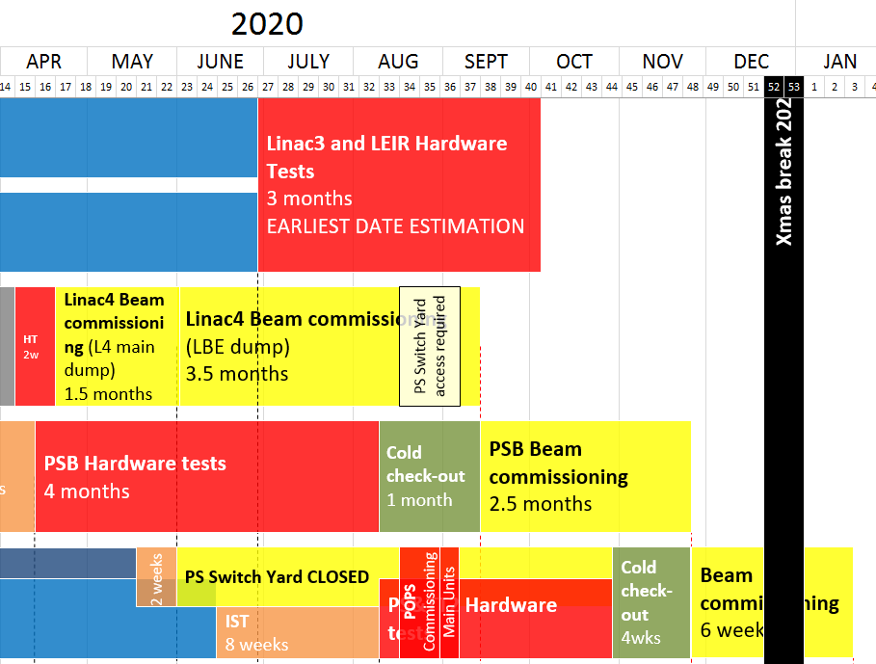
LS2 Master Schedule v.1.4 (In Work)

