Slide 1

Field Quality Analysis
in the HTS Dipole Insert-Magnet Feather M2
with the Finite Element Method
09-12 July 2019
L. Bortot^{1,2}, M. Mentink¹, C. Petrone¹,
S. Schöps², J. Van Nugteren¹, A. Verweij¹

Slide 2
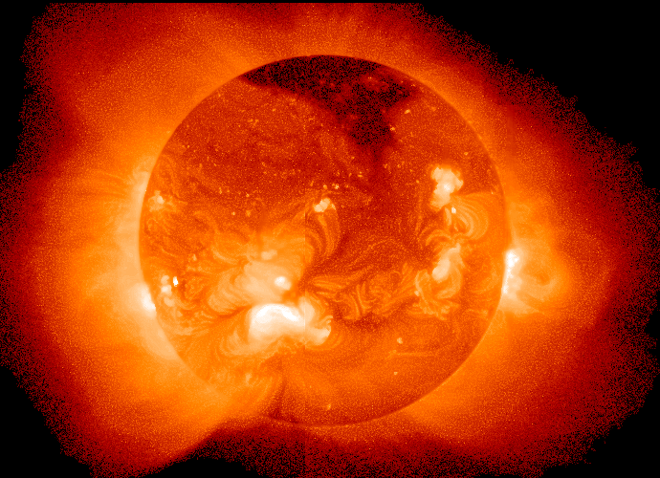
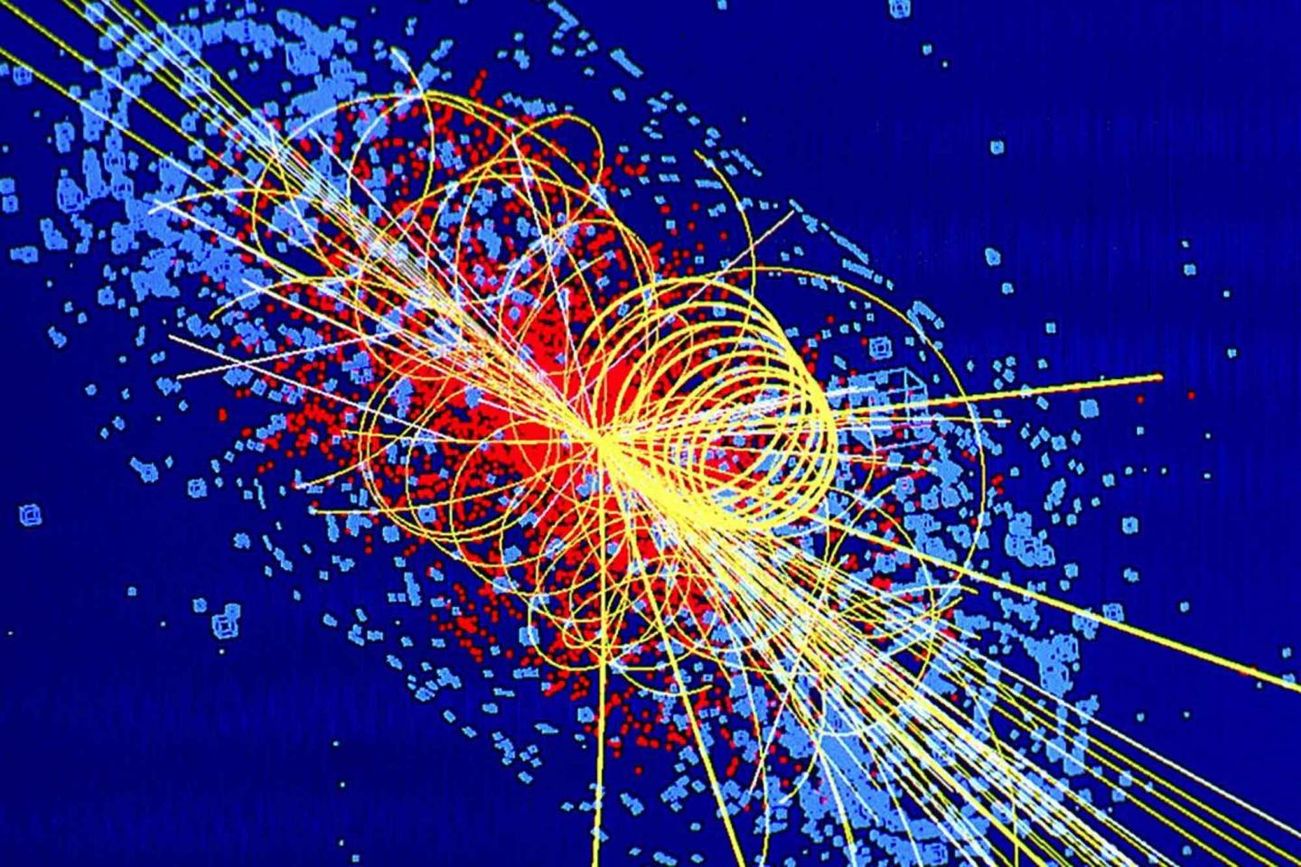

High-Temperature Superconductors
Cuprate compounds (CuO₂) doped with rare earth elements (La, Bi-Sr-Ca, Y-Ga-Ba …)
Higher Tc and Bc0 respect to the traditional low-temperature superconductors (LTS)
Higher performance comes with higher prices! $\$_{HTS}≈{1e}^{2} \$_{LTS}$
.. But in the early 2000s it was $≈{1e}^{3}$

Slide 3
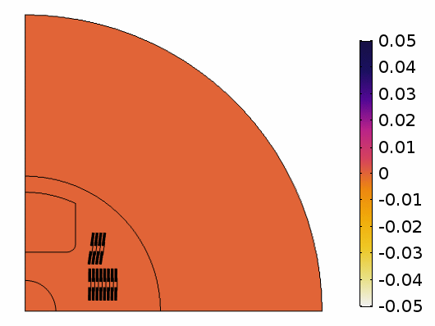


Outline
Introduction
Motivation
Formulation
Verification
Theoretical references
Validation
Measurements from Feather2
Summary and Outlook
$$i(A)$$
$$t(s)$$
B(T)
Feather2 magnet: net magnetic flux density contribution due to screening currents (first quadrant)
Notes:
From Oberkampf book:
[…].veriﬁcation can simply be described as “solving the equations right” and validation as “solving the right equations.”

Slide 4
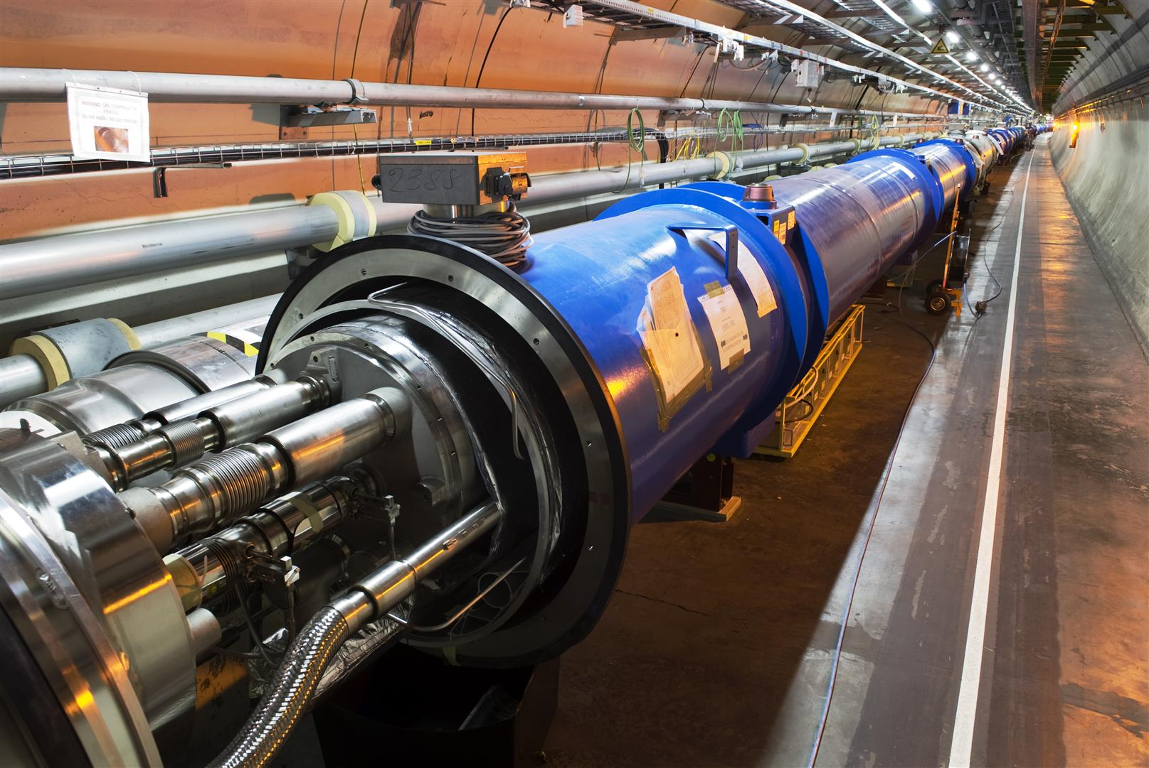








Introduction: Field Quality
Magnet aperture $Ω_{a}$
2D magnetostatic field $∇^{2}A_{z}=0$
General Solution: Fourier expansion series
$$B_{r}\left(r,φ\right)=\sum_{n=1}^{∞}{{nr}^{n−1}}γ_{n}cos⁡(nφ) +{nr}^{n−1}δ_{n}sin(nφ)$$
$A_{n}(r)$, $B_{n}(r)$ live on boundary $Γ_{a}$
skew and normal magnetic field multipoles
Determined by measurements (rotating coil)
Distortion Factor (metrics for field quality)
$$F_{d,1}\left(r_{0}\right)=\frac{1}{B_{1}(r_{0})}\sqrt{\sum_{n=2}^{k}{\left[{A_{n}(r_{0})}^{2}+{B_{n}(r_{0})}^{2}\right]}}$$
$A_{n}(r)$
$B_{n}(r)$
The LHC
$$Ω_{a}$$
$$φ$$
$$r_{0}$$
$$r$$
$$Γ_{a}$$
Cross section of the beam pipe
Notes:
Add field harmonics plot.

Slide 5
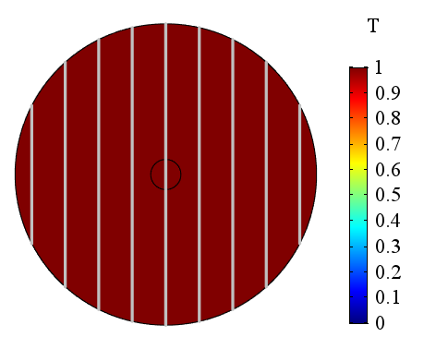
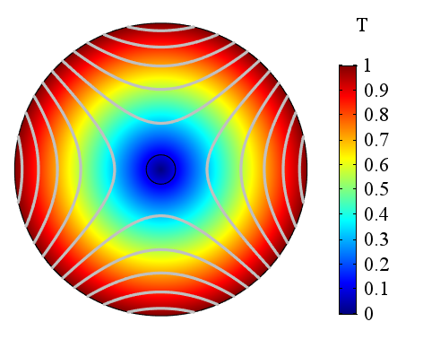
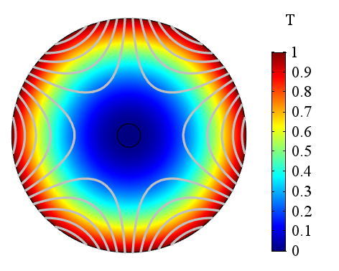
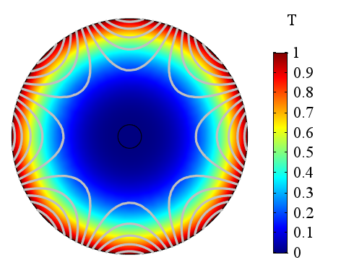
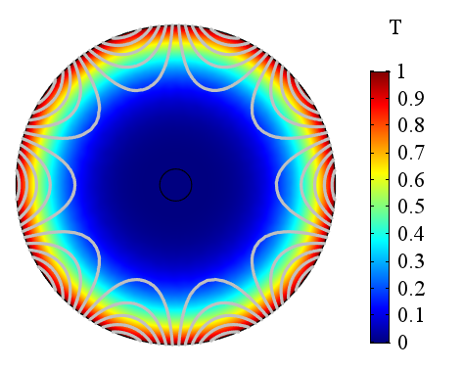
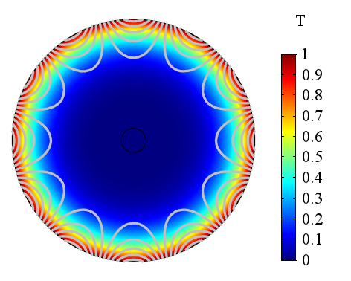

Introduction: Field Multipoles
Normal field multipoles for the reference circumference $r_{0}=1 m$
B₁ dipole
B₂ quadrupole
B₃ sextupole
B₄ octupole
B₅ decapole
B₆ dodecapole

Slide 6







Introduction: Screening (Eddy) Currents
ReBCO tape in an external magnetic density $\vec{B}$:
Magnetic field variation $∂_{t}\vec{B}$: → Screening currents ${\vec{j}}_{screen}$
$ρ→0$ → Persistent magnetization ${\vec{B}}_{screen}$
Large filament size (4~12 mm), significant persistent magnetization:
Field quality, especially at low field
Thermal behavior, principal Joule loss contribution
■ Copper ■ ReBCO ■ Substrate
$$∂_{t}\vec{B}$$
$${\vec{B}}_{screen}$$
$$\sim mm$$
$$\sim μm$$
$${\vec{J}}_{screen}$$
$ρ→0$

Slide 7
Motivation
Design of future HTS magnets for accelerators
Screening currents dynamics shall be taken into account
Field error due to screening currents shall be corrected, especially at low field
A code with this purpose shall be:
Numerically stable
Scalable to accelerator magnets
Validated, reliable, maintainable
Optionally:
Capable of field-circuit coupling
Efficient
Our contribution
Investigation and extension of a suitable field formulation
Implementation in a proprietary software (*), using the Finite Element Method
Scaling of the field formulation to an HTS magnet (Feather2)
(*) COMSOL Multiphysics® v. 5.3. www.comsol.com. Last access: 01/07/2019

Slide 8
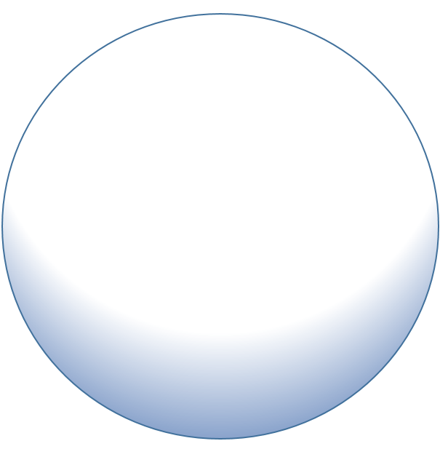
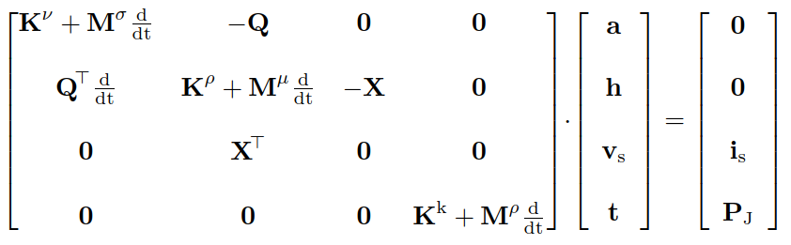







Formulation: 1) Mixed Fields
Mixed potentials
Domain decomposition
$\vec{A}$ solved in $Ω_{A}$ (air, iron), where $σ→0$
$\vec{H}$ solved in $Ω_{H}$ (conductors), where $ρ→0$:
T soved everywhere
Discrete weak formulation:
Finite material properties → bounded condition number → Numerical stability
$$\vec{A}→Ω_{A},ℝ^{3}$$
$$−$$
$$\vec{H}→Ω_{H},ℝ^{3}$$
$$v_{s}$$
$$+$$
$$i_{s}$$
Ampere-Maxwell
Faraday
Heat Balance
Field coupling
Circuit coupling

Slide 9

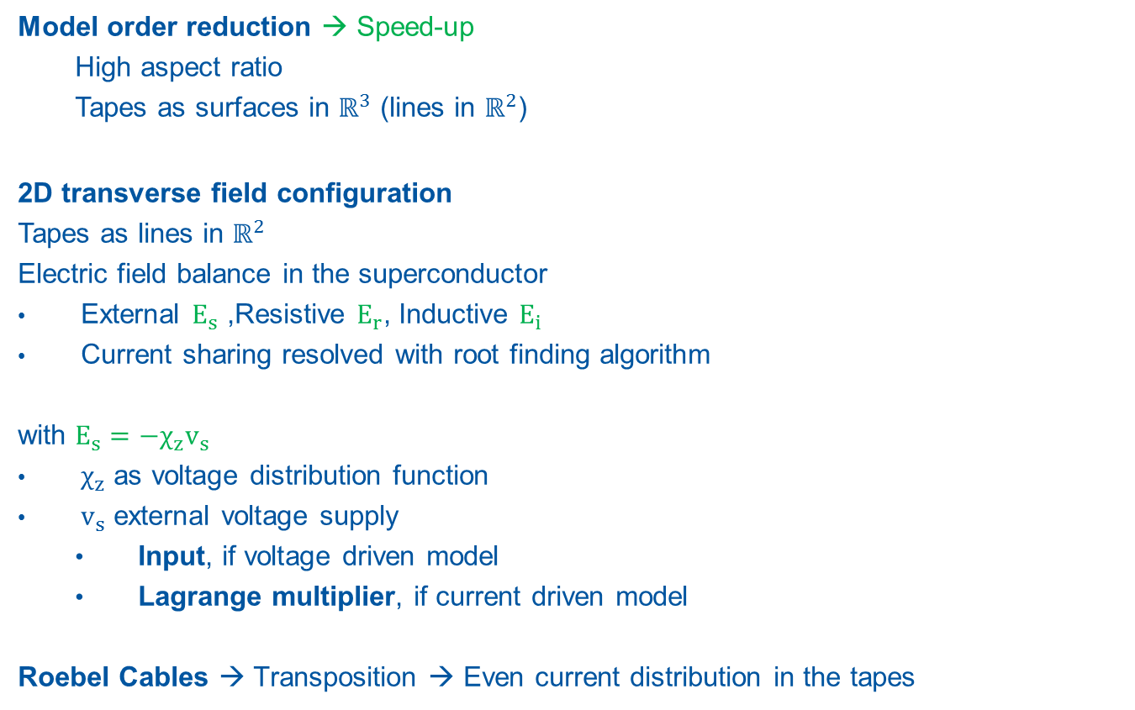







Formulation: 2) Model Order Reduction
$$−$$
$$−$$
Model order reduction → Speed-up
  High aspect ratio
  Tapes as surfaces in $ℝ^{3}$ (lines in $ℝ^{2}$)
2D transverse field configuration
Tapes as lines in $ℝ^{2}$
Electric field balance in the superconductor
External $E_{s}$ ,Resistive $E_{r}$, Inductive $E_{i}$
Current sharing resolved with root finding algorithm
with $E_{s}=−χ_{z}v_{s}$
$χ_{z}$ as voltage distribution function
$v_{s}$ external voltage supply
  Input, if voltage driven model
  Lagrange multiplier, if current driven model
Roebel Cables → Transposition → Even current distribution in the tapes
$$\vec{H}→Ω_{H},ℝ^{3}$$
$$\vec{H}→Γ_{H},ℝ^{2}$$
$$+$$
$$+$$
Model order reduction
$Ω_{A}$ : air
$Γ_{H}$ : coil
$$ρ=\frac{E_{c}}{J_{c}}{\left(\frac{J}{J_{c}}\right)}^{n−1}$$

Slide 10
Outline
Introduction
Motivation
Formulation
Verification
Theoretical references
    Critical State (Bean) Model
    Skin Effect
    Field Dependency
Validation
Summary and Outlook
Notes:
Some of the verifications.
Mention Current dependency, PEC behavior, comparison with other formulations..

Slide 11




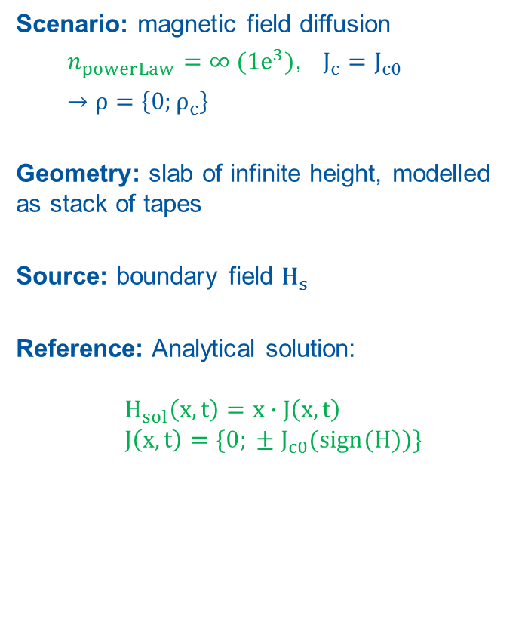


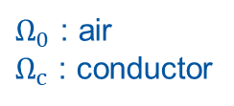





Verification – 1. Critical State (Bean) Model
Scenario: magnetic field diffusion
  $n_{powerLaw}=∞ ({1e}^{3})$, $J_{c}=J_{c0}$
  $→ρ=$ $\left\{0;ρ_{c}\right\}$
Geometry: slab of infinite height, modelled as stack of tapes
Source: boundary field $H_{s}$
Reference: Analytical solution:
$H_{sol}\left(x,t\right)=x∙J\left(x,t\right)$
$J\left(x,t\right)=\{0; ± J_{c0}(sign(H))\}$
$$Ω_{0}$$
$$Ω_{c}$$
$$Ω_{0}$$
$$H_{s}$$
$$H_{sol}$$
$$H_{s}$$
$$y$$
$$z$$
$$x$$
$Ω_{0}$ : air
$Ω_{c}$ : conductor
Computational domain
$$H_{s}$$
$$t$$
Source term

Slide 12
Verification – 1. Critical State (Bean) Model
Numerical Solution: magnetic field diffusion
time
B (T)
J/J_{c} (-)
x (mm)
x (mm)
x (mm)
x (mm)
Magnetic flux density and normalized current density distribution
→ Distributions consistent with theory

Slide 13


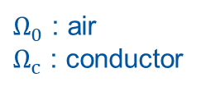

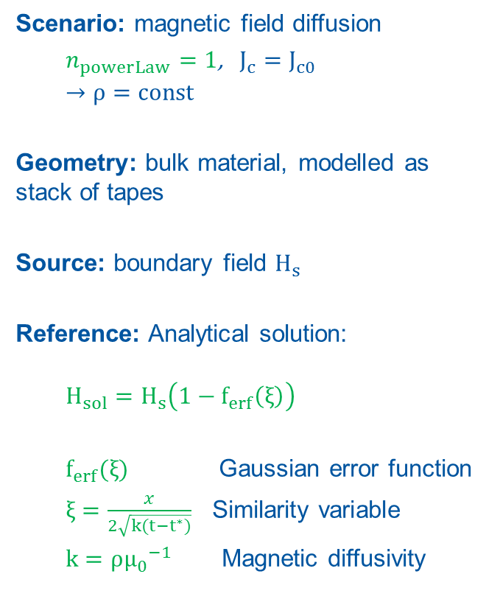







Verification – 2. Skin Effect
Scenario: magnetic field diffusion
  $n_{powerLaw}=1$, $J_{c}=J_{c0}$
  $$→ρ=const$$
Geometry: bulk material, modelled as stack of tapes
Source: boundary field $H_{s}$
Reference: Analytical solution:
  $$H_{sol}=H_{s}\left(1−f_{erf}\left(ξ\right)\right)$$
  $f_{erf}(ξ)$ Gaussian error function
  $ξ=\frac{x}{2\sqrt{k(t−t^{∗})}}$ Similarity variable
  $k=ρ{μ_{0}}^{−1}$ Magnetic diffusivity
$$Ω_{0}$$
$$Ω_{c}$$
$$H_{s}$$
$$H_{sol}$$
$$y$$
$Ω_{0}$ : air
$Ω_{c}$ : conductor
$$z$$
$$x$$
Computational domain
$$H_{s}$$
$$t^{∗}=0$$
$$t$$
Source term

Slide 14
Verification – 2. Skin Effect
Numerical Solution: magnetic field diffusion
Magnetic flux density distribution
in the conductive slab
Magnetic flux density distribution
at x=1 mm, as function of time: numerical solution (sol) and analytical solution (ref)
→ Consistent with theory [6]

Slide 15





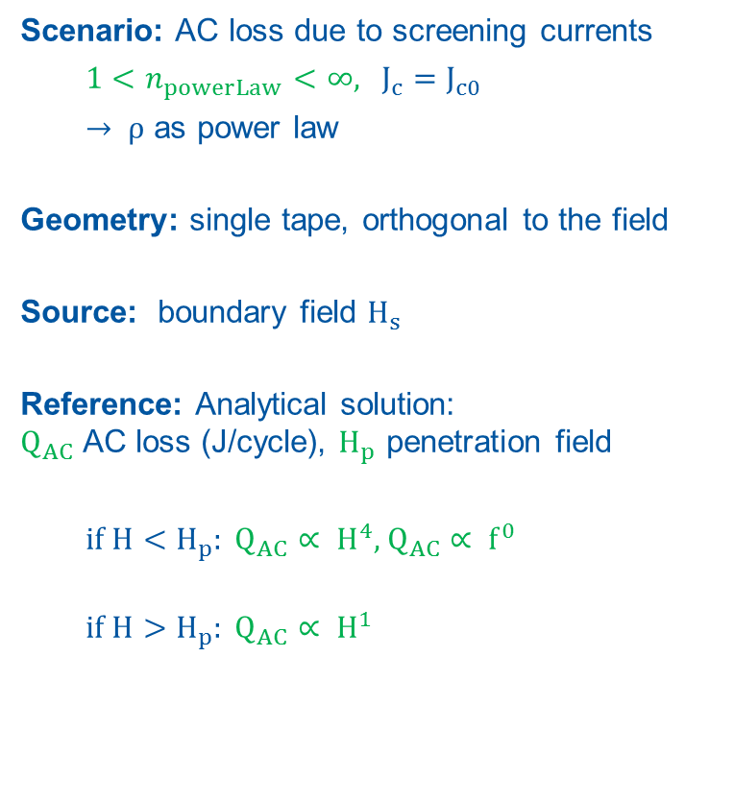



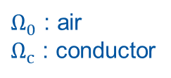

Verification – 3. Field Dependency
Scenario: AC loss due to screening currents
  $1<n_{powerLaw}<$ $∞$, $J_{c}=J_{c0}$
  $→ ρ$ as power law
Geometry: single tape, orthogonal to the field
Source: boundary field $H_{s}$
Reference: Analytical solution:
$Q_{AC}$ AC loss (J/cycle), $H_{p}$ penetration field
  if $H<H_{p}: Q_{AC}∝ H^{4}$, $Q_{AC}∝ f^{0}$
  if $H>H_{p}: Q_{AC}∝ H^{1}$
$$Ω_{0}$$
$$H_{s}$$
$$y$$
$$Ω_{c}$$
$$Q_{AC}$$
$Ω_{0}$ : air
$Ω_{c}$ : conductor
$$z$$
$$x$$
Computational domain
$$H_{s}$$
$$t$$
Source term

Slide 16

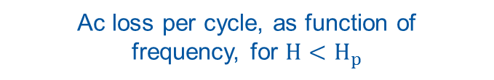


Verification – 3. Field Dependency
Numerical Solution: AC loss due to screening currents
$$∝H^{1}$$
$$∝H^{4}$$
$$∝f^{0}$$
Ac loss per cycle, as function
of the applied field
Ac loss per cycle, as function of
frequency, for $H<H_{p}$
→ Consistent with theory
Notes:
Meissner is reversible. Losses per cycle are always zero

Slide 17
Outline
Introduction
Motivation
Formulation
Verification
Validation
Crosscheck and Benchmark
Measurements on Feather2: Field quality assessment
    Magnetic Field Quality
    Screening Current Effects
Summary and Outlook

Slide 18

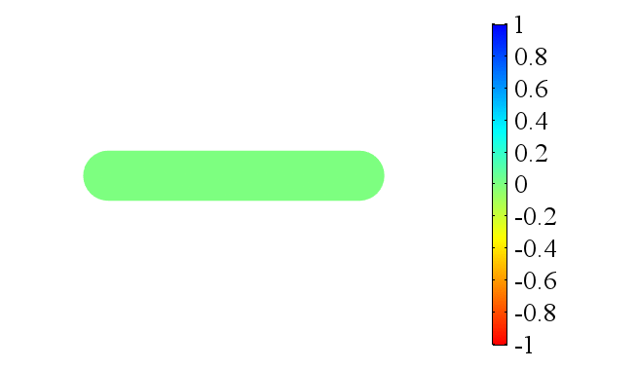

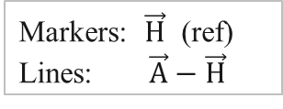

Crosscheck
Reference model based on the $\vec{H}$ formulation,
available at http://www.htsmodelling.com
2D model of a Single HTS tape in self-field
Source: $I_{s}=I_{0}sin(2πft)$, $I_{0}=2I_{crit}$ $t∈[0;1]$
1 Hz
10 Hz
100 Hz
1000 Hz
Markers: $\vec{H}$ (ref)
Lines: $\vec{A}−\vec{H}$
$\frac{J}{J_{crit}}$

Slide 19

Benchmark
Forecasts on expected computational time:
Same physics…
1 tape
8 h
5 tapes
10 tapes
Increased computational cost
CPU: Intel Core i7-3770 @ 3.40GHz. RAM: 32 Gb. OS: Win 10

Slide 20
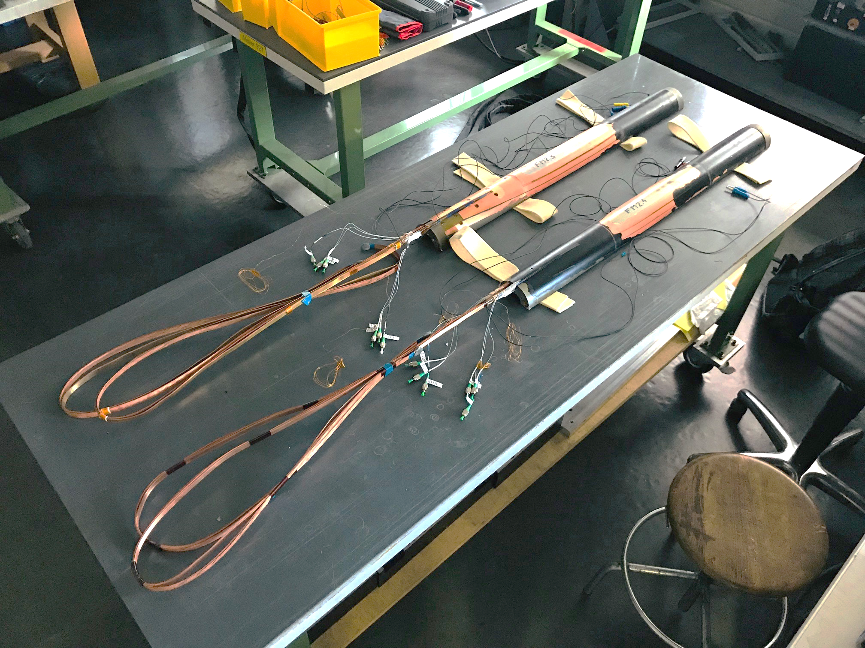
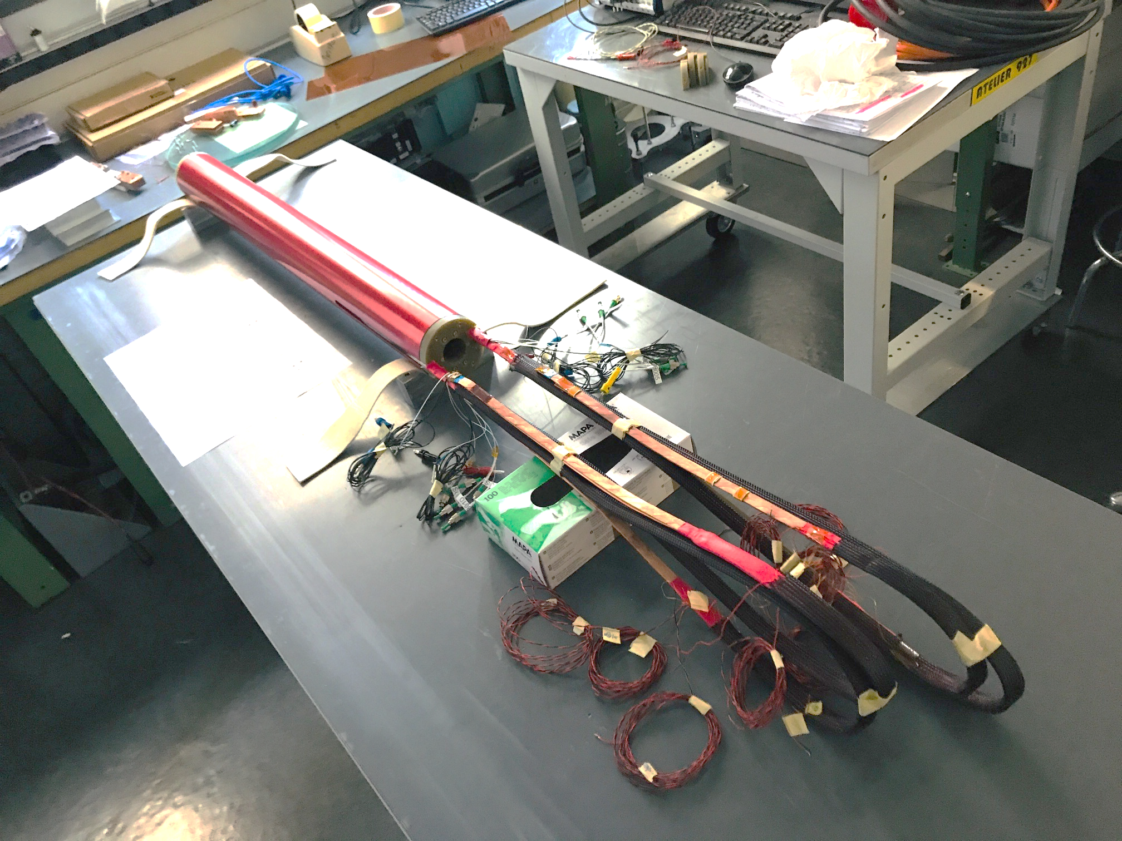
Feather2 Dipole Insert Magnet
Central and wing decks,
for upper and lower coils
External support cylinder
Current leads
Courtesy of J. Van Nugteren

Slide 21

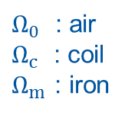

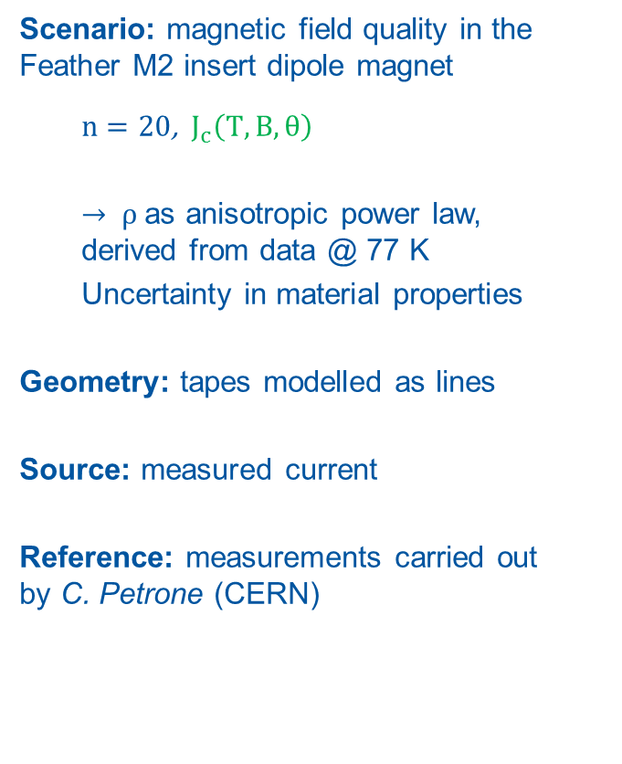





Measurements on Feather2
Scenario: magnetic field quality in the Feather M2 insert dipole magnet
  $n=20$, $J_{c}\left(T,B,θ\right)$
  $→ ρ$ as anisotropic power law,
  derived from data @ 77 K
  Uncertainty in material properties
Geometry: tapes modelled as lines
Source: measured current
Reference: measurements carried out
by C. Petrone (CERN)
$$Ω_{m}$$
$$Ω_{c}$$
$$Ω_{0}$$
$$Ω_{c}$$
$$y$$
$Ω_{0}$ : air
$Ω_{c}$ : coil
$Ω_{m}$ : iron
$$z$$
$$x$$
Computational domain

Slide 22


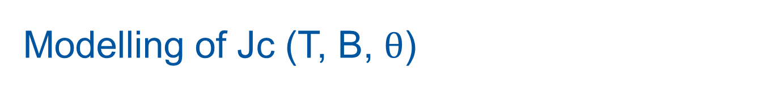


Modelling of Jc (T, B, $θ$)
$J_{c}$ available only for $T=77 K$ $→$ Need for a lift factor
Calibrated with the measured critical current $I_{c}$
Gauged with $θ=30\text{°}$ (magnetostatic simulation)
$$\vec{n}$$
$$\vec{B}$$
$$θ$$
→ Anisotropy included in the model, but uncertainty on material properties

Slide 23
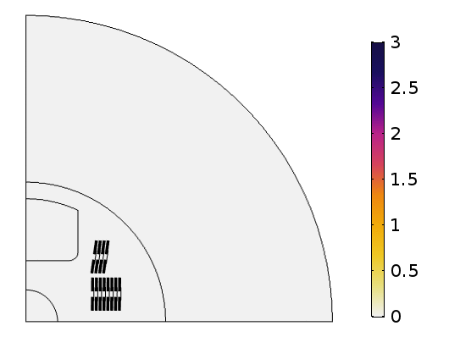



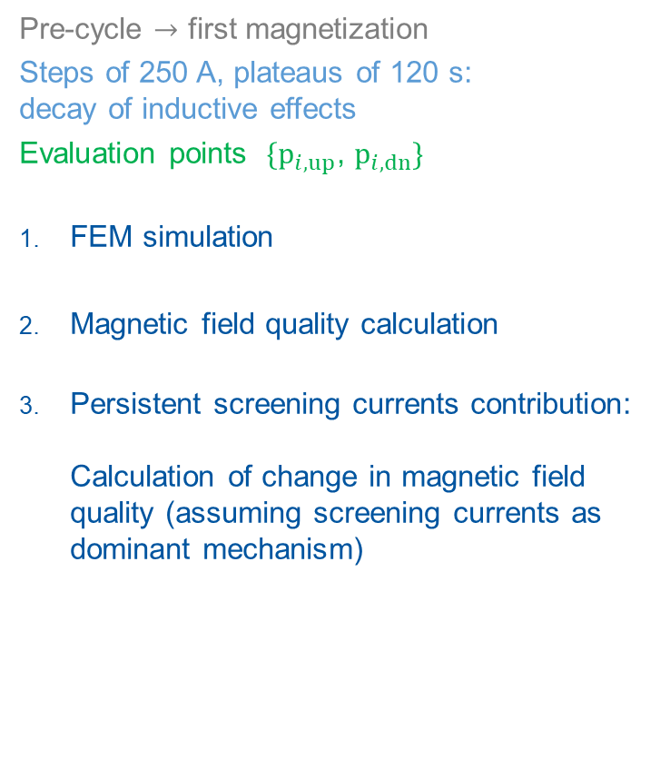
Field Quality Assessment
Pre-cycle $→$ first magnetization
Steps of 250 A, plateaus of 120 s:
decay of inductive effects
Evaluation points $\{p_{i, up}$, $p_{i, dn}\}$
FEM simulation
Magnetic field quality calculation
Persistent screening currents contribution:
Calculation of change in magnetic field quality (assuming screening currents as dominant mechanism)
$$p_{i, up}$$
$$p_{i, dn}$$
B(T)
Total magnetic flux density (T),
1 quadrant

Slide 24
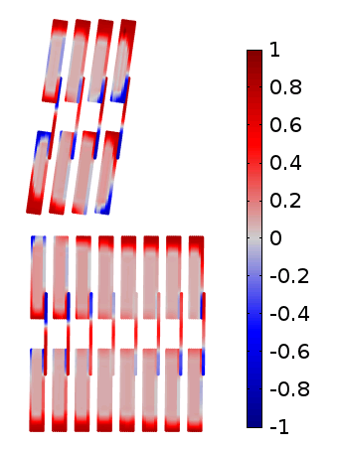
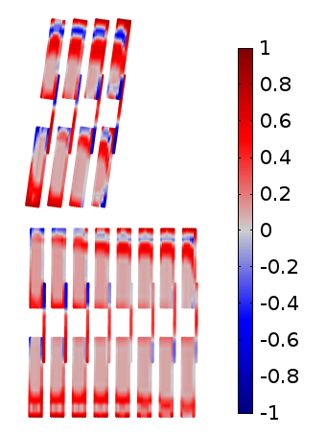
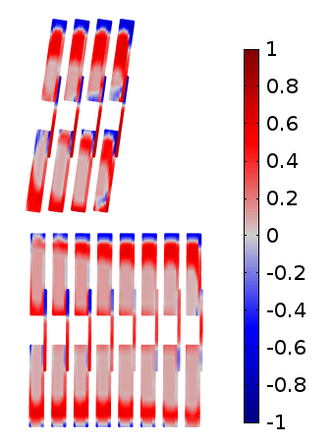



Results – FEM Simulation
Current density distribution in the coil:
Same external current, different time steps
Computational time: 120k DoF, 0.9 h (*)
$$i (A)$$
$$i^{∗}$$
a)
b)
c)
$$t (s)$$
J/J_{c} (-)
J/J_{c} (-)
J/J_{c} (-)
a)
b)
c)
Normalized current density in the coil, shown for the first quadrant
(*) CPU: Intel Core i7-3770 @ 3.40GHz. RAM: 32 Gb. OS: Win 10
Notes:
Influence of screening currents

Slide 25

Validation – 4. Magnetic Field Quality
Measurement
Simulation
$b_{i}$ field multipoles, as function of the normalized staircase time
B_{1 (T)}
4.5 K
25.0 K
68.0 K
b_{3 (units)}
b_{5 (units)}
t (s)
t (s)
t (s)
→ Very good agreement with measurements
Notes:
Multipoles dominated by geometry and iron errors.
High multipoles due to the non optimized iron yoke (magnet is an insert)
Multipoles minimized for operational conditions in background field
Screening currents only small contribution

Slide 26

Validation – 5. Screening Currents
Measurement
Simulation
$∆b_{i}$ field multipole variations, as function of current (in kA)
B_{1 (T)}
4.5 K
25.0 K
68.0 K
b_{3 (units)}
b_{5 (units)}
kA
kA
kA
→ Good agreement with measurements, considering uncertainty in $J_{c}\left(T,B,θ\right)$

Slide 27
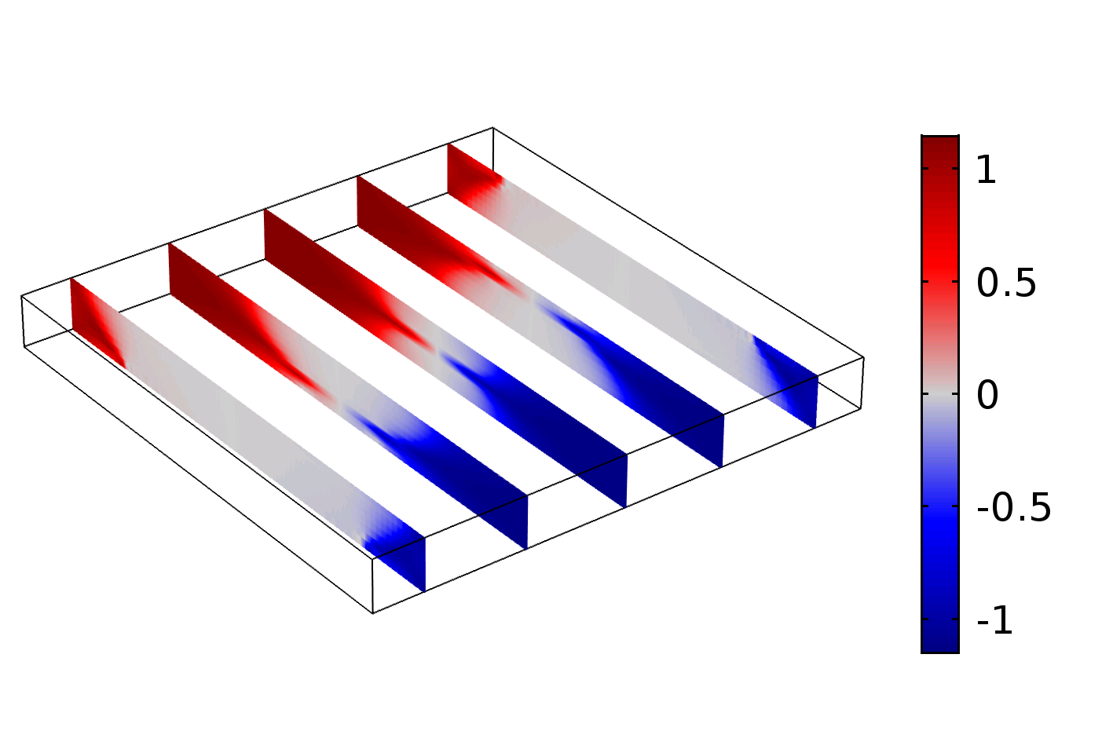
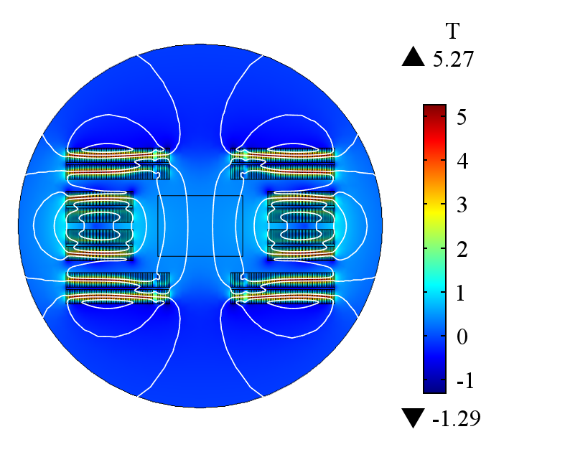
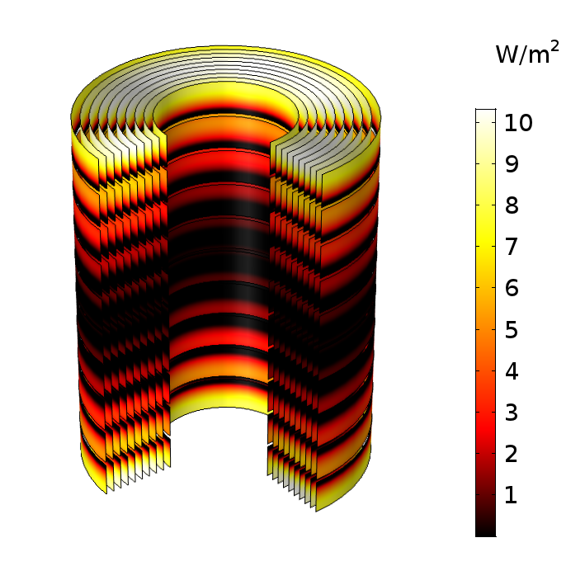

Summary and Outlook
Summary
$\vec{A}$-$\vec{H}$ weak formulation for FEM:
Excellent agreement with theory
Consistency with Feather2 measurements
Stable, scalable and fast (few hours for ~${10}^{4}$ tapes in 2D models)
Outlook
Include heat balance equation
Develop field-circuit coupling interface
Include the models in the STEAM co-simulation framework
Run field quality analysis and optimization
Run quench protection studies (e.g., Feather2 in FRESCA2)
Thank you for your attention!

Slide 28
References
Bíró, O. "Edge element formulations of eddy current problems." CMAM 169.3-4 (1999): 391-405.
Carpenter, C. J. "Comparison of alternative formulations of 3-dimensional magnetic-field and eddy-current problems at power frequencies." Proceedings of the Institution of Electrical Engineers. Vol. 124. No. 11. IET Digital Library, 1977.
Brambilla, R., Grilli, F., Martini, L., Bocchi, M., & Angeli, G. (2018). A finite-element method framework for modeling rotating machines with superconducting windings. IEEE Transactions on Applied Superconductivity, 28(5), 1-11.
Zhang, H., et al. "An efficient 3D finite element method model based on the T–A formulation for superconducting coated conductors.“ SuST, 30.2 (2016): 024005
Schöps, S., et al. "Winding functions in transient magnetoquasistatic field-circuit coupled simulations." COMPEL: The International Journal for Computation and Mathematics in Electrical and Electronic Engineering 32.6 (2013): 2063-2083
Russenschuck, S. Field computation for accelerator magnets: analytical and numerical methods for electromagnetic design and optimization. John Wiley & Sons, 2011.
Knoepfel, H. E., Magnetic fields: a comprehensive theoretical treatise for practical use. John Wiley & Sons, 2008
Brandt, E H., "Superconductors of finite thickness in a perpendicular magnetic field: Strips and slabs." Physical review B 54.6 (1996): 4246
Van Nugteren, J., et al. "Powering of an HTS dipole insert-magnet operated standalone in helium gas between 5 and 85 K." SuST 31.6 (2018): 065002.

Slide 30
Annex

Slide 31

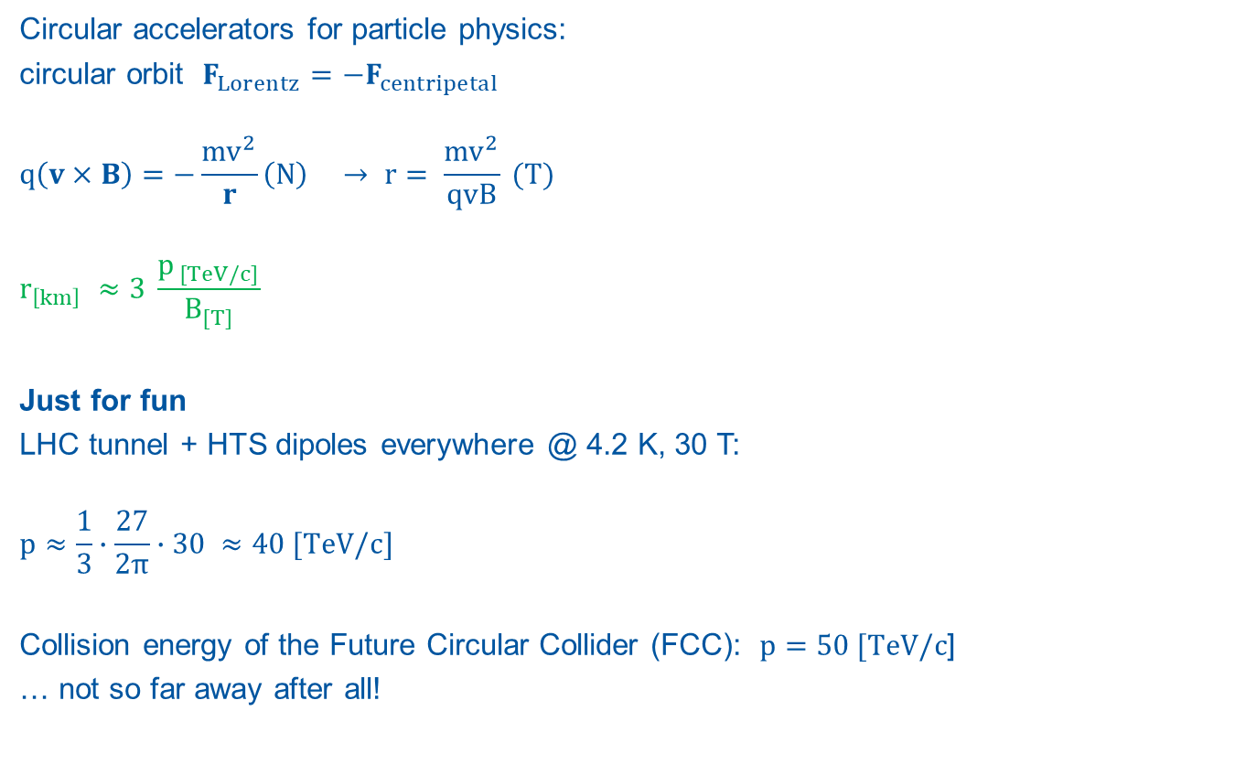



…Why HTS?
Circular accelerators for particle physics:
circular orbit $F_{Lorentz}=−F_{centripetal}$
$$q\left(v×B\right)=−\frac{mv^{2}}{r}\left(N\right) → r= \frac{mv^{2}}{qvB} (T)$$
$$r_{\left[km\right]} ≈3 \frac{p_{ [TeV/c]}}{B_{[T]}}$$
Just for fun
LHC tunnel + HTS dipoles everywhere @ 4.2 K, 30 T:
$$p≈\frac{1}{3}∙\frac{27}{2π}∙30 ≈40 [TeV/c]$$
Collision energy of the Future Circular Collider (FCC): $p=50 [TeV/c$]
… not so far away after all!
$$B_{y}$$
$$v_{z}$$
$$+q$$
$$F_{x}$$

Slide 32



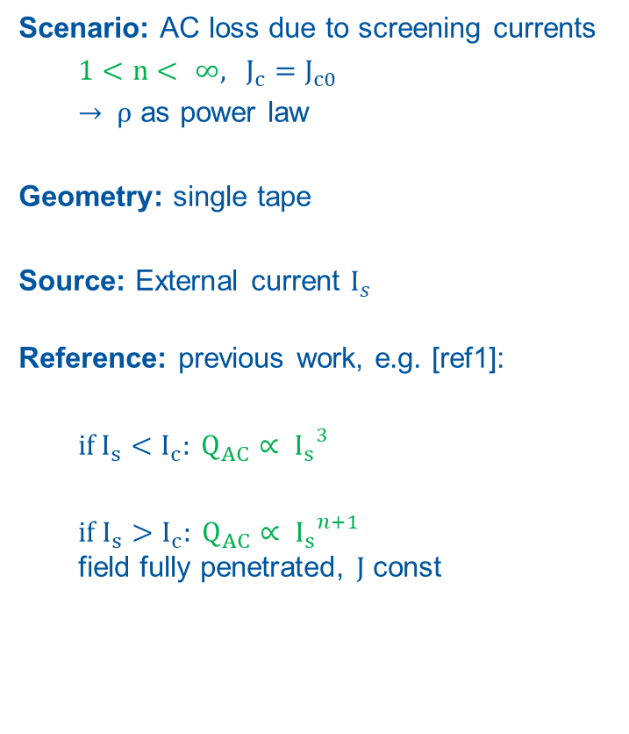




Verification – Current dependency
Scenario: AC loss due to screening currents
  $1<n< ∞$, $J_{c}=J_{c0}$
  $→ ρ$ as power law
Geometry: single tape
Source: External current $I_{s}$
Reference: previous work, e.g. [ref1]:
  if$I_{s}<I_{c}: Q_{AC}∝ {I_{s}}^{3}$
  if $I_{s}>I_{c}: Q_{AC}∝ {I_{s}}^{n+1}$
  field fully penetrated, $J$ const
$$Ω_{0}$$
$$Ω_{c}$$
$$Q_{AC}$$
$$I_{s}$$
$$y$$
$$z$$
$$x$$
$Ω_{0}$ : air
$Ω_{c}$ : conductor
Computational domain
$$I_{s}$$
$$t$$
Source term
[ref1] Grilli, F, et al. "Computation of Losses in HTS Under the Action of Varying Magnetic Fields and Currents." IEEE Transactions on Applied Superconductivity 24.1 (2014): 78-110.

Slide 33


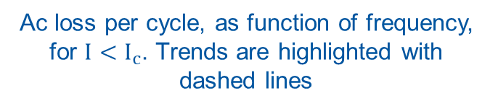


Verification – Current dependency
Solution of the transport + screening currents problem
$$∝I^{n+1}$$
$$I_{c}$$
$$∝I^{3}$$
$$∝f^{0}$$
$$I_{c}$$
Ac loss per cycle, as function of the applied current. Trends are highlighted with dashed lines
Ac loss per cycle, as function of frequency, for $I<I_{c}$. Trends are highlighted with dashed lines
→ Consistent with previous research

Slide 34

Magnetic field dynamics in superconductors
Type I: Meißner Effect
Thermodynamical state, reversible
London equation
  $∆\vec{B}−λ^{−2}\vec{B}=0$, if $B<B_{c1}$
Type II: Abrikosov fluxons
Flux pinning and motion, irreversible
Power-law (phenomenological)
  $$ρ\left(\vec{B},T\right)=\frac{E_{c}}{J_{c}(\vec{B},T)}{\left(\frac{J}{J_{c}(\vec{B},T)}\right)}^{n−1}$$
Faraday Law (eddy currents)
$∆\vec{H}−μρ^{−1}∂_{t}\vec{H}=0$
B
B-T Diagram
B_{c2}
Type II
B_{c1}
Type I
T_{c}
T

Slide 35











Formulation - Mixed potentials
$\vec{A}−\vec{H}$ formulation, weak form:
$Ω_{0}→$ Ampere-Maxwell Law
$Ω_{c}→$ Faraday Law
$Ω_{c}→$Constraint on transport current
$$\vec{A}→Ω_{0},ℝ^{3}$$
$$\vec{H}→Ω_{c},ℝ^{3}$$
$$−$$
$$v_{s}$$
$$+$$
$$i_{s}$$
$M_{ν}$ reluctance
$Q$ current
$M_{ρ}$ resistance
$M_{μ}$ flux
$X$ voltage
Advantages
$M_{ρ}\left(ρ\right)→$ finite conditon number
$\vec{A} →$ magnetostatic problem
Drawback
Weak form to be implemented

Slide 36

High-Temperature Superconductors
Cuprate compounds (CuO₂) doped with rare earth elements (La, Bi-Sr-Ca, Y-Ga-Ba …)
Higher Tc and Bc0 respect to the traditional LTS competitors
Higher performance comes with higher prices! $\$_{HTS}≈{1e}^{2} \$_{LTS}$
.. But in the early 2000s it was $≈{1e}^{3}$

Slide 37




Tapes and Cables
Tapes
ReBCO - Rare Earth Barium Copper Oxide tape
Batches of $\sim {10}^{2} m$ and beyond
Cost driven by production process
Features
Multi-layer, multi material
Aspect ratio ~${10}^{2}$ (tape), ~${10}^{3}$ (HTS layer)
HTS as anisotropic, nonlinear mono-filament $J_{c}(\overset{⃑}{B},T)$
AC losses: eddy currents
Cables
Roebel geometry (1912)
“Coil-able”, bended on the long edge
Fully transposed: even current distribution
Aligned-coil concept against AC losses
$$mm$$
$$μm$$
■ Copper ■ ReBCO ■Substrate
Source: CDS. Coiled Roebel cable (Henry Barnard, CERN).

Slide 38


Formulation - PEC Limit Behavior
$$∝f^{1}$$
$$∝f^{−1}$$
[1] Knoepfel, Heinz E. Magnetic fields: a comprehensive theoretical treatise for practical use. John Wiley & Sons, 2008.

Slide 39
Field multipoles without eddy currents
Staircase Scenario at 4.5 K
“Eddy” considers the HTS tape dynamics
“No Eddy” assumes a homogeneous current density in the tapes

Slide 40





Main Differences
Cable architecture:
LTS – filamentary compound
HTS – multi-layer tape
Resistivity $ρ$: power law
$$ρ=\frac{E_{c}}{J_{c}}{\left(\frac{J}{J_{c}}\right)}^{n−1}$$
$n_{LTS}≈40,n_{HTS}≈20$
$J_{c, HTS}$ anisotropic
CERNcourier.com
www.fujikura.co.uk
$$\vec{n}$$
$$\vec{B}$$
$$θ$$
$$J_{c}(T,B,θ)$$
Tape cross section

Slide 41

Formulations
Conductivity $σ−$ based:
$\vec{A}$: magnetic vector potential
  ill-conditioned mass-conductivity matrix ($∞$ condition number)
Resistivity $ρ−$ based:
$\vec{H}$: magnetic field strength
  $ρ≠0$ everywhere, unphysical eddy currents , computationally inefficient
$\vec{T}$-$Ω$: current vector potential-scalar magnetic potential
  cohomology basis functions for net currents in multiply connected domains
Mixed fields (from literature)
$\vec{A}$-$\vec{H}$: magnetic vector potential + magnetic field strength
Developed for 2D rotating machinery. Current driven, no external coupling
$\vec{T}$-$\vec{A}$: current vector potential + magnetic vector potential
Current driven, no external coupling, suitable only for slabs

