Slide 1
Strand-Jacket Contact thermal resistance measurement on dummy conductors
Rui Kang, Davide Uglietti, Changtao Kan
09.07.2019
Szczecin
Notes:
Dear all, now I’m going to share with you some effort we have made to estimate the contact thermal resistance between HTS strand and jacket. I have to say initially it was just an interest in our group to see if solder strand and jacket together can really decrease the thermal contact resistance a lot with a simple fast setup. As Monika told me some of you may also be interested in it, I made some more effort to make it a little bit more scientifically to discuss with you. If you find something you disagree, please feel free to point it out.

Slide 2






1. Motivation
Thermal contact resistance (H_{sj}) between strand and jacket is
$$Copper Profile$$
$$Strand$$
$${\dot{q}}_{sj}=\frac{T_{s}−T_{j}}{H_{sj}}$$
$H_{sj}$ is in Km/W
Strand
Soldered $HTS stack$
$${\dot{q}}_{sj}$$
Jacket
For modelling:
An important input parameter
Influenced by many factors: material type, roughness, temperature, contact area and pressure…
Difficult to estimate
Few relevant literatures can be found
For conductor design:
CS conductor has large cross section of steel, which dominates the heat capacity at temperature above 20 K
TCR decides how this huge heat capacity participates quench behavior of conductor
At least to know the magnitude.
Notes:
Some of you may be not familiar with our REBCO conductor. It is based on the twisted stacked tape cable concept. We use strand to represent the soldered REBCO stack and the copper profile outside. In our simulation model, as I will introduce to you on later, we assume the strand is a homogeneous element. In that case, the strand-jacket thermal resistance can be simplified as the thermal contact resistance of a copper rod and steel piece.
Why the thermal contact resistance is important?
It is an important input parameter for modelling, like in thea. However, it is difficult to estimate since it is influenced by many factors. On the other hand, few relevant literatures can be found. You can found a lot of publication discussing the TCR between two coppers or two steel, but between copper and steel? Hardly.
For us, another interest is for conductor design.
For us, it’s interesting to at least know the magnitude.

Slide 3

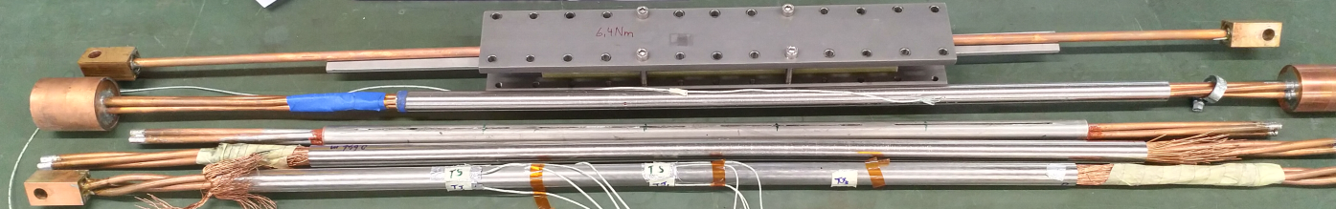
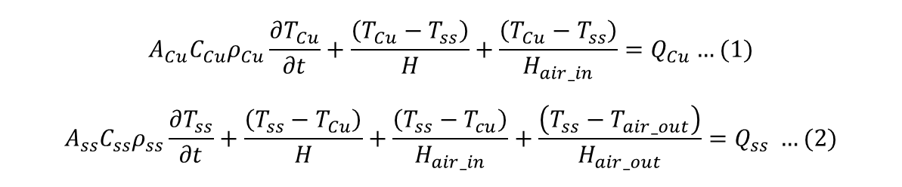
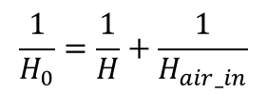
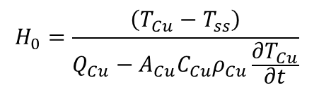
2. Method
The thermal equation can be descript with:
At 300 K, ρ_{ss}:ρ_{cu}~40
➔heat copper with current.
$$A_{Cu}C_{Cu}ρ_{Cu}\frac{∂T_{Cu}}{∂t}+\frac{\left(T_{Cu}−T_{ss}\right)}{H}+\frac{\left(T_{Cu}−T_{ss}\right)}{H_{air_in}}=Q_{Cu}…(1)$$
$$A_{ss}C_{ss}ρ_{ss}\frac{∂T_{ss}}{∂t}+\frac{\left(T_{ss}−T_{Cu}\right)}{H}+\frac{\left(T_{ss}−T_{cu}\right)}{H_{air_in}}+\frac{\left(T_{ss}−T_{air_out}\right)}{H_{air_out}}=Q_{ss} …(2)$$
$$\frac{1}{H_{0}}=\frac{1}{H}+\frac{1}{H_{air_in}}$$
$$H_{0}=\frac{\left(T_{Cu}−T_{ss}\right)}{Q_{Cu}−A_{Cu}C_{Cu}ρ_{Cu}\frac{∂T_{Cu}}{∂t}}$$
Introduce
Notes:
The measurement method is actually very simple. At room temperature, the electrical resistance of steel is about 40 times of copper. So we can use current to generate heat generation at copper. Then we can observe an obvious heat transfer from cooper to steel. According to the deposited heat, which can be easily calculated with resistance and current, and temperature difference, which is measured with thermal couples, we can then deduce the thermal resistance.
Here are some of the tested samples, which will be explained later. Another point is, the air at the void of a dummy conductor could also be a heat transfer media, so we should also find a way to subtract it.

Slide 4
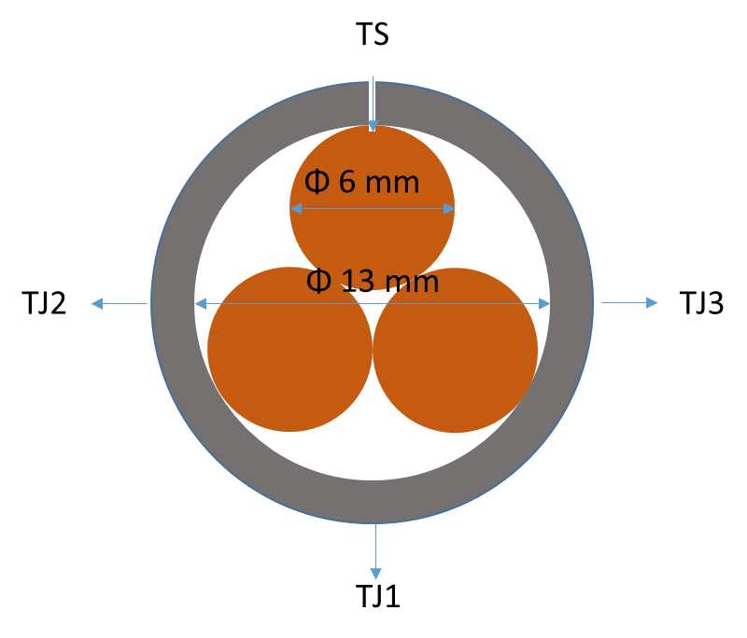
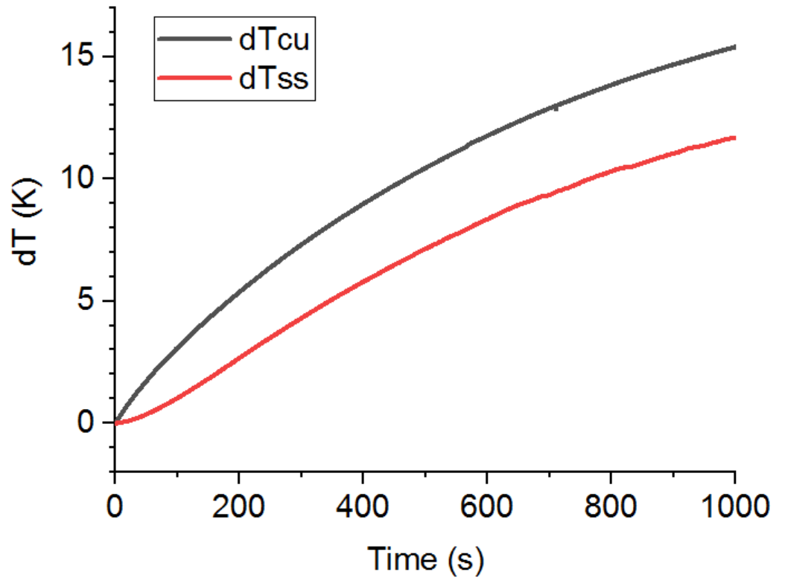
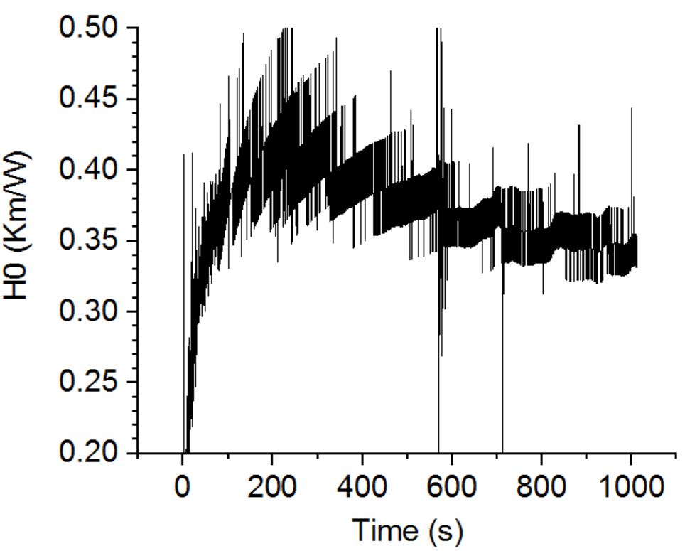
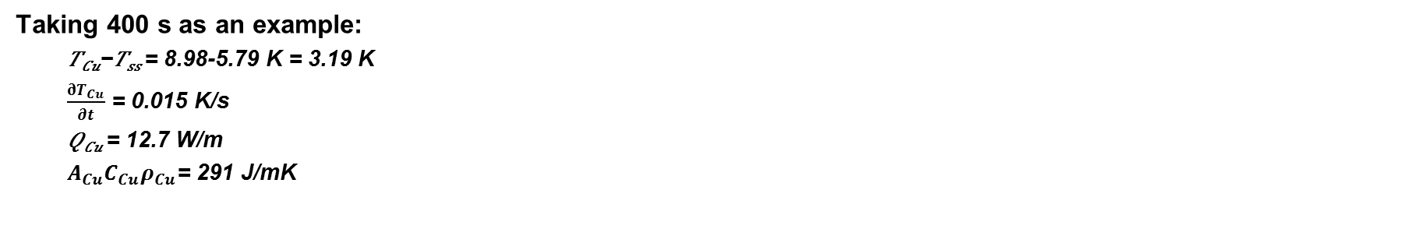
3. Triplet dummy
Current = 250 A
Taking 400 s as an example:
  𝑇_{𝐶𝑢}−𝑇_{𝑠𝑠} = 8.98-5.79 K = 3.19 K
  $\frac{∂T_{Cu}}{∂t}$ = 0.015 K/s
  𝑄_{𝐶𝑢} = 12.7 W/m
  $A_{Cu}C_{Cu}ρ_{Cu}$= 291 J/mK
➔ H₀ = 0.38 Km/W
H ?
Notes:
The first test was done on a triplet dummy. The 3 cooper strands are twisted and inserted into a steel tube, which is initially a little bit larger than the twisted strands. The jacket is then swaged to the nominal inner diameter. A hole is drilled to insert thermal couple at cooper strand. Jacket temperature is measured by thermal couple attached at the surface.
Here you can see the temperature of copper and steel change with time. The difference with room temperature is given. At first, temperature of cooper strand increase much faster than steel jacekt untile their difference is large enough. Then they start to increase with almost the same rate, which is however decreasing since the cooling effect of air is more and more important.
To show how the thermal resistance is calculated, let’s take 400 s as an example. The gradient of temperature is 3.19K, and the increasing rate of copper temperature is about 0.015 K/s. The heat generation at copper, which is double checked with the nominal resistance and measured voltage, is 12.7 W/m. The heat capacity of copper is 291 J/mK.
The thermal resistance between copper strand and steel jacket is then about 0.38 Km/W, which is an average value.

Slide 5
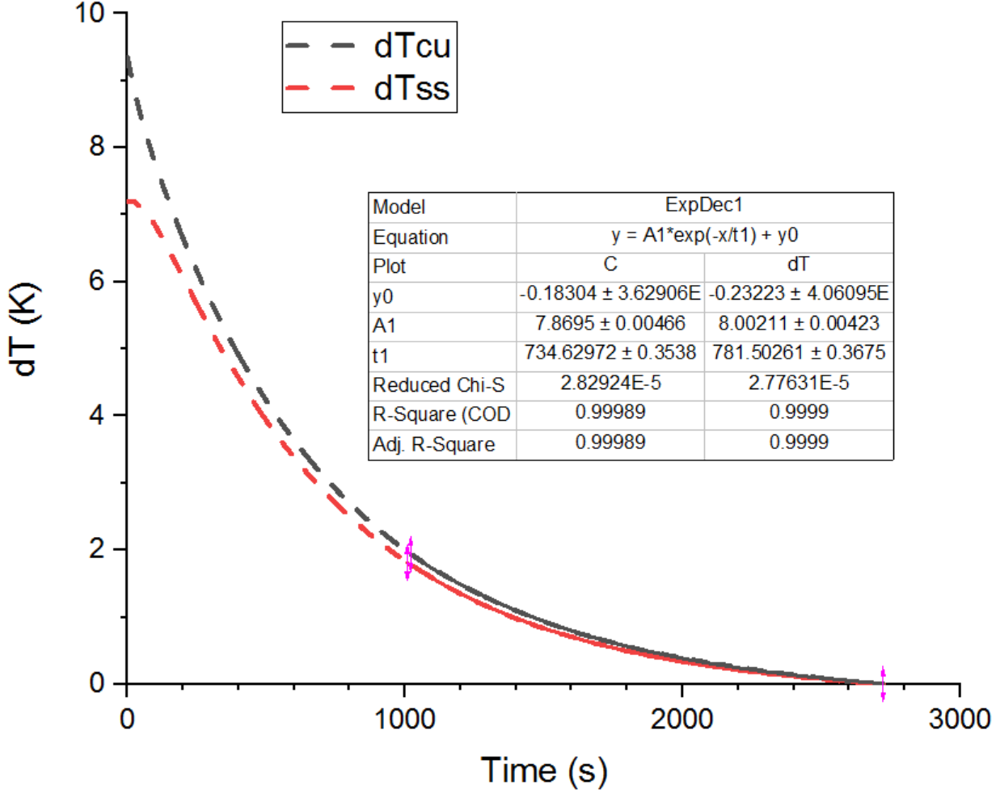

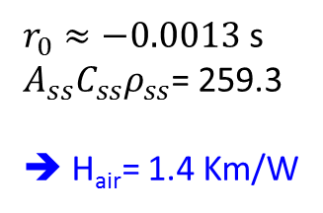
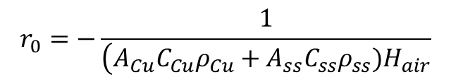

4. Heat exchange with air
During cooling down, T_{Cu} and T_{ss} soon become the same, and:
$(A_{Cu}C_{Cu}ρ_{Cu}+A_{ss}C_{ss}ρ_{ss})\frac{∂T}{∂t}+\frac{\left(T−T_{air}\right)}{H_{air}}=$0
$$T=e^{r_{0}t}+T_{air}$$
$$r_{0}=−\frac{1}{\left(A_{Cu}C_{Cu}ρ_{Cu}+A_{ss}C_{ss}ρ_{ss})H_{air}\right.}$$
$r_{0}≈−0.0013$ s
$A_{ss}C_{ss}ρ_{ss}$= 259.3
➔ H_{air}= 1.4 Km/W
➔ H = 0.5 Km/W (for triplet cable)
For each strand, H is about 1.5 Km/W.
Notes:
To extract the real contact resistance, we need to know the heat exchange with air. It can be estimated with the cooling process, as shown here. Regardless the details, which is quite simple, the thermal resistance for air is about 1.4 Km/W. So the real H for the total cable, i.e. three strands is about 0.5 Km/W. For each strand, it is 1.5 Km/W.

Slide 6
5. Some facts
After conductor manufacture:
What will be the contact length and pressure?
When cooling down:
Thermal strain could influence the contact length and pressure;
Thermal conductance of material (metals and alloys) reduces.
When charged:
Cable is pushed to one side by the Lorenz force, which influence the contact length and pressure.
Could this dominants the effect of pressure?
During quench:
Temperature is increasing (5 K to 250 K);
Contact pressure is dropping once current starts to dump;
Roughness, can it vary a lot?
The roughness of the copper and steel used in measurement are respectively 250 μm and 300 μm.
Notes:
On the other hand, the value is far to be a usable value in our simulation, since

Slide 7
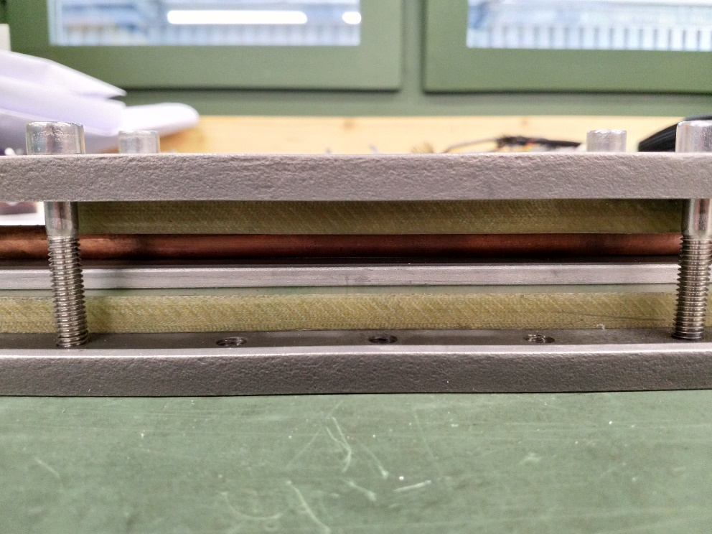
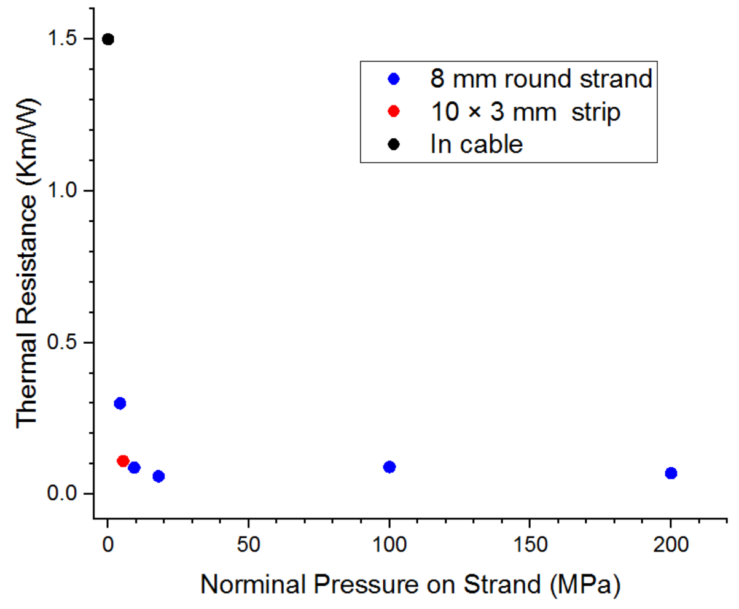
6. Scaling to operating condition
TCR V.S. Pressure
Fiberglass as insulation
Copper rod
Steel strip
Torque wrench is used to apply a certain pressure through the bolt
TCR decrease rapidly with contact pressure when pressure is below 10 MPa. Above that, it hardly changes and is around 0.1 Km/W.
The transverse pressure for our strand is about 10 Mpa.
From 300 K and 0 T (RT) to 4.75 K and 17.5 T, heat conductance of copper reduce from 386 W/Km to 102 W/Km.
For steel, it is from 15 W/Km to 0.3 W/Km. Which dominants, copper or steel?
An estimation of TCR at operation is then 0.1*386/102~0.4 Km/W or 0.1*15/0.3~5 Km/W (or some value in between).
Compare with the result with a 10 mm wide strip, the equivalent contact length for 8 mm strand is about 3.6 mm.
Notes:
Here is one idea how to scale the measured value to the operating condition. We measured the TCR at room temperature with different applied transverse pressure, which was done with this device. A torque wrench is used ….
The results are shown in this figure. We can see that
Now at least we have a range of the thermal contact resistance which we know how it is obtained.

Slide 8
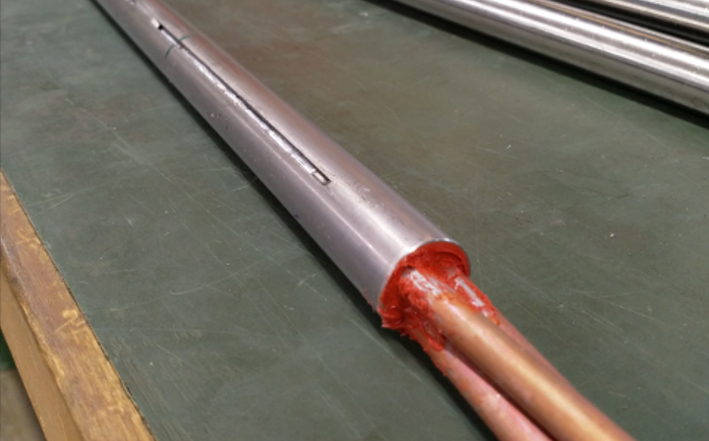
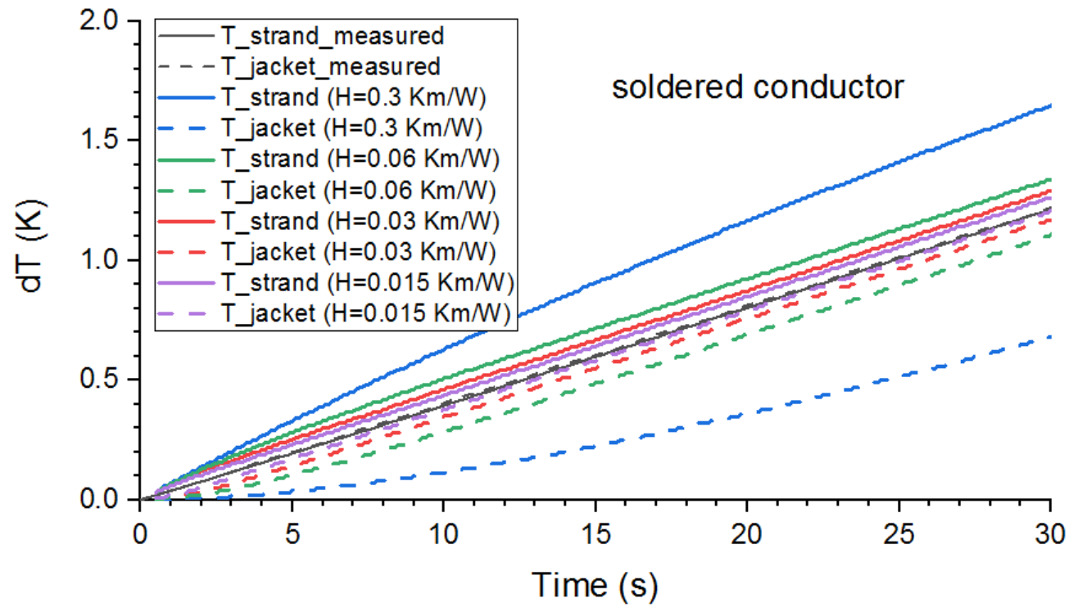
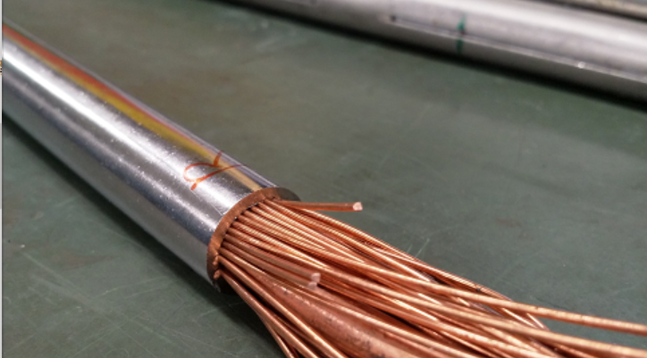
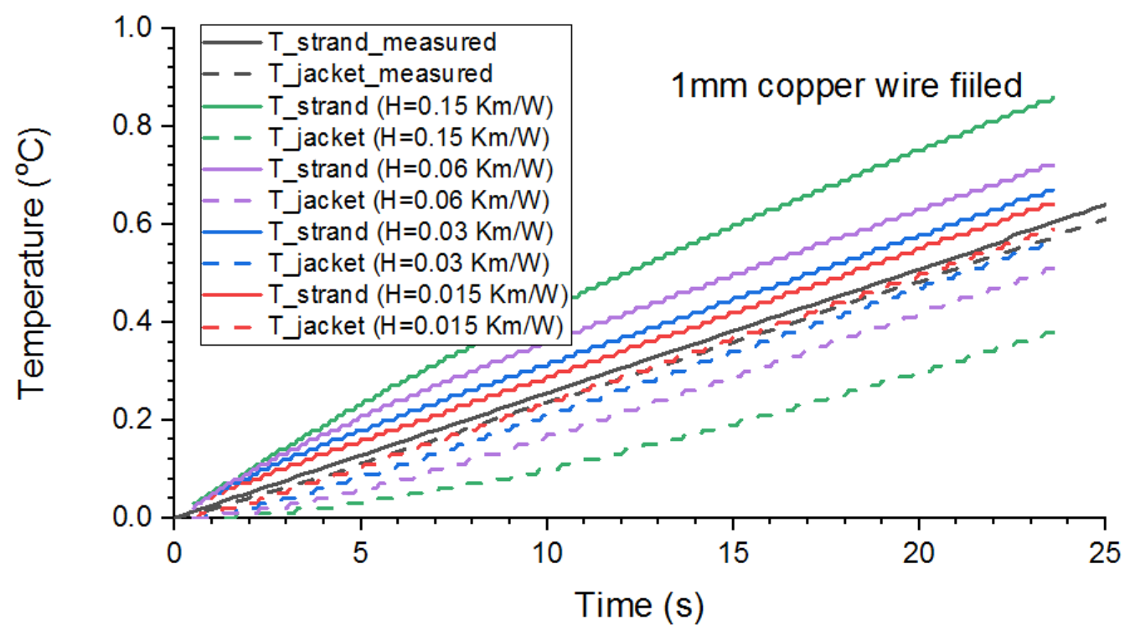
7. Other layouts
Solder filled
TCR < 0.015 Km/W at RT
At 5 K, TCR < 0.022 Km/W
Current = 400 A
Copper wire filled
Unknown pressure ☹
Notes:
We also used the same process to measure the thermal resistance in a soldered filled conductor and a small copper wire filled conductor. The idea is too see how much the heat transfer can be improved.
The data we measured gives one good news and one bad news. Good news is, little temperature gradient is observed in both cases, which means the thermal resistance is really low. On the other hand, since they are too low, it is difficult to distinguish the two temperatures. Therefore, an alternate approach is used here. The temperature change of the components are calculated with different TCR and compared with measured data, to see below which they show similar result.
With this method, we can found for both cases, the TCR should be below 0.015 Km/W at RT, which is much smaller than the normal conductor. For solder filled conductor, the dominant contribution should come from solder, so a scaling to operating condition can be estimated with the change of thermal conductance of solder from 300 K to 5 K. The TCR is less then 0.022 Km/W. For the copper wire filled one, unfortunately the pressure is unknow and hard to estimate, so the scaling is impossible. In any case, the solder filled conductor is more interesting for us, since it may increase the mechanical property of the conductor. As you may know, our strand suffers from the transverse load a lot.

Slide 9
8. Summary
During operation, the strand-jacket thermal contact resistance could be roughly estimated as 0.4-5 Km/W, the contact pressure of which is dominated by Lorenz force.
Fill the void with soldered or smaller copper wires are benefit for reduce the thermal contact resistance, but they also lead to different conductor layouts, which need further study.

Slide 10
Thank you for your attention!
Notes:
This is the end of this presentation. Thank you for your attention.

