Slide 2
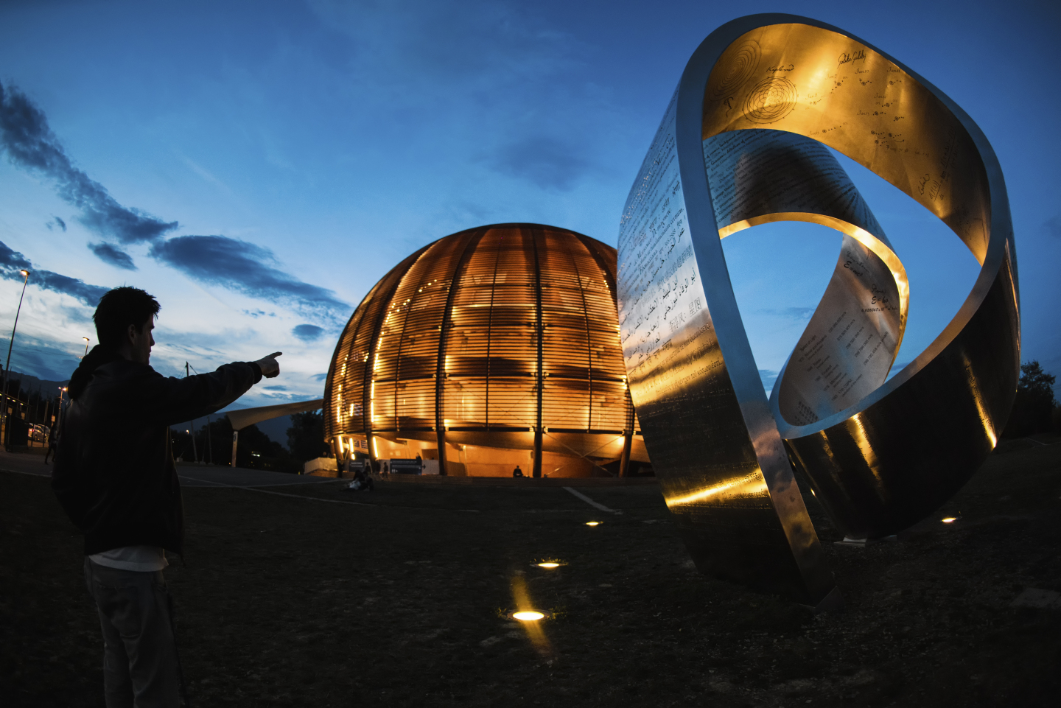

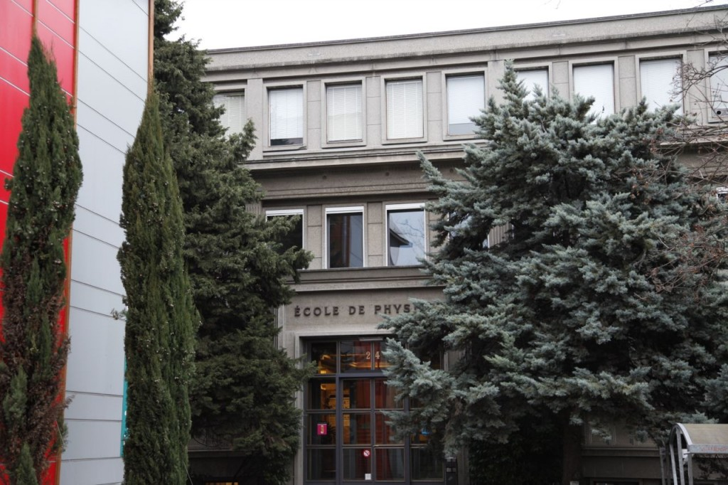
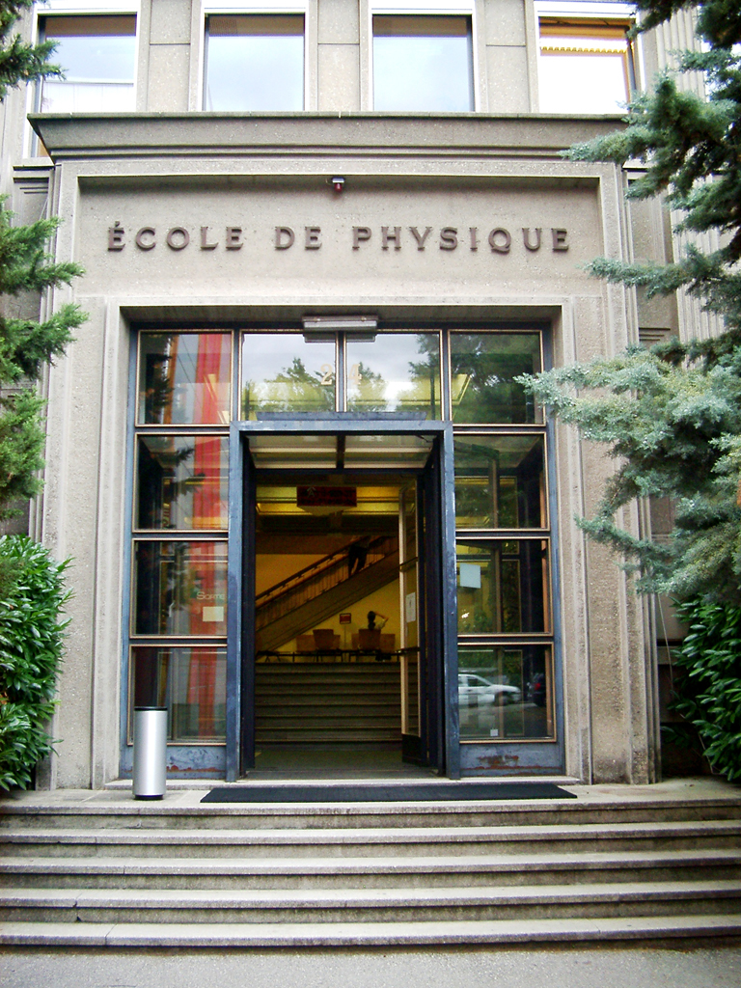
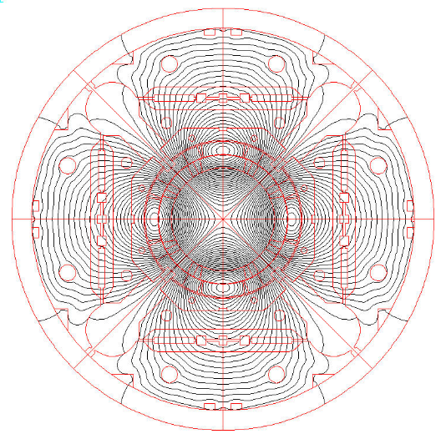

On the magnet mechanics during a quench:
Three-Dimensional Finite Element Analysis Of a Quench Heater Protected Magnet
CHATS On Applied Superconductivity 2019
09/07/2019
Jose Ferradas University of Geneva & CERN TE-MSC-MDT
Paolo Ferracin CERN TE-MSC-MDT
Carmine Senatore University of Geneva
Giorgio Vallone Lawrence Berkeley National Lab.
On behalf of a group of amazing experts:
G. Ambrosio, H. Bajas, M. Bajko, L. Bottura, L. Brouwer, B. Castaldo, M. Guinchard, S. Izquierdo Bermudez, J.V. Lorenzo Gomez, F.J. Mangiarotti, J.C. Perez, E. Ravaioli and E. Tapani Taakala

Slide 3
OUTLINE
1.- Introduction – Quench processes and superconducting magnets
2.- MQXF – The low-β quadrupole for HL-LHC
3.- Finite element modelling for the analysis of the magnet mechanics during a quench
4.- 2D FE Analysis of a quench heater protected magnet
5.- 3D FE Analysis of a quench heater protected magnet
6.- Final conclusions

Slide 4
OUTLINE
1.- Introduction – Quench processes and superconducting magnets
2.- MQXF – The low-β quadrupole for HL-LHC
3.- Finite element modelling for the analysis of the magnet mechanics during a quench
4.- 2D FE Analysis of a quench heater protected magnet
5.- 3D FE Analysis of a quench heater protected magnet
6.- Final conclusions

Slide 5
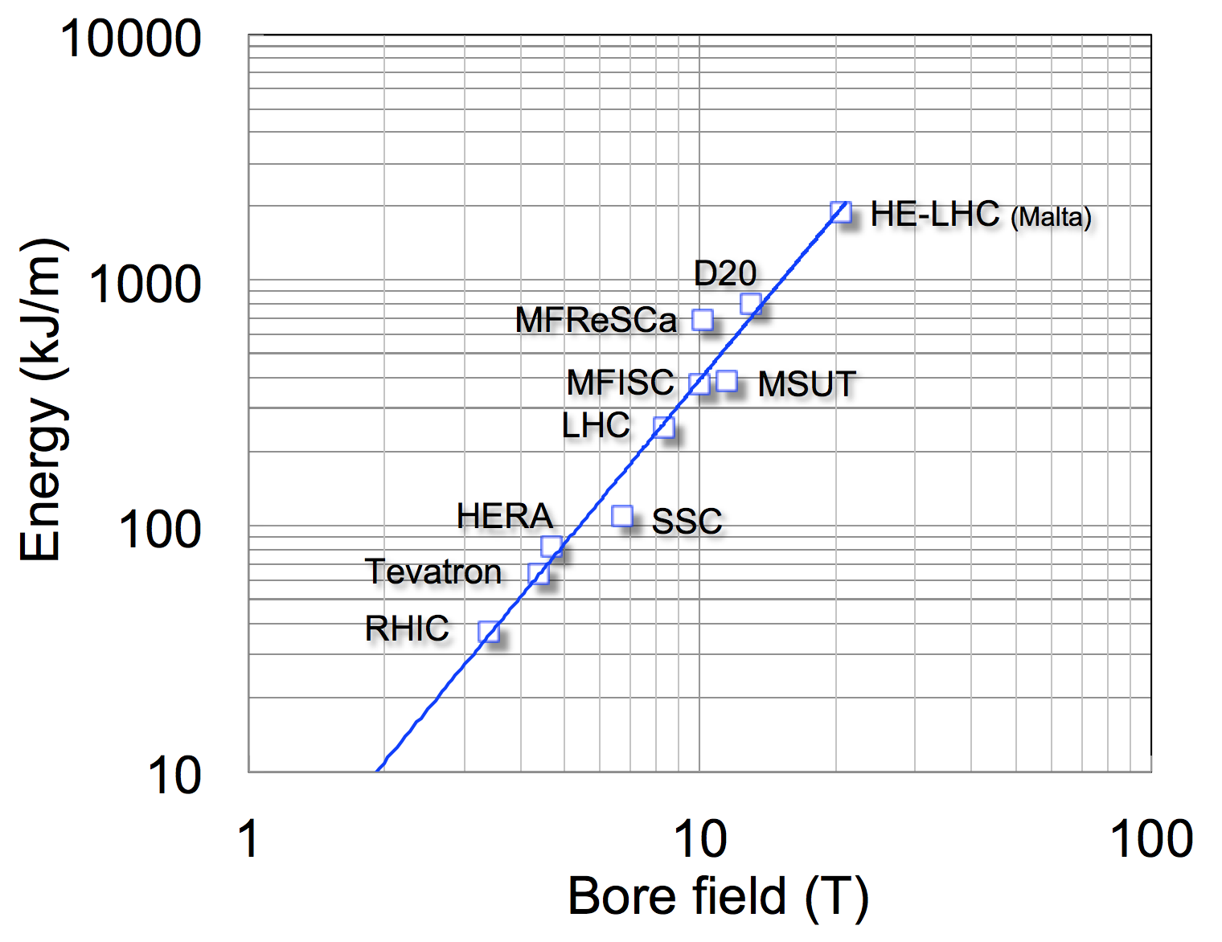
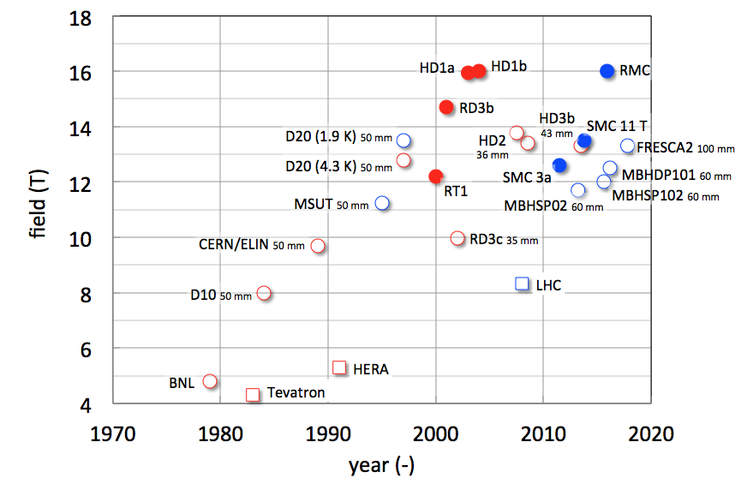
INTRODUCTION
Quench processes and superconducting magnets
New high-field Nb₃Sn accelerator magnets are pushing the boundaries of magnet design and quench protection towards new limits.
Their large stored energy and current densities pose new challenges for the community…
Scaling of the energy per unit length with the bore field
Courtesy of L. Bottura
Maximum magnetic field for state of the art superconducting accelerator magnets
Courtesy of L. Bottura

Slide 6
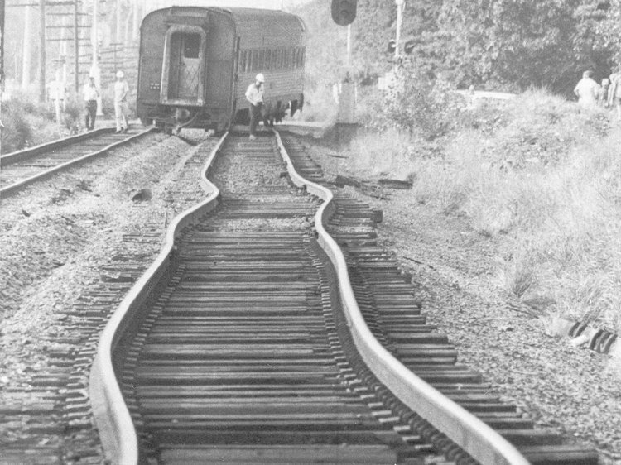
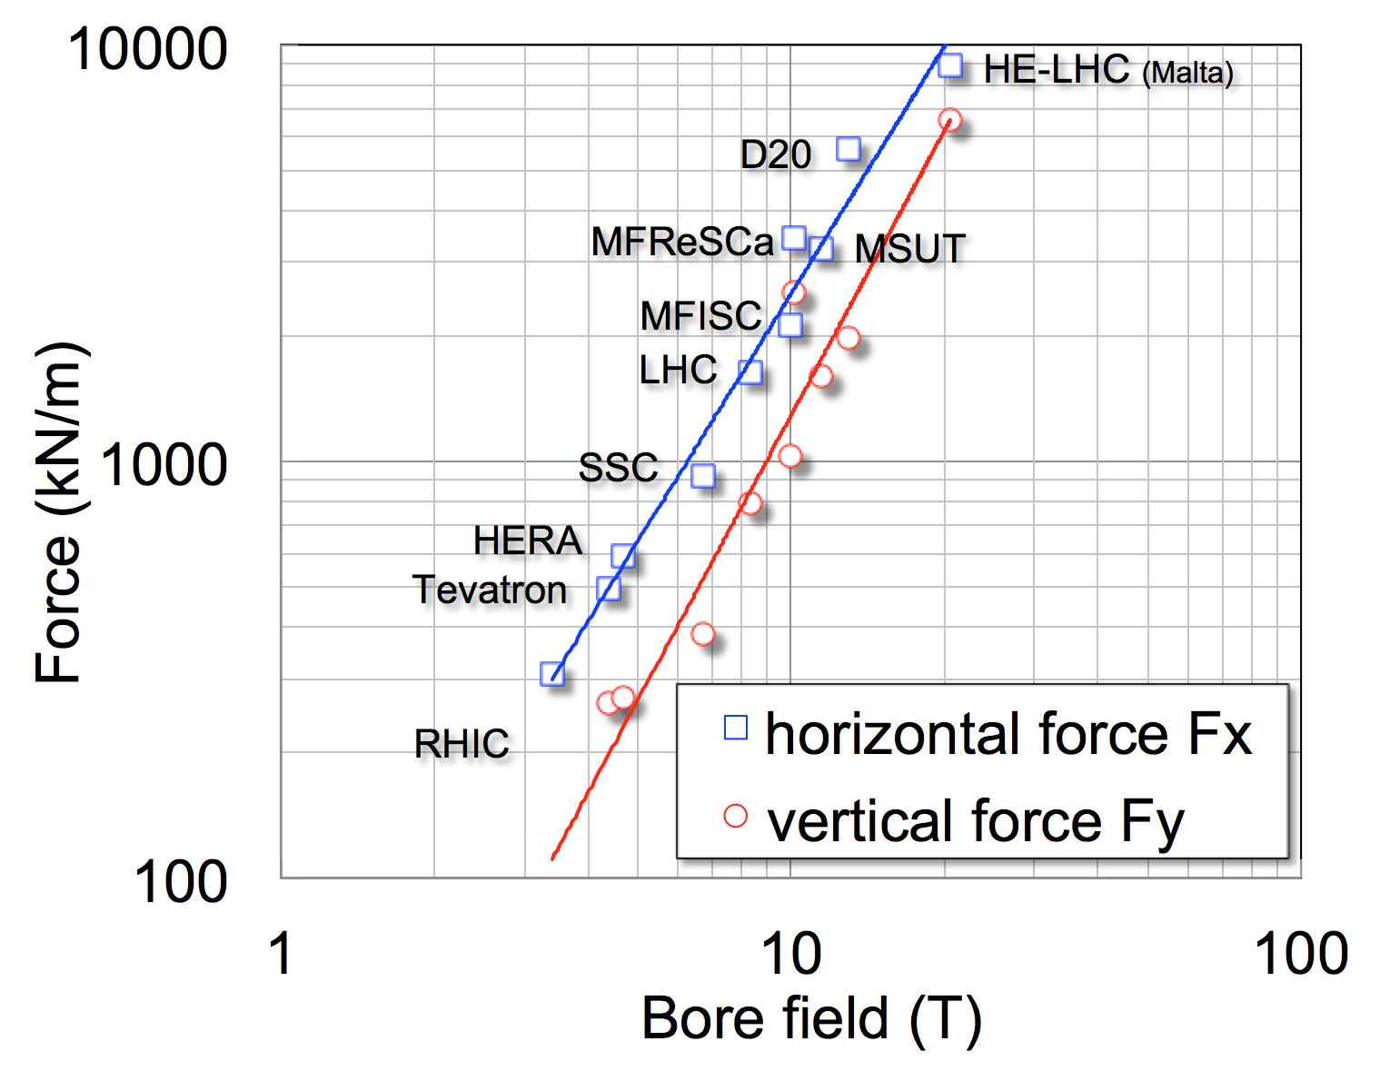
INTRODUCTION
Quench processes and superconducting magnets
… but also the electro-mechanical limits of the conductor become a parameter of extreme importance.
Digression on thermal stresses: Thermal buckling in railway tracks
Source: [Business Insider]
Courtesy of L. Bottura
Quench
Thermo-mechanical stresses
Risk of magnet damage / conductor degradation
The study of quench processes and their intrinsic mechanics becomes essential!
We need tools capable of predicting the mechanical response of the magnet during a quench

Slide 7
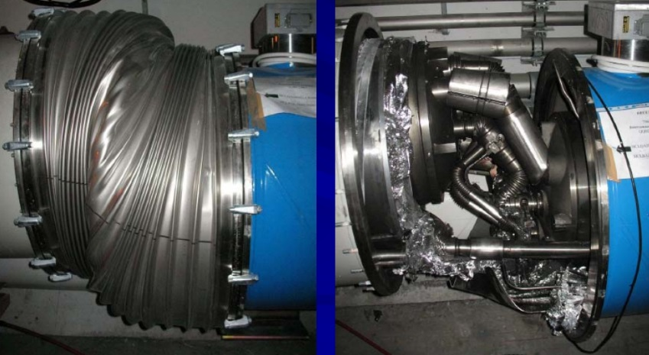
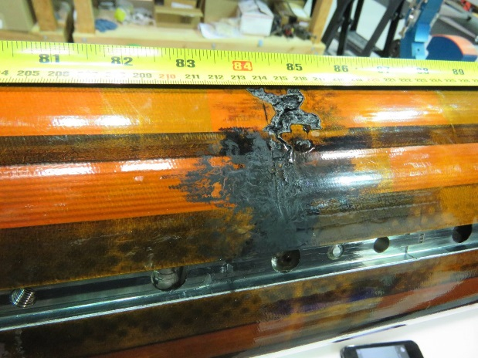
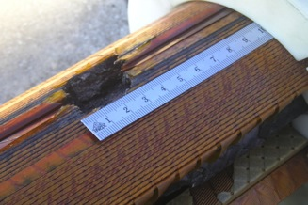
INTRODUCTION
Quench processes and superconducting magnets
At the same time one cannot forget that the accurate simulation of quench transients is a real multiphysics effort:
- Electromagnetic study ~ Safe voltage levels
- Thermal analysis ~ Safe temperature level
- Mechanical analysis ~ Safe stress levels
This is the result of a quench in the pre series magnet during its qualification test
Courtesy of Marta Bajko
This is the result of a chain of events triggered by a quench in an LHC bus-bar
Courtesy of Marta Bajko
Damage in HL-LHC coil as a result of an electrical fault
Courtesy of Paolo Ferracin

Slide 8
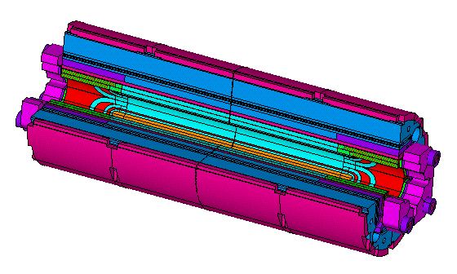
INTRODUCTION
Objective
Perform the 2D and 3D analysis of the magnet mechanics during a quench in relevant operation conditions using ANSYS APDL.
The HL-LHC MQXF Low-β quadrupole magnet, our playground field.
Magnet protected with quench heaters (placed in the outer layer of the coils), quench at nominal current. Characterize the magnet response.
The method should combine the necessary multi-physics models. They will provide the input for the mechanical model.
Main goal of today: Show that the methodology works.
3D MQXF magnet mechanical model
(G. Vallone, 2017)
Mechanical model
Thermal-electric model
Electro-magnetic model

Slide 9
OUTLINE
1.- Introduction – Quench processes and superconducting magnets
2.- MQXF – The low-β quadrupole for HL-LHC
3.- Finite element modelling for the analysis of the magnet mechanics during a quench
4.- 2D FE Analysis of a quench heater protected magnet
5.- 3D FE Analysis of a quench heater protected magnet
6.- Final conclusions

Slide 10
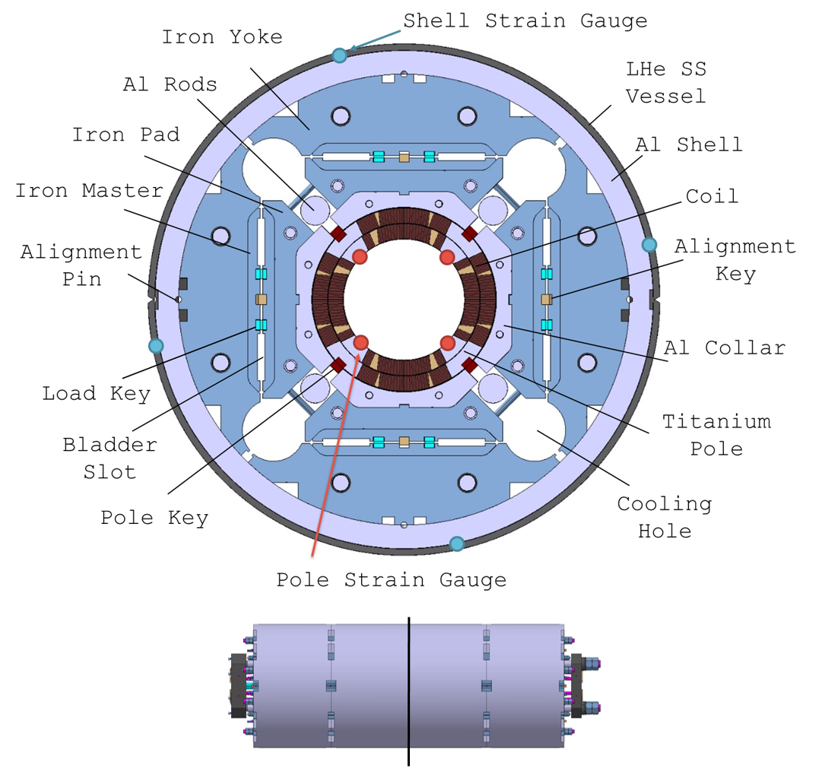
MQXF
MQXF Low-β quadrupole magnet
Nominal gradient: 132.6 T/m
Nominal current: 16470 A
Peak field in the conductor at I_{nom} : 11.4 T
Aperture: 150 mm
Magnet outer radius: 630 mm
Stored energy at I_{nom}: 1.17 MJ/m
F_{x} / F_{y} (per octant) at I_{nom} = +2.47 / -3.48 MN/m
F_{z} (Whole magnet) at I_{nom} = 1.17 MN
Mechanical concept: Aluminium shell pre-loaded with bladders.
First time for an accelerator magnet.
Courtesy of Giorgio Vallone

Slide 11
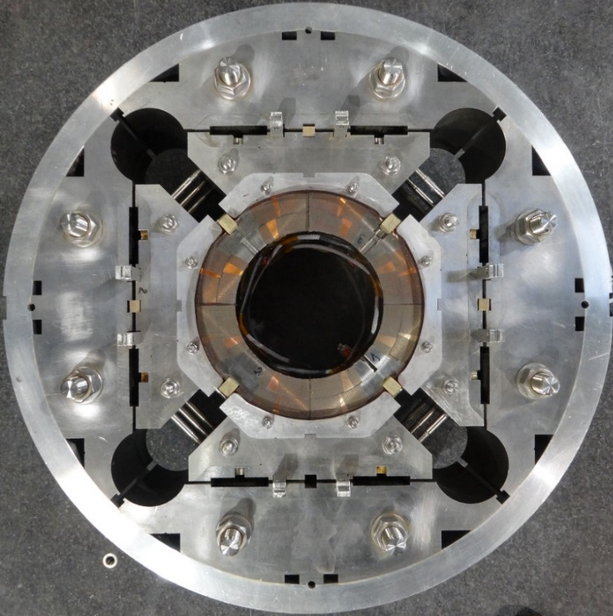
MQXF
MQXF Low-β quadrupole magnet
Nominal gradient: 132.6 T/m
Nominal current: 16470 A
Peak field in the conductor at I_{nom} : 11.4 T
Aperture: 150 mm
Magnet outer radius: 630 mm
Stored energy at I_{nom}: 1.17 MJ/m
F_{x} / F_{y} (per octant) at I_{nom} = +2.47 / -3.48 MN/m
F_{z} (Whole magnet) at I_{nom} = 1.17 MN
Mechanical concept: Aluminium shell pre-loaded with bladders.
First time for an accelerator magnet.
Courtesy of Paolo Ferracin

Slide 12
OUTLINE
1.- Introduction – Quench processes and superconducting magnets
2.- MQXF – The low-β quadrupole for HL-LHC
3.- Finite element modelling for the analysis of the magnet mechanics during a quench
4.- 2D FE Analysis of a quench heater protected magnet
5.- 3D FE Analysis of a quench heater protected magnet
6.- Final conclusions

Slide 13
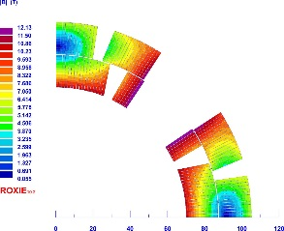
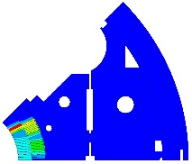

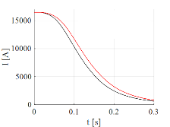
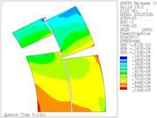

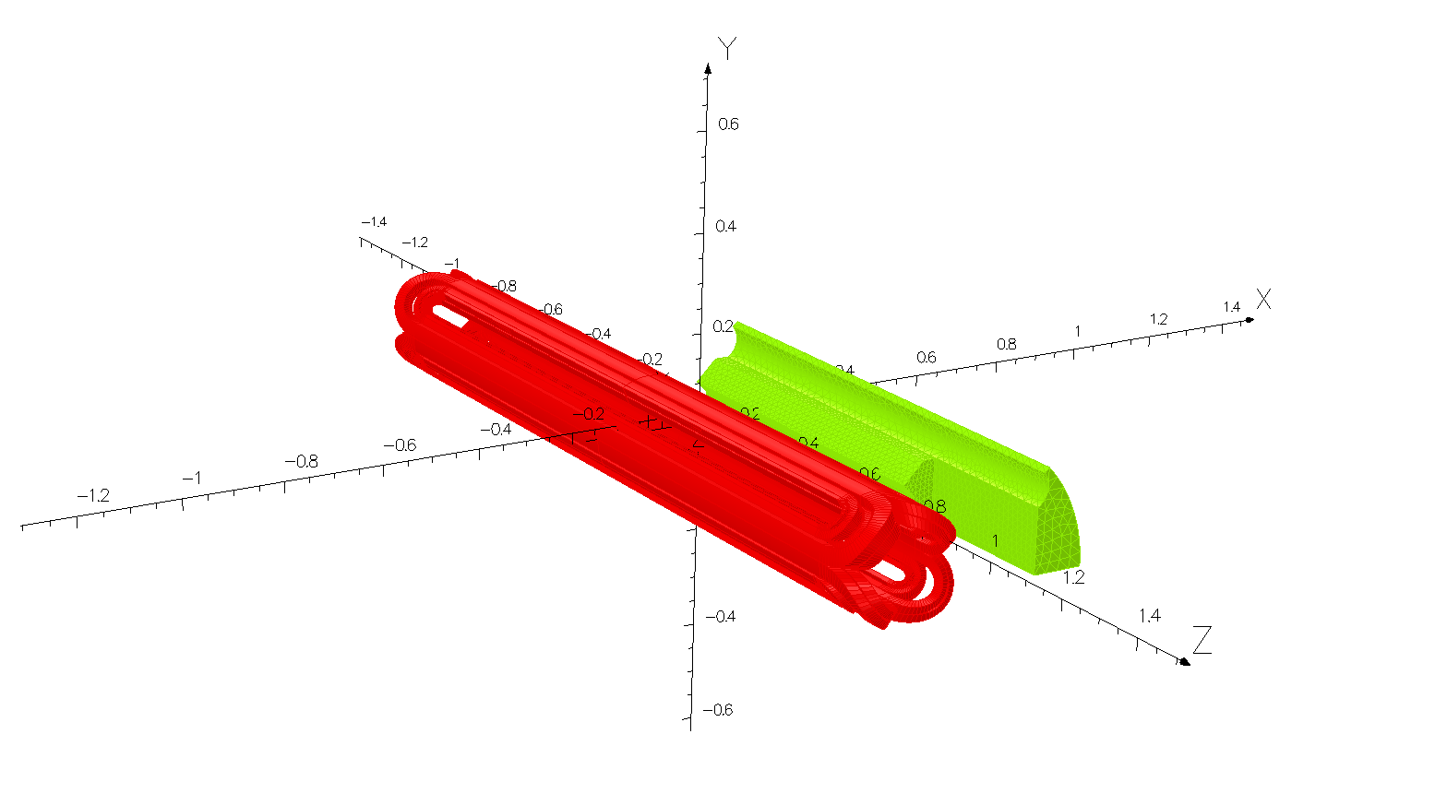
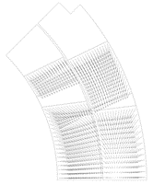
FE QUENCH ANALYSIS
Modelling strategy
2D/3D ROXIE electromagnetic model
Magnetic field on each conductor
3D Thermal-Electric quench simulation
Mechanical model
2D/3D Electromagnetic model

Slide 14
FE QUENCH ANALYSIS
Modelling strategy
Main focus of today’s talk
2D/3D ROXIE electromagnetic model
Magnetic field on each conductor
3D Thermal-Electric quench simulation
Mechanical model
2D/3D Electromagnetic model

Slide 15
FE QUENCH ANALYSIS
Modelling strategy
2D/3D ROXIE electromagnetic model
Magnetic field on each conductor
3D Thermal-Electric quench simulation
Mechanical model
2D/3D Electromagnetic model

Slide 16
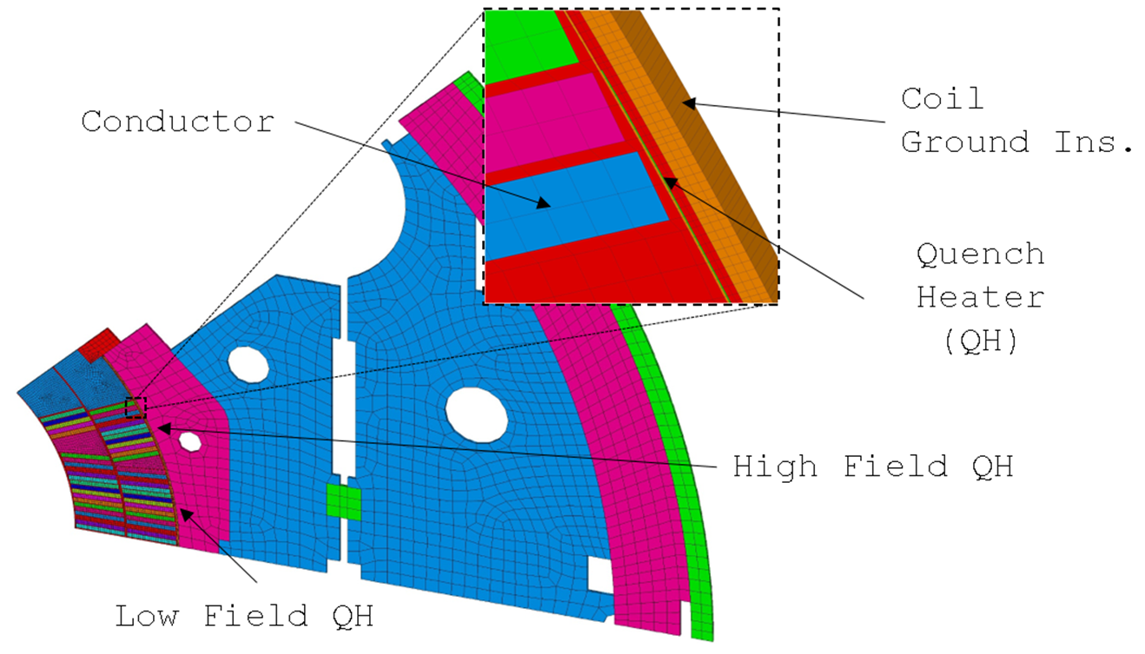
FE QUENCH ANALYSIS
3D MQXF Thermal-Electric model
Adiabatic boundary conditions

Slide 17
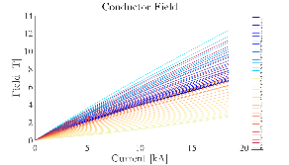
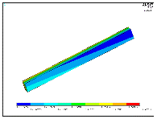
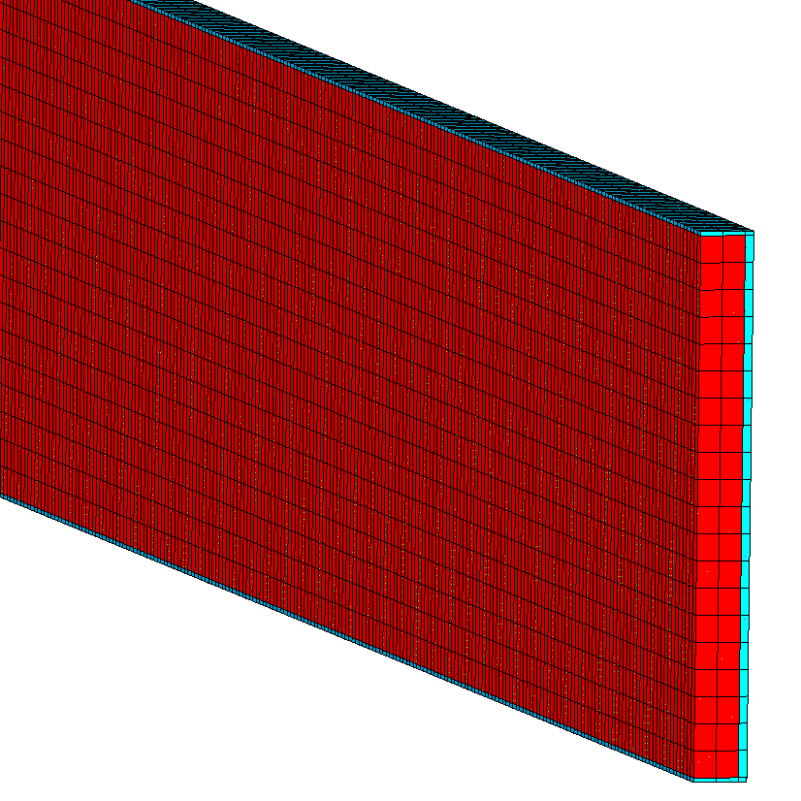
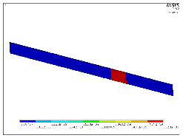
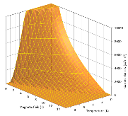




FE QUENCH ANALYSIS
From previous episodes (ASC 2018)…
ANSYS SOLID278
3-D 8-Node Thermal Solid
8 nodes 3-D space
DOF: TEMP
Non-conductor domains
$$t ≥tsim$$
Compute new I, B & update props.
$$End$$
$$Start$$
Check each element’s quench status
$t_{sim}$ divided in time steps $(∆t)$
Solve time step
Conductor
Critical Surf. Param.
ANSYS SOLID226
3-D 8-Node Coupled-Field Solid
8 nodes 3-D space
DOF: TEMP, VOLT

Slide 18
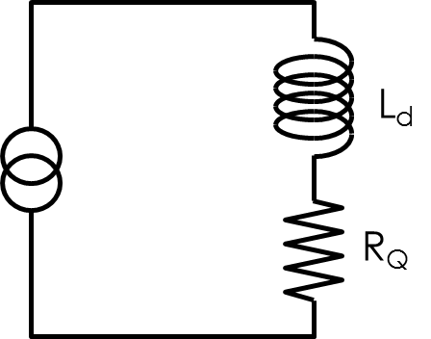
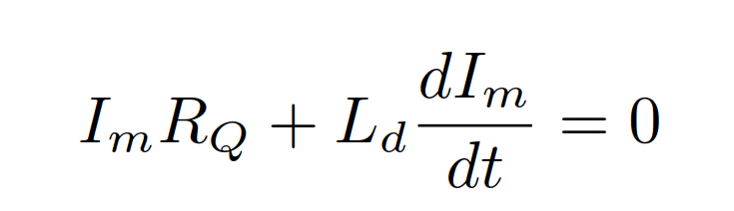


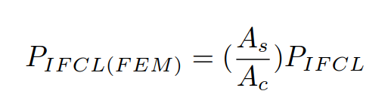
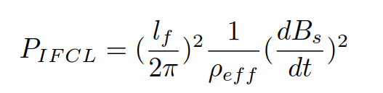
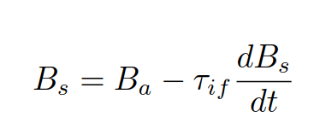
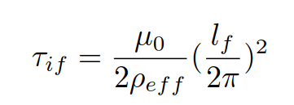
FE QUENCH ANALYSIS
Modelling the full current decay
On the assumption of a quench heater protected magnet without external dump:
Equation solved by the code with a step-by-step method. It provides a piecewise exponential decay for the current.
The model updates R_{Q} and L_{d} at each time step.
Inter filament Coupling Losses (IFCL) are included in the formulation [1].
Magnetic field on each conductor using ROXIE load lines.
LL_{B} [T A⁻¹]
B_{s}: Total field (under the effect of IFCC)
B_{a}: Applied magnetic
A_{s}: Total area of strands
A_{c}: Total area of the conductor
l_{f}: Filament twist-pitch
ρ_{eff}: Effective transv. resistivity
µ₀: Magnetic perm. of vaccum
[1] j. Ferradas Troitino et al, “On the magnet mechanics during a quench: 2D Finite element analysis of a quench heater protected magnet” Submitted for publ.

Slide 19

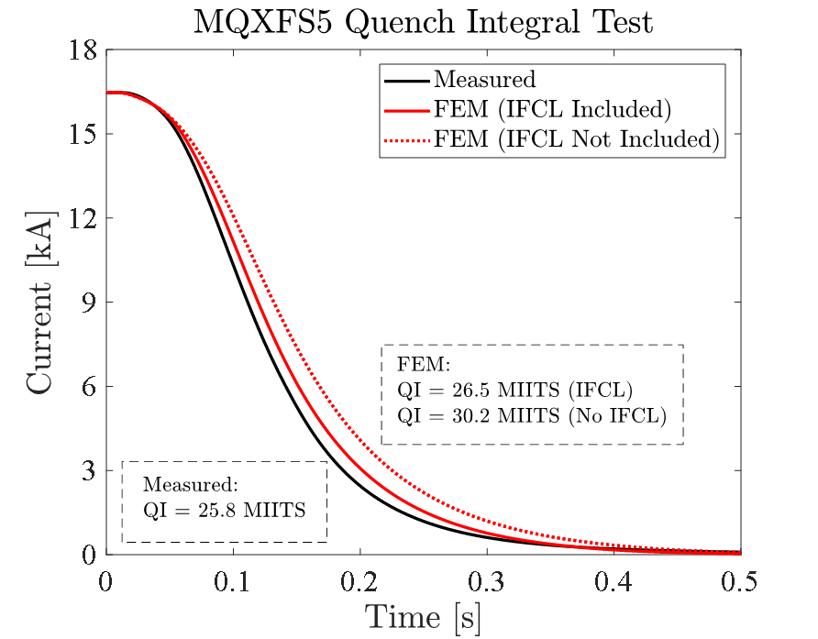
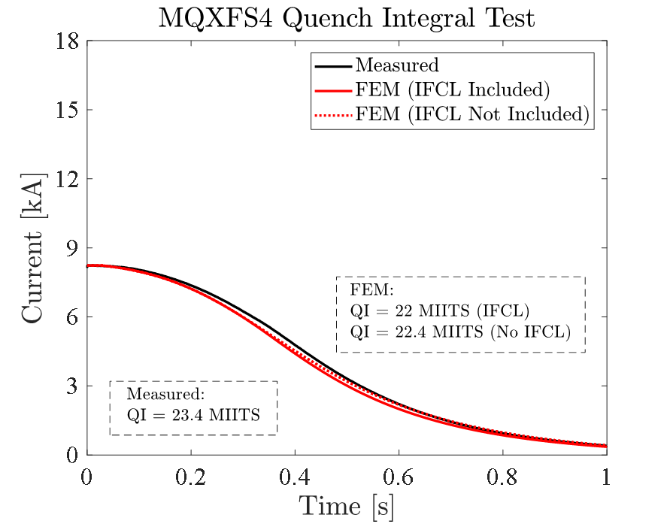
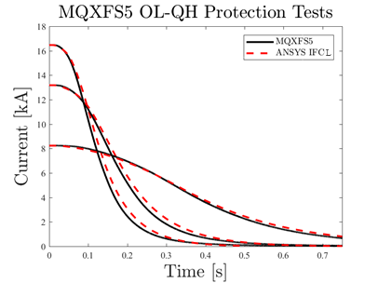
FE QUENCH ANALYSIS
Simulation results obtained under the explained assumptions.
An “error bar” should be always considered!
Model results and validation
The model could be validated using the extensive experimental campaign for MQXFS magnets:
Quench Integral (QI) tests
QI ~ Less than 10% difference w.r.t. experimental data in all tests

Slide 20
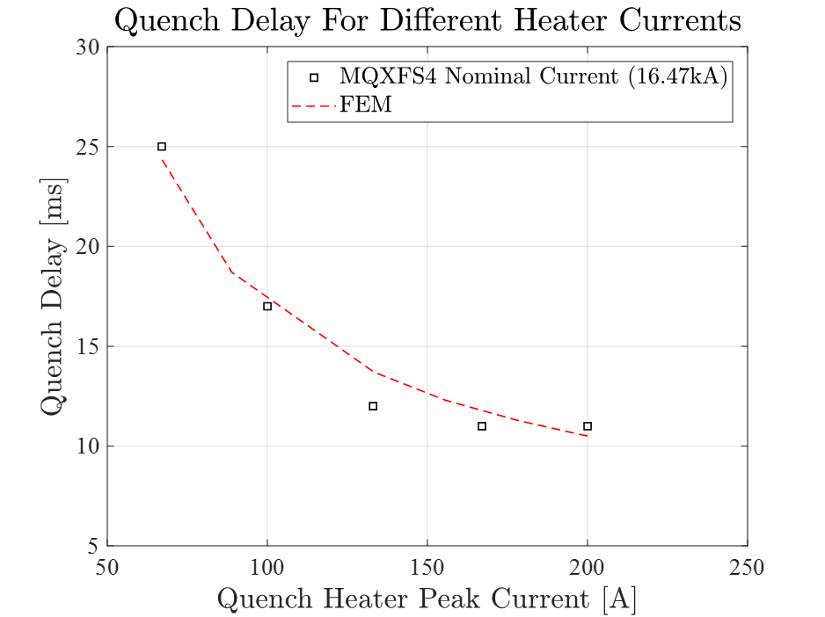
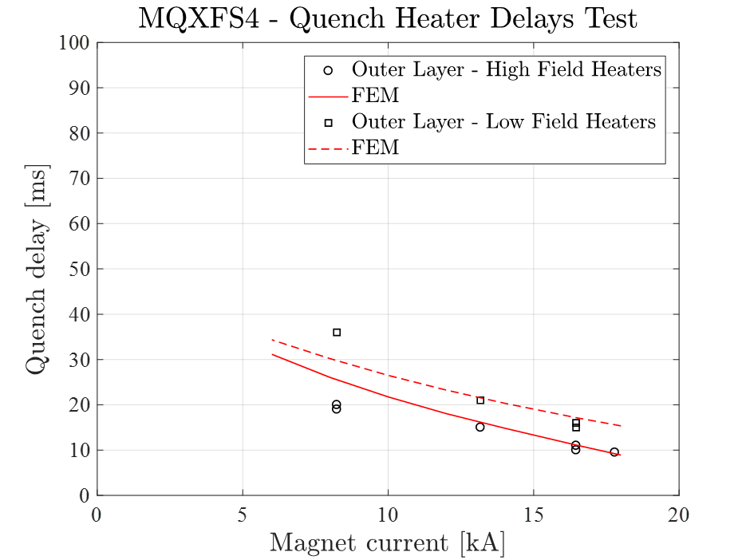
FE QUENCH ANALYSIS
Simulation results obtained under the explained assumptions.
An “error bar” should be always considered!
Model results and validation
The model could be validated using the extensive experimental campaign for MQXFS magnets:
Quench Heaters (QH) tests
Max. discrepancy ~ 14%
Delay precision ~ Around 1 ms at I_{nom}
Thermal behaviour matched

Slide 21
FE QUENCH ANALYSIS
Modelling strategy
2D/3D ROXIE electromagnetic model
Magnetic field on each conductor
3D Thermal-Electric quench simulation
Mechanical model
2D/3D Electromagnetic model

Slide 22
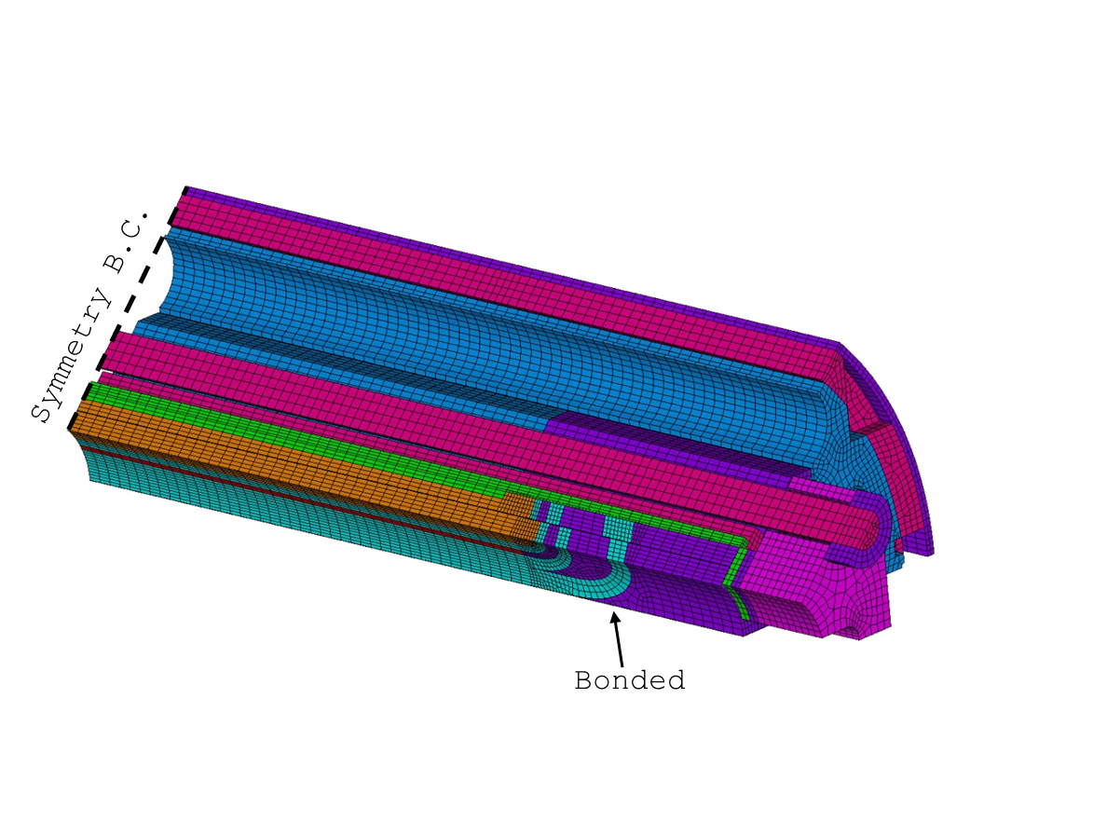
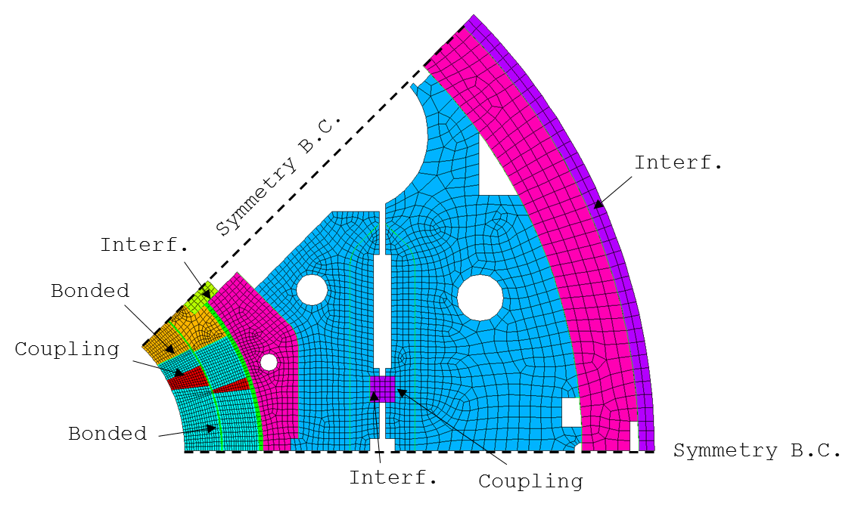
FE QUENCH ANALYSIS
Courtesy of Giorgio Vallone
2D & 3D MQXF Mechanical model
PLANE82 – structural 2D quadratic
Surf./Surf. contact elements (CONTA172/TARGE169).
Plane stress assumption, verified against 3D models and measurements.
Exploit the quadrupole symmetry.
Linear elastic material properties.
Coil simulated as a block with smeared properties (isotropic).
Adds:
Half-magnet length, longitudinal symmetry B.C.
Longitudinal loading
*Validation results in the backup slides

Slide 23
OUTLINE
1.- Introduction – Quench processes and superconducting magnets
2.- MQXF – The low-β quadrupole for HL-LHC
3.- Finite element modelling for the analysis of the magnet mechanics during a quench
4.- 2D FE Analysis of a quench heater protected magnet
5.- 3D FE Analysis of a quench heater protected magnet
6.- Final conclusions

Slide 24

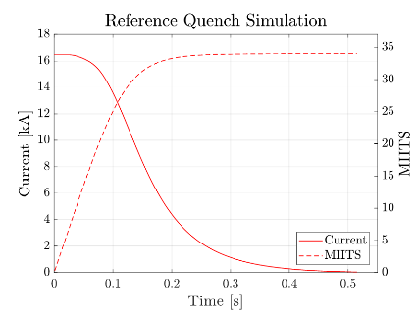
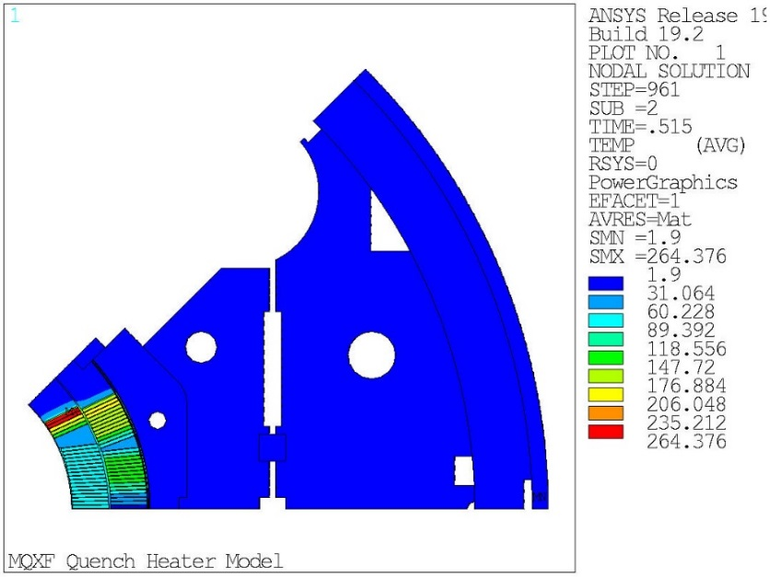
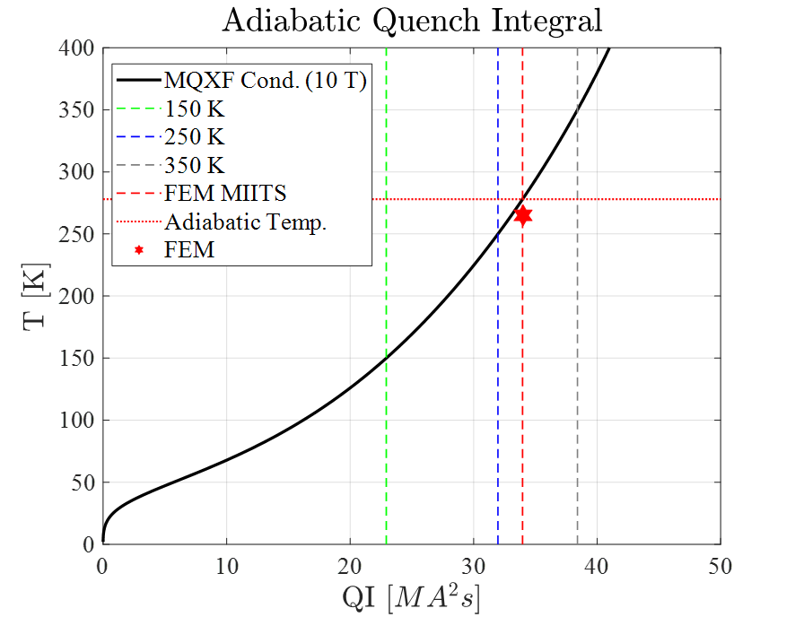
2D MECHANICS OF A QH PROTECTED MAGNET
Case study: Nominal current training quench
Adiabatic estimation of hot spot temp.
15 ms Detection + Validation time example.
  Inner layer pole turn quenched
  (Highest peak field conductor)
Magnet protected with outer layer QH:
  Reference MQXF conductor parameters.
  Results: 34 MIITS → Peak T at the end of disch. = 264 K

Slide 25
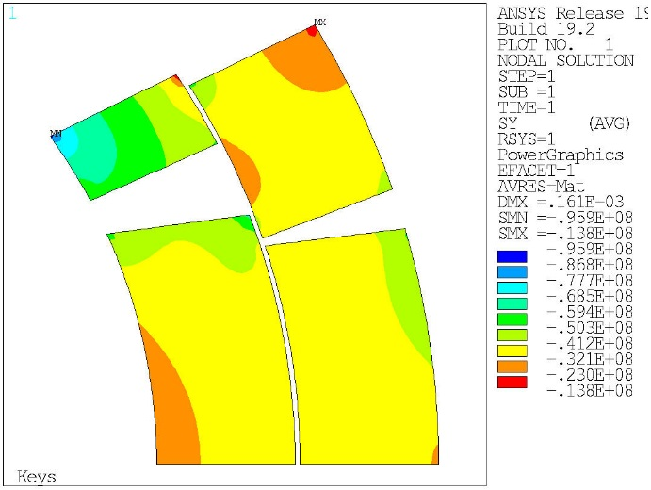
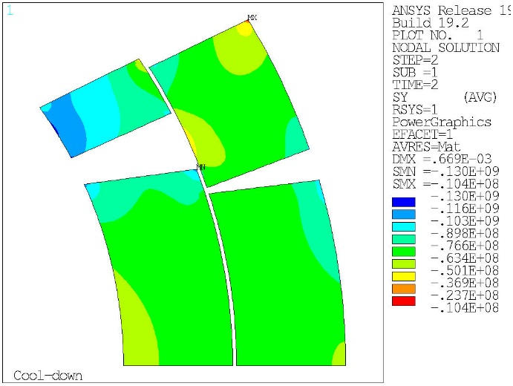
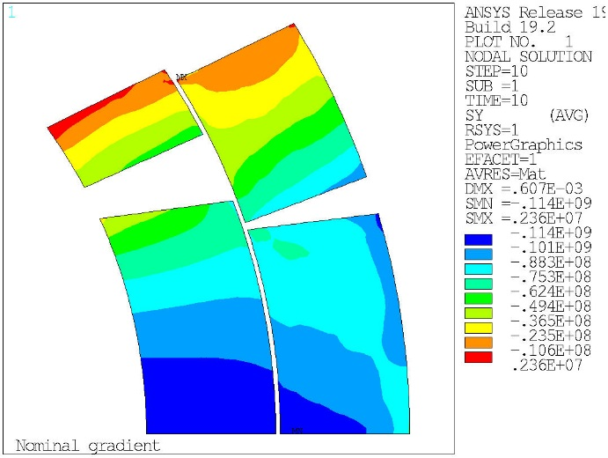
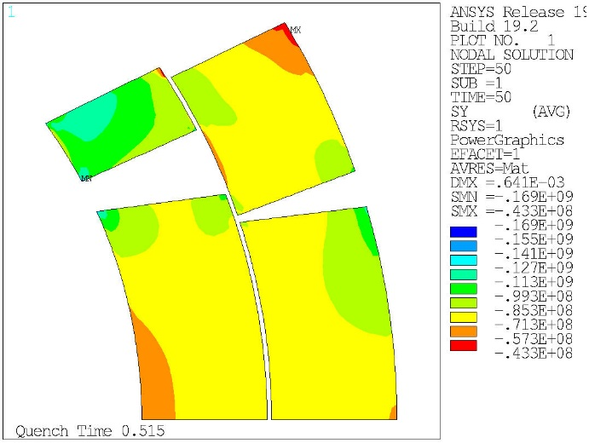
2D MECHANICS OF A QH PROTECTED MAGNET
2D Mechanical results: Azimuthal stress
Assembly
Cool-down
96 MPa*
118 MPa*
100 MPa
Careful interpretation needed!
*Singular corner values
More information in the 3D part
Nominal Operation
End of quench discharge
140 MPa*
114 MPa

Slide 26
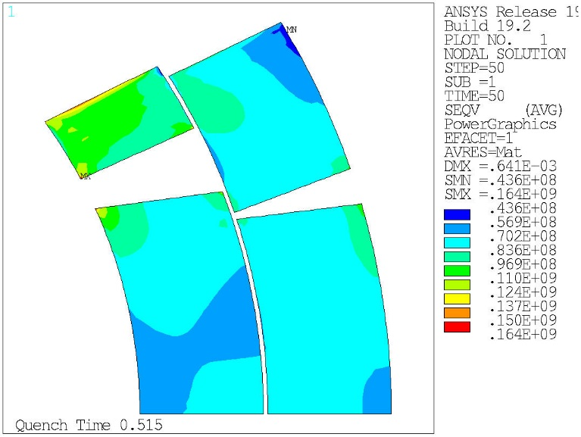
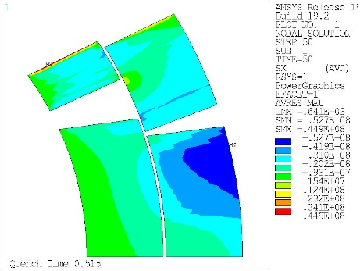

2D MECHANICS OF A QH PROTECTED MAGNET
2D Mechanical results: Stress evolution
Peak Von Misses equivalent stress at the end of the discharge ~ 146 MPa
  Stress evolution during quench is important.
VM Eqv.
OL Midplane
IL Pole
Radial
Shear
* Not necessary at the same place

Slide 27
2D MECHANICS OF A QH PROTECTED MAGNET
2D Mechanical results: Full nominal characterization
Results under the coil block assumption
Analysis on the peak stress impact respecting project tolerances:
Delta in hot spot temp. ~ 20 K
Conductor Parameters: 100< RRR <200
1.0 < Cu2SC < 1.4
Detection + Validation: 10 ms < time < 20 ms
Preload effect: Nom-20 MPa < Nominal preload < Nom+20 MPa
Corner nodes neglected

Slide 28
2D MECHANICS OF A QH PROTECTED MAGNET
Three main conclusions
For our reference case and under the modelling assumptions:
The peak stress during a quench in the coil block is not defined by the hot spot temperature. Rather than that, it is governed by an average/global temperature in the coil: Dissipated energy
In global terms, the parametric study shows that the mechanical response for a quench at nominal current does not change if the design parameters are kept within the established tolerances.
The quench transient adds an additional azimuthal compression of 40 MPa to the pole turn (Compared with the value after cool down).

Slide 29
OUTLINE
1.- Introduction – Quench processes and superconducting magnets
2.- MQXF – The low-β quadrupole for HL-LHC
3.- Finite element modelling for the analysis of the magnet mechanics during a quench
4.- 2D FE Analysis of a quench heater protected magnet
5.- 3D FE Analysis of a quench heater protected magnet
6.- Final conclusions

Slide 30
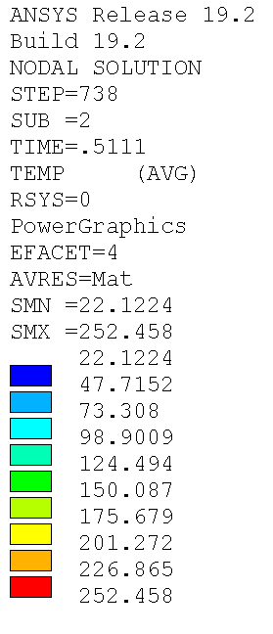
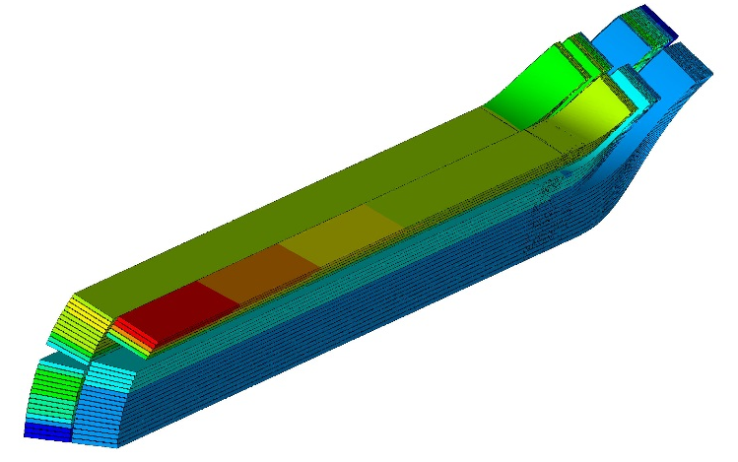
3D MECHANICS OF A QH PROTECTED MAGNET
Case study: Nominal current training quench
The reference case is simulated in 3D
  ~ 34 MIITS → Peak T at the end of the discharge = 252.5 K
  (Effect of longitudinal heat propagation)

Slide 31



3D MECHANICS OF A QH PROTECTED MAGNET
Case study: Nominal current training quench
A closer look to the 3D coil temperature (Insulation not shown)

Slide 32


3D MECHANICS OF A QH PROTECTED MAGNET
3D Mechanical results at the end of the discharge
AZIMUTHAL STRESS
Peak at Straight section = 137 MPa
Peak at coil ends = 154 MPa
Some areas in the coil ends see a higher stress. Some others see tension.
(Straight section results similar to 2D ~ 140 MPa)

Slide 33

3D MECHANICS OF A QH PROTECTED MAGNET
3D Mechanical results at the end of the discharge
RADIAL STRESS
Peak radial stress below 100 MPa

Slide 34


3D MECHANICS OF A QH PROTECTED MAGNET
3D Mechanical results at the end of the discharge
SPECIAL FOCUS ON HOT SPOT REGION
LONGITUDINAL STRESS
End of the discharge
Needs further study.
Work on-going with mech. model.
Local peak at Straight section = -71 MPa
For reference, after Cool down = +20 MPa

Slide 35



3D MECHANICS OF A QH PROTECTED MAGNET
3D Mechanical results at the end of the discharge
SHEAR STRESSES
SXY (Cartesian)
SYZ (Cartesian)
SXZ (Cartesian)

Slide 36
3D MECHANICS OF A QH PROTECTED MAGNET
Main conclusions and identified next steps
2D and 3D analysis of the quench mechanics give similar values in the straight section when singularities are neglected.
A peak azimuthal stress of 140 MPa appears close to the hot spot as a result of the thermal gradients. All other stresses remain well below that value.
Longitudinal stresses are very important close to the hot spot region. They need further study.
A more detailed analysis is necessary. Currently the 3D mechanical model is being re-checked by CERN and LARP. A new analysis will come soon.
This can be seen as a proof-of-concept right now.

Slide 37
OUTLINE
1.- Introduction – Quench processes and superconducting magnets
2.- MQXF – The low-β quadrupole for HL-LHC
3.- Finite element modelling for the analysis of the magnet mechanics during a quench
4.- 2D FE Analysis of a quench heater protected magnet
5.- 3D FE Analysis of a quench heater protected magnet
6.- Final conclusions

Slide 38

CONCLUSIONS
A methodology for the 2D and 3D study of the magnet mechanics during a quench has been presented.
It uses a combination of finite element models in ANSYS APDL with other usual tools used in the magnet community.
The different models have been validated with experimental measurements separately.
The method allows to extract essential information about the magnet behavior during a quench.
The 3D case needs to be further studied. The model is currently being re-checked.
More to come in the following months… stay tuned!

Slide 40


INTRODUCTION
Quench simulation in superconducting magnets
Many codes available in the community. From lumped elements formulations to Finite Element (FE) models.
Since FE models are our main tool for the simulation of the magnet mechanics during the assembly and operation…
Could we integrate the analysis of the magnet mechanics during quench in these models?
Temp. distribution in a racetrack coil during a quench
(P. Ferracin)
2004
The efforts on using ANSYS APDL to model quench processes started long time ago, now new and more advance techniques are available¹
Temp. distribution in a MQXF coil during a quench
(J. Ferradas)
2018
¹L. Brower, ANSYS User defined elements for quench simulation

Slide 41

MQXF
MQXF Low-β quadrupole magnet: Mechanical concept
Bladder Operation / Key Insertion (Azimuthal Loading)
Longitudinal Loading
Pressure vessel welding
Cool-down
Powering

Slide 42




FE QUENCH ANALYSIS
Model results and validation
Very good agreement along the experimental campaign, both 2D and 3D.
Assembly and magnet powering
Pole
Shell
Loading
Cool-Down

Slide 43

2D MECHANICS OF A QH PROTECTED MAGNET
2D Mechanical results: Stress evolution
Peak Von Misses equivalent stress at the end of the discharge ~ 164 MPa
  Stress evolution during quench is important
VM Eqv.
Most conservative, keeping corner nodes
Radial
Shear
* Not necessary at the same place

Slide 44


3D MECHANICS OF A QH PROTECTED MAGNET
3D Mechanical results before quench
Before quench load step, very similar stress results when comparing 3D to 2D
Less problematic corner nodes
2D Azim. Stress after Cool Down
3D Azim. Stress after Cool-down
118 MPa*
111 MPa
(With corner nodes active 130 MPa*)
Remember plane stress assumed.

