Slide 1
An update of dynamic thermal-hydraulic simulations of the JT-60SA cryogenic system for preparing plasma operation
Presented by F. Bonne
S. Varinª, F. Bonneª*, C. Hoaª, S. Nicollet^{b}, L. Zani^{b}, J-C Vallet^{b}, E. Di Pietro^{c}, K. Fukui^{d}, K. Hamada^{d}, K. Natsume^{d}
ªUniv. Grenoble Alpes, CEA IRIG-d-SBT, Grenoble, 38000, France
^{b}CEA/IRFM Saint-Paul-lez-Durance 13108 France
^{c}Fusion for Energy, Broader Approach Program and Delivery Department, Boltzmannstr. 2, D-85748 Garching, Germany
^{d}Naka Fusion Institute, National Institute for Quantum Radiological Science and Technology, 801-1 Mukoyama, Naka, Ibaraki, 311-0193 Japan4

Slide 2
Outline
Introduction
Description of TF loop
Description of the models
Model assumptions
Results & discussion
Conclusion

Slide 3
Introduction

Slide 4
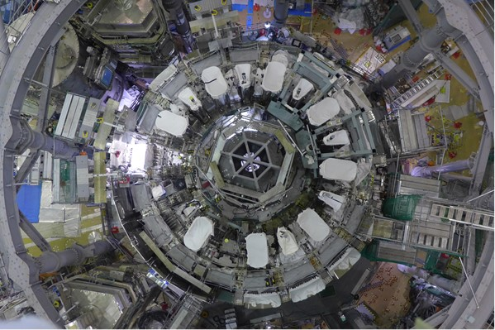
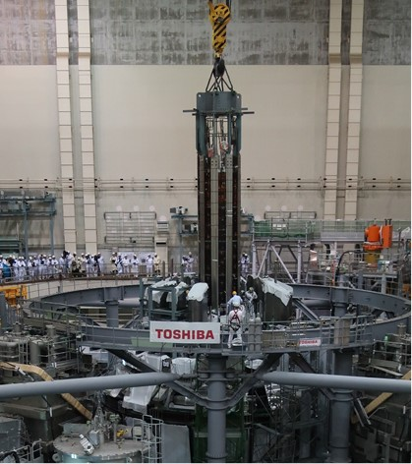
JT-60SA Tokamak
    Broader Approach agreement between Europe and Japan
    JT-60SA Tokamak currently under assembly in Naka, Japan
    First plasma operation in 2020

Slide 5
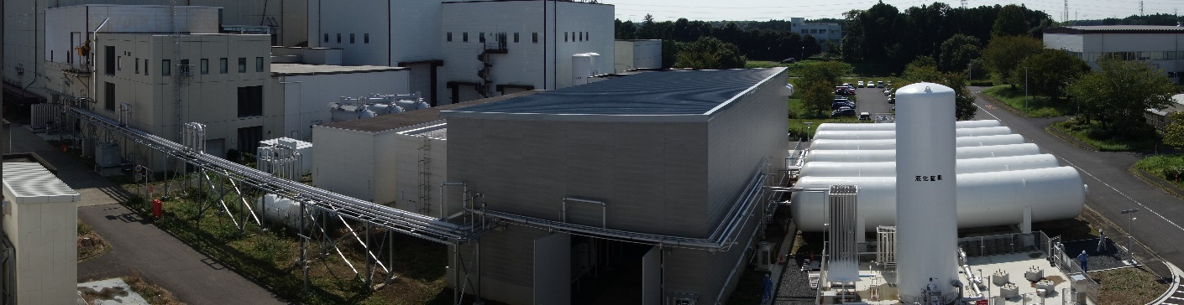
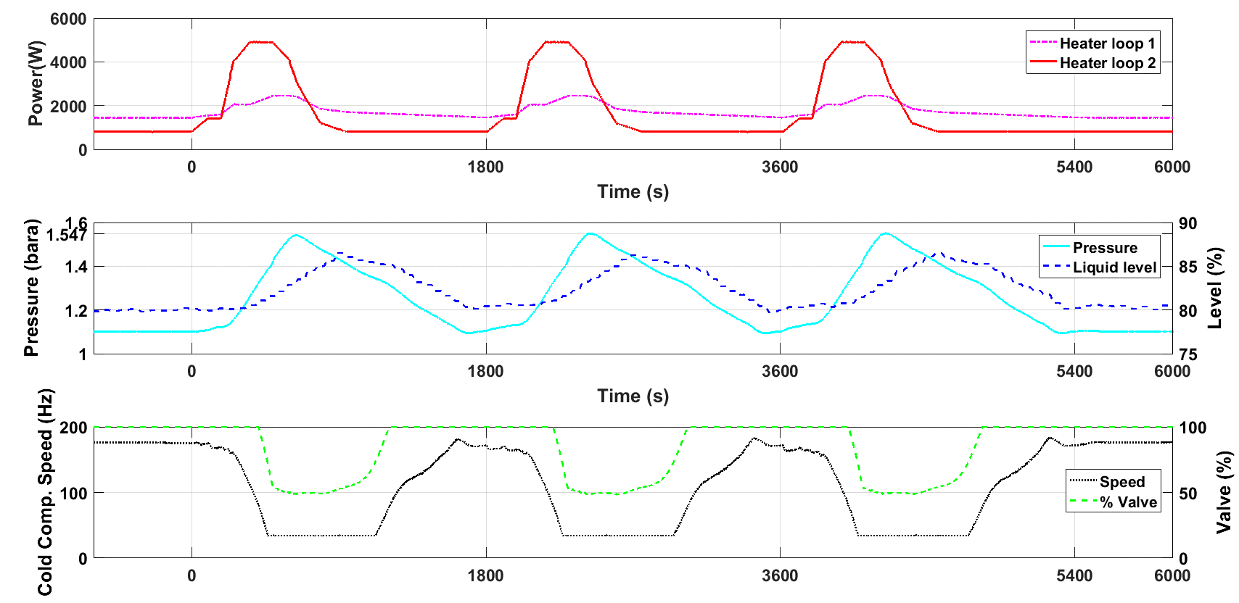
Acceptance tests of the cryogenic system
Commissioning of the cryogenic system in 2016 with the validation of the pulse operation
5

Slide 6
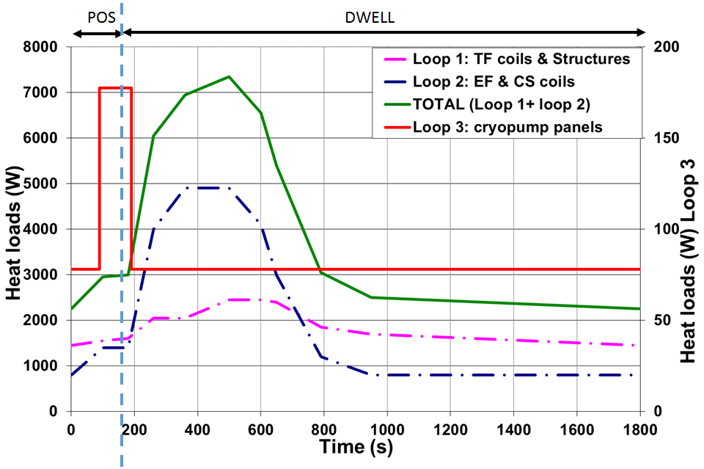
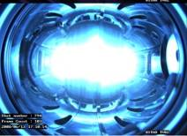


Motivations
        Reference scenario 60s/1800 s heat load profile was derived from Vincenta model (2010)
        Updated model with Simcyogenics to prepare the operation with first plasmas
          Cool down scenarios
          Short pulses

Slide 7
Motivations
New friction factor for TF is available
→ Measured with the cold test facility saclay
More realistic new assumptions are made

Slide 8
Description of TF loop

Slide 9
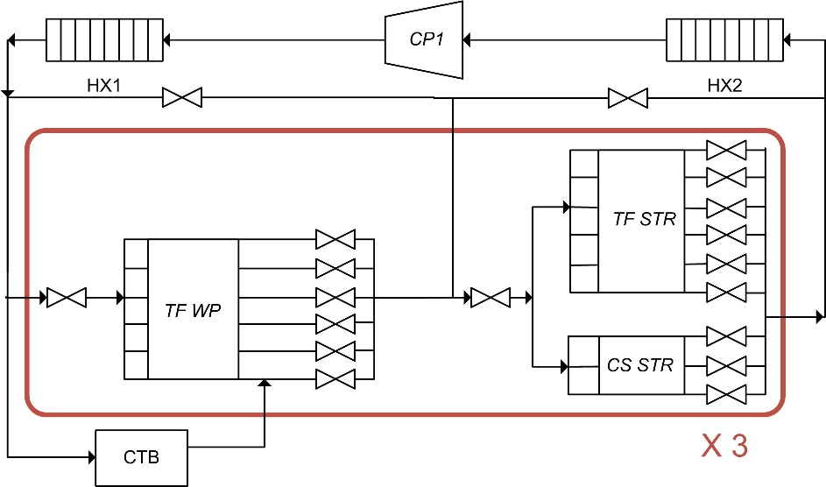
Description of TF loop & TF CICC
Description of TF loop & TF CICC
Simplified PFD of the TF loop
Characteristics of structures
6 bar
4.4 K
4.9 bar
4.4 K
 | TF str | CS str
Length (m) | 18.81 | 7.75
Helium cross-section area (m2) | 1e-4 | 1.963e-5
Number of structures | 18 | 9
Mass per structure (t) | 14.5 | 3.66

Slide 10
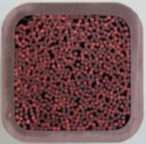
Description of TF loop & TF CICC
Description of TF loop & TF CICC
Characteristics of the TF CICC
Cross-section of the CICC
(Courtesy of S. Nicollet)
Properties
Length (m) | 113
Void fraction (-) | 0.32
Strand diameter (mm) | 0.81
Number of superconducting strands | 324
Number of copper strands | 162
Helium cross-section area (mm²) | 125.8
Wetted perimeter (m) | 1.108
Mass of winding pack (one TF coil) (t) | 5.7
22 mm
Stainless steel jacket
26 mm
NbTi & Cu strands

Slide 11
Description of the models

Slide 12
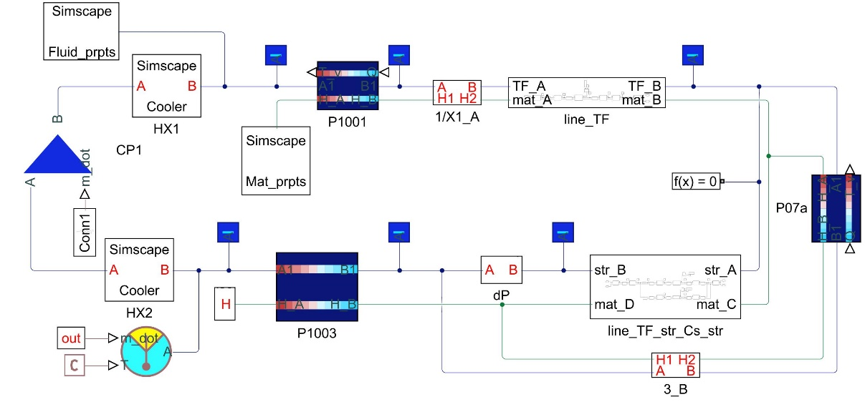
Description of the models
Vincenta model
Model using the Vincenta code with data available in 2010
Limitations & need for updates :
→ New values are now available for friction factor & heat load
→ Assumed an uniformly distributed heat load on the CICC
  → Ignored the inter-turn thermal coupling
Use Simcryogenics for an updated model

Slide 13

Description of the models
Simcryogenics model
Schematic of the TF loop

Slide 14
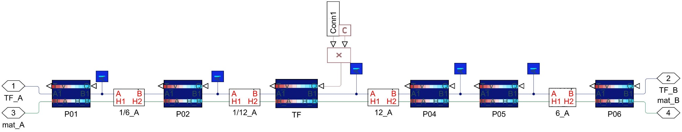
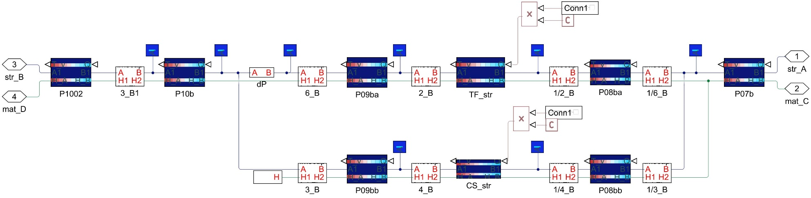
Description of the models
Simcryogenics model
Schematic of the branches containing TF CICC & structures
TF CICC
TF structure
cryo-distribution pipes
flow multipliers
CS structure

Slide 15
Model assumptions

Slide 16

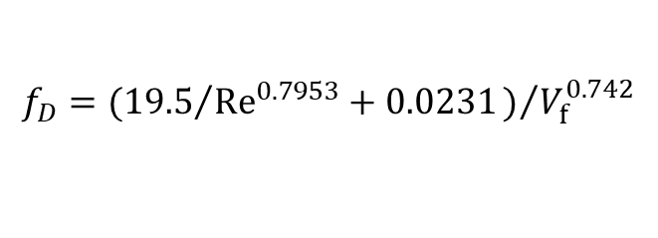
Model assumptions
Friction factor for the CICC
Previous method:
  A form of Katheder correlation proposed by Nicollet et al.
Correlations based on experimental data are now available:
$$f_{D}=({19.5}/{{Re}^{0.7953}}+0.0231)/{V_{f}^{0.742}}$$
$$f_{D}=α+β×{Re}^{γ}$$
(for TF coil 12: α: [0.09, 0.12], β: [14.3, 49.7], γ: [-0.79, -0.61])
A higher-than-expected pressure drop
➔ use of a reduced mass flowrate of 3 g/s in the TF CICC

Slide 17
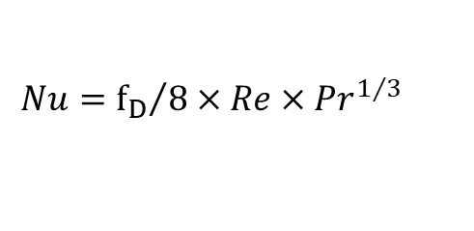
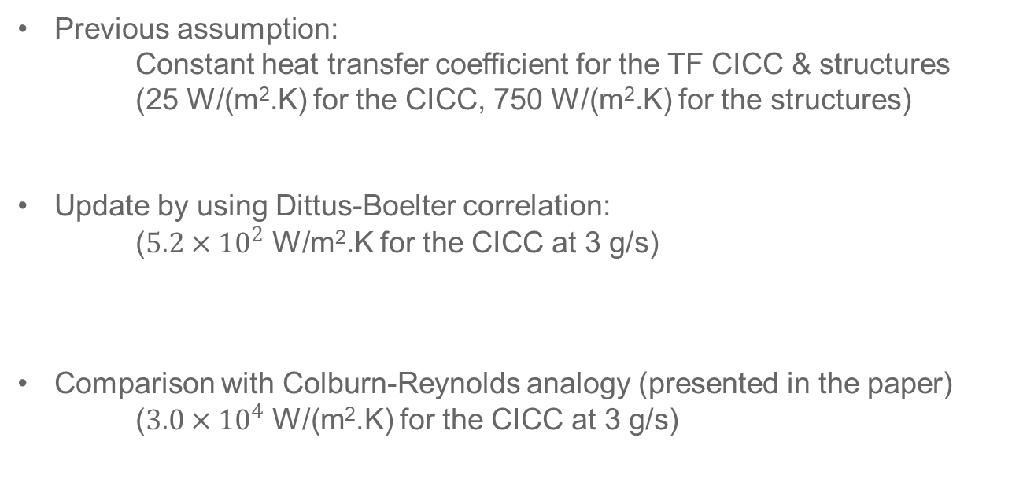

Model assumptions
Heat transfer coefficient
Previous assumption:
Constant heat transfer coefficient for the TF CICC & structures
(25 W/(m².K) for the CICC, 750 W/(m².K) for the structures)
Update by using Dittus-Boelter correlation:
($5.2×{10}^{2}$ W/m².K for the CICC at 3 g/s)
Comparison with Colburn-Reynolds analogy (presented in the paper)
($3.0×{10}^{4}$ W/(m².K) for the CICC at 3 g/s)
$$Nu=0.023×{Re}^{0.8}×{Pr}^{0.4}$$
$$Nu={f_{D}}/8×Re×{Pr}^{1/3}$$

Slide 18
Model assumptions
Heat load
Updated heat load : 14% contingency
Non-uniformly distributed heat load
 | Turn 1 | Turn 2 | Turn 3 | Turn 4 | Turn 5 | Turn 6
distribution | 51% | 21% | 13% | 7% | 4% | 4%

Slide 19
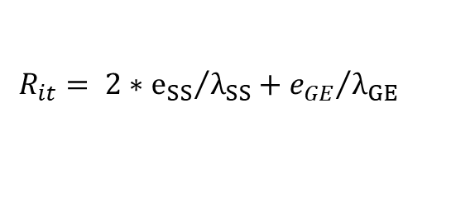
Model assumptions
Inter-turn thermal coupling
Thermal coupling between the successive turns of the jacket
22 mm
epoxy
Stainless steel jacket
turn 1
26 mm
NbTi & Cu strands
turn 2
inlet
turn 3
outlet
Cross-section of the CICC
turn 4
(Courtesy of S. Nicollet)
turn 5
turn 6
Calculation of thermal resistance
$$R_{it}= 2∗{e_{SS}}/{λ_{SS}}+{e_{GE}}/{λ_{GE}}$$
SS: stainless steel / GE: glass-epoxy
(typical values: 0.69 to 0.72 W/(m.K))
Simplified diagram of one pancake of TF coil

Slide 20
Results and discussion

Slide 21
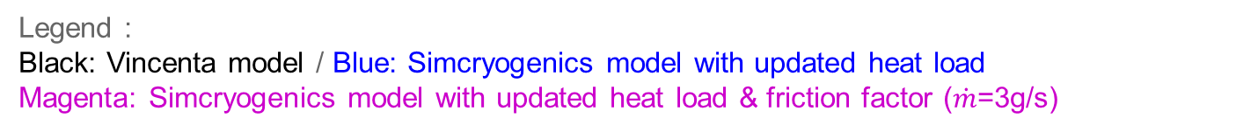
Results and discussion
Update of heat load & friction factor
Legend :
Black: Vincenta model / Blue: Simcryogenics model with updated heat load
Magenta: Simcryogenics model with updated heat load & friction factor ($\dot{m}$=3g/s)

Slide 22

Results and discussion
Update of heat load & friction factor
Combined updates of heat load & friction factor:
Increase of structure temperature
Longer duration for the CICC outlet temperature to reach its initial value
Decrease of the power received by HX2
Legend :
Black: Vincenta model / Blue: Simcryogenics model with updated heat load
Magenta: Simcryogenics model with updated heat load & friction factor ($\dot{m}$=3g/s)

Slide 23
Results and discussion
Inter-turn thermal coupling:
  Experimental test
Additional test in the Cold Test facility (CTF)
study the effect of the inter-turn thermal coupling
Compare experimental results to simulation results
Experimental setup
(Abdel Maksoud et al. 2015)

Slide 24
Results and discussion
Inter-turn thermal coupling:
  Comparison between the experiment and Simcryogenics model
Outlet temperature after a fast increase of 1K in inlet temperature
➔ A more consistent model after taking into account the inter-turn thermal coupling

Slide 25
Results and discussion
Update of heat load & friction factor (a quick reminder of the results)
Legend :
Black: Vincenta model / Blue: Simcryogenics model with updated heat load
Magenta: Simcryogenics model with updated heat load & friction factor ($\dot{m}$=3g/s)

Slide 26
Results and discussion
Inter-turn thermal coupling:
  model of the TF loop
Legend :
Black: Vincenta model / Blue: Updated Simcryogenics model with non-uniformly distributed heat load Magenta: Updated Simcryogenics model with non-uniformly distributed heat load & inter-turn thermal coupling

Slide 27
Results and discussion
Inter-turn thermal coupling: model of the TF loop
Non-uniformly distributed heat load:
Increase of CICC outlet temperature
Increase of the power received by HX2
Inter-turn thermal coupling:
Decrease of CICC outlet temperature
Decrease of the power received by HX2
Longer duration for the CICC outlet temperature to reach its initial value
Legend :
Black: Vincenta model / Blue: Updated Simcryogenics model with non-uniformly distributed heat load Magenta: Updated Simcryogenics model with non-uniformly distributed heat load & inter-turn thermal coupling

Slide 28

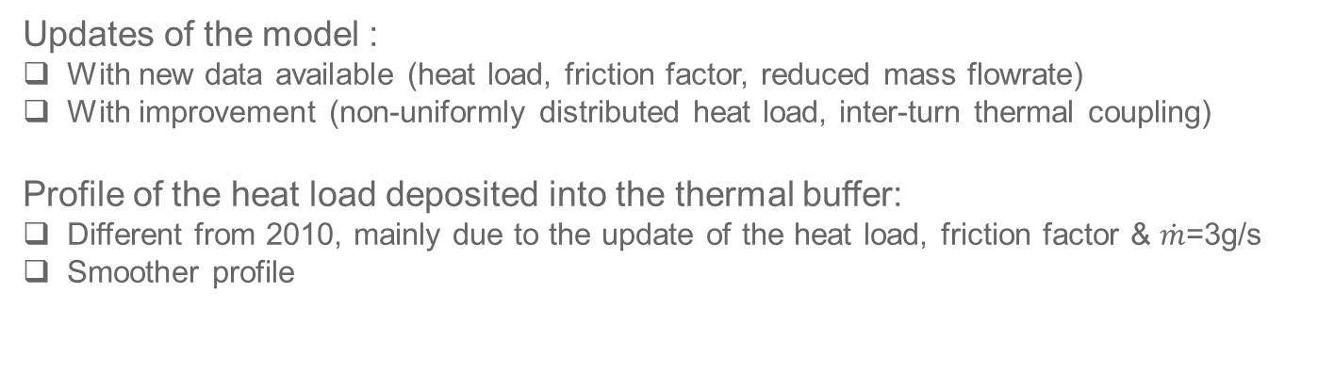
Conclusion
Conclusion
Updates of the model :
With new data available (heat load, friction factor, reduced mass flowrate)
With improvement (non-uniformly distributed heat load, inter-turn thermal coupling)
Profile of the heat load deposited into the thermal buffer:
Different from 2010, mainly due to the update of the heat load, friction factor & $\dot{m}$=3g/s
Smoother profile
Future applications:
The model can be used:
for preparing plasma operation in the coming years
for being coupled with the cryogenic system
for testing the control strategies related to pulse operation
for investigating cool down scenarios

