Slide 1
Hollow Electron Lens
Quench Protection Design and Analysis status update
TE-MPE (HEL Quench Protection):
M. Maciejewski, M. Mentink, D. Wollmann, A. Verweij
EN-MME (HEL Design):
G. Gobbi, D. Perini + G. Kirby (TE-MSC)

Slide 2
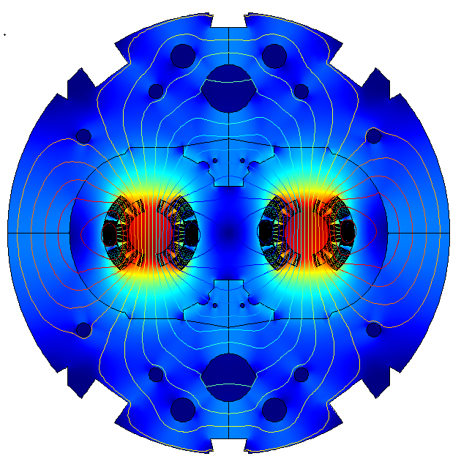




Superconducting Accelerator Circuits
– Numerical Challenges
LHC
27 km
Field/network model of a magnet
Partial differential equations
Varying time constants
~10us (quench) - ~10ms (losses)
Varying geometric scales
~10 um (filaments) - ~10 m (magnet)
~10 k degrees of freedom
Highly non-linear material properties
and equations
$$\vec{B }$$
Controller Model
Differential-algebraic equations
Fixed frequency of operation
10-100 elements
Non-linear behaviour
$$\vec{F }$$
$$\vec{v }$$
Network model of a circuit
I_{ref}
+
PI
Differential-algebraic equations
Varying time constants
~1 ms (switch) - ~10 min (circuit discharge)
Varying geometric scales
~10 cm (diode) - ~10 km (circuit)
~10 k elements
Non-linear behaviour
-
M2
M154
U
A
R
Busbar Model
Partial differential equations
Varying time constants
Adaptive mesh refinement
~1k elements
Non-linear behaviour
Multi-Domain, Multi-Physics, Multi-Rate and Multi-Scale Problem

Slide 3



Simulation of Transient Effects in Accelerator Magnets
- Our Solution
Multi-domain – dedicated, domain-specific numerical tools
Multi-physics – strong coupling in single model,
weak coupling of independent models
Multi-rate – interaction, coupling of two or more models
Multi-scale – interaction, coupling of two or more models
We use our models for performance evaluation of SC magnets and circuits for
LHC
No free lunch theorem – One tool can not simulate it all!

Slide 4

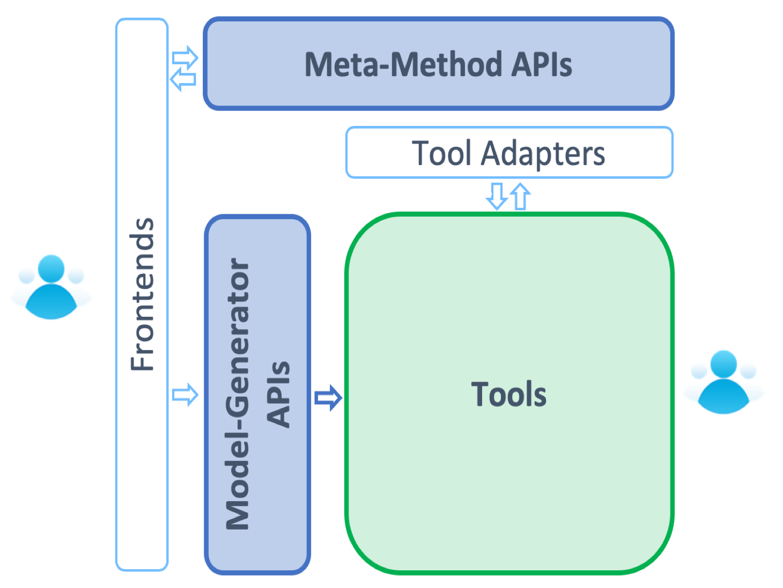
STEAM Overview
4. Meta-Methods
(Co-simulation, optimization)
STEAM is a simulation framework to study transient effects in SC magnets.
STEAM consists of five pillars:
Numerical tools
→ standalone, co-simulation
Model generation API
Tool adapter API
Meta-Methods
→co-simulation, optimization
Front-end to interact with APIs
3. Tool Adapter APIs
5. Frontends (Jupyter, Matlab)
1. Tools
(BBQ, ProteCCT, LEDET, ANSYS, COMSOL, PSIM, PSpice, LTSpice, QLASA)
2. Model-Generator
APIs
https://cern.ch/steam

Slide 5
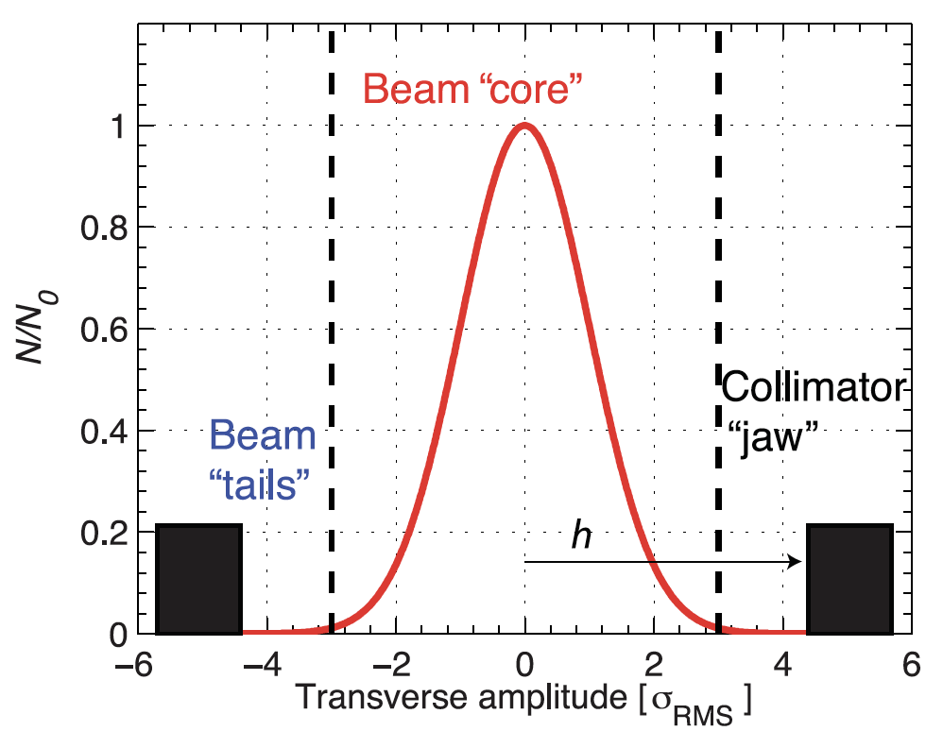
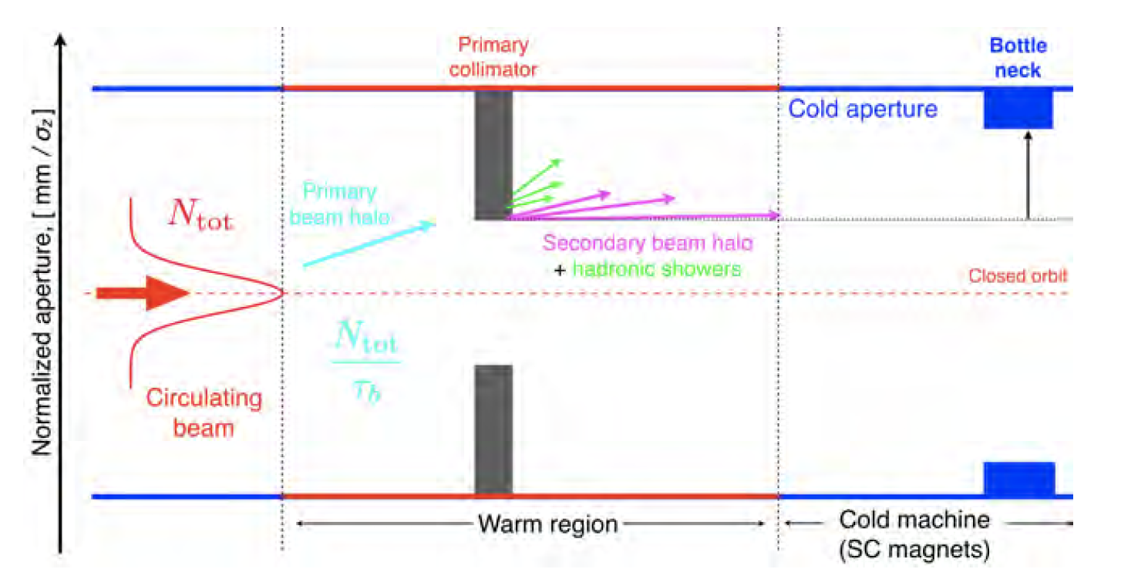
Beam Cleaning – Collimation system
LHC
27 km
S. Redaelli, Beam Cleaning and Collimation Systems

Slide 6
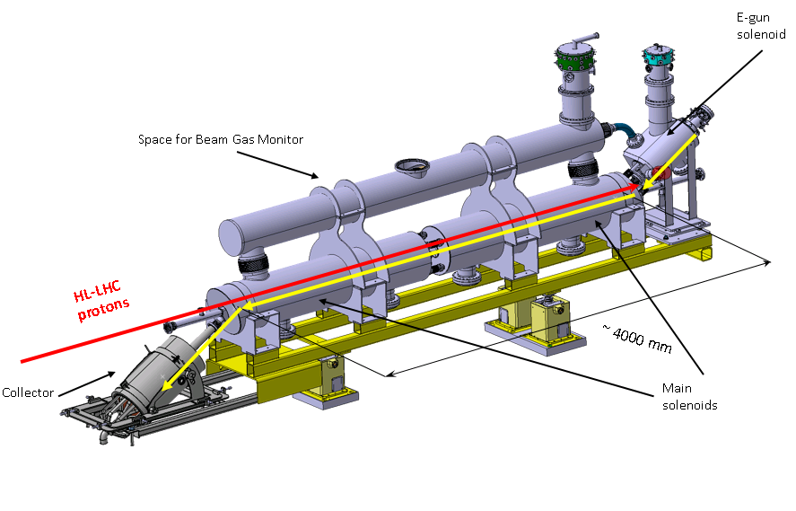
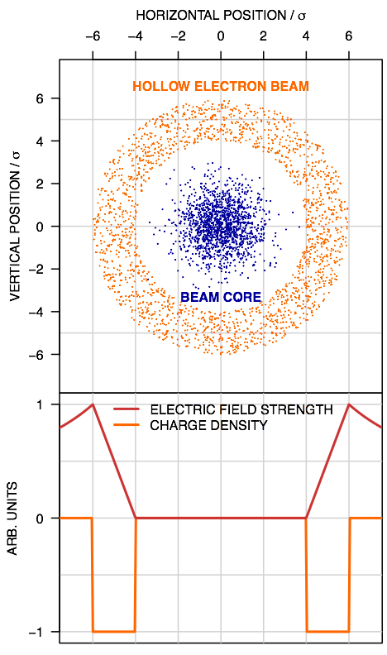
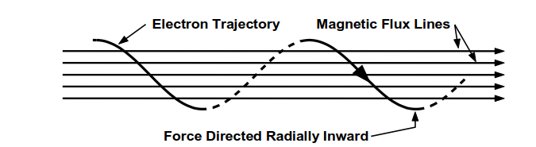
The HEL System – SC Magnets
Operating Principle (Collimator)*
-
-
-
-
+
-
-
-
-
Magnetic Flux Lines
Electron Trajectory
Force Directed Radially Inward
The Hollow Electron Lens system consists of multiple superconducting magnets for
Guiding the hollow beam of electrons:
  (main solenoid, bending solenoid, solenoid after valve, e-gun, CCT)
Correcting the field imperfections and fine tune the beam position:
  (4 for the main solenoid, 4 for the main bending, 2 for the e-gun)
The aim of this work is to study the protectability of the superconducting circuits.
HL-MCF Meeting # 46: Conceptual Design of IFS, CLIQ and K-MOD Feeders+ Quench Study for MCBXF Magnets + Status on HEL Circuits, https://indico.cern.ch/event/794680/ D. Perini: Status Report on HEL Circuits
*A. Bertarelli, et al. Hollow Electron Lens Update, Collimation Upgrade Specification Meeting #56

Slide 7
Outline
System Overview + Methodology
Quench Protection Design
  E-gun cathode
  Solenoid After Valve + e-gun
  Main Bending Solenoids
  Main Solenoids
Summary
direction of electrons

Slide 8
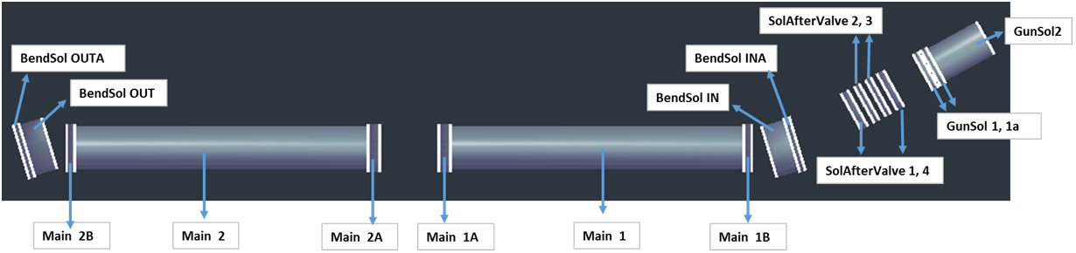
1. System Overview*
direction of electrons
- Bx
- By
- Bz
- Btot
* Bcathode
* Bvalve
*G. Gobbi, D, Perini: Main parameters of HEL electrical circuits, EDMS 2036694

Slide 9
2. Solenoids – Powering Scheme
MainSol2_tot
MainSol1_tot
BendSolGunSol_tot
GunSol
PC+EE
330 A
PC+EE
330 A
PC+EE
320 A
PC+EE
257 A
BendSol_tot
PC+EE
335 A
Differential Inductance [mH]
Stored Energy [kJ]
 | GunSol | BendSolGunSol_tot | BendSol_tot | MainSol1_tot | MainSol2_tot
GunSol | 834.18 | 100.79 | 1.63 | 1.92 | 0.19
BendSolGunSol_tot | 100.79 | 806.74 | 13.24 | 7.29 | 0.34
BendSol_tot | 1.63 | 13.24 | 2146.47 | 130.35 | 130.35
MainSol1_tot | 1.92 | 7.29 | 130.35 | 8877.46 | 49.91
MainSol2_tot | 0.19 | 0.34 | 130.35 | 49.91 | 8877.46
GunSol | 32
BendSolGunSol_tot | 47
BendSol_tot | 135
MainSol1_tot | 494
MainSol2_tot | 493
BendSolGunSol_tot = SolAftValve1…4 + GunSol1 + GunSol1a; GunSol = GunSol2
MainSol1_tot = Main1 + Main1A + Main1B; MainSol2_tot = Main2+Main2A + Main2B
BendSol_tot = BendSolIN + BendSolINA + BendSolIN + BendSolINA

Slide 10
2. Strategy for Quench Protection Analysis
We study the protection of busbars, magnets, and circuits.
We assume that if one of the main circuits quenches, all circuits are discharged.
For coils, we consider 100 mV threshold for quench detection and 10 ms validation.
In order to explore the parameter space, the following strategy was applied:
Quench propagation to calculate the quench detection time – 1D STEAM-BBQ model
Calculation of the maximum hot-spot temperature
  Quench integral curves with 1D STEAM-BBQ model
Calculation of minimum quench integral for a given maximum voltage to ground – Excel
  Neglecting internal magnet resistance growth and assuming constant inductance
  Constant energy extraction resistance
Iterate 3. varying energy extraction resistance until to conditions (can be adjusted) are met
T_{hot-spot} < 200 K - to limit the thermal load on the conductor as well as the cryogenic system
V_{ground,max} < 500 V - to limit the power converter common mode voltage and the insulation testing voltage
1
2
Design
iterations
3

Slide 11
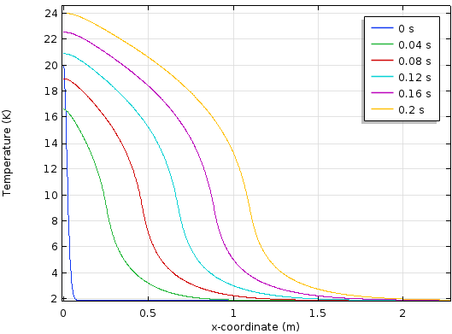
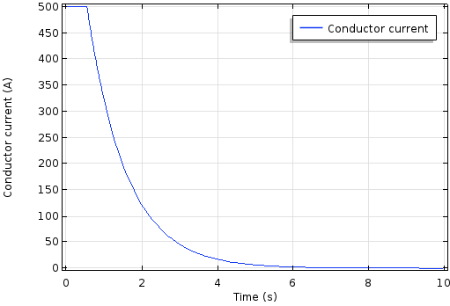
2. STEAM-BBQ - Overview
STEAM-BBQ [1]: FEM-based COMSOL model (inspiration: [2])
Calculation of quench-related conductor properties:
  Quench propagation velocity v_{Q}
  Development of voltage after quench origination for quench detection
  Hotspot temperature as a function of quench integral
For circuit with known discharge quench integral:
  Time-dependent current (Exponential decay after quench detected)
  Time-dependent hotspot temperature
Compatible with STEAM co-simulation framework
Temperature [K]
v_{Q}
x [m]
Temperature-development along length of conductor
Circuit current [A]
Time [s]
Courtesy: M. Mentink
Circuit current discharge
[1] M. Mentink and M. Maciejewski, “STEAM-BBQ User manual”, EDMS nr. 2159478, (2019)
[2] D. Paudel, CERN thesis 2015-090, June 30th (2015)

Slide 12
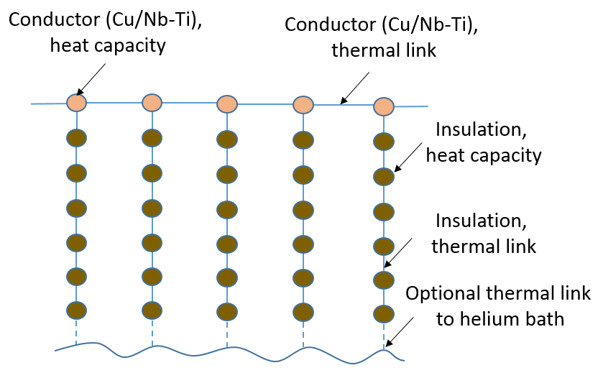
STEAM-BBQ - Thermal Aspects
BBQ dimensionality: 1+1D
  Longitudinal heat transfer
  Transverse heat transfer
  (one node for core, six for insulation layers)
  Optional heat transfer to helium bath
BBQ simultaneously calculates the busbar hotspot temperature in two ways:
  ‘Adiabatic hotspot temperature’:
  No longitudinal heat propagation
  perfect transverse heat propagation without cooling to bath
  Regular hotspot temperature, with longitudinal heat propagation and transverse heat propagation
Uses STEAM material library for user-selected material properties (with cross-checked temperature and magnetic-field dependence)
Thermal layout: 1+1D dimensionality
Courtesy: M. Mentink
[1] M. Mentink and M. Maciejewski, “STEAM-BBQ User manual”, EDMS nr. 2159478, (2019)
[2] D. Paudel, CERN thesis 2015-090, June 30th (2015)

Slide 13
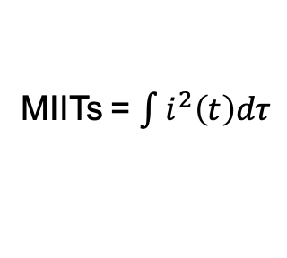
Computation methodology
The goal is to calculate the peak voltage to ground and hot-spot temperature.
i(t)
→
MIITs = $\int{i^{2}\left(t\right)dτ}$
→
t_{q}
t_{d}
t_{d+v}
t
→
Vmax
Tmax
Voltage to ground
Hot-spot temperature
100 mV detection threshold
Energy extraction resistance

Slide 14
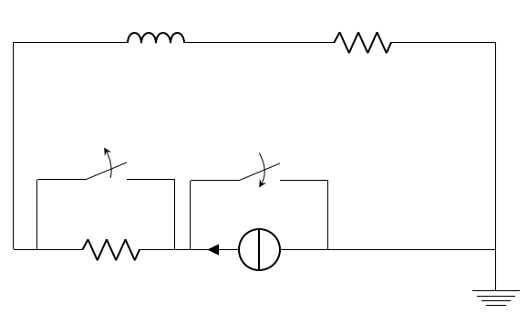
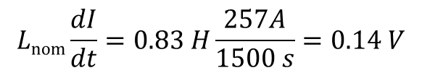
2.A. E-gun Cathode - Parameters
Magnet geometry
Parameter | Value
Cu/Nb-Ti | 4:1
I_{c}(5 T, 4.2 K) | >= 750 A
RRR | >=100*
I_{nom} | 257 A
J_{nom} | 149 A/mm²
L_{nom} | 0.83 H
B_{nom,max} | 3.7 T
V_{Rleads} @ I_{nom} | 1 V
15-20 um
1.05 mm
1.65 mm
Cable with polymide insulation
76 mm
Same conductor for all coils
109 mm
39.6 mm
Circuit topology
HEL circuits follow LHC powering cycle
L_{nom}
I [A]
R_{leads}
I_{RB} = 11850 A
t = t_{detect+validate}
I_{nom} = 257 A
1500
t [s]
R_{EE}
I_{nom}
Inductive voltage during ramp-up
$$Lnom\frac{dI}{dt}=0.83 H\frac{257A}{1500 s}=0.14 V$$

Slide 15
2.A. E-gun – Energy Extraction Resistance Sweep
Quench detection and validation time
RRR | 80 | 100 | 150 | 300
t_{detect+validate} [ms] | 160 | 190 | 220 | 270
Voltage to ground and hot-spot temperature as a function of energy extraction resistance.
Energy extraction grounded at the input terminal.
With the maximum temperature (200 K) and voltage to ground (500 V)
the permissible energy extraction resistance values span from 0.12 to 1.9 Ω.
Notes:
Results are available at \\cern.ch\dfs\Projects\STEAM\HL-LHC\Hollow Electron Lens\Th\COMSOL\9
Results are available at \\cern.ch\dfs\Projects\STEAM\HL-LHC\Hollow Electron Lens\El\Excel\2

Slide 16
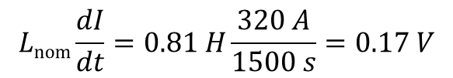
2.B. Solenoids After Valve + e-gun - Parameters
Magnet geometry
Same conductor as in the e-gun solenoid
Parameter | Value
I_{nom} | 320 A
J_{nom} | 185 A/mm²
L_{nom} | 0.81 H
B_{nom,max} | 3.1 T
39.6 mm
76 mm
109 mm
Circuit topology
Inductive voltage during ramp-up
L_{nom}
R_{leads}
$$Lnom\frac{dI}{dt}=0.81 H\frac{320 A}{1500 s}=0.17 V$$
t = t_{detect+validate}
R_{EE}
I_{nom}

Slide 17
2.B. Solenoid after Valve + e-gun – Energy Extraction Resistance Sweep
Quench detection and validation time
RRR | 80 | 100 | 150 | 300
t_{detect+validate} [ms] | 105 | 115 | 125 | 165
Voltage to ground and hot-spot temperature as a function of energy extraction resistance.
Energy extraction grounded at the input terminal.
With the maximum temperature (200 K) and voltage to ground (500 V)
the permissible energy extraction resistance values span from 0.2 to 1.56 Ω.
Notes:
Results are available at \\cern.ch\dfs\Projects\STEAM\HL-LHC\Hollow Electron Lens\Th\COMSOL\8
Results are available at \\cern.ch\dfs\Projects\STEAM\HL-LHC\Hollow Electron Lens\El\Excel\2

Slide 18
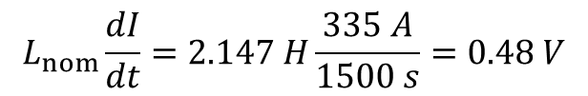
2.C. Bending Solenoids - Parameters
Magnet geometry
Same conductor as in the e-gun solenoid
150 mm
Parameter | Value
I_{nom} | 335 A
J_{nom} | 193 A/mm²
L_{nom} | 2.147 H
B_{nom,max} | 3.5 T
258 mm
321 mm
Circuit topology
Inductive voltage during ramp-up
L_{nom}
$$L_{nom}\frac{dI}{dt}=2.147 H\frac{335 A}{1500 s}=0.48 V$$
R_{leads}
t = t_{detect+validate}
R_{EE}
I_{nom}
CCT temporarily removed from the circuit.

Slide 19
2.C. Bending Solenoids - Energy Extraction Resistance Sweep
Quench detection and validation time
RRR | 80 | 100 | 150 | 300
t_{detect+validate} [ms] | 105 | 115 | 125 | 165
Voltage to ground and hot-spot temperature as a function of energy extraction resistance.
Energy extraction grounded at the input terminal.
With the maximum temperature (200 K) and voltage to ground (500 V)
the permissible energy extraction resistance values span from 0.65 to 1.5 Ω.
To stay below the limits, the maximum allowed inductance for the CCT is 8 H.
Notes:
Results are available at \\cern.ch\dfs\Projects\STEAM\HL-LHC\Hollow Electron Lens\Th\COMSOL\7
Results are available at \\cern.ch\dfs\Projects\STEAM\HL-LHC\Hollow Electron Lens\El\Excel\2

Slide 20
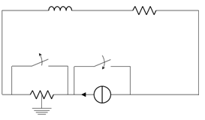
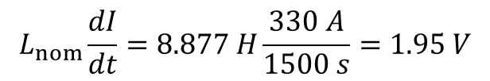
2.D. Main Solenoid - Parameters
Magnet geometry
Same conductor as in the e-gun solenoid
1599 mm
Parameter | Value
I_{nom} | 330 A
J_{nom} | 191 A/mm²
L_{nom} | 8.877 H
B_{nom,max} | 5 T
180 mm
249.3 mm
Circuit topology
Inductive voltage during ramp-up
L_{nom}
R_{leads}
$$L_{nom}\frac{dI}{dt}=8.877 H\frac{330 A}{1500 s}=1.95 V$$
t = t_{detect+validate}
R_{EE}
I_{nom}
Feasibility of application of 600 A LHC power converter with EE grounded in the middle
for this circuit (maximum voltage, stored energy, inductance) has to be studied by TE-EPC.
20

Slide 21
2.D. Main Solenoid - Energy Extraction Resistance Sweep
Quench detection and validation time
RRR | 80 | 100 | 150 | 300
t_{detect+validate} [ms] | 65 | 75 | 85 | 95
Voltage to ground and hot-spot temperature as a function of energy extraction resistance.
Energy extraction grounded in the middle.
500 V during standard operation, up to 1 kV under earth fault on current lead.
With the maximum temperature (200 K) and voltage to ground (500 V)
the permissible energy extraction resistance values span from 2.46 to 3 Ω.
Notes:
Results are available at \\cern.ch\dfs\Projects\STEAM\HL-LHC\Hollow Electron Lens\Th\COMSOL\6
Results are available at \\cern.ch\dfs\Projects\STEAMHL-LHC\Hollow Electron Lens\El\Excel\2

Slide 22
3. Conclusion
    STEAM-BBQ allowed to carry out an end-to-end analysis
    All circuits except the main solenoid are protectable with a regular EE system.
    To limit the voltage to ground in the main solenoid circuit, for the main solenoid we assume that the energy extractor is grounded in the middle.
    The choice of the final EE resistance is a trade-off between the peak voltage and temperature (the peak values might need to be adjusted).
    Further studies involve analysis of protectability of corrector magnets.

