Slide 1
Interacting Gravitational Waves
Arundhati Dasgupta, University of Lethbridge
Siddhartha Morales, ADG `Scalar and Fermion Field Interaction with a Gravity Wave’ (to appear)

Slide 2
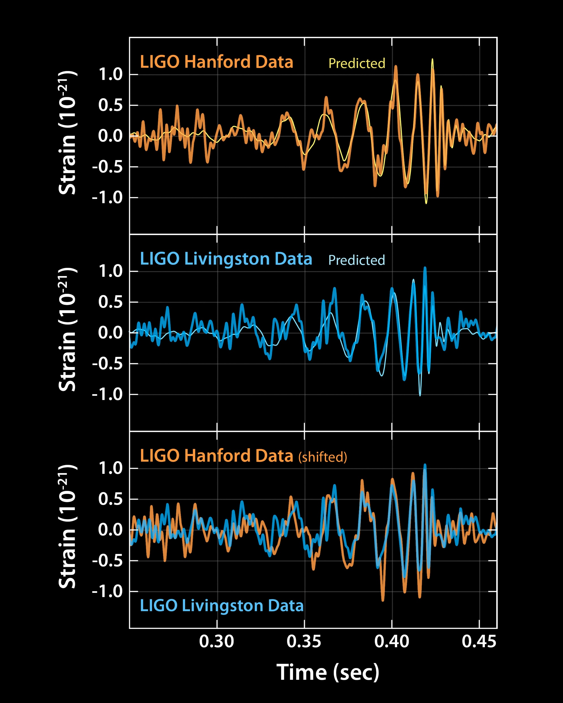
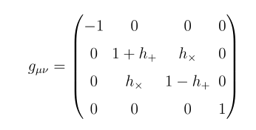


Gravitational Waves

Slide 3
Gravity Waves as the window to the Universe
Gravity waves from Black Hole binary mergers/Neutron Star mergers have already been detected
Gravity waves are expected to be emitted during the initial formation of the Universe. These are known as early Universe gravity waves, or primordial gravity waves
One expects them to have a stochastic distribution
They have not been detected yet
Could there be interactions/scatterings we have yet to search for?

Slide 4



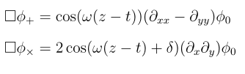
How does a scalar field (maybe the inflaton) react to the wave?
a Perturbative solution
Inhomogeneous differential equations

Slide 5
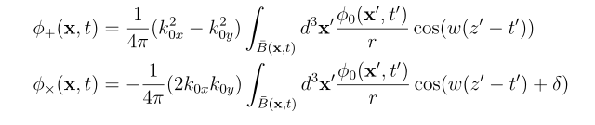

Kirchoff’s Laws and Duhamel’s principle
Solutions exist if the scalar wave has transverse components to the gravitational wave
No resonance, but an additional mode

Slide 6
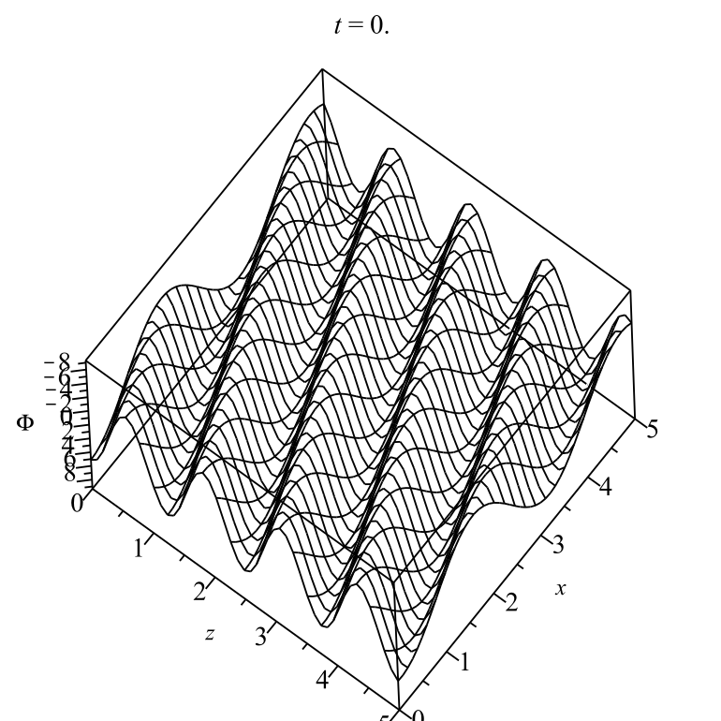
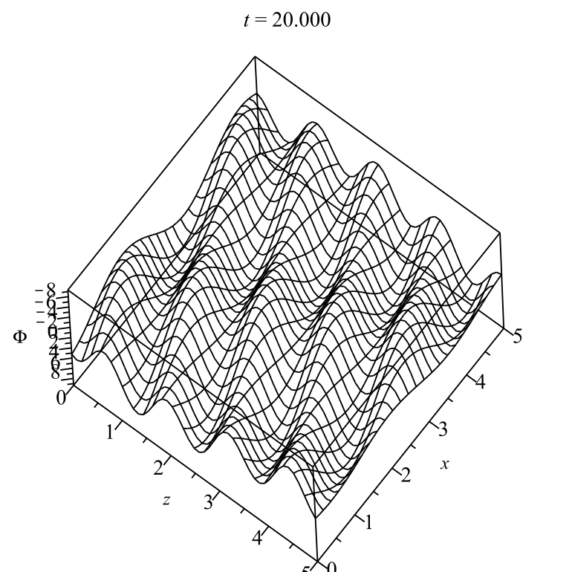
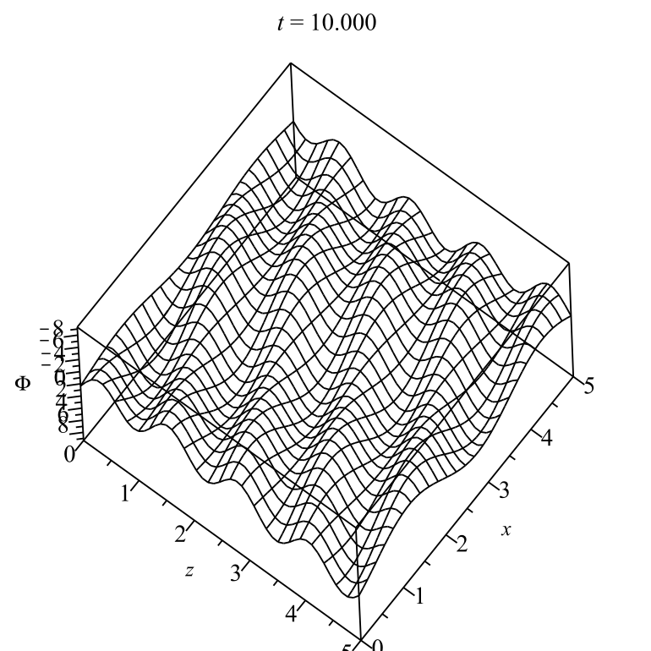

The scalar wave perturbation
In addition to the usual frequency, there is a new wave mode with dispersion

Slide 7



Massive scalar perturbation
Usual `beats’ pattern if one uses the linear propagator; and no resonance

Slide 8
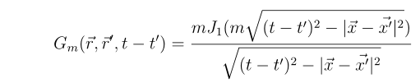
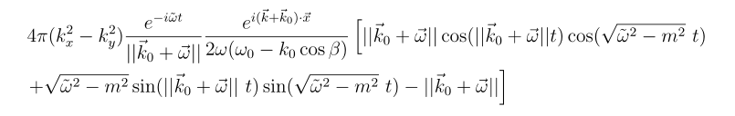
Spherical propagator
Similar perturbation to the massive scalar wave as the massless wave

Slide 9





Neutrino or massless fermions
Cross Polarization
Plus polarization

Slide 10
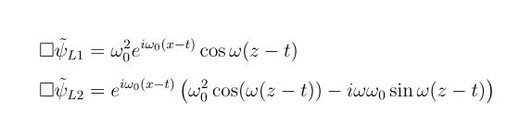
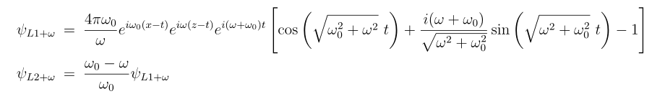
The plus polarization causes a perturbation in the Neutrino wave

Slide 11
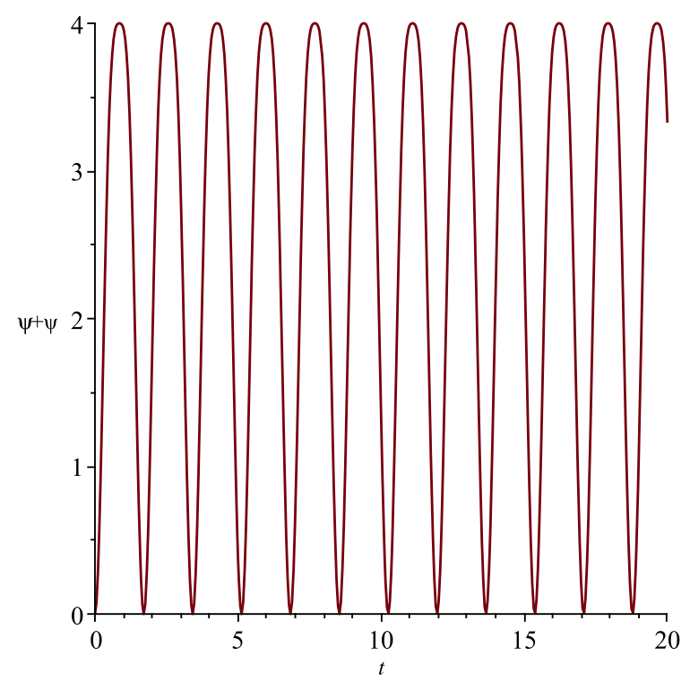
The Dirac Bilinear

Slide 12
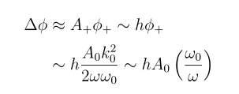

Can we use these oscillatory modes to detect gravity waves?
~10⁻³ -10⁻¹³

Slide 13
Multi-messenger astronomy
Neutron star mergers are expected to release both gravity waves and neutrinos.
The above calculation could have important implications for neutrinos from the event GW170817
This event did not detect any neutrinos by Ice Cube and ANTARES, but that is expected from the prediction that the outflow jet was not pointing towards the earth
We expect the neutrino flux to be perturbed when interacting with gravity waves

Slide 14

Early Universe Cosmology
Neutrinos from the early universe constitute what is known as the cosmic neutrino background
From the cosmological data it seems there is a slight discrepancy in the number of degrees of freedom, pointing towards small fluctuations
It could be that what we are observing is the regular neutrino flux+ perturbations due to interactions with gravity waves
N=3.13 +/- 0.31 (CMB data)
= 3.01+/- 0.15 (95% Planck+ BBN)
Neutrino density
Photon density

Slide 15
Detection on Earth
scalar waves can be used to detect gravitational waves
A normal stream of fermion waves will interfere with the gravitational waves to produce tiny oscillations, which can be detected.
Electromagnetic waves will also see such an oscillatory perturbation, it is not difficult to see, that a change in frequency of the Electromagnetic wave would be easy to detect on earth (work in progress)

