Slide 1



Towards measuring atomic parity violation effects in francium
Mukut Ranjan Kalita
TRIUMF
CAP 2019
Gerald Gwinner, Tim Hucko, Michael Kossin,
Andrew Senchuk, Anima Sharma
John Behr, Alexandre Gorelov, Matt Pearson
Eduardo Gomez
Luis Orozco
Seth Aubin
Operational funding by NSERC, NSF, NRC/TRIUMF.
Infrastructure support by DOE and NRC/TRIUMF.
Student support by the U. of Manitoba, travel support by CONACYT and Fulbright.

Slide 2
Atomic parity violation (aka APNC, PNC)
Atomic physics experiment, we use laser cooling and trapping techniques and study electronic transitions dominated by electromagnetism.
Small contribution to electronic transitions by Z boson exchange leading to parity violation effects.
e
e
V_{e}
Nuclear spin independent:
Weak neutral interaction between electrons and nucleons (mostly neutron)
Z⁰
A_{N}
N
N
e
e
Nuclear spin dependent:
Main contribution from anapole moment of heavy nuclei.
𝛾
W± ,Z⁰
N
N
Notes:
Small contribution to electronic transitions by parity violating effects and that is what we want to measure, When I say small it is really small, the oscillator strength is 10**-20 th of allowed transitions.

Slide 3
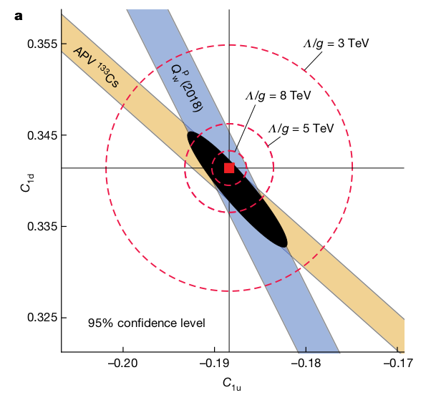

Atomic parity violation (aka APNC, PNC)
Q_{weak} Collaboration, Nature 557, 207–211 (2018)
Test SM at low energies
Search for extra bosons
M. S. Safronova et al. Rev. Mod. Phys. 90, 025008
G. Toh et al. arXiv:1905.02768v2

Slide 4
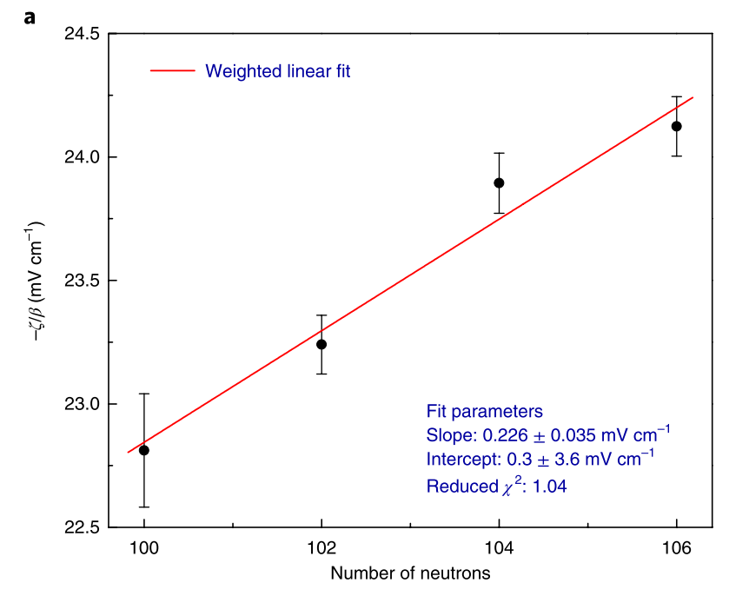
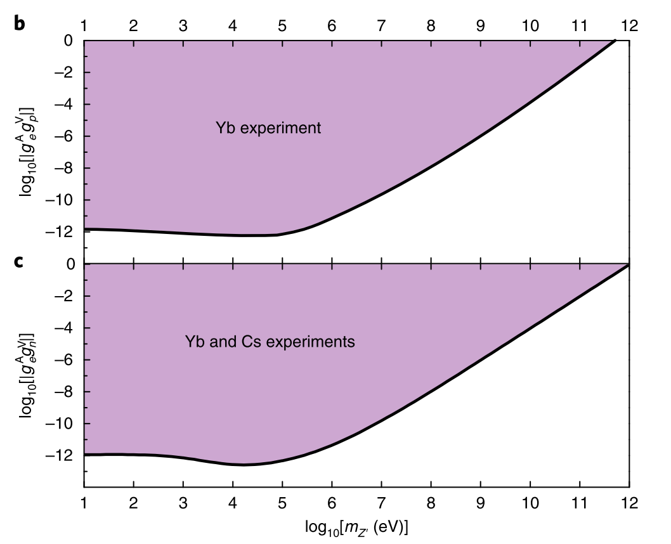
Atomic parity violation (aka APNC, PNC)
Isotopic variation of APV
Bounds on z/ boson mediated interactions
D. Antypas et al. Nat. Phys. 15, 120–123 (2019)
R. Diener et al. Phys. Rev. D 86, 115017
Test SM at low energies
Search for extra bosons

Slide 5
Measuring APV in ns ⇾ (n+1)s transition in heavy alkali atoms
Electric dipole forbidden.
Small transition probability due to APV effects ( ≈ 10⁻²⁰ of allowed in Fr).
Use Stark Interference technique.
(M. Bouchiat, C. Bouchiat J. Phys. (Paris) 36 (1975), 493)
R ∝ |A_{stark}+A_{APV}|² ≈ (A_{stark}) ² ± 2Re(A_{stark}A_{APV}*)
Interference term changes sign upon parity reversal
(n+1)s
Not detected
np_{3/2}
Excite
np_{1/2}
1
2
Detect
⇾ Modulation of decay fluorescence
ns
Average of 1 and 2: nuclear spin independent APNC
Difference of 1 and 2: Anapole

Slide 6
From measurement to extracting Q_{w}
Modulation of decay fluorescence measurement ➛ A_{APV} / A_{stark}
A_{stark} calibrated by separate measurements
A_{APV} = k_{PV} Q_{w}
Atomic structure factor from theory
Weak charge
Good experiment and good theory⇒ good test

Slide 7
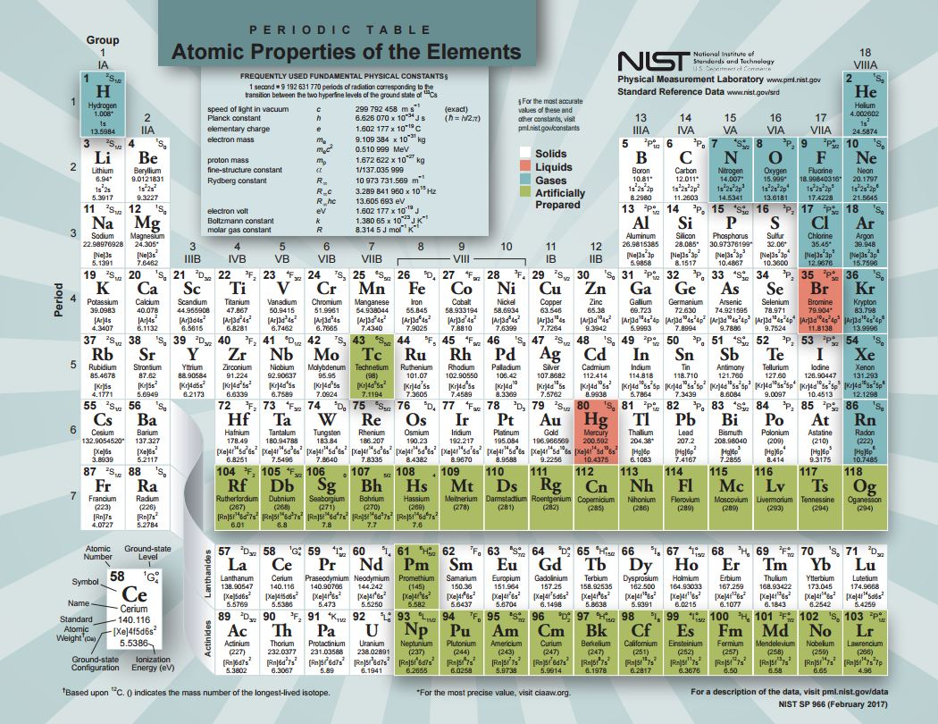
APV experiments:
Best measurement so far (Boulder) 0.35% (exp.) measurement.
Science 275 (1997) 1759
Purdue Elliot et at.
(in preparation).
1-2% measurement
done. Theory at several % level.
Planned exp. using
ions (Groningen, U. of Washington, UCSB)
Yb (exp. 0.5% level)
Nat. Phys. 15, 120–123 (2019)
APNC 18x larger
Th. can be done ≈ Cs
Range of isotopes available
Efforts to push Cs, Fr theory to 0.1%. (PRA 98, 032504 (2018))
Notes:
Cut time here.

Slide 8
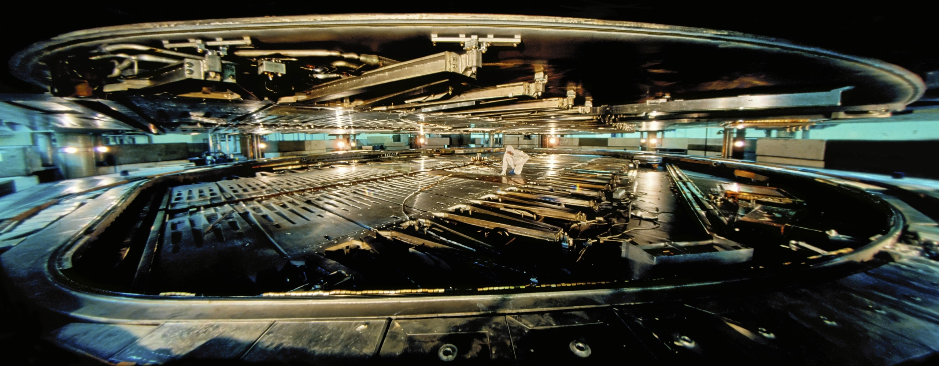
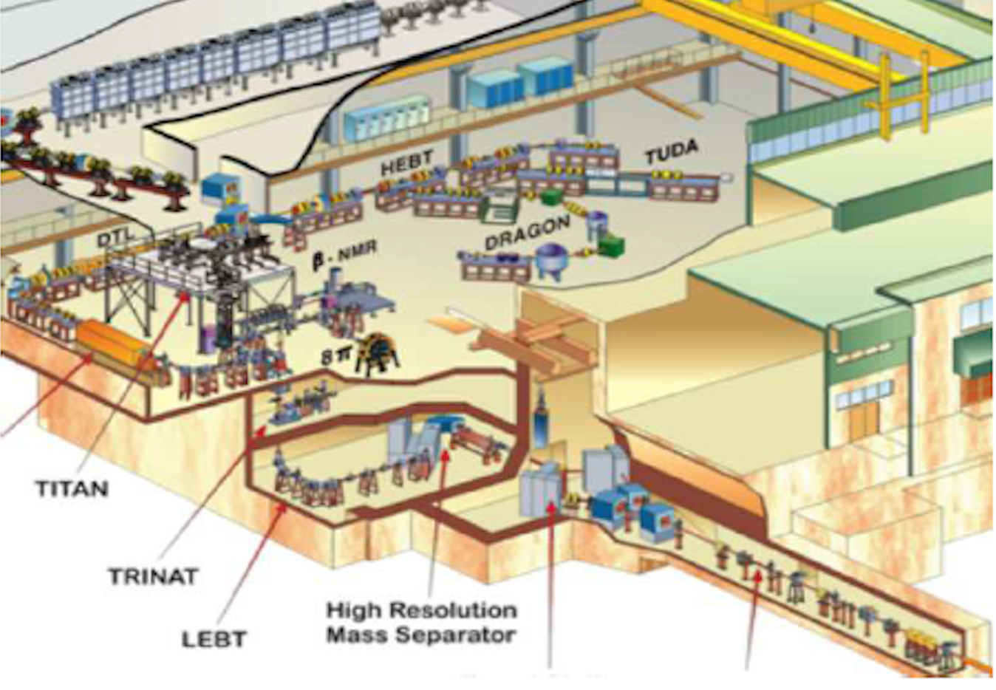
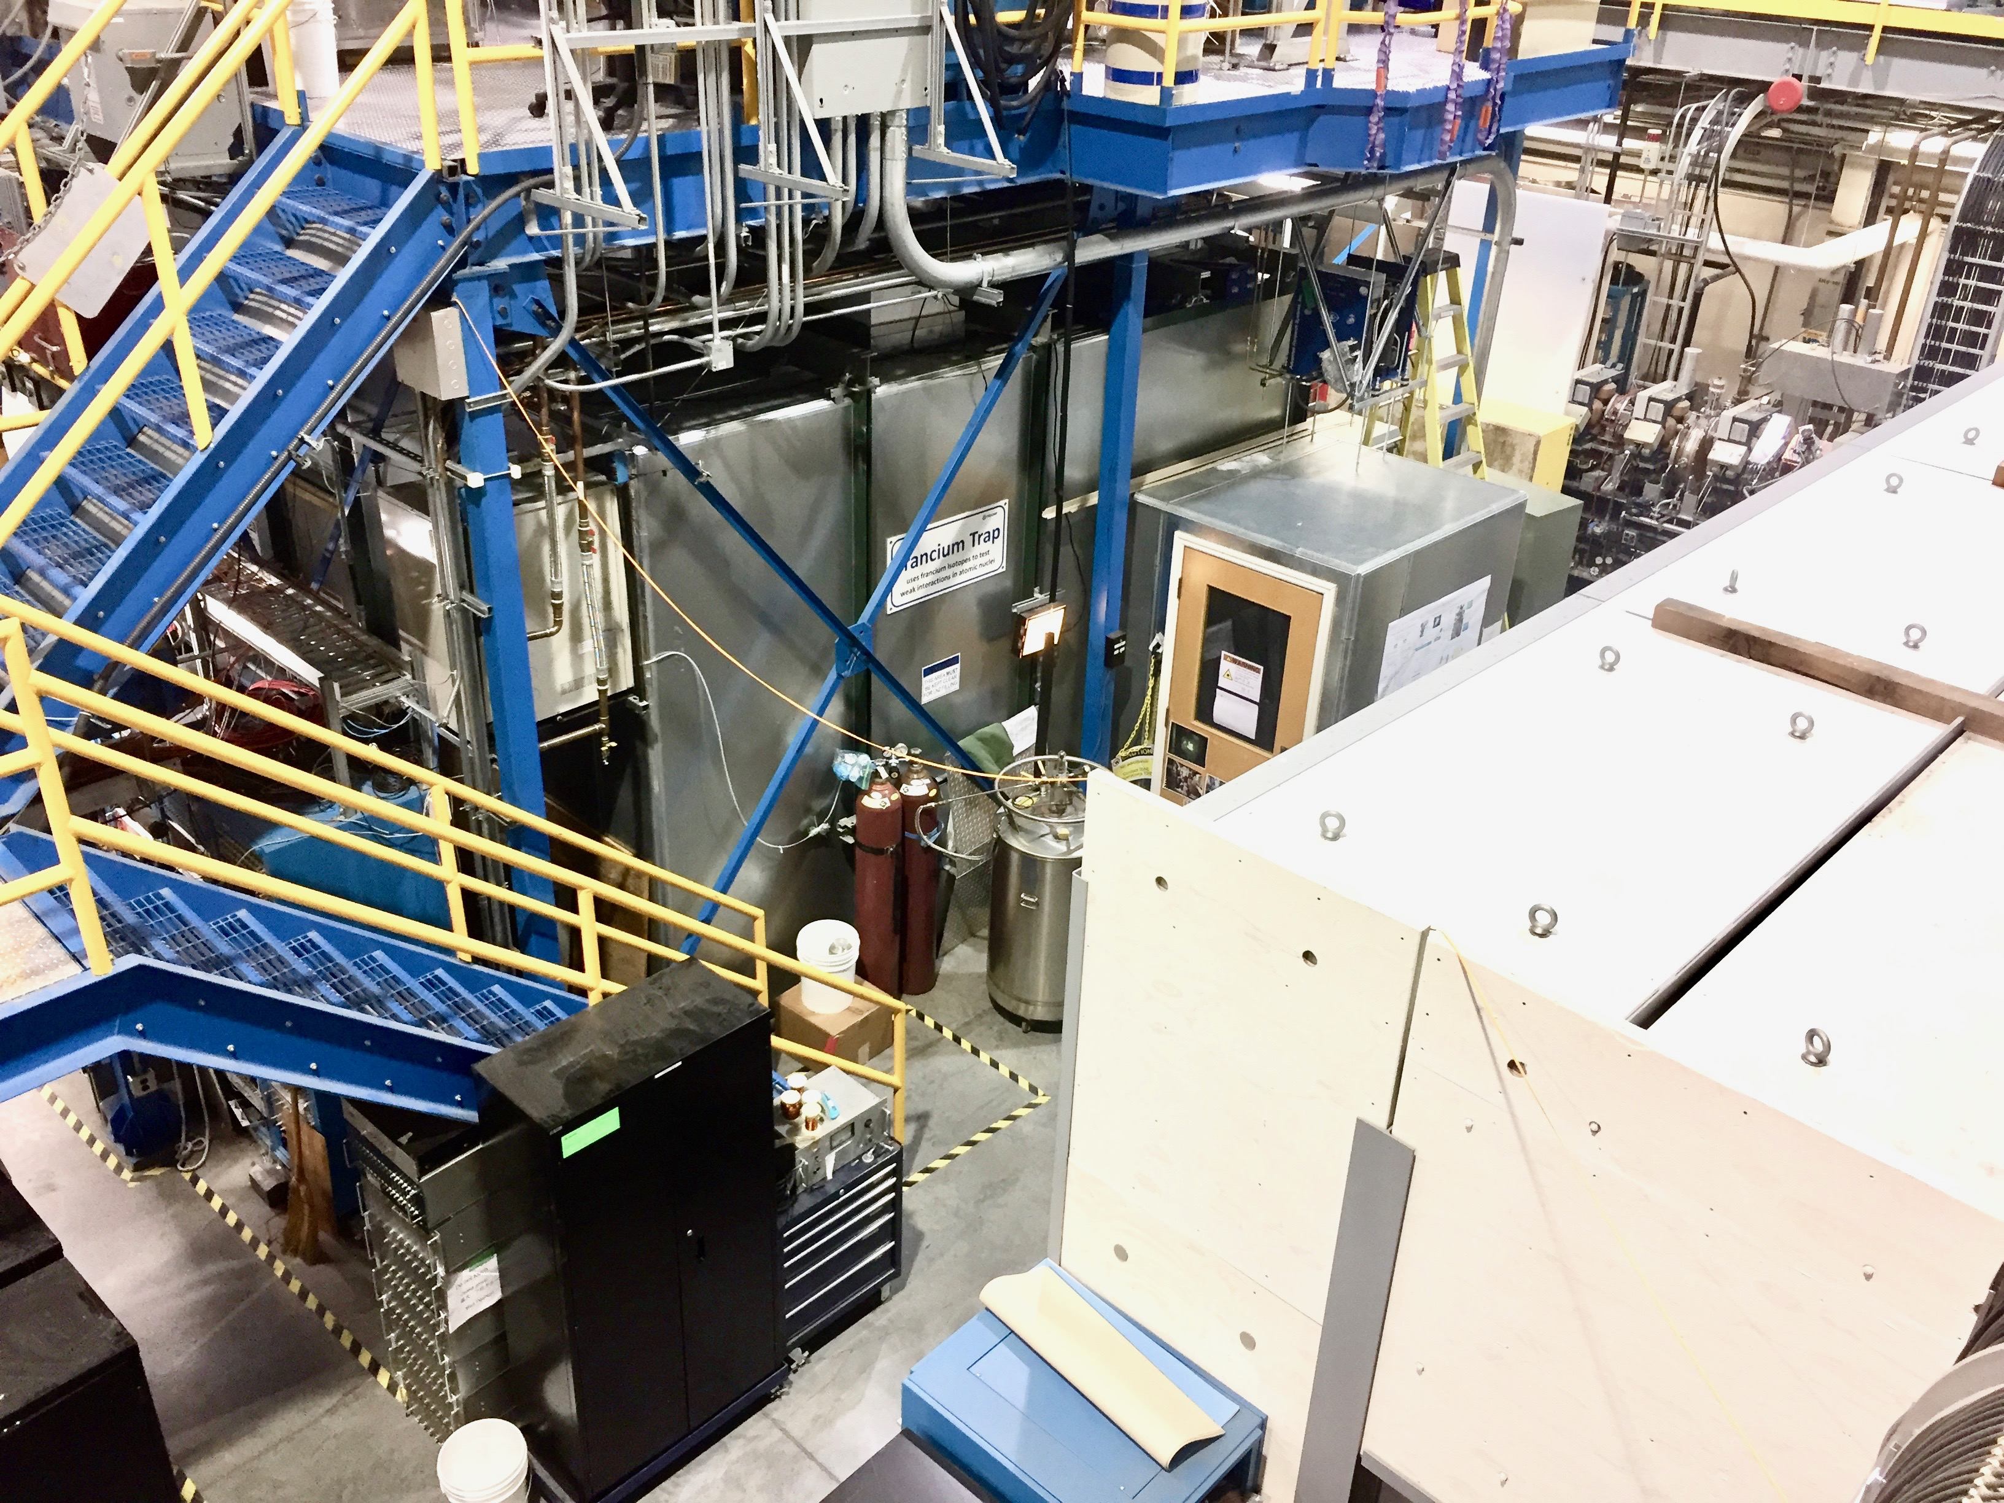
The francium trapping facility
Fr has no stable isotope → experiment at TRIUMF
500 MeV proton beam, UC_{x} target.
FTF
Francium trapping facility at ISAC at TRIUMF

Slide 9
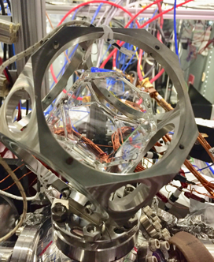
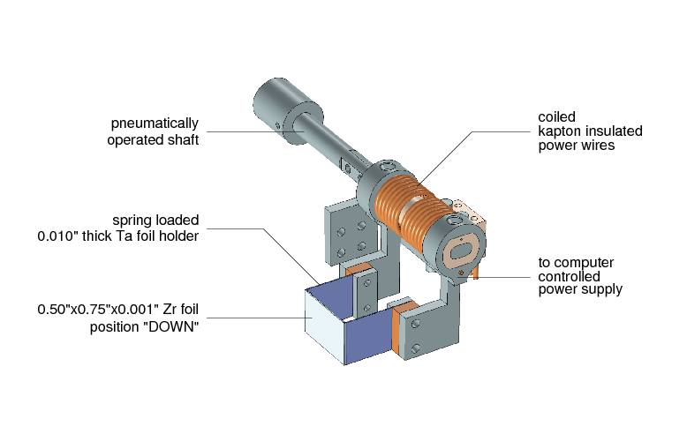
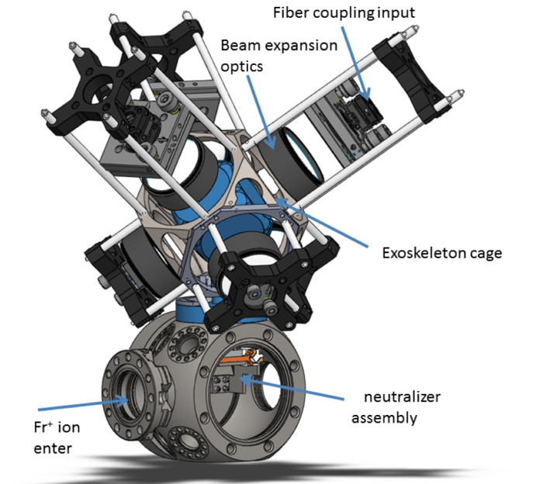
The francium trapping facility
Glass cell with non stick coating
(J. A. Fedchak et al. NIM Phys. R A
391 (1997) 405-416)
Ions up to 2 ×10⁹ /s delivered
2 inch
Magneto optical trap
Trapping F = -kx
Cooling F = -av
Two lasers.
Quadrupole B field.
≈ 1 million atoms trapped
Other Fr traps:
INFN Legnaro (Italy).
Tohoku University (Japan).
Notes:
TRIUMF can give the largest number of atoms.

Slide 10
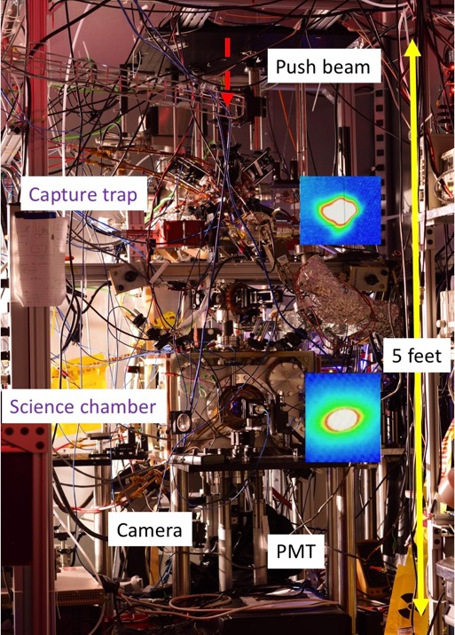
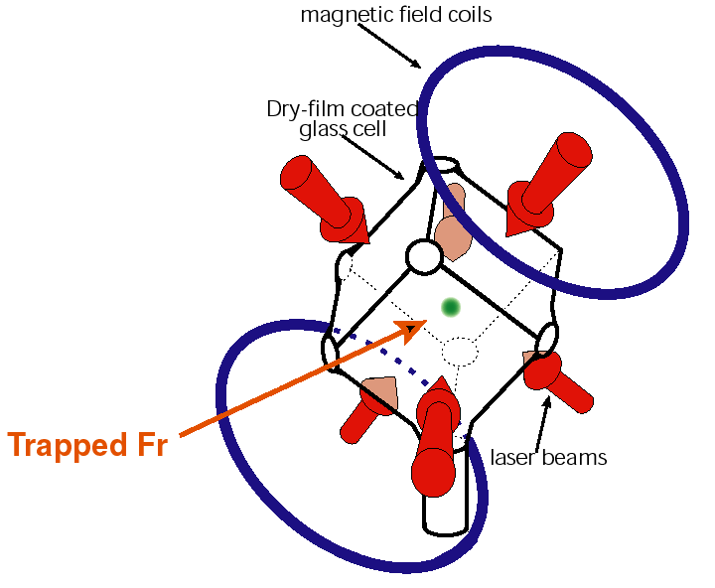
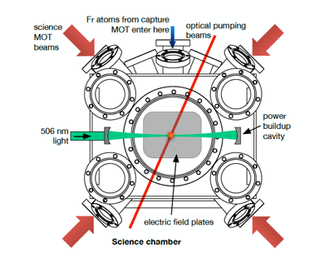
The francium trapping facility
Push atoms
Up to 50% transfer
20 s lifetime
Capture trap
Capture trap
Fr ion
Fr ion
Zr foil
1.5 m
5, 6 days of beamtime/year
Tune with Rb
Science chamber
M. Tandecki et. al. JINST 8, P12006 (2013)

Slide 11
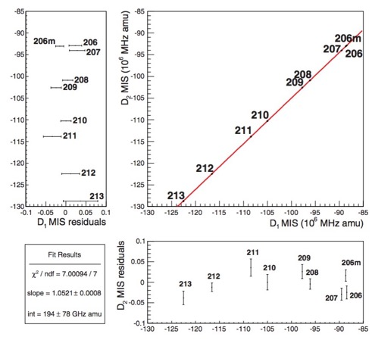
Completed measurements at the francium trapping facility
D1 isotope shifts in a string of light Fr isotopes.
Collister et. al. Phys. Rev. A 90 052502 (2014) and A 92, 019902(E) (2015).
Benchmarks state of the art atomic theory.
These are all dipole allowed transitions !
R. Collister, PhD, 2015 (U. of Manitoba)
J. Zhang, PhD, 2014 (U. of Maryland)

Slide 12
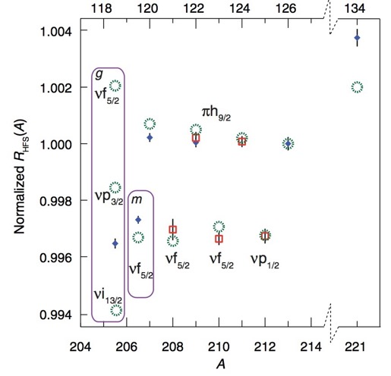
Completed measurements at the francium trapping facility
Hyperfine anomaly in light Fr isotopes.
Zhang et. al. Phys. Rev. Lett. 115 042501 (2015)
Reconfirms that in terms of nuclear structure 208-213 are “simple” nuclei for APNC/anapole.
These are all dipole allowed transitions !
R. Collister, PhD, 2015 (U. of Manitoba)
J. Zhang, PhD, 2014 (U. of Maryland)

Slide 13
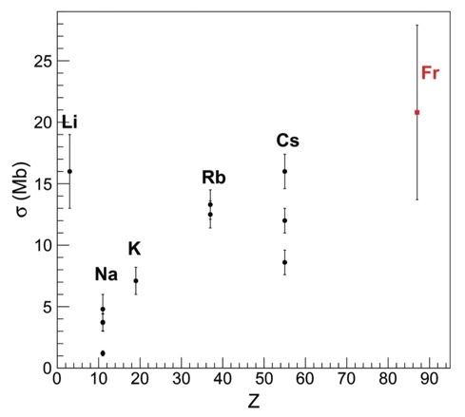
Completed measurements at the francium trapping facility
Francium 7p_{3/2} photoionization
Collister et. al. Can. J. Phys (2017)
Determines loss of atoms from trap during spectroscopy
These are all dipole allowed transitions !
R. Collister, PhD, 2015 (U. of Manitoba)
J. Zhang, PhD, 2014 (U. of Maryland)

Slide 14
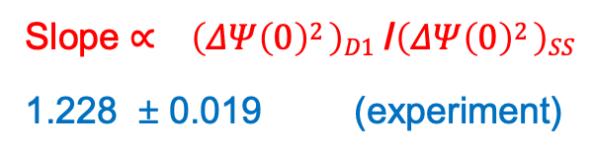
Completed measurements at the francium trapping facility
Observed for the first time 7s-8s transition using two photon spectroscopy in ²⁰⁸Fr, ²⁰⁹Fr, ²¹⁰Fr, ²¹¹Fr, ²¹³Fr. Radioactive lifetime (T_{1/2} ) from 50 s to 192 s.
Isotope shifts.
King plot
8s
Not detected
7p_{3/2}
1012 nm
7p_{1/2}
Detect
$$\left(\frac{M_{A}M_{A′}}{M_{A}{−M}_{A′}}\right){δθ}_{IS,D1}=\left(N_{D1}+S_{D1}\right)−\left(N_{SS}+S_{SS}\right)\frac{F_{D1}}{F_{SS}}+\frac{F_{D1}}{F_{SS}}\left(\frac{M_{A}M_{A′}}{M_{A}{−M}_{A′}}\right){δθ}_{IS,SS}$$
7s
Slope ∝ $\left(ΔΨ\left(0\right)2 \right)D1$ /$\left(ΔΨ\left(0\right)2 \right)SS$
1.228 ± 0.019 (experiment)
M. Kalita et al. with theory by V. Dzuba, V. Flambaum, M. Safronova Phys. Rev. A 97, 042507 (2018)
1.234 ± 0.010
(ab. initio theory)

Slide 15
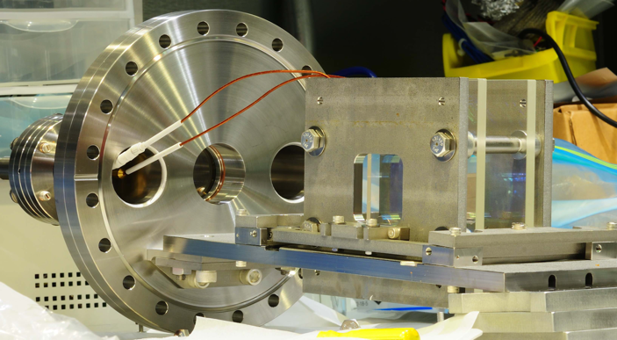
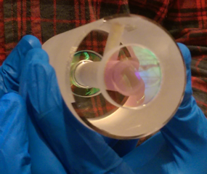
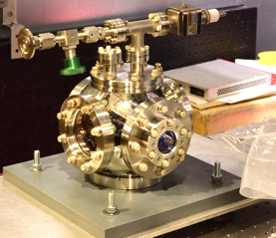
Transparent electrodes, ultra precise laser lock for 7s ⇾ 8s
Transparent Electric field plates with ITO coating.
Works at 10⁻¹⁰ Torr, up to 6200 V/cm without sparks for hours at a time.
Operate magneto optic trap between the field plates !
11.4 cm
Laser lock for 506 nm based on ULE Fabry Perot cavity.
< 200 kHz drift in 6 hr ⇾ absolute stability at the 10⁻¹⁰ level !
EOM
PBS
𝜆/4
1012 nm
Freq.
shifter
ULE FP
in vacuum
Feedback
to laser
LO
10 cm
PID
Low
pass
Mixer
Photo
diode
Masters thesis A.C. Dehart, U of Manitoba, 2018

Slide 16
Basis for PNC : Stark induced 7s ⇾ 8s
Laser locked to ULE Fabry Perot cavity.
E field using ITO electrodes.
8s
7p_{3/2}
506 nm
7p_{1/2}
7s

Slide 17
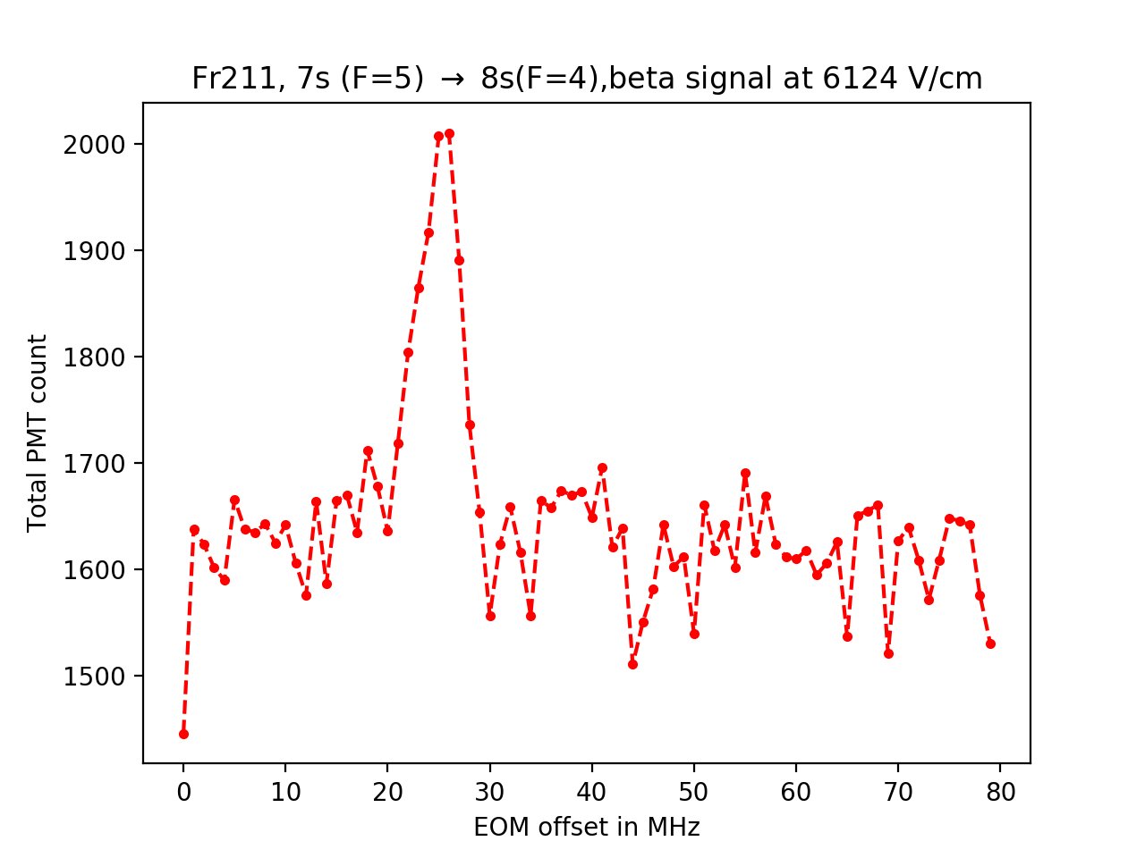
Basis for PNC : Stark induced 7s ⇾ 8s observed in September 2018 !
Laser locked to ULE Fabry Perot cavity.
E field using ITO electrodes.
23rd September, 2018
8s
Not detected
7p_{3/2}
506 nm
7p_{1/2}
817 nm detect
7s
This is the transition we will use to do our PNC experiment.
10⁻⁹ times smaller than allowed transition
Side note: we have also observed the equivalent transitions in ⁸⁷Rb. Poster

Slide 18
Things to do before attempting Stark interference:
Magnetic dipole transition M_{hf} and M_{rel.}
Measure M_{hf} / A_{stark} .
M_{hf} can be calculated accurately
Calibrate A_{stark}
Use calibrated A_{stark} in A_{APV} / A_{stark}
8s
Not detected
1.
Stark induced
10⁻⁸ to 10⁻¹⁰
2.
M1
10⁻¹¹
3.
PNC
10⁻²⁰
7p_{3/2}
7p_{1/2}
817 nm
Detect
7s

Slide 19
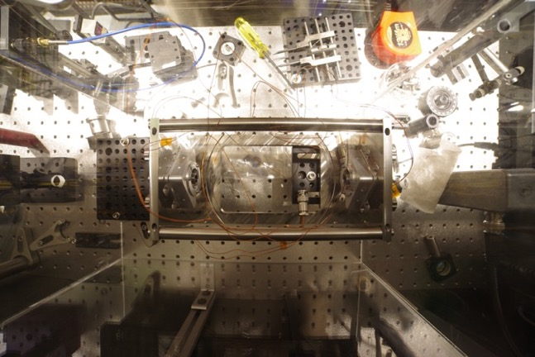
System upgrade: increase power for 7s ⇾ 8s using a cavity in vacuum
Science chamber
Lock power build up cavity to ULE cavity stabilized laser.
TiSapphire
Freq. Doubler
PBC in vacuum
1012 nm
506 nm
😁
Feedback
to laser
Freq. shifter
Feedback to PBC
ULE based laser
Freq. stabilization
PBC stabilization
Aim for first generation: factor of 1000 build up
Install late summer, 2019
17 cm

Slide 20
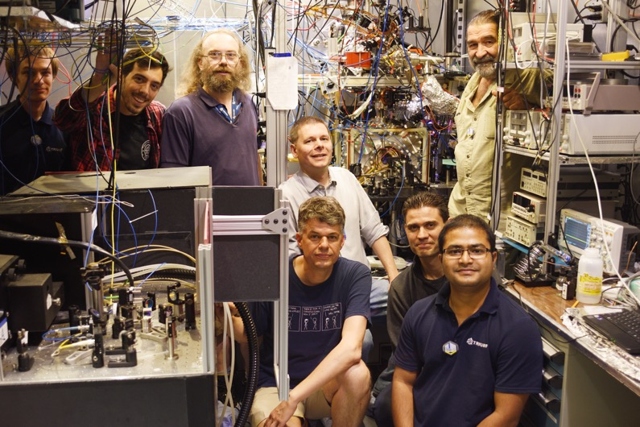



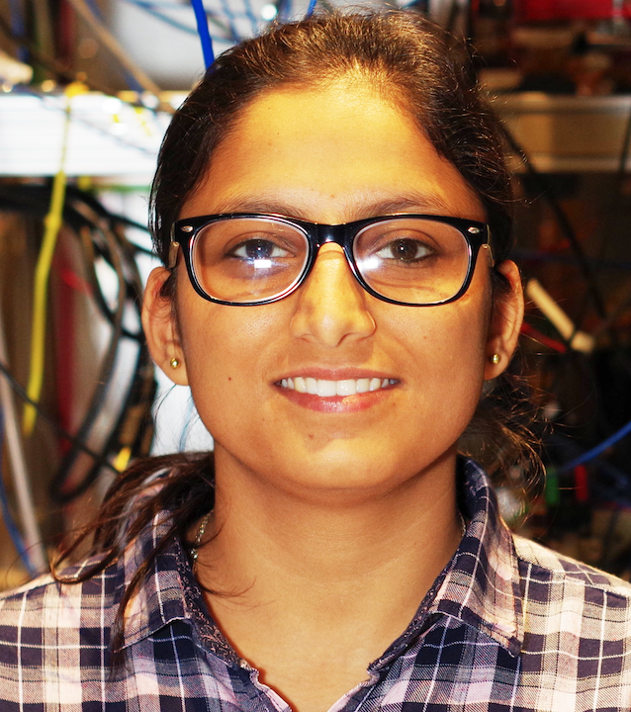
From left to right: Michael Kossin, A.C. DeHart, Matt Pearson, Seth Aubin, Gerald Gwinner, Eduardo Gomez, Mukut Kalita, Alexandre Gorelov, John Behr, Luis Orozco, Tim Hucko, Anima Sharma. Not in the picture: Andrew Senchuk

Slide 21
Conclusion:
We can routinely trap francium at the Francium Trapping Facility at TRIUMF and transfer them to our measurement region.
We have observed the 7s-8s transition in several isotopes using two photon spectroscopy.
Recently, we have observed the single photon Stark induced 7s-8s transition in ²¹¹Fr for the first time
This is the transition we will use to do our PNC experiment.
We are preparing for measurement of magnetic dipole transition in the 7s-8s in Fall 2019.
We are aiming to do our first attempt at observing the PNC effect in francium in a year or two.
Thank You

Slide 22
Back up slides after this

Slide 24
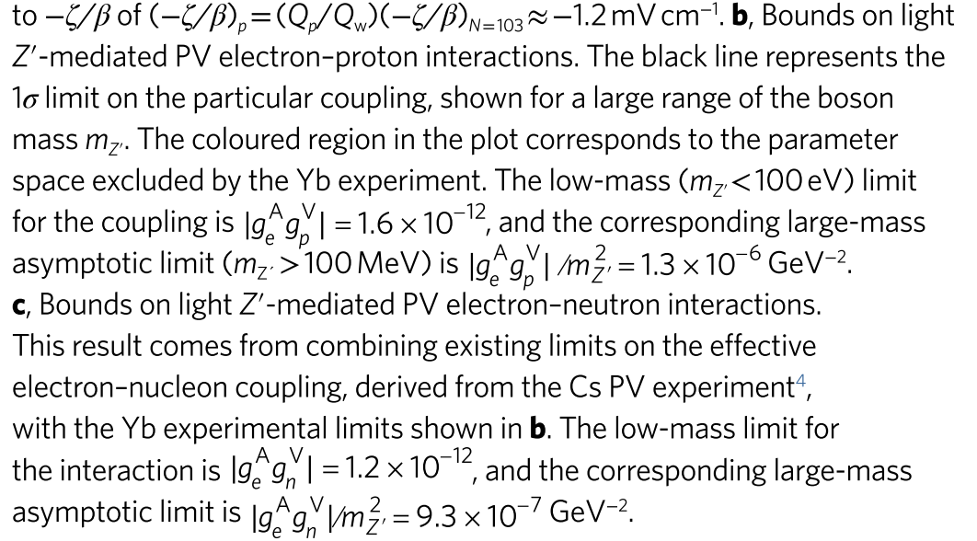
The francium experiment
﻿Accounting for correlations in some systematic uncertainties between the two measurement periods, the combined result is Aep = −226.5 ± 7.3 (statistical) ± 5.8 (systematic) p.p.b. The total uncertainty achieved (9.3 p.p.b.) sets a new level of precision for parity-violating electron scattering (PVES) from a nucleus
Magneto optical trap
Trapping F = -kx
Cooling F = -av
Neutralizer:
Zr, work function 4.0 eV, mechanically strong, ionization potential of Fr 4.1eV.
Up-to 30% release, 800℃, 500,000 cycles.
(A. Gorelov et al. in preparation)

