Slide 1



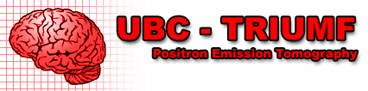
Positron emission tomography (PET) contributions to a better understanding of brain function
Vesna Sossi, PhD
Dept. of Physics and Astronomy, UBC
DM Center for Brain Health
Symposia Day - Nuclear Astrophysics and Medical Isotopes (in honour of Prof. John D'Auria)

Slide 2
Personality - mind
‘Aberrant’ behavior
Physical/brain illness

Slide 3
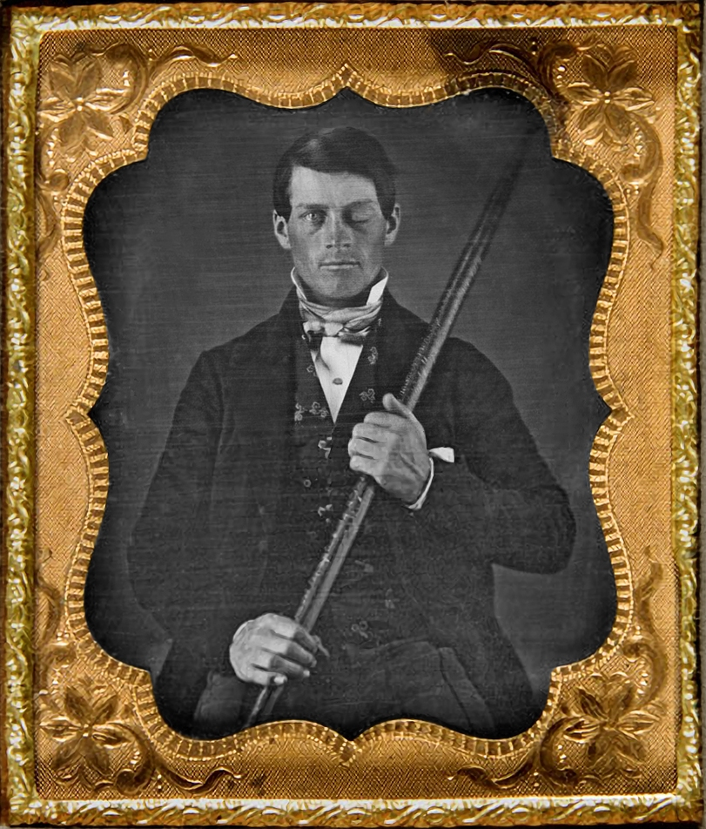
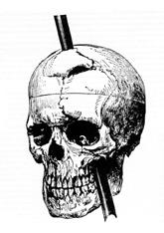
Phineas Gage (1823–1860)
Possibly first case to suggest a relationship between
brain damage and personality changes
brain and personality

Slide 4
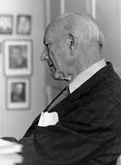
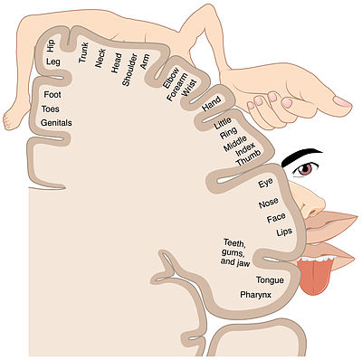
Dr. Wilder Penfield (1891–1976)
Founder and director of the Montreal Neurological Institute (1934)
Operated on patients with intractable epilepsy under local anaesthesia.
Stimulated areas of the brain surface to demarcate the part producing epilepsy and observed reactions
Map of sensory and motor cortex (cortical homunculus)
Stimulation of temporal lobe: vivid recall of memories
Stimulation of temporal and parietal cortex: recall of dreams and hallucinations: evoked smells, sensations of flashing light, etc. Other stimulations had patients experiencing déjà vu, fear, loneliness, and strangeness.
Quote: ‘This is a startling discovery. It brings psychical phenomena into the field of physiology. It should have profound significance also in the field of psychology provided we can interpret the facts properly. We have to explain how it comes about that when an electrode …is applied steadily to the cortex it can cause a ganglionic complex to recreate a steadily unfolding phenomenon, a psychical phenomenon.

Slide 5
Conceptual shift:
….. ‘(Weird)‘ personalities also possibly related to brain ‘(mal)‘ functioning, i.e. brain function (illness)?

Slide 6
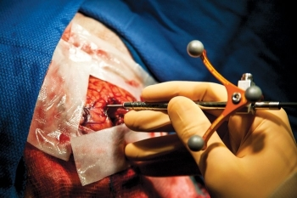
Brain
Invasive surgery
Post-mortem studies
Imaging is essential
PET
(MRI)

Slide 7
Positron emission tomography (PET)
(antimatter…)
[Magnetic resonance imaging (MRI)
(quantum mechanics…)]

Slide 8
PET
p → n + β⁺ + ν + energy

Slide 9
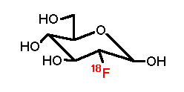
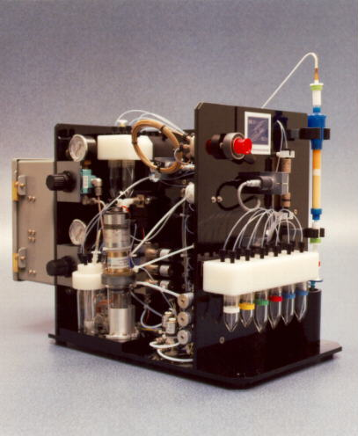
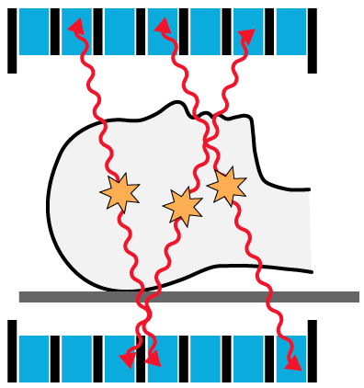
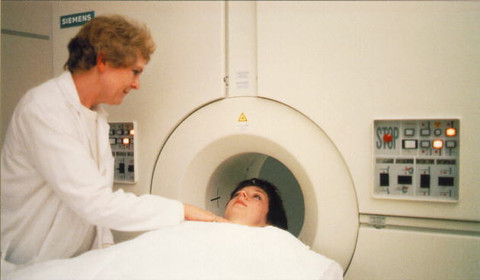
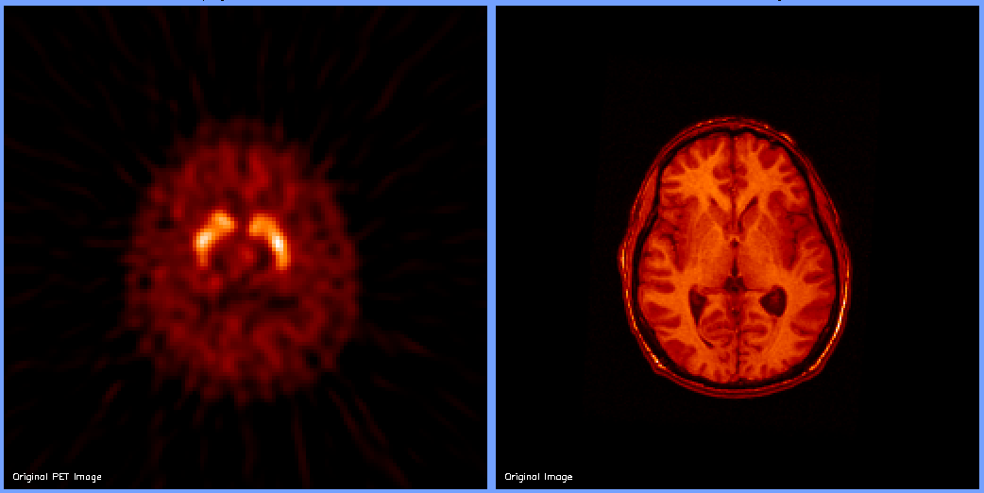
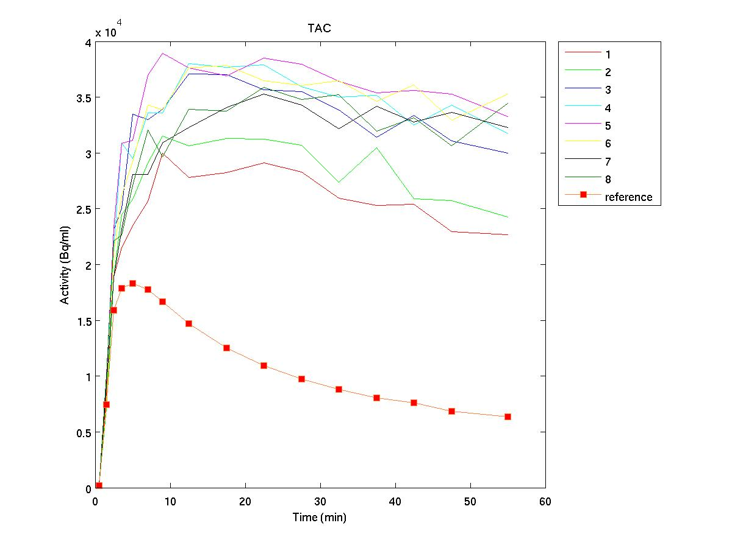
Positron emission tomography (PET) molecular imaging: neurochemical function
Molecular target identification
Radiotracer
Confers neurochemical specificity
WHAT
Imaging instrumentation, data quantification and image reconstruction
Defines the spatial resolution and image quality
HOW
Data modeling and interpretation
Relates acquired data to biologically relevant variables
HOW MUCH

Slide 10
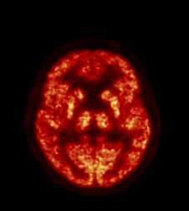
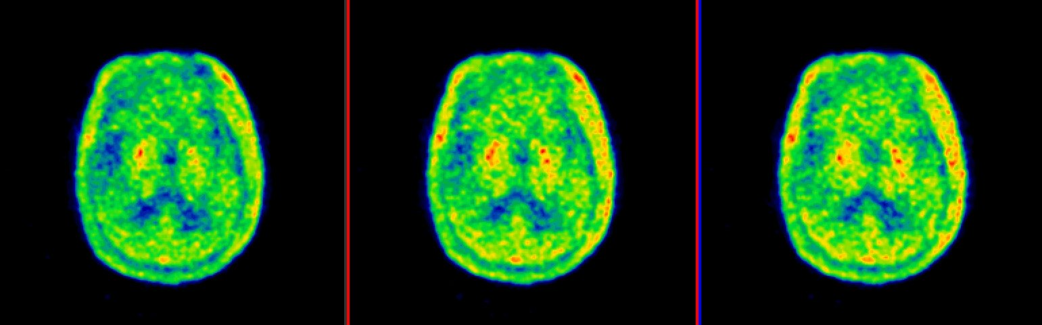
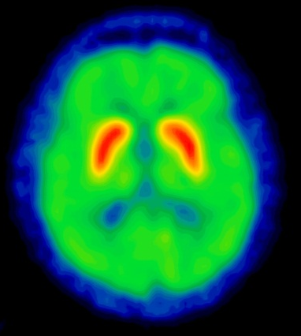
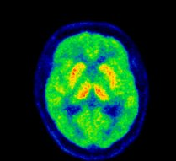
Examples of tracers and related images
¹⁸F-FDG
¹¹C-PBB3
Glucose metabolism
Abnormal protein aggregation: amyloid and tau
Inflammation
Neurotransmitters/receptors
¹¹C-PBR28
¹¹C-DTBZ
¹¹C-DASB

Slide 11
PET is more than pictures

Slide 12
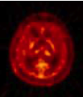
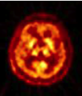
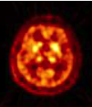
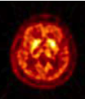
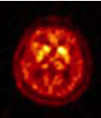
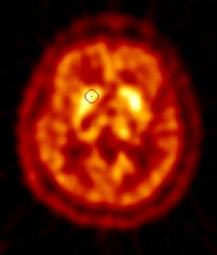
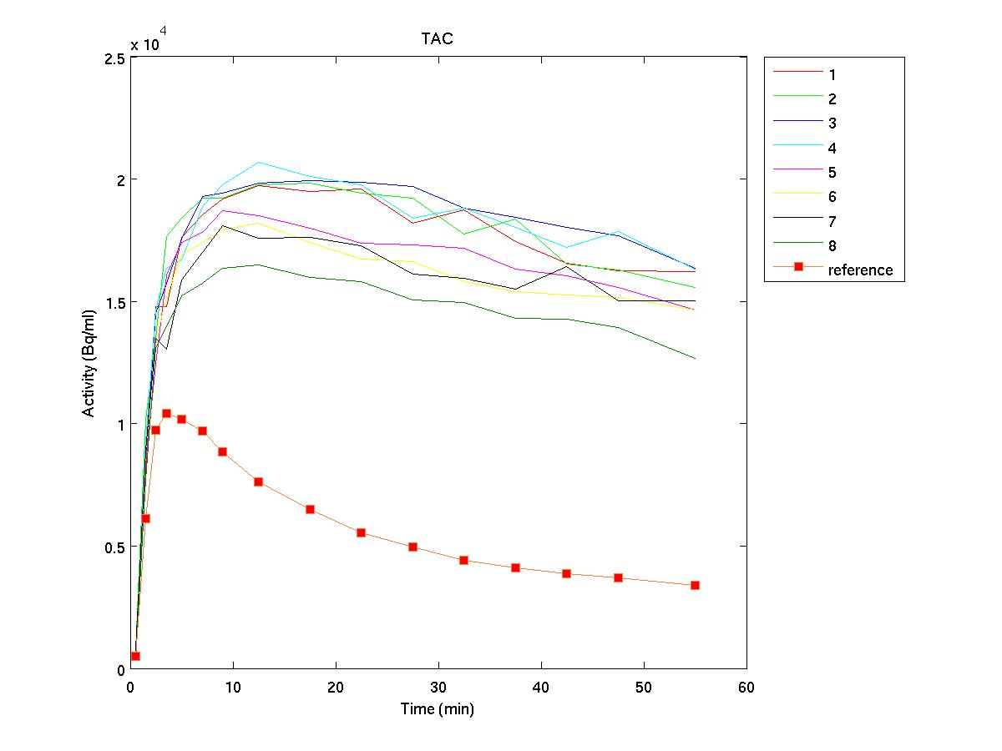
Quantitative dynamic PET imaging
Scan Start
Scan time
1 min
1 min
3 min
3 min
5 min
Time-Activity curve (TAC)
Biology-related parameters:
Binding Potential
Uptake Rate
ROI placement
Notes:
Here stress that the shape of the time activity curve needs to contain only biology related information – so the data must be corrected for all physics related effects.

Slide 13
Brain as a circuit

Slide 14
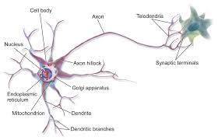
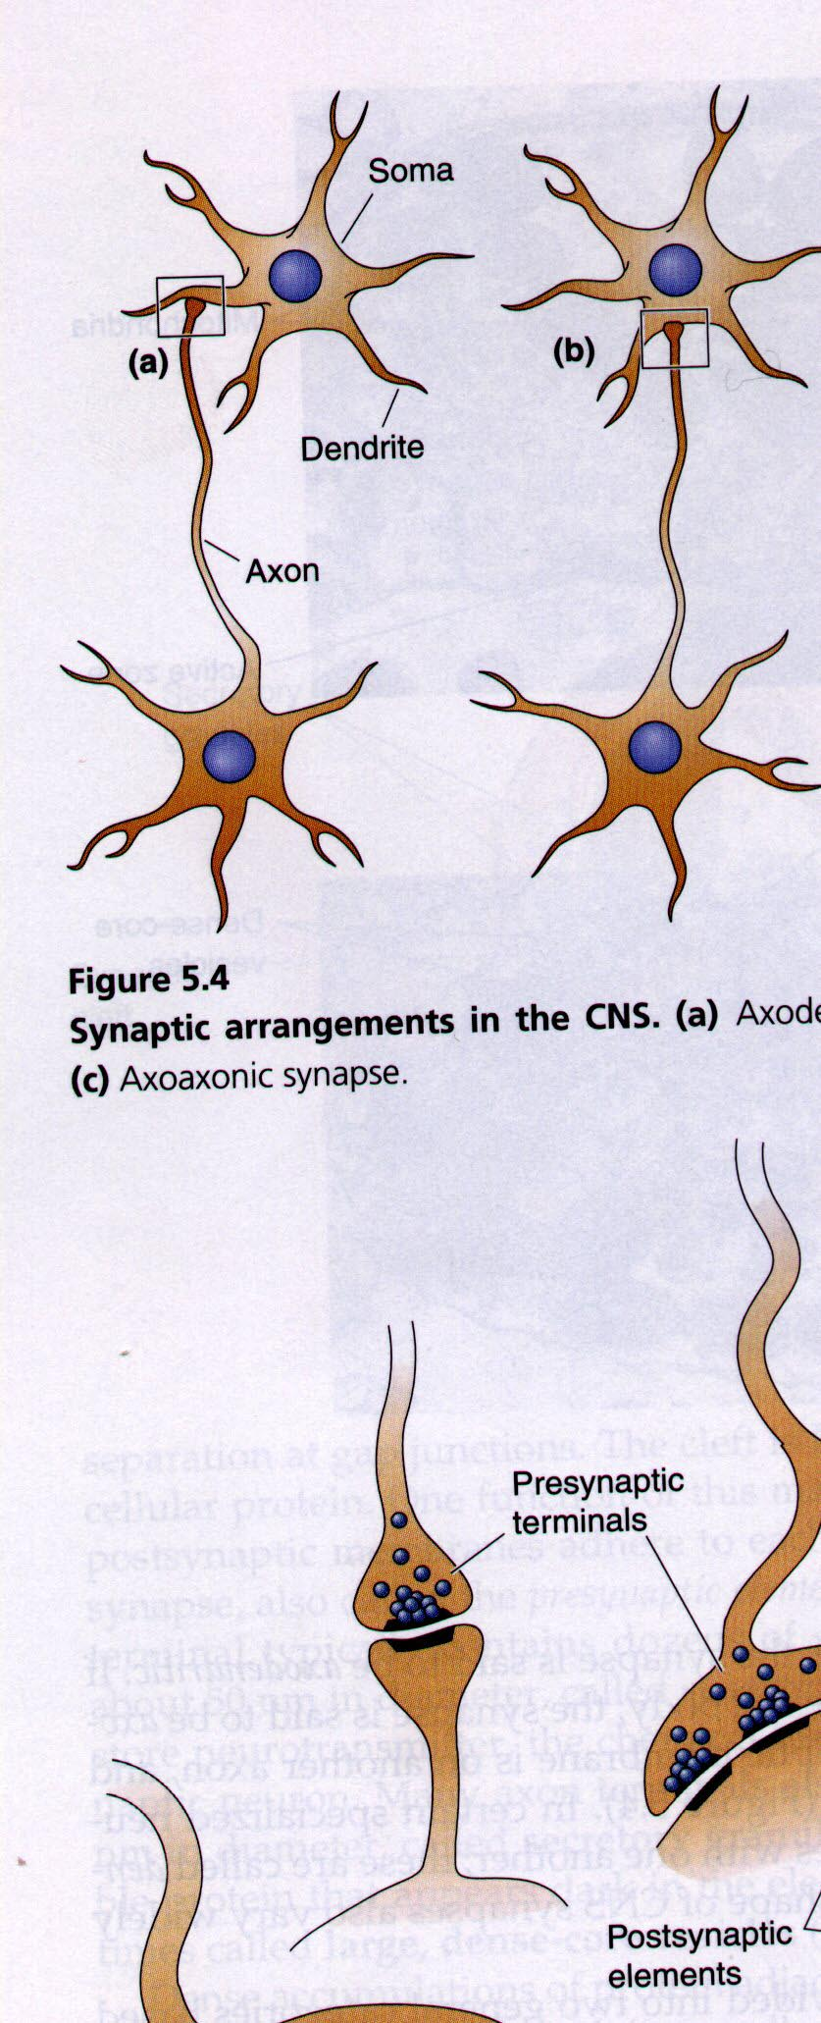
Brain as a circuit - neurotransmitters
Neuron
Serotonergic system
Cholinergic system
Dopaminergic system

Slide 15
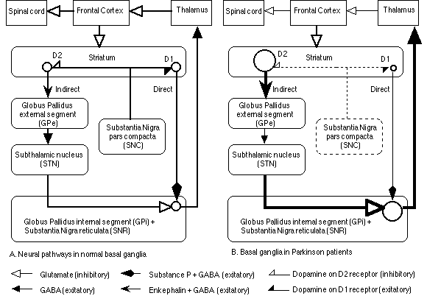
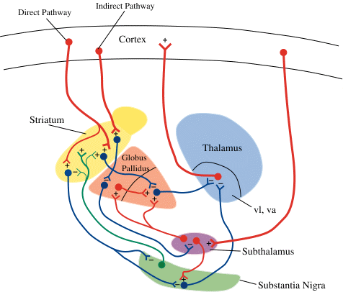
Signaling
Proper function depends of a balance between excitation and inhibition, it involves a cascade of events and circuitry

Slide 16
Functional connectivity – resting state functional MRI

Slide 17
Resting state MRI - connectivity
Altered in MANY disease states

Slide 18
Network degeneration hypothesis
Initiation and progression of disease-specific pathological changes occur within specific brain structural and functional networks and are mediated by abnormal protein aggregation, inflammation and impaired cellular energetics coupled to abnormal neurotransmission.
Seeley WW, et al. 2009. Neuron 62:42-52
→ PET/MRI
Analyses that accounts for connectivity and interactions

Slide 19
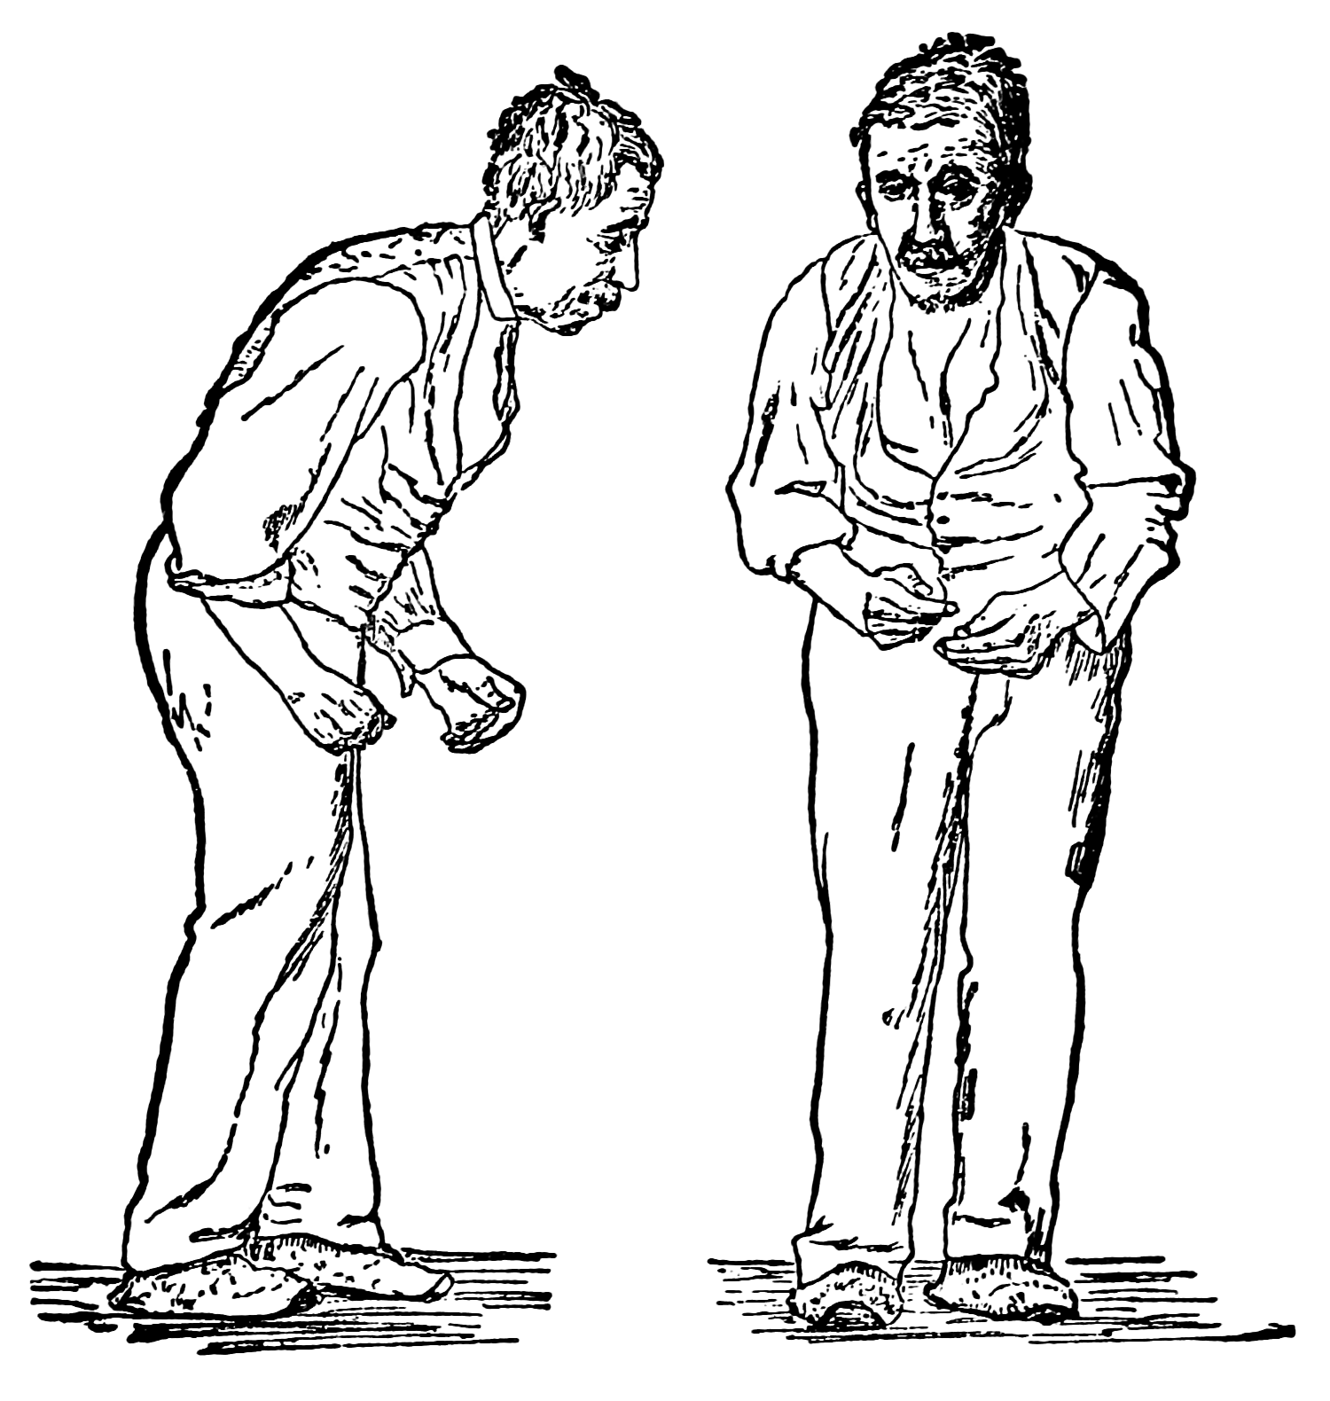
Parkinson’s disease
Affects 300/100,000 of the general population
Characterized by slowness of movements and generally tremor
(J Parkinson 1817)
Degeneration of the dopamine producing neurons (~ 1960)
(Motor) Clinical symptoms appear after ~50-80% of dopaminergic neurons have degenerated
~ 10-15% of PD is of genetic origin, REM sleep behavioral disorders (RBD) increasingly recognized risk factor
Increasing recognition of the existence and relevance of non-motor symptoms and involvement of other systems
Origin still unknown

Slide 20
PD - neurotransmitter systems

Slide 21
PET imaging of the dopaminergic system (at UBC)
Binding values
Uptake rate constants

Slide 22
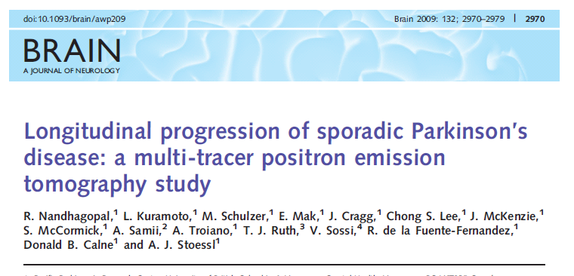
Disease progression

Slide 23
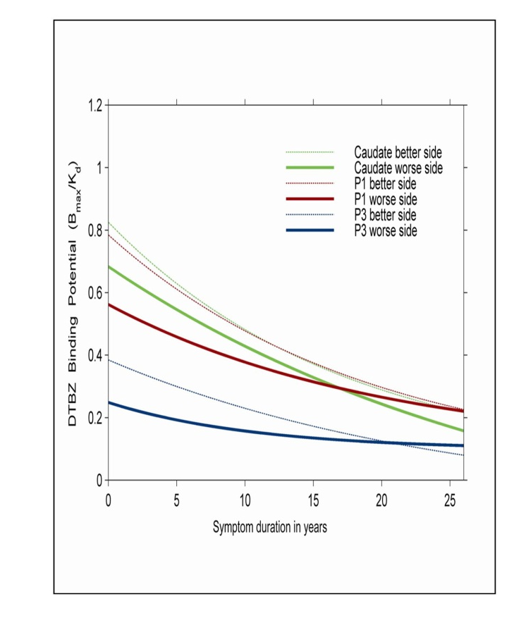
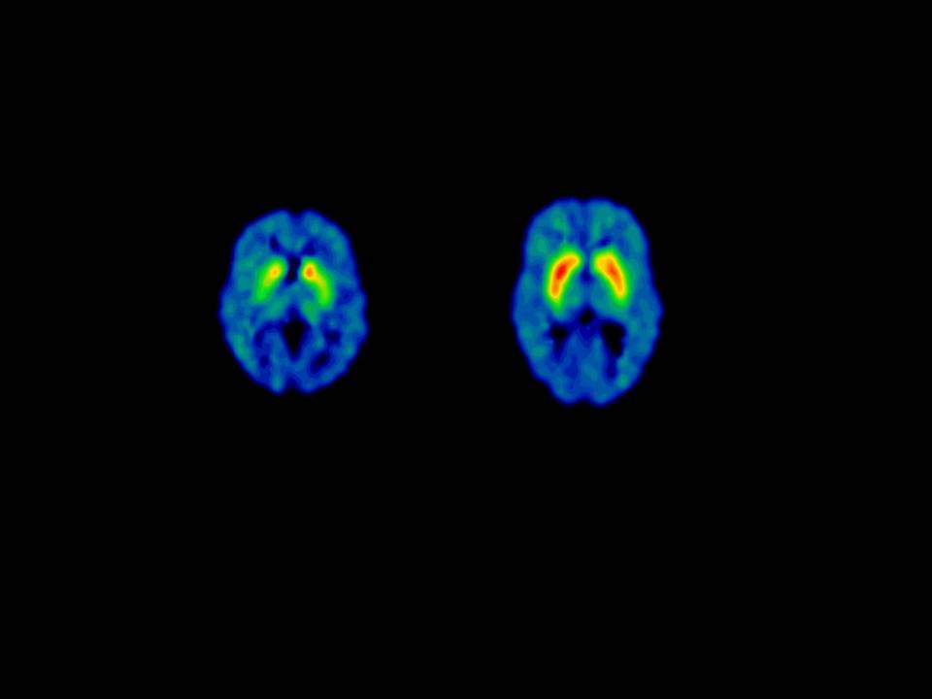
DTBZ (VMAT2)
Integrity of striatal dopaminergic terminals
~ 60% denervation by the time symptoms occur
Rate of progression same for all regions
Intercept different.
→ Disease initiating factor ≠ factor responsible for progression
Nandhagopal et al., Brain 2009

Slide 24
Cholinergic system

Slide 25
PD and the cholinergic system ¹¹C-PMP
Shimada et al, Neurology 2009
Differences from controls
PD with dementia

Slide 26
Serotonergic system – ¹¹C-DASB

Slide 27
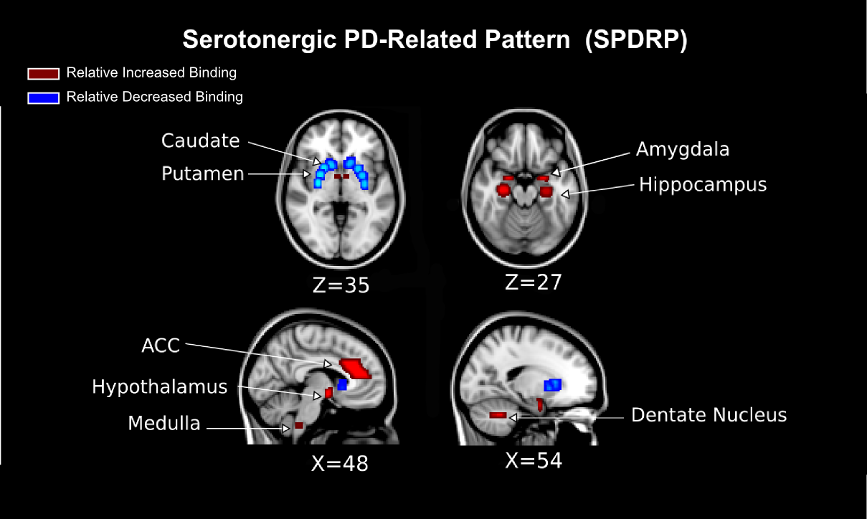
Correlation with disease duration and dopaminergic deficit
Fu et al Neuroimage:Clinical 2019

Slide 28
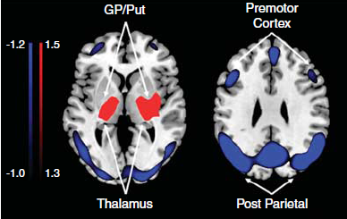
Parkinson’s and glucose metabolism
Pattern analysis
FDG
Motor function Cognition
Tang et al., J Neurosci 2010

Slide 29
rfMRI in PD – altered connections

Slide 30
Presymptomatic period
LRRK2 mutations
Subjects with REM sleep behavior disorder (RBD)

Slide 31
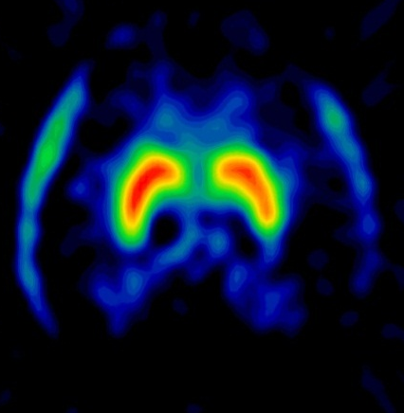
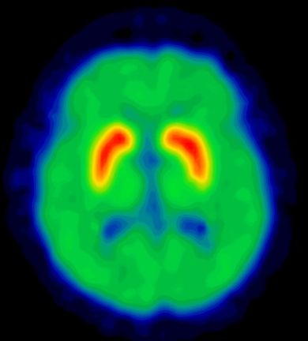
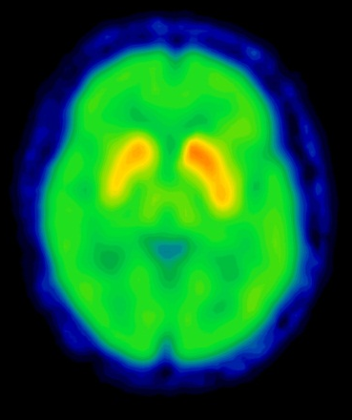
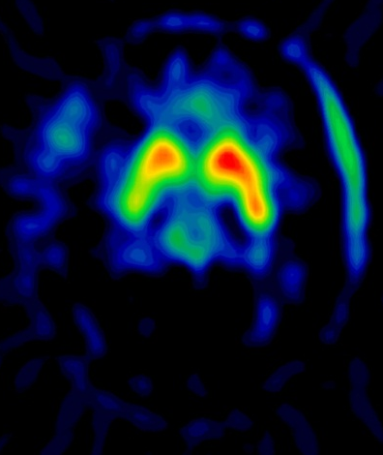
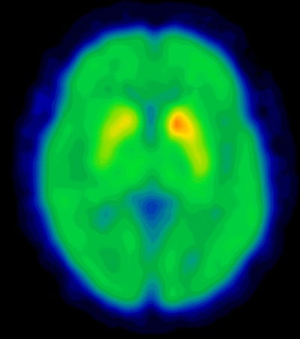
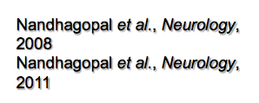
PD imaging prior to clinical symptoms
¹¹C-DTBZ
¹⁸F-FDOPA
¹¹C-MP
Healthy
Controls
LRRK2
Mutation carriers
(asymptomatic)
Asymptomatic mutation carriers have altered dopaminergic function
Notes:
Here you come back to the question of what is happening in the preclinical period
Obe way to answer it is to investigate subjects that have a higher than average risk of developing PD.
Mutations in LRRK2 are the most common genetic risk factor (penetrance 50-60%).
Likewise subjects that act out dreamsn
Asymptomatic mutation carriers – abnormal imaging
Say that there are now many studies that establish quantitiatve essessments of several fucntions of this mutation carriers these mutation carriers.

Slide 32
Alterations in
Several neurotransmitter systems
Patterns of glucose metabolism
Patterns of brain connectivity at rest
(how the brain works at rest)
Patterns of brain connectivity in response to a task
Presence of inflammatory processes early in the disease

Slide 33
Brain and behavior
  Personality

Slide 34
High detachment (traditionally considered negative social trends – some found in schizophrenia)
Cold, socially aloof and vindictive in their relationships
Low detachment -
Overly nurturing and exploitable

Slide 36
Risk taking – gambling – addiction

Slide 37
Outlook
Multi-modality imaging: PET/MRI
      Neurovascular coupling
      Multimodality-derived disease identification (dementia)
      Brain energetics
      Metabolic and functional networks
      Better understanding of signals
      → Technical development

Slide 38
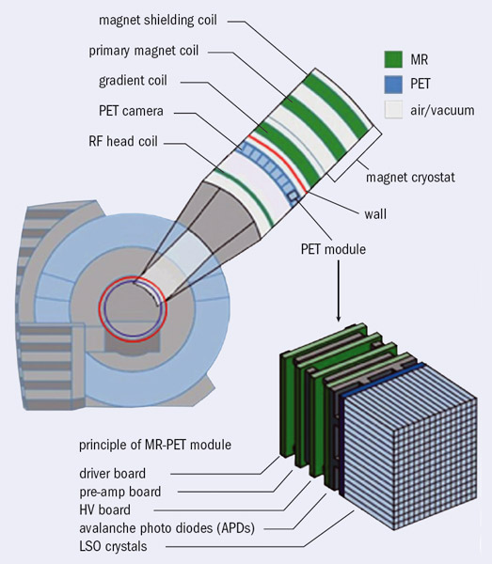
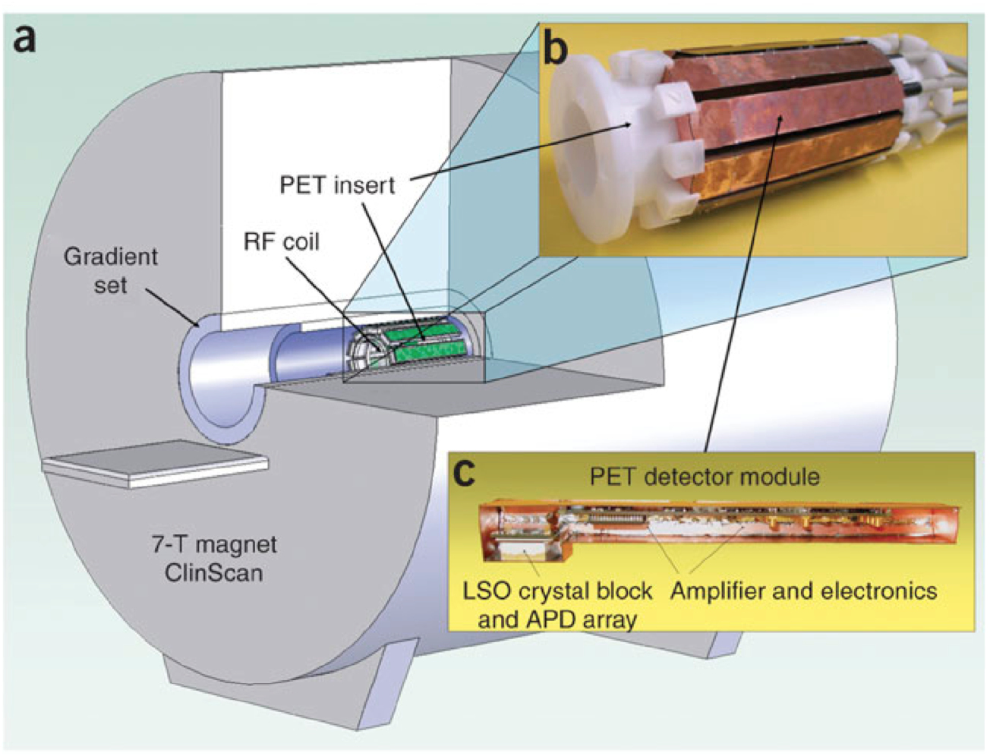
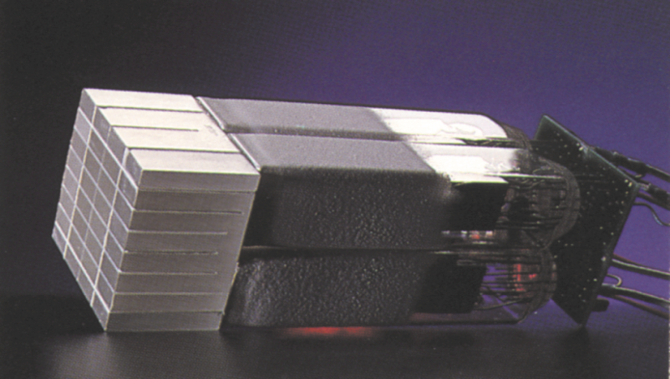
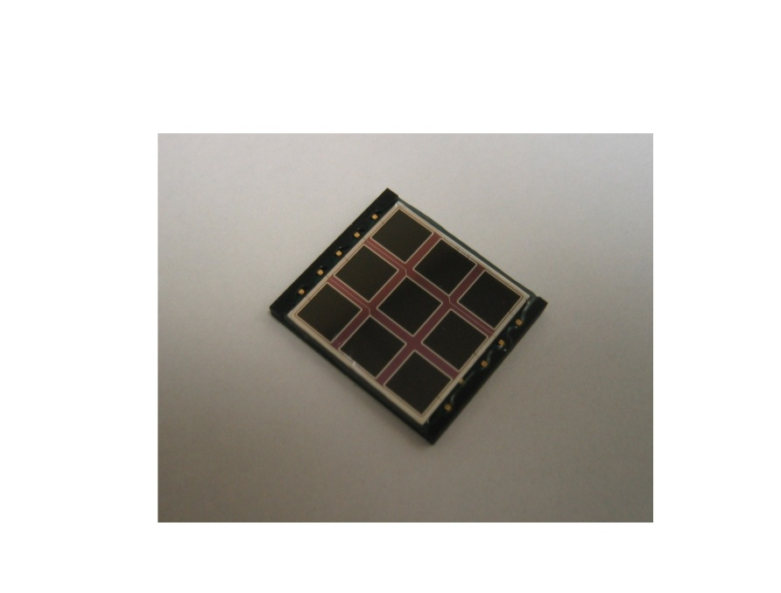
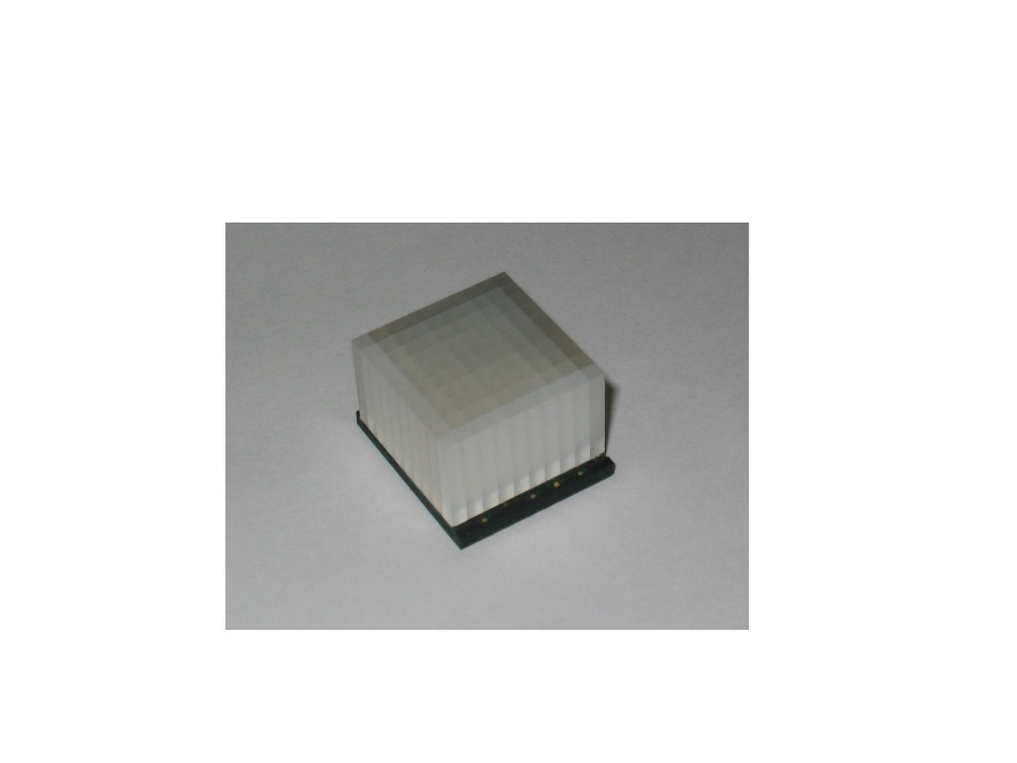
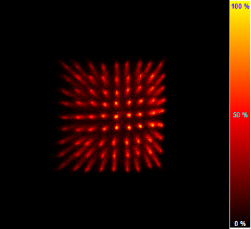
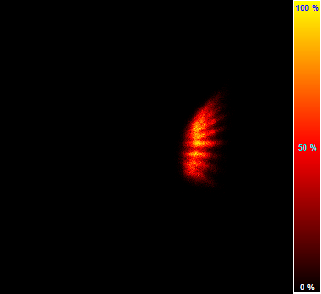
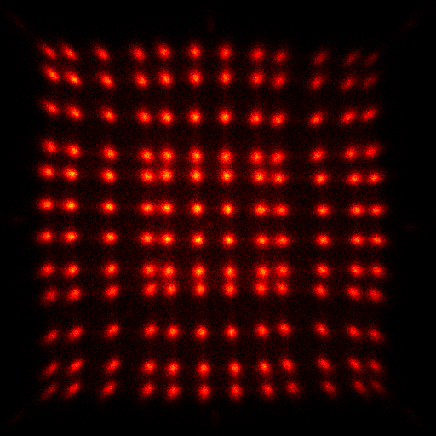
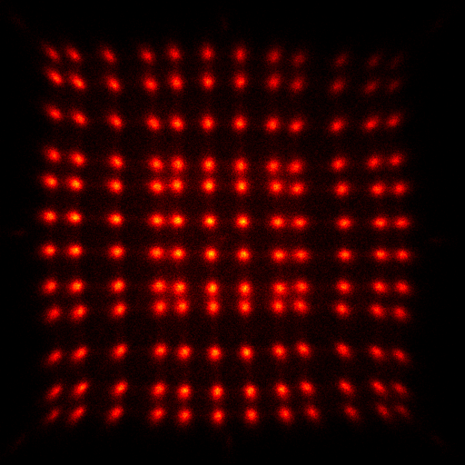
Sophisticated technology (PET inside the MRI)
B=0
B=0
B=0
B=0

Slide 39
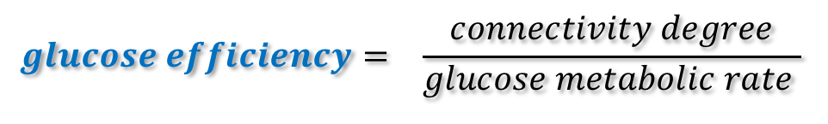
glucose metabolic rate (~ energy consumed by neurons) FDG -PET
degree of functional connectivity (~ number of voxels functionally connected to each voxel) rfMRI
$$glucose efficiency= \frac{connectivity degree}{glucose metabolic rate }$$
Areas of the brain with high glucose efficiency
Possibly more vulnerable to disease?
→ Disease origin/mechanisms

Slide 40
Signal interpretation

Slide 41
Resting state MRI - connectivity

Slide 42
Understanding the relationship between metabolism and rfMRI signal

Slide 43
Imaging
  Essential for managing disease
  … behavior….

Slide 44
Editorial, Lancet Neurology, Jan 2018

Slide 45
…….Just to make some examples, we have gone from recording electrical activity by means of EEG in strictly clinical settings to neurofeedback with portable instruments that monitor and modulate the individual’s attention to specific tasks (Thibault et al., 2016). We can predict intentions and choices that will be made within a few seconds by means of fMRI (Haynes et al., 2007; Soon et al., 2008, 2013). We can interpret the neural activity of an individual by means of fMRI scans and understand whether he is thinking about, say, a motorcycle or a knife (Kay et al., 2008). We are able to identify forms of awareness thanks to brain activation in subjects that are in an apparent vegetative state (Monti et al., 2010), and we can understand the neural signature of political orientation (Schreiber et al., 2013). Neuromarketing makes it possible to know and/or manipulate someone’s taste with various direct or indirect techniques that capture hidden preferences (McClure et al., 2004). In the legal field it seems possible to understand with different methods if subjects are lying (Wolpe et al., 2005; Monaro et al., 2017) and to evaluate the possibility of recidivism by observing the brain profiles of individuals released from prison on parole (Aharoni et al., 2013). There have been……..

Slide 46
Conclusion
Imaging is revealing the complexity of the brain (and disease)
Disease: novel therapeutic targets
patient stratification
patient screening?
How much are ‘we’ determined by the chemical and physical process of the brain?
Genetics vs epigenetics
        And possibly just as many new questions as answers

Slide 47
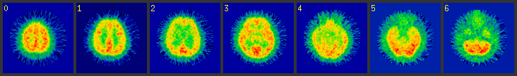



PETTVI – FDG image ~ 1986
2019 FDG –PET only
FDG –PET overlaid with MRI
GE Signa
Thanks to the pioneers, such as John!

