Slide 1
Status and planning of the PSB B-train
J. Vella Wallbank, M. Amodeo, A. Beaumont,
M. Buzio, V Di Capua, D. Giloteaux, C. Grech, M. Roda
TE-MSC-MM
Contents:
B-train sensors and electronics
Preliminary results of the reliability run:
- White Rabbit issues
- metrological characterization
Final system – status and planning
Conclusions

Slide 2
B-train sensors and electronics
Preliminary results of the reliability run:
- White Rabbit issues
- metrological characterization
Final system – status and planning
Conclusions

Slide 3
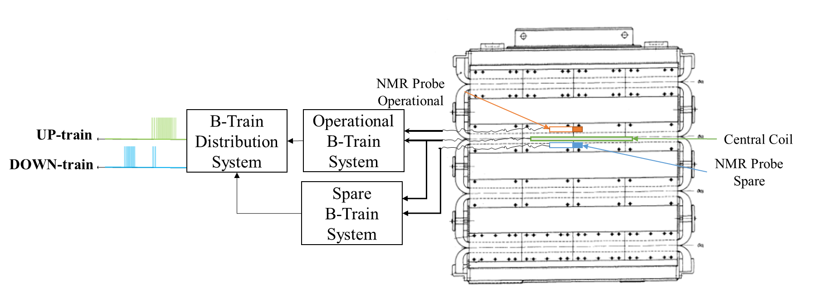
Legacy B-Train Sensors
Legacy B-Train in place since 1998, prototype PSB bending dipole used as reference
Includes a central coil in Ring 3 for measuring dynamic field
NMR probe for setting initial field value
Incremental distribution of B through two pulse trains

Slide 4
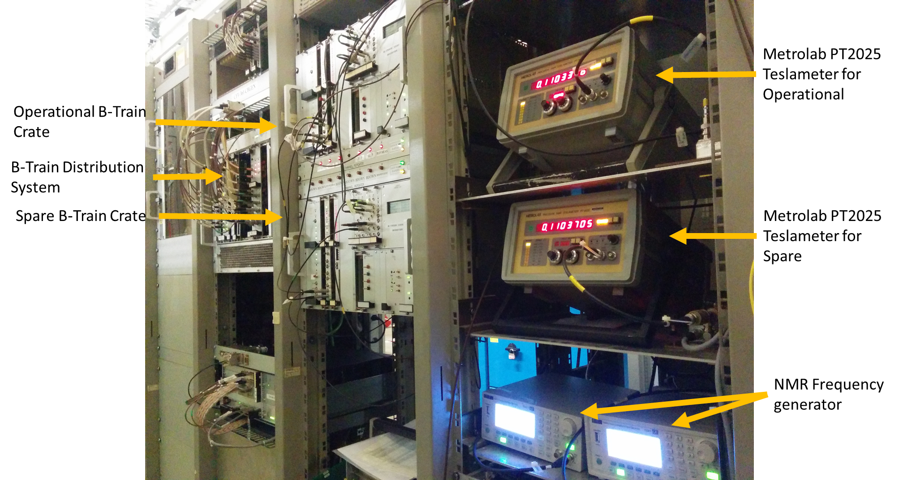
Legacy B-Train Electronics
Legacy B-Train crate consists of outdated electronics with dwindling stock
Calibration of new coils possible but difficult (hard-wired in the integrator gain)
Distribution system limits resolution to 10 μT, dB/dt to 2.5 T/s

Slide 5
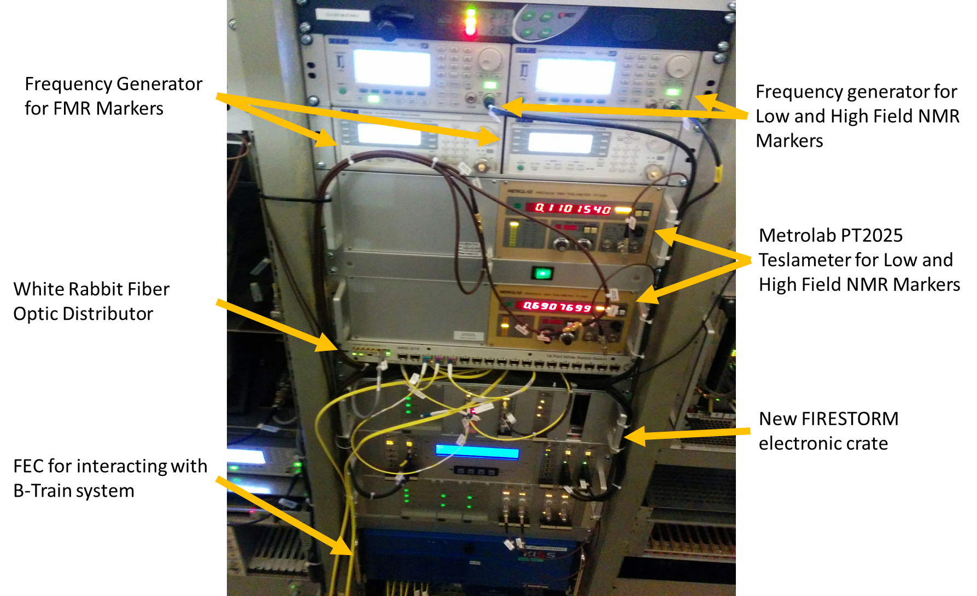
New FIRESTORM B-Train System
New electronics crate which future proofs B-Train system
Optical fiber distribution system improves reliability,
theoretical resolution to 10 nT, theoretical bandwidth to 500 kHz
Standard CERN FEC/FESA implementation provides remote configuration and diagnostics, including flexibility for calibration coefficients

Slide 6
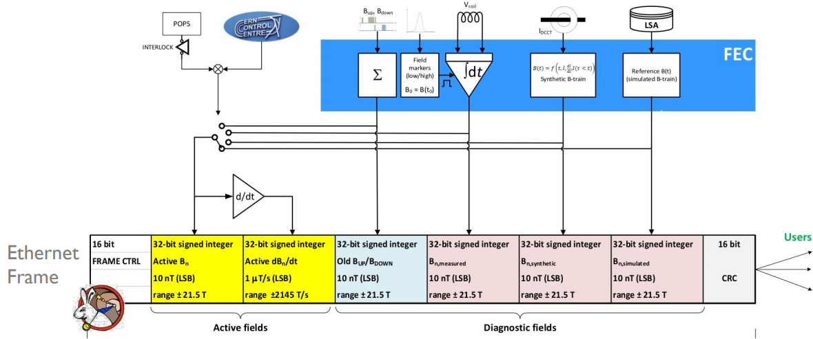

White Rabbit Distribution System
New distribution system using the fiber-optic White Rabbit Network
All B-Train data transmitted in a single Ethernet frame
  users can extract the desired field version
  CCC-chosen version copied up front, to be used by default for consistency

Slide 7
B-train sensors and electronics
Preliminary results of the reliability run:
- White Rabbit issues
- metrological characterization
Final system – status and planning
Conclusions

Slide 8
PSB B-train Reliability Run
Part of CERN wide reliability run for testing of White Rabbit distribution system and the consolidated FIRESTORM B-Train systems
Four systems (PS, PSB, LEIR and ELENA) currently under test with beam,
27 months of operation in 2018 (aggregated).
That is over 3 million beam cycles in the PSB !!
All tested B-trains share the same essential HW and SW components
Input from same sensors (coil in R3, central NMR @ 1108 G) as legacy system →
exactly same measured magnetic field is expected
WR also used successfully in the last month for beta normalization by the BCT

Slide 9

Time Line of PSB Reliability Run
WR→RF: ISOGPS, ISOHRS only All beams
19/04
22/04
23/05
10/06
21/06
17/07
28/07
15/08
30/10
19/11
29/10
New VSX in LEIR
Beam lost on R4
(constant received B values)
Back to B_{up}/B_{down} on R4 only
RR stopped on 24/04
New VSX in ELENA
No WR after power cut
Back (1 day) to B_{up}/B_{down}
no special action taken
New VSX firmware in R0
RR interrupted (unrelated issues)
Instability traced to
the receiver’s VSX switch
workaround: use spare SFP3 input
No WR on R3 after power cut
Back (1 day) to B_{up}/B_{down} workaround: use spare SFP3 input
Beam lost again in R4
(after network interruption)
R4 VXS switch changed (TS1)

Slide 10
White Rabbit issues and solutions
Timing constraints in the receiver’s VXS switch
(potentially affects the new LLRF in LEIR, PSB, AD and ELENA)
- new WR core firmware being deployed progressively
- adds new diagnostic facilities, greatly facilitates future upgrades
- all seems right so far
- testing can continue w/o beam throughout LS2
“Power cycle” bug in the new WR network switches
- affects randomly ∼6% of restarts after a power cut
- BE-CO-HT working are with high priority towards a permanent fix
- different workarounds possible e.g. plugging/unplugging the fiber, or re-establishing automatically the link by simple remote FPGA register access (no lost beam time)

Slide 11
B-train sensors and electronics
Preliminary results of the reliability run:
- White Rabbit issues
- metrological characterization
Final system – status and planning
Conclusions

Slide 12
NMR field marker results
NMR trigger provides initial field value and removes accumulated drift
New system provides better control over trigger
Repeatability of old and new systems is closely comparable
NMR Trigger Time | Value [ms] | σ [ms] | σ [G]
True Min. | 196.8 | 0.18 | 0.13
Legacy | 196.8 | 0.20 | 0.14
FIRESTORM | 196.9 | 0.18 | 0.13
NMR trigger causes difference in systems

Slide 13
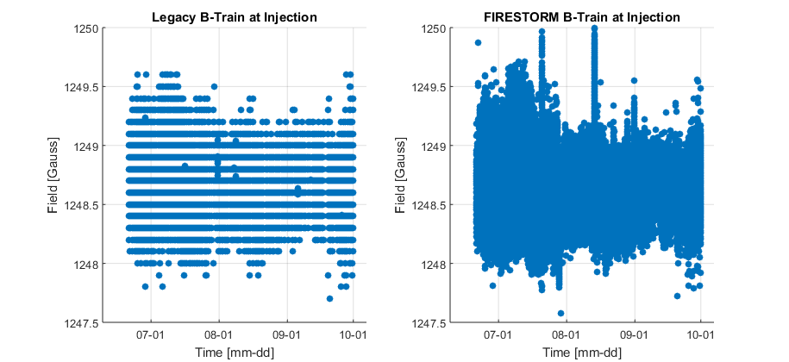
Comparison of measured field at injection
B-train | Avg. [G] | σ [G] | σ/avg [ppm]
Legacy | 1248.6 | 0.2 | 160
FIRESTORM | 1248.7 | 0.2 | 160
MD cycles
Deviation due to NMR Trigger
banding shows 0.1 G B_{up}/B_{down} resolution
Consistency between old and new B-trains tested on 40k operational cycles
Systematic difference at injection well below the scatter of the values
Equal standard deviations ∼140 ppm likely to reflect magnetic field reproducibility

Slide 14
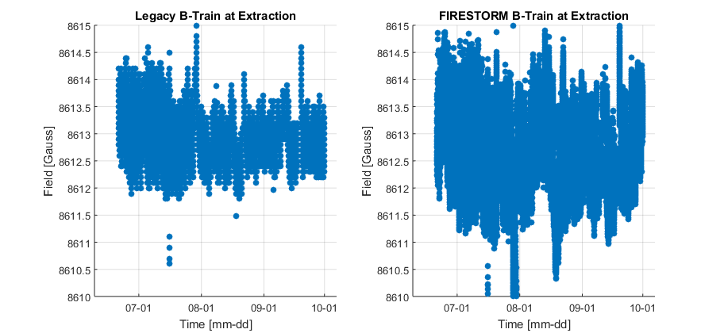
Comparison of measured field at extraction
B-train | Avg. [G] | σ [G] | σ/avg [ppm]
Legacy | 8612.9 | 0.3 | 35
FIRESTORM | 8612.6 | 0.6 | 70
Deviation due to change in compensation
Systematic difference at extraction twice as large than at injection
(still ≤ scatter; compatible with 30 ppm gain error)
Standard deviation of FIRESTORM twice as high than legacy,
may be due to uncorrected integrator drift
(0.6 G = 300 Hz, well within the correction range of the radial loop)
Deviation due to NMR Trigger

Slide 15
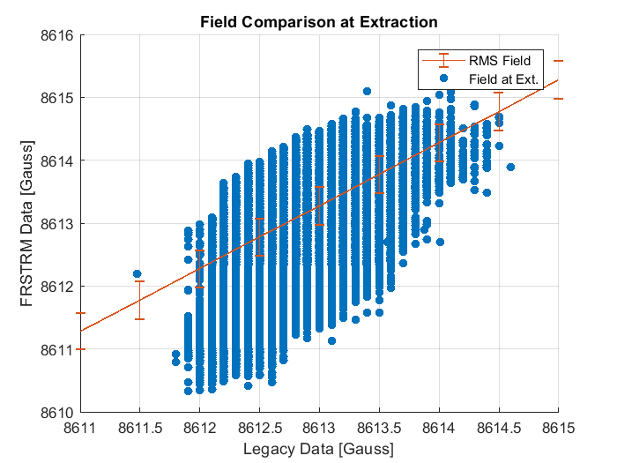
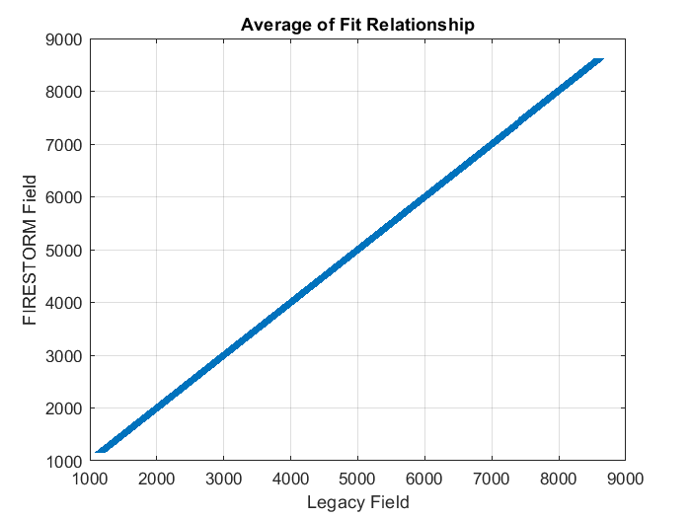
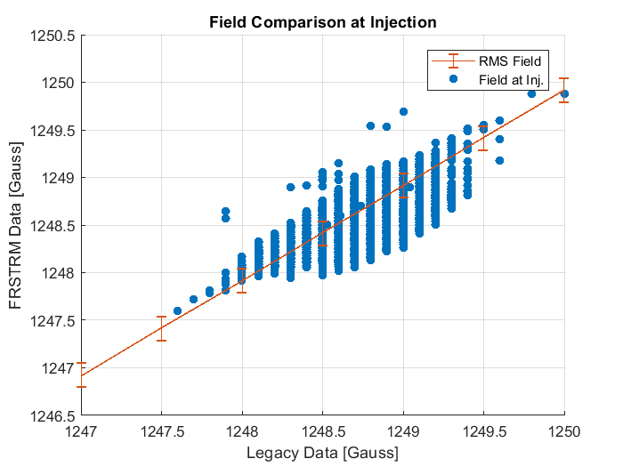
Comparison of measured field throughout a cycle
Correlation parameter | Value | Unit
Offset | -0.14 | G
Slope | 1.00005 | G/G
RMS residual | 0.4 | G
Peak residual | 2.4 | G
Prototype FIRESTORM system shows similar
performance to Legacy B-Train

Slide 16
Integrator drift correction
Outliers in the measured field at extraction are correlated to large DPOT settings, suggesting a possible problem with the correction algorithm or the coil signal conditioning (investigation ongoing)
Additional correction methods to be
implemented during LS2
Digital calibration value reduces drift & error at extraction
Large variation in digital calibration value

Slide 17
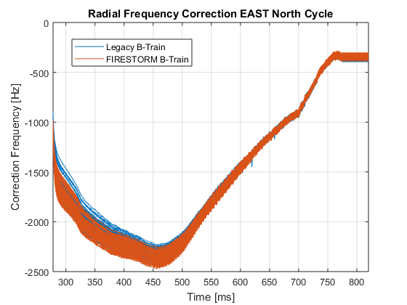
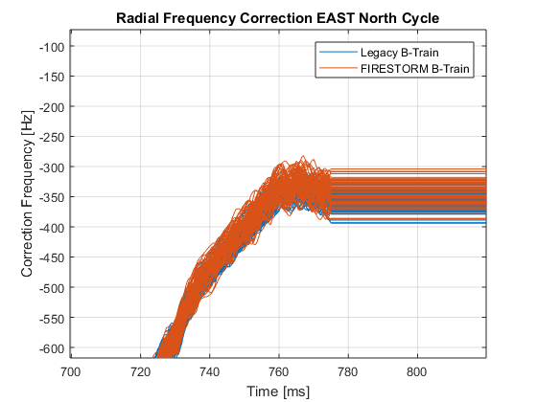
Impact on radial loop
Radial Correction at Extraction | Value [Hz] | σ [Hz] | Value [Gauss] | σ [Gauss]
Legacy | -354 | 13 | 0.71 | 0.03
FIRESTORM | -352 | 30 | 0.70 | 0.07
Radial Loop correction is closely comparable

Slide 18
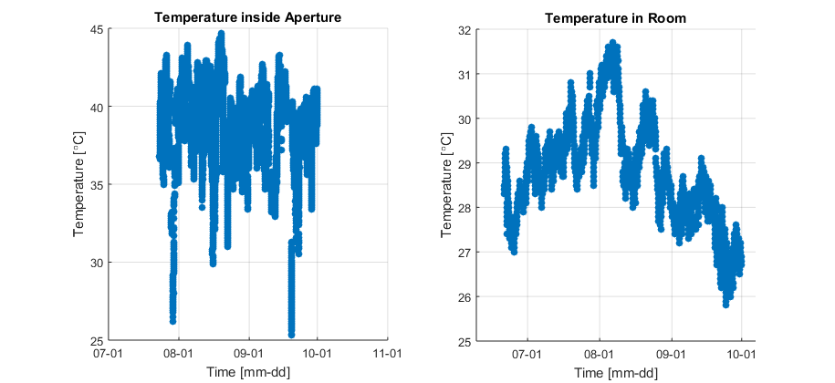
Possible temperature effects
Power cut
TS2
ΔT between reference and ring magnets expected to have negligible impact
Coil calibration error in reference magnet = 10 ppm/deg
ΔT between reference magnet and electronic rack ⇒ thermocouple offset voltages
Need and possibilities for on-line correction to be investigated during LS2

Slide 19
B-train sensors and electronics
Preliminary results of the reliability run:
- White Rabbit issues
- metrological characterization
Final system – status and planning
Conclusions

Slide 20
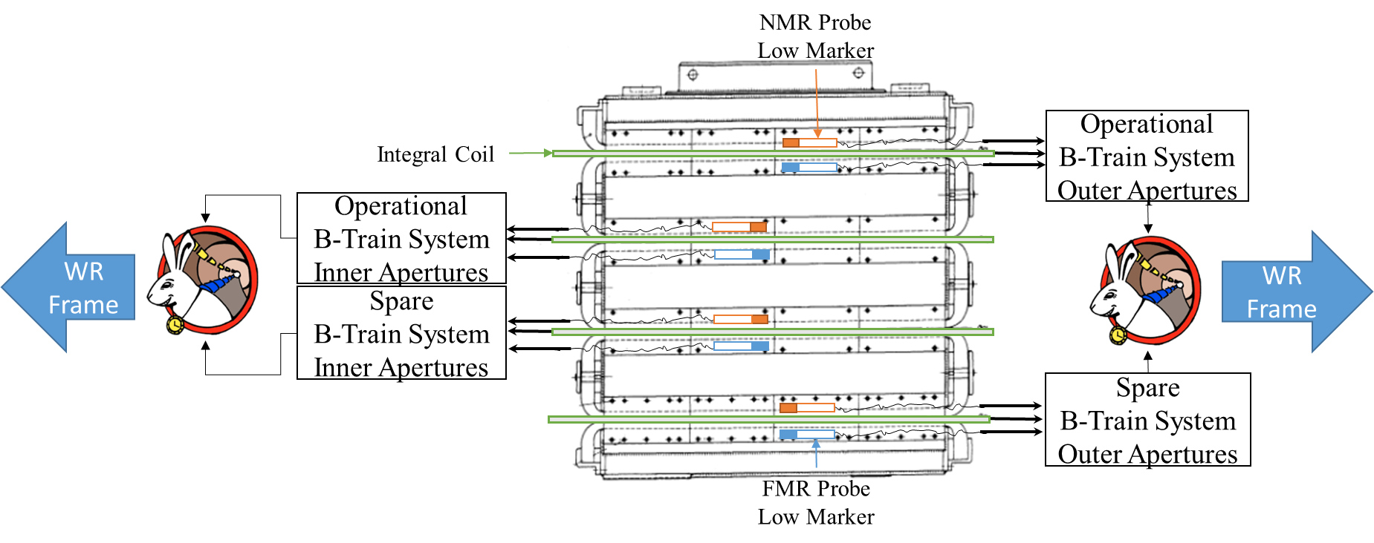
Final FIRESTORM B-train system
B-Train System will be located in B. 245
Two parallel and (in principle) independent systems for the inner and outer rings
Proposed routing: R3(1) → POPS-B 13, LLRF R2 & R3, BCT
R4(2) → POPS-B 24, LLRF R1 & R4

Slide 21
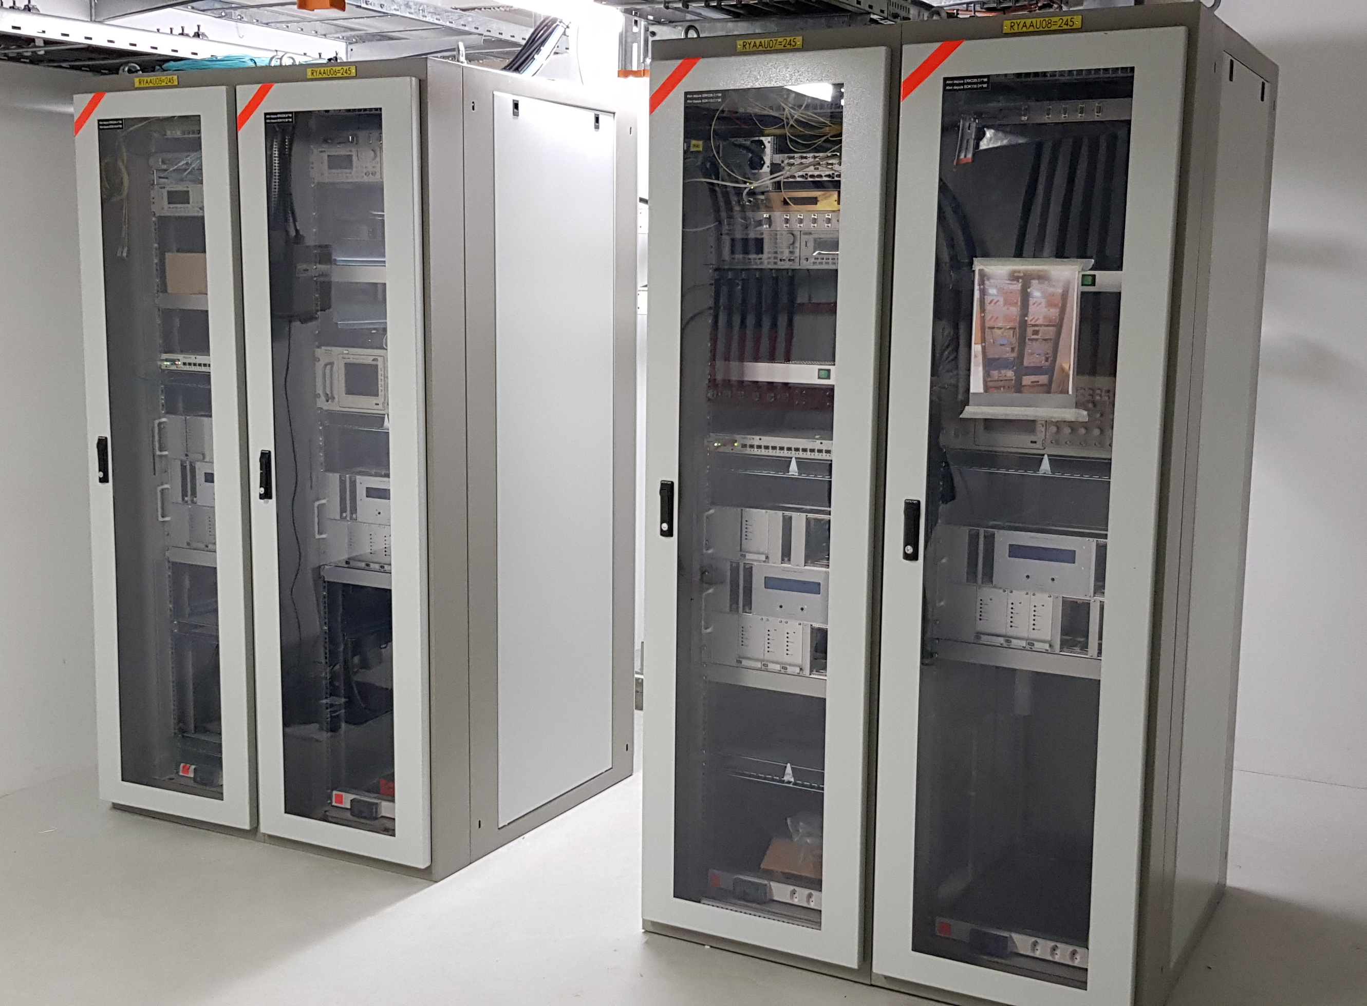
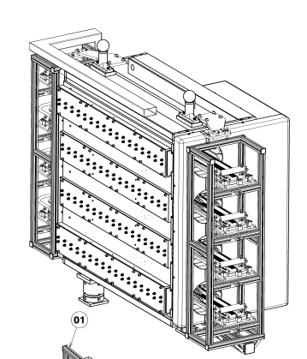
Status
Bldg. 245: racks installed, electronic components ordered and mostly installed,
all cabling demands done
New sensor support structure in preparation, expected end 2018
New induction coils: winding forms in stock, winding process just started,
(four coils essential for start of commissioning, expected Feb 2019)
NMR markers available, new FMR field markers being manufactured
Sensor support

Slide 22
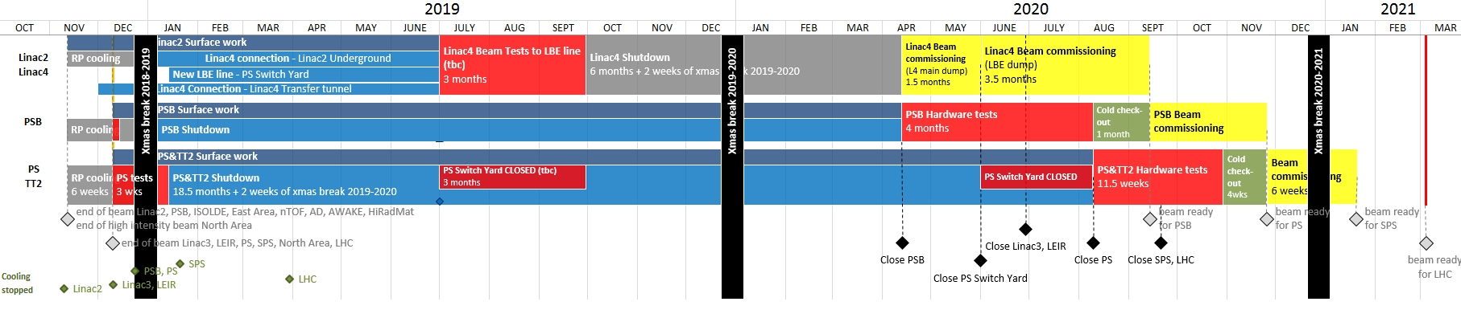
Planning
B-train commissioning and in-situ calibration
(POPS-B on the dummy load)
B-train tests in the shadow
of HW tests
2019/01 Dismantle the prototype FIRESTORM installation in 361-1-012
In particular: recover FEC, B-train SPEC/FMC, OASIS crate
and NMR teslameter & probes
2019/09 Installation of reference magnet in 245-S-243
2019/10 Assembly of sensors and electronics completed
2020/08 5 days of dedicated MD tests with RF + POPS-B, no beam
2020/09 2 days of dedicated MD tests with RF + POPS-B + beam

Slide 23
B-train sensors and electronics
Preliminary results of the reliability run:
- White Rabbit issues
- metrological characterization
Final system – status and planning
Conclusions

Slide 24
Conclusions
Measurement performance of the new FIRESTORM
B-train on a par or better than legacy system
Overall reliability of the new system established by several years of cumulated operation
Sporadic White Rabbit instabilities being fixed, no impact expected after LS2 (many thanks to BE/CO, BE/RF and BE/OP teams for their efforts !)
Notes:
The fix can be propagated quickly to all VXS switch firmware nodes except for the PS (where the problem did not appear, continuous running since 2014)

Slide 25
Additional slides

Slide 26
Integrator Drift Over Time
RMS average integrator drift 0.5 G/s is higher than other systems (e.g. 0.05 G/s in ELENA)
Input voltage offset correction in FIRESTORM is similar to legacy B-trains:
  Manual correction of the systematic offset once a year via analog potentiometer
  Automatic subtraction of the short-circuit input voltage every n^{th} zero-cycle (n=15)
  via a digital potentiometer (DPOT)
Drift over multiple cycles is non-existent
due to NMR marker repeatability
Drift | Average [G/s] | σ [G/s]
Single Cycle | 0.5 | 0.5
Cycle to Cycle | 0.007 | NA

Slide 27
Test campaign in bldg. 867
Extensive test campaign carried out on the new reference dipole (one of the two old spares, refurbished) in 2018 to validate final configuration (new stainless steel side plates: laminated outer rings, solid inner ring)
New Side plate reduces field difference between Inner and Outer apertures to 120 units
New Side plate reduces field by 60 units
New Side plate Increases field by 170 units

