Slide 1
Status update from LBNL
MDP - FCC - EuroCirCol Meeting
03/12/2018
Soren Prestemon
for the (LBNL) MDP team

Slide 2
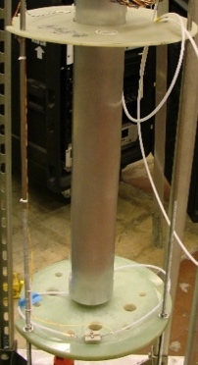
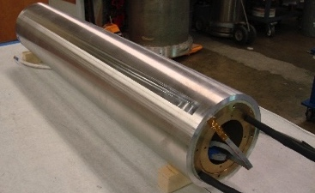
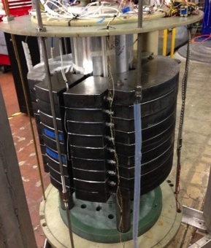
History of CCT Dipole Tests at LBNL
CCT1
CCT1
2.5 T short-sample dipole
50 mm clear bore
8 strd. NbTi cable (0.65 mm SSC Outer)
not impregnated
11/2013: tested up to 2.5 T
CCT2
5.3 T short-sample dipole
90 mm clear bore
23 strd. NbTi cable (0.8 mm SSC Inner)
epoxy impregnated
5/2015: tested up to 4.7 T
CCT3/4
10.5 T bore field at round wire short-sample
90 mm clear bore
CCT3 03/2016: reached bore field of 7.4 T (conductor damage)
CCT4 08/2017: reached bore field of 9.1 T (substantial training)
CCT2
CCT3 / CCT4

Slide 3
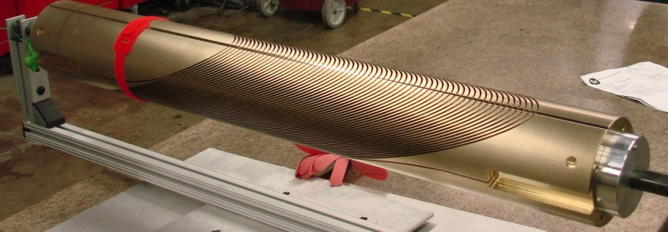
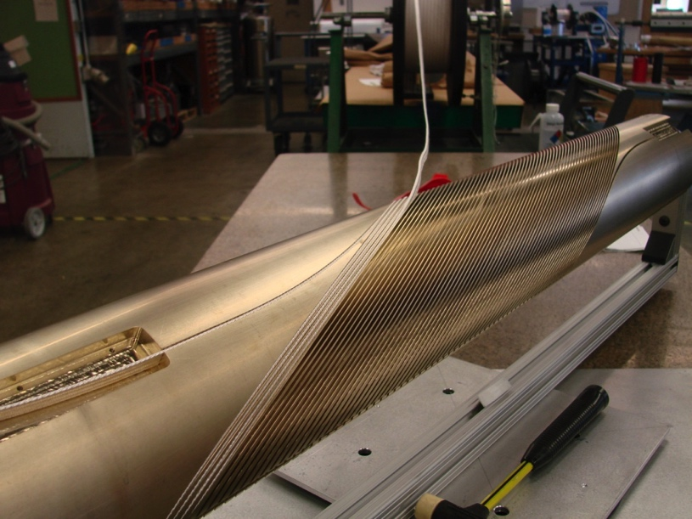
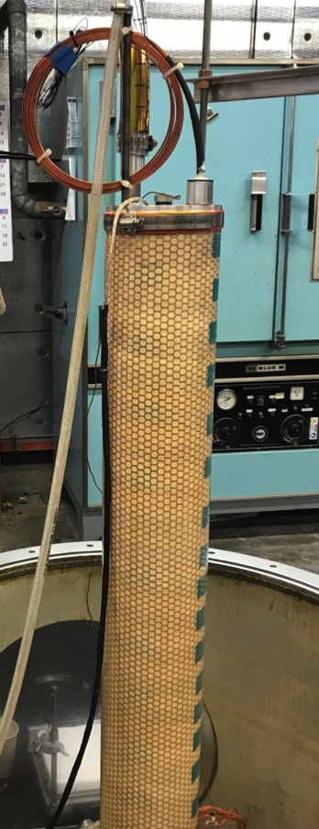
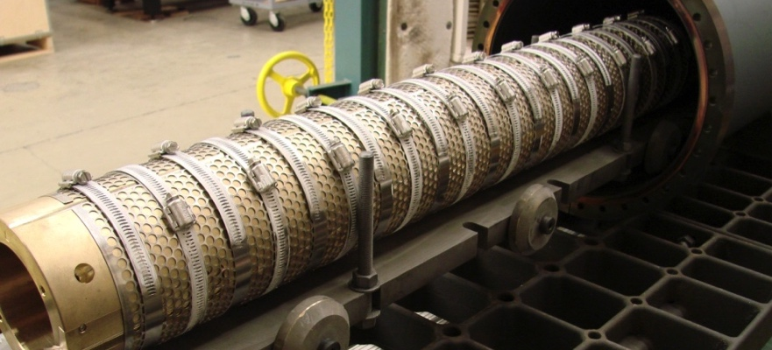
CCT Design Requires Minimal Amount of Tooling and Parts When Compared to Traditional Dipole Magnets
Aluminum Bronze mandrels incorporate features for stress management and cable positioning
Minimal tooling is required for heat treatment and epoxy impregnation
Machined Mandrel
Coil Winding
Coil Impregnation
Heat Treatment with SST Sheet and Clamps

Slide 4
Main Technology Issues Are Being Addressed With CCT 2-Layer Magnet Series
 | CCT3 | CCT4 | CCT5
Bore size [mm] | 90 | 90 | 90
Groove design | constant width | 1.25 mm gap at pole | 1.65 mm gap at pole
Conductor | RRP 54/61 Ta doped | RRP 54/61 Ta doped | RRP 108/127 Ti doped
HT Temp [C] | 650 | 660 | 675
Potting configuration | full magnet | full magnet | individual layers
Epoxy | CTD-101K | CTD-101K | FSU Mix 61
Layer-to-layer interface | bonded | mold released | bend and shim process
Short Sample Current | 19.3 kA | 19.3 kA | 17.8 kA
Field quality
Conductor damage/stability
Cost and scalability
Training

Slide 5
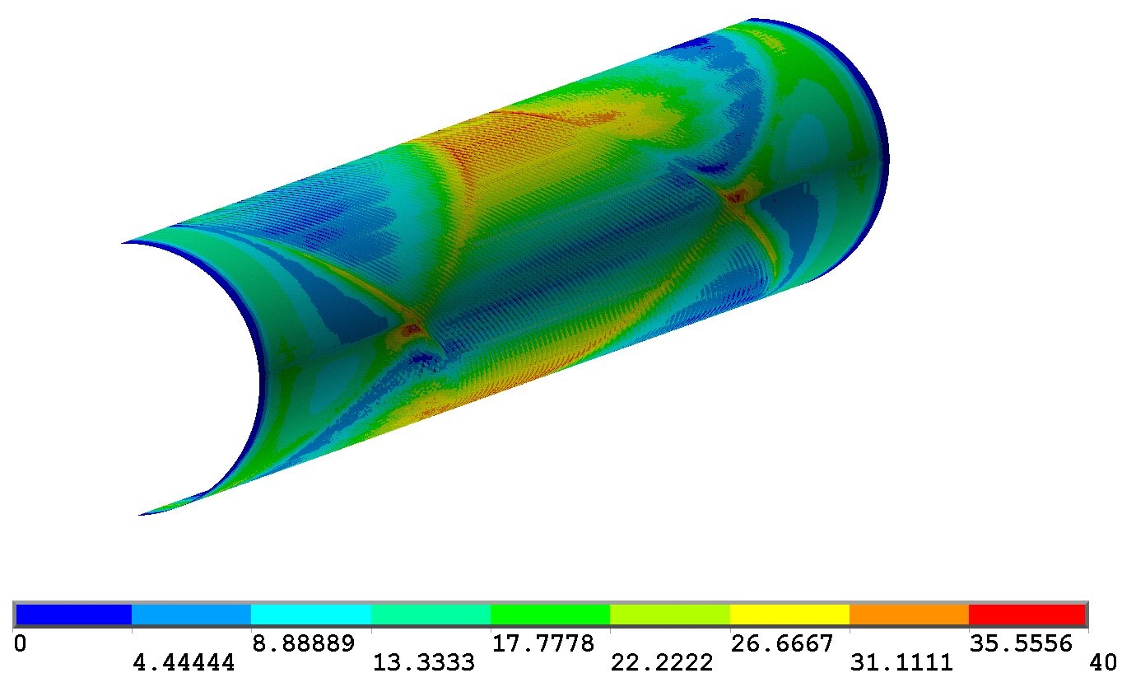
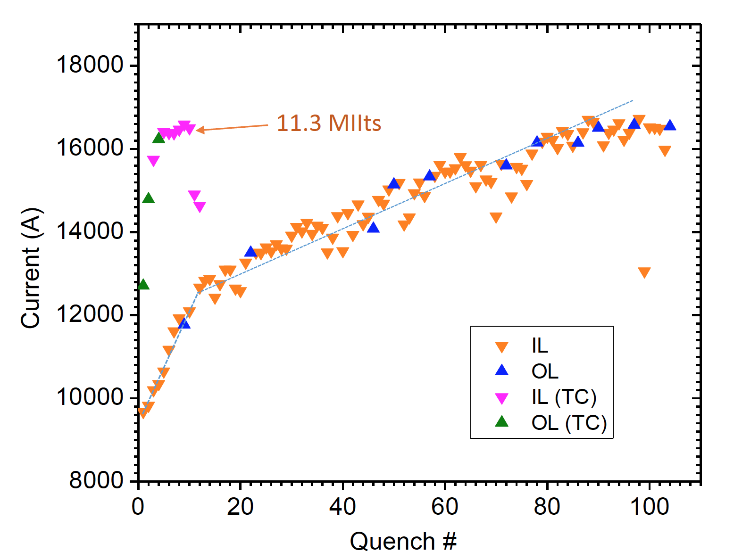
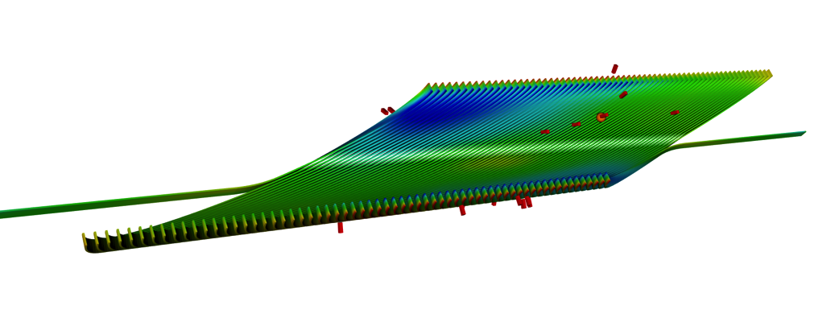
Conductor Damage Problems Were Resolved for CCT4 and Results Lead to Focus on Training Reduction for CCT5
Reached 86% of round wire short sample after 85 quenches
Maximum current is 16.7 kA
Maximum bore field is 9.14 T (90 mm aperture)
Magnet exhibits long training but good memory after thermal cycle
Reduction in training is the main focus for CCT5
  Impregnation material (CCT5 uses tougher epoxy)
  Frictional interfaces (CCT5 uses shim interface)
Stress at Layer-to-Layer Interface
CCT4 Training Behavior
After Thermal Cycle
Localization of Quenches from Acoustic Signals
See talk by M. Martchevskii

Slide 6
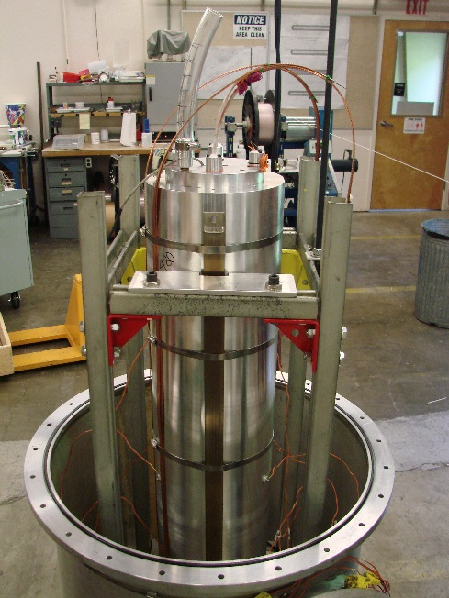
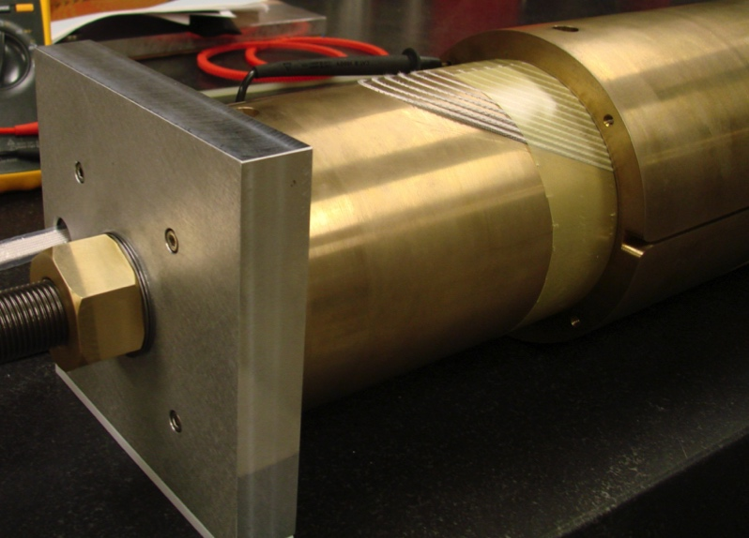
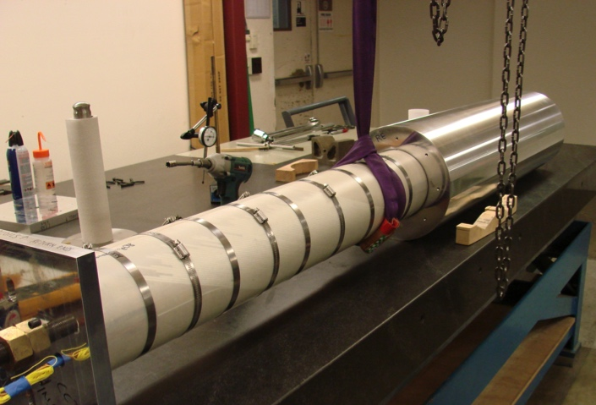
Reminder: CCT3/CCT4 Layers Were Assembled Into The Shell And Impregnated As One Unit
Reacted coils are assembled together with G10 shim between layers
Coils are inserted into the Aluminum shell and the entire assembly is vacuum impregnated with epoxy
Areas of unfilled epoxy remain between the layers
  G10 shim has to be substantially thinner than gap between layers due to distortion of the mandrels during heat treatment
Step 3. all impregnated together
with the shell used as tooling
Step 1. Assemble Layers
Layer 2
Step 2. Layers 1+2 into shell
Layer 1
Linear driver
G10 slip plane
6

Slide 7
CCT5: New Method Developed for Coupling of Individually Potted Layers (Bend-and-Shim)
Contact location between layers is controlled by using shims and Kapton bags that are filled with glass and epoxy
  Allows for control of contact location
  Fracture in interface epoxy does not propagate to the coil
  Improved cooling at the pole regions from direct contact with LHe
Directional preload to reduce energized stress can be applied by bending layers or shell, filling and curing epoxy in bent state, releasing bending pressure
Applied Force
Force Release After Cure
epoxy filled Kapton bag
shell
layer 1
Directional
Pre-Load on Coils
layer 2

Slide 8
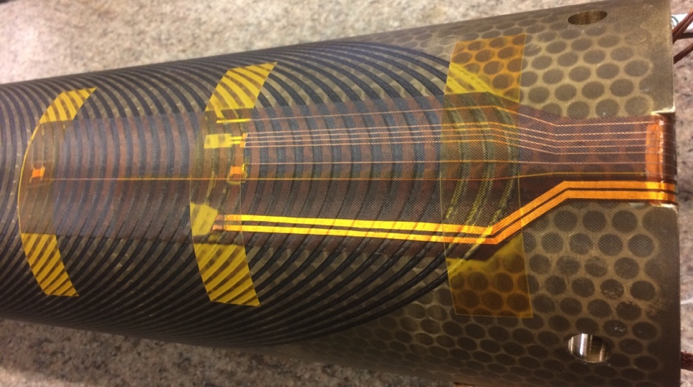
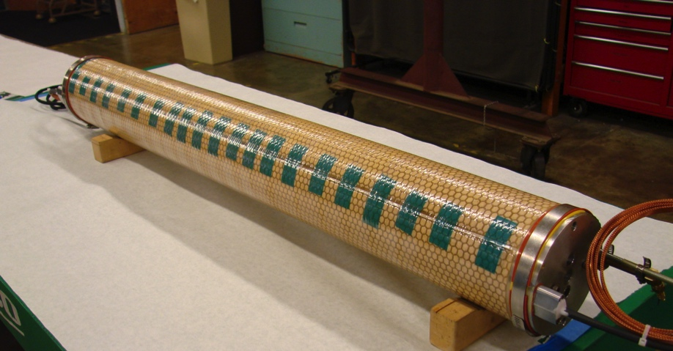
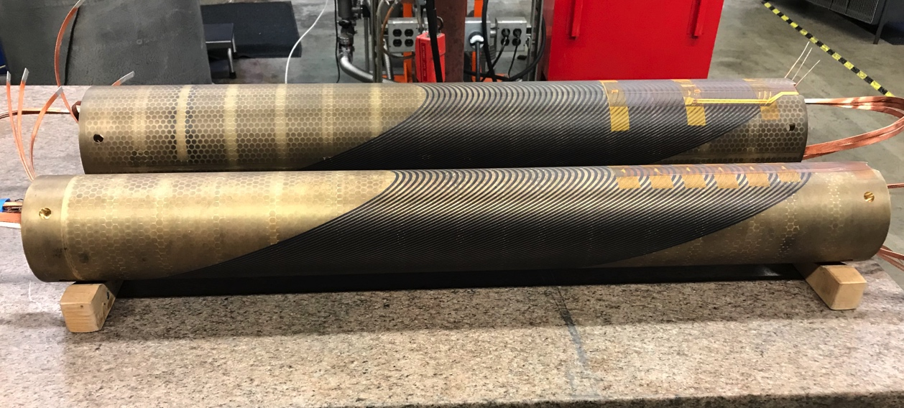
Vacuum Impregnation of CCT5 1 Meter Coils using New Process Was Successful
Instrumentation Trace After Potting
Coils are impregnated with mix 61 epoxy
CCT5 coils were successfully impregnated with new process
Instrumentation traces were included in the impregnation
V taps
Thermometer
Heater
Wrapped Coil After Impregnation

Slide 9
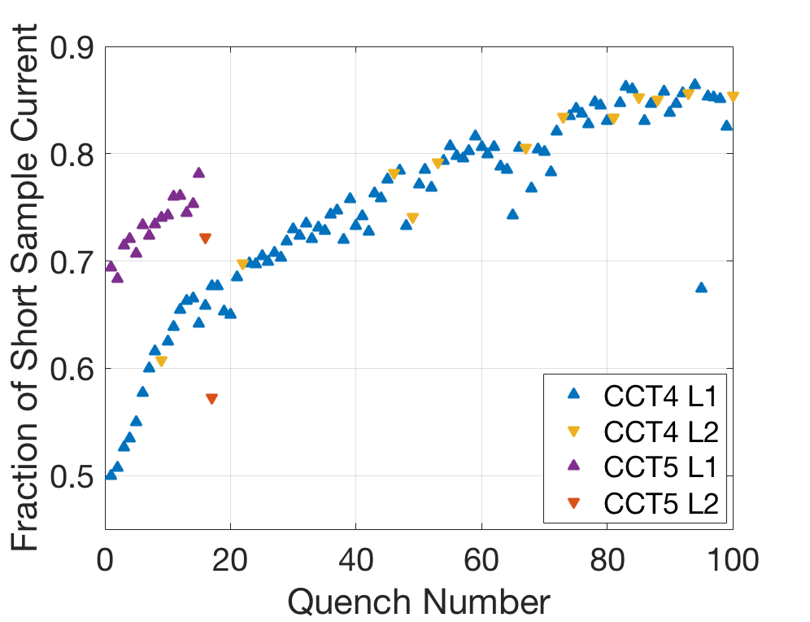
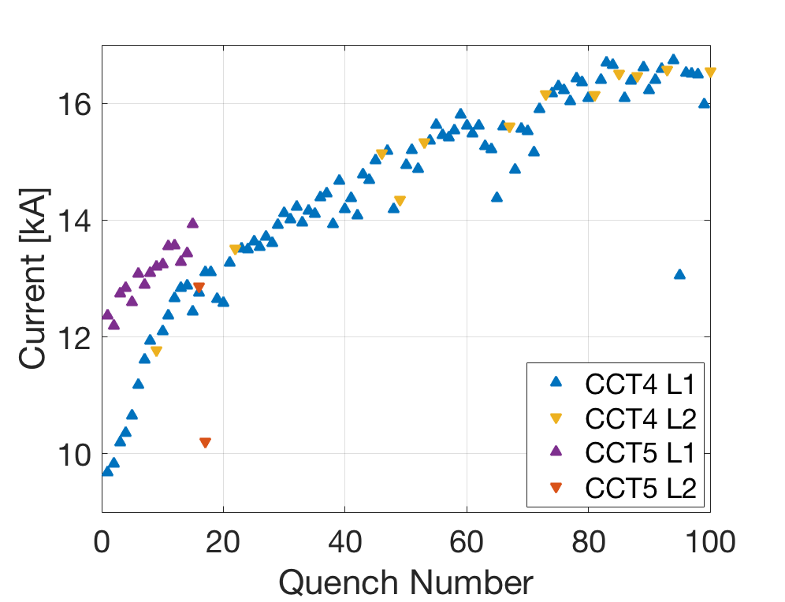
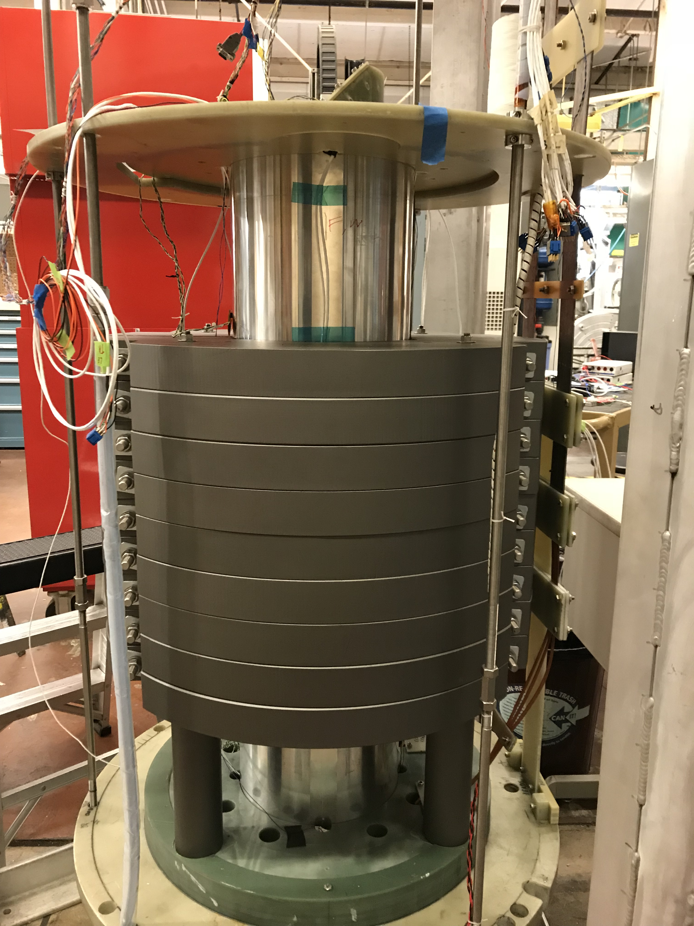
First Quench Training Results
First quench at 69% of short sample
Magnet reached 78% of short sample after 15 training quenches
Outer layer (L2) quench current drops substantially after highest current quench
  Quench was initiated in the inner layer (L1)
  Irregular voltage develops during extraction
Improvement in early training (e.g. first quench current) and training rate possibly improved, but not dramatically
Quench Current Relative to SSL
Quench Current

Slide 10
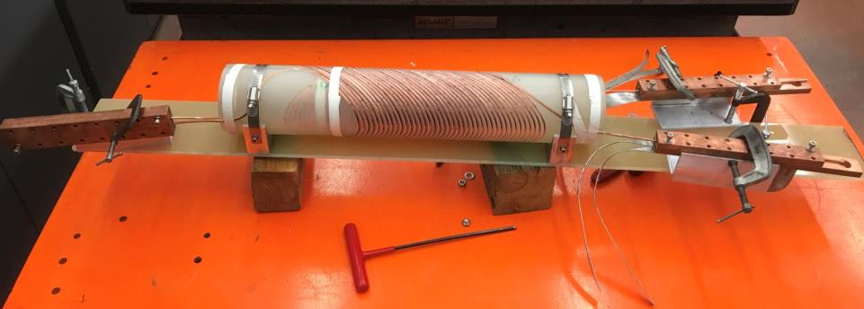
Successfully scaled up and developed C1 magnet, the first 2-layer CORC® CCT dipole magnet
Return-end joint
Lead-end joint
Strongback to anchor the coils and joints
C1 mockup
NbTi cable leads

Slide 11
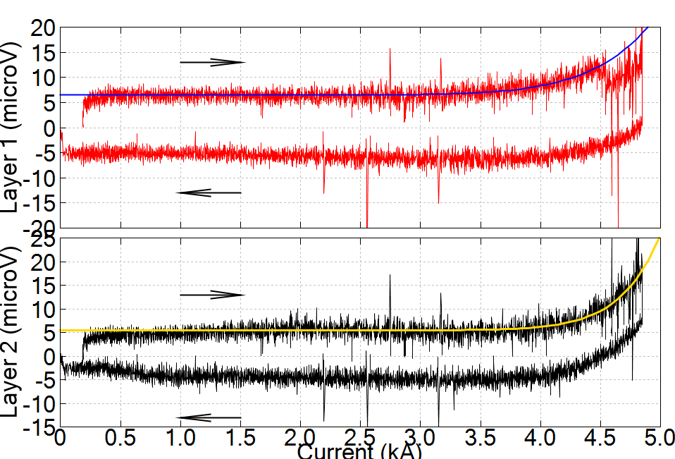
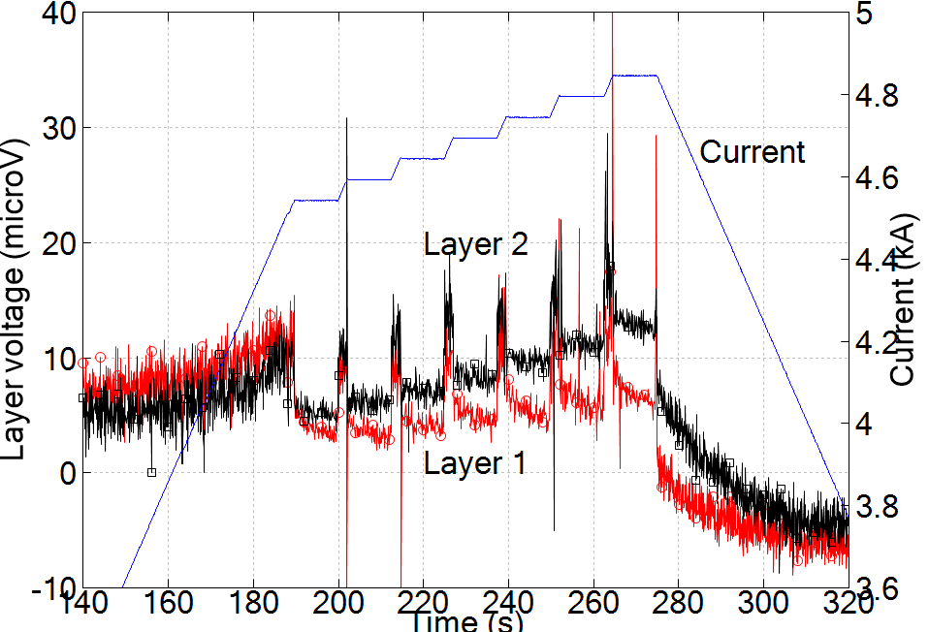
C1 showed high thermal stability during the superconducting-normal transition
J_{e} ~ 620 A/mm²
100 mW peak power generation without thermal runaway
Enable stable magnets that have no training and can tolerate high heat load
Next CCT magnets will be impregnated and thermal stability will be evaluated

Slide 12
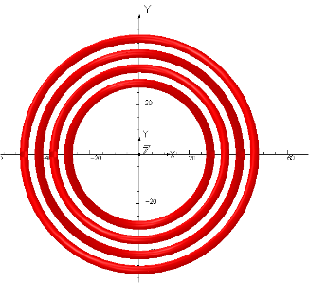
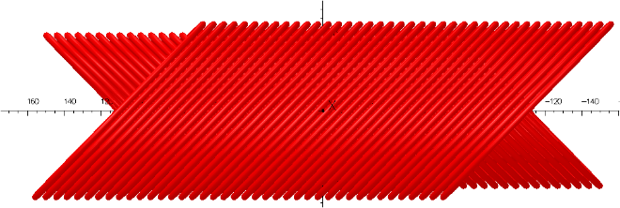
Based on the C1 experience, we are making
C2 magnet as a next step
4-layer design
  3 T at 4.2 K and 8 kA
  70 mm ID, 130 mm OD (compatible with a future MDP Nb₃Sn outsert for hybrid testing)
  630 mm long
  Tilt angle: 50° for Layer 1/2; 35° for Layer 3/4
30-tape CORC® wire
  SuperPower 30 µm substrate
  81 m long wire (4.2 km of tape)
  Wire OD: 3.65 mm
  Minimum bending radius: 30 mm

Slide 13
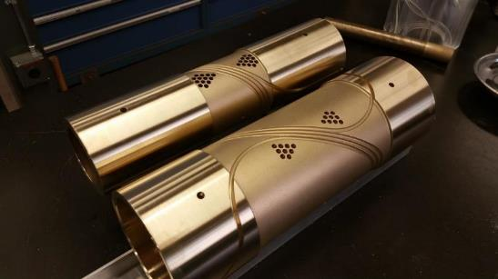
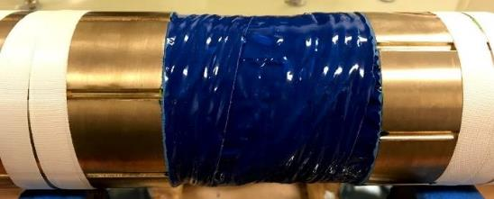
C2 will test several key technology features required for high-field REBCO accelerator insert magnets
Develop strong metal mandrels
  Friendly design for coil winding
  Convenient to machine
  Aluminum-Bronze (leveraging MDP Nb₃Sn CCT knowledge)
Constrain conductors with epoxy
  Stycast 2850 MT

Slide 14
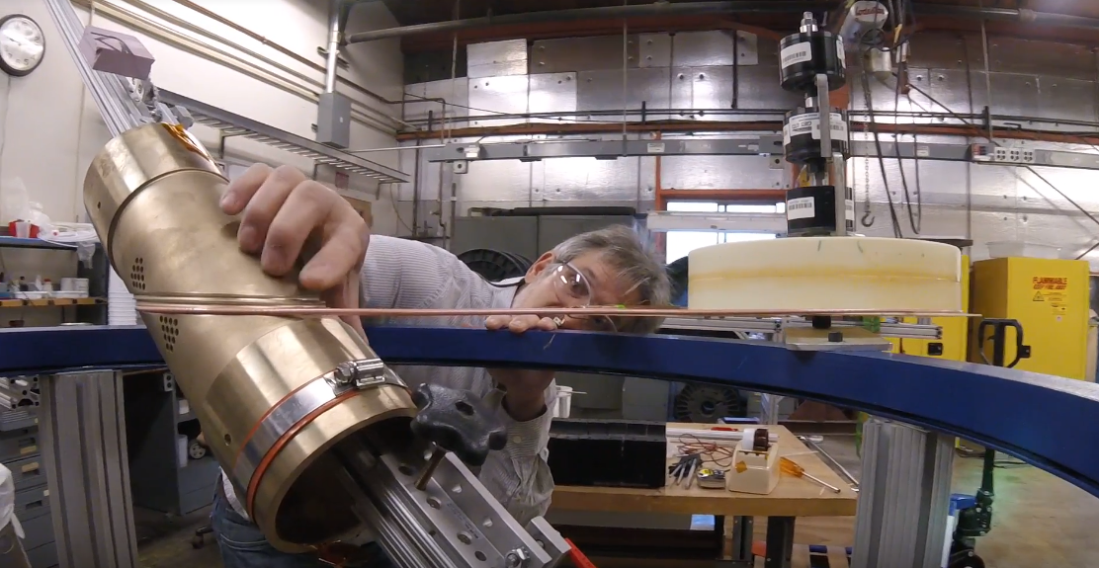
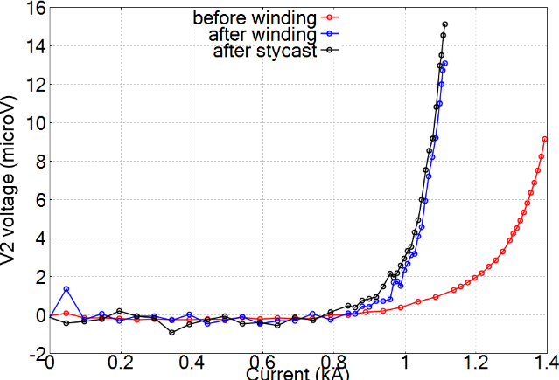
3-turn subscale coils provided first positive feedback on the wire performance for C2 magnet
77 K
After bending & stycast
Before winding
C2 wires will be bent to a minimum radius of 30 mm
2 – 3 m long CORC® wire used for each 3-turn coil
We observed 27% I_{c} reduction at 77 K after winding and applying stycast
Stycast has negligible impact (1% I_{c} reduction)

Slide 15
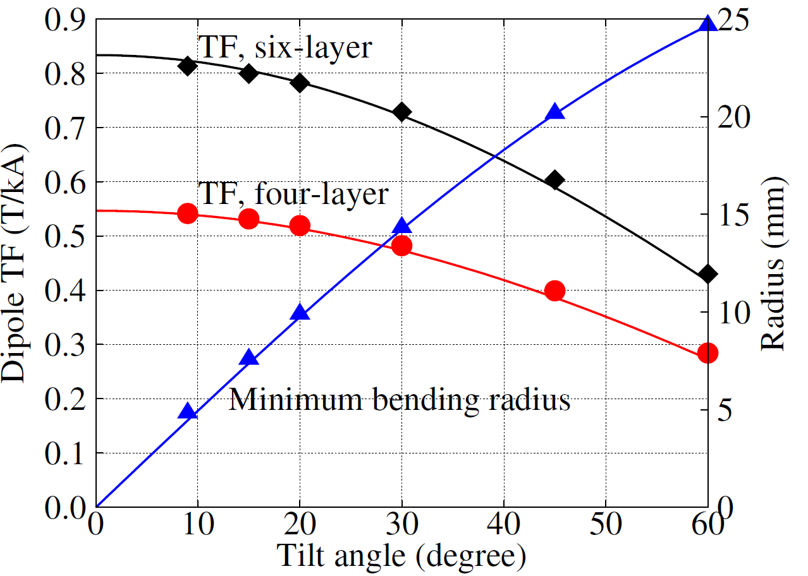
More flexible high-current REBCO wires are critical to demonstrate higher dipole fields
Thinner tapes are the key
  They permit smaller CORC® bending radii and tilt angles → higher dipole fields
  30 µm substrate → 25 µm corresponds to 25% increase in J_{e}
  Increase pinning performance at 4.2 K
The resulting tapes will have strong technology and market impact
  Need to develop them now
Radius (mm)
Tilt angle
Wang et al., 2018 SuST, 31, 045007
Notes:
Je increase with no increase in Jc of tape

Slide 16
Summary comments
This provides a snapshot of a subset of MDP activities
  Note that significant work is ongoing at FNAL and at ASC/NHMFL as part of MDP as well
Other areas that may serve for dedicated presentations in the future include…
  Advances in modeling, e.g. custom FEA elements
  Advances in diagnostics, e.g. active acoustics and machine learning
  Advances in Nb₃Sn superconductors
  Developments in epoxies
  …

