Slide 1
Status and Update
CERN
MDP - FCC - EuroCirCol Meeting
03/12/2018
Susana Izquierdo Bermudez and Juan Carlos Perez
Nicolas Bourcey, Michael Guinchard, Sohrab Emami Naini, Francois-Olivier Pincot, Ricardo De Paz Ludena, Jerome Fleiter, Salvador Ferradas Troitino, Carlo Petrone, Bernardo Castaldo , Manuel Francisco Garcia Perez, Davide Tommasini.

Slide 2
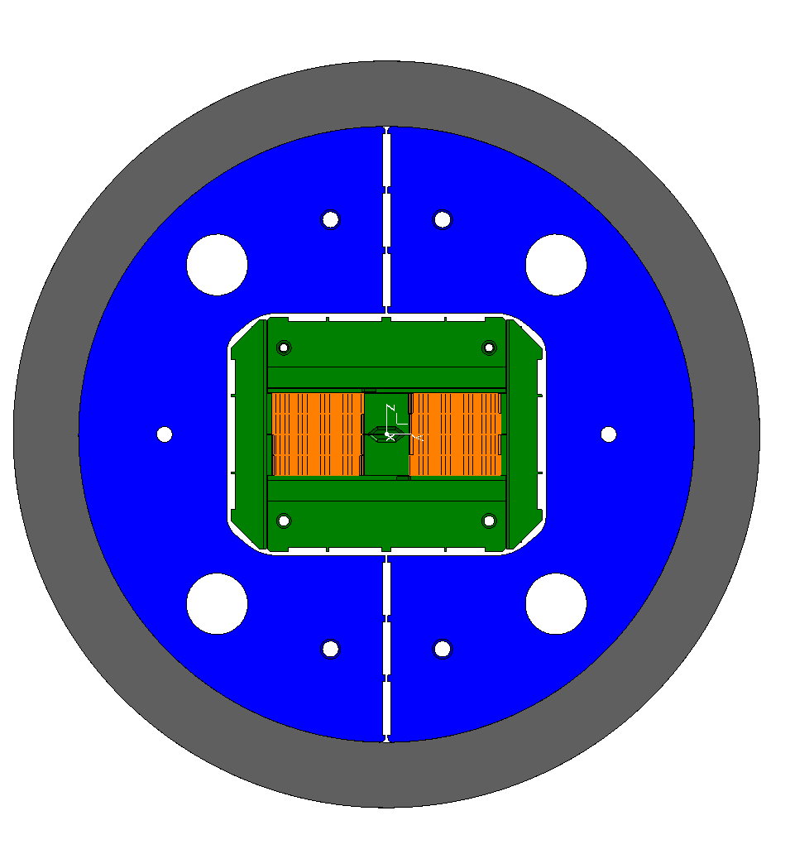
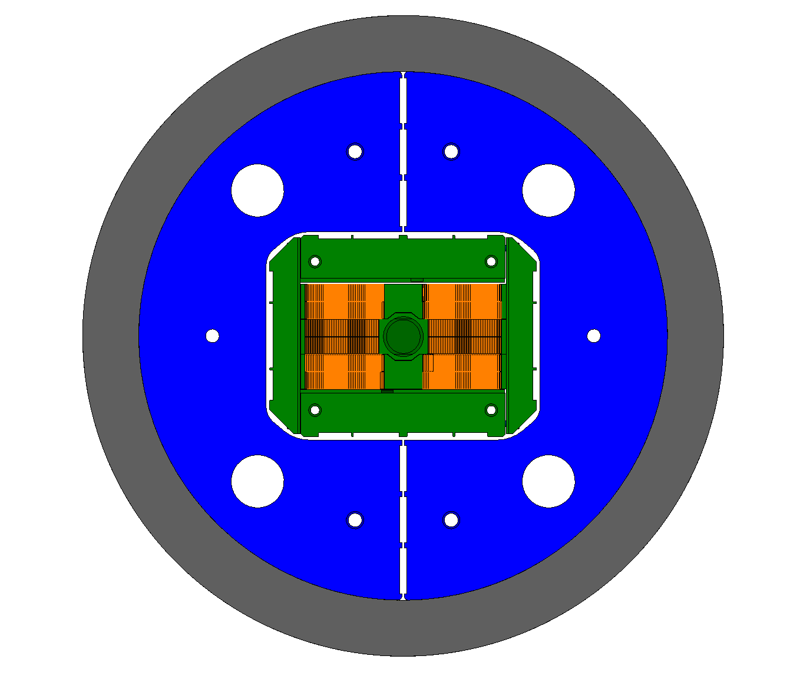
General overview
eRMC
  Three coils (2 + 1 spare) finished.
  First assembly with Aluminum dummy coils, including thermal cycle to 80 K done.
  We plan to increase the pre-load (+ 20-30 MPa, before the end of the year) and perform a second thermal cycle.
  Magnet assembly planned for January-February 2019
RMM
  Coil parts available
  2 cable unit lengths (1 + 1 spare) should be produced before the end of 2018
  Procurement of lateral pad launched, all rest of the magnet parts are those of eRMC.
SMC
  Plan to use it to qualify new resin systems and develop high field internal splices (and any additional new feature coming).
  SMC11 T cable planned for beginning of 2019
eRMC
RMM

Slide 3
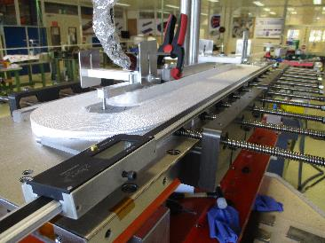
eRMC – Coil winding
Three coils has been wound
No issues found during winding, but low packing of the coil in the longitudinal direction (∿ 0.2 mm/turn longer longitudinally)
“Novel” features:
  Mica around the pole, to minimize the bonding strength between cable and pole.
  End spacers polished to maximize the bonding strength between cable and end parts.
  End parts not coated, but 0.5 mm of extra S2 glass between cable and metallic parts to enhance the electrical insulation.

Slide 4
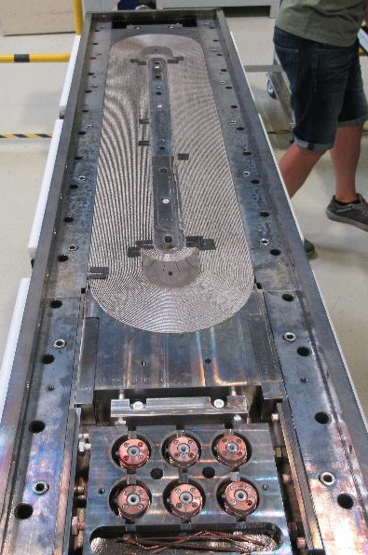
eRMC – Reaction
Coil after reaction
Three coils have been reacted
Gaps in between poles to allow longitudinal movement during reaction.
  Goal: gaps are almost closed after reaction; achieved for coil 101 and 103, different behavior of coil 102.

Slide 5
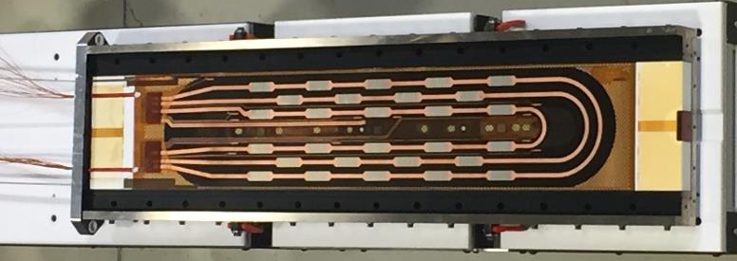
eRMC – Impregnation
Three coils have been impregnation without any particular issue.
Only the geometry of one out of the three coils have been measured
  Coil azimuthal oversize + 0.130 mm, with a longitudinal variation of ± 0.05 mm
  Iteration on azimuthal alignment in the impregnation tooling for coils 102 and 103 in order to improve the coil asymmetry
  Coil 102 and 103 will be measured this week

Slide 6
eRMC – Electrical tests & Instrum.
In spite of the large amount of insulation between coil and pole (1 layer of Mica (0.1 mm) + 2 layers of Fiber glass (2x0.250 mm) + cable insulation), weak electrical insulation coil to pole.
Instrumentation:
  Fiber optics in the coil lost for coil 101 and not installed in coil 103
  Heaters and VTAPS OK.
  Hall sensors and PCB probes have been produced, getting ready for the assembly.
 |  | Coil 101
Insulation resistance | U[test] | Before Reaction | After Impregnation
 | [V] | [GΩ] | [GΩ]
coil ---> Central Post (GROUND) | 100 | 0.027 | X
coil ---> SPACER NCS | 100 | 36.6 | X
coil ---> SPACER CS | 100 | 35.9 | X
coil ---> Central Post | 500 | X | 594KΩ /348V
coil ---> all QHs | 3000 | X | 6.54
coil ---> Endshoe CS | 1000 | X | 36.1
coil ---> Endshoe NCS | 1000 | X | 768KΩ /750V
QHs ---> Endshoe CS | 2500 | X | 17.6
QHs ---> Endshoe NCS | 2500 | X | 6.38

Slide 7
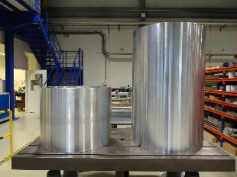
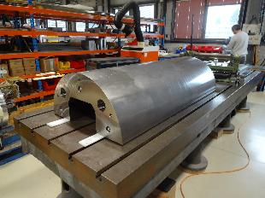
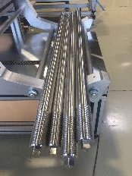
eRMC – Dummy structure
In order to explore different assembly parameters:
  Full aluminum shell and half length shell options available.
  Aluminum and Stainless Steel rods available for the longitudinal loading.
A first assembly with dummy coils (including thermal cycle to 80 K) has been done, using full length shell and aluminum rods.
  The plan is to slightly increase the pre-load and do a second thermal cycle.

Slide 8
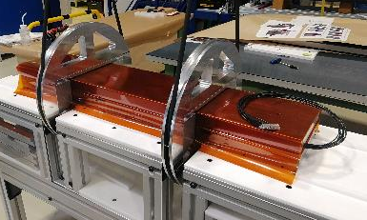
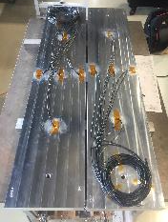
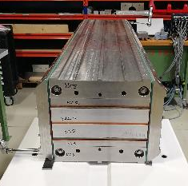
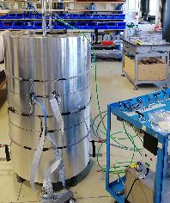
Mechanical Test Assembly
Instrumented Aluminum Dummy Coils
Coil rotation tooling and ground insulation
Coil Pack
Shell-yoke pre-assembly

Slide 9
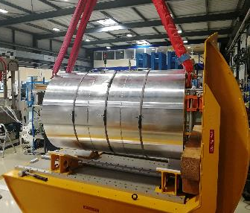
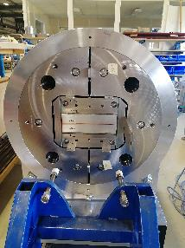
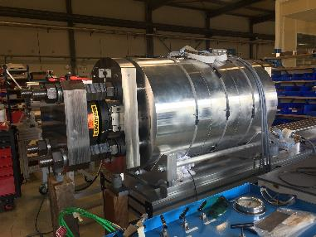
Mechanical Test Assembly
Shell-yoke rotation
Magnet pre-assembly, including yoke keys (to be removed before the first loading step)
Magnet including axial loading system

Slide 10
Mechanical Test Assembly
The increase of stress during cool down is lower than expected in the shell (30 MPa instead 80 MPa) of and higher than expected in the coil (80 MPa instead of 50 MPa).
  Investigations on going to understand the source of the discrepancy.

Slide 11
Mechanical Test Assembly
Longitudinal rods behave as expected.
  For the first assembly, we tested the case “low pre-load” with aluminum rods.
Axial preload | Coil | Room temp. preload | Cool down @ 4.2 K | Powering @ 16T
Al rods, low pre-load | Nb₃Sn | [41] (11%) | [302] (83%) | [323] (88%)
 | Al | [37] (10%) | [200] (55%)
Al rods, high pre-load | Nb₃Sn | [227] (62%) | [505] (138%) | [526] (144%)
 | Al | [221] (60%) | [393] (108%)
SS rods, low pre-load | Nb₃Sn | [73] (20%) | [172] (47%) | [207] (57%)
 | Al | [60.8] (17%) | [13.6] (4%)
SS rods, high pre-load | Nb₃Sn | [349] (95%) | [461] (126%) | [495] (135%)
 | Al | [362] (99%) | [324] (89%)

Slide 12
Summary
A first assembly test using Aluminum dummy coils, including a cool down to 80 K was done
  We plan to slightly increase the pre-load and perform a second cool down.
Three eRMC coils have been produced, the plan is to assemble the magnet in January-February 2019.
If the cable is available, RMM winding can start beginning of 2019.
We plan to keep SMC as a tool for R&D development activities.

Slide 13
Additional slides

Slide 14
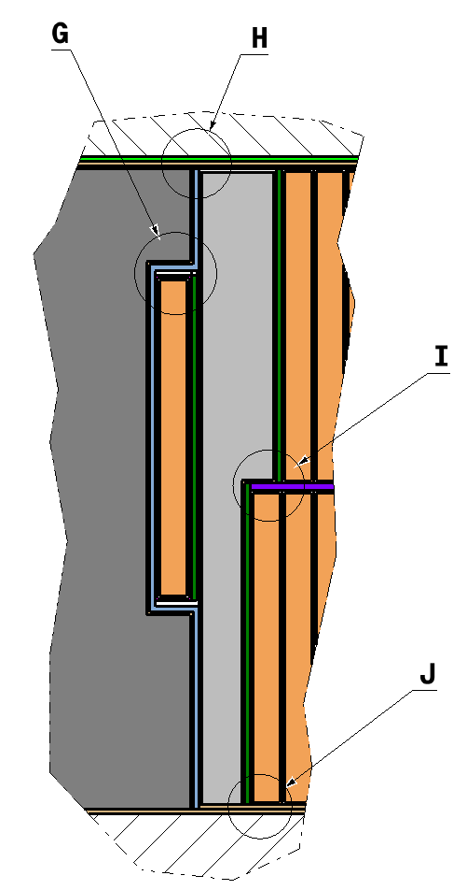
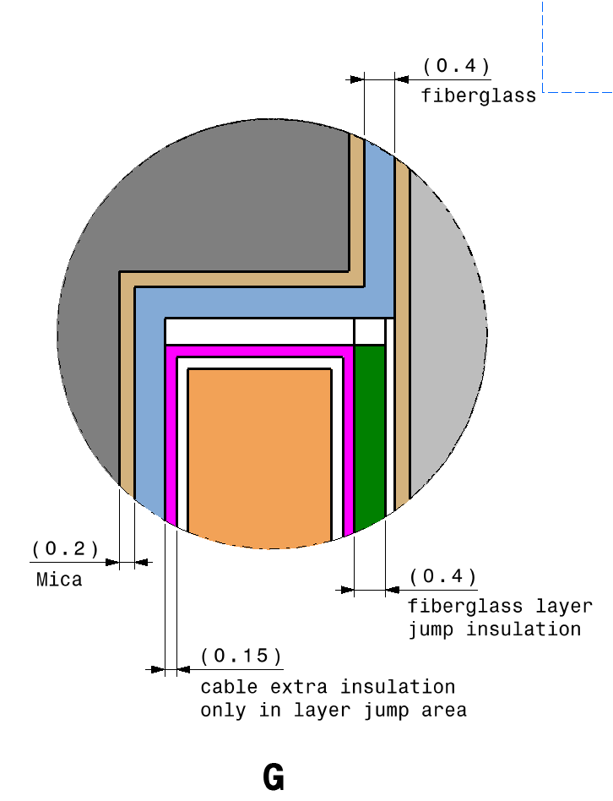
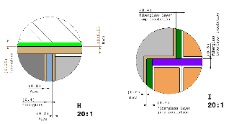
Variation of Insulation Layers with respect to nominal
- Pole insulation (mm)
Nominal:
0.2 MICA + 0.4 Fiberglass
Assembled:
0.08 MICA + 2 x 0.25 Fiberglass
- Spacer (mm)
Nominal:
0.6 Fiberglass
Assembled:
2 x 0.25 Fiberglass
- Layer Jump Cable (mm)
Nominal:
Fiberglass: 0.15 (around cable) + 0.4 Fiberglass
Assembled:
3 x 0.15 Fiberglass (around cable)
- Layer Jump Plate (mm)
Nominal:
Inner surface: 0.2 MICA
Outer surface: 0.2 MICA + 0.4 Fiberglass
Assembled:
Inner surface: 0.08 MICA
Outer surface: 0.08 MICA + 2 x 0.25 Fiberglass
Modification of the Drawings is needed

