Slide 1

Status of the CCT @ PSI
B. Auchmann CERN/PSI, R. Felder PSI, J. Gao PSI, G. Montenero PSI,
S. Sanfilippo PSI, S. Sidorov PSI, L. Brouwer LBNL, S. Caspi LBNL
EuroCirCol/US-MDP Meeting, December 3rd, 2018.
Work supported by the Swiss State Secretariat for Education, Research and Innovation SERI.

Slide 2
Overview
CCT @ FCC
SC Magnet Lab @ PSI
CD1 Manufacturing and Trials

Slide 3
Overview
CCT @ FCC
SC Magnet Lab @ PSI
CD1 Manufacturing and Trials

Slide 4
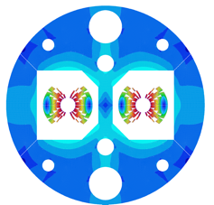
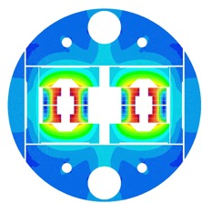
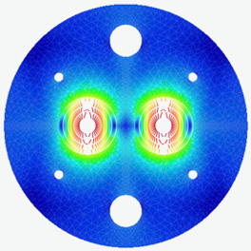
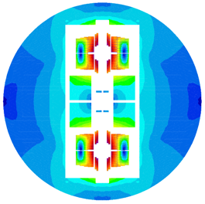




EuroCirCol Designs
Cos-theta
Block coil
Canted Cosine Theta
Common coils

Slide 5
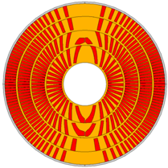
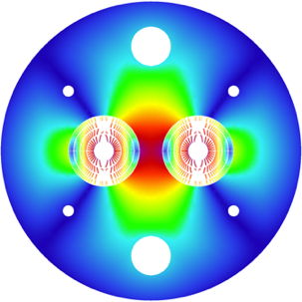
PSI’s CCT Design for FCC
Current: 18135 A
Optimize J_{e} optimal winding angle,
minimal spars, and ribs, wide cable.
FCC-wide conductor use: 9.7 kt
Total inductance: 19.2 mH/m
  Total energy: 3.2 MJ/m
Opportunity to reduce unit length
and peak voltage to ground via double-helix.
Ribs
Layer # | n_{S} | diam [mm] | cuNc | loadline marg. [%] | current marg. [%] | T_{peak} [K] | V_{grnd} [V] | J_{cu} [A/mm²]
1 | 29 | 1.2 | 0.8 | 14.2 | 111 | 292 | 1133 | 1237
2 | 25 | 1.2 | 1.1 | 14.4 | 95 | 342 | 1264 | 1217
3 | 22 | 1.2 | 1.95 | 14.4 | 74 | 310 | 1156 | 1096
4 | 20 | 1.2 | 2.6 | 15.7 | 70 | 338 | 1144 | 1103
Spar

Slide 6
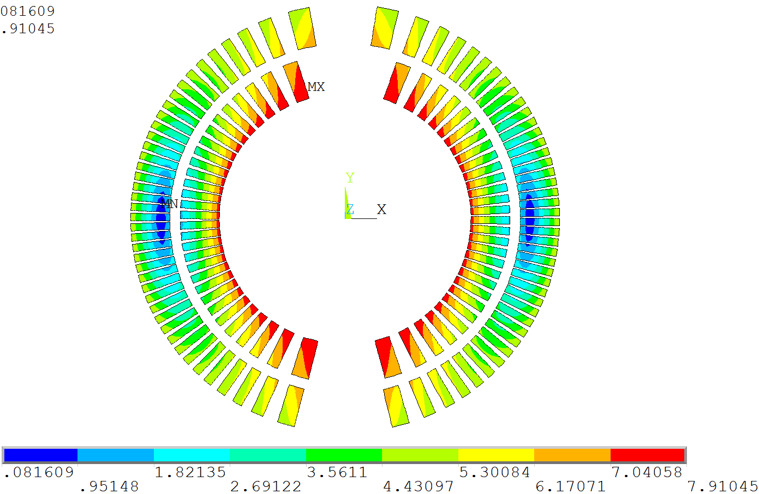
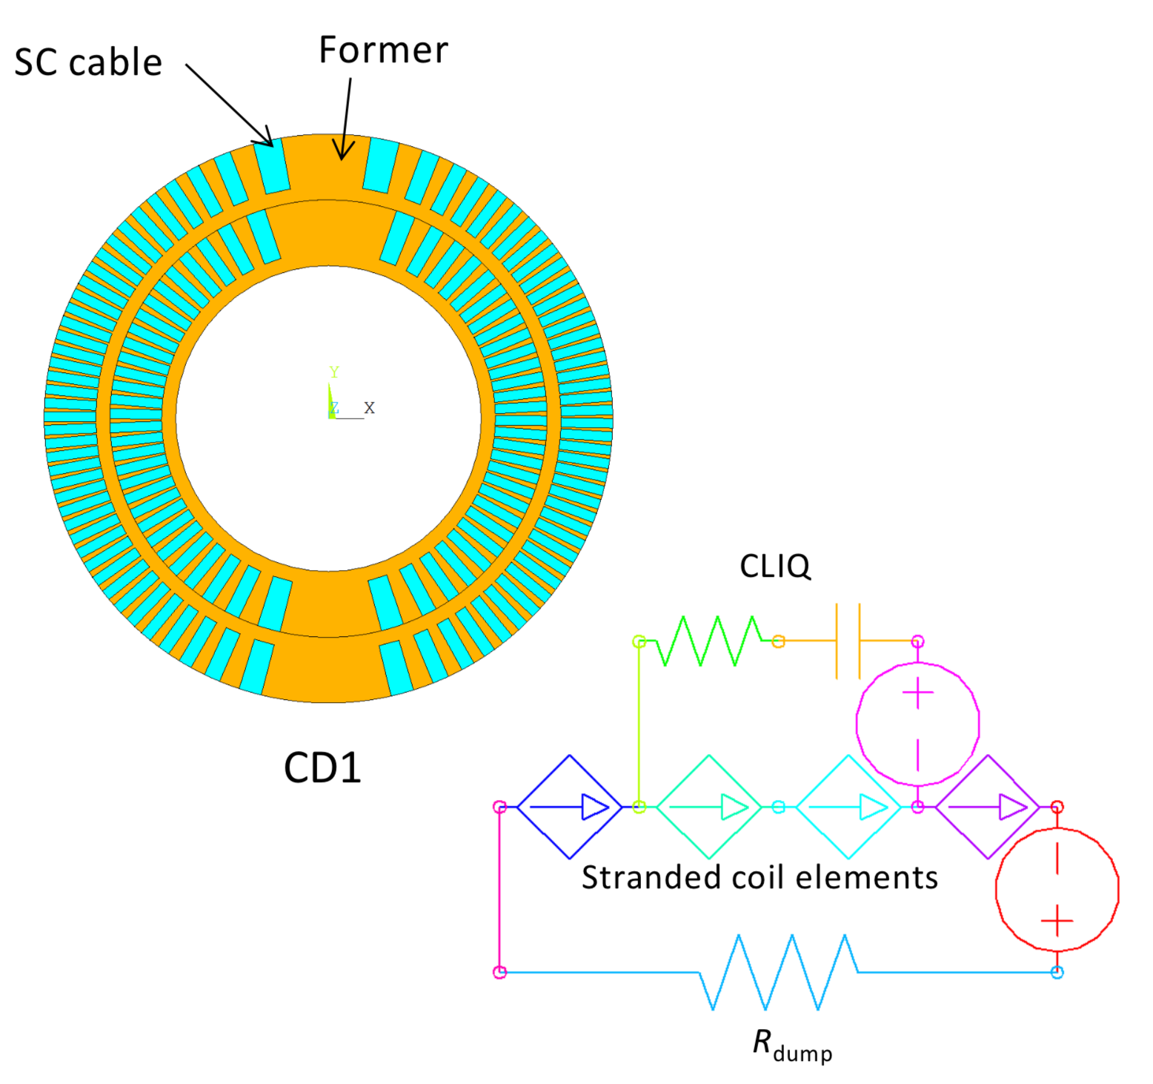
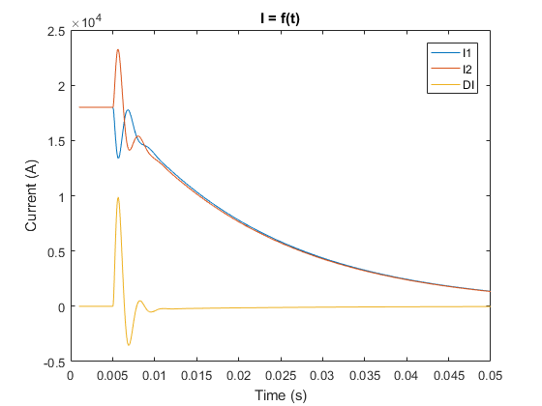
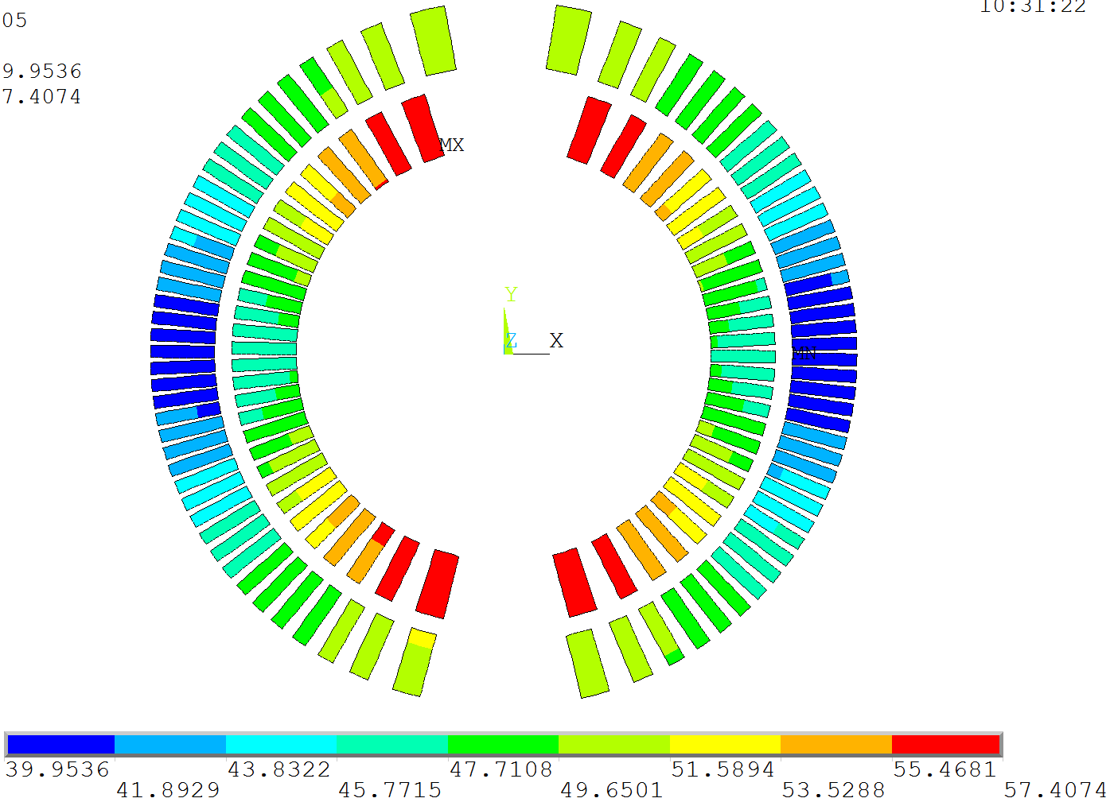
Quench Simulation for CCT
ANSYS user-defined elements by L. Brouwer (LBNL)
CLIQ sim. on CD1 geometry in final debugging stage.
4-layer FCC CCT to follow.
Courtesy J. Gao PSI and L. Brouwer LBNL

Slide 7
Overview
CCT @ FCC
SC Magnet Lab @ PSI
CD1 Manufacturing and Trials

Slide 8
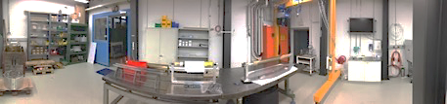
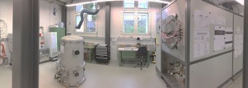
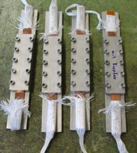
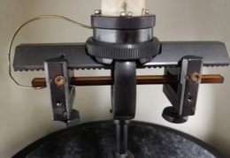
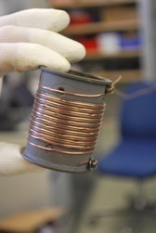
CHART (Swiss Accelerator Research and Technology Center) – Magnet Activities
ETHZ
EPFL
UniGE

Slide 9
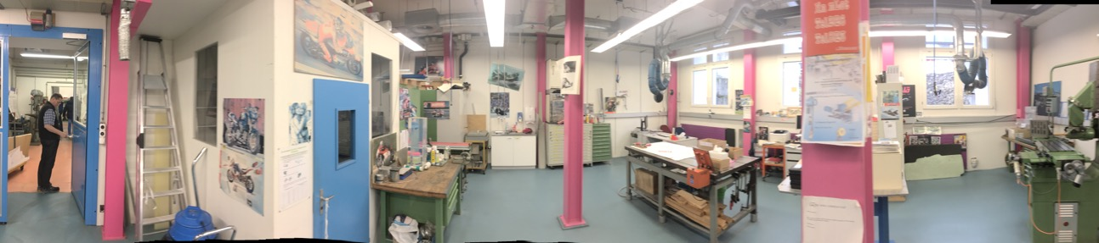
PSI SC Magnet Lab

Slide 10
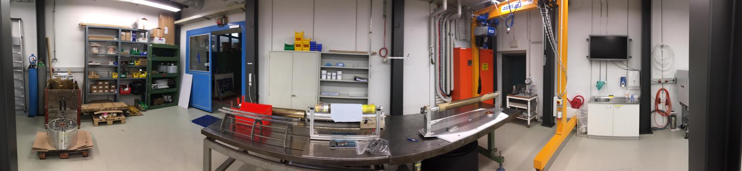
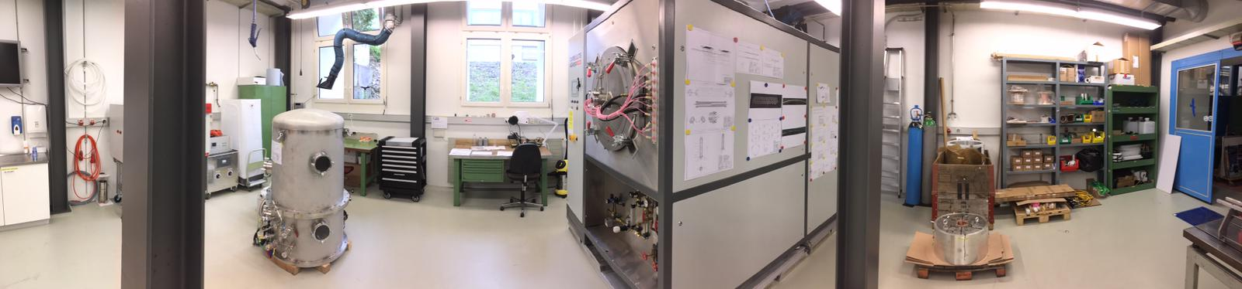
PSI SC Magnet Lab
Portal crane
Storage
Winding table
4-m winding/instrum/assembly bench
Vacuum Impregnation
Coil reaction

Slide 11
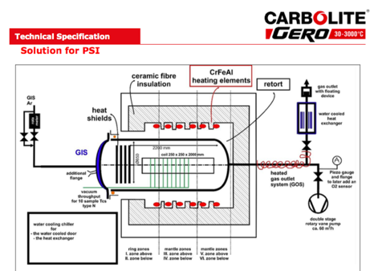
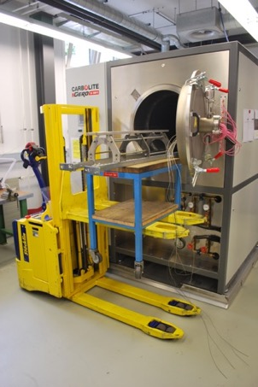
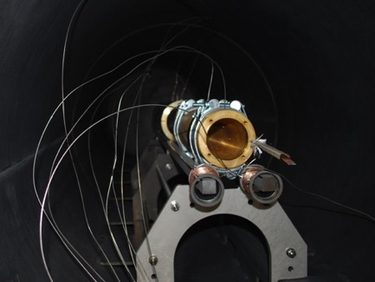
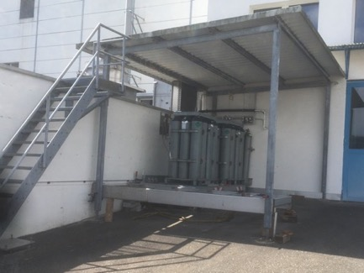
Reaction Commissioning
Furnace fully operational (Ar supply, water chiller, ventilation, electricity, DAQ).
Loading tooling complete and tested.
Reaction of 5-turn test former complete.
Short-sample confirmation by UniGE not
before ASC.
First coil reaction expected for Week 44.

Slide 12
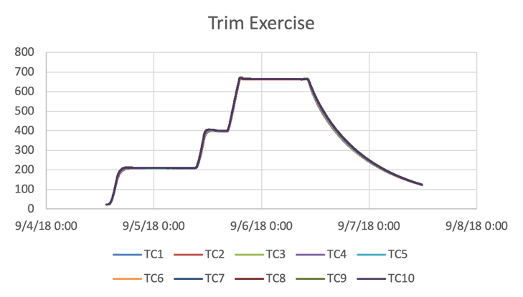
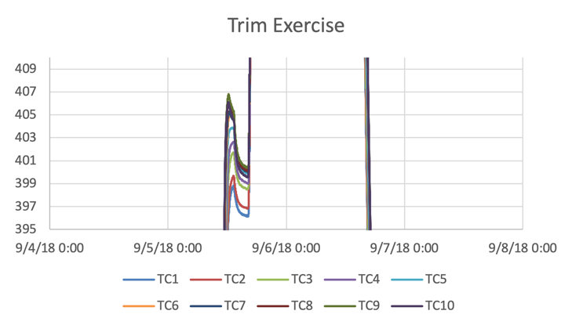
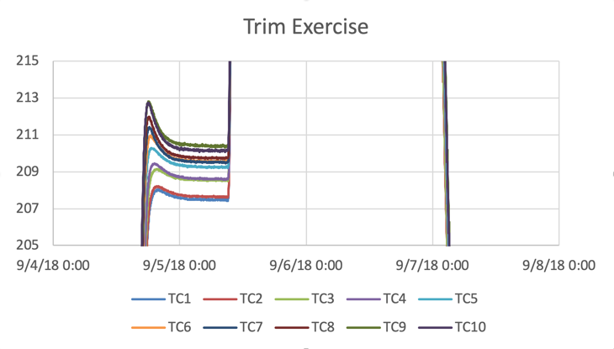
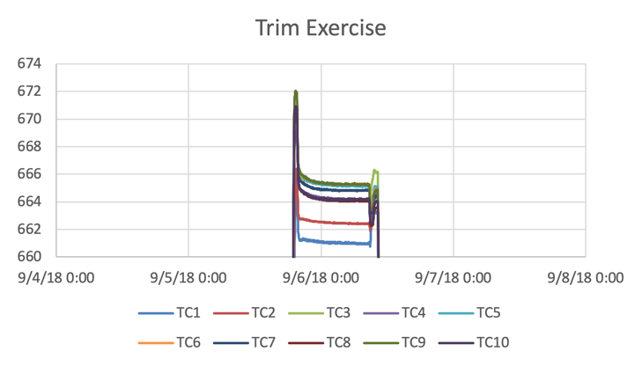
Reaction Furnace Trimming
All plateau axial maps within +/- 3 K.

Slide 13
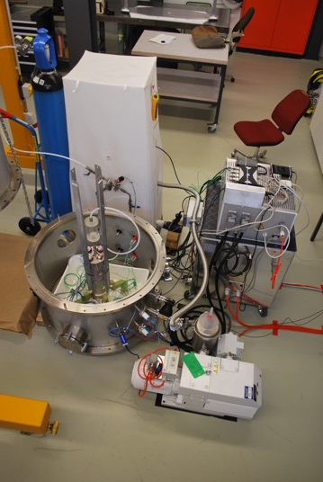
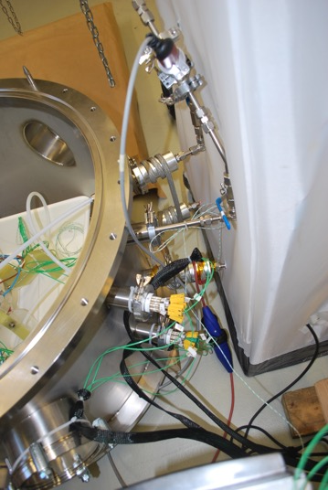
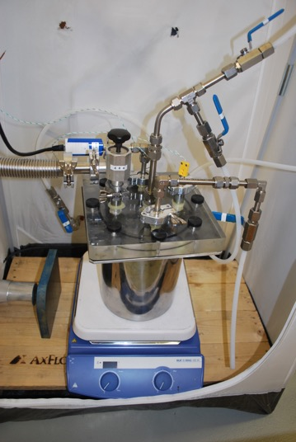
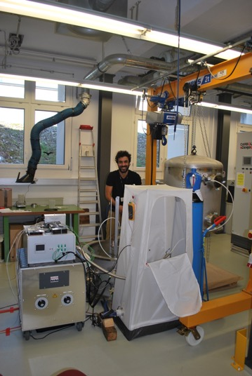
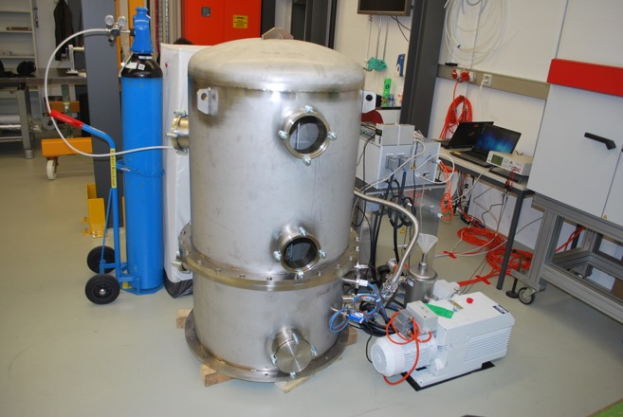
Impregnation Infrastructure
Vacuum vessel with feed-throughs in bottom part.
50 m³/h vacuum pump with LN₂ trap
N₂ bottle for over-pressure and purging.
Control and powering units with voltage selection
Heated “green-house”
Heated feed-throughs into the vessel
See-through mixing pot
DAQ and alarm PCs
Capacitive monitoring as level indicator
Box oven for ingredient heating, sample and waste curing

Slide 14
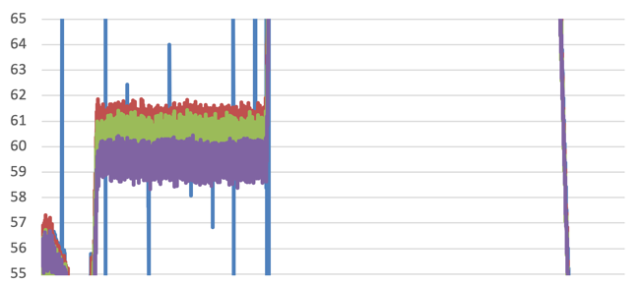
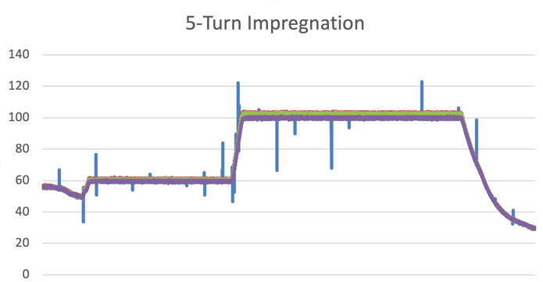
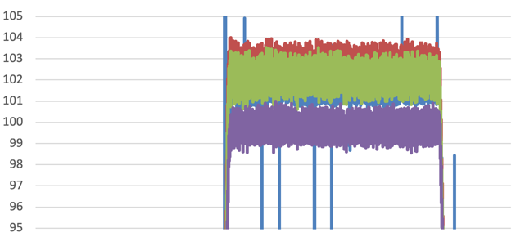
Impregnation Commissioning
5-turn coil impregnation.
Coil temperatures (Top, Center, Down, Heater) within 3 K at curing plateaus.

Slide 15
Overview
CCT @ FCC
SC Magnet Lab @ PSI
CD1 Manufacturing and Trials

Slide 16
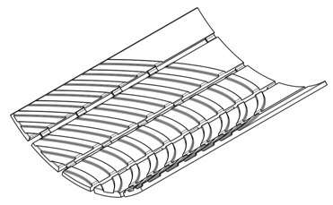
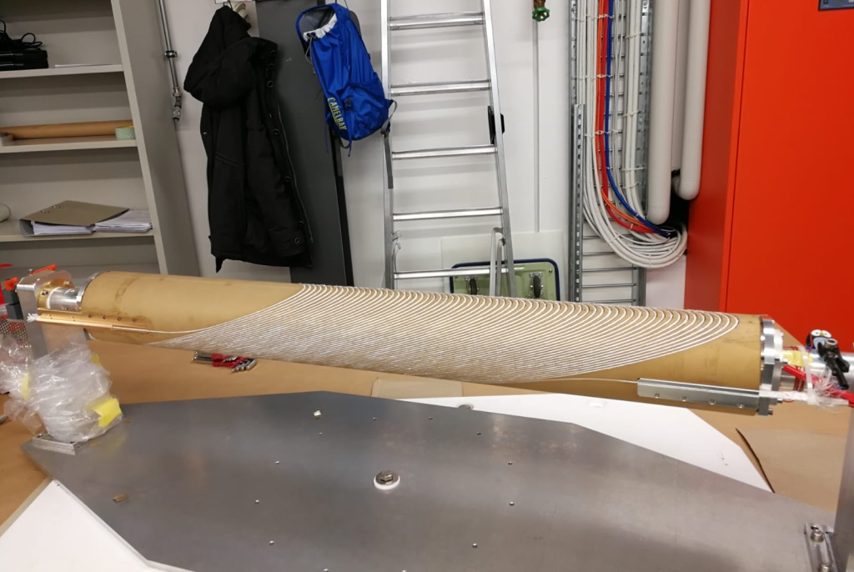
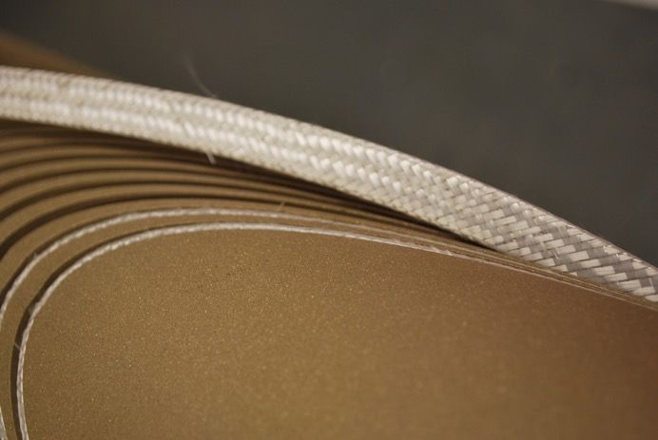
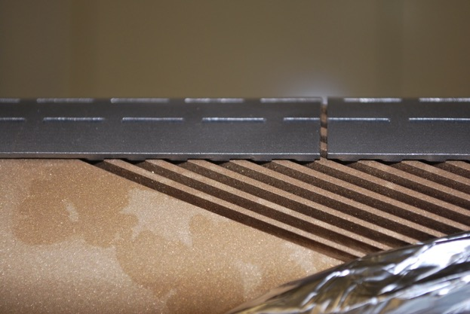
CCT Winding
OL winds easily and without cable
popping up (see below).
IL has tendency to pop up from the
channels.
Cable keepers were designed, tested,
and printed in steel for the CD1 IL.
Insulation is an issue!

Slide 17
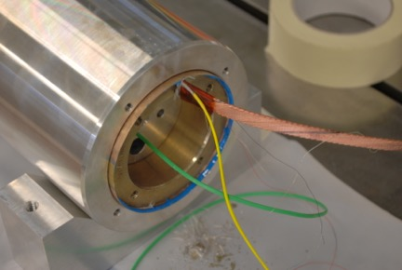
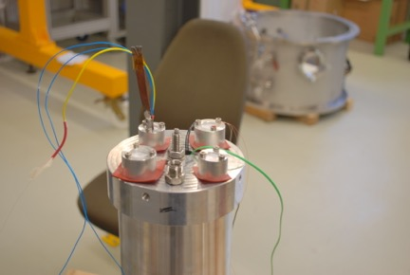
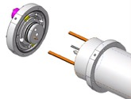
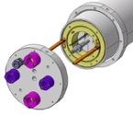
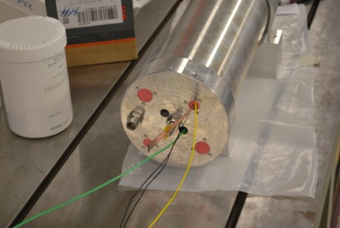
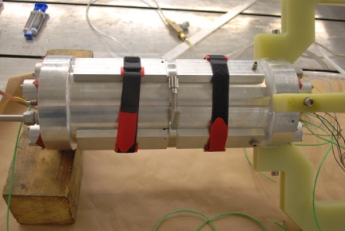
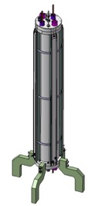
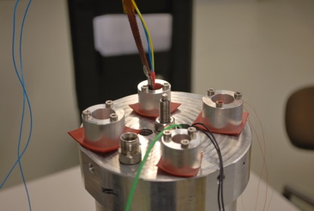
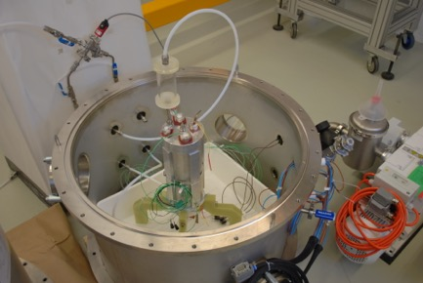
5-Turn Sample Preparation, CD1 Mold

Slide 18
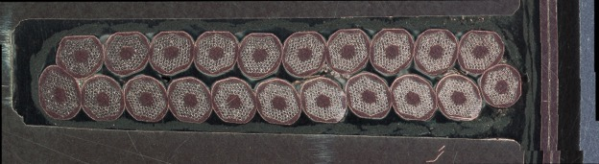
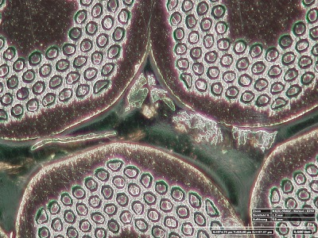
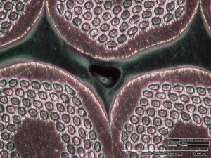

Impregnation Results
Some potential bubbles visible.
Next step: improve control of injection flow rate via peristaltic pump.

Slide 19


Sliding Plane Tests
Microscopic analysis – note glass wrap layers, inner and outer sliding planes,
soldering, and filling of assembly gap with resin.
Separation of layers post impregnation – sliding planes in action:

Slide 20
Conclusion
FCC magnet design:
  Compliant with FQ requirements.
  Persistent-current simulations now available also for CCT.
  Quench simulation (CLIQ with ANSYS) under preparation.
Significant progress in infrastructure at PSI.:
  Commissioning complete.
Technology model magnet CD1:
  Part design, procurement, QA complete.
  Production-Readiness Review passed in August ‘18 (http://indico.psi.ch/event/cd1prr)
  Coil manufacturing started (and interrupted, restart imminent).
Next steps:
  High hopes that funding for coming 5 years of continued R&D is secured.
  Main focus will be on CCTs for FCC.
  First up: repeat CD1 to straighten out problems (or to show repeatability).
  Only then we will step to a 4-layer design with wider cable.

Slide 21


3-D Magnetic Design
3-D modeling results:
Yoke cut-back not needed (20 mT peak-field enhancement in ends).
Magnetic length with yoke equal to that of bare coil.
Physical length minus magn. length = 53 cm; equal to 11 T magnet.
Peak field minus main field at 16-T bore field: 0.14 T excluding self field.
  comparable or lower than cos-theta due to continuous current distribution.
Courtesy M. Negrazus

Slide 22

a)
b)
c)
d)

Slide 23


3-D Periodic Simulation
Generalized plane stress condition applied (following D. Arbelaez, L. Brouwer, LBNL)
Initial 3-D results confirm 2D, but show distinct imprint of scissors lams
→ increase protective shell thickness, change its material to iron
→ decrease lamination thickness.
135 MPa on conductor
Courtesy G. Rolando

Slide 24




Persistent Currents
First-of-a-kind CCT persistent-
current simulation assuming
axial current-flow like in any
2-D electromagnetic simulation.
Similar order of magnitude as other
designs.

Slide 25

Field Quality
b₂ correction (-26 to -16 units) by winding-path modification.
  25%-reduction in rib bottom thickness.
  Chamfering/stepping of channel bottom may be required
  (could also be used to enhance efficiency).
  Further FQ tuning is possible.

Slide 26

5-Turn Reaction
Overshoots of loop temperatures diminish with temperature.
Back-side probes arrive on
  210ºC reached 6-7 hours after WSP out of 72 h on plateau.
  400ºC reached 3 hours after WSP out of 48 h on plateau.
  665ºC reached 50 min after WSP out of 50 h on plateau.

Slide 27






Mechanical Instrumentation and Assembly
Mechanical model test in Dec. 2017.

