Slide 1
LS2 preparatory meeting
A.Tauro

Slide 2
General information
LS2 duration: 27 months
Access mode: general
Underground visits: possible from 16 December 2018 (no visits during Xmas closure)
IMPACT requests: possible to make one request per activity (e.g. TPC disconnection). Not possible to make generic request to cover 1 year…
RP: personal dosimeter needed (no declassification)

Slide 3
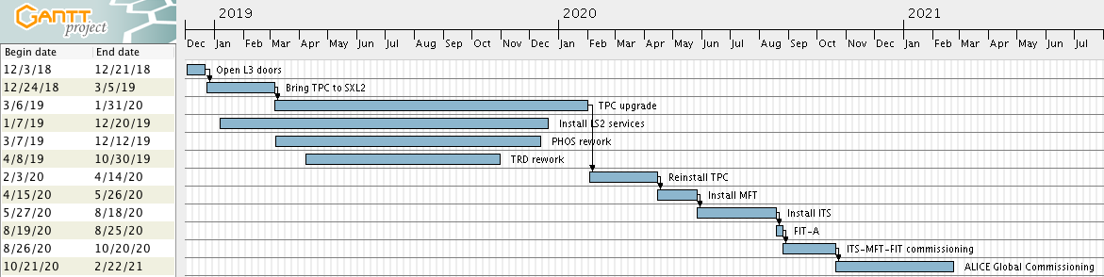
LS2 master plan

Slide 4
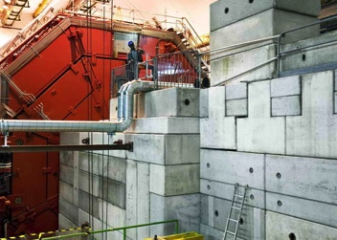
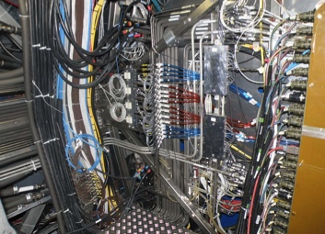
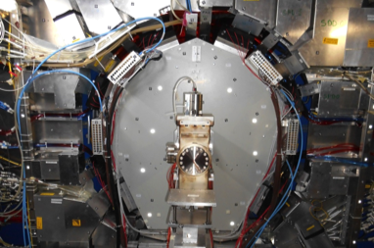
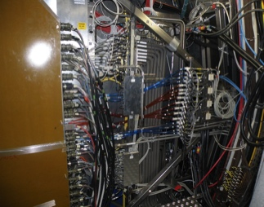
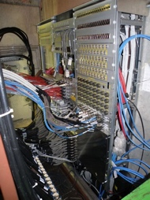
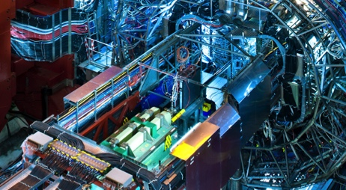
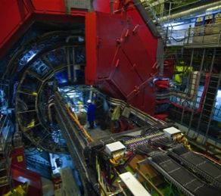
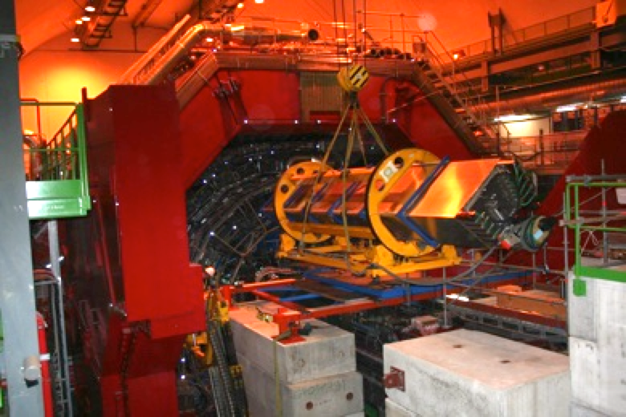
December timeline
Remove shieldings
Disconnect PP0/PP1
Remove forward detectors and beampipe
Open L3 doors
Extract TRD SM6
LS2 starts
3 Dec ‘18
10 Dec
13 Dec
19 Dec
21 Dec ‘18

Slide 5
December key dates
ZEM removal: 3 Dec
BLM removal: 4 Dec
PMD removal: 7 Dec
FMD1-V0A and T0A removal: 10 Dec
ADA removal: 10 Dec
TPC disconnection: from 3 Dec
ITS disconnection: from 11 Dec
Open L3 doors: Friday 14 Dec
TRD6 disconnection: 17-18 Dec
TRD6 extraction: 19 Dec
Please make sure you are available on these dates!

Slide 6
LS2 planning meetings
Daily meetings from 3rd Dec at 16h30 (P2) – No Vidyo unless specifically requested
Weekly meetings, every Friday at 10:00 (P2) – Vidyo and INDICO

Slide 7
Underground access in December
w49:
  No access between 6:00 AM and 10:00 AM (ALTEAD only)
  Restricted access between 10:00 AM and 17:00 PM (Miniframe disconnection)
  Normal access after 17:00 PM
w50:
  No access between 6:00 AM and 10:00 AM (ALTEAD only)
  Normal access after 10:00 AM
w51:
  Normal access
No activities foreseen during Xmas closure

Slide 8
EN-EL interventions
Test secours: 19 Dec 2018 6:00 AM to 6:10 AM – no access from 5:00 AM to 8:00 AM
AUG on Monday 25 March 2019 - no access on site (both surface and underground)
Diesel maintenance: 1 Apr 2019
CERN wide 66kV maintenance: 28 May 2019 to 19 July 2019 – reduced consumption (i.e. no magnets)
18kV, 3.3kV and LV network maintenance:
  Mon 20 to Wed 22 Jan 2020: 3 days no general services - no access on site (both surface and underground)
  Thu 23 to Fri 24 Jan 2020: 2 days ‘’Limited access’’ → details being worked out
AUG on Monday 27 January 2020 - no access on site (both surface and underground)
Auto transfer test: 11 Apr 2020
BIW test: 5 and 6 Oct 2020 from 18:00 to 00:00 – no access underground

Slide 9
EN-CV interventions
Big maintenance:
  SF: from Nov 2019 to mid Jan 2020. NO impact on ALICE as both magnets will be OFF.
  UW: stop UX mixed water for 2 days in week 40/2019 (October).
  SU: various small perturbations + 1 day stop all cooling UX + 1 day stop all cooling SXL2 in week 16/2020 (April).
Small maintenance:
  UW: from mid Aug 2020 to mid Sep 2020. Stop mixed water UX for 1 day in week 37/2020 (September).
  SF+SU: weeks 45-47/2020: cleaning towers (stop SF 1 week) + 1 day stop all cooling UX.
Ventilation:
  Maintenance SXL2 cleanroom before April 2019. Procedure to be established (CV).
  SG2: w7/2019
  Gas extraction: w8/2019
  UX25 cavern: May 2020 (tbc)
  MCH and MTG: Apr 2020 (tbc)
  L3: Apr 2020 (tbc)
  ITS: Apr 2020 (tbc)
Raw water:
  Test after Apr 2019. Short interruption (1 day), can be used tap water during the test.

Slide 10
Gas systems status
 | Xmas status | LS2 status
TPC | TPC disconnected | Detailed plan exists
TRD | Xe recuperation early Jan-19 | Run CO2 till Oct-19, and with Xe from Nov-19
TOF | Back-up with R134a | Back-up with R134a until late 2020. Need a few weeks with system ON in late 2019 or 2020 (tbc)
HMP | Always under Ar backup; stop CH4 3-Dec-18 | Always under Ar backup
PHO | Keep N2 until 14-Dec-18, then OFF | OFF till Oct-19, then need N2
CPV | OFF | OFF till Oct-19, then need gas (Ar/CO2 80/20) Need humidifier in RUN3
PMD | OFF | Dismounting
MCH | OFF | OFF till May-19, then need gas (Ar/CO2 80/20)
MTR | OFF; stop i-buthane 3-Dec-18 | missing info

Slide 11
Safety systems maintenance
Fire detection: w2-3/2019
Gas detection: w7/2019 (in parallel to SG2 ventilation maintenance)
Red emergency phones: 20/2/2019
Fire detection (racks): w10/2019

Slide 12
CERN Open Days
14 and 15 September 2019

Slide 13
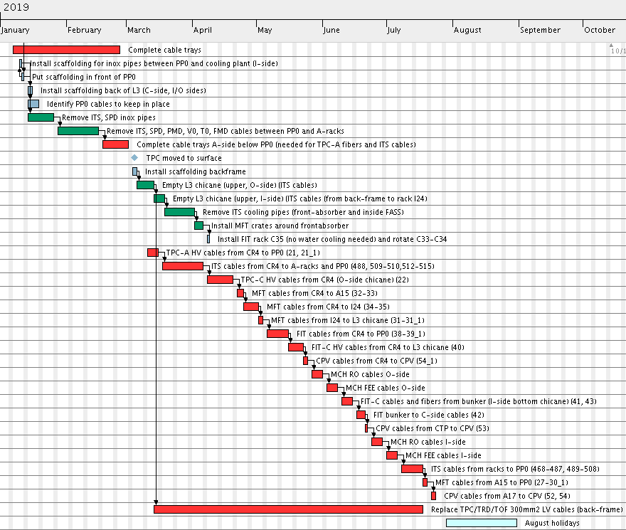
Optical fibers installation
Planning copper cables (EN-EA)
Mar to Aug: pull cables
ALICE tech.
EN-EA

Slide 14
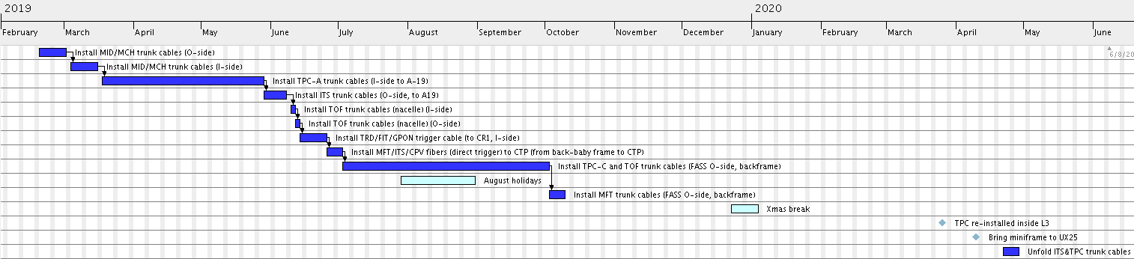
Planning optical fibers (EN-EL)
Feb to October: install and test all trunk cables
April 2019: install TPC/ITS fibers after Miniframe installation

Slide 15
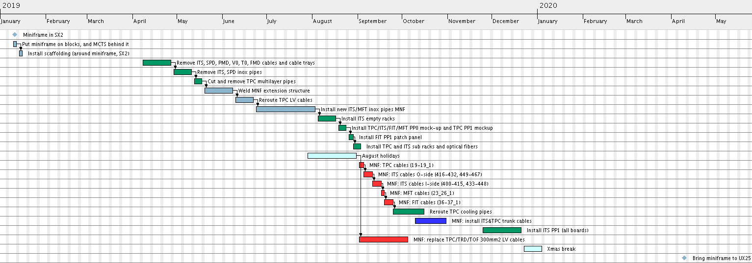
Miniframe planning (rework in SX2)
Details about ITS PP1-PP2 cables missing
ALICE tech.
EN-EL
EN-EA

Slide 16
Day-by-day sequence w49
ALICE technicians
Institutes
Transport
Scaffolding
Other CERN groups

Slide 17
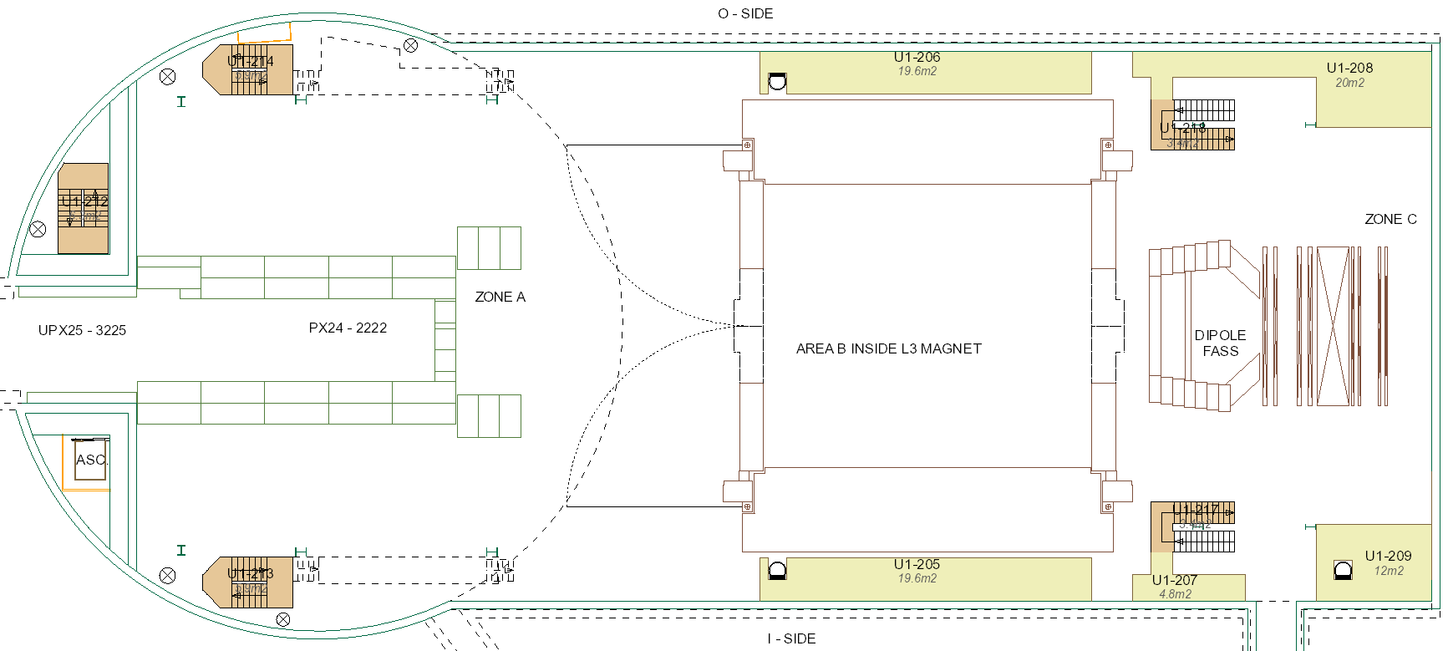
UX25 activities w49 – Mon 3 Dec 2018
Stop beam Sunday 2nd at 18:00
Klaus: electrical lockout L3 + Dipole
Close sector valves and vent vacuum sector with air (TE-VSC), access at 8:00 AM (start injection at 9:00)
Unrestricted cavern access starting at 8:30 (RP check)
Reinstall crane electronics
Stop flammable gases
Start racks lockout
RP+CV analysis cooling fluids
TRD work in SXL2 (whole week)
EN-CV: put ITS cooling plant in Stand-by
Start warming-up PHOS (10 days)
TE-VSC
PMD crates
ALTEAD: open PX24 plug
PMD CROCUS
Remove TPC gas lines
(L3-MNF)
Remove TPC gas battery (plug). Disconnect at 8:00 (Chilo)
Surface: SX2-CR0 asphalt – until 7 Dec

Slide 18
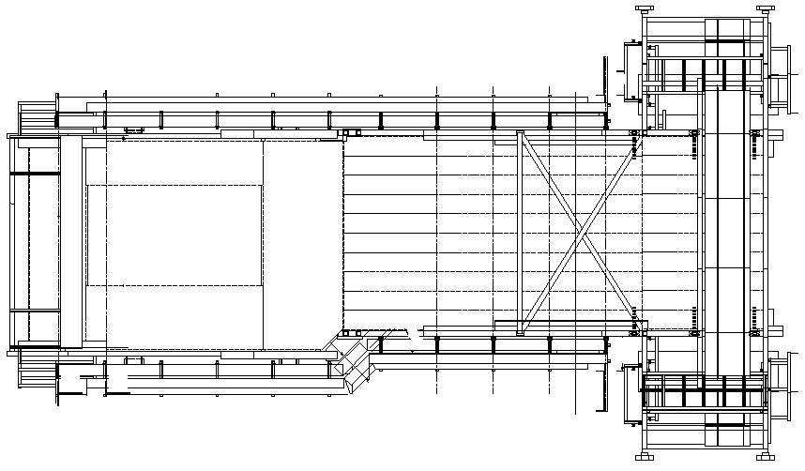
Miniframe activities w49 – Mon 3 Dec 2018 AM
Miniframe access from 10:00
Remove GEM chambers
Close GEM gas lines (Chilo at 8:00)
PP0
MCTS
TPC
After GEM removal: remove winches and reinstall ladder

Slide 19
Miniframe activities w49 – Mon 3 Dec 2018 PM
Miniframe access from 10:00
Start at 14:00
Remove ZEM
Remove BCM
TE-VSC: close manual valve (around 15:00)
PP0
MCTS
TPC

Slide 20
UX25 activities w49 – Tue 4 Dec 2018
Cavern access from 10:00, restricted access until 17:00
No access CR1-5 and Exhibition
ALTEAD (SX2): start bringing concrete blocks outside
ALTEAD (SX2): move TRD rotator (10:00)
TOF FW upgrade: 4 to 7 Dec
Electrical lock-out compensator magnet (TE-MSC)
PMD crates
ALTEAD: open PX24 plug
PMD CROCUS
ST2
After 17:30

Slide 21
Miniframe activities w49 – Tue 4 Dec 2018
Cavern access from 10:00, restricted access until 17:00
Disconnect PMD
After 17:30

Slide 22
UX25 activities w49 – Wed 5 Dec 2018
Cavern access from 10:00, restricted access until 17:00
Bring down cherry pickers and transport boxes
Install 7 ‘pallets grillagées’ for TPC (A-side)
TPC/FMD cooling water evacuation
Transport GEMs to GIF++
ALTEAD: MNF roof
ST2
VIC at 15:00
Start at 17:00: remove all MANU cards and CROCUS boxes of ST2

Slide 23
Miniframe activities w49 – Wed 5 Dec 2018
Cavern access from 10:00, restricted access until 17:00
Remove BLM + cables
Remove BLM + cables
Remove beampipe protection
Remove RB24 beampipe and cables (TE-VSC)
Disconnect TPC-A

Slide 24
UX25 activities w49 – Thu 6 Dec 2018
Cavern access from 10:00, restricted access until 17:00
Delivery 11 cable drums (ITS)
After 17:00
ALTEAD: MNF roof
ST1
ST2

Slide 25
Miniframe activities w49 – Thu 6 Dec 2018
Cavern access from 10:00, restricted access until 17:00
Protect beampipe
Remove yellow support
Remove ZEM table
Remove PMD/FOCal ventilation ducts
Disconnect TPC-A

Slide 26
UX25 activities w49 – Fri 7 Dec 2018
Cavern access from 10:00, restricted access until 17:00
VIP visit (Luciano, 10:45 to 11:45) – surface only
After 17:00
ALICE TC + TPC: cut 150mm2 cable for EN-EA test
ALTEAD: bring VSC transportation box and put 2 beampipe elements inside
Remove Stabilizers
MNF wall
ST1
ST2

Slide 27
Miniframe activities w49 – Fri 7 Dec 2018
Cavern access from 10:00, restricted access until 17:00
Start at 10:00. Pieter: disconnect gas pipes
Remove
PMD + CROCUS support
Remove ADA shielding
Remove
MCTS beam
Disconnect TPC-A
And remove beampipe protection
After PMD removal: install wooden access

Slide 28
Miniframe activities w49 – Sat 8 and Sun 9 Dec
Borge + Jimmy: Sunday PM
Possible on weekend? TBC
Remove
ADA + cables
Disconnect FMD1-2 services
Disconnect TPC-A

Slide 29
P2 status as of today
Shieldings: 12/13 beams PX24 removed, Miniframe roof opened
RB24 beampipe removed (along with cables)
Detectors: BLM, BCM, ZEM removed (along with cables). PMD being removed now. Disconnection of ST2 started (FE electronics, CROCUS modules and patch cables removed)
TPC disconnection (A-side) started on Wednesday
ADA shielding being removed now

Slide 30
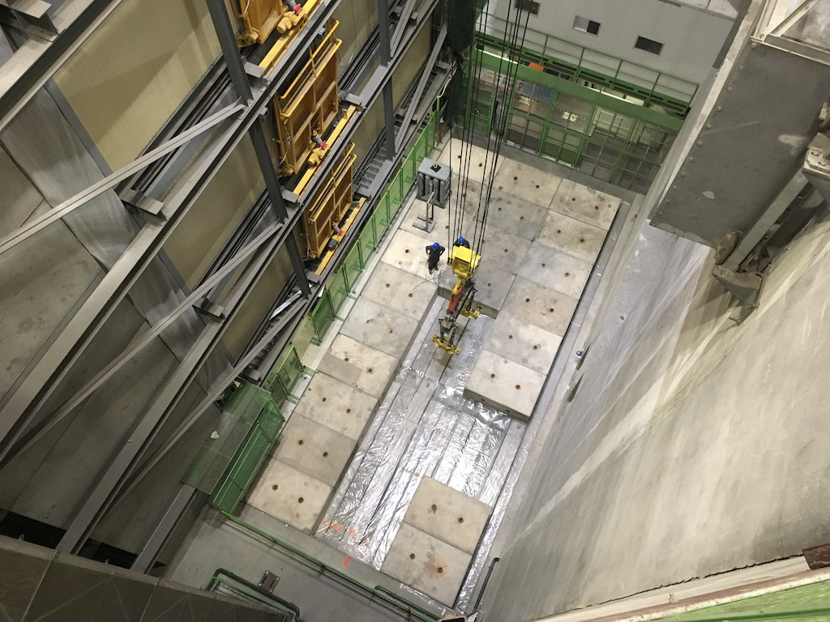
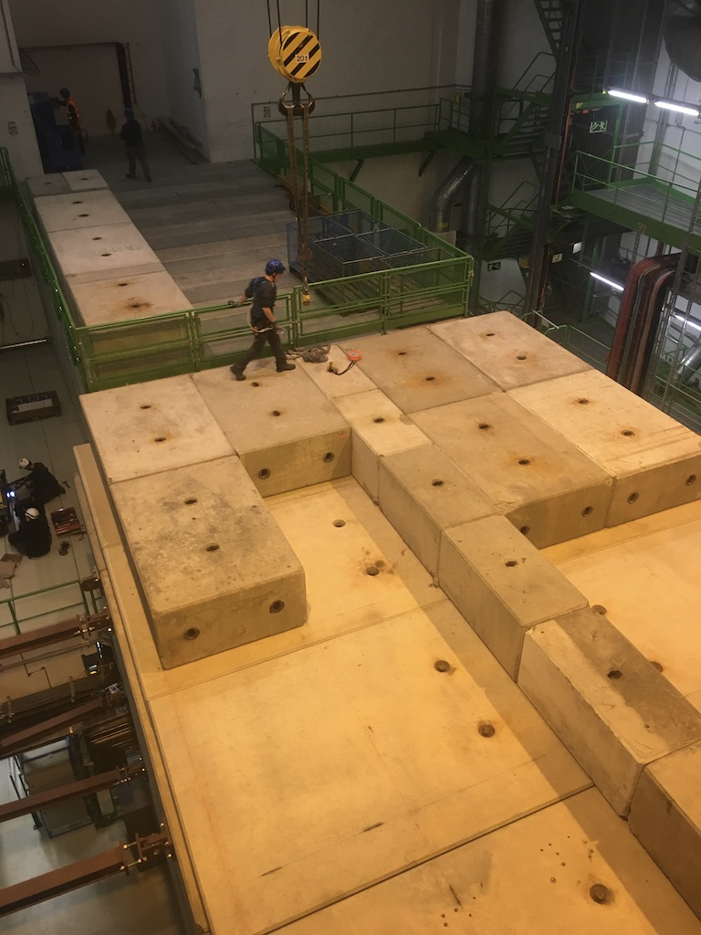
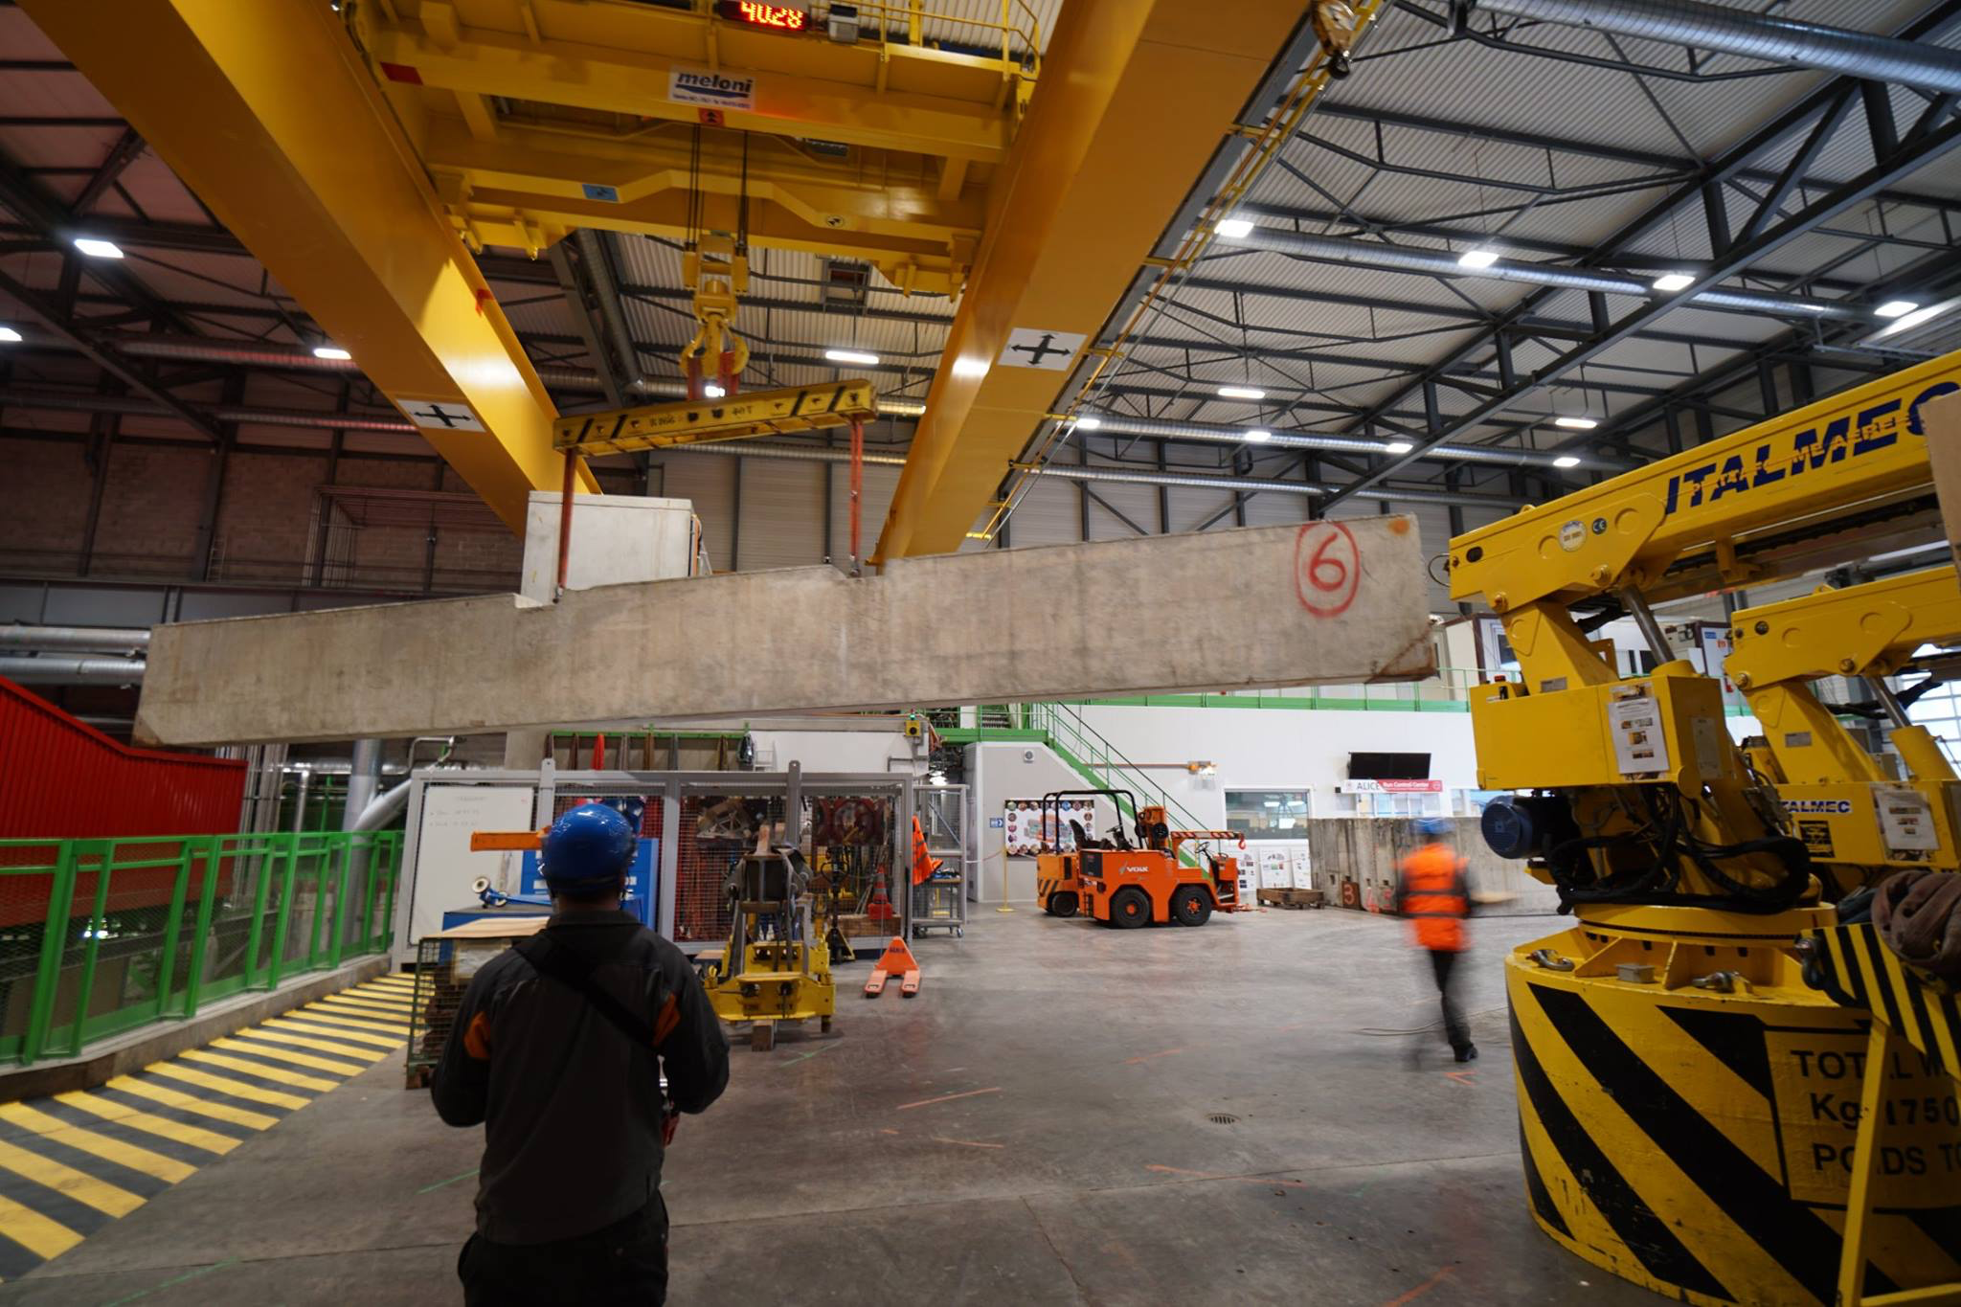
Photos w49

Slide 31
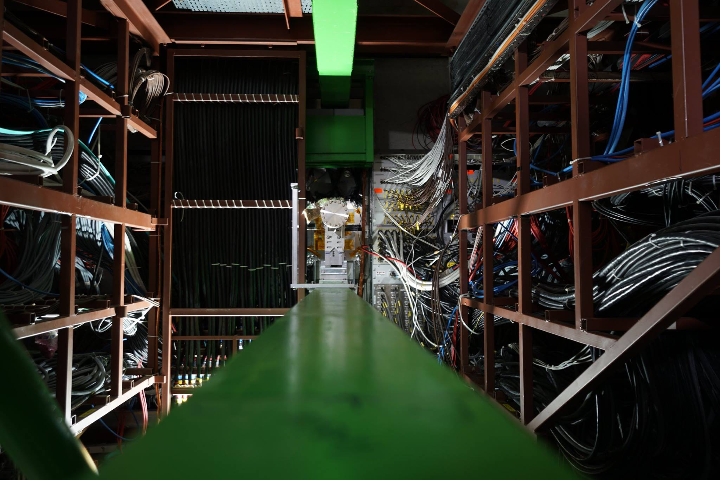
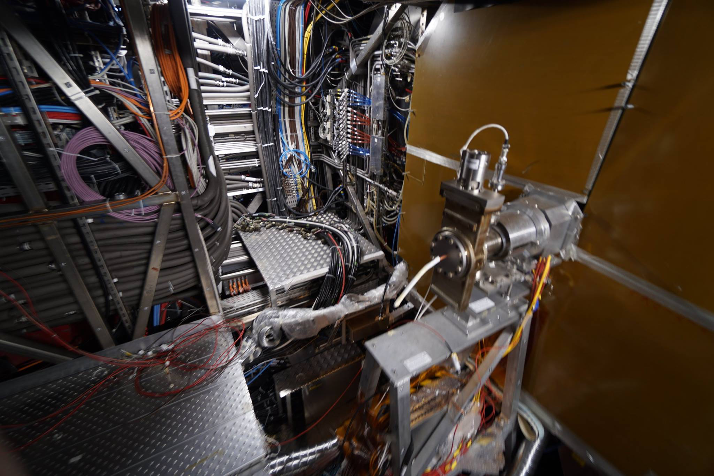
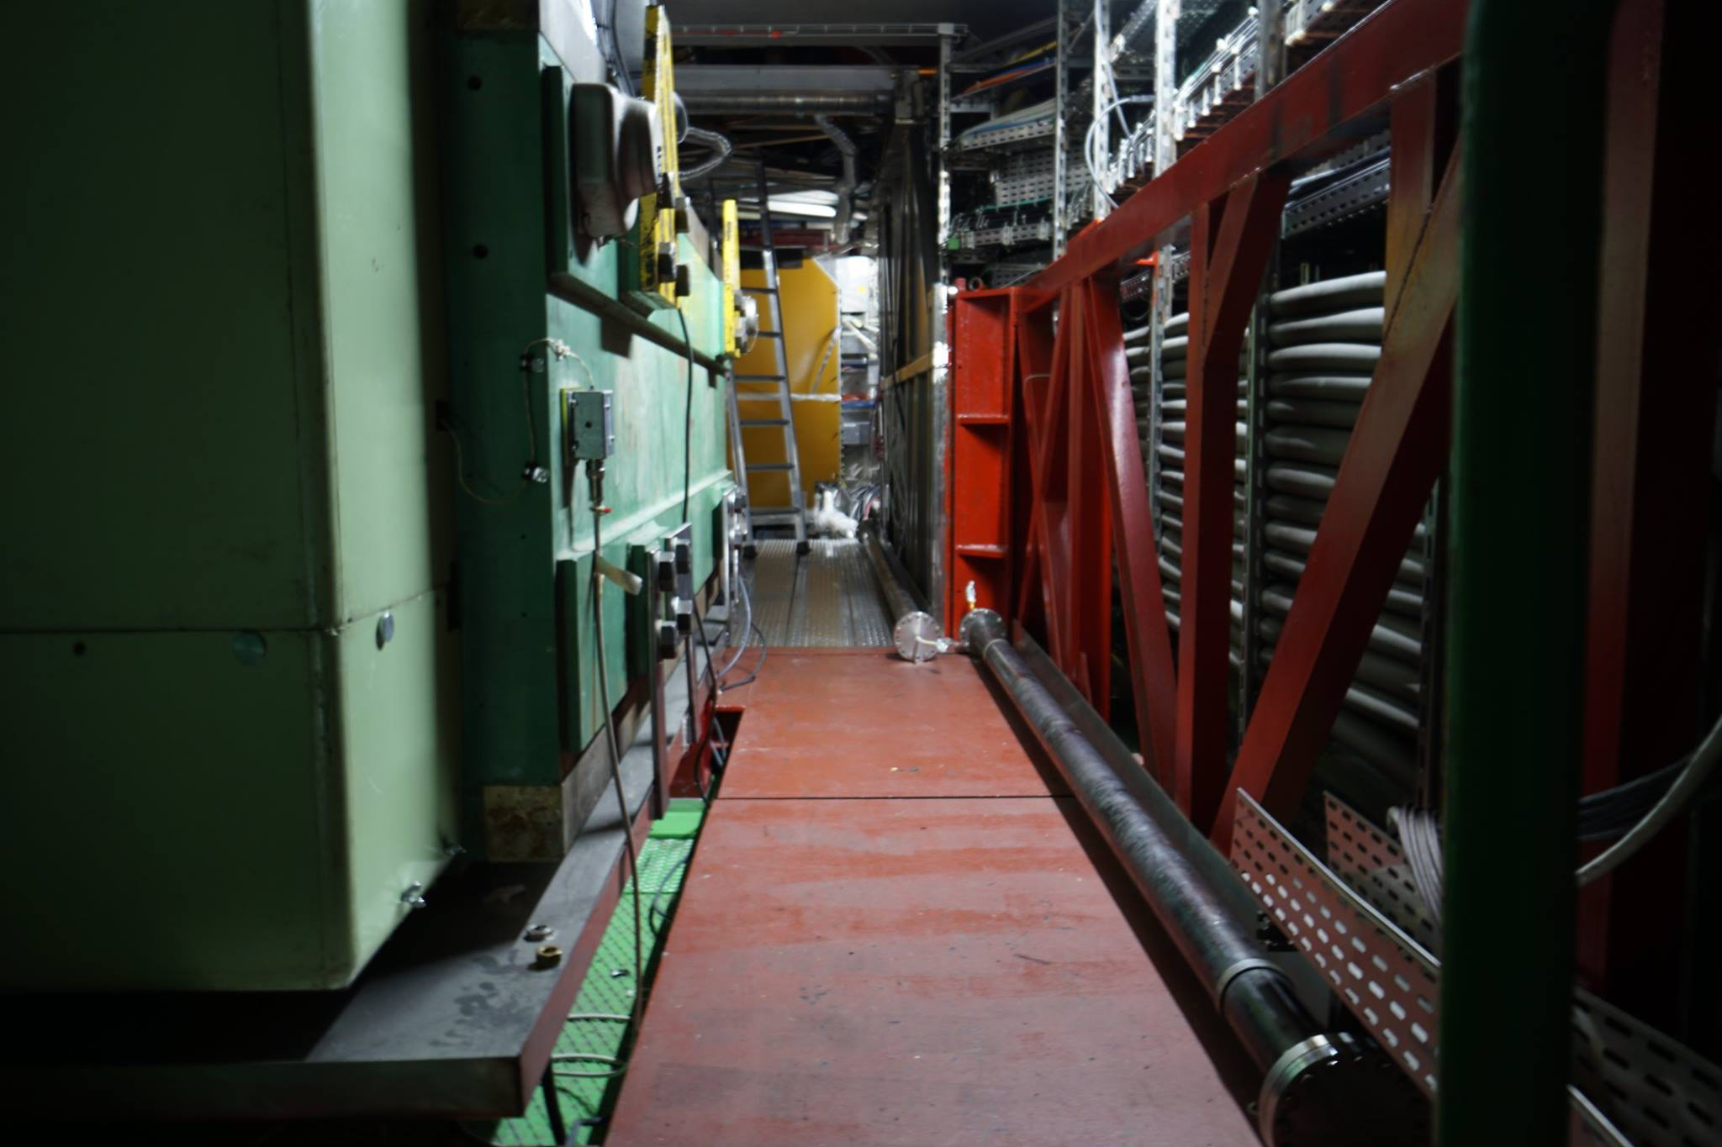
Photos w49

Slide 32
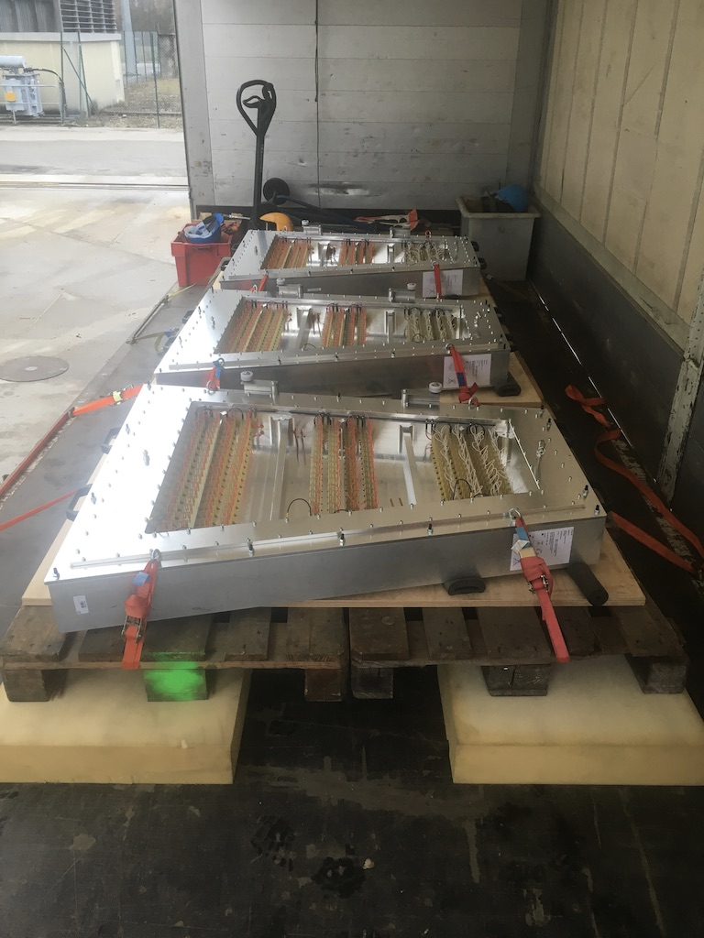
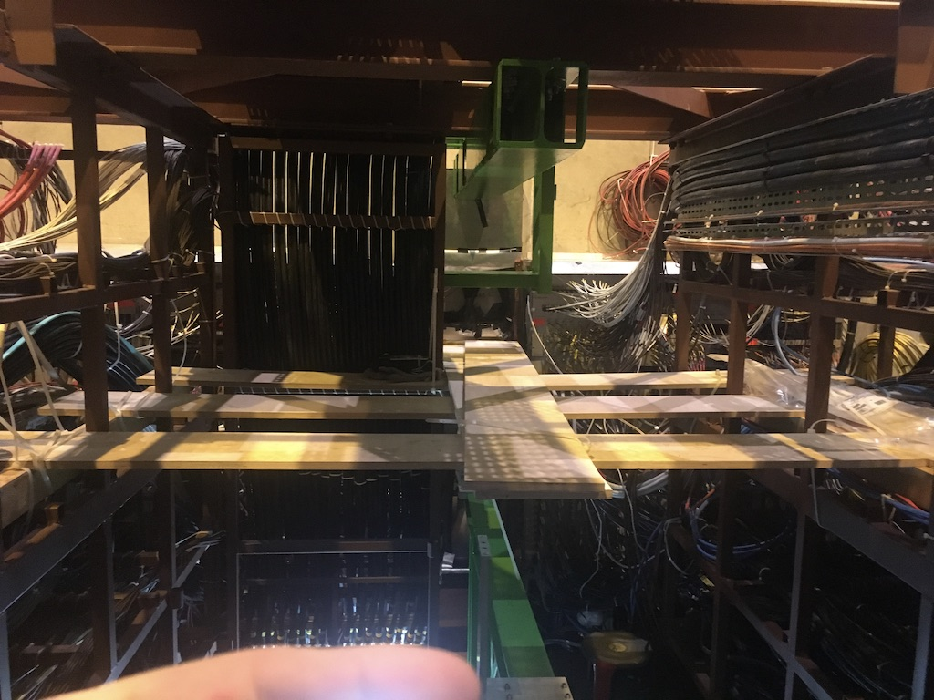
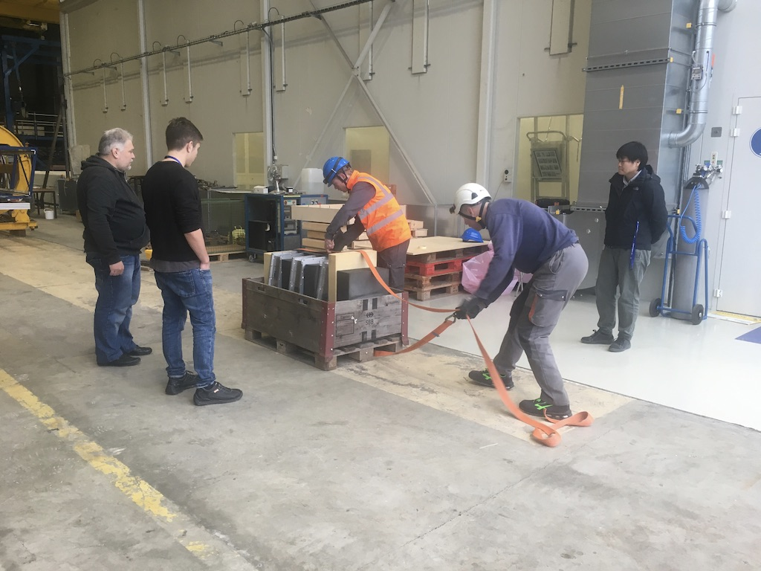
Photos w49

Slide 33
Day-by-day sequence w50
ALICE technicians
Institutes
Transport
Scaffolding
Other CERN groups

Slide 34
UX25 activities w50 – Mon 10 Dec 2018
Cavern access from 10:00
All racks locked-out
Start emptying CR1, switch off CR1 by end week
Guide training (15:00 to 16:00)
EN-CV: empty ITS/SPD cooling plant tanks + lockout
ALTEAD transport 4 ST2 quadrants to SX2
LV busbar
MNF wall
ST1
ST2
Remove green fences (Didier)
Removal of the four quadrants from the Cradle → ALTEAD + Jaap

Slide 35
Miniframe activities w50 – Mon 10 Dec 2018
Cavern access from 10:00
Install temporary protection (net)
Remove
ADA + cables
Remove Radmon
Remove
FMD1-V0A and T0A
Disconnect TPC-A
T0A: remove crates in racks C33-34

Slide 36
UX25 activities w50 – Tue 11 Dec 2018
Unrestricted cavern access
VIP visit (A.Knospe, 16:50 to 17:20) – surface only
Start at 6:00 (Didier + ALTEAD)
ALTEAD transport 4 ST2 quadrants to SX2
Unbolt door
No access inside L3
No access Dipole/FASS
Disconnect TPC laser cables
Ventilation (top+MNF)

Slide 37
Miniframe activities w50 – Tue 11 Dec 2018
Unrestricted cavern access
Disconnect power and cooling comp.magnet
MCTS scaffolding
Remove comp. magnet
Disconnect ITS PP1 (attach cables on TPC)
Disconnect TPC

Slide 38
UX25 activities w50 – Wed 12 Dec 2018
Unrestricted cavern access
Transport GEMs to GIF++
Start at 6:00
No access inside L3
Open O-side door
No access Dipole/FASS
ST3
Remove Stabilizers
VIC at 15:00. Dismantle the LV filter boxes of CH5 (and perhaps CH6)

Slide 39
Miniframe activities w50 – Wed 12 Dec 2018
Unrestricted cavern access
Remove power/control cables comp.magnet
(store in UX cavern) (EN-EL)
Disconnect ITS PP1 (attach cables on TPC)

Slide 40
UX25 activities w50 – Thu 13 Dec 2018
Cavern access from 10:00
Start L3 access without watcher
Start LHC tunnel access
MNF wall
Put TRD scaffolding
PHOS cooling
ST3
L3 access bridge
Clean the compressor and pump stations, collect and remove residual C6F14. RP check (Klaus)
Transfer blocks from I to O-side

Slide 41
Miniframe activities w50 – Thu 13 Dec 2018
Cavern access from 10:00
Remove cooling hoses comp.magnet
(store in UX cavern) (EN-CV)
Disconnect ITS PP1 (attach cables on TPC)
Remove
beampipe shielding behind ADA
Start at 8:30

Slide 42
UX25 activities w50 – Fri 14 Dec 2018
Unrestricted cavern access
ALTEAD + P2 tech (SX2): load test Miniframe lifting jig
PHOS cooling
Ventilation (bottom+ top)
ST3
Open I-side door
Continue Saturday if not finished (2 people ALTEAD needed)

Slide 43
Miniframe activities w50 – Fri 14 Dec 2018
Unrestricted cavern access
ALTEAD: bring compensator magnet to SX2
Install cable baskets
Put plate to close shielding opening
Disconnect ITS PP1 (attach cables on TPC)
Remove beampipe sticking out from LHC tunnel
Remove beampipe beam
Disconnect PP0
Install cable baskets

Slide 44
Day-by-day sequence w51
ALICE technicians
Institutes
Transport
Scaffolding
Other CERN groups

Slide 45
UX25 activities w51 – Mon 17 Dec 2018
Unrestricted cavern access
Start UX visits (Sunday 16 December)
Visit (77 people, 13:30): Despina
Switch-off CTP crates
EN-CV: put TRD cooling plant in stand-by and drain water
TOF: disconnect services in view of TRD6 extraction
Disconnect
6 TRD SMs
Noise measurement
TRD survey
TRD wall

Slide 46
Miniframe activities w51 – Mon 17 Dec 2018
Unrestricted cavern access
See TRD patch panel (Kai, Arturo)
Disconnect PP0
(unfold cables into miniframe)
Disconnect ITS PP1 (attach cables on TPC)
Disconnect TPC-A (after working hours)
Disconnect ITS/SPD/TPC cooling hoses (nacelle)
Disconnect optical fibers (nacelle)

Slide 47
UX25 activities w51 – Tue 18 Dec 2018
Cavern lift maintenance from 6:00 AM to 8:00 AM, cavern access after 8:00 AM
Unrestricted cavern access
Nacelle
TRD platform and rotator
Disconnect TPC-C
Noise measurement
MTR
Check of FE card extraction tools + visit of CERN EN-EA-CT team. Need to open one half plane of MTR

Slide 48
Miniframe activities w51 – Tue 18 Dec 2018
Cavern lift maintenance from 6:00 AM to 8:00 AM, cavern access after 8:00 AM
Disconnect optical fibers (nacelle)
Unrestricted cavern access
Disconnect ITS/SPD/TPC cooling hoses (nacelle)
Disconnect PP0
(unfold cables into miniframe)
Disconnect ITS PP1 (attach cables on TPC)
Disconnect TPC-A (after working hours)

Slide 49
UX25 activities w51 – Wed 19 Dec 2018
Unrestricted cavern access
ALTEAD (SX2): bring big PX24 beams outside
EN-EL: test secours. Cut general-services (6:00 AM - 6:10 AM). No access from 5:00 to 8:00
ALTEAD: bring TRD6 in SXL2 tent (transfer into blue frame)
Transport GEMs to GIF++
Switch-over to ARCAL 10 (SG2)
Extract TRD6
Nacelle
Noise measurement
MTR
Disconnect TPC-C

Slide 50
Miniframe activities w51 – Wed 19 Dec 2018
Unrestricted cavern access
Disconnect PP0
(unfold cables into miniframe)
Disconnect ITS PP1 (attach cables on TPC)
Disconnect TPC-A (after working hours)

Slide 51
UX25 activities w51 – Thu 20 Dec 2018
Unrestricted cavern access
Nacelle
Remove TRD scaffolding
Remove TRD platform and walls
Disconnect TPC-C
MTR

Slide 52
Miniframe activities w51 – Thu 20 Dec 2018
Unrestricted cavern access
Disconnect PP0
(unfold cables into miniframe)
Disconnect ITS PP1 (attach cables on TPC)
Remove beampipe protection
between MNF and TPC

Slide 53
UX25 activities w51 – Fri 21 Dec 2018
No access cavern whole day (ALTEAD starts at 6:00 AM)
Remove TRD walls

Slide 54
Miniframe activities w51 – Fri 21 Dec 2018
No access cavern whole day (ALTEAD starts at 6:00 AM)
Remove MCTS scaffolding

Slide 55
Activities Xmas closure

Slide 56
Activities Xmas closure
No access to CERN during Xmas closure. Please send an email to us (Arturo/Andre) before Wednesday 19.12 if you plan to access CERN.
BE-ICS: evacuation sirens tests – 27.12 from 8:00 to 12:00

Slide 57
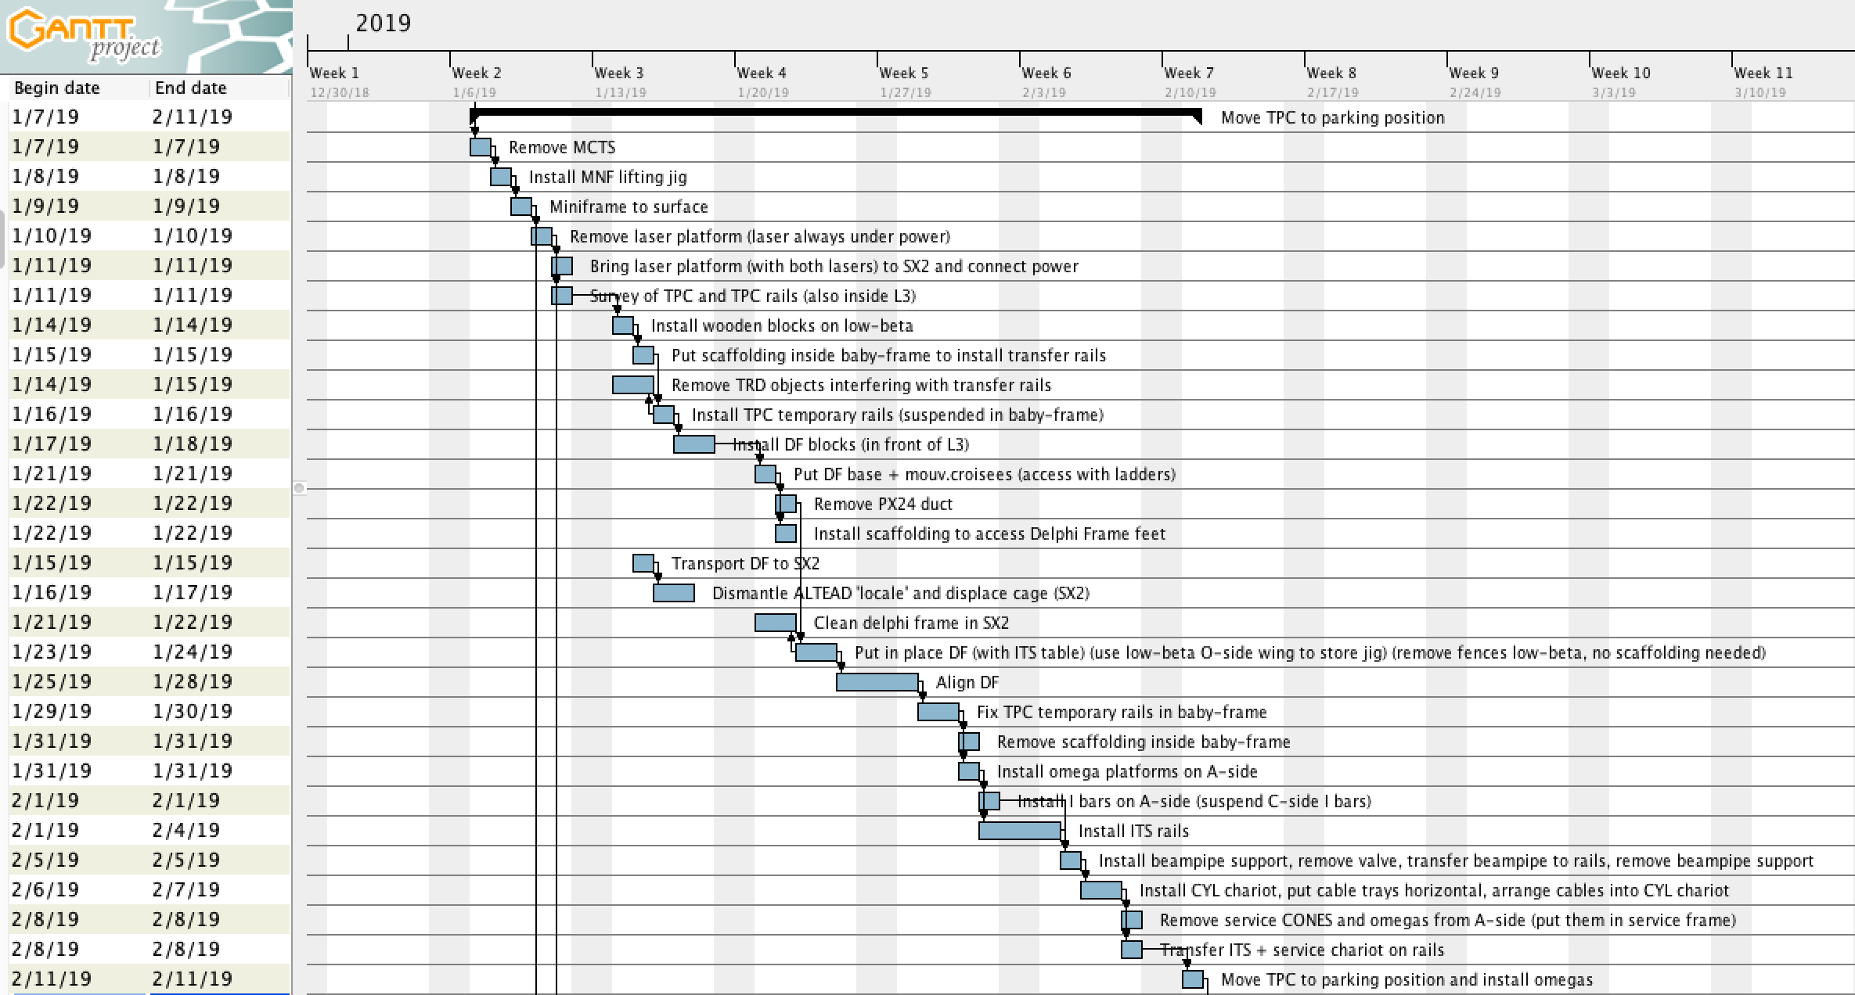
Jan-Feb activities 1/2

Slide 58
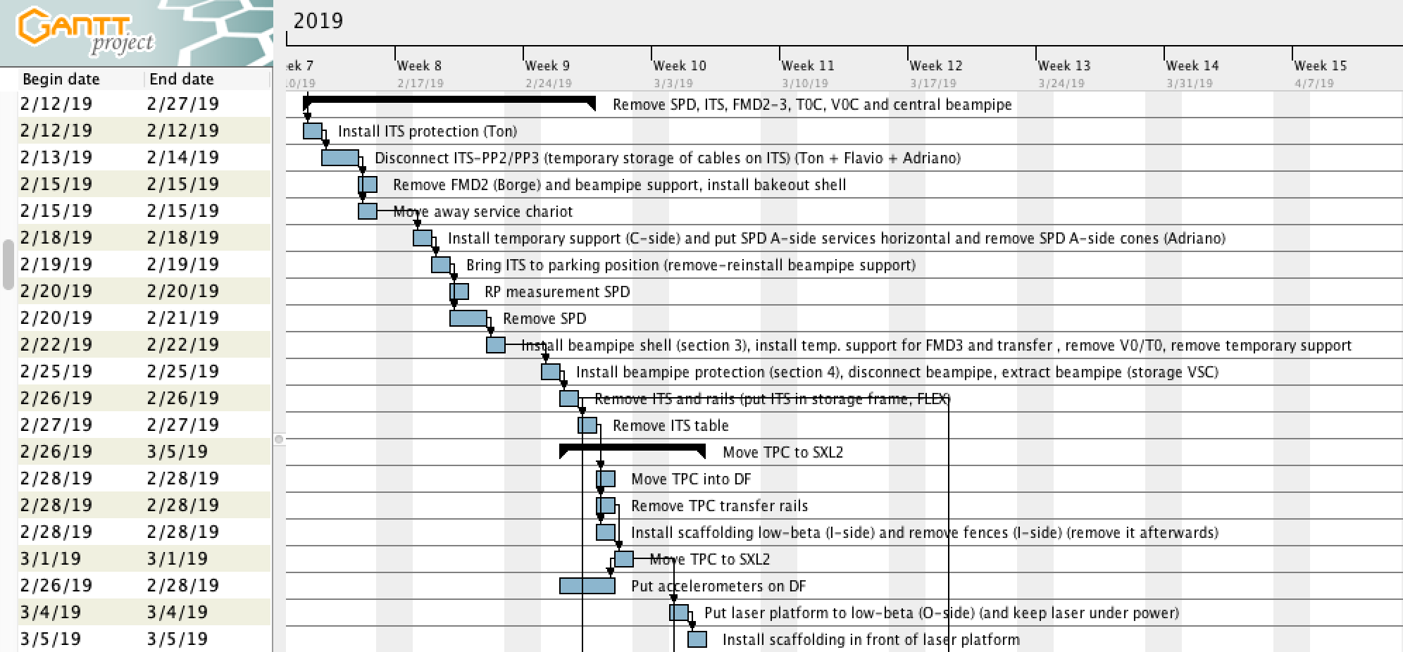
Jan-Feb activities 2/2

Slide 59
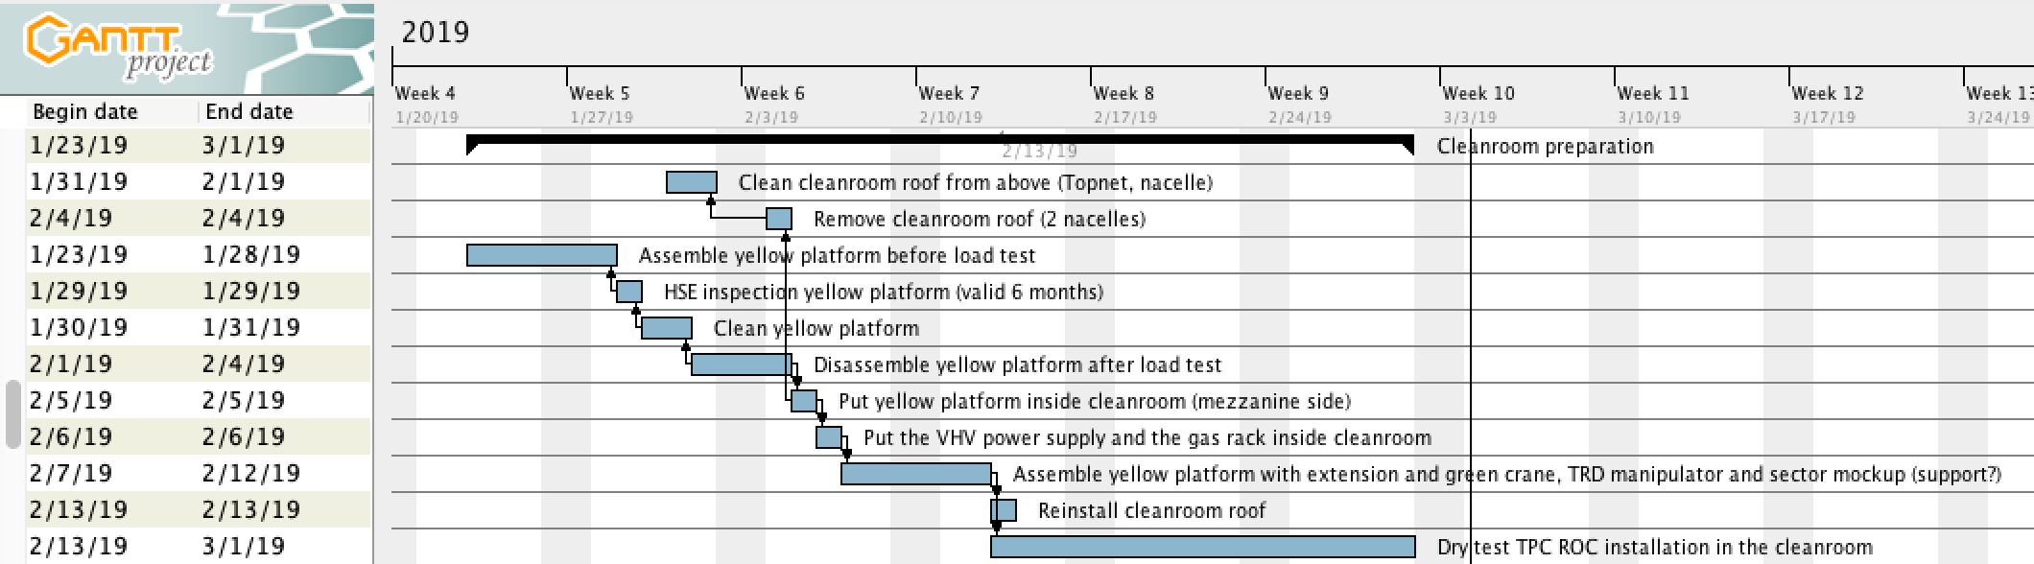
TPC preparation (cleanroom)

Slide 60
Day-by-day sequence w2
ALICE technicians
Institutes
Transport
Scaffolding
EN-EA
Other CERN groups
Pakistani team

Slide 61
UX25 activities w2 – Mon 7 Jan 2019
Arrival 5 Pakistani team
Maintenance fire detection, whole week
Start removing ITS crates from racks (tbc)
Disconnect TPC-C
ST3
Install Solar crates, remove CROCUS, cables, boxes (nacelle, scaffolding)

Slide 62
Miniframe activities w2 – Mon 7 Jan 2019
Remove MCTS

Slide 63
UX25 activities w2 – Tue 8 Jan 2019
Disconnect TPC-C
ST3

Slide 64
Miniframe activities w2 – Tue 8 Jan 2019
Miniframe lifting jig

Slide 65
UX25 activities w2 – Wed 9 Jan 2019
Disconnect TPC-C
ST3

Slide 66
Miniframe activities w2 – Wed 9 Jan 2019
SX2: put Miniframe and MCTS on blocks
Miniframe to surface

Slide 67
UX25 activities w2 – Thu 10 Jan 2019
EN-EL: install CR0 UPS switchboard
Remove laser platform
Disconnect TPC-C
ST3
Scaffolding ITS/SPD inox pipes
Bring platform to SX2 and connect power to laser

Slide 68
UX25 activities w2 – Fri 11 Jan 2019
TPC survey
TPC survey
Scaffolding PP0
ST3

Slide 69
Storage in December

Slide 70
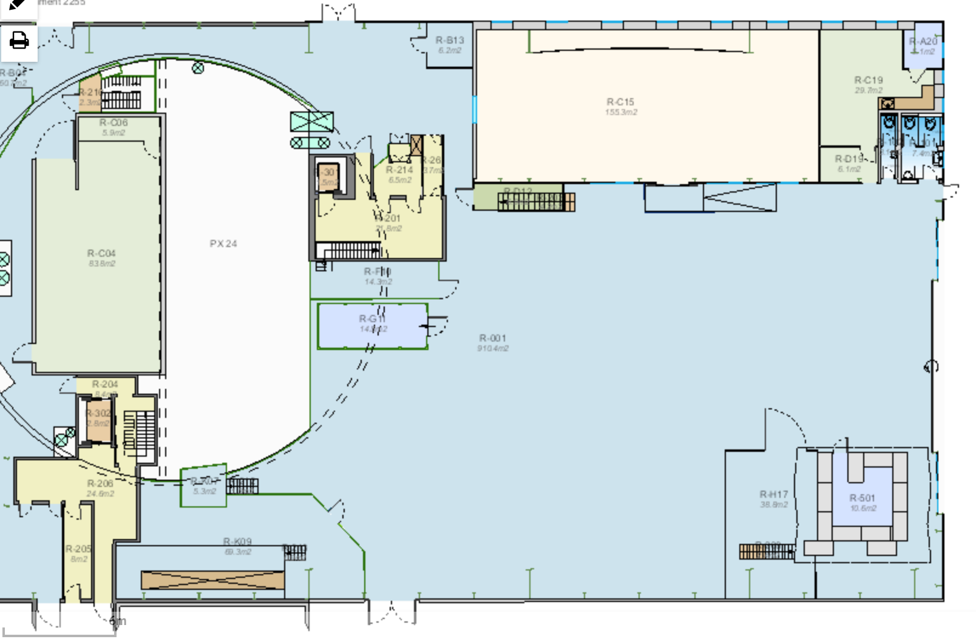
SX2 in December, storage
V0A-FMD1 → 3297
ADA → 3297; ADA shielding → SU2
PMD ventilation pipes → bin
ZEM → 3297; ZEM table → SU2
RB24 beampipe + vacuum equip.→ FLEX
Beampipe protection → SU2
BCM → Pieter
BLM → BLM team
TPC black hoses and supports → 3297
ITS PP1 and PP0 services → bin
TRD table → outside behind tent
Detector crates → 610
Comp.
magnet
PX24 beams
All blocks evacuated before Xmas
PX24 beams outside SXL2
UX25 blocks on the parking, next to SG2
UX25 blocks
PX24 beams

Slide 71
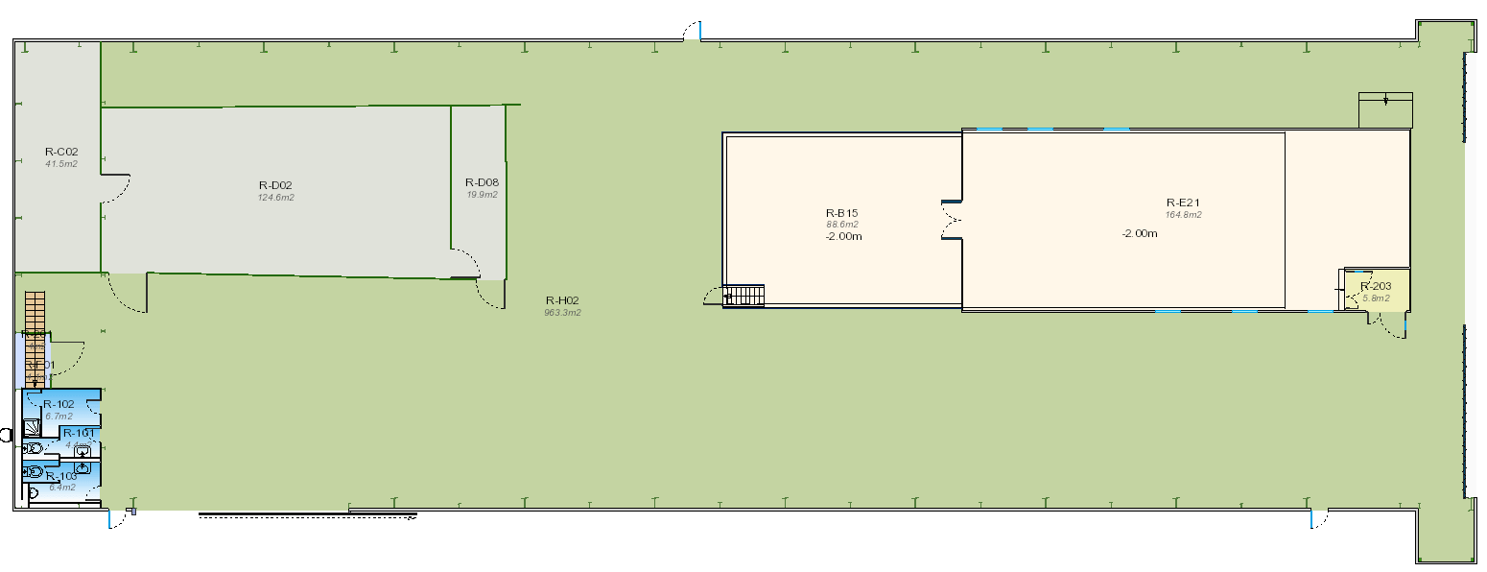
SXL2 in December, storage
Delphi frame
TRD6
TRD, EMCal rotators
7-21 Dec: PMD dismantl.
Yellow platform
L3 ventilation pipes → SXL2 ?

