Slide 1
ApPEC-ECFA-NuPECC working group
Recognition of individuals in large collaborations
Meeting with “ECFA Collaborations”
Recognition Working Group – 5-10-2020

Slide 2
Reminder: Who are your convenors?
From ApPEC:
Karl-Heinz Kampert (kampert@uni-wuppertal.de), co-chair
Emmanuel Gangler (emmanuel.gangler@clermont.in2p3.fr )
From ECFA:
Bogna Kubik (bkubik@ipnl.in2p3.fr )
Djamel Boumediene (Djamel.Boumediene@cern.ch )
Marcel Merk (marcel.merk@nikhef.nl ), co-chair
From NuPECC:
Eberhard Widmann (Eberhard.Widmann@oeaw.ac.at ), co-chair
Gerda Neyens (Gerda.neyens@cern.ch )
Nasser Kalantar (nasser@kvi.nl )

Slide 3
What do we do?
Key objectives within an advisory and exploratory mandate of the working group:
  exchange and discuss best practices, and reflect on alternative or additional procedures,
  potentially perform a second survey in 2020-2021 to monitor the progress on the topic,
  however, the group will not be an ombuds-committee for individual problems.
The collaborations remain themselves responsible for the actions of the working group and to implement (or not) recommendations.

Slide 4
Planning
Due to the large number of collaborations proceed to discuss in sub-working group meetings; merge ideas from fields later on
Proceed from the earlier ECFA survey as starting point
Two discussion sessions with collaborations
  First meeting to provide further clarifications and initial discussions: July 8, 2020
  Second meeting to collect feedback from the collaborations: October 5, 2020
Follow up meeting with JENAS working group convenors
  Oct-8-2020: discuss how to proceed
Feedback to ApPEC-ECFA-NuPECC chairpersons in Fall

Slide 5
Goals and Feedback
Our Goals:
  Create awareness
  Initiate discussions inside collaborations
  Exchange best practices
  We are not an ombudscommittee
Ask for feedback on general questions:
  Do you recognize the issue in your collaboration?
  Does your collaboration consider it an important/urgent topic?
  Do you already have a forum to discuss this?
  Can you provide feedback on ”best practices” that you already have implemented?

Slide 6
Specific topics for feedback - 1
  What does your collaboration think about the conclusions of the ECFA report?
  Were some important issues perhaps not addressed?
  Which system do you use for authorlists (alphabetical, opt-in, opt-out, other)? Is it generally appreciated?
  Which system do you use for assigning conference talks? How are talks prepared within the collaboration? Do people feel there is enough freedom to determine the contents of their talk?
  What do you think of making analysis notes (limited authorlist of analysis proponents) public? What are reasons pro and con to do that? Would you object to a system where statistics can be collected for the proponents of such ana-notes? Would it be useful to introduce a JENAS wide system?
  What is your opinion of prizes and awards? Do you differentiate between awards (a prize for “the best”) and “rewards” (a prize for “an achievement” – no selection).

Slide 7
Specific topics for feedback - 2
  One way to recognize achievement is appointing people to responsible positions (board member, conveners, reviewer etc.). How does that work in practice in your collaboration? Does it have a political aspect e.g. equal share between countries?
  Analysis reviews are sometimes lengthy procedures that take longer than the job contract of individuals doing the analysis, such that papers are not ready to be published or that results unblinded before graduation or end of contract. Is this an issue? If so, is there a mechanism to deal with that?
  Do you have specific policies or practices to promote the work of juniors?
  Do you have something in place for recognition for technical issues?
  What do you put in place to help the recognition of individuals by members external of the collaboration (for instance for their career advancement). Is there a way for external referee to asses what a convenership entails ?
  Are specific measures in place to include individual’s opinion in decision making processes?

Slide 8
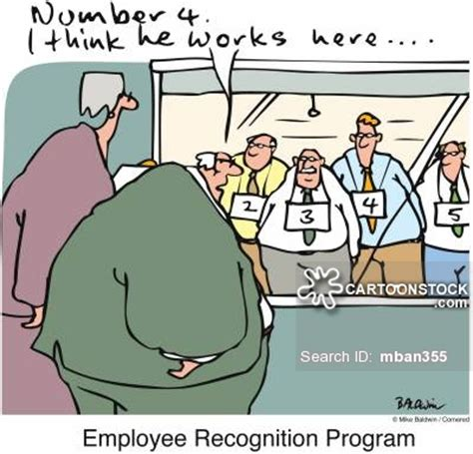
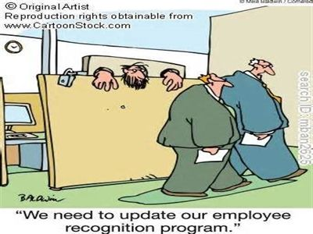
Let’s stimulate individual recognition

