Slide 1
MD#4147
50Hz harmonics perturbation
H. Bartosik, S. Kostoglou, Y. Papaphilippou, G. Sterbini
D. Alves, G. Arduini, C. Baccigalupi, M. C. Bastos, A. Beaumont, X. Buffat, J.-P. Burnet, M. Buzio,
L. R. Carver, R. De Maria, S. Fartoukh, R. T. Garcia, G. Iadarola, L. Intelisano, T. Levens, O. Michels,
V. Montabonnet, D. Nisbet, J. Olexa, M. Pojer, A. Poyet, M. Soderen, M. Solfaroli, H. Thiesen, G. Trad,
N. Triantafyllou, S. Uznanski, D. Valuch, J. Wenninger
Special thanks to BI, EPC, OP
LSWG, 04.12.2018

Slide 2
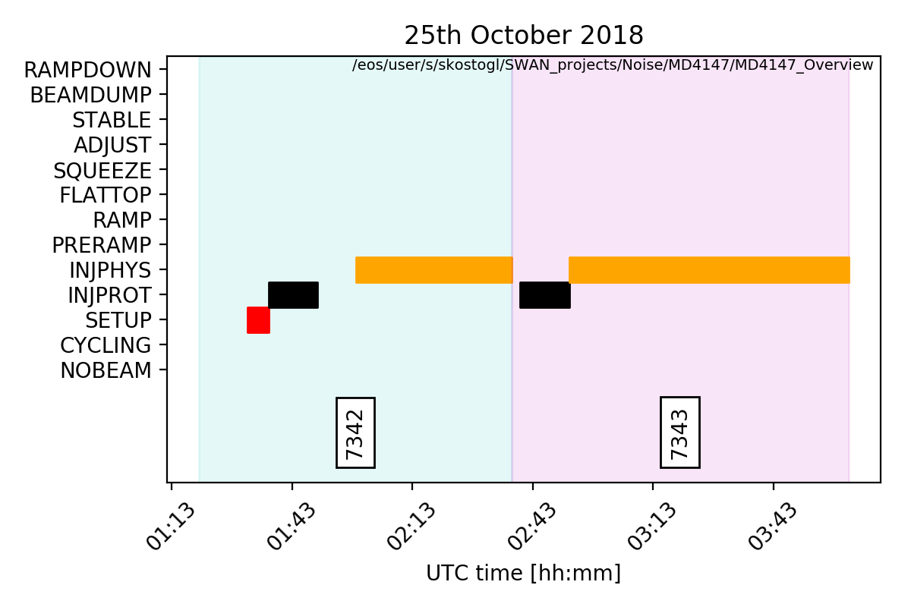
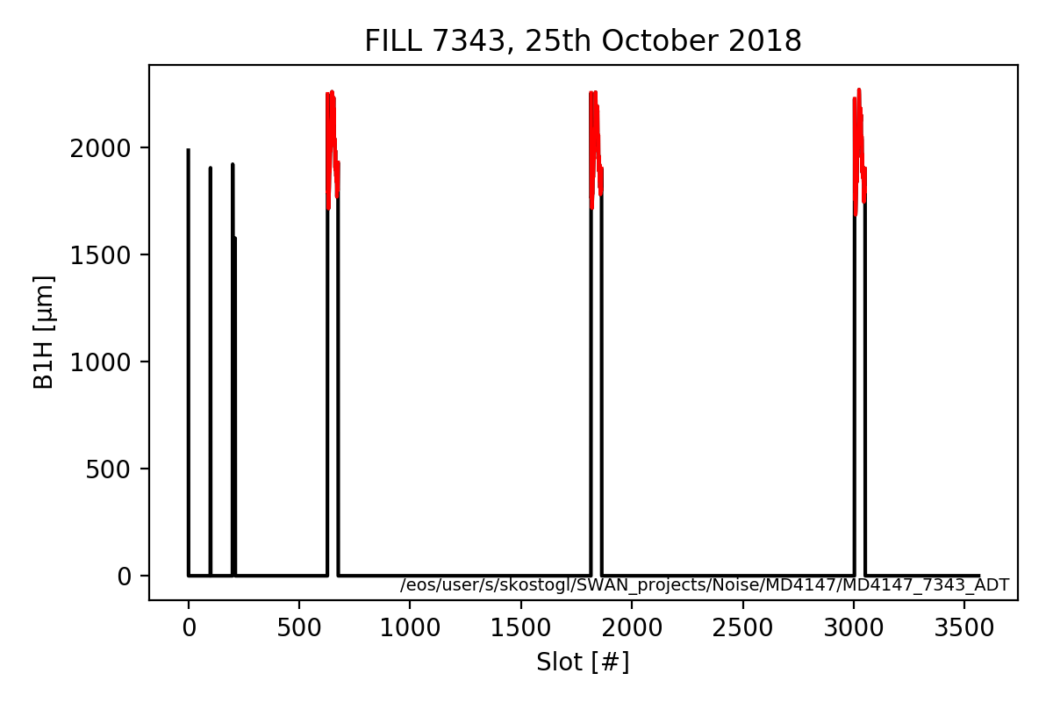
MD#4147 Overview
Motivation: Investigate the source of the 50 Hz harmonics at injection & study if there is an impact on the beam performance. (MD#4, 4h+1h)
Filling scheme
INDIVS
3x48 b
Trains with 120 degrees phase difference for constant sampling rate

Slide 3
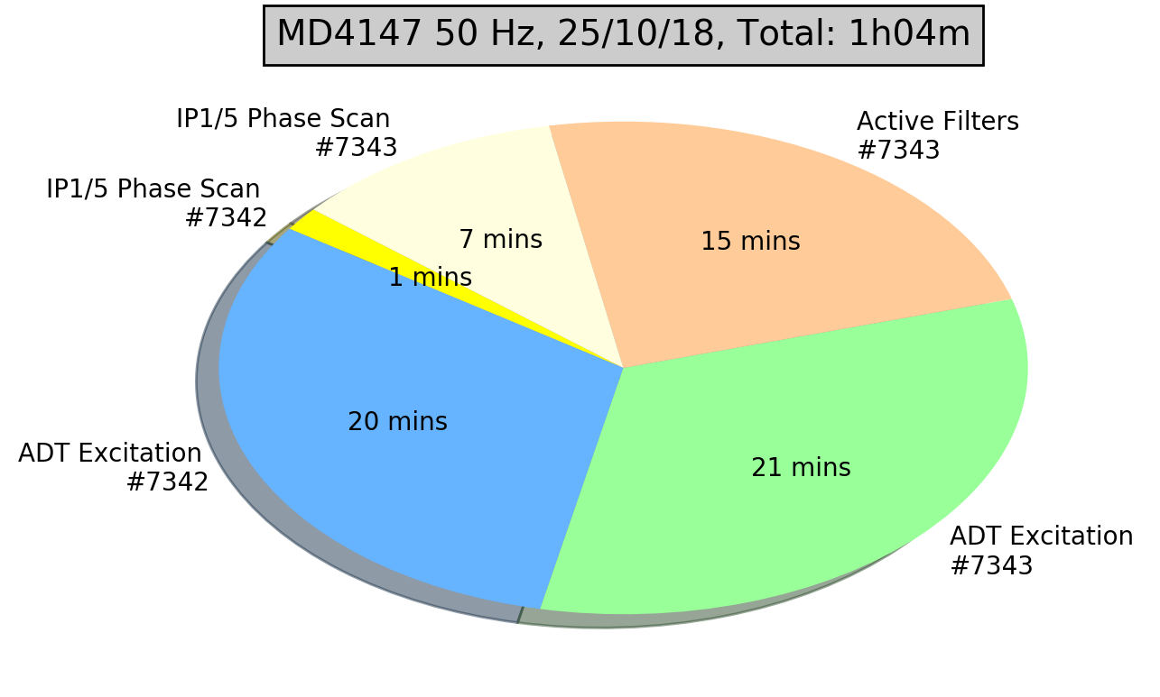
MD#4147 Overview
~2.5 h delay
ADT excitations to validate lifetime simulations with voltage ripples. ☑
Active filters of the MB sector by sector. ☑
IP1/5 phase scan ± 40 degrees. ☑ (± 8 degrees)
Tune scan to closest 50 Hz harmonics. ☒
Investigate if there is also a tune modulation with 50 Hz. ☒
Observables
✓ | ADTObsBox | Only for 12b for AF and IP1/5 phase scan. All trains for ADT excitations
✓ | BBQ
✗ | MIM
✓ | Head-Tail | Only pm
✓ | DOROS | For multiple PUs DOS & DOR every 1 minute
✓ | Schottky
✓ | BSRT
✓ | Power converter S12 | Acquisition set to 1 minute

Slide 4
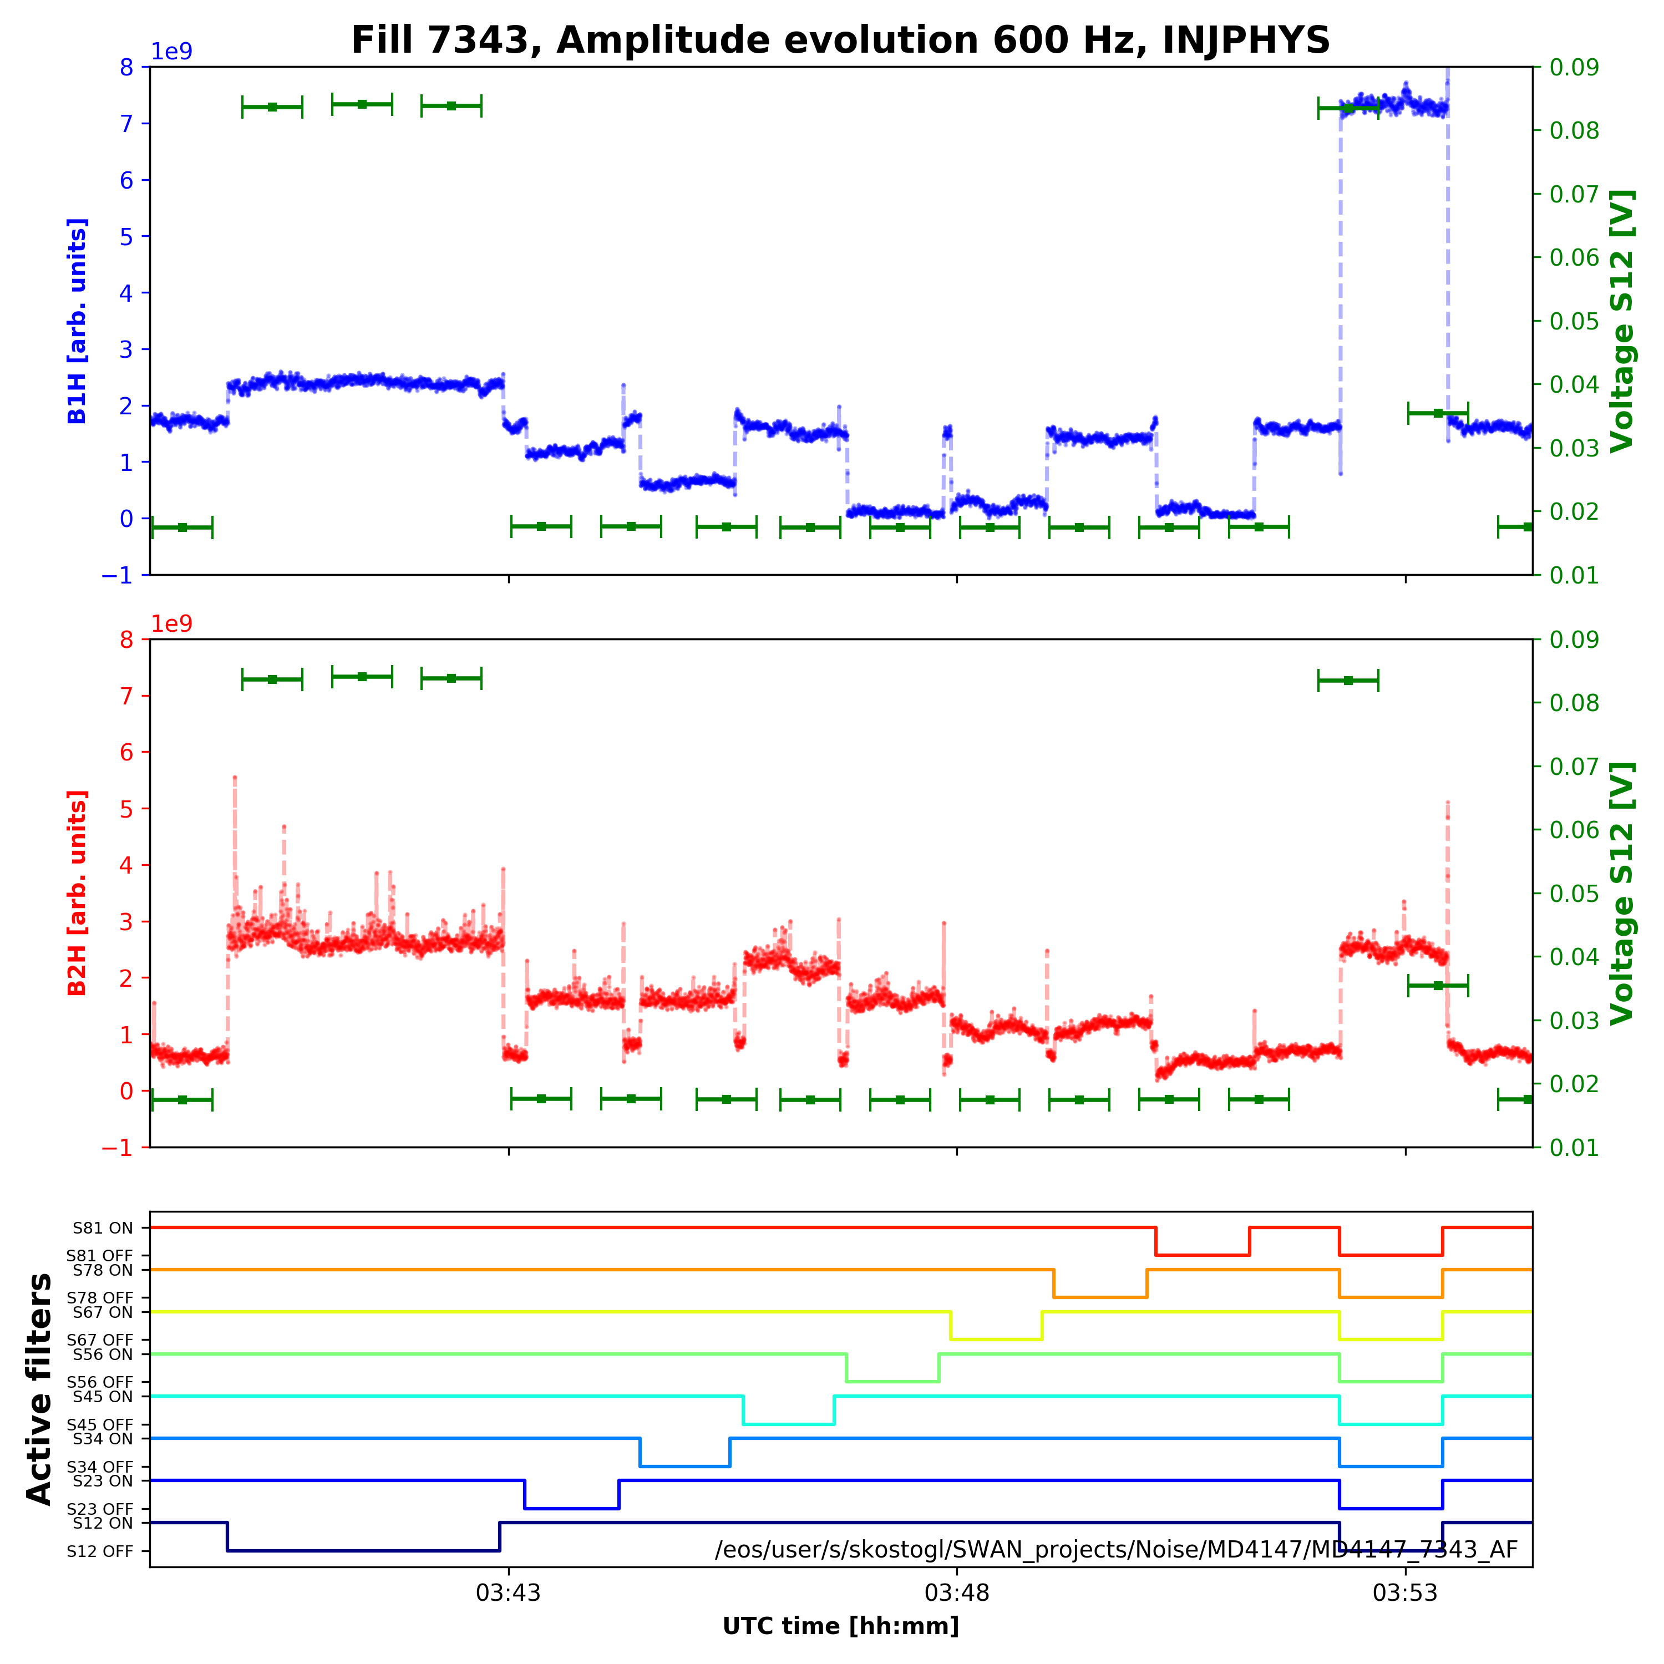
Active filters
Response map of each sector.
Different for B1 & B2, for different harmonics, for injection & flattop.
Compatible with the power converter S12 spectrum.
Phase component of each sector to be defined.

Slide 5
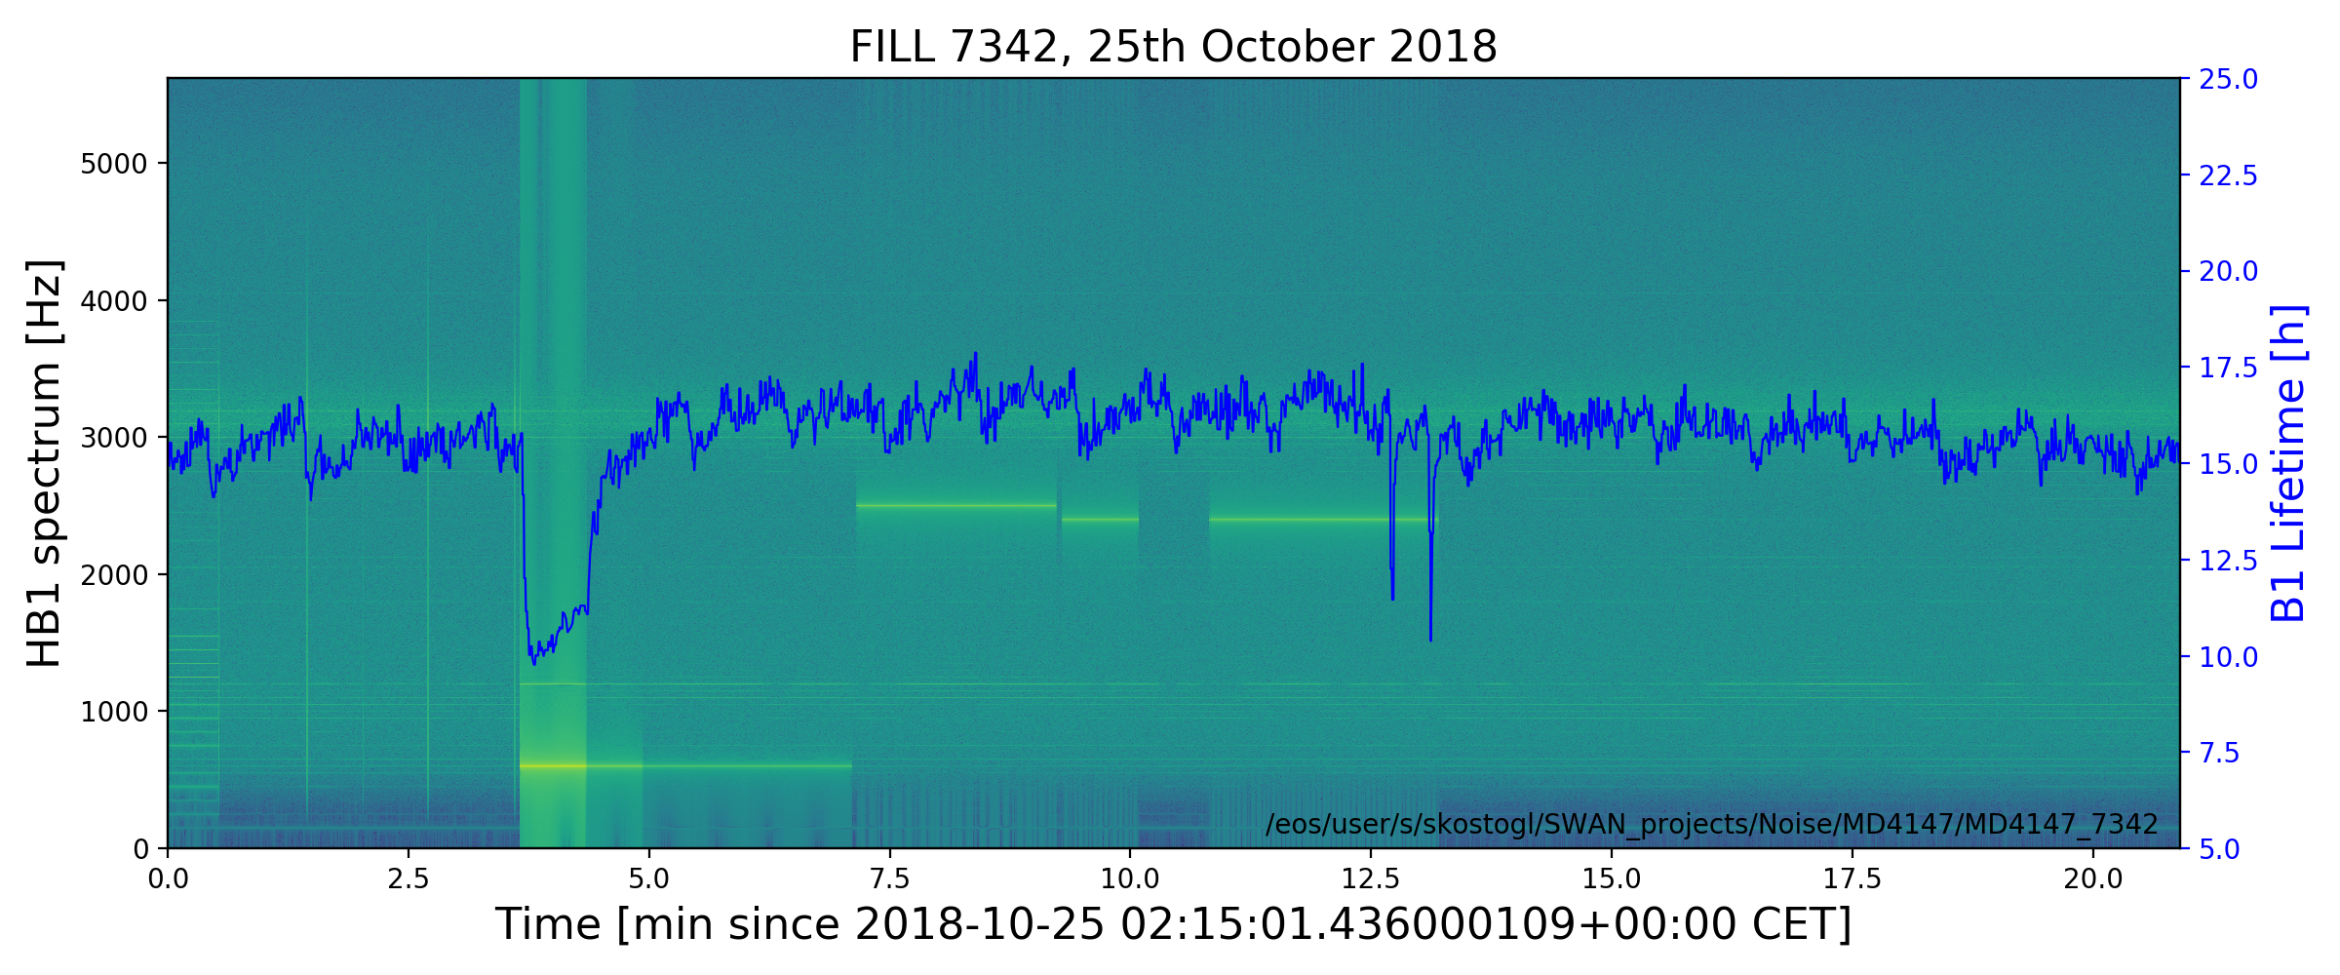
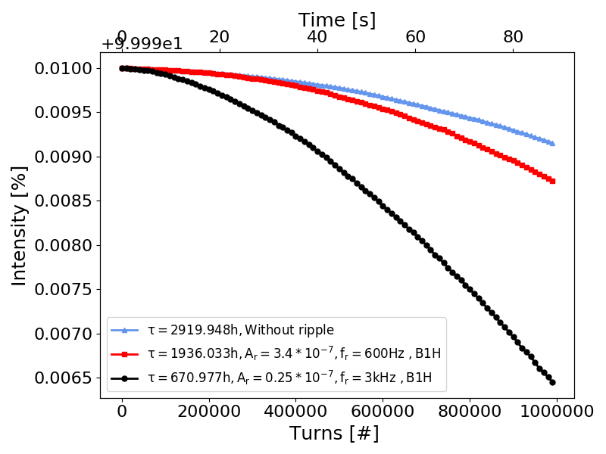
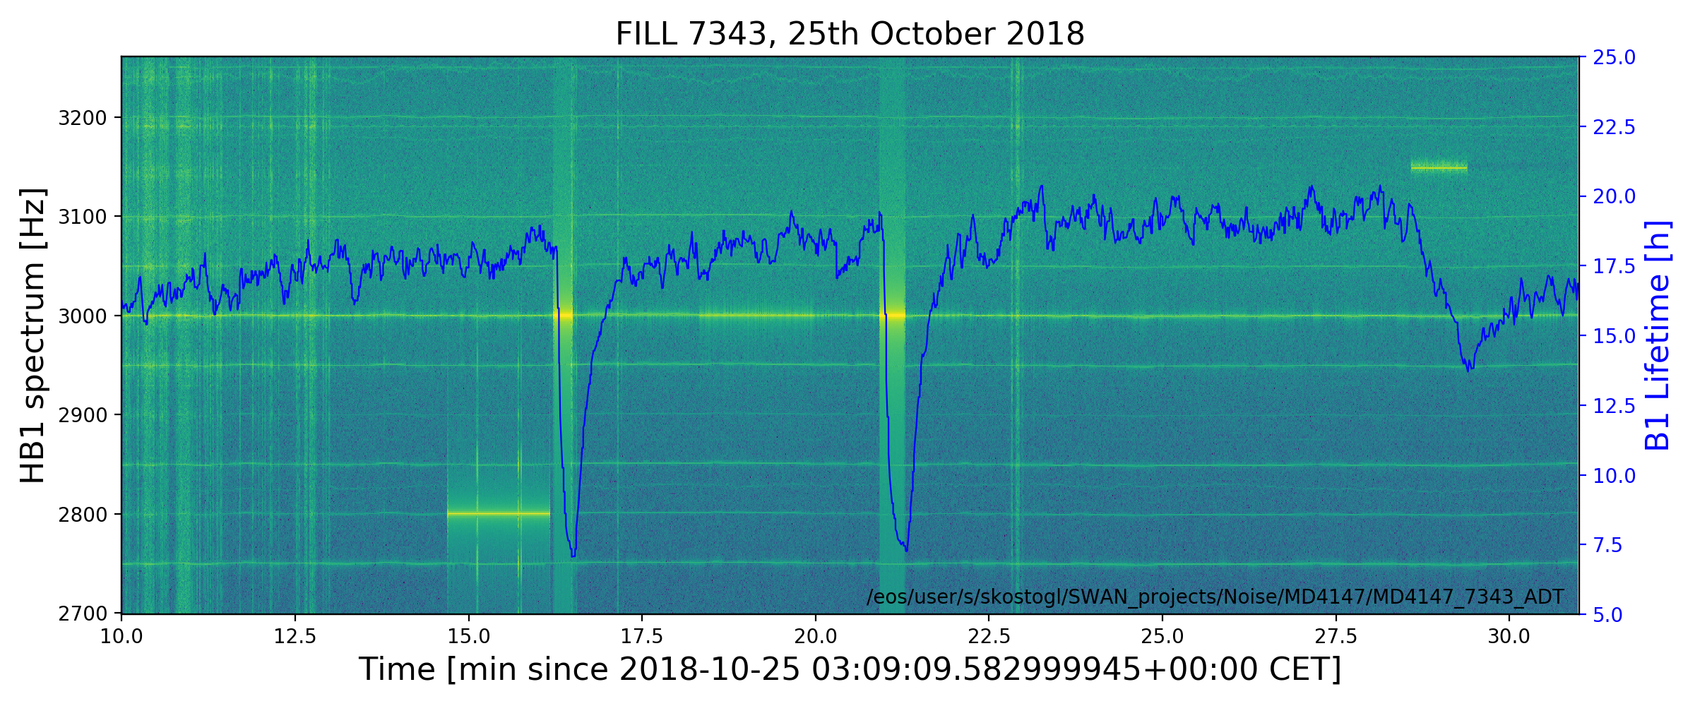
ADT excitations
Lifetime
fr [Hz] | MD | Simulations
600 | -37.5% | -33.69
3000 | -60.5% | -77.02%
INDIVs
600 Hz, 0.34 μrad
Simulations @ Injection
Preliminary
Trains
3 kHz, 0.025 μrad
600 Hz
3 kHz

Slide 6
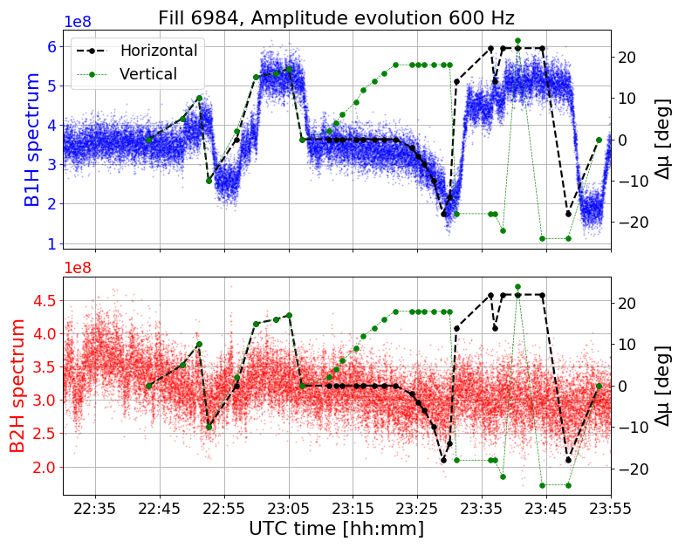
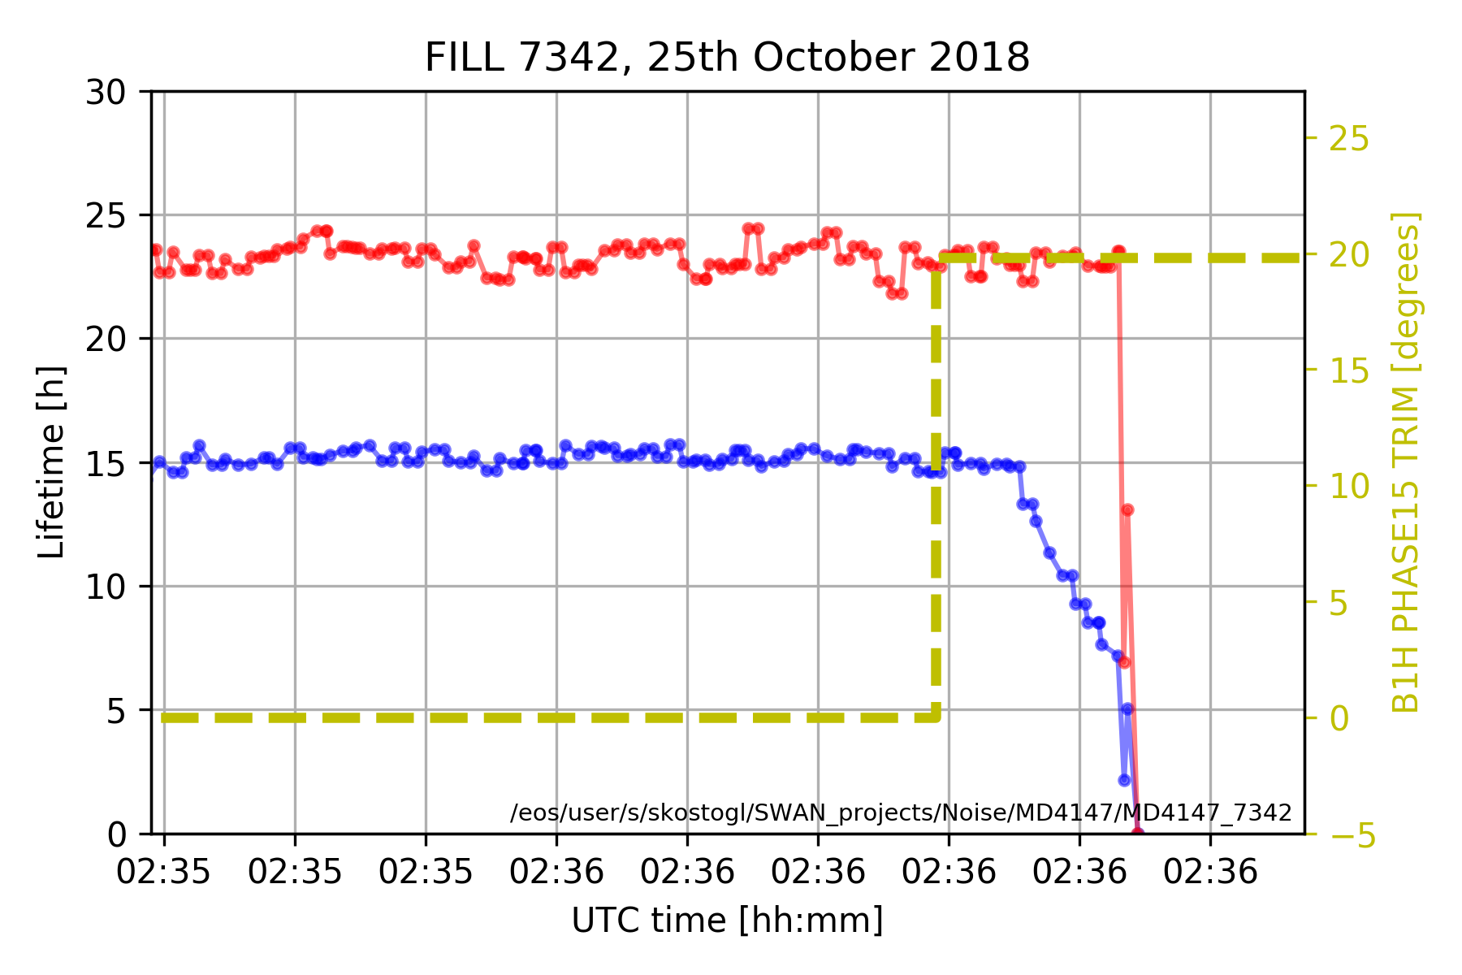
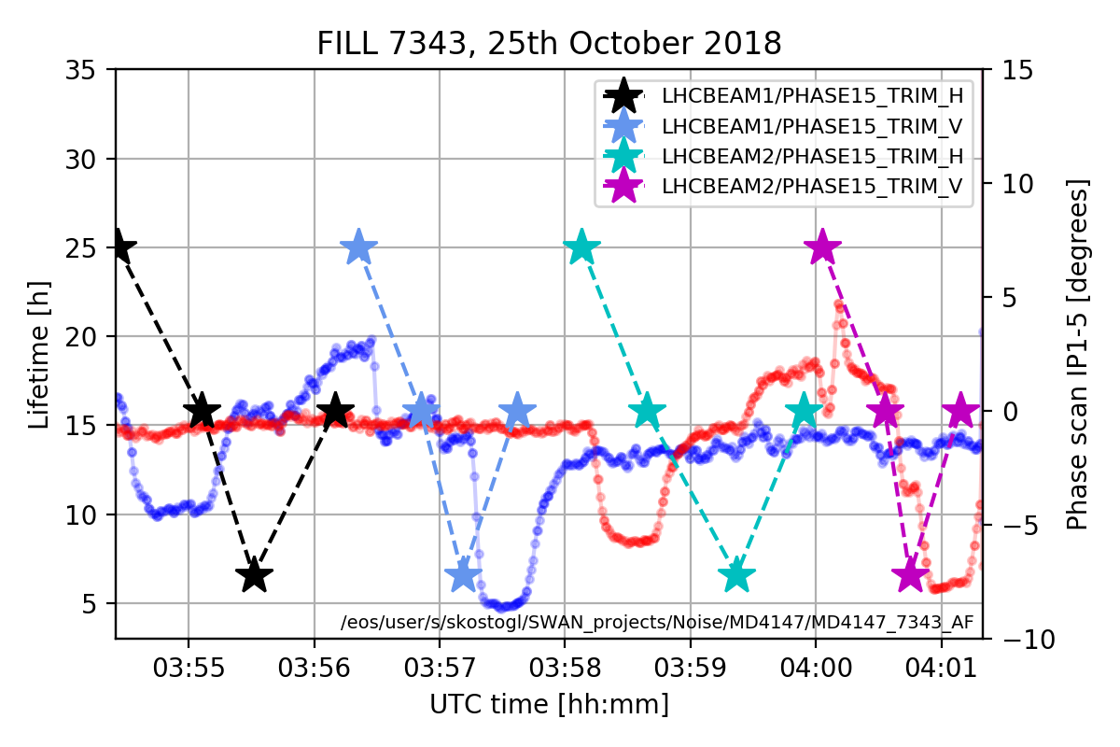
IP1/5 Phase Scan
During MD#4 INJ
Impact on lifetime at injection:
  At +20 degrees with INDIVs.
  Degradation or improvement even at 8 degrees.
  No change in the 50 Hz amplitude evolution.
During MD#2 FT
No impact in lifetime
Change in amplitude evolution of 50 Hz
B1
INDIVs
Trains
B1H
B1V
B2H
B2V
B2
B1H TRIM

Slide 7
Conclusions
MD started with a 2.5 h delay due to RF problem.
We now have a response matrix of the active filters sector by sector both at injection and top energy. Ongoing studies for the determination of the phase component of each sector.
Excitations with ADT have provided a metric of the impact on lifetime from dipolar excitations close and far away from the tune.
We did not manage to reproduce the change of amplitude of the 50 Hz harmonics with the IP1/5 phase knob at injection (losses after 8 degrees). Investigation on the lifetime variation during the change of IP1/5 phase advance.

