Slide 1

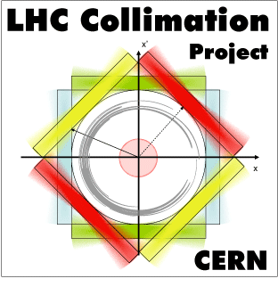
MD4506: APERTURE MEASUREMENETS WITH AC DIPOLE
N. Fuster-Martínez, M. Hofer, E. Maclean, D. Mirarchi,
R. Bruce, R. Tomas, S. Redaelli
On behalf of the collimation and OP team.

Slide 2
Motivation
A new global aperture measurement method based on using the AC dipole beam excitations plus a collimator scan was tested for the first time in 2017 in MD2396 on B1 at injection.
  New method could be combined with optics measurements providing the largest AC dipole kick amplitude.
Bottleneck at injection for B1H | AC dipole | ADT blow-up
Q6R2 | 12.9±0.8 | 12.7±0.8
Q4L6 | 12.7±0.8 | 12.6±0.8
Compatible results were obtained between methods in the MD2396 for B1H at injection.
  The method was tested at top energy during optics MD in 2017.
  For B2H methods disagree by 1𝜎.
Date | B1H [𝜎] | B1V [𝜎] | B2H [𝜎] | B2V [𝜎]
AC dipole Dec. 2017 30 cm 150 urad | Q3R5 10.8-11.3 | Q2R5 and Q3L1 10.5-11 | Q3R5 and Q3L1 11.8-12.3 | Q3R1 10-10.5
ADT TS2 2017 30 cm 150 urad | Q3R5 and Q3L1 10.6-11.1 | --- >10.5 | Q3R5 10.9-11.4 | Q3R1 10.5-11
  In the 2018 commissioning the aperture for B2H was measured with the AC dipole method.
  Same level of discrepancy was observed.

Slide 3
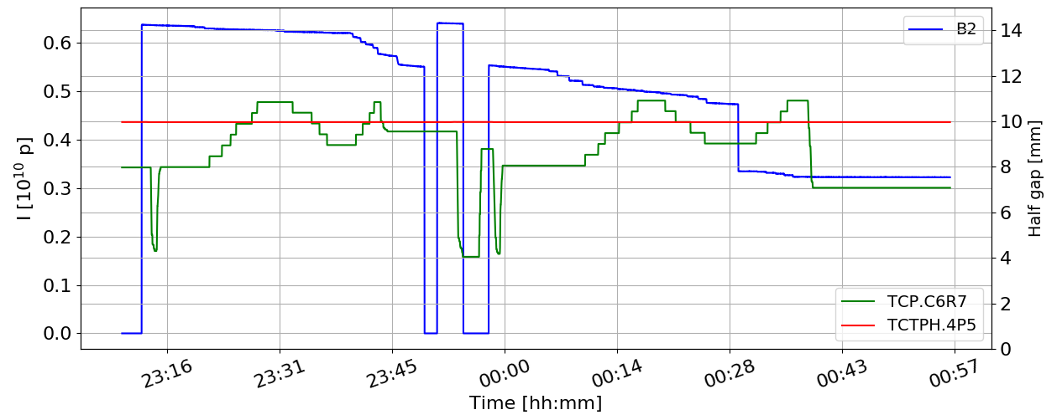
MD overview
MD merit:
Investigate if the observed discrepancy in physics at FT energy occurs also at injection.
Investigate the effect of the AC dipole tune, vertical settings and chromaticity on the measurements.
4h MD.
Injection optics.
B2H.
TCTPH.IP5 fixed to 10𝜎
Aperture scanned with TCP.
Measurements performed:
Aperture measurements with the AC dipole method.
  Different AC dipole delta tunes to test the β-βeating introduced by the AC dipole oscillations.
  Different vertical working point and AC dipole vertical kick amplitude.
  Different chromaticity.
Aperture measurements with the ADT method for benchmarking.
TCP and the TCT alignment for each scan because of the orbit drift due to ALICE solenoid ramp down.

Slide 4
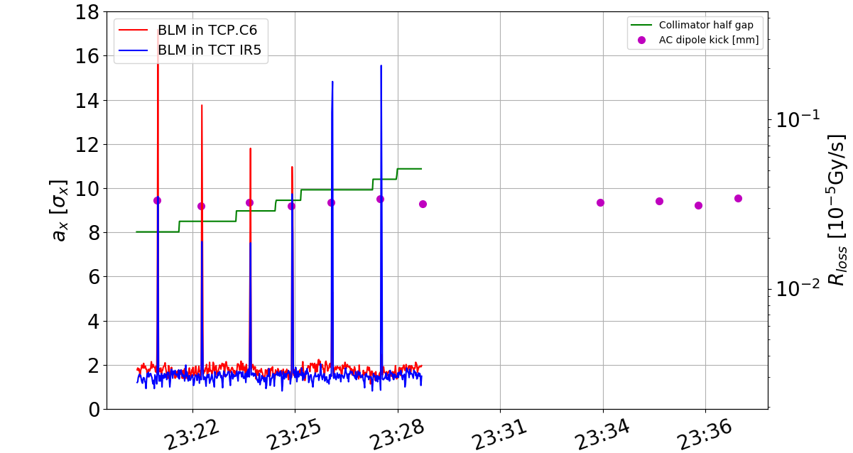
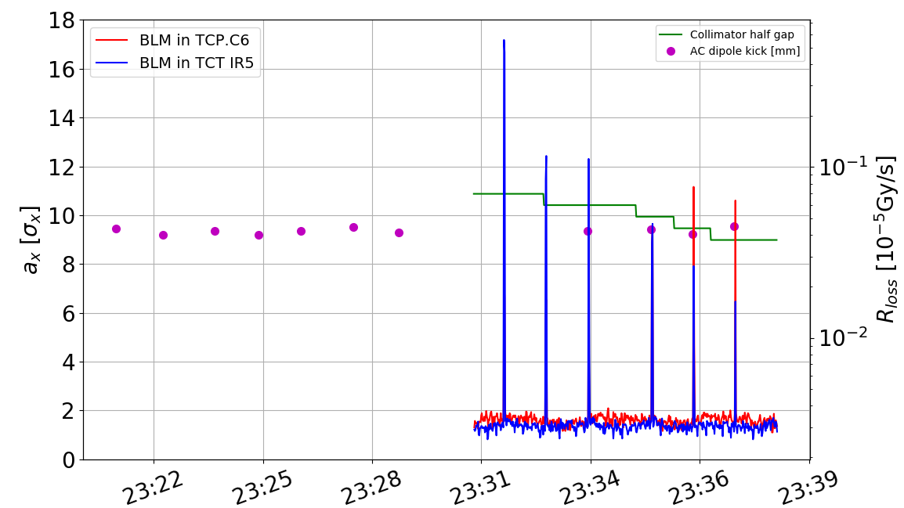
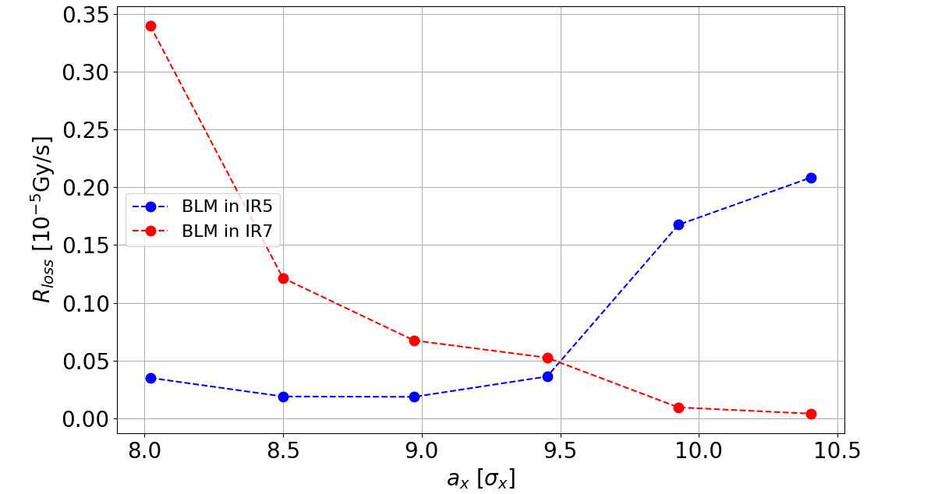
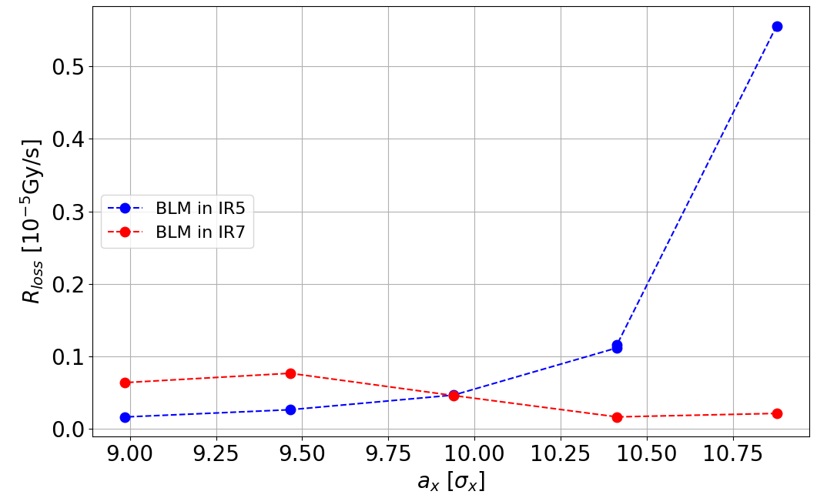
MD results: AC dipole tune effect
△^{n-ac}q_{x} = +0.012
△^{n-ac}q_{x} = -0.012
TCP
Bottleneck
Bottleneck
a=9.5𝜎
a=9.9𝜎
Opening of the TCP collimator
TCP
△a ~0.4𝜎 observed between positive and delta tune.
Could be explained by the β-βeating introduced by the AC dipole in agreement with MADX predictions.

Slide 5
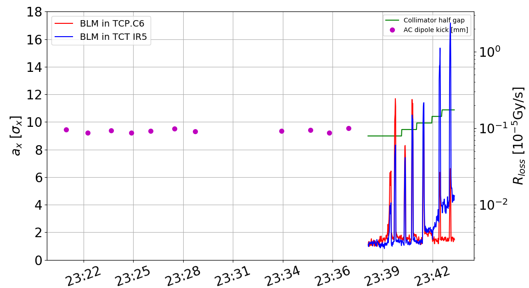
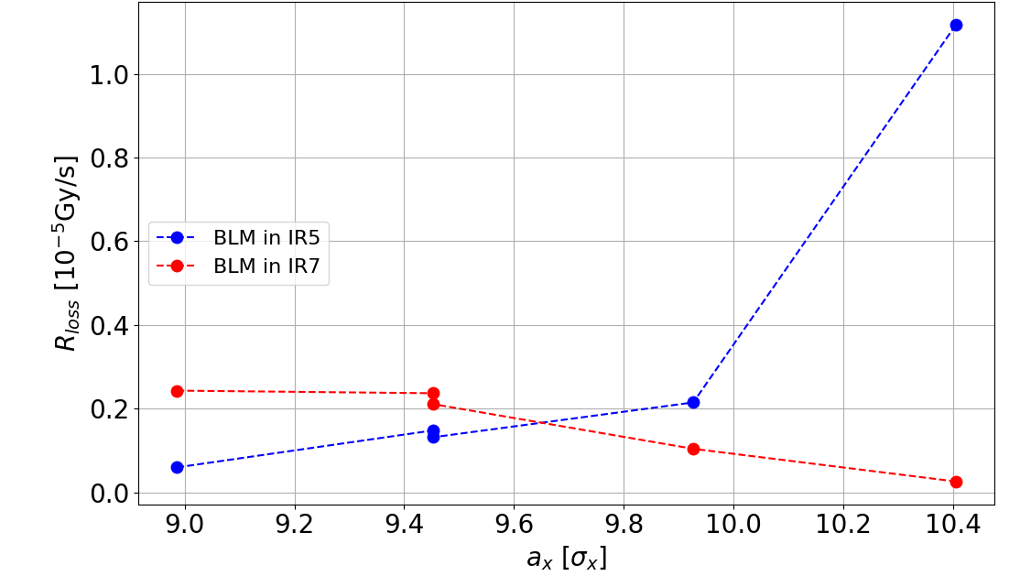
MD results: ADT blow-up method for benchmarking
B2H | AC dipole
△^{n-ac}q_{x} = +0.012 | 9.5
△^{n-ac}q_{x} = -0.012 | 9.9
ADT blow-up method | 9.7
TCTPH half gap | 10
ADT
ADT-blow up method aperture measurement in the same fill.
Good agreement between the methods.
200 µm beam drift observed between the start and end if this fill (~0.2 𝜎).
a=9.7 𝜎

Slide 6
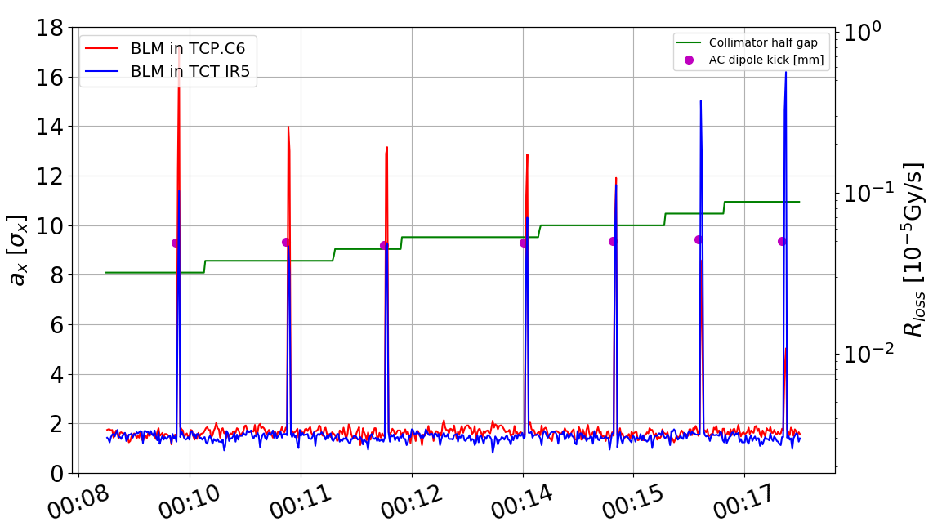
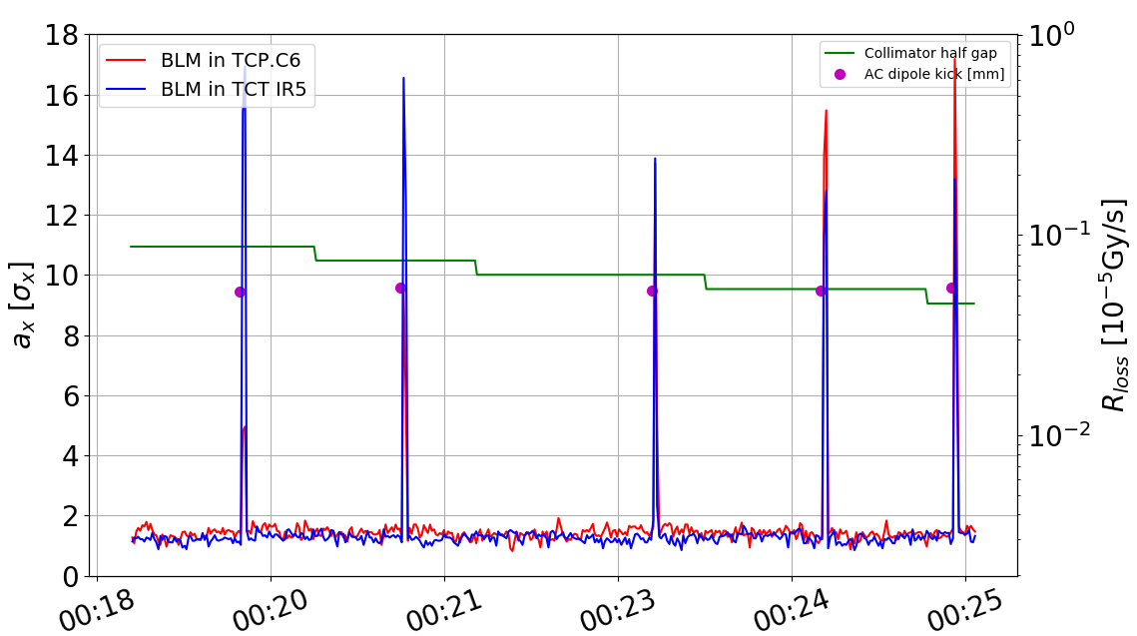
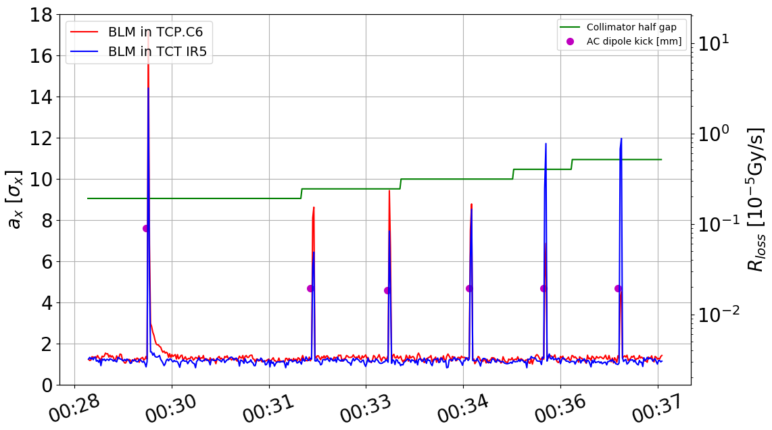
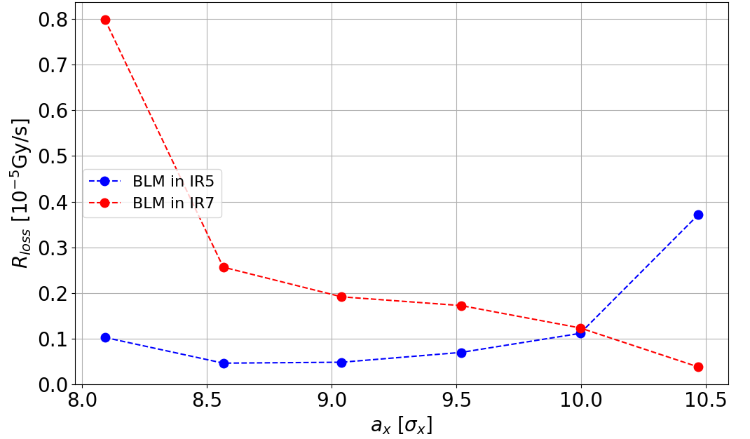
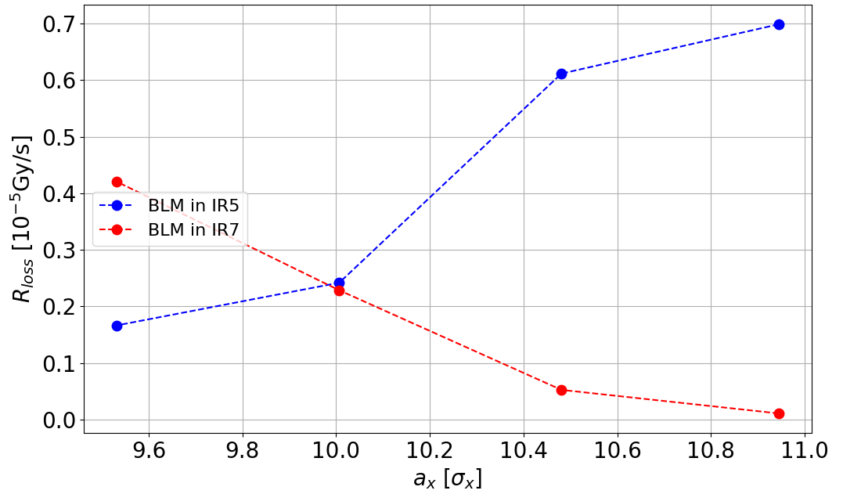
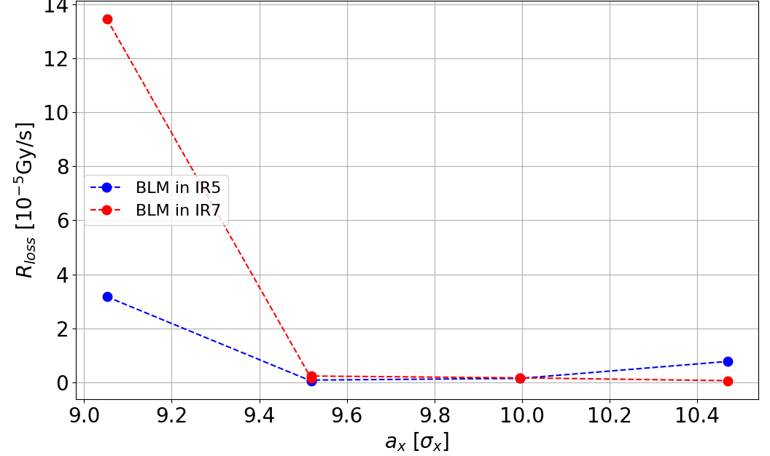
MD results: vertical settings and chromaticity effect
Possible effect from vertical plane
Qy=0.3105 -> Qy=0.295 1% increase on the vertical kick
Higher chromaticity
a=10 𝜎
a=10 𝜎
a=10 𝜎
No impact on the measurements.

Slide 7
Conclusions
  Good agreement is found between the AC dipole measurements and the ADT blow-up standard method for all the cases studied at injection.
    At injection the methods are equivalent for B1 and B2.
  There is not a big effect from tune and the chromaticity.
    Results are in agreement with the MADX predictions.
    This does not explain the observed discrepancies at FT.
    Observed discrepancy at FT will require further investigation.

