Slide 1

MD3563
Improving b3 model in the first part of the ramp
(performed on the night between 15th and 16th Sep 2018)
M. Solfaroli, J. Wenninger

Slide 2
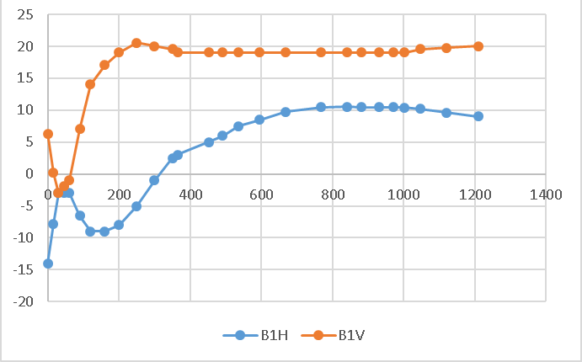
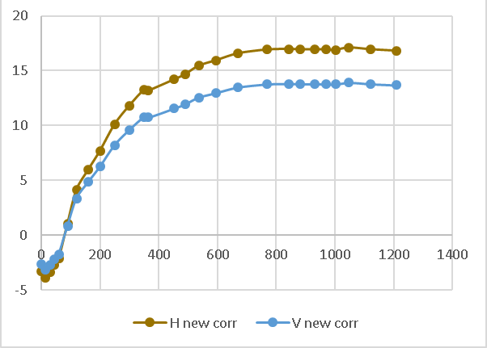
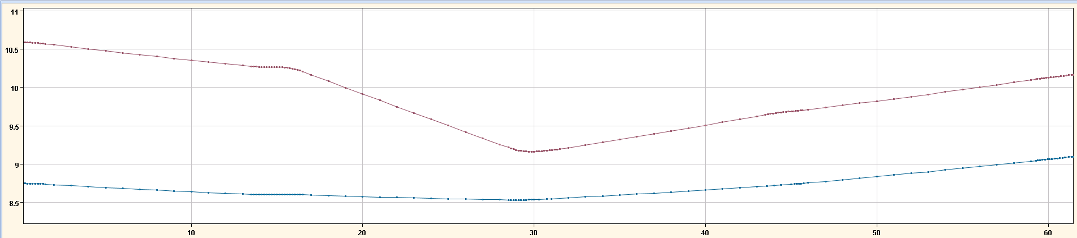
Motivation
Nominal Q’ corrections (B1)
Sign and dimension of ramp Q’ corrections clearly indicate a b3 error
“Cleaning” was done during LS1, updating the b3 model (increase of about 1 unit in the first part of the ramp)
Situation can be further improved
Beyond magnetic cleanness, acceleration may become an issue, especially with full telescopic ATS optics
New Q’ corrections (B1)
Current in the first 60 sec of the ramp for RSD2.A12B2 (before and after b3 cleaning)

Slide 3
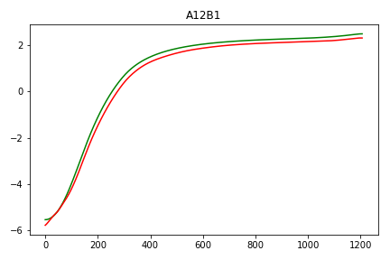
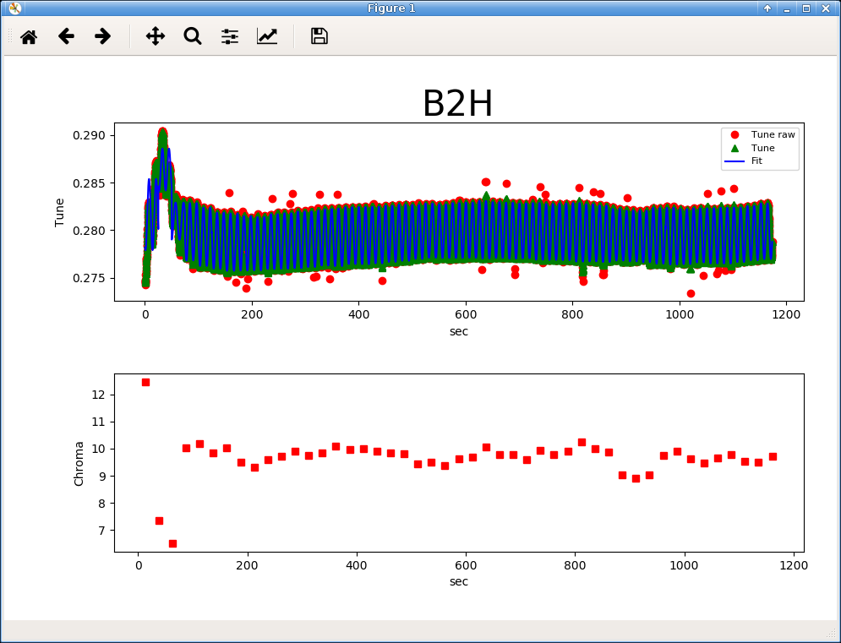
Results
b3 systematic were inserted in the functions (removed from the lattice sextupole corrections)
OLD model
NEW model
A few problems of sign on the modified b3 functions were found
The first ramp already showed a very stable chromaticity throughout the whole process
Manual feed-forward to clean the correction done in the ramp-down
Flat Q' at 10 units throughout the second ramp
Established starting point for Run3

