Slide 1

MD3246 16L2 UFO dynamics investigations
MD3207 UFO dynamics studies during physics operation with blown-up bunches
M. Väänänen, A. Gorzawski, B. Lindström, J. Kral, D. Wollmann
CERN
Many Thanks to D. Valuch, the OP shift team and ecloud/heat load team for supporting these studies
LSWG – 4 December 2018

Slide 2
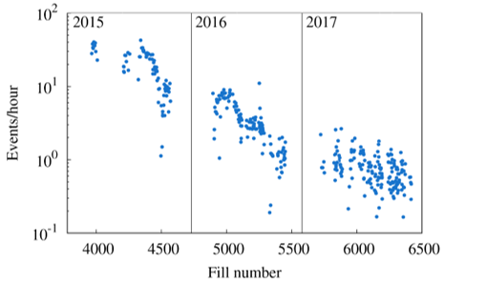
Motivation
UFOs have had a significant impact on LHC availability on run 1 and beginning of run 2
Conditioning and optimization of BLM thresholds has largely mitigated this issue
Nevertheless, the source, release mechanism, UFO dynamics and conditioning mechanism are not sufficiently understood
UFO rate post LS2 is expected to increase significantly (to 2015 levels?)
Difficult to predict impact on 7 TeV operation (lower quench margins etc)
Courtesy A. Lechner
Goal of the MDs:
Improve knowledge of UFO dynamics and validate simulation models by
  Confirming the plane of movement
  Comparing the energy deposition and # of nuclear interactions with simulations -> identify UFO material/size
Blown-up bunches allow studying dynamics
M. Väänänen
2

Slide 3
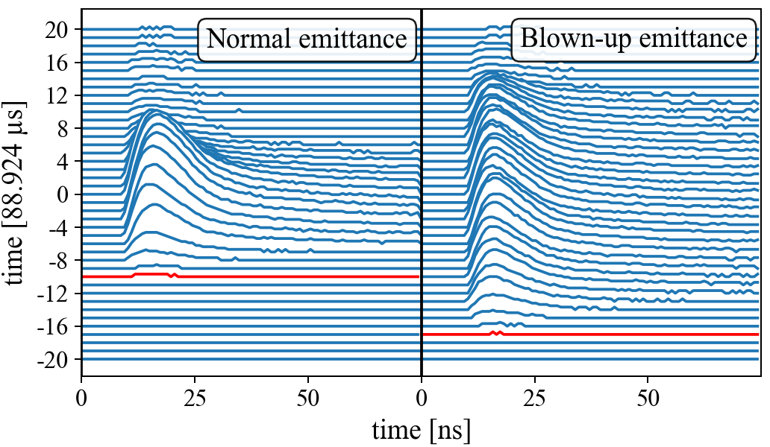
Method and Experiments
Observe bunch-by-bunch losses with diamond detectors
  two per beam downstream of primary collimators in IR7, one per beam at 16L2
Position of macro particle in relation to beam can be derived from the loss signals
UFO dynamics study (MD3207):
  Blow up 2b per beam (ver/hor) in non-colliding 12b train
  Procedure applied to all normal proton physics fills from 29th September until MD4
16L2 dynamics study (MD3246, parasitic on MD2484):
  Blow up 36 bunches (3 x 12b trains)
    6b per train vertically, 6b per train horizontally
  EOF: blow up hundreds of bunches, switch off 16L2 solenoid to trigger 16L2 type UFOs → dumped fill during blow-up of first 576 bunches
M. Väänänen
3

Slide 4
Recorded UFO Events
11 events recorded with dBLMs during physics fills with blown up bunches
  3 at 6.5 TeV
  8 during ramp (1.1 – 4.5 TeV)
UFO Buster detected 33 UFOs
  6 coincident events
Difference to UFO buster detections due to:
  Different algorithm (spatial versus temporal pattern)
    dBLMs trigger on peak detection and integration
    UFO Buster triggers only on integration
  UFO Buster is blind to events at TCP and the experiments
  dBLM depends on phase advance UFO source -> TCP
One 16L2 event recorded during heat load MD
M. Väänänen
4

Slide 5
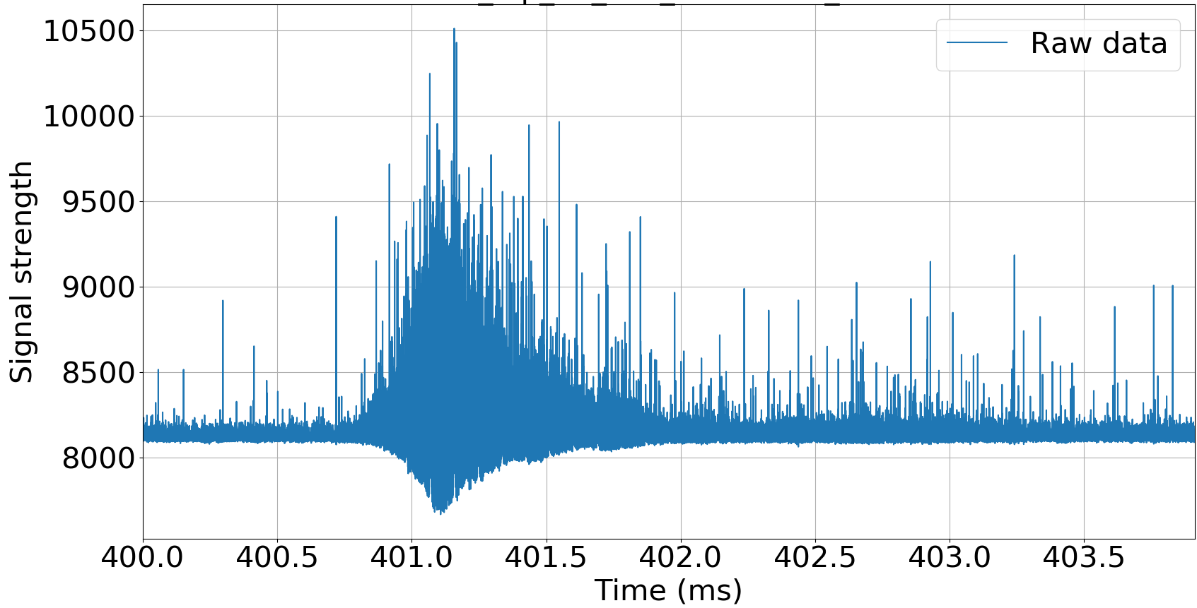
Raw waveform – full event
1.5 ms (16 turns)
Event 30/09 22:47:52 (6.5 TeV)
M. Väänänen
5

Slide 6
Raw waveform – full event
Event 30/09 22:47:52 (6.5 TeV)
M. Väänänen
6

Slide 7
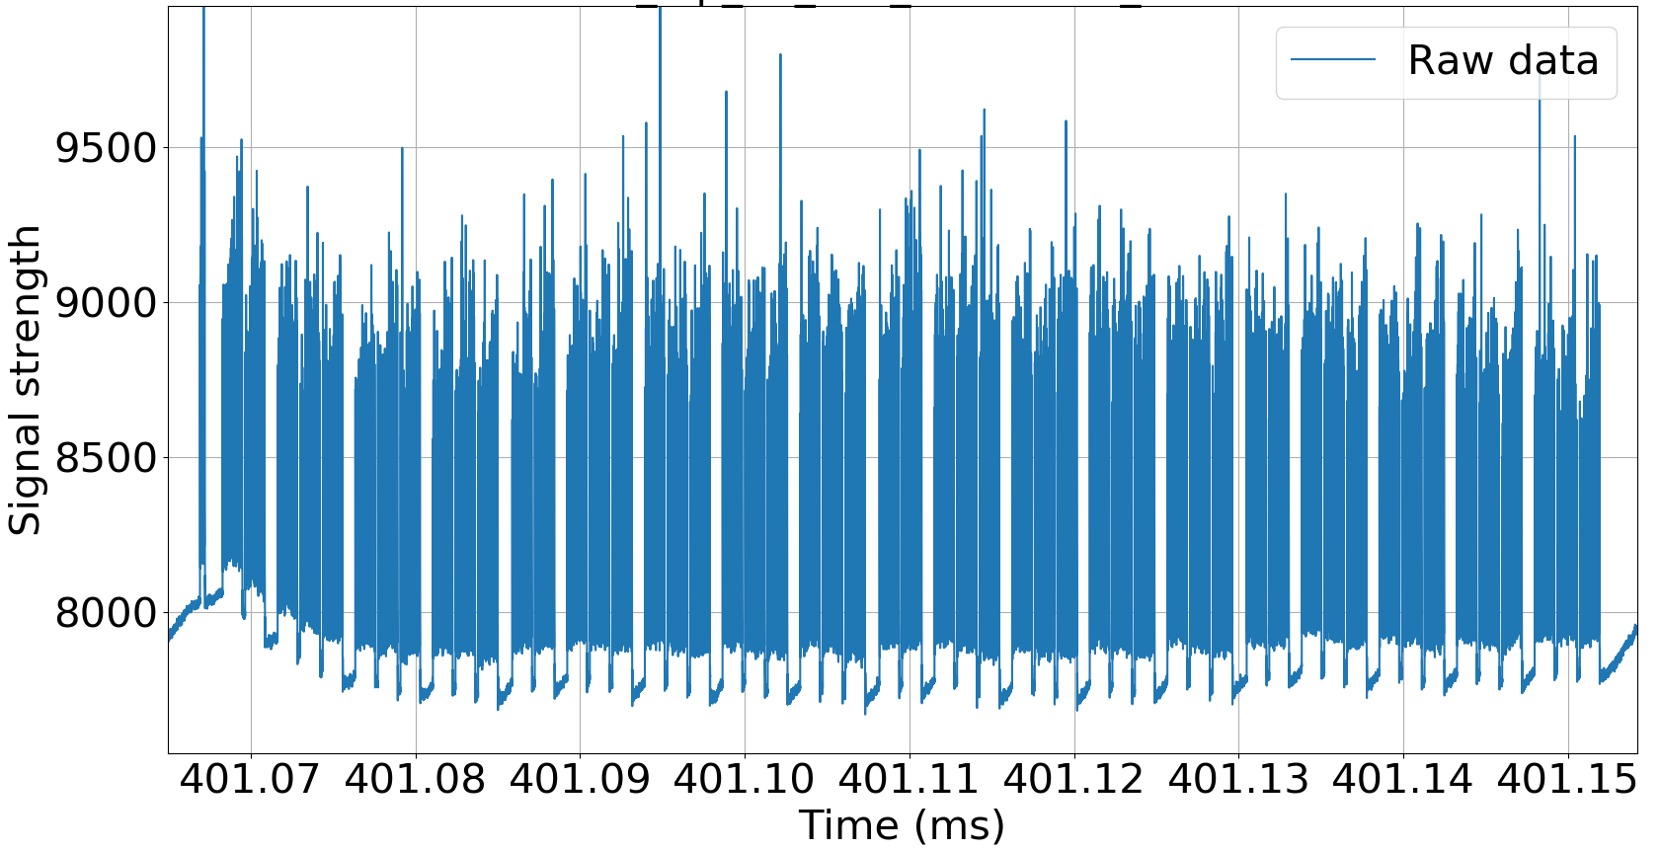
Raw waveform – zoom in one turn
Event 30/09 22:47:52 (6.5 TeV)
M. Väänänen
7

Slide 8
Raw waveform – zoom in one turn
Event 30/09 22:47:52 (6.5 TeV)
M. Väänänen
8

Slide 9
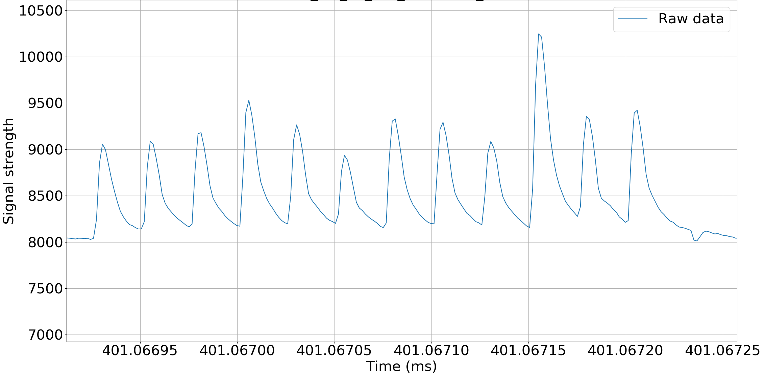
Raw waveform – zoom in 12 b train
Horizontal
Vertical
Event 30/09 22:47:52 (6.5 TeV)
M. Väänänen
9

Slide 10
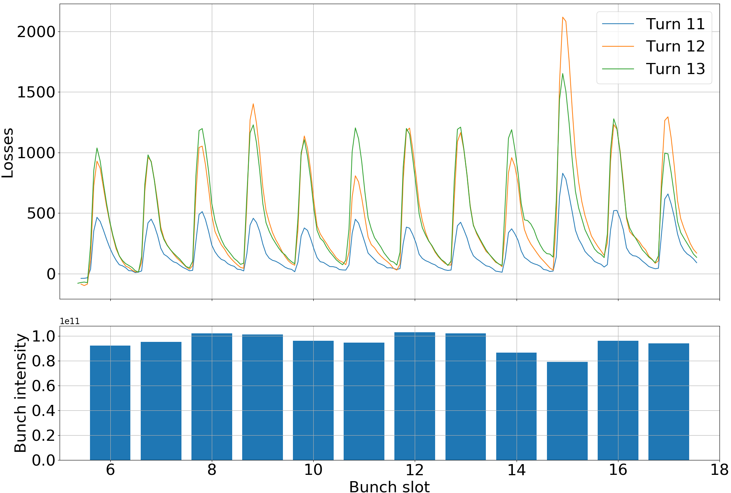
Time evolution of losses in 12 b train
1e11
Horizontal
Vertical
M. Väänänen
10

Slide 11
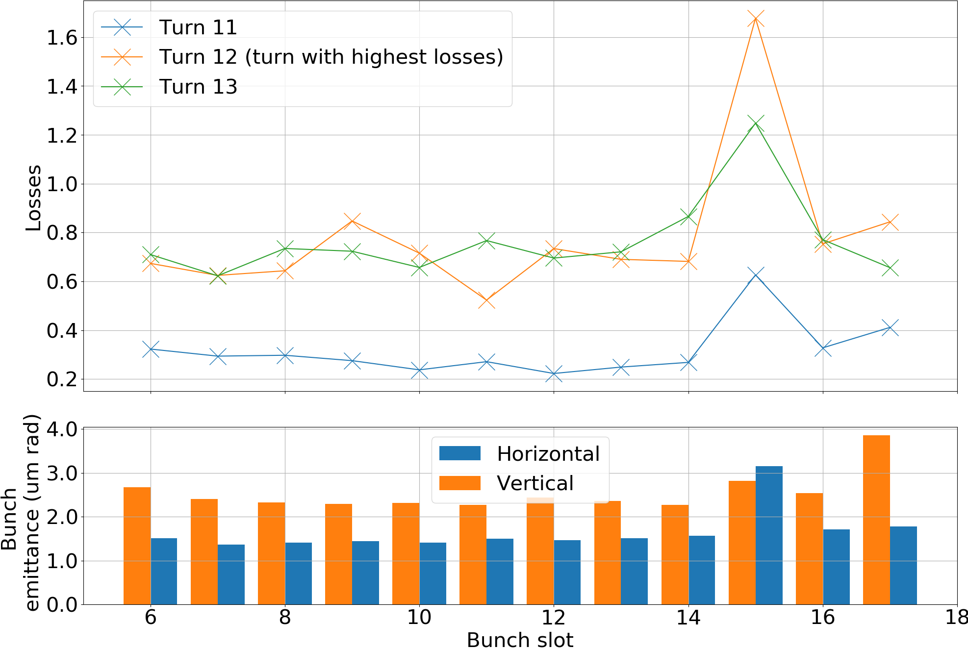
Bunch-by-bunch losses normalised to intensity
1e-7
Horizontal
Vertical
M. Väänänen
11

Slide 12
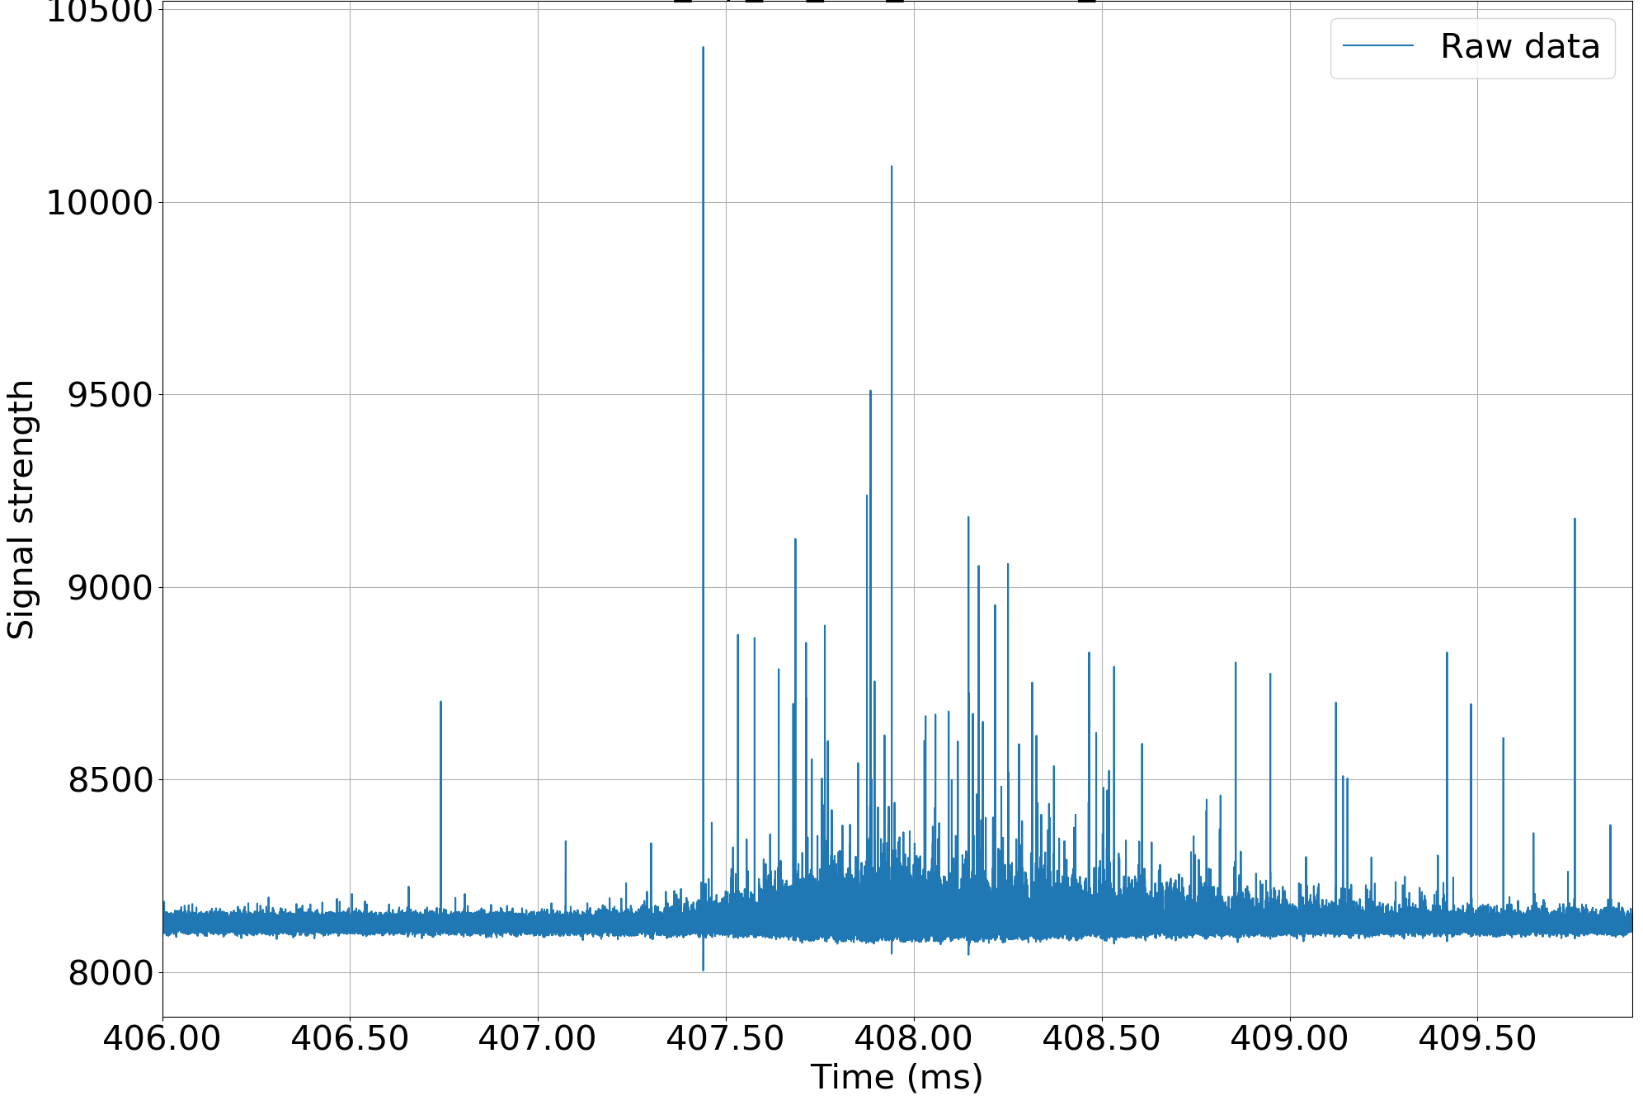
Event 17/10 23:53:50 (1.6 TeV) Raw waveform – full event
1 ms (11 turns)
M. Väänänen
12

Slide 13
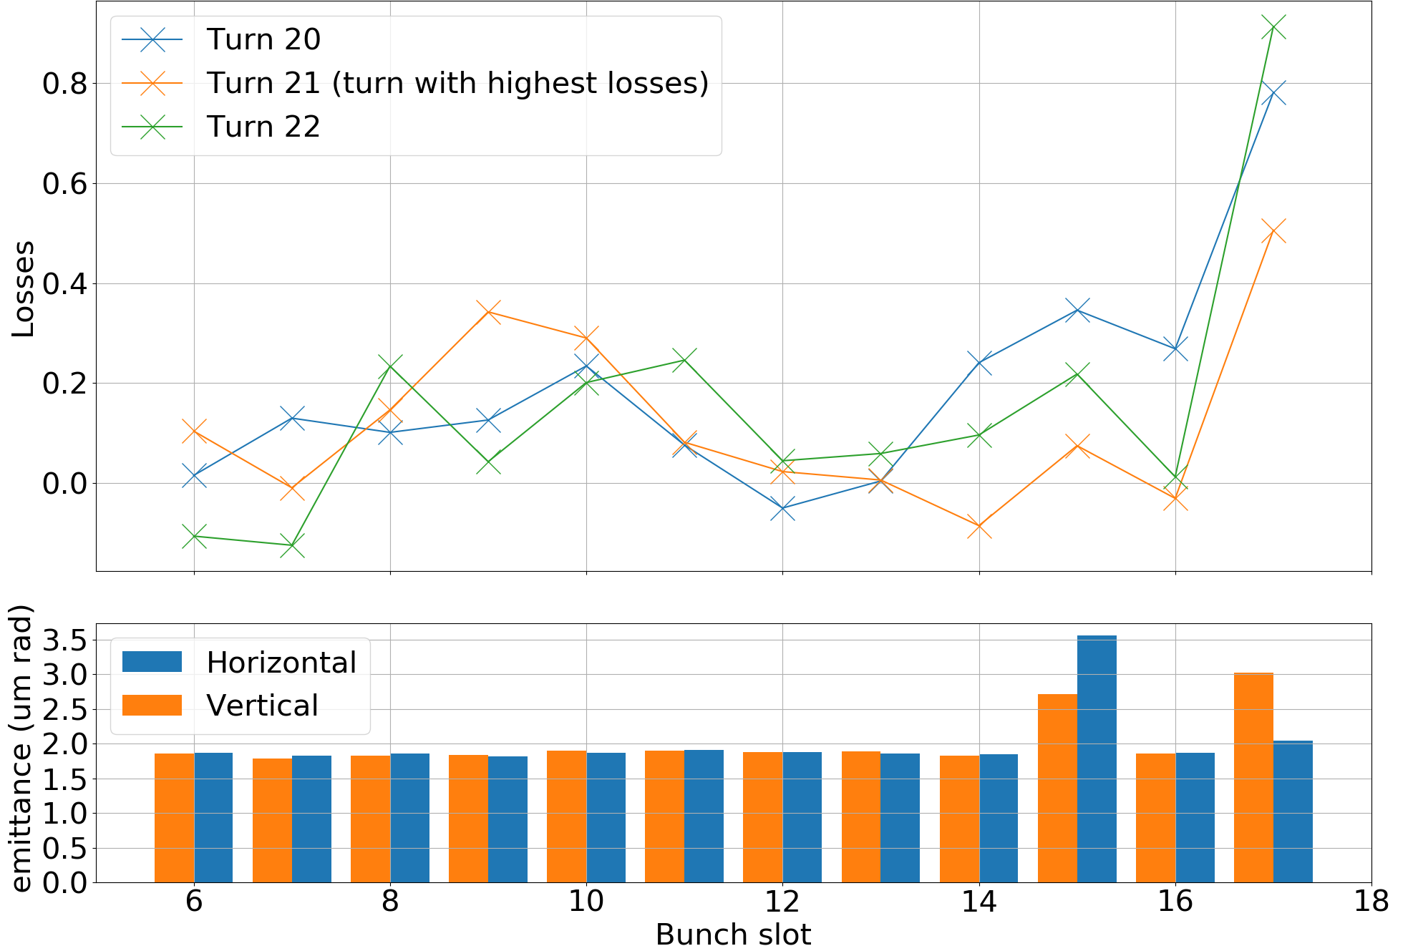
Event 17/10 23:53:50: Bunch-by-bunch losses normalised to intensity
1e-8
Horizontal
Vertical
M. Väänänen
13

Slide 14
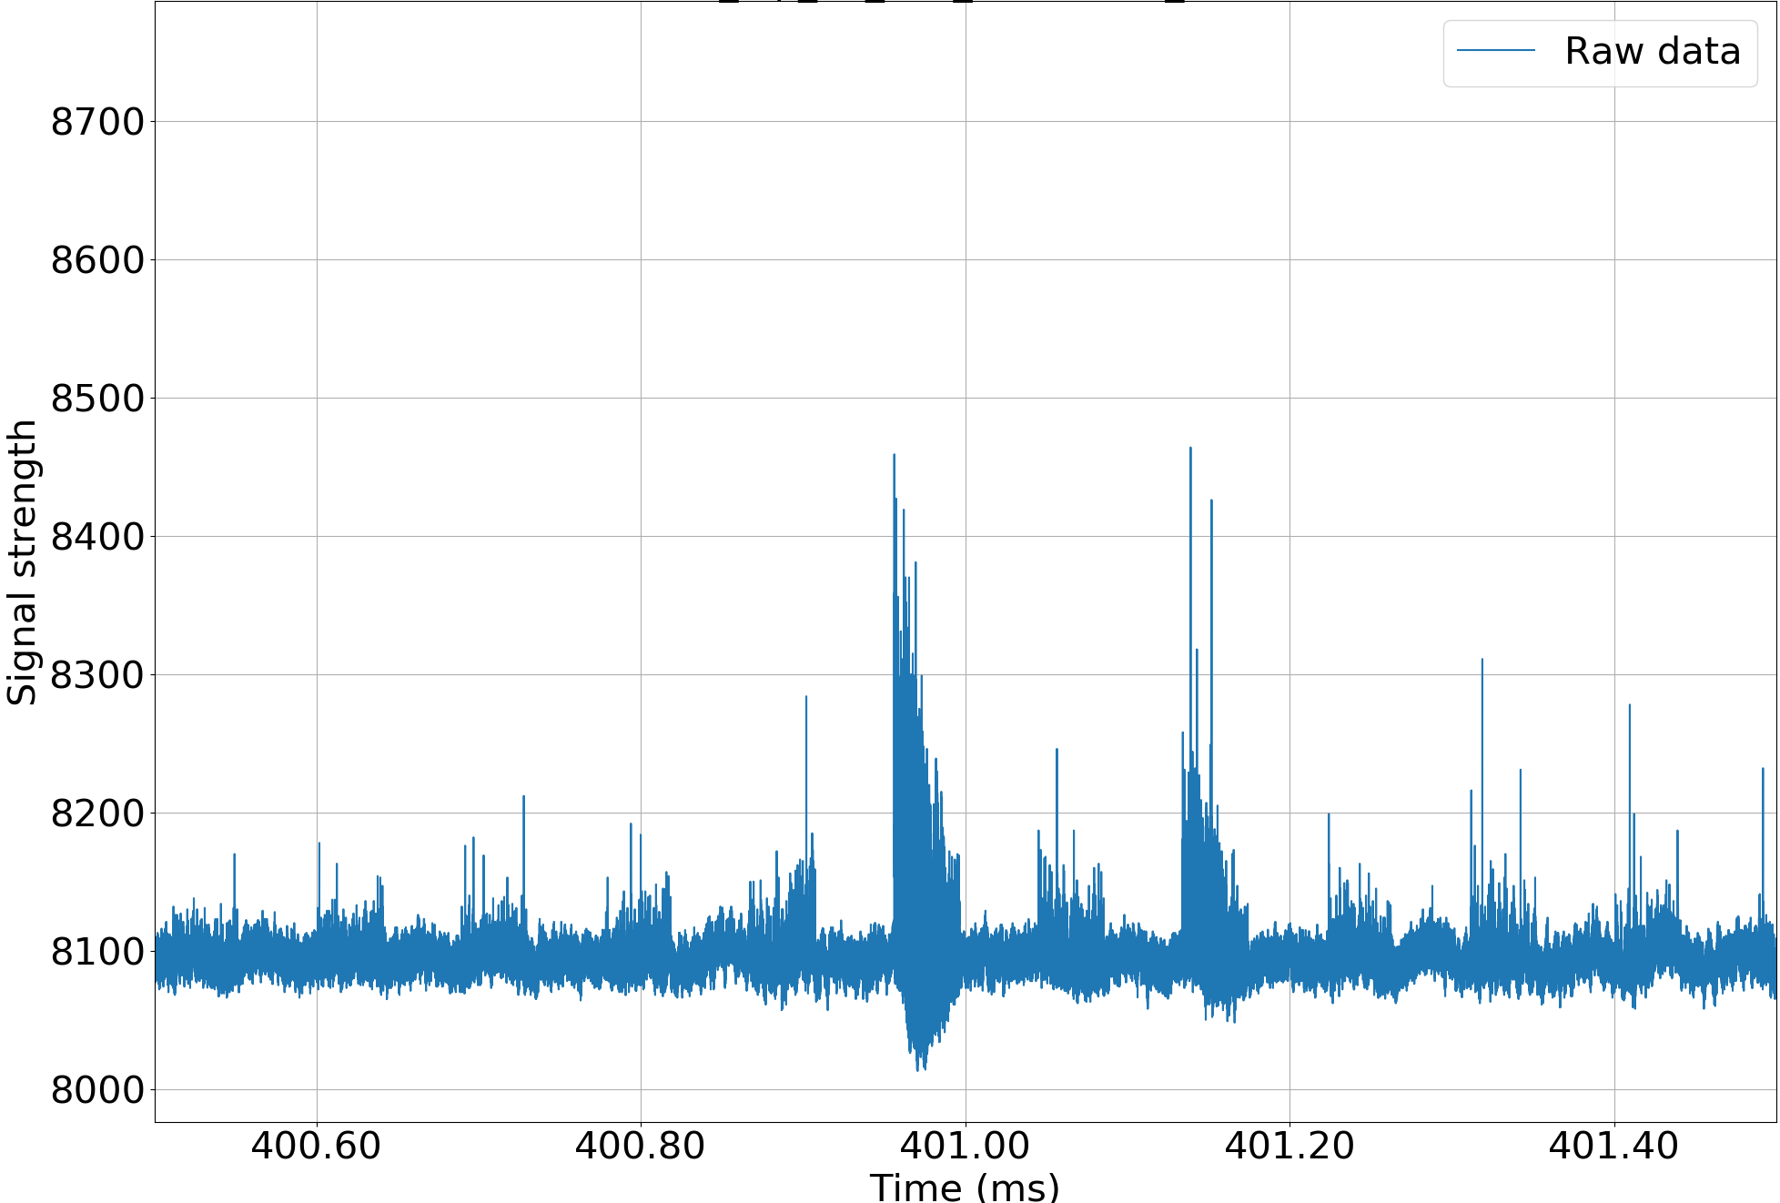
16L2 event (TCP, 6.5 TeV): raw waveform – full event
0.2 ms (2 turns)
M. Väänänen
14

Slide 15
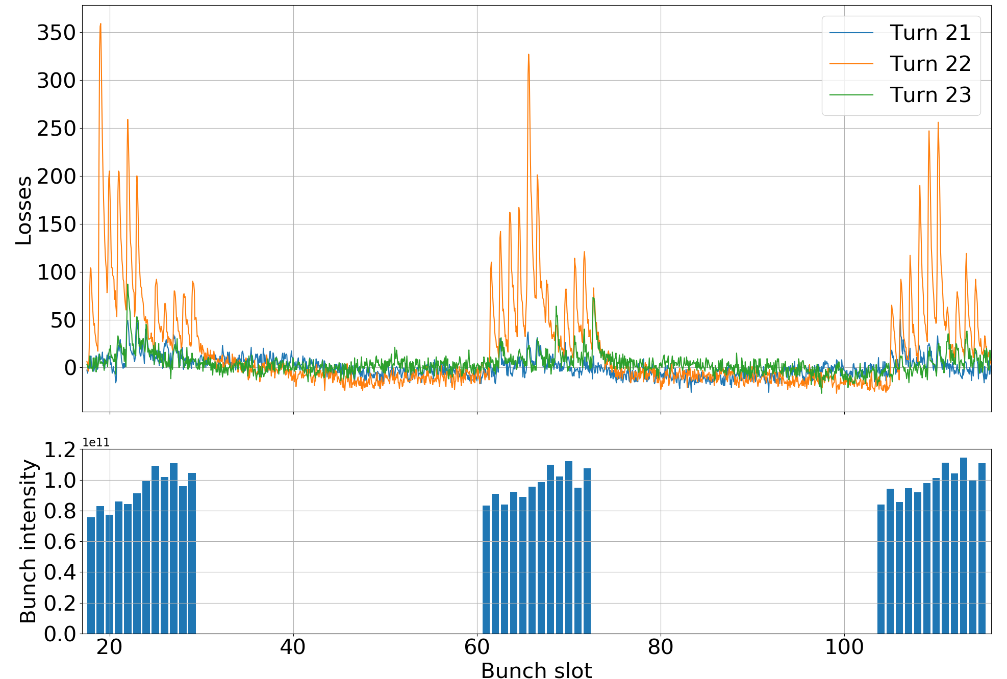
16L2 event: bunch-by-bunch losses (3 x 12b trains)
1e11
M. Väänänen
15

Slide 16
Preliminary Conclusions
Successfully used blown-up bunches in all normal proton physics fills without issues and triggered dBLMs on UFOs
Observed UFO losses in horizontally and vertically blown-up bunches → indicates that movement is in both planes, to be confirmed by further simulation studies
Blown-up bunches in combination with dBLMs and the new read-out electronics (VFC) are good tools to study UFO events
  Sensitivity of method is closely correlated to number of blown-up bunches & emittance → careful statistical analysis together with simulations (on-going)
  Biasing on UFO detection during ramp to be understood
Detailed analysis ongoing
Optimized system should be available for restart after LS2 to confirm conclusions → higher expected UFO rates
M. Väänänen
16

