Slide 2
Balancing projects and operations in IT/CS
Gyorgy Balazs
David Gutierrez
04.12.2018

Slide 3
NOC Structure
CERN Users
On-site
Outsourcing
Service Desk
Standard incidents
and user support
Network 2nd line Support
(IT 2nd line contract)
Field Technicians
(Firstline/Wigner)
CERN accelerator and
experiment
control rooms
Network and Telecom
Operations
(Netcom)
Computer Centre
Operator (24/7)
Service Monitoring
And advanced support
Advanced incident
and problem management
Network & software experts
(CE/DO/CT)
Telecom experts
(TR)
External support and collaboration
External Entities
(Vendors, CIXP, LHCOPN...)
External Entities
(Vendors, Telecom operators…

Slide 4
Projects vs Operations
CERN Users (eg. Experiments)
Service Desk
Operations Standard requests
Small deployments
Network 2nd line Support
(IT 2nd line contract)
Network and Telecom Operations
(Netcom in DO)
Network & software experts
(CE,CT)
Deployment specialists
(DO)
Telecom experts
(TR)
Projects, advanced requests
Large deployments
Group management

Slide 5
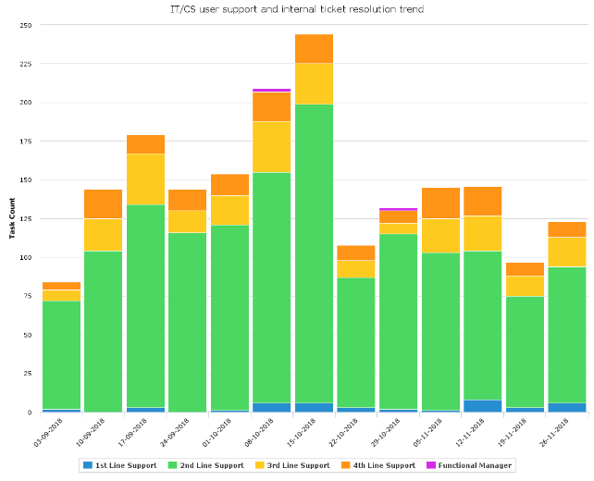
Request resolution rate by support level

Slide 6
Projects vs Operations
Netcom in DO
Operations
Small infrastructure extensions
Basic vendor cases (hw failure)
Deployment specialists in DO
Internal and external network installation projects
Client relation, select and adapt standard solution, plan and deploy, financials
Within the team specialists for
  experiments (advanced infrastructures)
  accelerators (much coordination needed)
Engineering teams (CE, TR, CT)
Develop standard solutions (hardware, protocols, configuration)
Overall network design
Software to manage infrastructure and configuration (CT)
Automate configuration (CE)
Telecom relies more on manual configuration (TR)
Higher level support

