Slide 2
CERN Networks
Automation
IT-CS Marwan Khelif

Slide 4
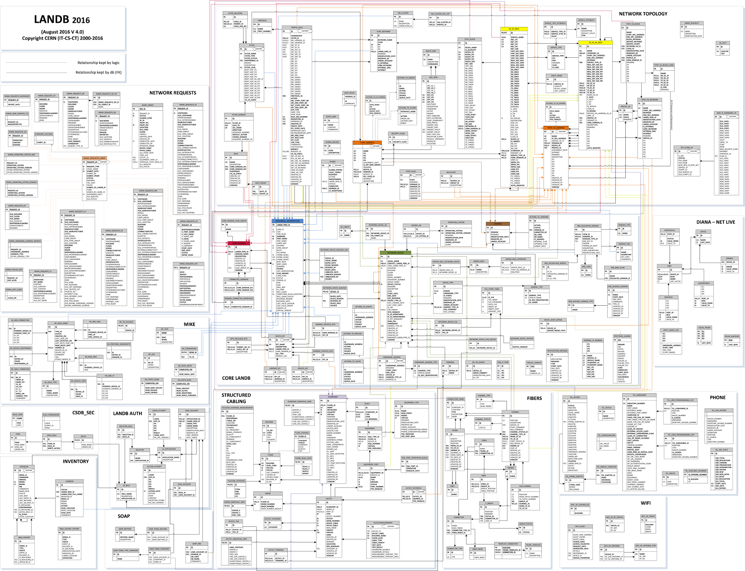

Slide 5
LANDB
20+ years old Oracle database
Covers many aspects of Communication Systems:
  IPAM / DNS / DHCP
  Network Topology
  Network devices
  Firewall
  Structured cabling
  Telephony
  Security

Slide 6
LANDB
Multiple applications:
  CSDBweb (Web) – Network administrators
  LanDB Portal / WebReq (Web) – End-users
  SOAP API (Web) – Specific services and users (experiments)
  CFMGR (CLI) – Configuration management
Large variety of languages:
  Java
  PL/SQL
  Perl
  Python

Slide 7
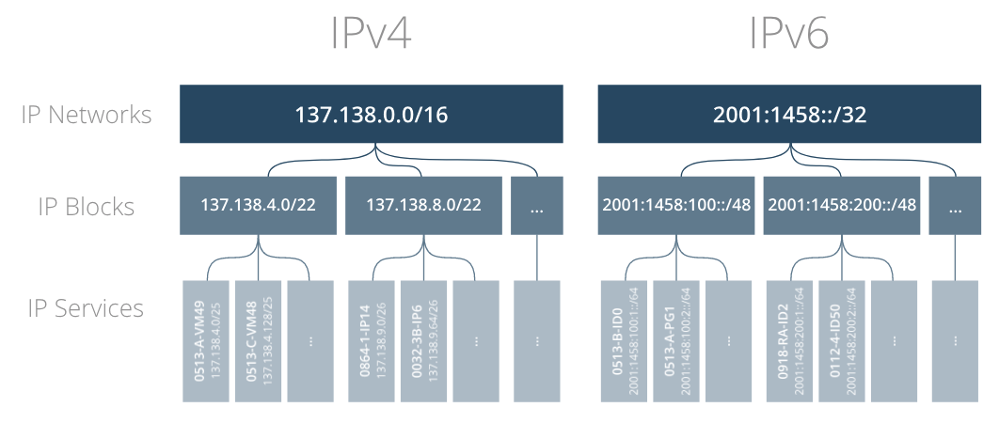
IPAM

Slide 8
IPAM – IP Blocks
Assigned to Network Domains (GPN, TN, ITS, LCG, …) interconnected by Gates (router interfaces with ACLs)
Provide same configuration for all IP services – Gateway / DNS / NTS

Slide 9
IPAM – IP Services
IP Services = Subnets
Type of service defines configuration properties (MTU, IP 4/6 stack, MPLS, OSPF, …)
Support both dynamic/static addressing (campus)

Slide 10
DHCP
Dynamic addressing by default (Campus)
  Static addressing on users’ request
  Public/internal IP address assignment (IP service)
Static addressing required for TN
Pool of IP addresses for unregistered devices

Slide 11
DNS
Static configuration for main .CERN.CH zone
  Generated every 5min from LANDB
Dynamic zones delegated to users
  Eg: nodes load-balancing service, experiments
  Specific zone .DYNDNS.CERN.CH for “dynamic” devices (updated from DHCP)

Slide 13
Plans
DNS
  Decrease time required to generate configuration (go to dynamic?)
DHCP
  Allow user to choose public/internal dynamic addressing
Standardise applications
  Standard protocol: NETCONF
  Languages: Java + Python
  OpenSource?

