Slide 2
Wi-Fi Service Enhancement at CERN
Project overview
Adam SOSNOWSKI
adam.sosnowski@cern.ch
Vincent DUCRET
Vincent.ducret@cern.ch

Slide 3
Agenda
Initial situation (before 2016)
WiSE project
Global project timeline
Pre-deployment site preparation
Tender process & Technical evaluation
Final technical setup overview
Deployment process & Communication with users
Project management
Problems and challenges
Next steps

Slide 4
Initial situation (before 2016)
Wi-Fi service was provided in conference/meeting rooms and few buildings
No possibility of roaming between buildings, nor often between floors in a single building
No guest Wi-Fi
Autonomous access-point configured independently of each others
Power/frequency setting done manually
Not scalable for global campus deployment

Slide 5
WiSE Project
= Wi-Fi Service Enhancement project
Goals of the project, launched in 2015:
  Provide high quality Wi-Fi coverage in all office buildings and public areas across the CERN campus (~200 buildings)
  Ensure seamless roaming within the Wi-Fi coverage area
  Support the latest available Wi-Fi standard 802.11ac
  Provide additional services such as Wi-Fi for visitors

Slide 6


Global project timeline
Wi-Fi Planning and Validation
RF Simulation + Site survey
to validate the AP positions
Outdoor deployment
Cabling of the Buildings
First activated building
2017
2018
2016
2015
Market Survey
Technical Evaluation
Pilot implementation
3 buildings, including a restaurant
New Wi-Fi infrastructure deployed
Guest Wi-Fi pilot
Global deployment
New AP installation
Post deployment Site surveys
Tender Process

Slide 7
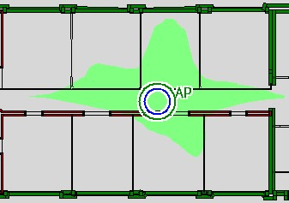
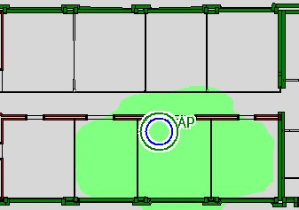
Pre-deployment site preparation
Install the access-points where the users are located
Minimize the cell size to provide a better signal quality
before 2016 after 2016
1 Access-point per 3 offices on average, installed inside the office
1 new outlet per office for future proof (Cat6A cabling)

Slide 8
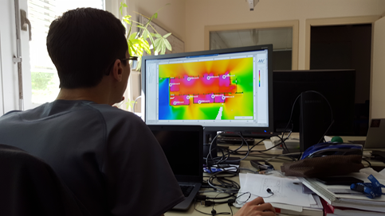
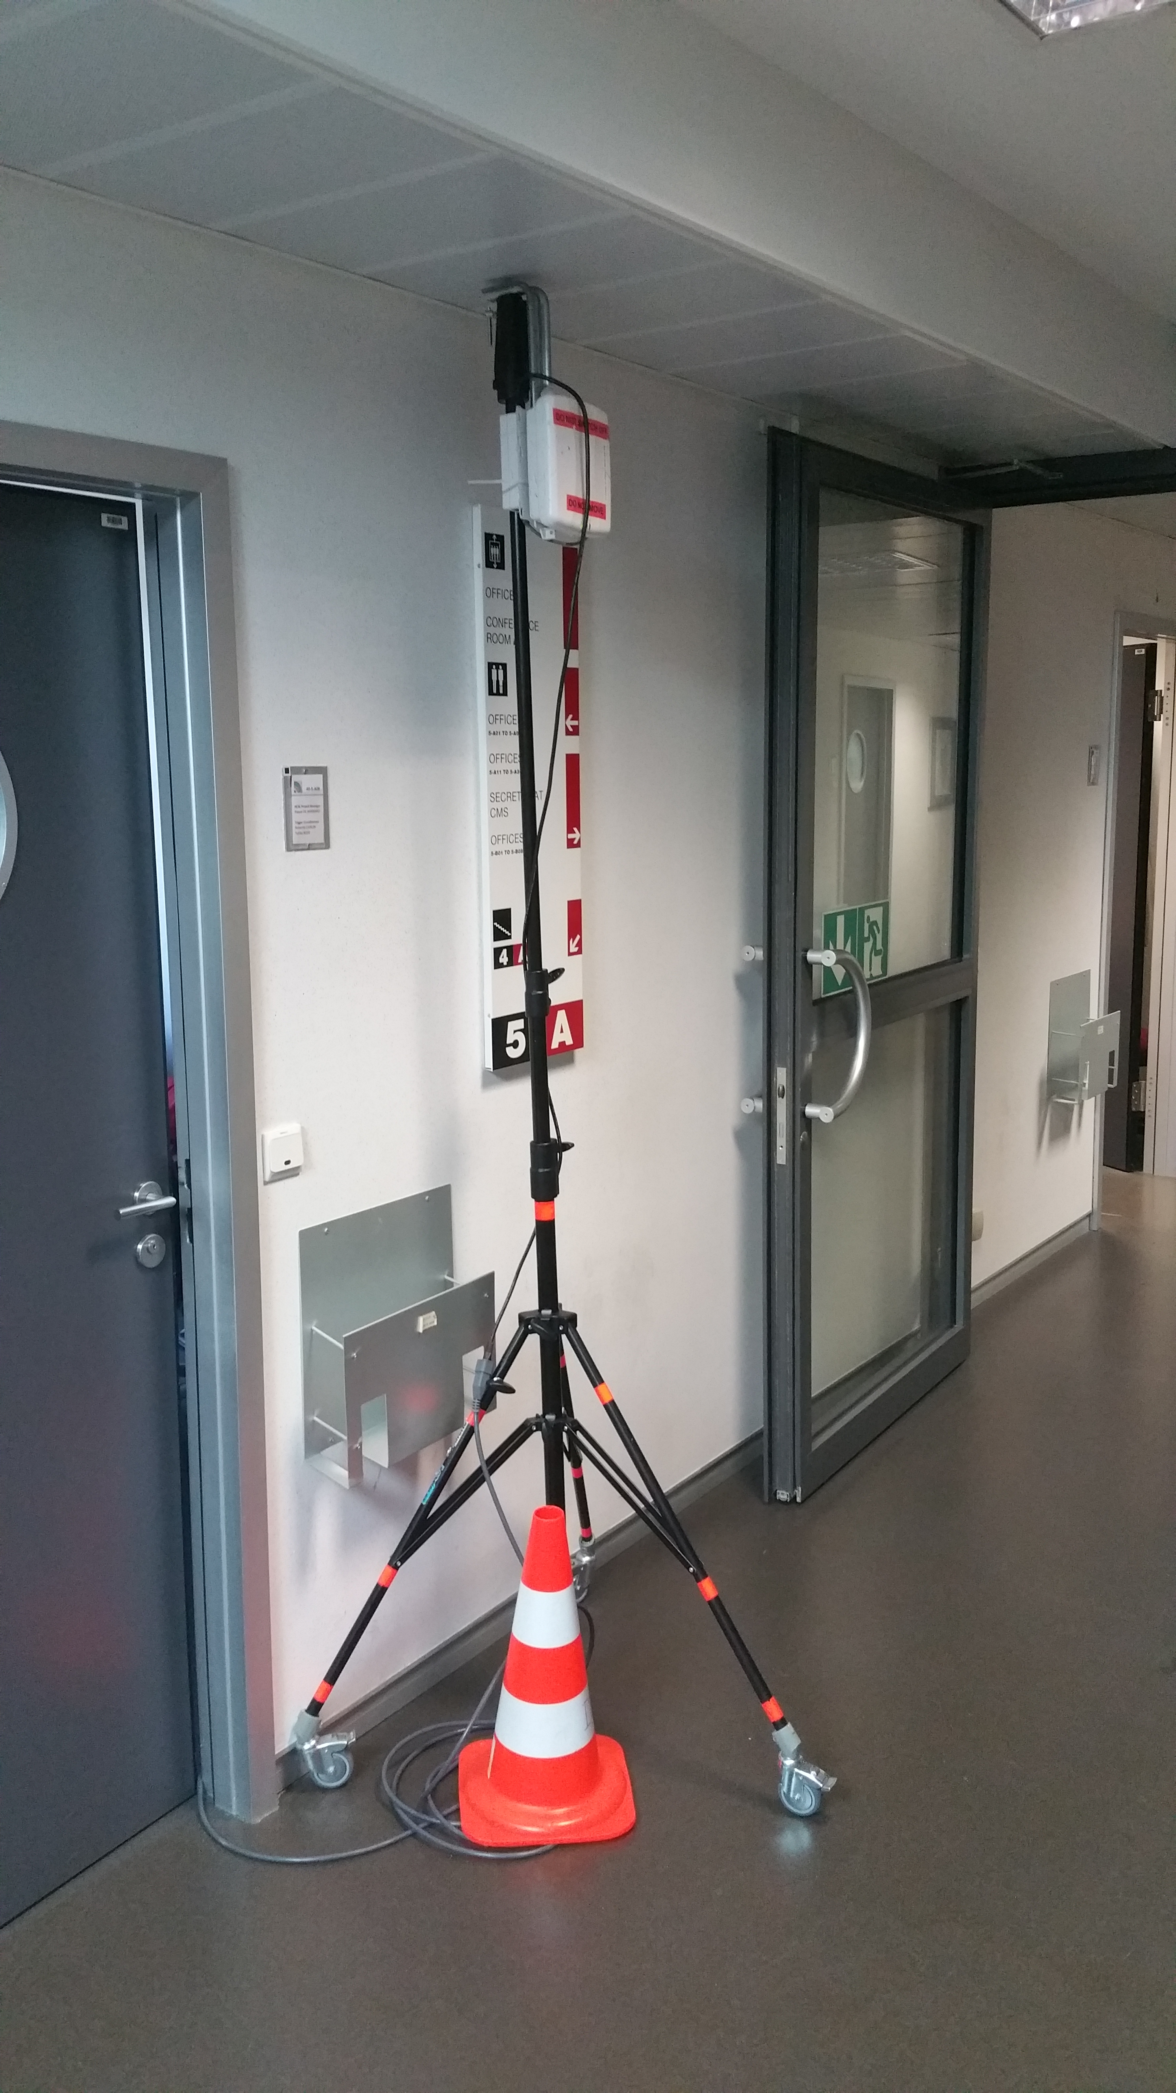
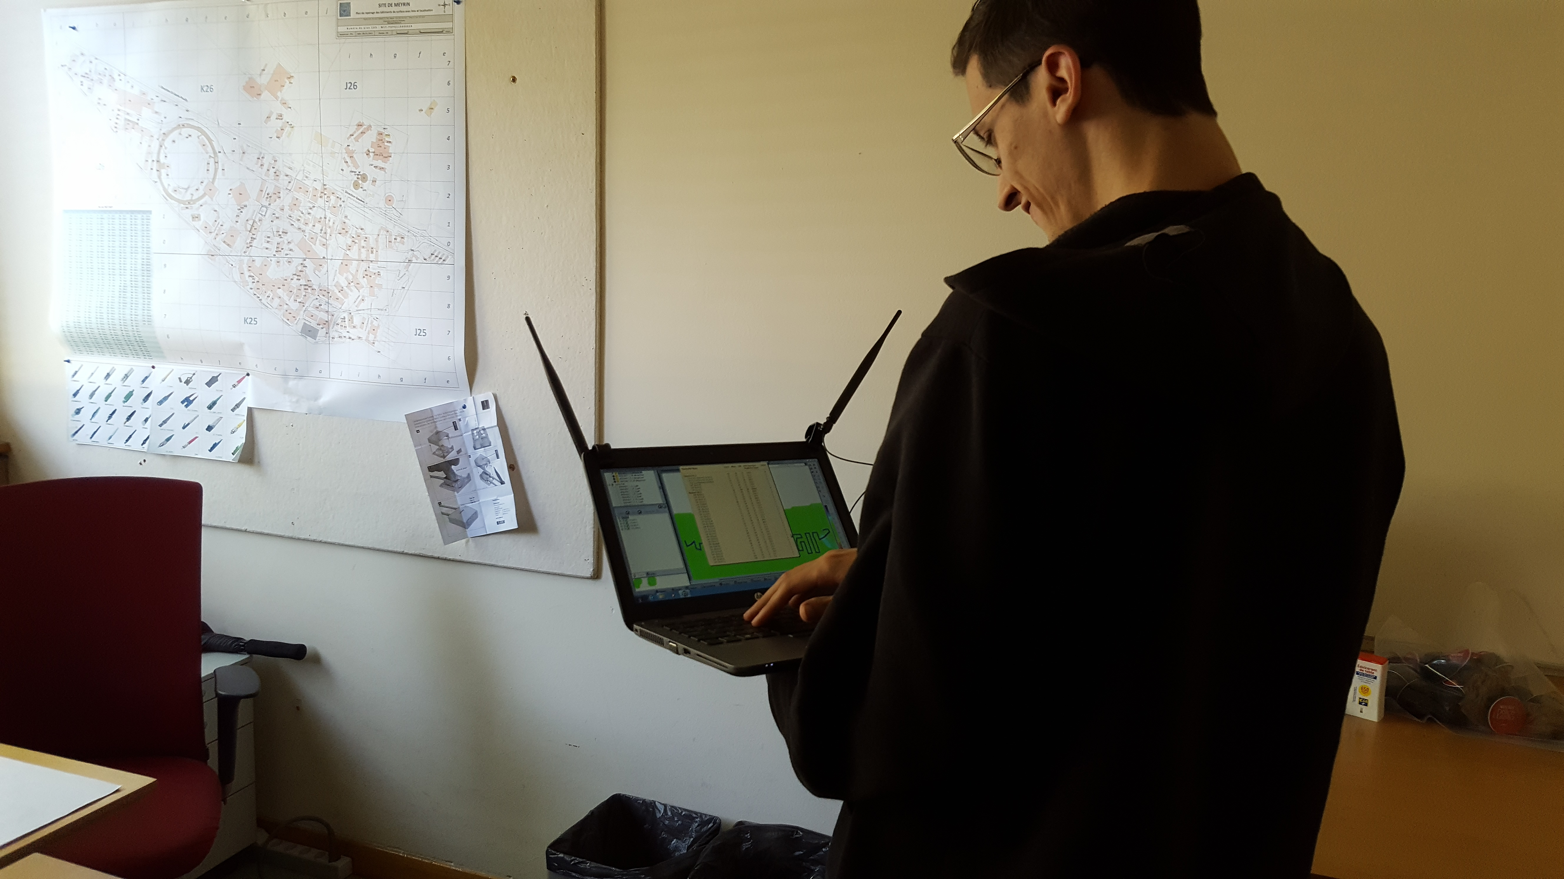
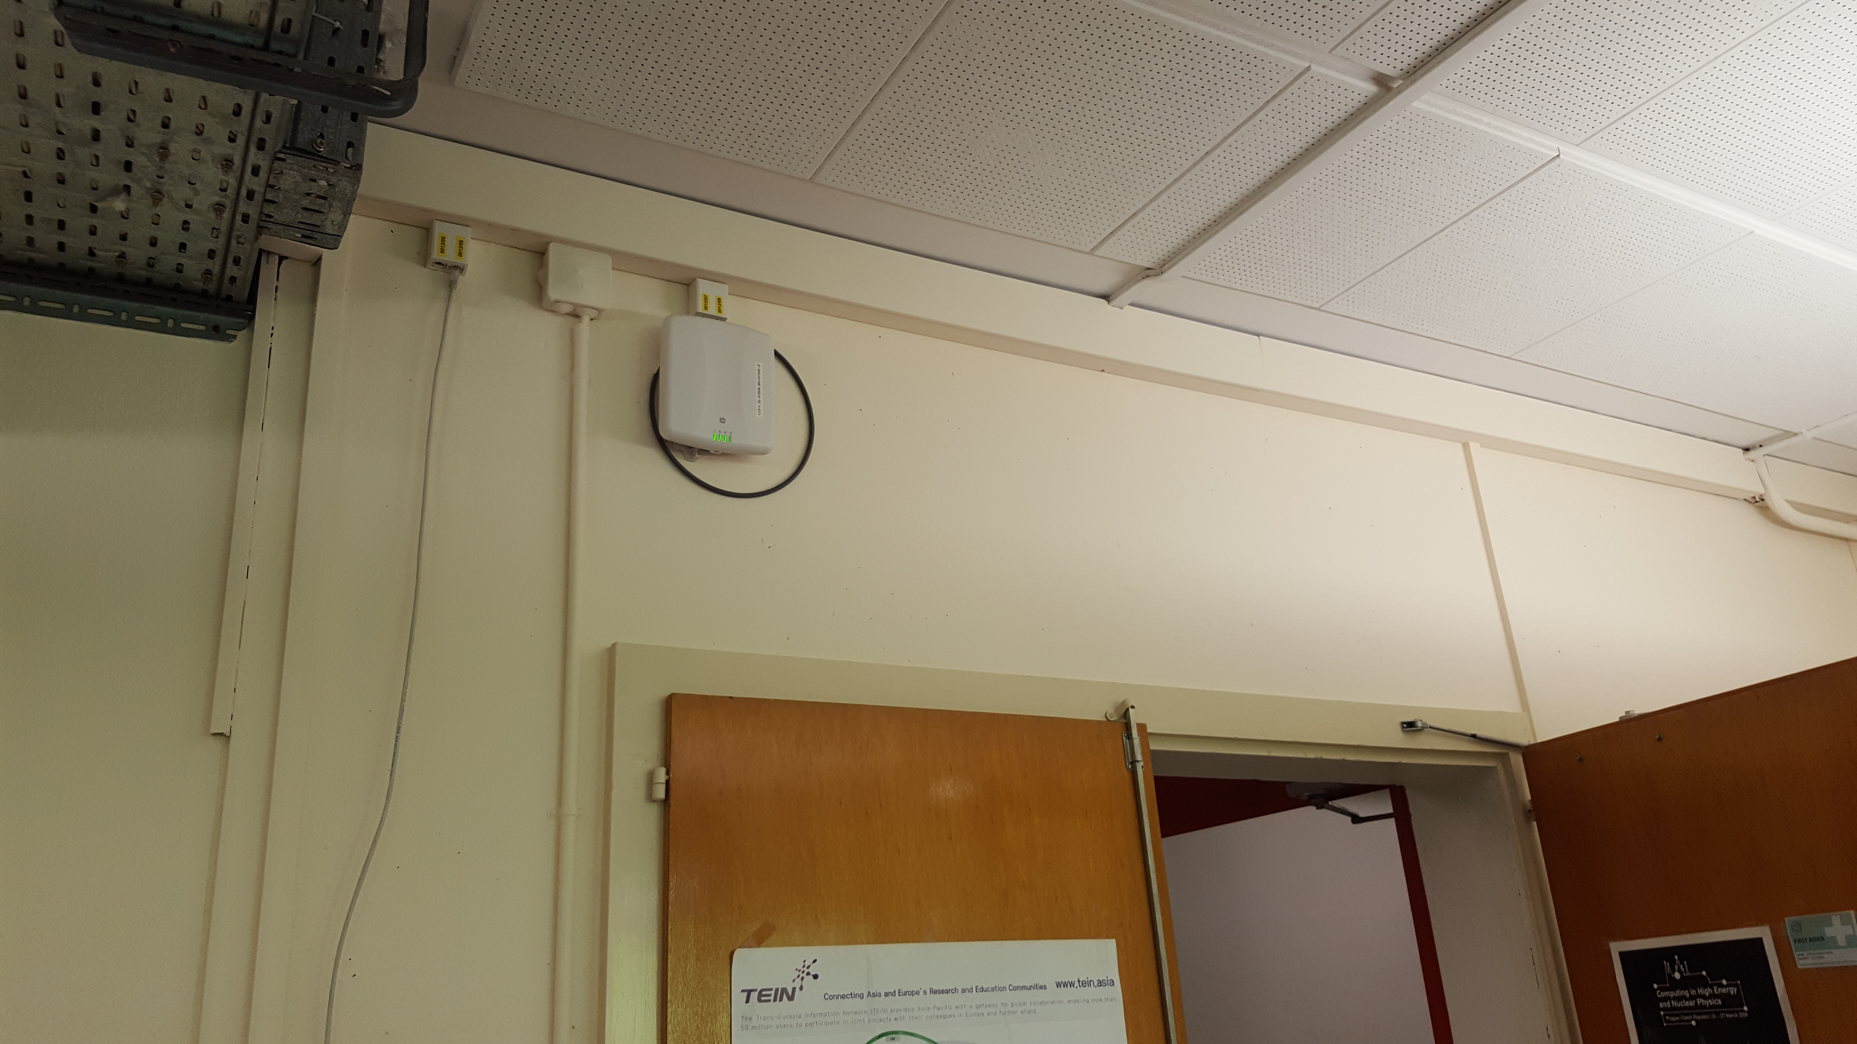
Pre-deployment site preparation
For each building:
RF simulation to estimate the AP position
Site Survey to validate the deployment plan
Cabling (new outlets)

Slide 9
Tender process
Tender process
  Five vendors contacted
  Three replied
  One bid was rejected based on the documents (technically not compliant)
  Equipment from two bidders were tested
Technical evaluation
  Trial devices, similar to the ones proposed in the bid
  Two months of tests
  Dedicated building (226)

Slide 10
Technical evaluation
Test setup in a dedicated building
Detailed test book
Ixia Wifi client generator (rented)
Test overall behaviour + possible integration with our own tools

Slide 11
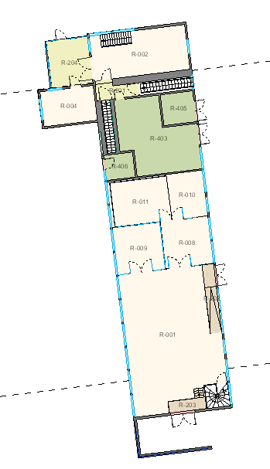
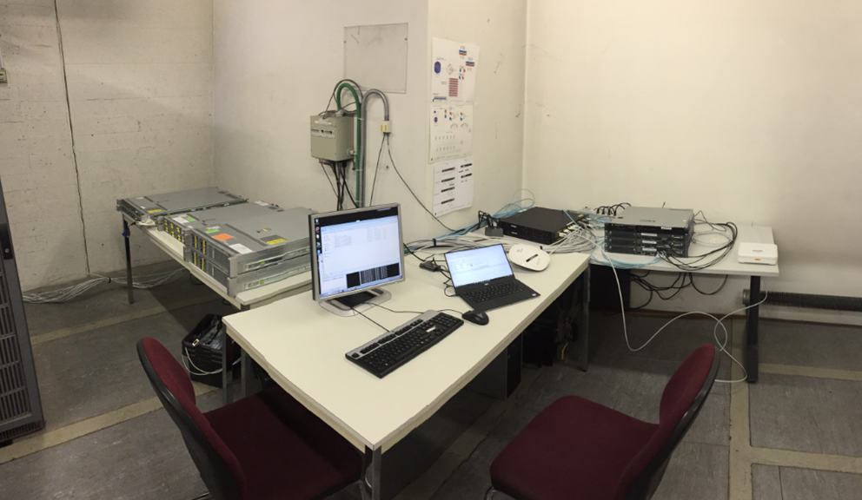
Test environment
Controllers
Routers, switches and connection to GPN
Iperf/FTP server
Access-Point

Slide 12
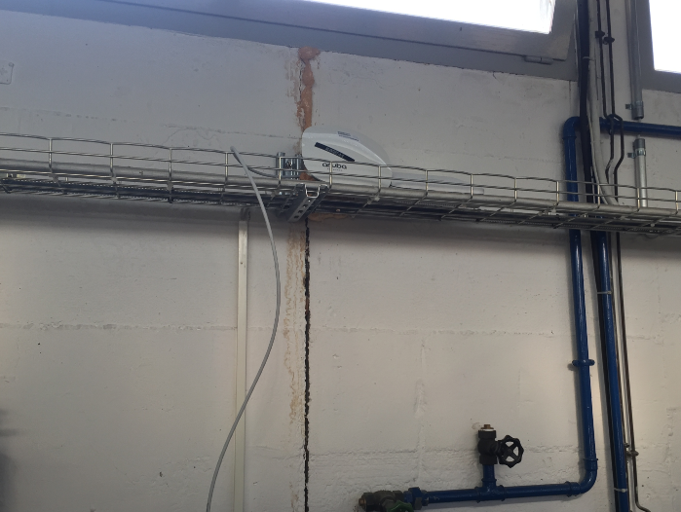
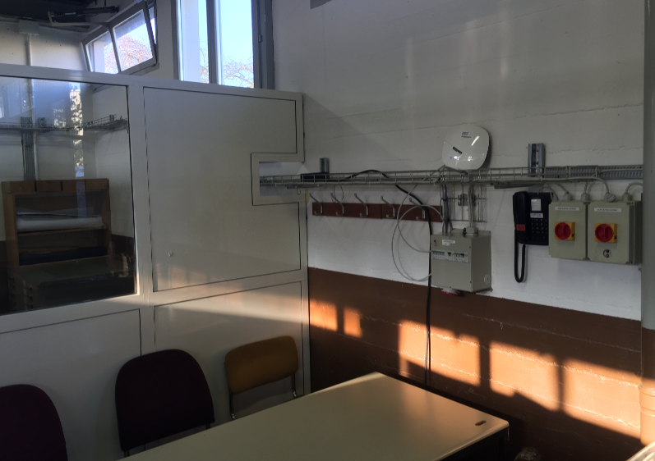
Test environment
Several Access-Points

Slide 13
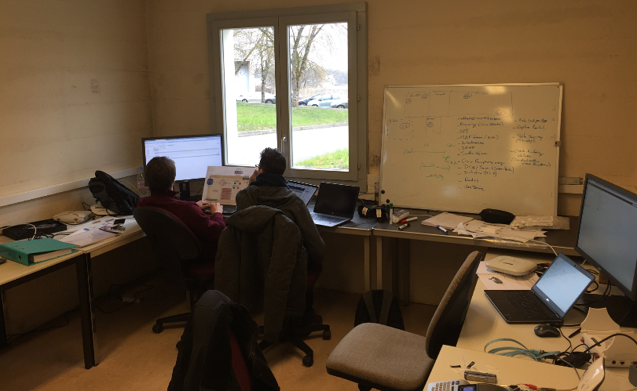
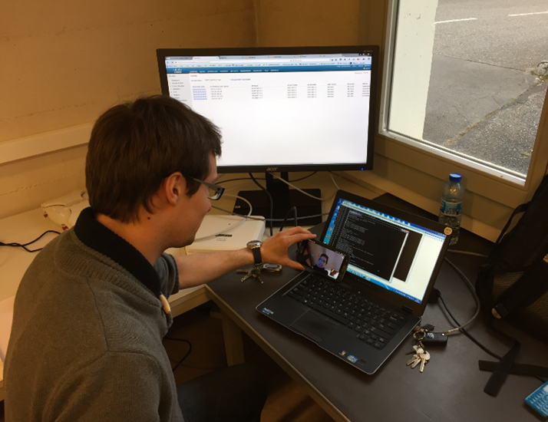
Test environment
“Office”
Access-Points

Slide 14
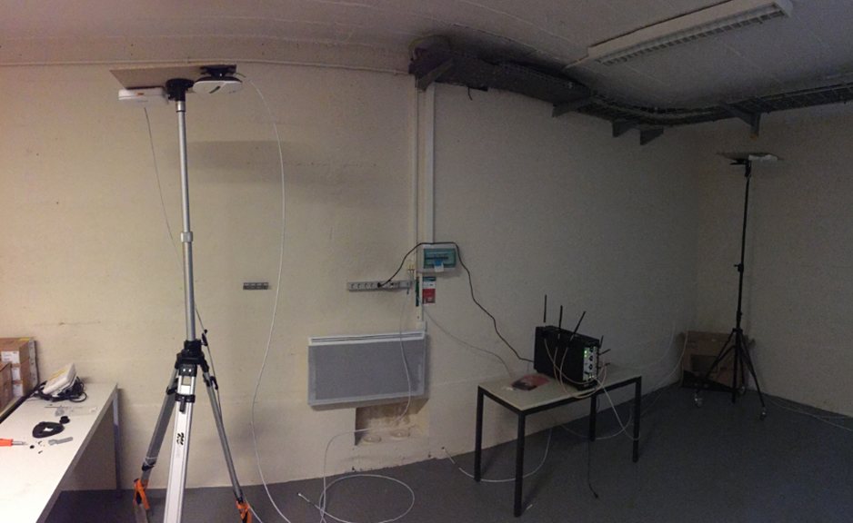
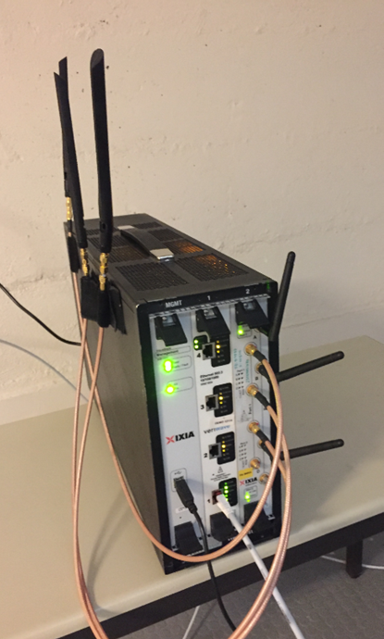
Test environment
Ixia tests (in the basement)

Slide 15

Final technical setup overview
Tender winner:
Aruba controller-based solution
  Traffic centralisation for seamless roaming
  Configuration centralisation
  Scalability and redundancy
  Radio Frequency settings automation
  Configuration automation using API

Slide 16
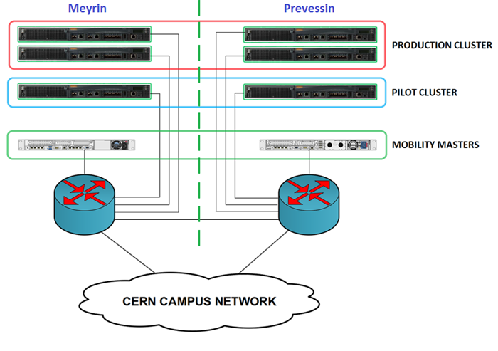
Final technical setup overview

Slide 17

Final technical setup overview
Configuration automation:
  Based on the API available on the Mobility Master
  Simplifies deployment process
LANDB
CFMGR
NETMGR
MM

Slide 18

Deployment process
Preparation to RF simulation
RF simulation
Pre-deployment RF Survey
Starpoint review
FirstLine (EMTE)
CS-CE
CS-CE
FirstLine (EMTE)
CS-DO
CS-DO
FirstLine (EMTE)
CS-DO
CS-CE CS-DO
FirstLine (EMTE)
CS-CE/DO
EMTE
CS-DO
Post-deployment RF Survey
AP set up
Switch installation & set up
AP Deployment
Cabling

Slide 19
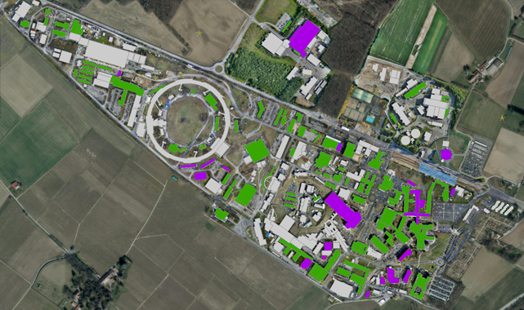
Communication with users
Activated buildings
Buildings to be equipped with APs

Slide 20
Project management
Example of Project report

Slide 21
Problems and challenges
Planning and communication challenges
  Explain the disturbance to the end user (cabling inside the building, etc…)
  Scheduling and synchronizing all the works
Technical challenges
  New version = bugs
  Internally developed tools adaptation
  Managing the network – software upgrades and monitoring
Others
  Aesthetics (removing old APs)
  Some concerns about RF and AP inside the offices

Slide 22
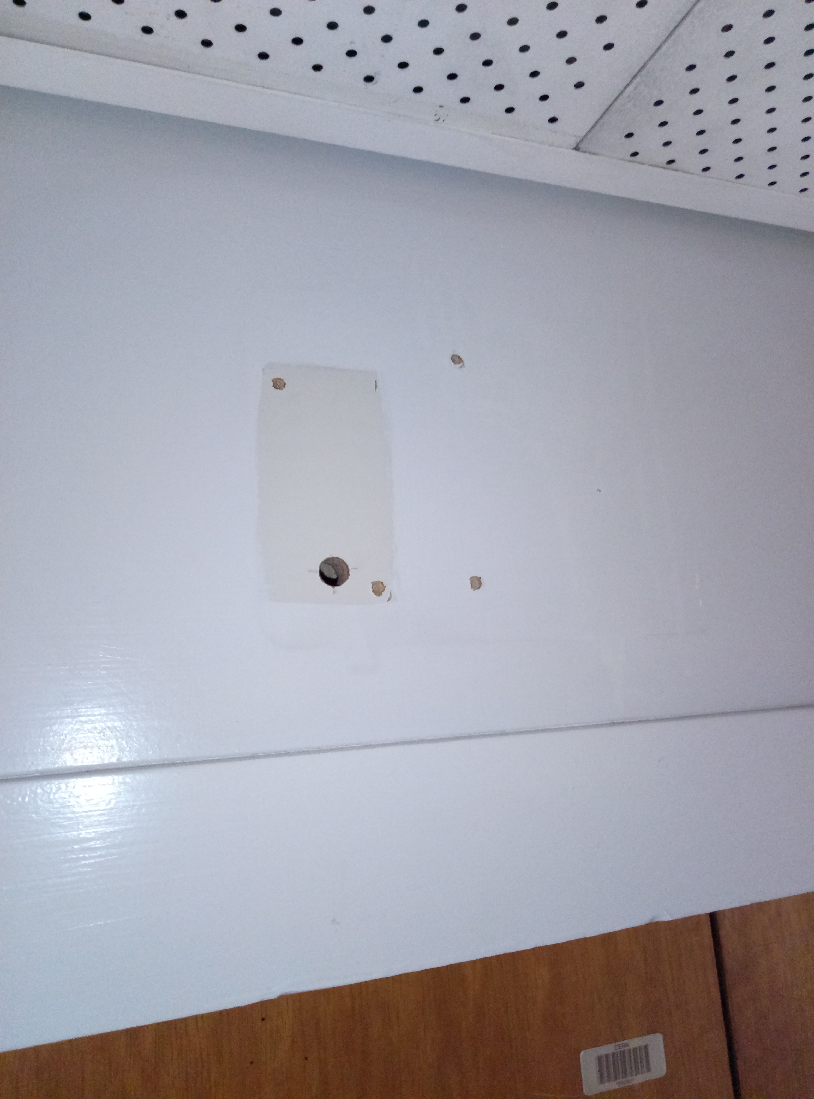
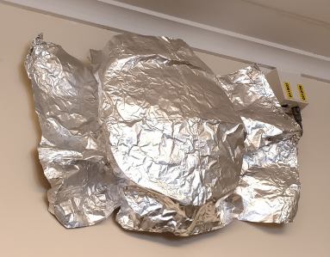
Problems and challenges
Planning and communication challenges
  Explain the disturbance to the end user (cabling inside the building, etc…)
  Scheduling and synchronizing all the works
Technical challenges
  New version = bugs
  Internally developed tools adaptation
Others
  Aesthetics (removing old APs)
  Some concerns about RF and AP inside the offices

Slide 23
Next steps
Finish deployment in Office area and Outdoor coverage
Prepare plan to replace old HP infrastructure and provide coverage in technical areas
Add controllers to the cluster to keep initial redundancy level (>4.000AP)
Upgrade security of the Wi-Fi networks to WPA3 (when it will be standardize)
Test and evaluation of new APs with ZigBee radio

Slide 24

Any questions?

