Slide 1
Proton beam measurements
Alexander Gorn, Vasyl Hafych

Slide 2
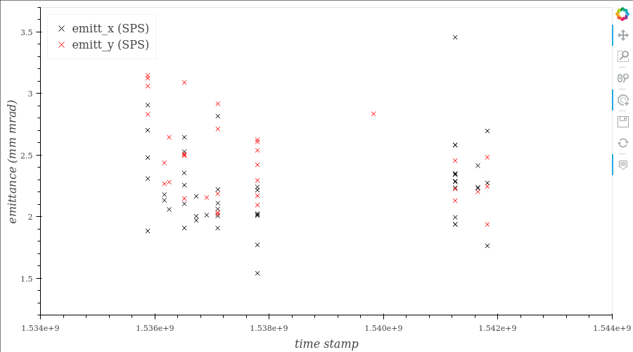
SPS measurements show significant fluctuations of the beam emittance

Slide 3
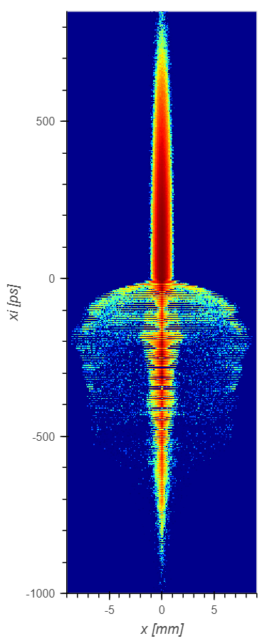
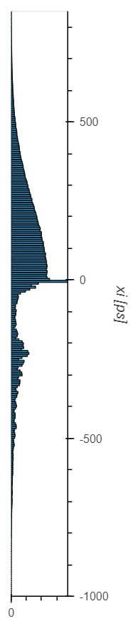
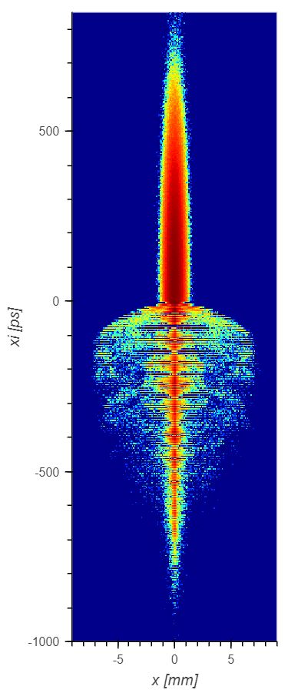
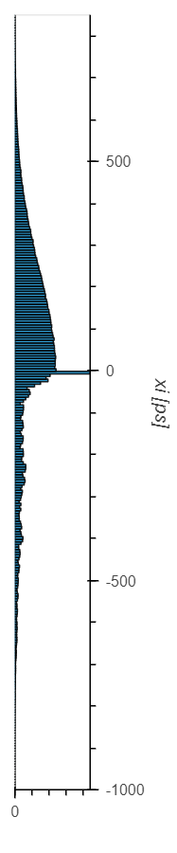
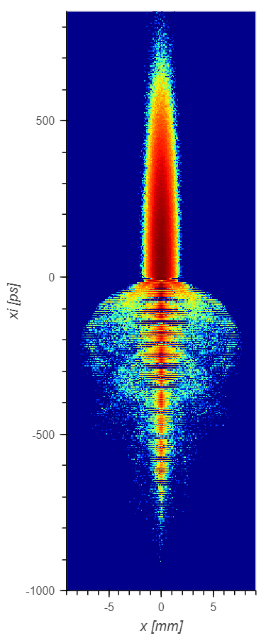
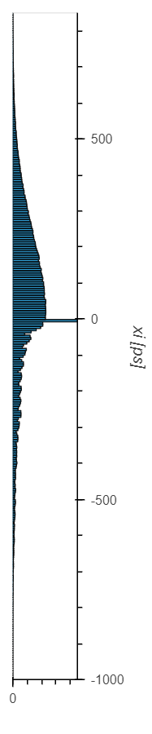









Result of simulations is sensitive to input beam size (emittance)
$$σ_{r}=100 μm$$
$$σ_{r}=150 μm$$
$$σ_{r}=200 μm$$
$(ε_{n}=1 mm⋅mrad)$
$$(ε_{n}=2 mm⋅mrad)$$
$$(ε_{n}=3.5 mm⋅mrad)$$
$$r_{max}=8.86 mm$$
$$r_{max}=7.74 mm$$
$$r_{max}=8.07 mm$$

Slide 4
Overview
Goal: Construct the model based on the proton beam measurements that predicts parameters of the bunch close to the plasma cell entrance. These parameters should further be used as input parameters for the simulations.
Strategy:
Measure transverse profiles of the proton bunch using BTVs
  Construct statistical model
  Test the model with MCMC
  Extract beam size directly from BTV images
  Construct simplified analytical model
Use calculated beam parameters for the simulations

Slide 5
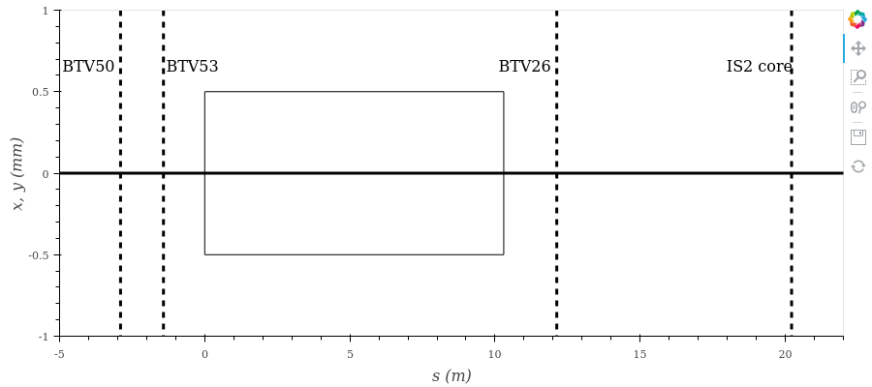
Measurements
BTV50
BTV53
BTV26
IS2: Core Camera
Data that has been collected:
- Set #1: Charge 3e11 [p], Bunch rotation ON (120 events).
- Set #2: Charge 3e11 [p], Bunch rotation OFF (120 events).
- Set #3: Charge 1e11 [p], Bunch rotation ON (120 events).
- Set #4: Charge 1e11 [p], Bunch rotation OFF (120 events).

Slide 6
Typical signal from BTVs

Slide 7
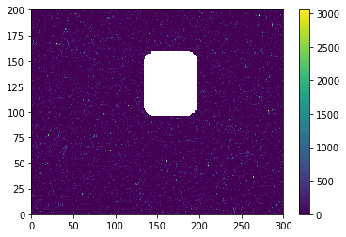
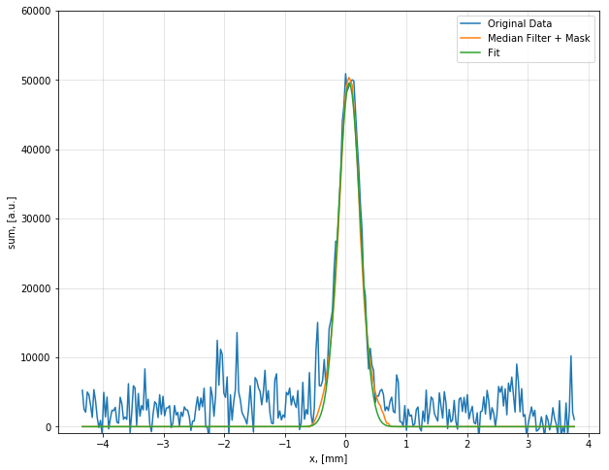
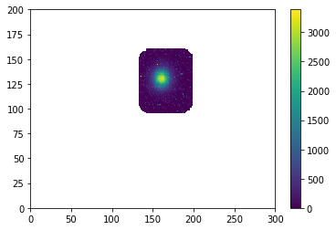
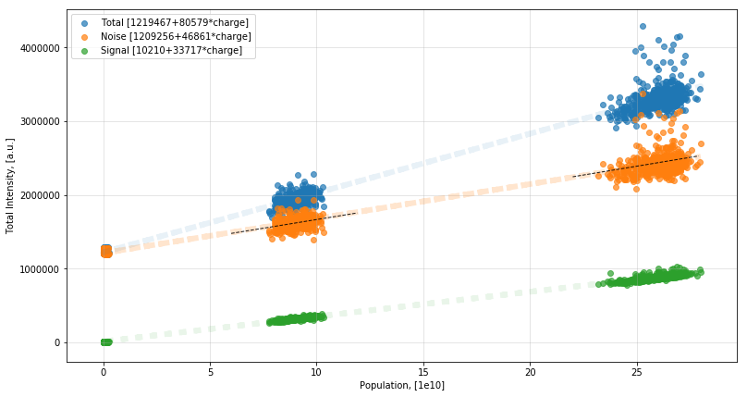
Image processing

Slide 8

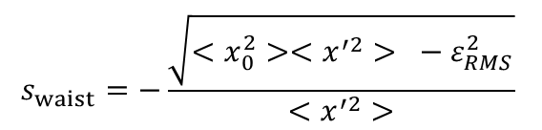



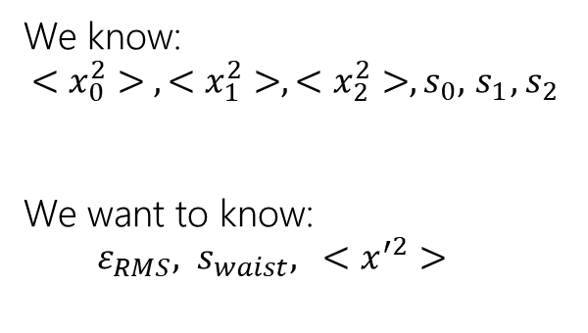
Beam dynamics in vacuum
Assume there are no forces acting on each proton:
$$x^{′′}=0$$
$$x^{′}=const$$
$$ε_{RMS}=\sqrt{<x^{2}><x^{′2}> − <xx^{′}>^{2}}=const$$
Square and average the law of motion to get formula for beam envelope:
$$x=x_{0}+x^{′}⋅s$$
$$<x^{2}> = <x_{0}^{2}>+2<x_{0}x^{′}>s+{<x^{′}}^{2}>s^{2}$$
Extracting $<x_{0}x^{′}>$ term from $ε_{RMS}$ define the waist position $s_{waist}$:
$$s_{waist}=−\frac{\sqrt{<x_{0}^{2}><x^{′2}> −{ ε}_{RMS}^{2}}}{<x^{′2}>}$$
$$<x^{2}> = <x_{0}^{2}> − 2s_{waist}<x^{′2}>s+{<x^{′}}^{2}>s^{2}$$
We know:
$$<x_{0}^{2}> , <x_{1}^{2}>, <x_{2}^{2}>, s_{0}, { s}_{1}, s_{2}$$
We want to know:
$ε_{RMS}, s_{waist}, <x^{′2}>$
$$<x_{0}^{2}> = <x_{0}^{2}>$$
$$<x_{1}^{2}> =<x_{0}^{2}> − 2s_{waist}<x^{′2}>s_{1}+{<x^{′}}^{2}>s_{1}^{2}$$
$$<x_{2}^{2}> =<x_{0}^{2}> − 2s_{waist}<x^{′2}>s_{2}+{<x^{′}}^{2}>s_{2}^{2}$$

Slide 9
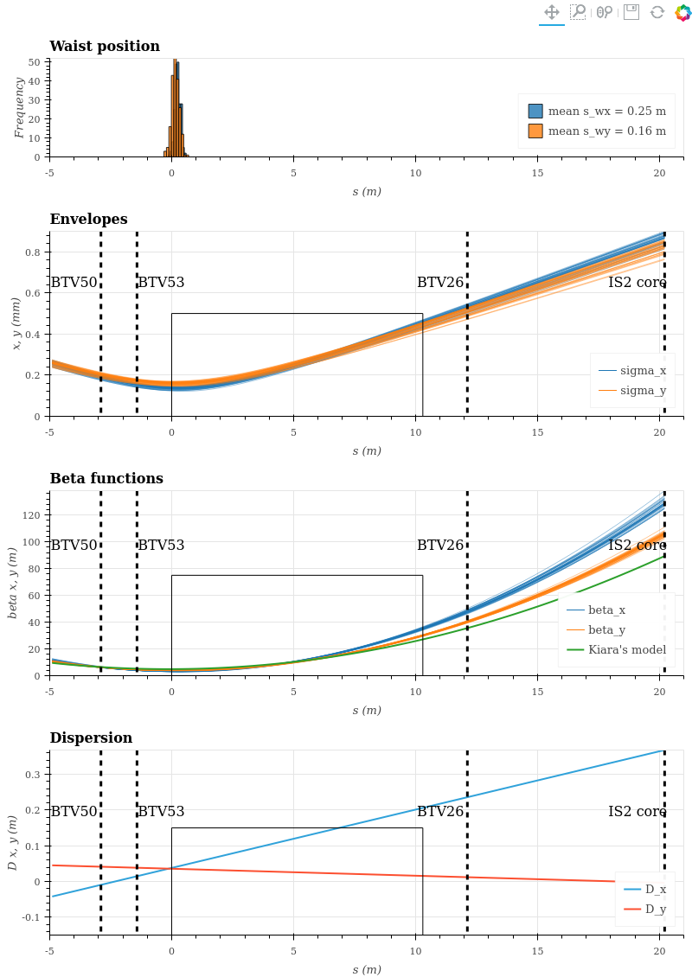
Set #1
(High charge)
Chiara’s

Slide 10
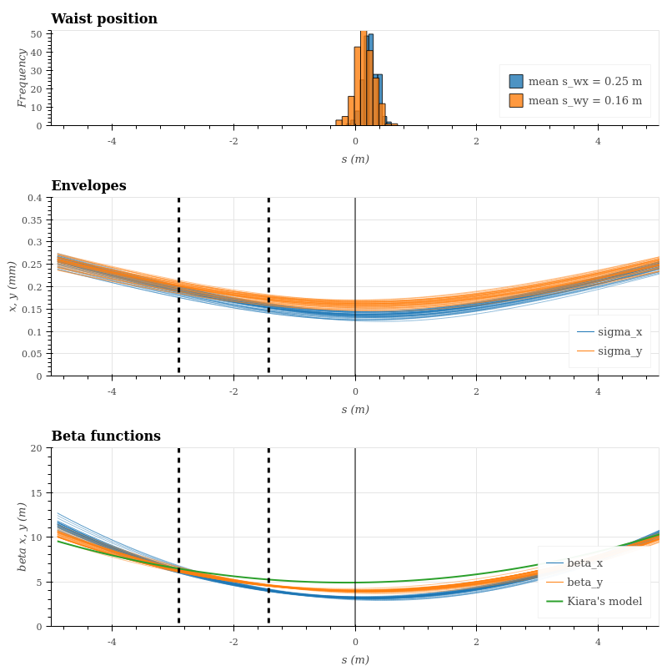
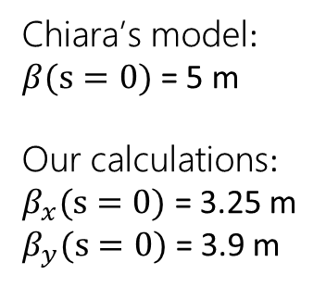

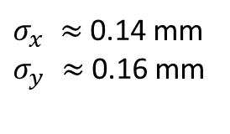
Near the iris:
$s_{waist}≈$0 $±$ 20 cm
$σ_{x} ≈$0.14 mm
$σ_{y} ≈$0.16 mm
Chiara’s model:
$β(s=0)$ = 5 m
Our calculations:
$β_{x}(s=0)$ = 3.25 m
$β_{y}(s=0)$ = 3.9 m
Chiara’s

Slide 11
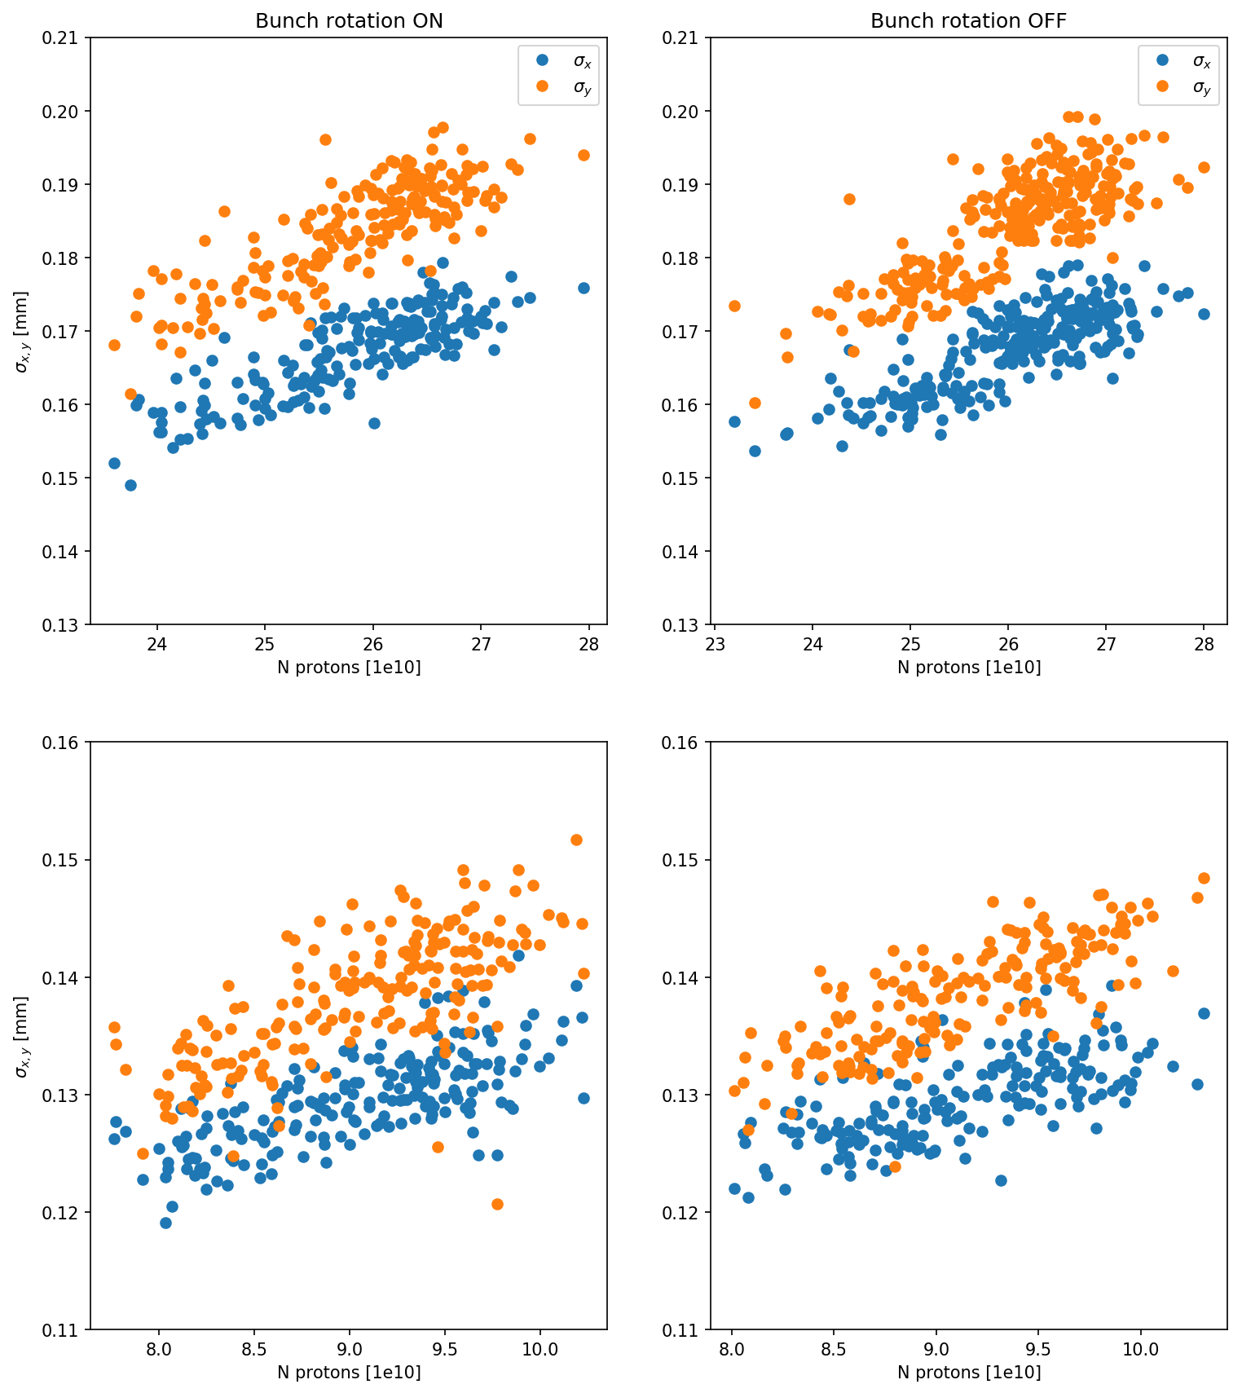
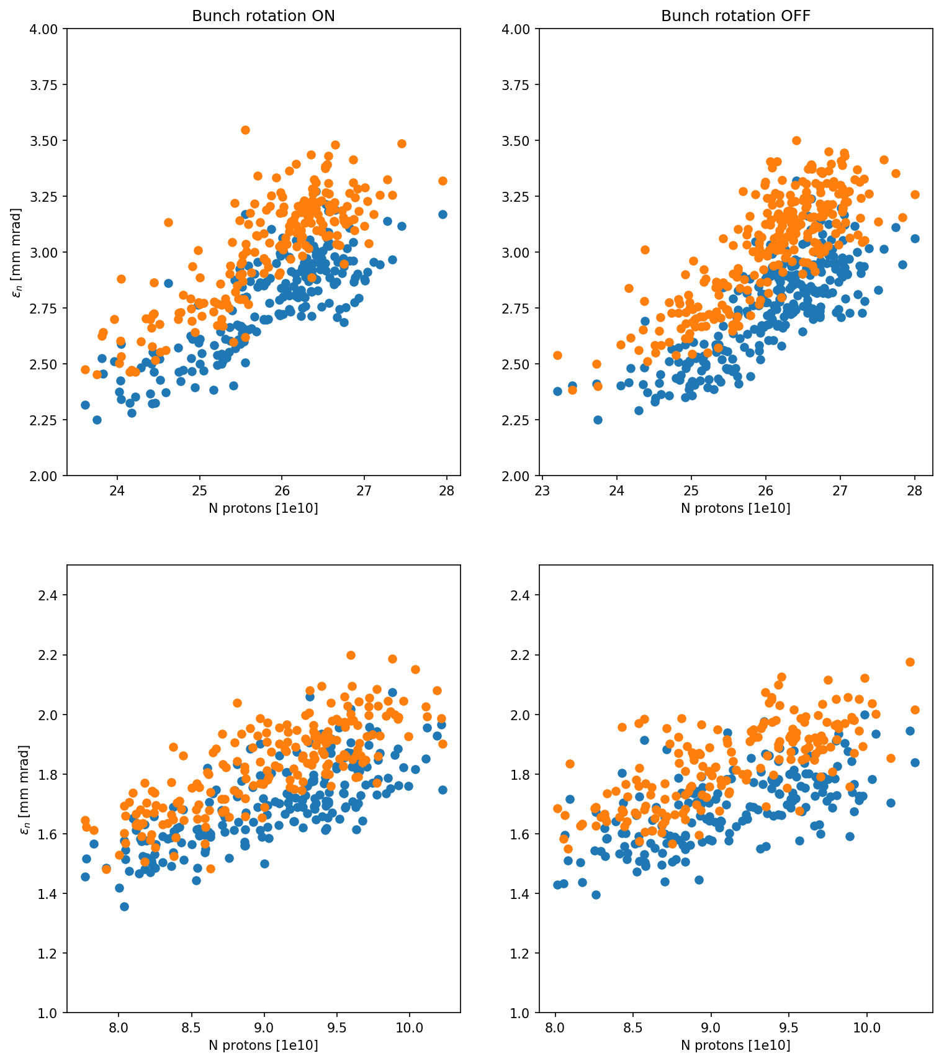
Beam sigma and emittance vs. population using data from BTV26
Sigma
Emittance
x – blue, y – orange

Slide 12
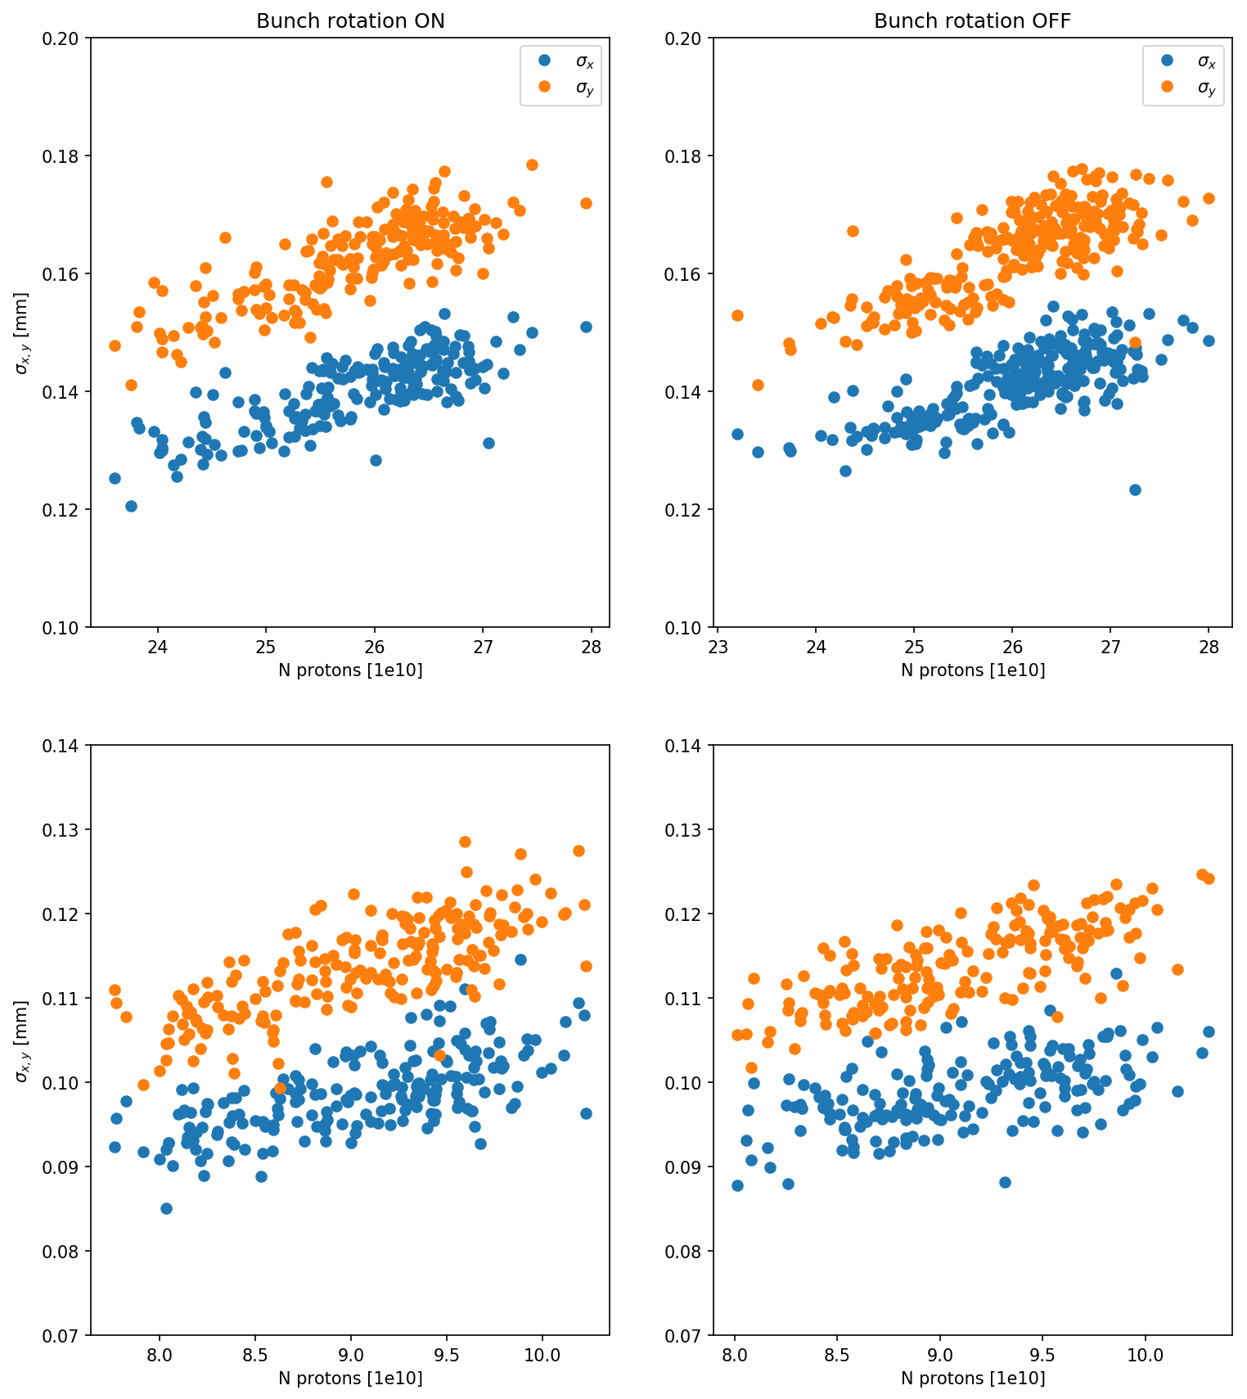
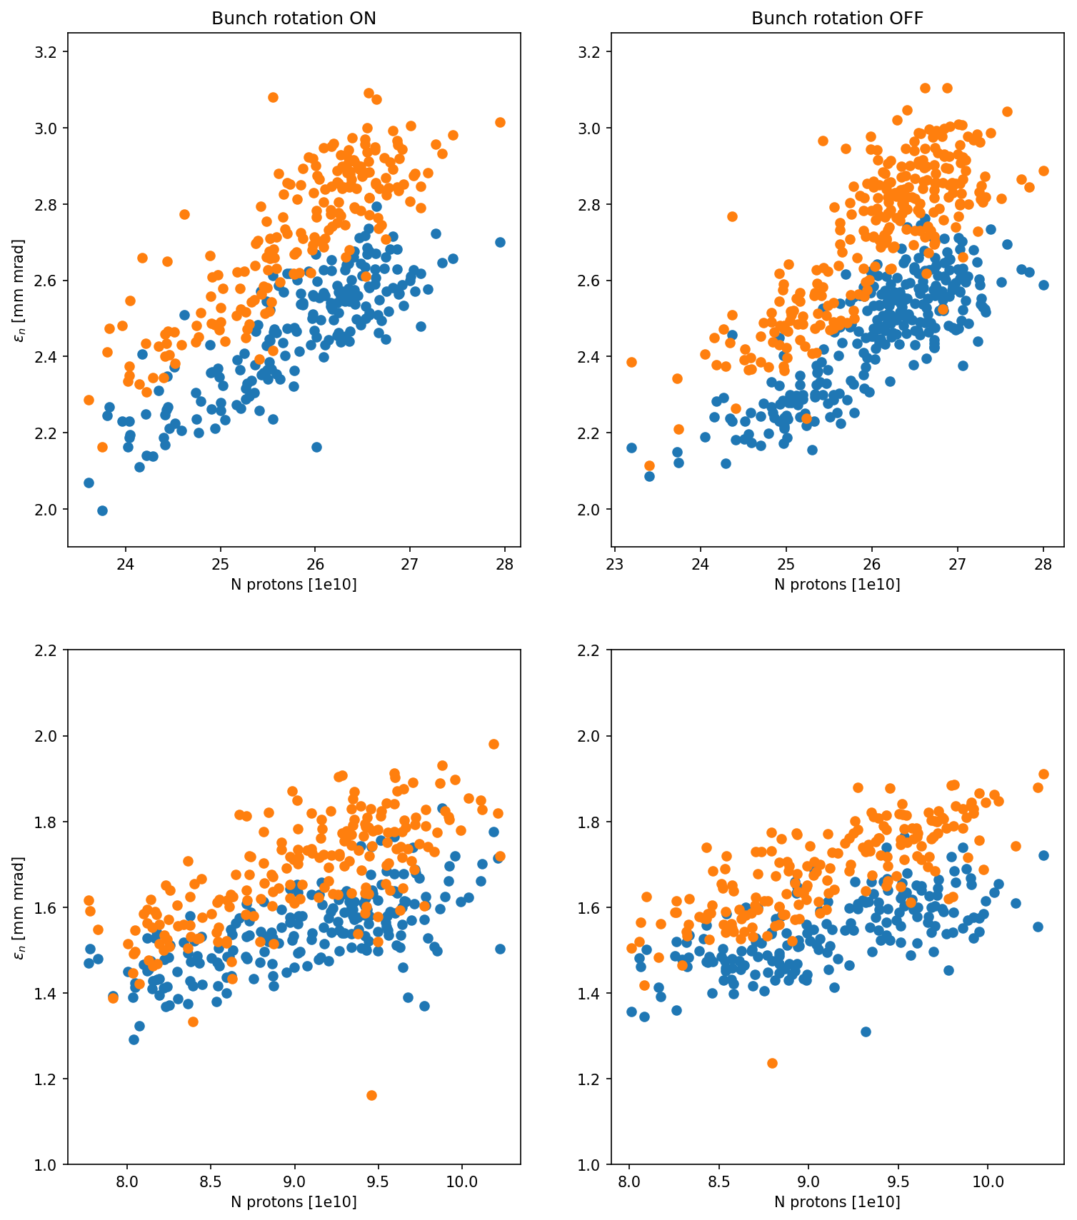
Beam sigma and emittance vs. population using data from IS2 core camera
Sigma
Emittance
x – blue, y – orange

Slide 13
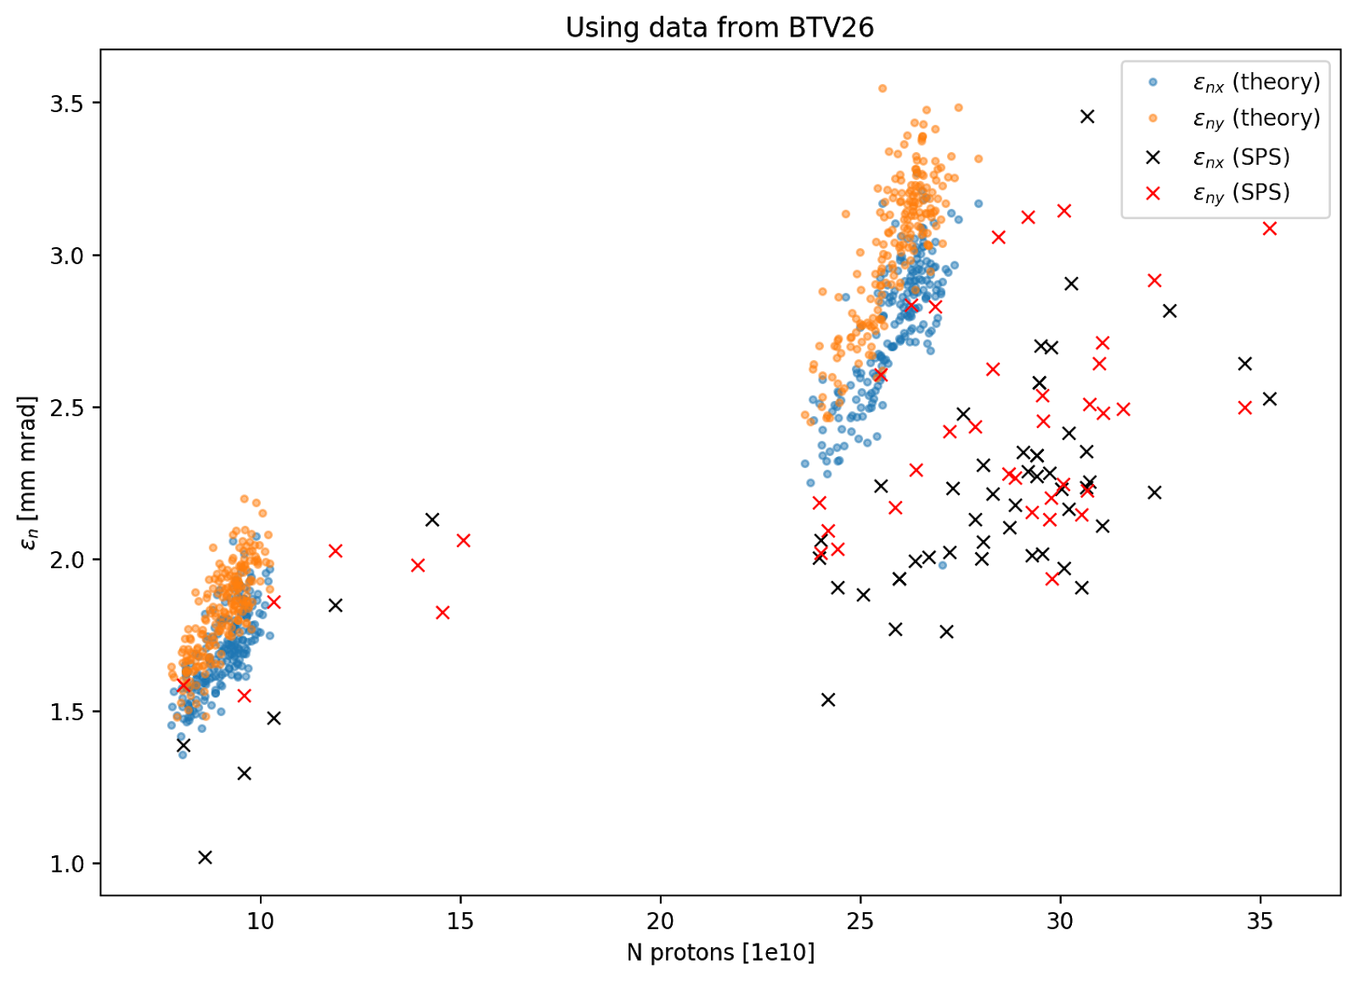
Comparison of calculated emittance with SPS measurements

Slide 14
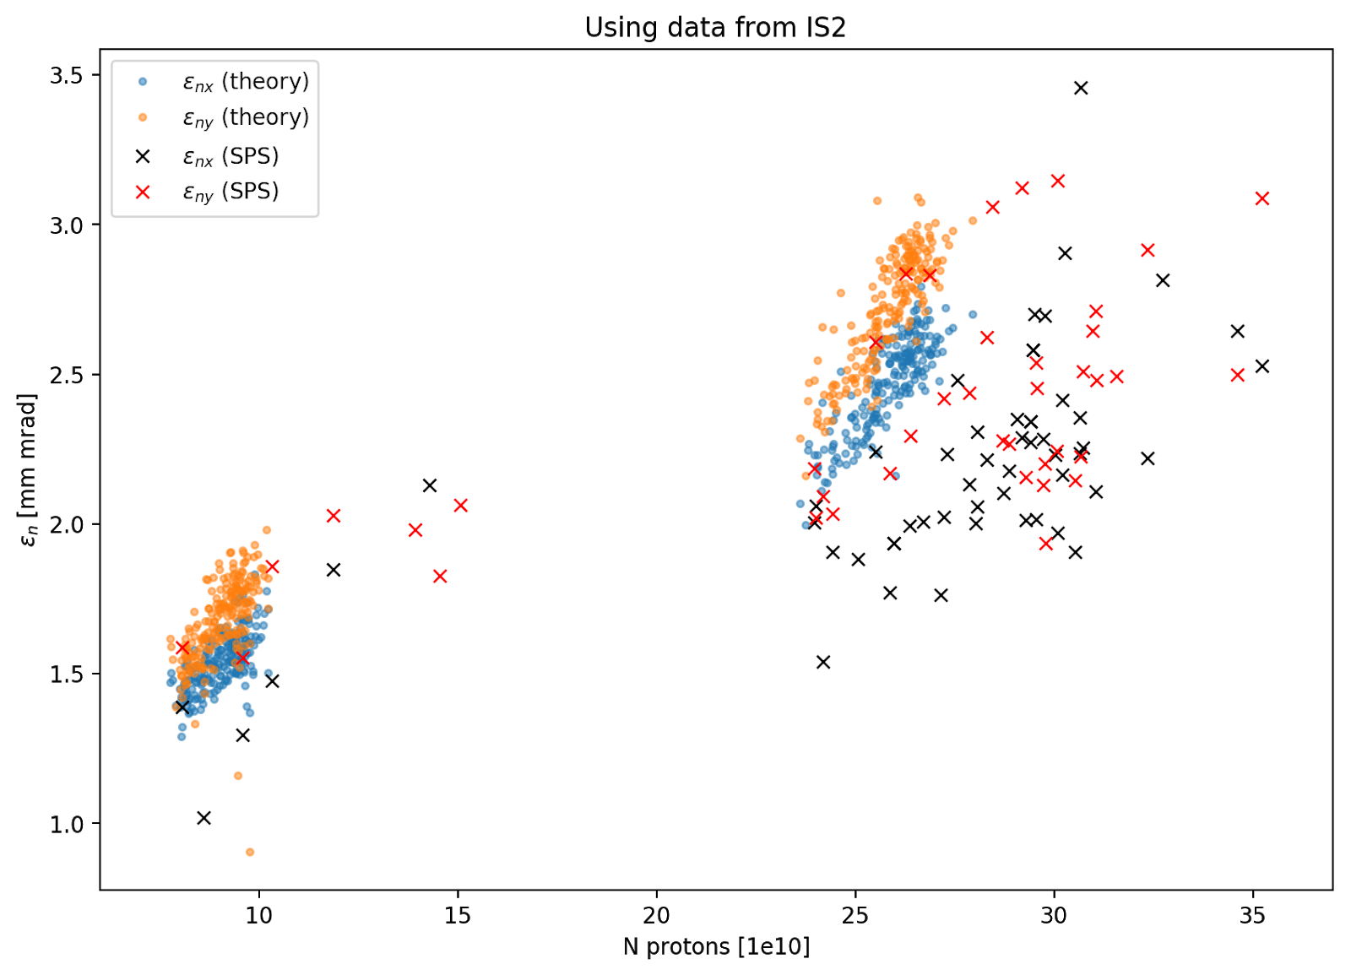
Comparison of calculated emittance with SPS measurements

Slide 15
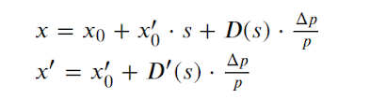
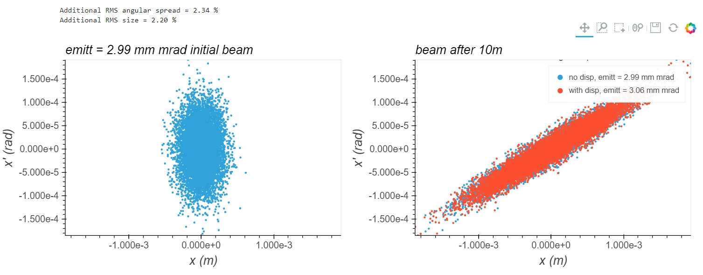

Can be emittance overestimated because of dispersion?
$$\frac{Δp}{p} \sim 6⋅{10}^{−4}$$

Slide 16
Summary
Calculations show strong correlation between the bunch charge and beam size/emittance and have relatively low spread. We can use this fact in order to reduce the uncertainty of the input value of emittance for the simulations.
Likely, at the plasma entrance the beam is smaller then we expected especially in low charge case.
There is no significant influence of the bunch rotation and dispersion on transverse beam dynamics.
Calculated emittance may be overestimated because of blurring of the beam image on BTVs and IS2 core camera.
That also may be a reason why using the data from BTV26 and IS2 core camera gives a bit different results.

Slide 17
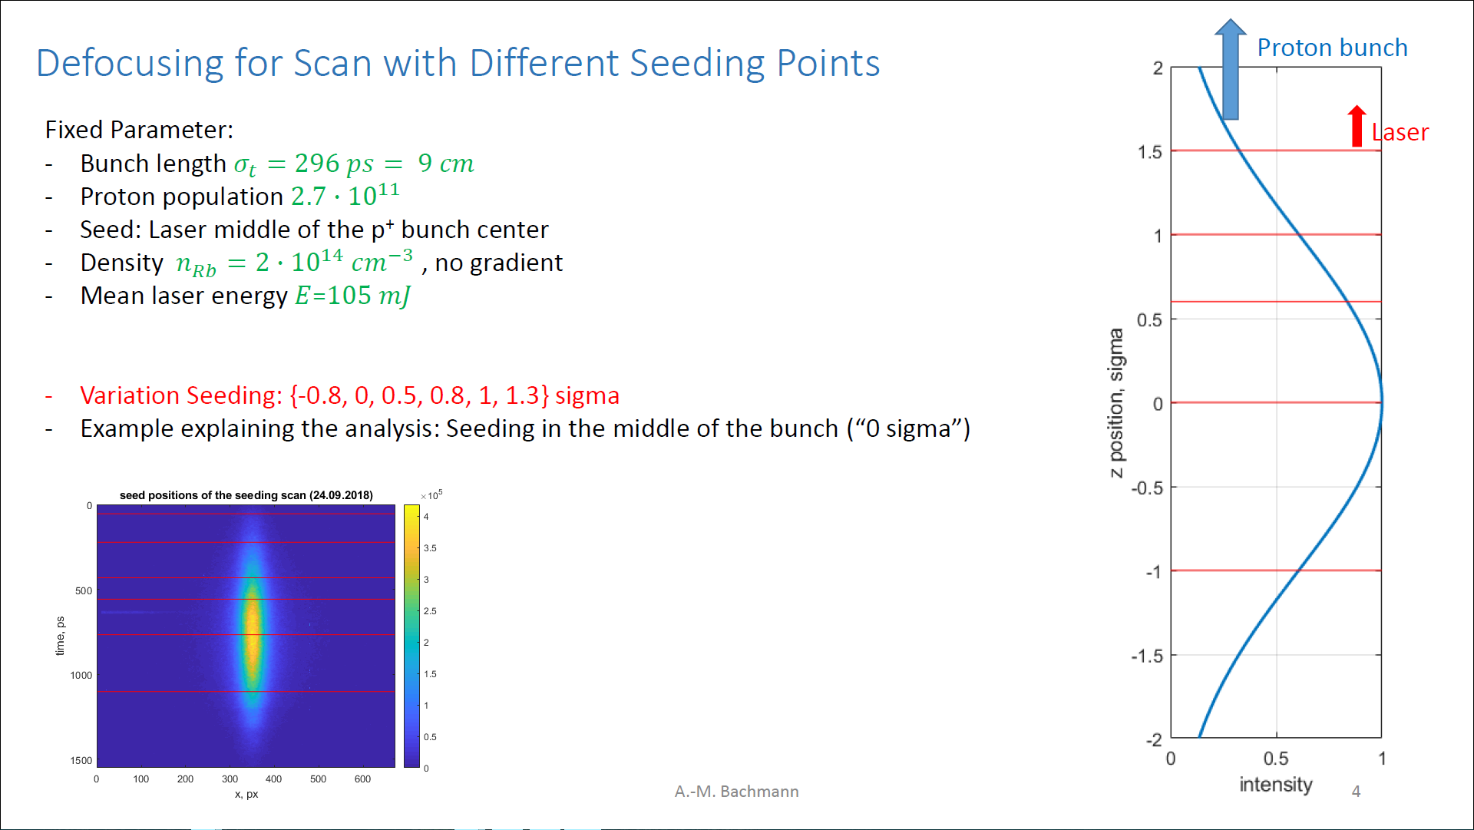
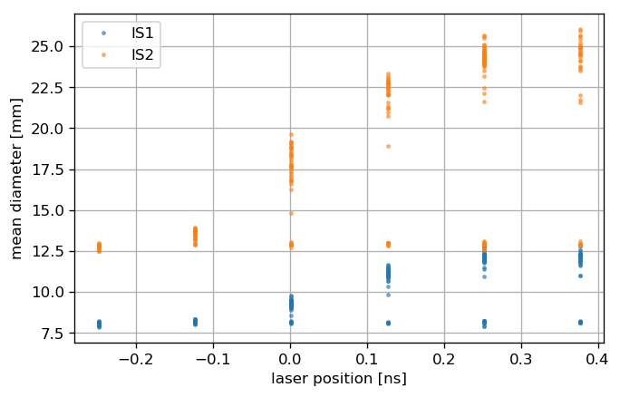
Next steps
Simulations for seeding scans

Slide 18
Thanks

Slide 19
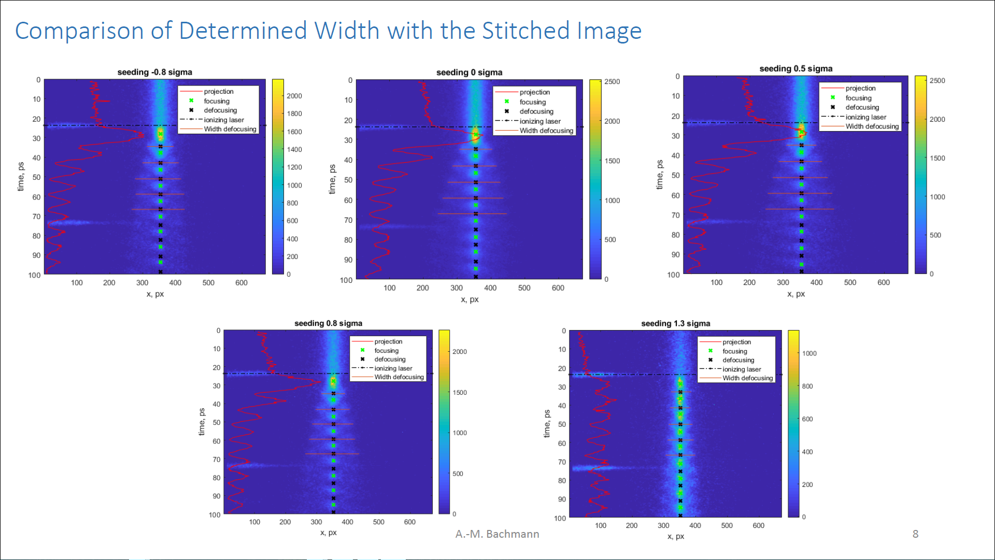
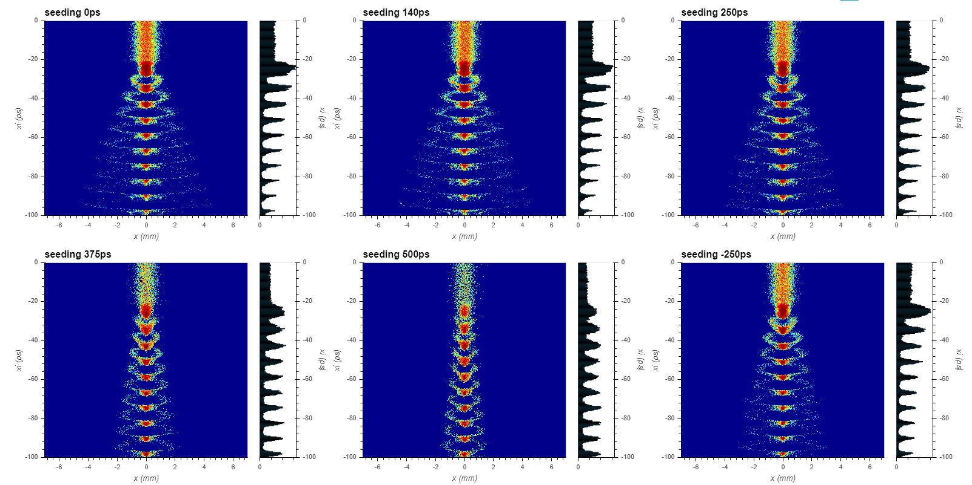
Scan from
September 24-25, 2018

Slide 20
