Slide 1

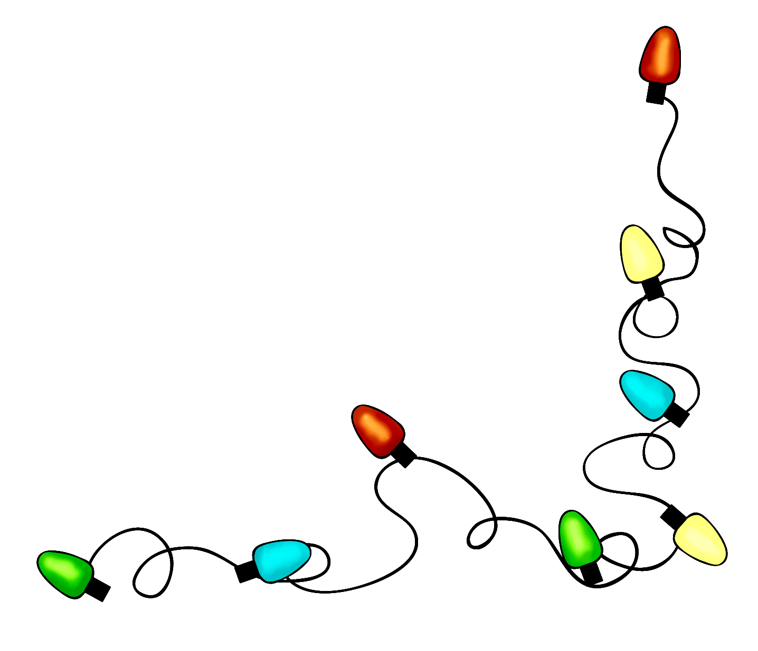
CERN Children’s Christmas Party 2018
Lenka Thomas Bajbarova
Staff Association

Slide 2

Saturday 1st December
13.30 - 15.15
15.30 - 17.15
Show
Snack
Santa
Session 1: 125 children, 12 groups (A-L)
Session 2: 95 children, 9 groups (A, B, C, D, E, F, G, H, J)
Three types of Parent Helpers
  List Checkers
  Mobile Helpers
  Group Leaders

Slide 3

Doors open 13.30 & 15.30
Please arrive 15 min early: 13.15 or 15.15
Check in your child, dress up, take your position
List checkers check in all children at the entrance
Mobile Helpers take children into groups in the Auditorium
Group Leaders wait inside, put on name stickers and check group list
L
G
H
I
M
J
D
E
F
K
A
B
C
Stage

Slide 4

Show 14.00 & 16.00
List Checkers prepare gifts and snacks downstairs
Mobile Helpers sit on the sides, help, and
lead the way downstairs after the show
Group Leaders sit with their group –
raise your hand if you need help!
Groups leave one by one (A, B, C, D,…)
Ask children to hold hands
Follow the signs for snack downstairs

Slide 5
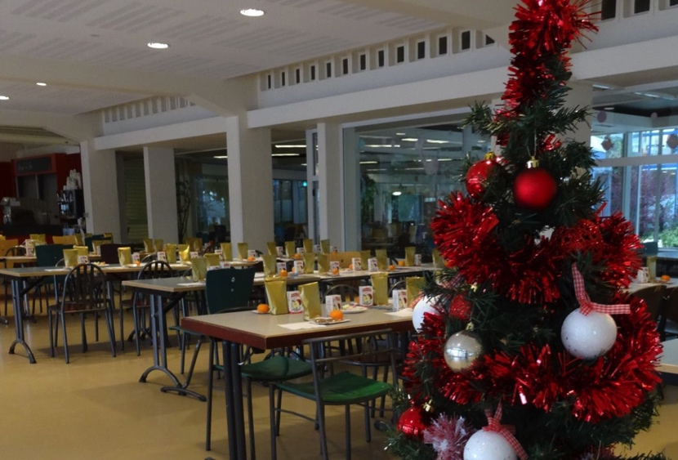
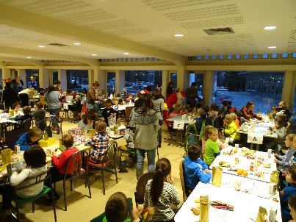
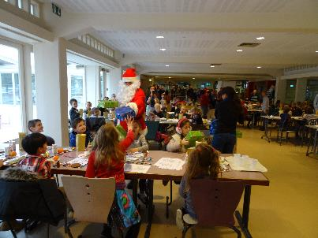
Snack & Santa 14.45 & 16.45
Each table has goodie bags, snacks, and coloring supplies
Santa Claus visits each table and hands out the presents

Slide 6

When it’s time to go home…
Group Leaders ask parents to sign the group list when they pick up their child, and stay with the group until the last child leaves
Please return borrowed hats and antlers before you go!

Slide 7

Let’s…
Be on time – at the Auditorium at least 15 min before doors open (13.15 and 15.15)
Dress up and bring the holiday spirit
Try our best to be efficient
Help each other look after the kids
..make this a party to remember!

Slide 8

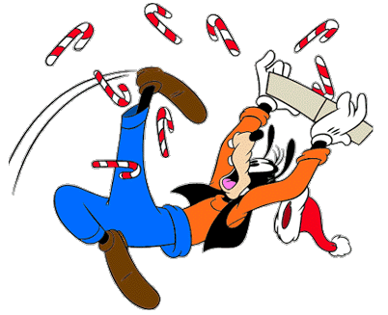
Thank you!

