Slide 1
AD/ELENA beam instrumentation
Status and activities

Slide 2
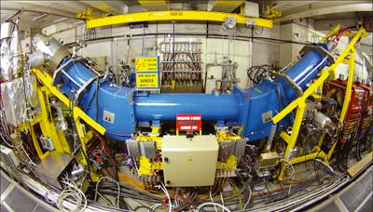
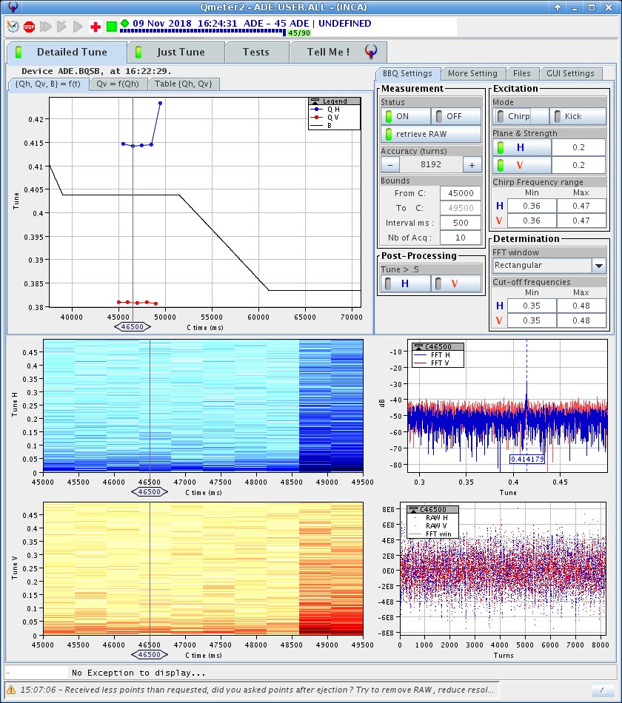
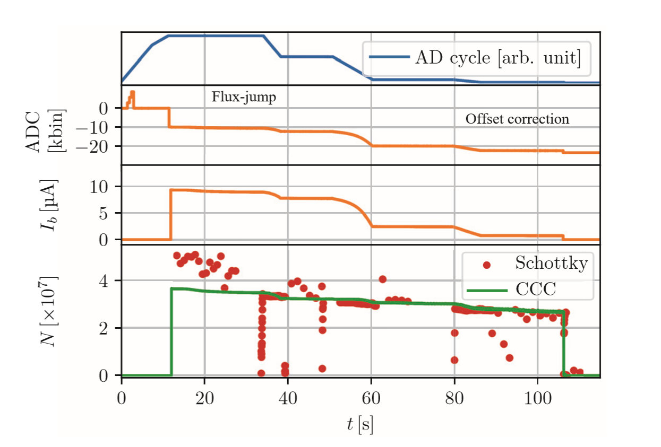
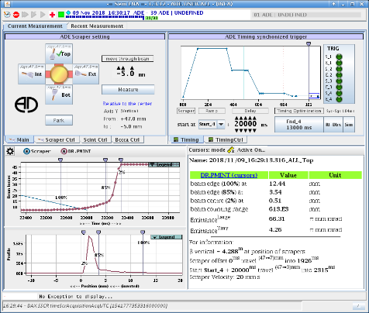
Beam instrumentation at AD
What worked well at the AD 2018:
New tune and orbit measurement system – now also available on the ramps!
Schottky system – unmissable diagnostic system! Will be updated as part of RF C02 LL renewal
Scraper system renewed – issue with the results as compared to the old system.
BCT:s
BTV:s (new unit in target area in LS2, better observation of spotsize on target)
What worked less well in 2018 – worst AD uptime performance ever! (~64%):
Electron Cooler ! Down for a total of about 2 months – new Collector design to be produced and installed during LS2
BCCCA. Worked very well for part of the year but still have issues with staying cold
AD electron cooler with collector on the left.
Tune measurement with new system
The BCCCA and comparison to Schottky
Scraper measurement with new system.

Slide 3
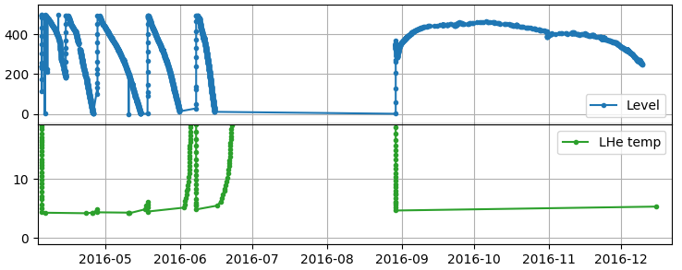
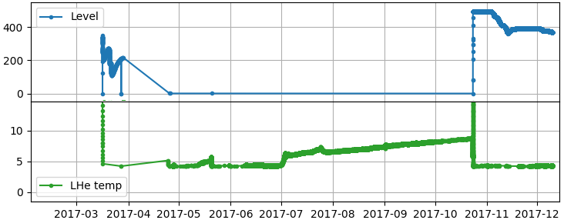
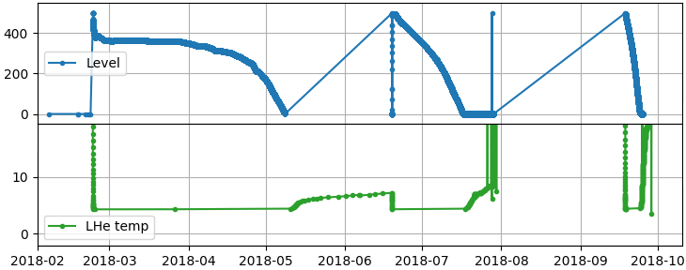
AD BCCCA cryogenic availability
BCCCA cryostat LS2 actitivies
Cryostat insulation vacuum:
Check Helium difusion through ceramic breaks in helium vessel
Study possibility of using another gas to saturate ceramics just before cooling, in order to block helium diffusion
Liquid helium vessel contamination:
Visual inspection of interior to check for water that could still be present since contamination incident in E2016
Check safety valves for leak-tightness in reverse direction
Cryocooler compressor:
Perform scheduled compressor filter change
Change insulation vacuum port of cryocooler vessel
Re-Measure:
Performance of cryocooler with test cryostat
Heat in-leak of BCCCA cryostat

Slide 4
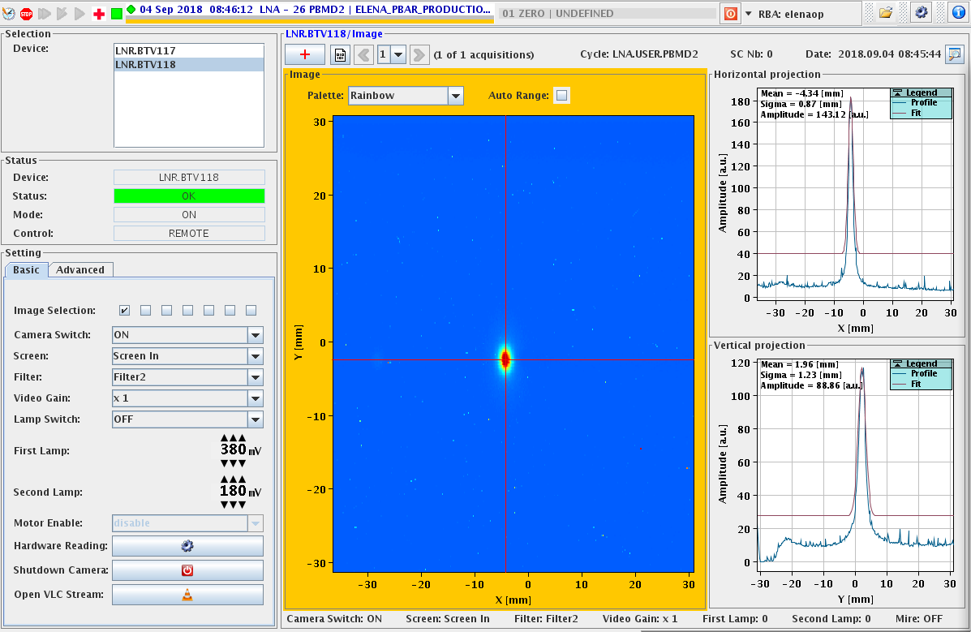
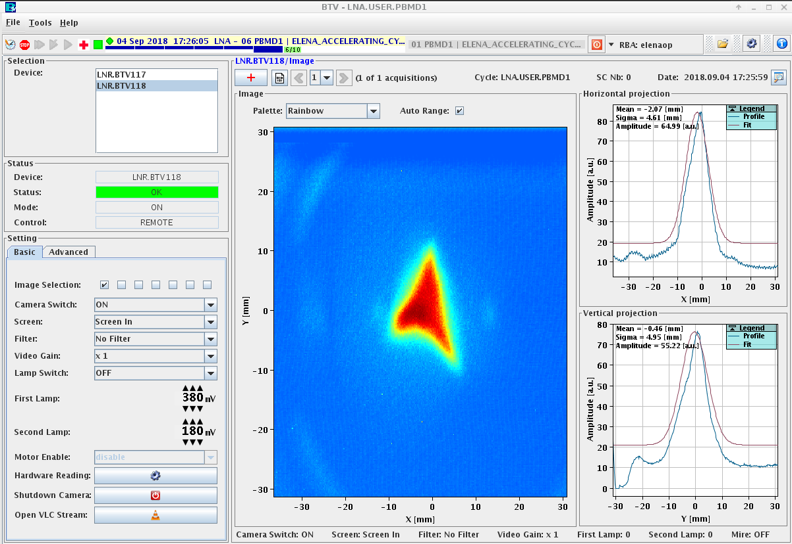
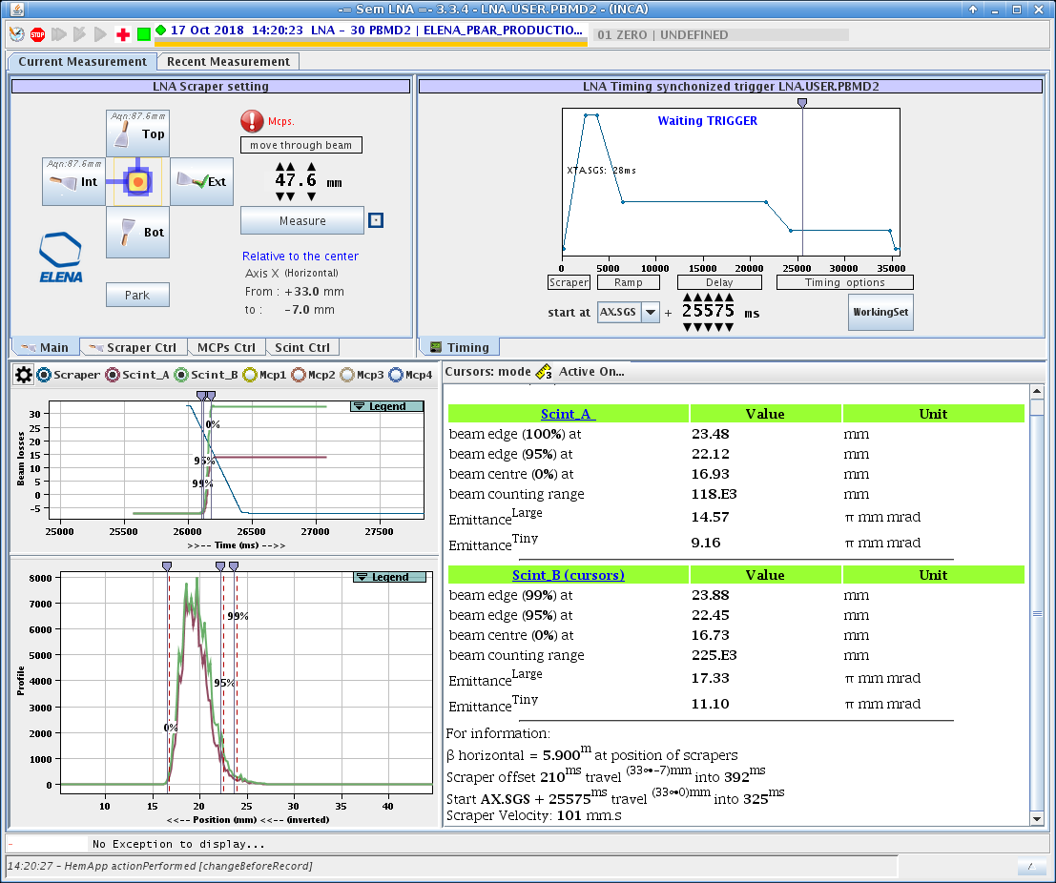
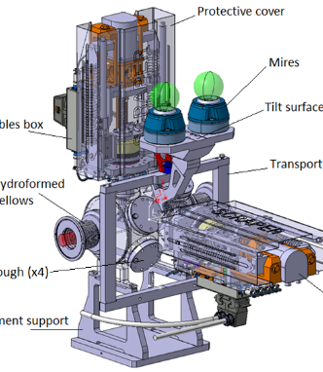
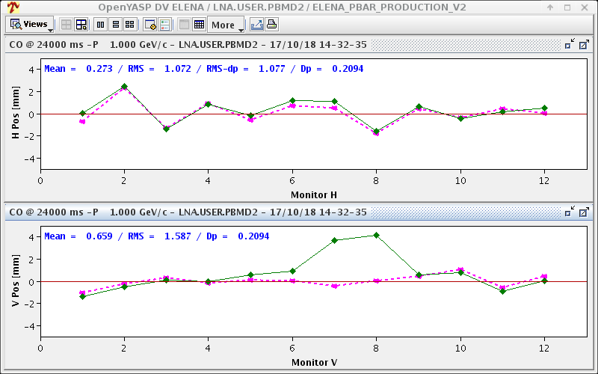
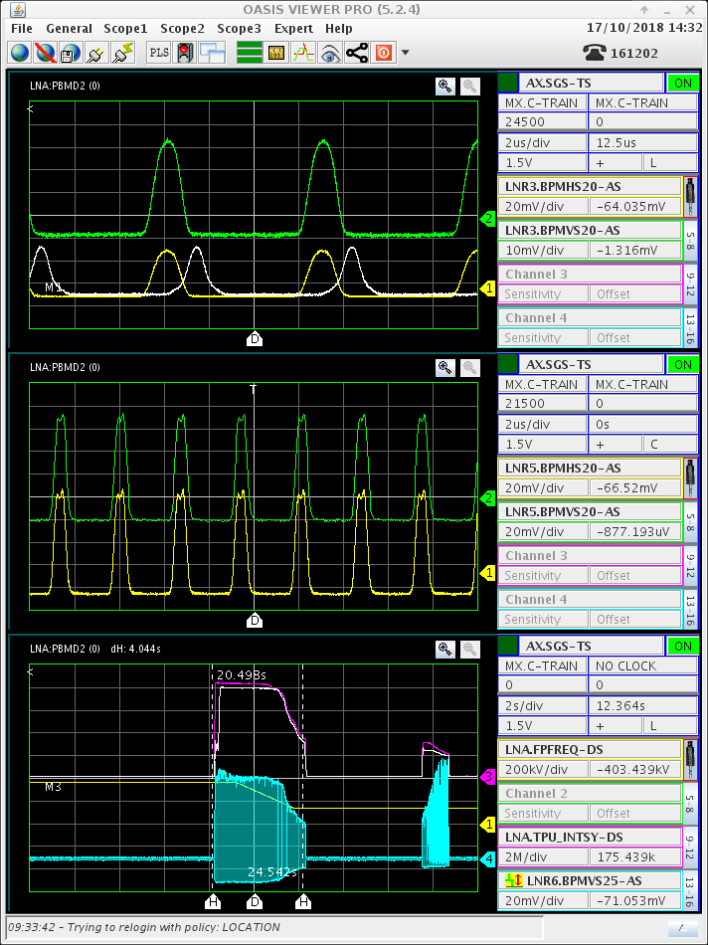
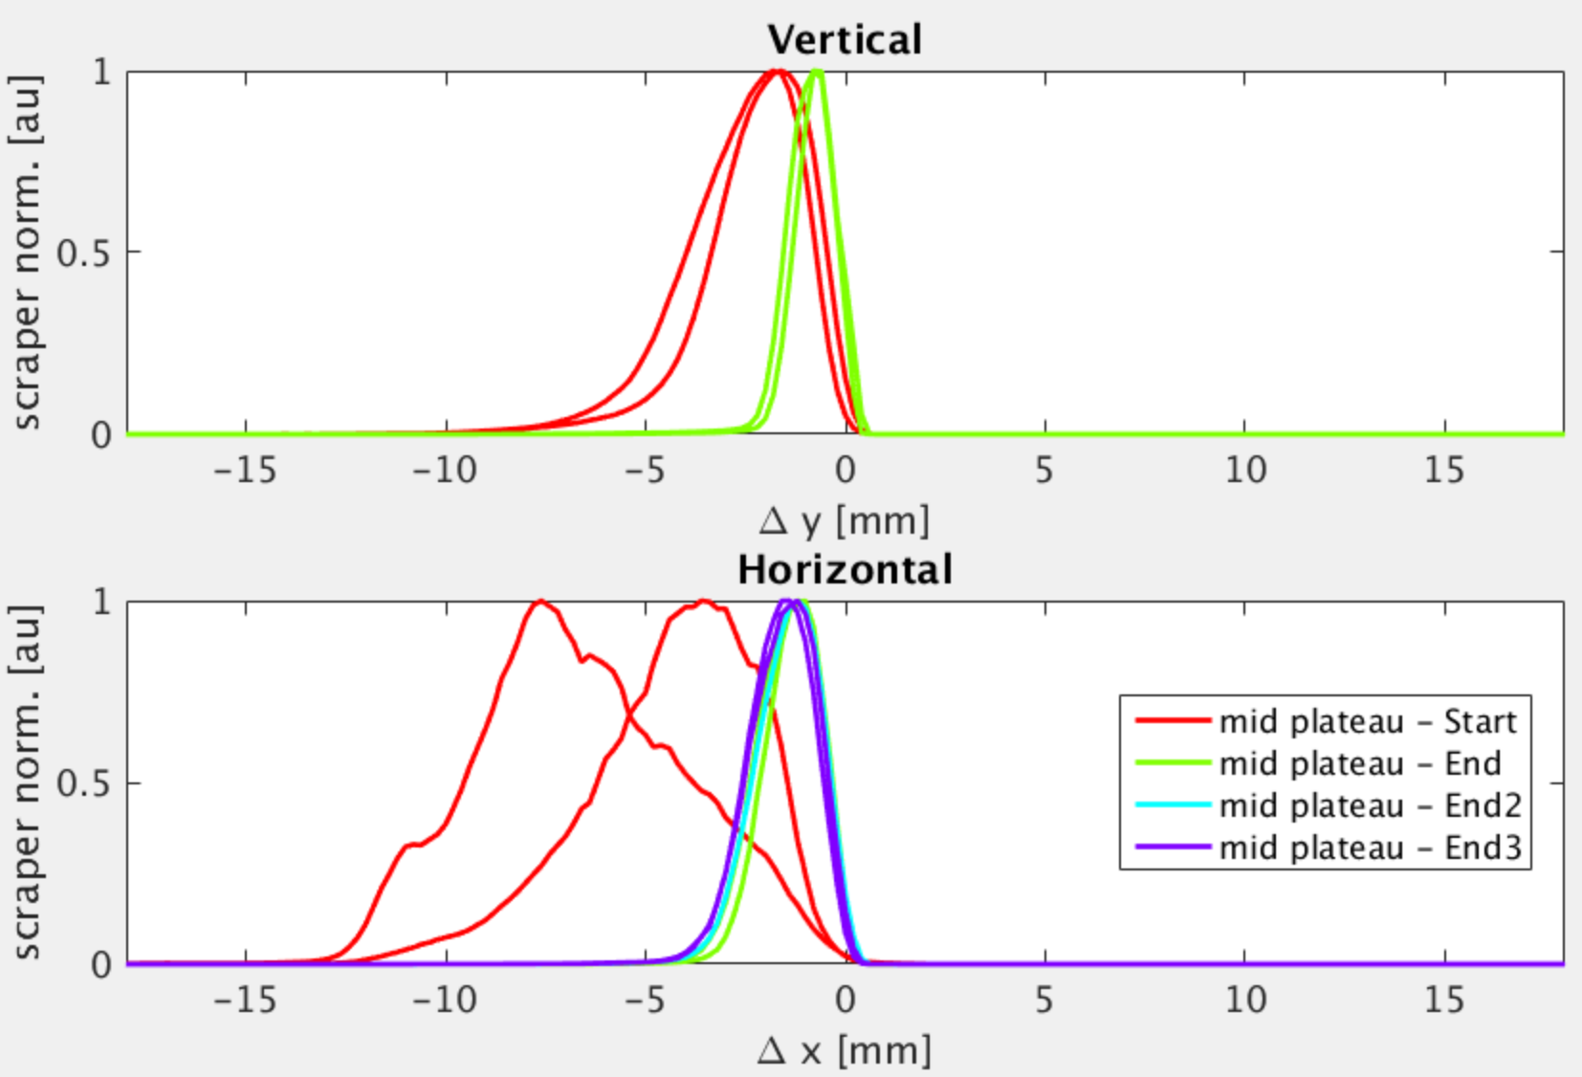
Beam instrumentation at ELENA
H-minus ions at the entrance to ELENA.
What worked well in 2018:
BTVs (but no SEM:s yet…)
Scrapers/detectors for profile measurements
BPMs & YASP 0rbits (+rough estimation of intensity). Also on ramps.
Antiprotons at the entrance to ELENA.
Horizontal beam profile at 13.7 MeV/c
Emittance evolution during beam cooling
The new scraper system for ELENA.
And of course – OASIS !

Slide 5
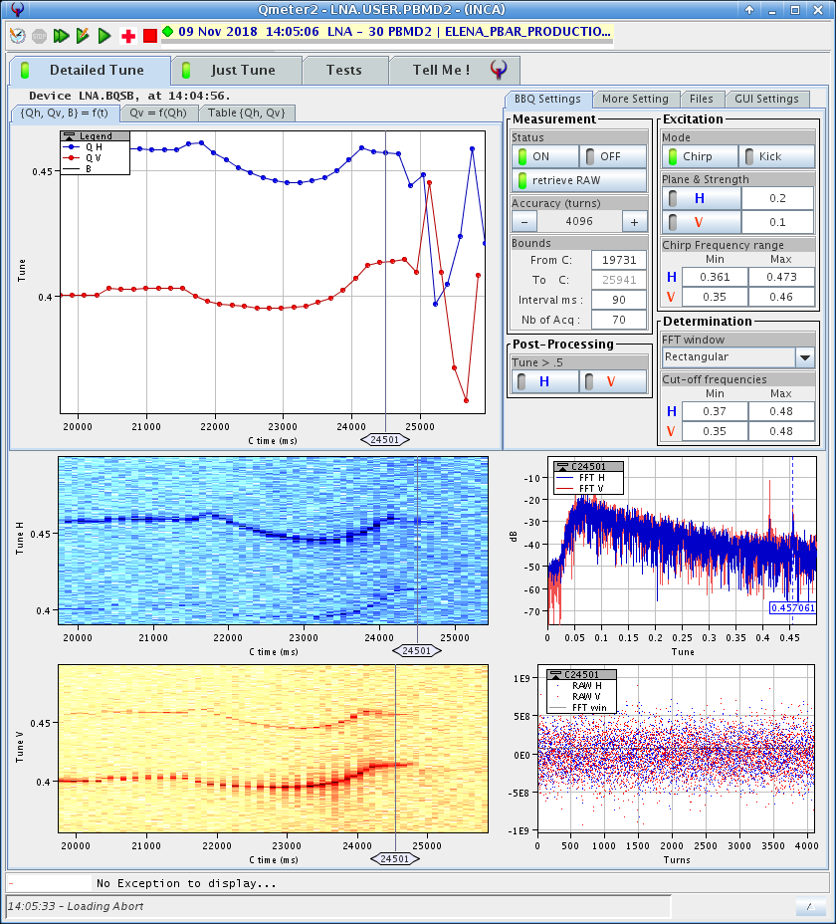
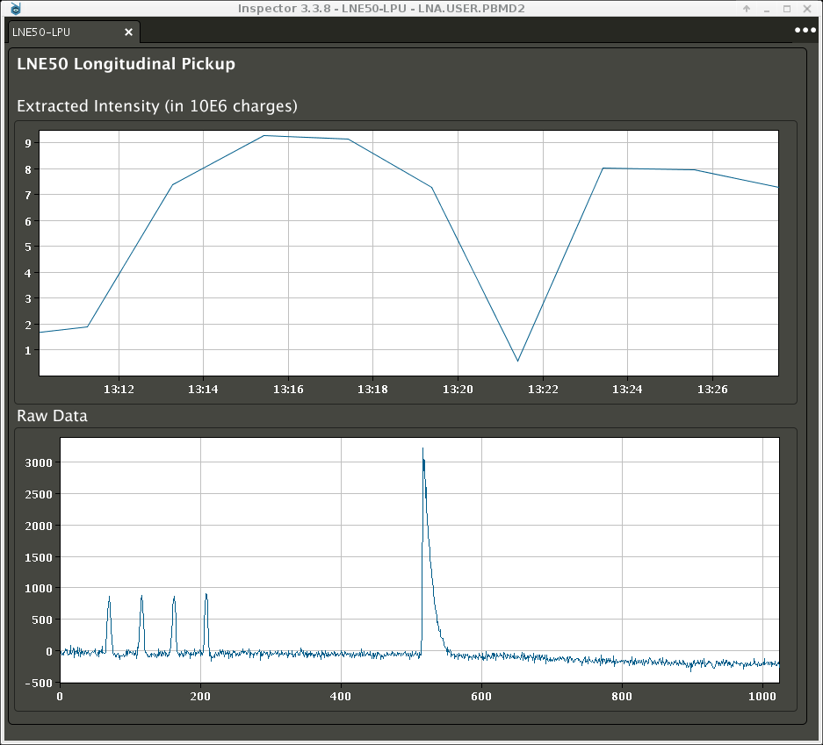
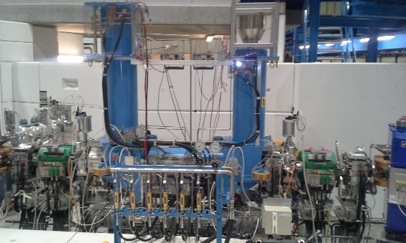
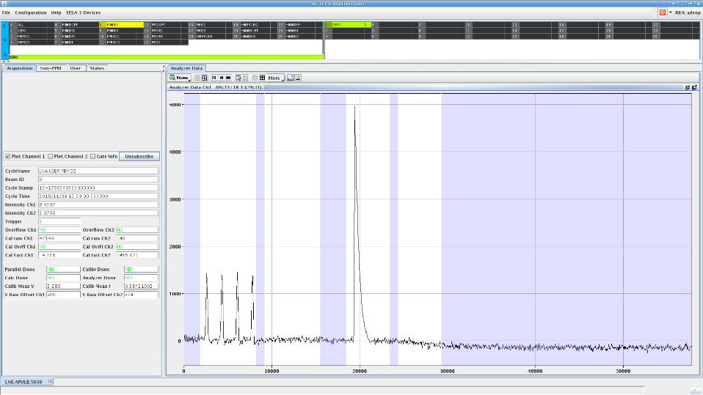
Beam instrumentation at ELENA
What worked well in 2018:
BBQ tune system – also on ramps!
BCT (LPU) in LNE50 (Gbar) line
H & V tunes at end of cycle (ramp + plateau)
Inspector panel showing up to 1E7 Pbars/cycle
LNE50 BCT:4 Pbar bunches & calibration pulse
And also: Electron cooler – BI but not BI….

Slide 6
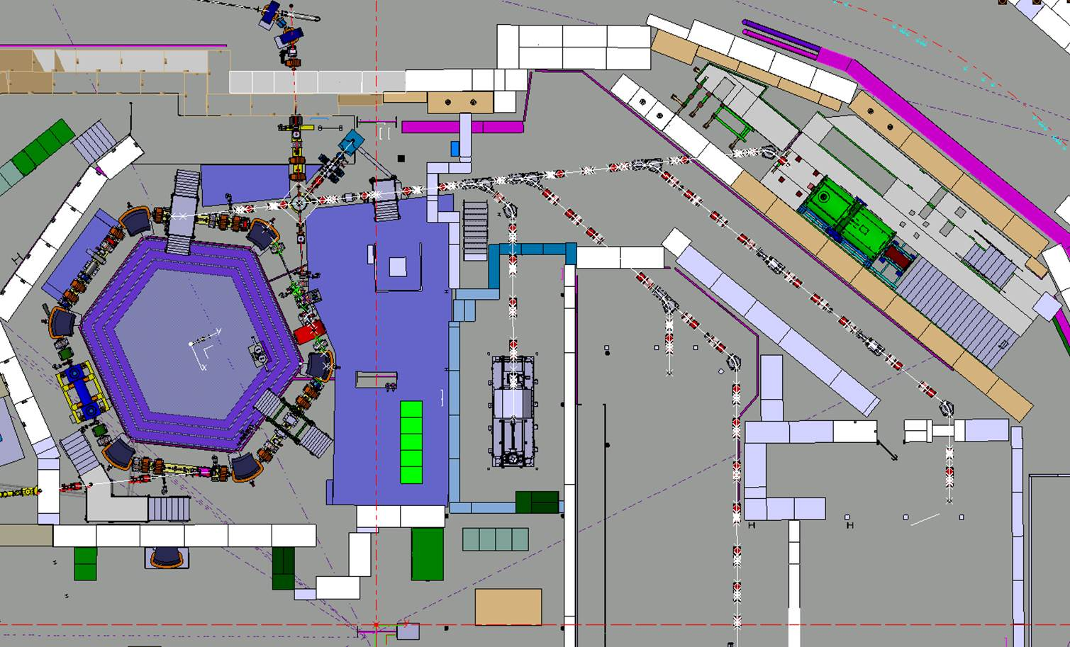
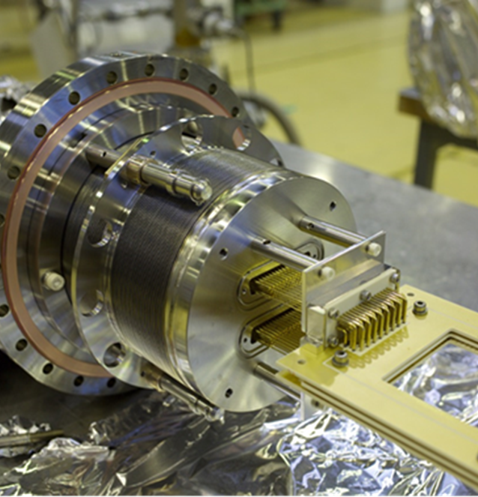
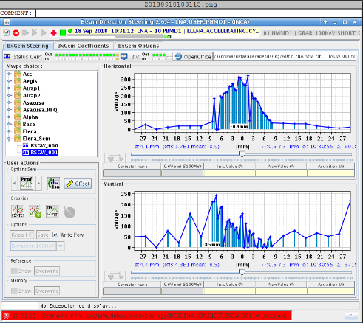
ELENA SEM grids
~40 units to be installed in ELENA 100keV extraction lines during LS2
3 units tested and used for Gbar transfers during 2018 commissioning (with 1 set of electronics)
Essential for set-up and optics validation of ~100m beam lines in 2020 !
Now on critical path – major concern!
  Electronics under development/manufacturing; collaboration ASACUSA/CERN
  Major concern is wirebonding of electrodes, 40% of 11000 wires completed (Japan)

