Slide 1
Quench protection studies on 11 T dipole and comparison with test results
Susana Izquierdo Bermudez, Gerard Willering
Acknowledgement for discussions and contributions:
Luca Bottura, Franco Julio Mangiarotti, Alejandro Fernandez Navarro, Ludovic Grand Clement, Fernando Menendez Camara, Francois Olivier Pincot, Felix Rodriguez Mateos, Frederic Savary, Juan Carlos Perez, Jan Petrik, Christian Scheuerlein, Emmanuele Ravaioli, Michal Maciejewski.
CERN. 11/01/2019. Review of 11 T dipole quench protection and electrical tests

Slide 2
Outline
Protection design and reference parameters.
Overview on quench protection test results.
Summary and conclusions.

Slide 3
Outline
Protection design and reference parameters.
Overview on quench protection test results.
Summary and conclusions.

Slide 4
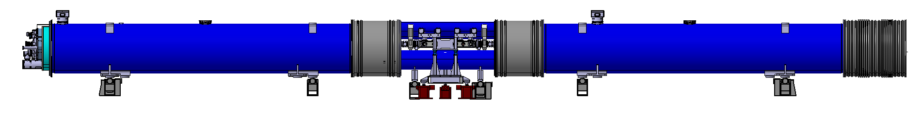
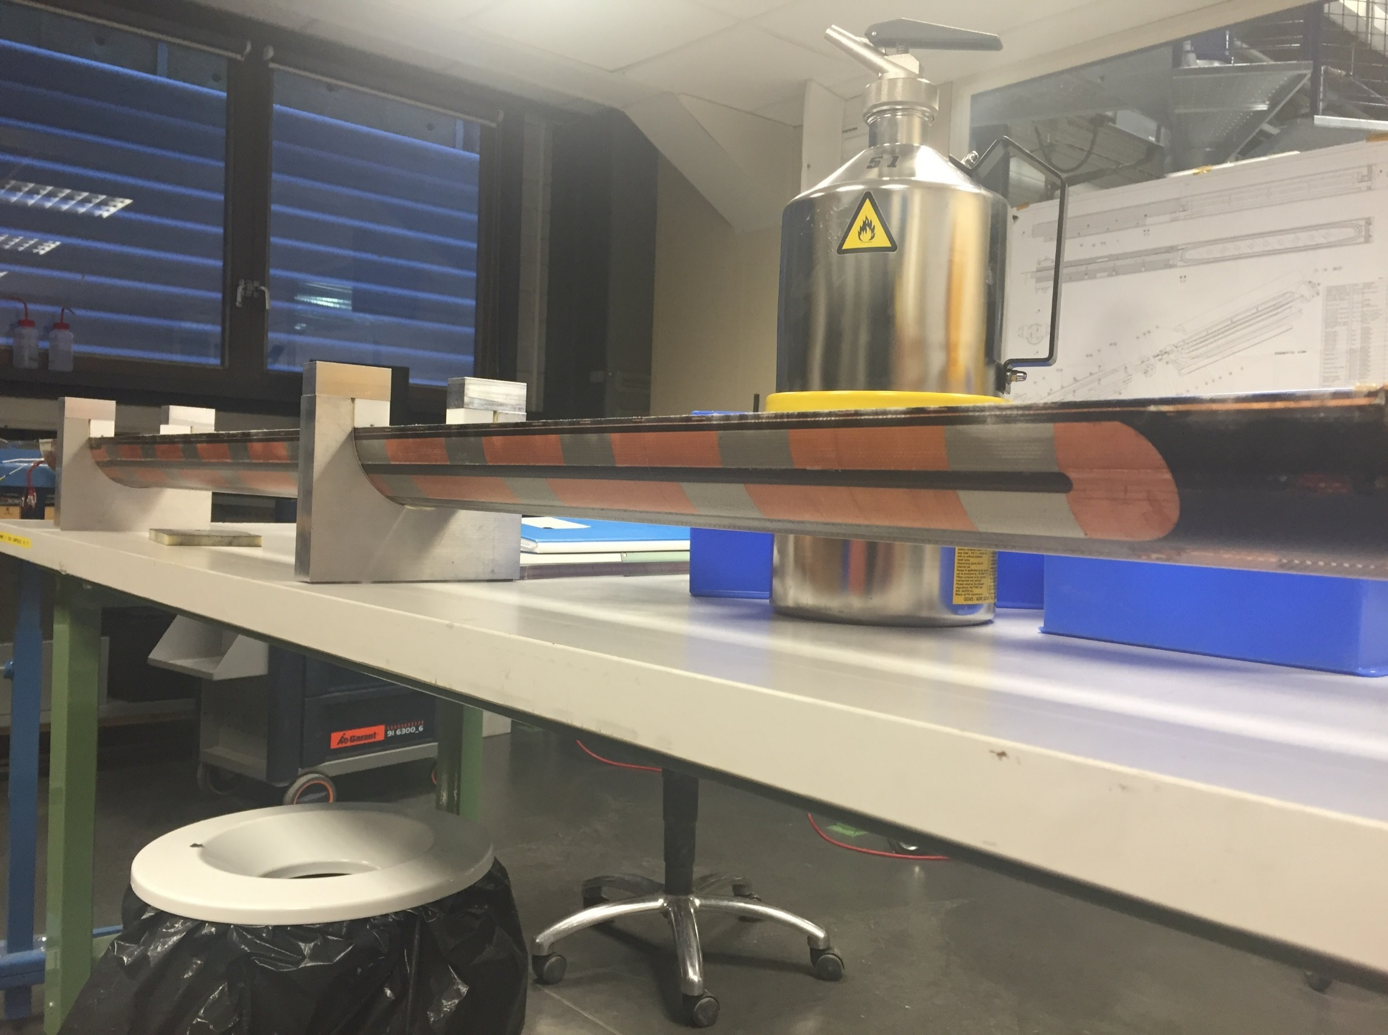
Baseline protection scheme
Every cryo-assembly is composed by two 11 T x 5.5 m connected in series and protected by a cold diode.
Each QH power supply is connected to two outer layer strips in series (i.e. 2 heater circuits per coil, 4 circuits per aperture, 16 circuits per 11 T full assembly.)
U-shaped heaters with connections only in the magnet connection end (reduce the number of connections but worse voltage distribution in failure cases)
L_{11T} ≈ 130 mH
(Total Inductance of two Magnets)
11T Magnet
Collimator
11T Magnet
Unit 1, Ap. 1
Unit 2, Ap. 1
Unit 1, Ap. 2
Unit 2, Ap. 2

Slide 5
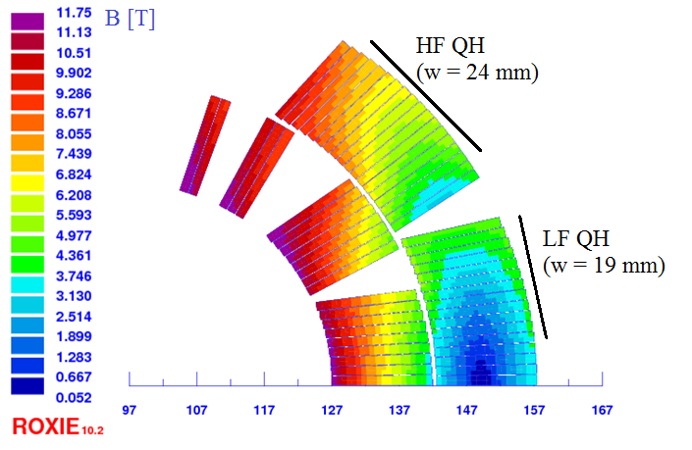
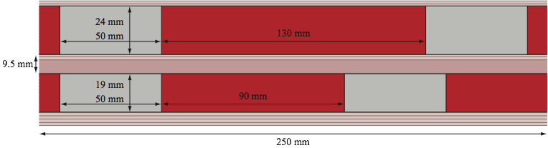
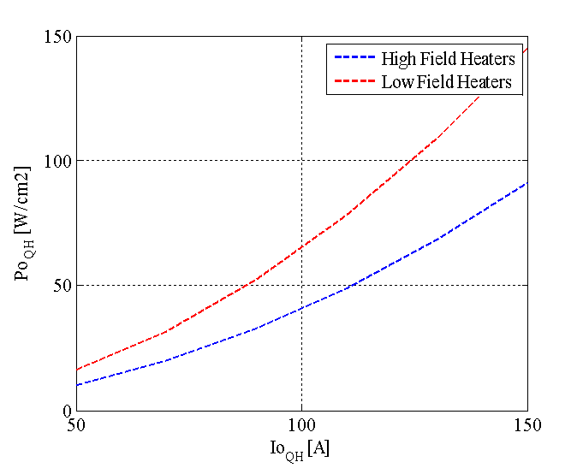
Outer layer heater design
Each aperture is protected with 4 quench heater circuits
  Heater geometry optimized to have a uniform quench in the magnet cross section and a propagation in between stations faster than 5 ms.
  High field and low field quench heater in series (better for redundancy)
“Standard” LHC quench heater power supply:
  Charging voltage: 900 V (± 450 V)
  Maximum current through the heaters: 150 A (instead of 80 A in the MB-LHC)
    This means that the design was done for a max. heater circuit resistance (including leads) of 6 Ω (there is some margin here, see additional slides).
  Capacitance: 7.05 mF
  Heater power density: 85/136 W/cm²

Slide 6
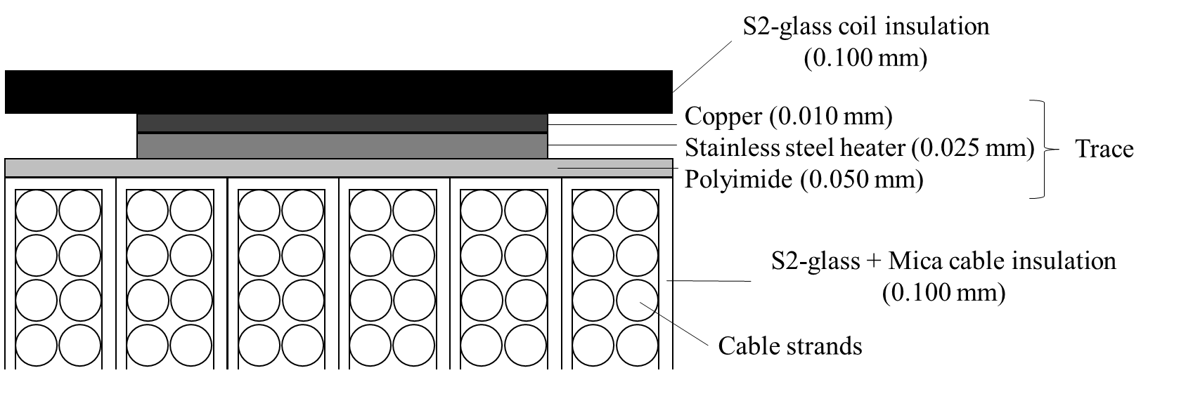
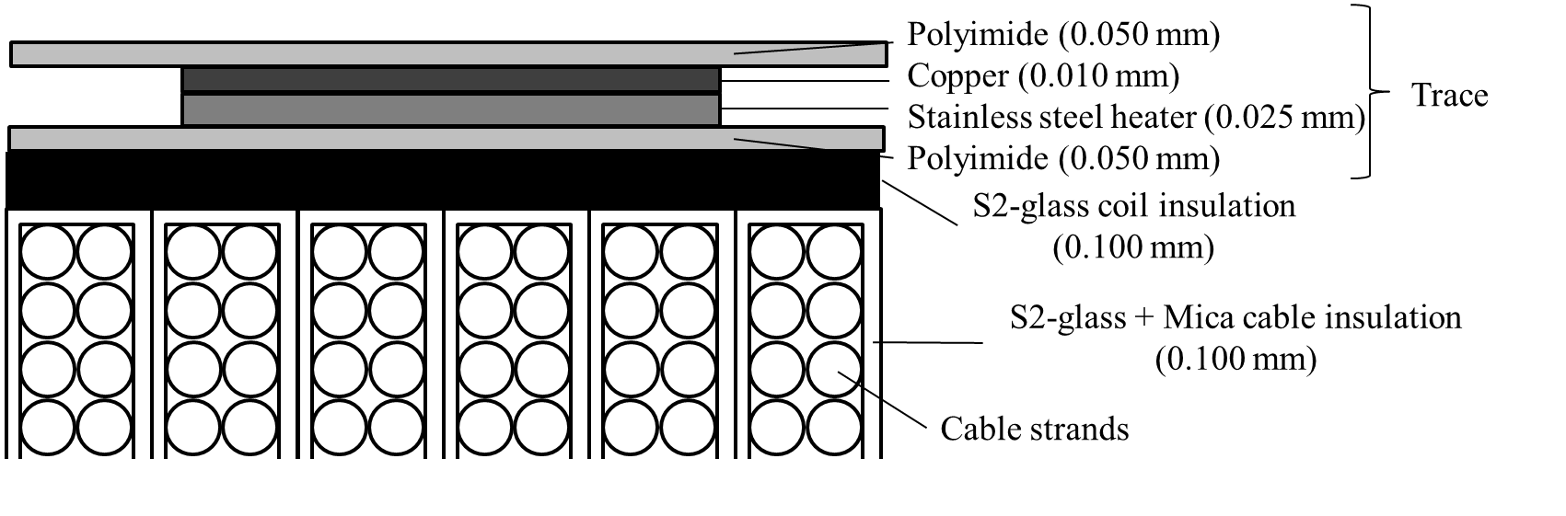
Heater insulation scheme
Impregnated heaters
Impregnated coil
Baseline since 2016
Non-Impregnated heaters
Impregnated
coil

Slide 7
Protection strategy
EDMS 1764166: Engineering Specification; 11T dipole Circuit - Powering and protection
The strategy to follow in case of a failure of the quench protection system is:
If one quench heater power supply fails, the heater power supply will be replaced during the next access.
If two quench heater power supplies fail, the beam is dumped and the heater power supply is replaced.
If one out of the sixteen heater circuits fail, during next long shut down the magnet will be replaced.
If more than two circuits fail the individual case needs to be studied.

Slide 8
Protection without failure
EDMS 1764166: Engineering Specification; 11T dipole Circuit - Powering and protection
Table 5. Simulated quench integral, hot-spot temperature, peak voltage to ground and peat turn to turn voltage at nominal and ultimate current for default conductor and protection parameters.
 |  | SUPERMAGNET |  | ROXIE |  | TALES
 |  | I_{nom} | I_{ult} | I_{nom} | I_{ult} | I_{nom} | I_{ult}
Current | kA | 11.85 | 12.85 | 11.85 | 12.85 | 11.85 | 12.85
Quench integral | MA²s | 15.7 | 16.8 | 15.9 | 16.9 | 15.8 | 16.2
Hot spot temperature | K | 320 | 360 | 310 | 350 | 320 | 342
Peak voltage to ground | V | n.a. | n.a. | 350 | 450 | 245 | 340
Peak turn to turn voltage | V | n.a. | n.a. | 63 | 95 | 75 | 80
Assuming:
5 ms for quench detection + 10 ms for validation
5 ms of heater firing delay
Heaters with nominal powering parameters, impregnated with the coil
RRR = 100 and cu/sc = 1.15

Slide 9
Failure case analysis
EDMS 1764166: Engineering Specification; 11T dipole Circuit - Powering and protection
Table 10. Failure case analysis. Simulated quench integral, hot-spot temperature, peak voltage to ground and peak turn-to-turn voltage obtained for one failure or two simultaneous failures of QH circuits, at nominal and at ultimate current (TALES, Alejandro Fernandez Navarro).
 |  | Nominal |  | 1 circuit failure |  | 2 circuits failure
 |  | I_{nom} | I_{ult} | I_{nom} | I_{ult} | I_{nom} | I_{ult}
Current | kA | 11.85 | 12.85 | 11.85 | 12.85 | 11.85 | 12.85
Quench integral | MA²s | 15.8 | 16.2 | 16.1 | 16.4 | 16.2 | 16.5
Hot spot temperature | K | 320 | 342 | 327 | 349 | 333 | 356
Peak voltage to ground | V | 245 | 340 | 570 | 680 | 950 | 1070
Peak turn to turn voltage | V | 75 | 80 | 80 | 90 | 90 | 95
Assuming:
5 ms for quench detection + 10 ms for validation
5 ms of heater firing delay
Heaters with nominal powering parameters, impregnated with the coil
RRR = 100 and cu/sc = 1.15

Slide 10
Overview on short model magnets tested
Magnet | Collared coil | Coil | Conductor | cu/sc | Coil R at 300 K | RRR | Heater Type | Glass heater-coil
 |  |  |  |  | mΩ | 293K/4K |  | mm
SP101 | CC101 | 106 | RRP 108/127 | 1.22 | 423 | 66 | Glued | 0.00
 |  | 107 | RRP 108/127 | 1.22 | 426 | 97 | Glued | 0.10
SP102 | CC102 | 106 | RRP 108/127 | 1.22 | 423 | 66 | Glued | 0.00
 |  | 108 | RRP 132/169 | 1.22 | 407 | 185 | Glued | 0.10
SP103 | CC103 | 109 | RRP 132/169 | 1.27 | 400 | 131 | Glued | 0.00
 |  | 111 | RRP 132/169 | 1.27 | 401 | 124 | Glued | 0.10
DP101 | CC102 | 106 | RRP 108/127 | 1.22 | 423 | 66 | Glued | 0.00
 |  | 108 | RRP 132/169 | 1.22 | 407 | 185 | Glued | 0.10
 | CC103 | 109 | RRP 132/169 | 1.27 | 400 | 131 | Glued | 0.00
 |  | 111 | RRP 132/169 | 1.27 | 401 | 124 | Glued | 0.10
SP104 | CC104 | 112 | RRP 132/169 | 1.27 | 403 | 125 | Glued | 0.08 (E-glass)
 |  | 113 | RRP 132/169 | 1.27 | 403 | 115 | Glued | 0.08 (E-glass)
SP105 | CC105 | 114 | RRP 150/169 | 0.98 | 432 | 115 | Impregnated | 0.00
 |  | 115 | RRP 150/169 | 0.97 | 436 | 110 | Impregnated | 0.00
DP102 | CC104b | 109 | RRP 132/169 | 1.27 | 400 | 131 | Glued | 0.00
 |  | 112 | RRP 132/169 | 1.27 | 403 | 125 | Glued | 0.08 (E-glass)
 | CC105b | 114 | RRP 150/169 | 0.98 | 432 | 115 | Impregnated | 0.00
 |  | 115 | RRP 150/169 | 0.97 | 436 | 110 | Impregnated | 0.00
SP106 | CC106 | 116 | RRP 150/169 | 0.97 | 449 | 103* | Impregnated | 0.00
 |  | 117 | RRP 150/169 | 0.97 | 450 | 100* | Impregnated | 0.00
SP107 | CC107 | 120 | RRP 108/127 | 1.19 | 413 | 190* | Impregnated | 0.00
 |  | 121 | RRP 108/127 | 1.19 | 413 | 190* | Impregnated | 0.00
SP109 | CC109 | 119 | RRP 108/127 | 1.19 | 411 |  | Impregnated | 0.00
 |  | 123 | RRP 108/127 | 1.19 | 409 |  | Impregnated | 0.00
* 296K/20K
RED: numbers bellow specifications
Final conductor
“Final” heater lay-out
More details on:
https://espace.cern.ch/HiLumi/WP11/Shared%20Documents/tested_magnet_parameters.xlsx?Web=1

Slide 11
Outline
Protection design and reference parameters.
Overview on quench protection test results.
  Standard:
    Quench heater delay
    Quench integral
    Minimum quench energy
  Additional tests:
    Quench heater performance at nominal current
    Fast energy extraction tests
    High MIITs test
Summary and conclusions.
Do heaters behave as expected?
Is there room for improvement?
What are the limits in terms of hot spot?
How much margin we have?

Slide 12
Quench heater delay
Aim:
Determine precisely the quench onset time due to quench heater firing.
Procedure:
One heater strip is fired.
Upon quench detection, rest of the strips and dump are fired to protect the magnet
Main outcome
0.1 mm increase of the glass insulation thickness between heater and coil increases the delay by 10 ms, in agreement with expectations.
Similar delays for impregnated and glued heaters if there is not additional layers of insulation between heater and coil.
COMSOL, S2 glass 0.08 mm
COMSOL, S2 glass 0.1 mm
COMSOL, S2 glass 0.0 mm
Glued heaters additional insulation heater to coil:
0.00 mm: Coils 106&109
0.08 mm E glass: Coils 112&113
0.10 mm S2 glass: Coils 107, 108 & 111
Impregnated heaters:
Coils 114-117

Slide 13
Quench integral studies
Aim:
Study the quench heater efficiency and quench propagation in machine relevant conditions (without dump)
Procedure:
All heaters are fired, and dump resistor is delayed by 1 s.
Main outcome
Large spread on measured quench integral, due to the difference in conductor properties (well understood).
Measured current decay can be used to derive the hot spot temperature under adiabatic assumptions.
Quench integral from heaters powered
T_{hot} based on quench integral tests,
assuming 5 ms for detection, 10 ms for validation and 5 ms for heater firing delay
Magnet | Cu/SC | RRR293K/20K | I_{nom}(11.85 kA) |  | I_{ult}(12.85 kA)
 |  |  | QI [MA2s] | T_{Adiab} [K] | QI [MA2s] | T_{Adiab} [K]
DP101 | 1.22-1.27 | 66-185 | 16.1 | 285-335
SP105 | 0.97 | 112 | 15.1 | 341
SP106 | 0.97 | 103 | 14.8 | 335
SP107 | 1.19 | 190 | 17.1 | 325
SP109 | 1.19 | 190* | 17.0 | 325 | 17.7 | 365
*Assumed RRR, measurements not available yet.

Slide 14

Minimum quench energy
Aim:
Verify that the heaters are able to protect the magnet at all current levels.
Procedure:
Magnet is ramped to a given current. Quench heater voltage progressively increased to find the minimum required to induce a quench.
Main outcome
Quench heaters can induce a quench in the magnet with half of the nominal energy density at 1 kA.
Bellow that current level, the magnet is self protected.

Slide 15
Quench heater performance at I_{nom}
Heater strips were designed accounting for some margin for leads resistance/manufacturing parameters.
  Based on the current parameters, quench heater current can increased from 150 A to 200 A.
The increase of the heater nominal powering will have a small impact on the delay (less than 2 ms)
Impact of the heater current on the quench heater onset for the nominal heater to coil insulation lay out (heaters impregnated with the coil).

Slide 16
Quench integral with enhanced QH parameters
The impact on performance was tested by powering heaters in coil 119 with 200 A.
Resistance growth in the coil powered with 200 A is 2 ms faster than in the rest of the coils, confirming the low impact of an increase of the heater power density.
Quench integral decreased by only 0.1 MIITs, which corresponds to a decrease on T_{hot} of 5 K. If all coils are powered with enhanced parameters, T_{hot} would decrease by about 10 K.
SP109 with enhanced heater parameters in coil 109 |  | Outer layer heaters
 |  | Coil 123 (nominal) | Coil 119 (enhanced)
Peak current | (A) | 150 | 200
Total Resistance Heater Circuit | (Ω) | 6 | 4.5
RC | (ms) | 42 | 32
Peak power density (HF/LF) | (W/cm²) | 85/136 | 242/196
Heater peak temperature (HF/LF) | (K) | 120/160 | 155/200

Slide 17
Experience from High MIITs studies in SP106
Two type of quenches:
High MIITs natural quenches
Magnet ramped to quench, protected only with outer layer quench heaters.
Every step, the firing of the heaters is delayed by 3 ms up to a maximum of 40 ms.
HT Inter-Layer Provoked
Magnet ramped to I_{nom} protected only with outer layer quench heaters.
Quench provoked at nominal current with one of the inter-layer quench heaters, using the minimum required power to start a quench. Every step, the firing of the heaters is delayed by 10 ms.

Slide 18
Experience from High MIITs studies in SP106
2 % degradation on the load line

Slide 19
Experience from High MIITs studies in SP106
2 % degradation on the load line
No degradation

Slide 20
Confidence on the adiabatic estimate of the hot spot
SP106 High MIITs tests, temperature of the pole turn
Pole turns and coil blocks are instrumented with voltage taps.
Since in SP106 the quench start location is block 3, actual hot spot temperature cannot be determined based on resistive voltage (only the average block temperature).
Nevertheless, temperature estimates of the pole turn (where quench starts 10-20 ms later) can be used to validate the adiabatic approach.
u = u_{i} + u_{r} = L∙dI/dt + R∙I
R=η_{Cu}(T, B, RRR )∙l/A_{Cu}

Slide 21
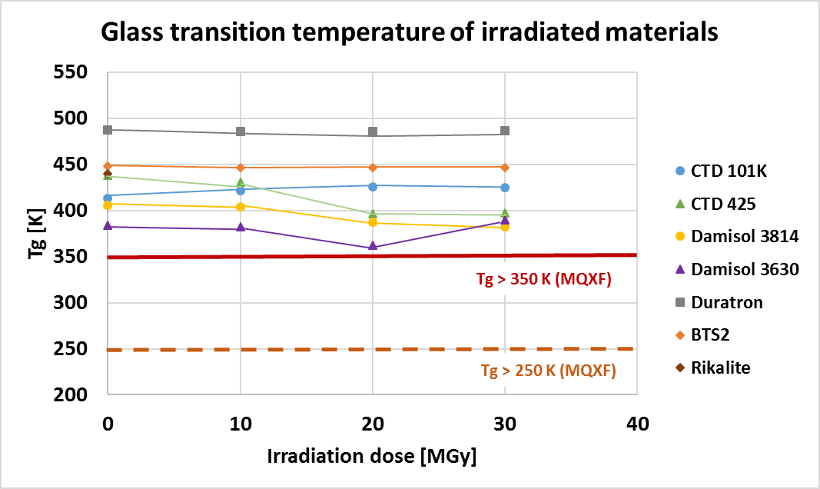
Physical limits for T_{hot}
The 420 K limit found in SP106 as the safe limit for protection, it is very close to the glass transition temperature of our resin (CTD 101K).
350 K was set as our design limit in order to have some margin.
[Beatriz Del Valle Grande, 2018, CERN Polymer LAB]

Slide 22
Outline
Protection design and reference parameters.
Overview on quench protection test results.
Summary and conclusions.

Slide 23
Summary (1/2)
The baseline protection scheme for the 11 T magnet relays on outer layer quench heaters impregnated with the coil.
  In case of installing the heaters after coil impregnation, the extra amount of insulation between heater and coil is a critical parameters since every 0.1 mm increases the heater delay by 10 ms.
Systematic protection tests were done along the short model program, confirming the values predicted by models.
Quench heaters are able to quench the magnet at all current levels.
An increase of the heater power density (I_{QH} = 200 A instead of 150 A) would have a modest increase on the protection performance (2 ms faster heaters, 10 K lower T_{hot})

Slide 24
Summary (2/2)
Expected hot spot temperature in the 11 T at nominal operation conditions is 320 K.
If the heaters are 10 ms slower, the hot spot would increase to 370 K.
At ultimate current, we will be close to 400 K (+ 20-40 K), which is just slightly below the 420 K reached in SP106 without degradation.
In case of heater failure (2 circuits out of 16), hot spot will be 15 K higher.
We never studied experimentally protection under failure cases, but it will be done in SP109
2 % I/I_{ss} degradation in SP106
Safe limit in SP106
370 K @ I_{nom,} additional 0.1 mm G10 between heaters and coil, no failure.
320 K I_{nom}, nominal protection parameters, no failure.

Slide 25
Closing remarks
Remark 1: there are a significant number of uncertainties on quench simulations, we don’t expect to be more precise than 20 K in the estimation of the hot spot temperature, but the same assumptions are used for High MIITs tests on SP106 and the evaluation of the impact of additional delay on baseline operation conditions.
Remark 2: These numbers have 3 ms (15 K) of margin since we assume 5 ms for heater firing delay (what we always see in SM18) but according to MPE this should be 2 ms for the machine.
Remark 3: We are in a rather steep a rather steep area in terms of delay-hot spot, and variation of copper content gives a large impact (± 10 K for a copper to superconductor ratio 1.15 ± 0.05).

Slide 26
Additional slides

Slide 27
References
ASC-2018: “Quench Protection Study of a 11 T Nb₃Sn Model Dipole for the High Luminosity LHC” (High temperature tests in SP106)
SP106
  https://edms.cern.ch/document/2026033/1
SP107
  https://edms.cern.ch/document/2026033/1
11 T dipole Circuit - Powering and protection; Engineering Specification; EDMS 1764166
  Needs to be updated with the latest test results (SP106 and SP107).

Slide 28
Impact on hot spot temperature (2)
420 K @ I_{nom,} additional 0.15 mm G10 between heaters and coil,
no failure.
370 K @ I_{nom,} additional 0.1 mm G10 between heaters and coil, no failure.
320 K I_{nom}, nominal protection parameters, no failure.

Slide 29
Impregnated vs. Non-impregnated heaters
If the amount of insulation between heater and coil is the same, impregnated (114&115) and non impregnated (106&109) heaters have a similar quench delay time

Slide 30
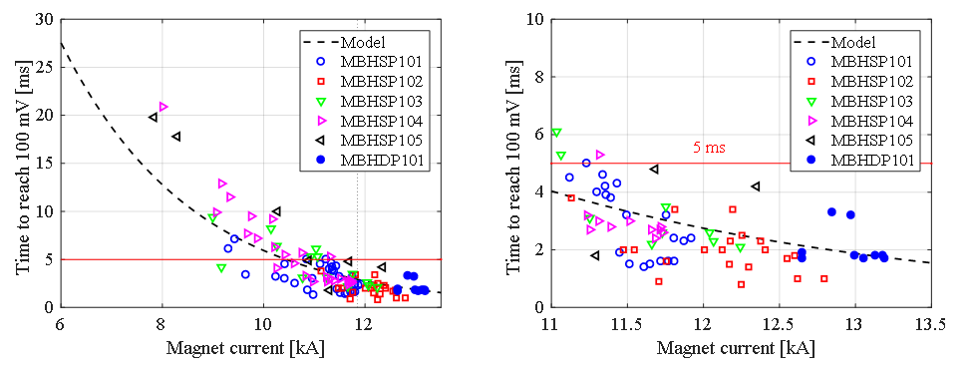
Detection
Time required to reach the 100 mV detection threshold during training as compared to the THEA model for a quench happening in the pole turn.

Slide 31
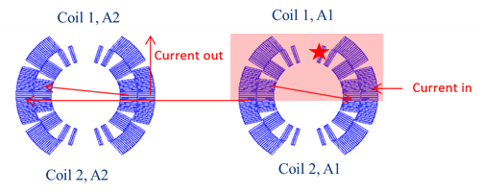
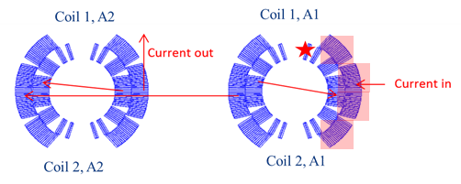
Failure case analysis 11 T
https://indico.cern.ch/event/549979/contributions/2263234/
[A. Giannopulos and A. M. Fernandez Navarro]
 |  | Peak voltage to ground(V) | Peak turn to turn voltage(V) | T_{max}(K)
Nominal | ROXIE (1x11 T magnet) | 352(without quench back) | 78 | 318
 | TALES (1x11 T magnet) | 260(with quench back) | 75 | 325
 | TALES (2x11 T magnet) | 260(with quench back) | 75 | 325
Worst case scenario heater wiring option 1 | ROXIE (1x11 T magnet) | 1001 (with quench back) 1480 (without quench back) | 85 | 355
 | TALES (1x11 T magnet) | 860 (with quench back) 1500 (without quench back) | 90 | 355
 | TALES (2x11 T magnet) | 950(with quench back) 1570 (without quench back) | 90 | 339
Worst case scenario heater wiring option 2 | ROXIE (1x11 T magnet) | 701 (without quench back) 1060 (without quench back) | 85 | 355
 | TALES (1x11 T magnet) | 750 (with quench back) 1100 (without quench back) | 85 | 356
 | TALES (2x11 T magnet) | 950(with quench back) 1500 (without quench back) | 95 | 339

Slide 32
Additional slides
TOTAL = 32 Voltage Taps for the Cryo-Assembly

Slide 33
Quench heater circuit resistance
At the time of the heater design there were “large” uncertainties:
  Lack of experience on the production of copper plated heaters, not clear what we were going to be able to achieve in terms of RRR, total thickens, uniformity…
  It was not clear the length of the heater powering leads, i.e., the additional resistance to be added to the heater circuit.
We went for a conservative approach, designing the heaters with margin to be sure that the heater current was at least 150 A (100-150 W/cm²) → R_{max} = 6 Ω
Based on the experience from the 1st prototype magnet, we have 2 Ω of margin for leads and all additional resistance in the heater.
Quench heater resistance for the heaters installed in the 1st 11 T porotype magnet
Company | Circuit Name | Resistance RT (Ω) | Resistance 1.9 K (Ω)
 | Nominal | 5.81 | 3.48
Technomec | YT 111 | 5.82 | 3.99
 | YT 112 | 5.85 | 4.04
 | YT 121 | 5.43 | 4.01
 | YT 122 | 5.92 | 4.03
Trackwise | YT 211 | 5.43 | 3.77
 | YT 212 | 5.37 | 3.69
 | YT 221 | 5.43 | 3.73
 | YT 222 | 5.43 | 3.73

