Slide 1

Cosmological Implications of Electroweak Vacuum Instability
Arttu Rajantie
Beyond19, Warsaw, Poland
1 July 2019
In collaboration with:
Daniel Figueroa, Matti Herranen, Andreas Mantziris,
Tommi Markkanen, Sami Nurmi, Stephen Stopyra, Francisco Torrenti

Slide 2
Based on:
Herranen, Markkanen, Nurmi & AR, PRL113 (2014) 211102
Herranen, Markkanen, Nurmi & AR, PRL115 (2015) 241301
AR & Stopyra, PRD95 (2017) 025008
AR & Stopyra, PRD97 (2018) 025012
Figueroa, AR & Torrenti, PRD98 (2018) 023532
Markkanen, Nurmi, AR & Stopyra, JHEP 1806 (2018) 040
Markkanen, AR & Stopyra, Front.Astron.Space Sci. 5 (2018) 40

Slide 3
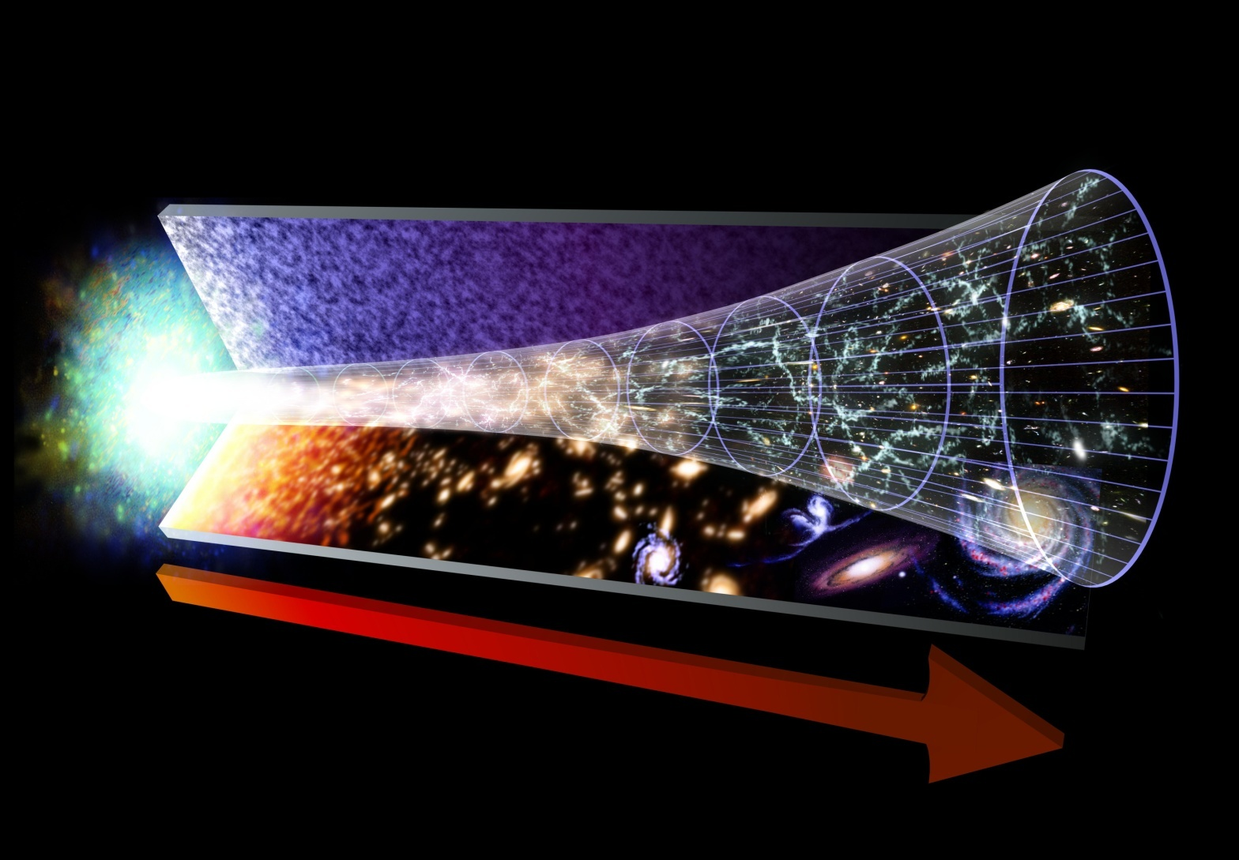
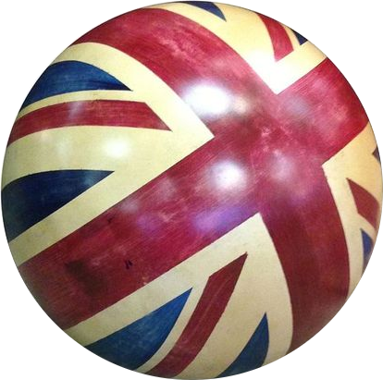

Brexiton
Hypothetical phenomenon:
Brexiton decouples from other fields
and turns into a slowly decaying spectator

Slide 4

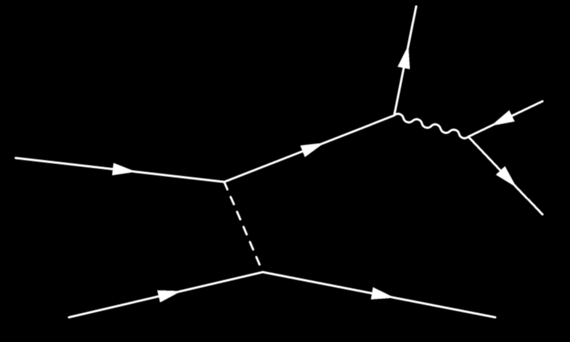





Brexiton
Decays due to interaction with the real world

Slide 5

Standard Model of Particle Physics
All renormalisable terms
allowed by symmetries
in Minkowski space
19 parameters –
all have been measured
Can be extrapolated all
the way to Planck scale
For central experimental
values $M_{H}=125.18 GeV$
and $M_{t}=173.1 GeV$
  $λ$ becomes negative at $μ_{Λ}≈9.9×{10}^{9} GeV$
  Minimum value $λ_{min}≈−0.015$ at $μ_{min}≈2.8×{10}^{17} GeV$
(Buttazzo et al 2013)

Slide 6
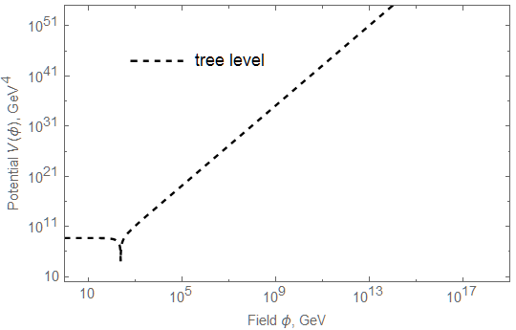
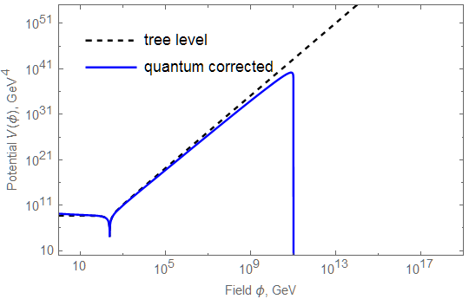

Vacuum Instability
Higgs effective potential
$V\left(φ\right)≈λ\left(gφ\right)φ^{4}$
Becomes negative
at $φ>φ_{c}≈{10}^{10}GeV$
True vacuum at
Planck scale?
Current vacuum
metastable against
quantum tunnelling
Barrier at
$φ_{bar}≈4.6×{10}^{10} GeV$,
height $V\left(φ_{bar}\right)≈{\left(4.3×{10}^{9} GeV\right)}^{4}$
(Based on a 3-loop calculation by Bednyakov et al. 2015)

Slide 7
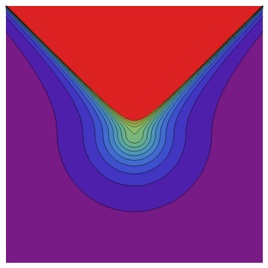

Tunneling Rate
Bubble nucleation rate:
  $Γ∼e^{−B}$, where
  $B=$ “bounce” action (Coleman 1977)
  Solution of Euclidean eom
Constant $λ<0$: (Fubini 1976)
$φ\left(r\right)=\sqrt{\frac{2}{|λ|}}\frac{2R}{r^{2}+R^{2}}$
Action $B=\frac{8π^{2}}{3\left|λ\right|}$
When $λ$ runs, $B≈\frac{8π^{2}}{3\left|λ_{min}\right|}≈1800$
and $Γ∼μ_{min}^{4}e^{−B}$
Depends sensitively on Higgs and top masses

Slide 8


Past Light Cone
Assumptions:
  Bubbles grow at the speed of light (see Stopyra’s talk)
  and destroy everything they hit
⇒ There cannot have been any bubbles in our past light cone
today $η_{0}$
conformal time $η$
hot Big Bang
inflation
comoving distance

Slide 9
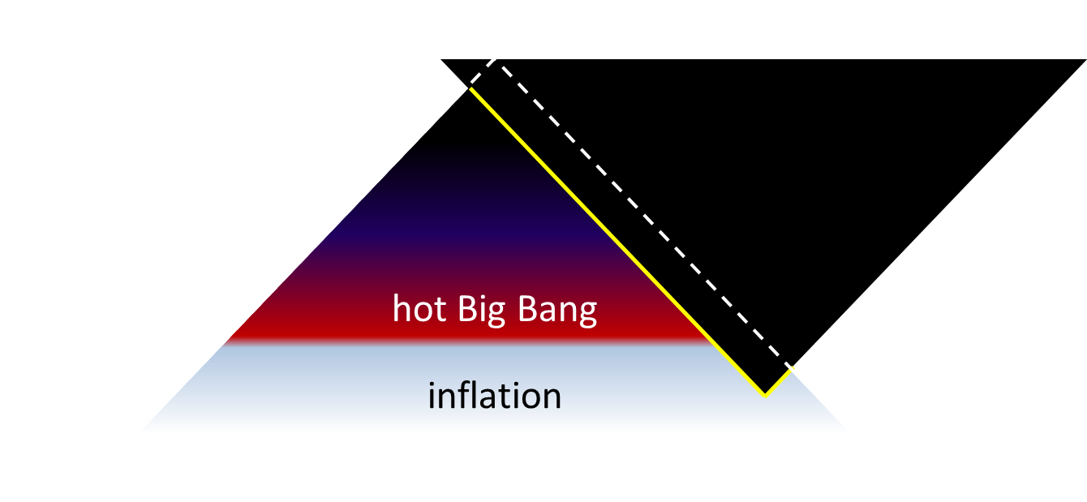

Past Light Cone
Probability of no bubble in the past light cone:
$$P\left(𝒩=0\right)=e^{−\left\langle 𝒩\right\rangle },$$
where $\left\langle 𝒩\right\rangle$ is the expected number of bubbles ($dη=dt/a$),
$$\left\langle 𝒩\right\rangle =\frac{4π}{3}\int^{η_{0}}{dη a{\left(η\right)}^{4}{\left(η_{0}−η\right)}^{3}Γ\left(η\right) }$$
Therefore, we must have $\left\langle 𝒩\right\rangle ≲1$
Integrate over the whole history
of the Universe:
inflation, reheating, hot Big Bang,
and late Universe
(For anthropists: $\frac{d\left\langle 𝒩\right\rangle }{dt}Δt≲1$)
((For quantum immortalists:
You may go. There is nothing for you in this talk.))

Slide 10

Late Universe Stability Bounds
Number of bubbles in past lightcone: $〈𝒩〉≈0.125Γ/H_{0}^{4}$
If $〈𝒩〉≪1$, no contradiction ⇒ Metastability
(Buttazzo et al. 2013)

Slide 11
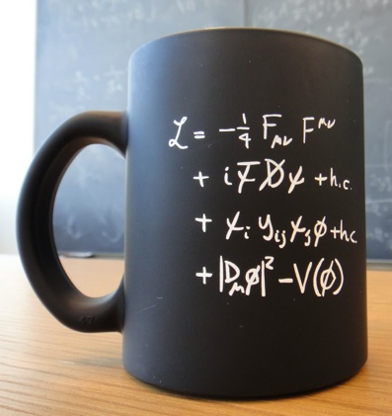


Higgs-Curvature Coupling
Curved spacetime:
$$ℒ=ℒ_{SM}+ξRφ^{†}φ$$
$\text{(}\text{Chernikov}\text{\&}\text{Tagirov}\text{ 1968)}$
Symmetries allow one more renormalisable term:
Higgs-curvature coupling $ξ$
Required for renormalisability,
runs with energy –
Cannot be set to zero!
Last unknown parameter
in the Standard Model
$$+ξRφ^{2}$$

Slide 12
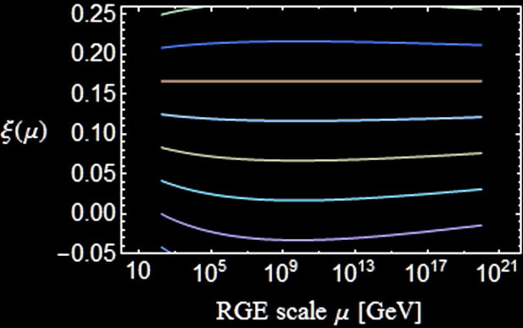


Running $ξ$
$$μ\frac{dξ}{dμ}=\left(ξ−\frac{1}{6}\right)\frac{12λ+6y_{t}^{2}−\frac{3}{2}g^{′2}−\frac{9}{2}g^{2}}{16π^{2}}$$
Becomes negative
if $ξ_{EW}=0$
Conformal value
$ξ=1/6$
RG invariant at 1 loop
but not beyond

Slide 13


Measuring $ξ$
Curved spacetime:
$$ℒ=ℒ_{SM}+ξRφ^{†}φ$$
Ricci scalar $R$ very small today
⇒ Difficult to measure $ξ$
Colliders: Suppresses Higgs couplings (Atkins&Calmet 2012)
  LHC Bound $\left|ξ\right|≲2.6×{10}^{15}$
  Future (?) ILC: $\left|ξ\right|≲4×{10}^{14}$
In contrast, $R$ was high in the early Universe

Slide 14
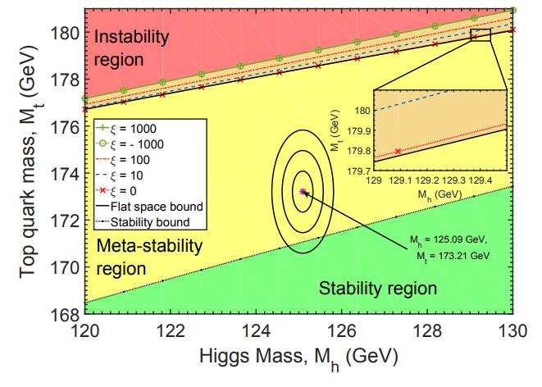
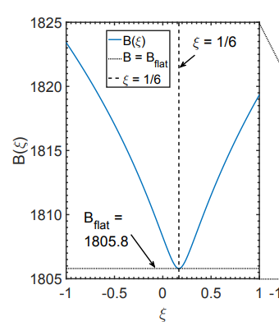
Late Universe Stability Bounds
Find the gravitational
instanton by solving
field + Einstein equations
numerically
(AR&Stopyra 2016)

Slide 15
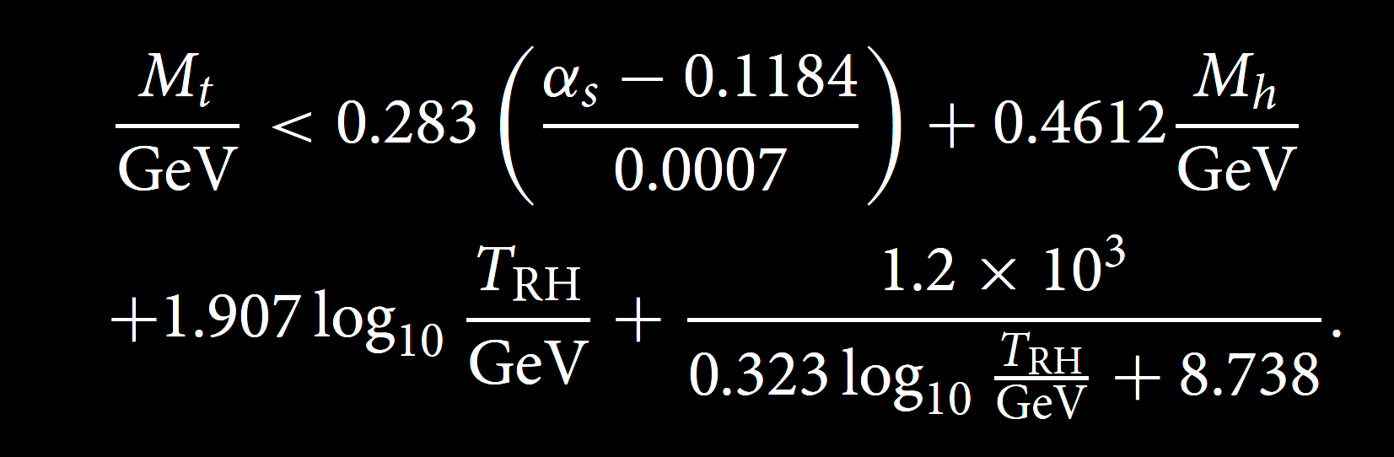

Hot Big Bang
High temperature:
Higher bubble nucleation
rate (Espinosa et al 2008)
If reheat temperature $T_{RH}$
is high enough, this
dominates over late-time
contribution
Top mass bound
(Delle Rose et al 2016):
(Markkanen, AR, Stopyra, 2018)

Slide 16

Higgs Fluctuations from Inflation
Inflation: $H≲9×{10}^{13} GeV$ (Planck+BICEP2 2015)
Assume light Higgs, no direct coupling to inflaton
Equilibrium field distribution (Starobinsky&Yokoyama 1994)
$P\left(φ\right)∝exp\left[−\frac{8π^{2}}{3H^{4}}V\left(φ\right)\right]$
Tree-level potential
$V\left(φ\right)=λ{\left(φ^{2}−v^{2}\right)}^{2}$
Nearly scale-invariant
fluctuations with
amplitude $φ∼λ^{−1/4}H$
Higgs fluctuations

Slide 17

Higgs Fluctuations from Inflation
Equilibrium $P\left(φ\right)∝exp\left[−\frac{8π^{2}}{3H^{4}}V\left(φ\right)\right]$
Running $λ$:
Fluctuations take the
Higgs over the barrier
if $H≳φ_{bar}≈{10}^{10}GeV$
(Espinosa et al. 2008;
Lebedev&Westphal 2013;
Kobakhidze&Spencer-Smith 2013;
Fairbairn&Hogan 2014;
Hook et al. 2014)
Does this imply
$H≲{10}^{10}GeV$ ?
Higgs fluctuations

Slide 18

Spacetime Curvature
Effective Higgs mass term $m_{eff}^{2}(t)=m_{H}^{2}+ξR(t)$
Ricci scalar in FRW spacetime:
$$R=6\left(\frac{{\dot{a}}^{2}}{a^{2}}+\frac{\ddot{a}}{a}\right)=3\left(1−3w\right)H^{2}$$
  Radiation dominated $w=1/3$ $R=0$
  Matter dominated $w=0$ $R=3H^{2}$
  Inflation / de Sitter $w=−1$ $R=12H^{2}$

Slide 19

Higgs During Inflation
Inflation: Constant $R=12H^{2}$
Effective mass term
$$m_{eff}^{2}=m_{H}^{2}+ξR=m_{H}^{2}+12ξH^{2}$$
Tree level: (Espinosa et al 2008)
  $ξ>0$: Increases barrier height
  Makes the low-energy vacuum more stable
  $ξ<0$: Decreases barrier height
  Makes the low energy vacuum less stable
$H$ contributes to loop corrections:
For $H≫φ$, $V\left(φ\right)≈λ\left(H\right)φ^{4}$  No barrier! (HMNR 2014)

Slide 20
Effective Potential in Curved Spacetime
One-loop computation in de Sitter:
(MNRS 2018)

Slide 21

Potential in Curved Spacetime
One-loop computation for $ξ=0$ (in units of $μ_{inst}≈6.6×{10}^{9} GeV$)
(MNRS 2018)

Slide 22




(De-)Stabilising the Potential
$$ξ≳0.06$$
$$V_{max}∼\frac{36ξ^{2}H^{4}}{|λ|}$$
$$V\left(φ\right)$$
Minkowski
$$φ$$
$$ξ≲0.02$$

Slide 23

(De)Stabilising the Potential
If $H≳μ_{inst}=6.6×{10}^{9}GeV$ and there is no new physics,
vacuum stability during inflation requires $ξ≳0$
(MNRS 2018)

Slide 24
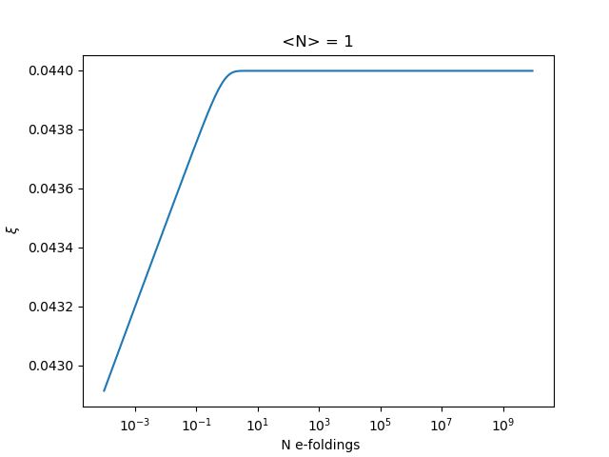

Time-Dependent Hubble Rate
In real inflationary models, $H$ depends on time:
Affects decay rate $Γ$ and volume of past light cone
Simplest case:
Quadratic chaotic inflation
$V\left(χ\right)=\frac{1}{2}m^{2}χ^{2}$
Most bubbles produced
near the end of inflation
Stability requires
$ξ≳0.044$
(Mantziris, Markkanen & AR,
in progress)

Slide 25
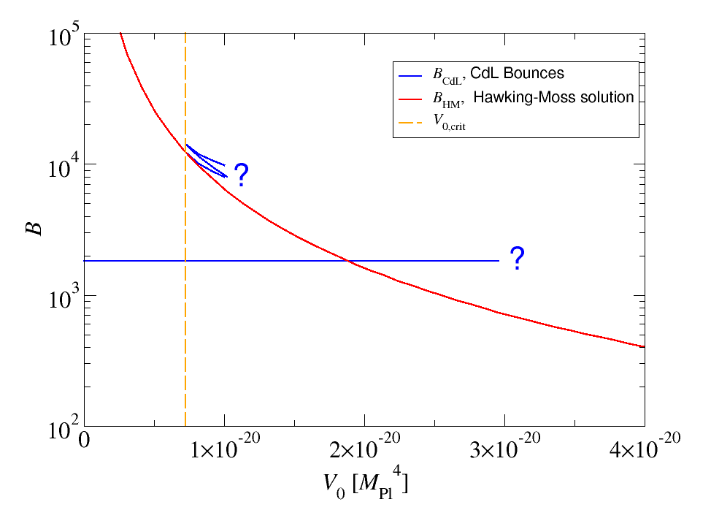

Quantum Tunneling
Toy model potential
Standard Model potential
Multiple coexisting solutions (AR&Stopyra, PRD 2018)
Quantum (Coleman-de Luccia) tunnelling rate $Γ∼e^{−B}$ nearly constant until Hawking-Moss starts to dominate
⇒ Hawking-Moss is always the relevant process for the constraint

Slide 26
Multiple Solutions
(AR&Stopyra, PRD 2018)

Slide 27

End of Inflation
Reheating: Inflation ($R=12H^{2}$) → radiation ($R=0$)
$$R\left(t\right)=\frac{2m^{2}χ^{2}− {\dot{χ}}^{2}}{M_{Pl}^{2}}$$
Effective Higgs mass $m_{eff}^{2}=m_{H}^{2}+ξR$ oscillates:
  Parametric resonance (“Geometric preheating”)
  (Bassett&Liberati 1998, Tsujikawa et al. 1999)
$R$ goes negative when $χ∼0$
  If $ξ>0$, Higgs becomes tachyonic (HMNR 2015)
  Exponential amplification
  $${\left\langle φ^{2}\right\rangle }_{H}∼\frac{2}{3\sqrt{3}ξ}{\left(\frac{H}{2π}\right)}^{2}e^{\frac{2\sqrt{ξ}χ_{ini}}{M_{Pl}}}∼\frac{H^{2}}{ξ}e^{2\sqrt{ξ}}$$

Slide 28
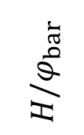
Vacuum Decay at the End of Inflation
Not enough
growth
Instability!
?
Becomes
nonlinear
$$H/φ_{bar}$$
Field backreaction
(HMNR 2015)

Slide 29

Lattice Simulations
$V\left(χ\right)=\frac{1}{2}m^{2}χ^{2}$, $M_{top}=172.12 GeV$
true
vacuum
Figueroa, AR & Torrenti, 2018

Slide 30

Instability Time
Stability depends on top mass and speed of reheating
$M_{top}=173.34 GeV:$ vacuum decay before $mt=100$if $ξ≳9$
Figueroa, AR & Torrenti, 2018

Slide 31


Constraints on $ξ$
Minimal scenario:
Standard Model + $m^{2}χ^{2}$ chaotic inflation,
no direct coupling to inflaton
$$0.04≲ξ≲9$$
15 orders of magnitude stronger than the LHC bound
$\left|ξ\right|≲2.6×{10}^{15}$
Caveats:
  Assumes no direct coupling to inflaton (see, e.g., Ema et al. 2016, 2017)
  – Would still need $|ξ|≲O(1)$
  Assumes no new physics
  – Could stabilise potential altogether, or destabilise further
  Assumes high scale inflation $H≳{10}^{9} GeV$

