Slide 1
WLCG operations
ALICE T1-T2 Workshop
UPB, Bucharest
May 14-16, 2019
Maarten Litmaath
CERN-IT v1.0

Slide 2
Central service main issues
August
  Task queue DB HW issue on a Sat afternoon
    Fixed late evening thanks to heroic efforts by Miguel and Costin
  Fallout from CA reorganization in AliEn
    Some new CAs are incompatible with the old OpenSSL in AliEn
  Several cache crashes required manual restarts
    Due to huge query rates from badly behaved jobs
October
  Task queue host erratic I/O performance
    Task queue had to be moved to another machine
November
  Instabilities due to raw data replication traffic
    Cured by various improvements

Slide 3
Site evolution
University of Derby
  PoC cluster of 120 cores since June 19
New site ICM (Warsaw) being set up
New or enlarged EOS instances at several sites
  The third EOS workshop was held Feb 4-5
Growth – 2018 and 2019 pledges
  More disk space is welcome in particular!

Slide 4
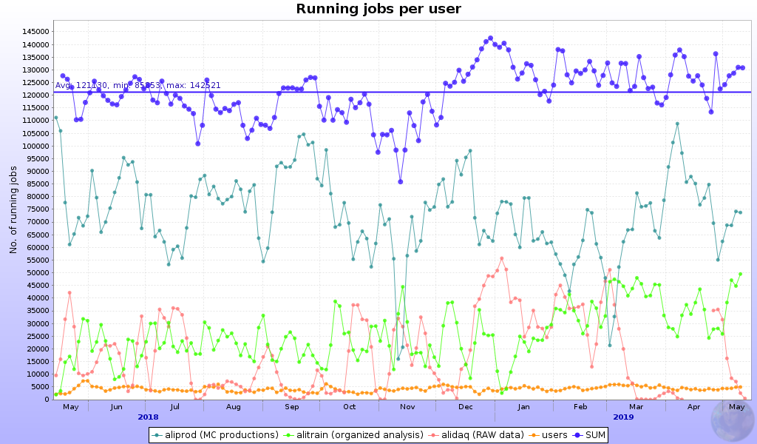
High activity
150k reached
in EOY break
+8k average of
started + saving
In time for SQM 2019, June 10-15

Slide 5
Storage
Heavy-ion data taking
  Sufficient disk space on eosalicedaq to allow all data to be kept on disk for reconstruction
  Export to the T1 sites and copy to CASTOR completed during the end-of-year break
CERN
  EOS name space upgraded to QuarkDB
    More scalable & robust

Slide 6
Issues at sites or with jobs (1)
IN2P3-CC: 110 TB lost due to RAID problem
WN had to be rebooted everywhere to fix L1 Terminal Fault kernel vulnerabilities
Occasionally high error rates due to bad jobs
  Fallout at sites will be limited when containers are used
Clermont unusable for 1 month due to huge failure rates
  Weird errors that finally were gone unexplained
Prague unusable for 2 months due to network issues
  Recovered thanks to a big effort of the Prague team!

Slide 7
Issues at sites or with jobs (2)
CERN: 20k “ghost jobs” discovered on March 12 and another 10k on March 20
  Not visible in MonALISA
  Several example jobs found stuck in gdb
  During ~1.5 days the number of such jobs steadily shrunk to zero
  Root cause was not found

Slide 8
Middleware
CentOS/EL7 has become the default
  SL6 will be supported (critical fixes) until Dec 2020
CREAM CE supported until Dec 2020
  EGI Ops and WLCG Ops will provide guidelines for helping sites replace CREAM CEs with suitable choices from a set of potential alternatives
    ARC – already in use at many sites since many years
    HTCondor – being integrated into the UMD
    Solutions without a CE – if all your customers can handle that
    See the Future After CREAM-CE sessions (first, second) held on May 7 at the EGI Conference and the May 8 GDB summary
UMD only has officially supported products
  Products like Maui remain available in the Community Repository

Slide 9
Containers
WLCG Containers WG intends to provide common guidelines for Singularity deployment on WN
  Driven by CMS and ATLAS use cases
  Should suffice also for ALICE and LHCb
As of RHEL/CentOS 7.6 there is a sysctl to enable unprivileged mount namespaces (not yet default)
  That allows Singularity to be deployed and used without the need for setuid root → avoids being affected by yet more critical vulnerabilities in that package…
For ALICE the use of containers by jobs is linked to the deployment of JAliEn
  More in Maxim’s talk

Slide 10
EU cloud projects
Helix Nebula Science Cloud project has finished
  Up to ~20k cores were available to the 4 LHC experiments plus other participating projects until Dec
  Virtual sites Capella and Regulus were used by ALICE to target the 2 consortia providing resources
    400k MC jobs delivered
  ALICE use cases served for WLCG/HEP TCO studies
Non-trivial to configure/debug such resources
  Network and other issues
  Default easy use case: MC production
As of Jan this year the next phase has started: Open Clouds for Research Environments (OCRE)

Slide 11
SAM
Reminder: SE test failures reduce the A / R!
Corrections are applied as needed
  A policy defines thresholds to reduce the number of recalculations

Slide 12
Xrootd reminder
Sites should continue upgrades to Xrootd >= 4.1
  Almost all sites have done that already, thanks!
  Required for IPv6 support
  EOS → upgrade to v4 a.k.a. Citrine
Communication via LCG Task Force list as usual for expert advice
ALICE add-ons are available through rpms
  http://linuxsoft.cern.ch/wlcg/
  Thanks to Adrian Sevcenco!

Slide 13
Networks
WLCG IPv6 deployment
  Status recently presented in Apr GDB
  ALICE storage majority available through IPv6
    73% at CERN + T1 sites
    46% at T2 sites
  ALICE needs ~all storage to be dual-stack before IPv6-only computing can be used
4th Asia Tier Center Forum, held Nov 20–21
  Hosted by SUT – thanks!
  Fostering network evolution in Asia – well done!

Slide 14
Tips for sites – thanks!
Possible issues on VOBOX, CE, WN
  CVMFS problem, CE not ready for jobs,
  myproxy running low, …
  Absence of “system” library
    HEP_OSlibs rpm helps avoid that
Jobs may fail due to SE problems
Admins please check site issues page
  http://alimonitor.cern.ch/siteinfo/issues.jsp
Subscribe to relevant notifications
  http://alimonitor.cern.ch/xml.jsp

