Slide 1
Report: #1
Activity: PS complex
Jose A. Ferreira
10th December 2018

Slide 2
Performed activities during last 2 weeks
AD
  Disconnection of old AD transfer lines (in plan)
  Preparation of first magnets to consolidate (QDS03, QFN04, BHN05 and QDN05)
LINAC2
  Venting of tanks, source and RFQ
nTOF
  Venting of collimator

Slide 3
Planned activities for next 2 weeks
Power cut 19/12 → All systems stopped
LINAC4
  W50-51. Disconnect reliability run configuration. Remove instrumentation (SEMgrids)
  W2-3. Installation of transfer line. Sectors 4.5, 4.6 and 4.7
LINAC2
  W2-3. Disconnect equipment upstream LT.QFN50

Slide 4
Planned activities for next 2 weeks
PSB
  Electrical lockout 21-12
  W3. Venting and disconnection of
    BI line
    BR10: Disconnect BHZ151, BHZ162, BHZ11 and BI.SMH.
    BR20 and BR30 → FINEMET cavities

Slide 5
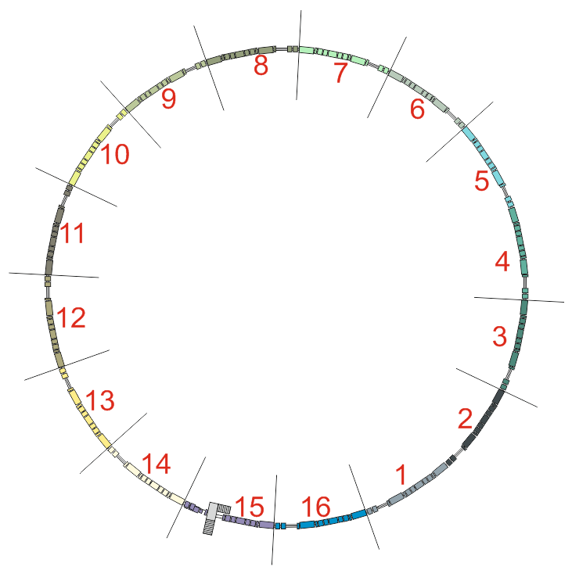
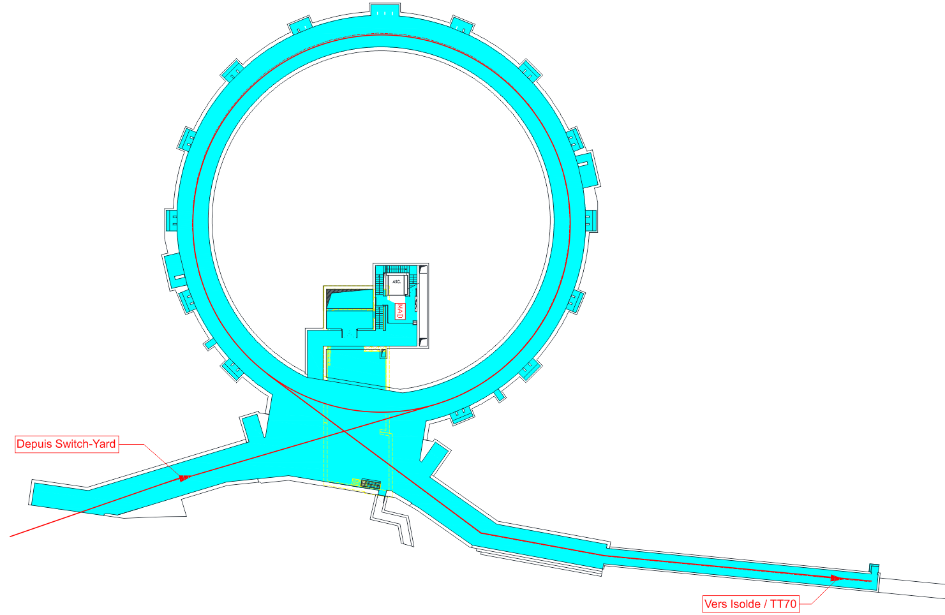
PSB
Remove prototype Finemet cavities (BR4.ACWF 6L1)
Replace RF cavities with new finemet cavities (BRr.C16 5L1, BR2.C02 7L1 & BR4.C02 7L1, BRr.C04 13L1)
Replace kicker magnets (16L4, 2L1)
New PSB Injection Region
Remove the current sector (1L1)
New H- charge exchange injection systems
Replace bending magnets (INJ BHZ162, EXT BHZ151)
Remove BHZ152 and BHZ161)
Injection line BI:
New Injection bending (BHZ INJ)
New Distributor (BI.DIS10)
New Septa (BI.SMV10)
Relocate beam instrumentation (BI.BTV30)
Change of the magnets (BVTs, correctors)
New BPMs
New beam loss monitors
New RF bypasses
Vers PS

Slide 6
Planned activities for next 2 weeks
PS
  W2: Vent vacuum sector PR80, remove and pump KFA79, SS73, pump KFA71 prepare magnet MU73
  W2: Vent PR50. Prepare magnet MU44 and SS44 for tests in KFA45
  W2-3: Vent PR30. Prepare SS24, MU24, SS27, MU27, SS22, MU22, SS29 and MU29
  W3: Remove SMH16!
  W2: Open SS01

Slide 7
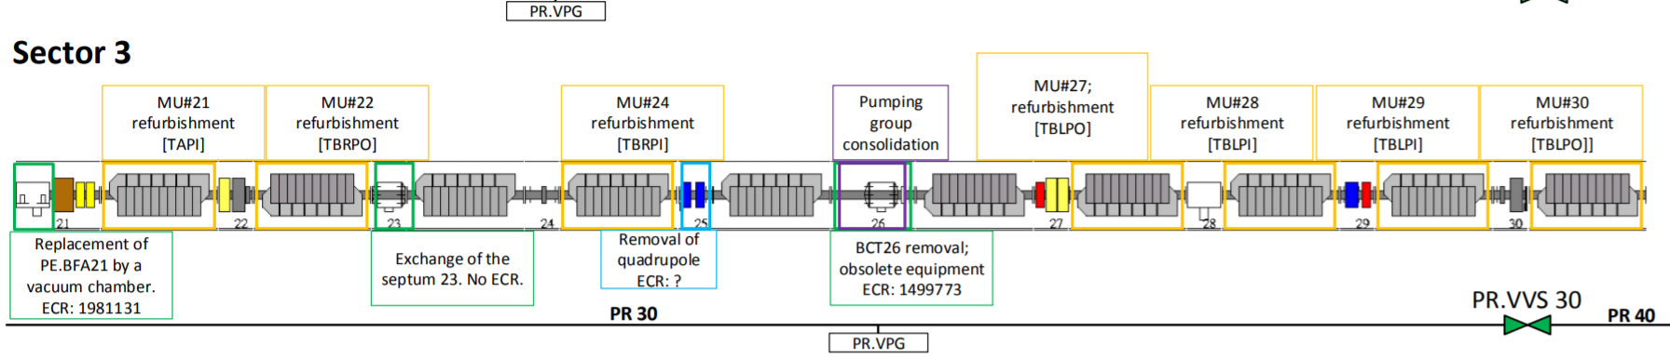
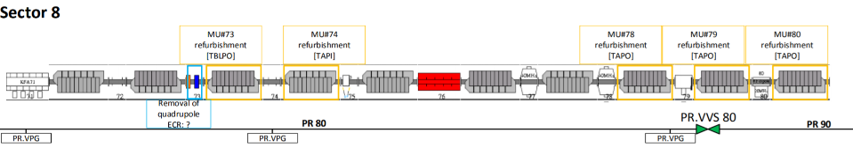

Slide 8
Planned activities for next 2 weeks
AD
  W50-3 Remove magnets QDS03, QFN04, BHN05 and QDN05
  W2-3 ELENA transfer lines dismantling
nTOF
  W50. Remove chamber of sweeping magnet. Disconnection of chambers in TT2A: Removal of shielding and magnets
HIE-ISOLDE
  Prepare for LS2. Disconnect sector valves, static vacuum (follow-up warm-up)

Slide 9
Resources distribution
Russian team: Training? Availability?
No issues before Xmas
W2:
      1 team: Alice + Nico, LINAC2 + LINAC4 + lab 101 and 867
      1 team: Guillermo + Paul + 1 team 40/30: training and advance in PS as much as possible
      1 team Alex + 40/30 ELENA/AD
      Claude preparation of tools and transport. Preparation of new FrontEnds
W3
      1 team: Alice + Nico, LINAC2 + LINAC4 + lab 101 and 867 → Participation disconnection of SMH16
      1 team: Guillermo + Paul: PSB
      1 team 40/30: Progressing magnet preparation and follow-up first magnet
      1 team Alex + 40/30 ELENA/AD → Participation disconnection of SMH16
      Claude preparation of tools and transport. Preparation of new FrontEnds

Slide 10
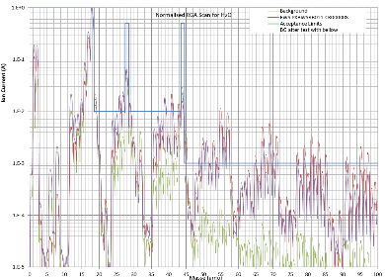
Technical problems
Bumper magnet chambers late → January
Jobs to open to produce chambers for magnets in transfer lines
Design of sweeping magnet
Issue with FWS contamination → Research will require time
High peak of activities in January
Only two cars with minimum of 3 different workplaces

Slide 11
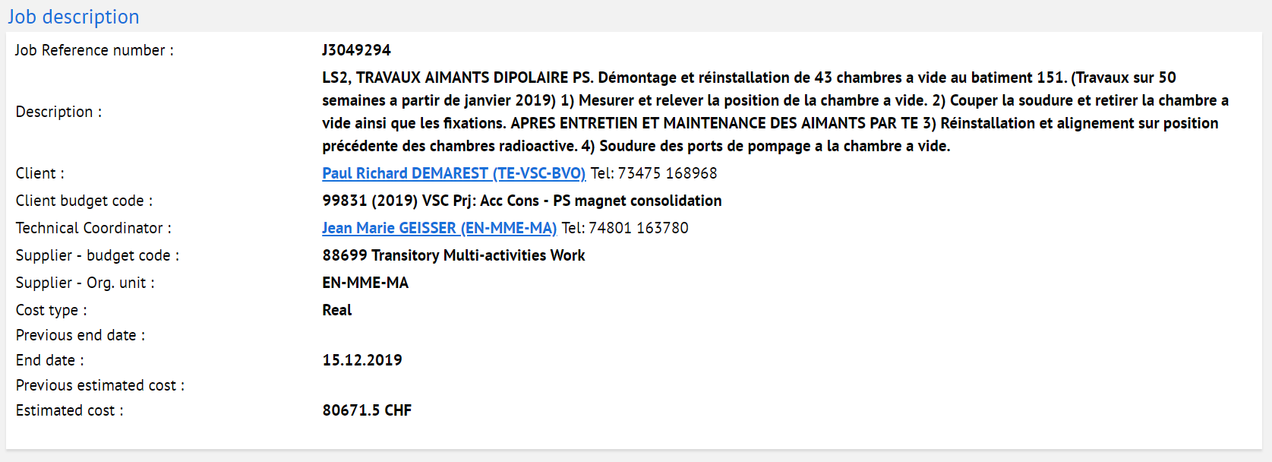
Technical problems

Slide 12
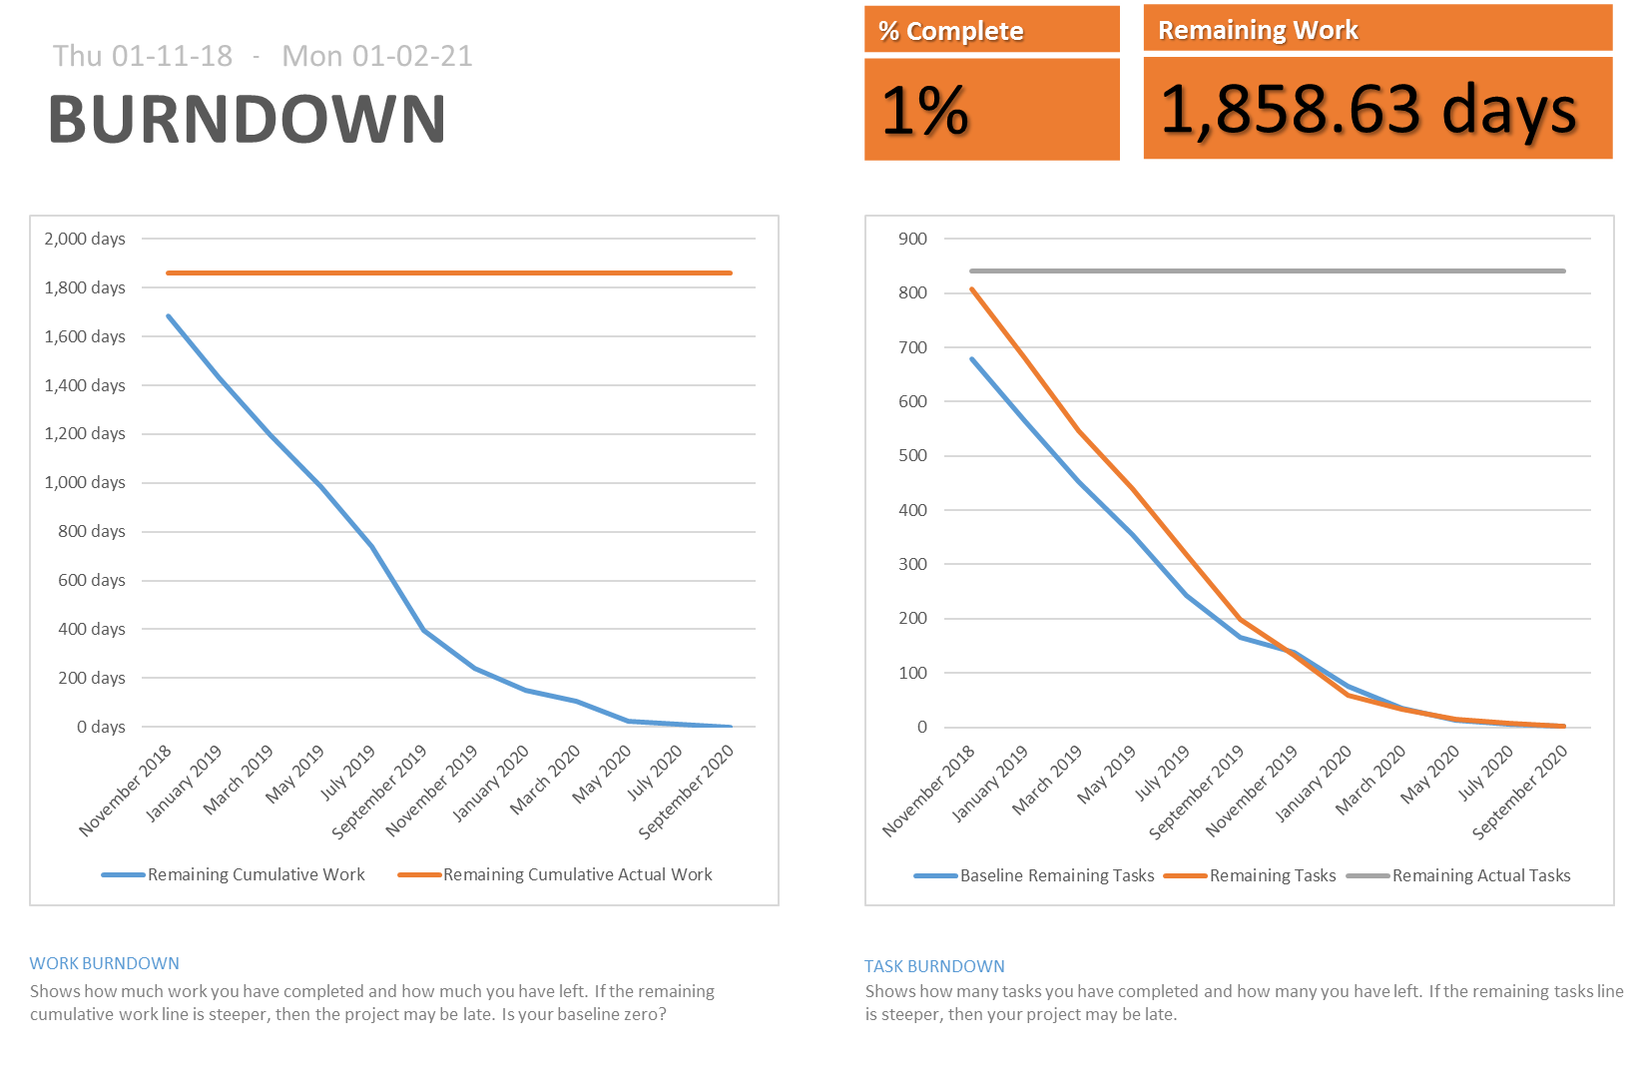
Dashboard and work evolution
TOO EARLY
https://en.wikipedia.org/wiki/Burn_down_chart

Slide 13
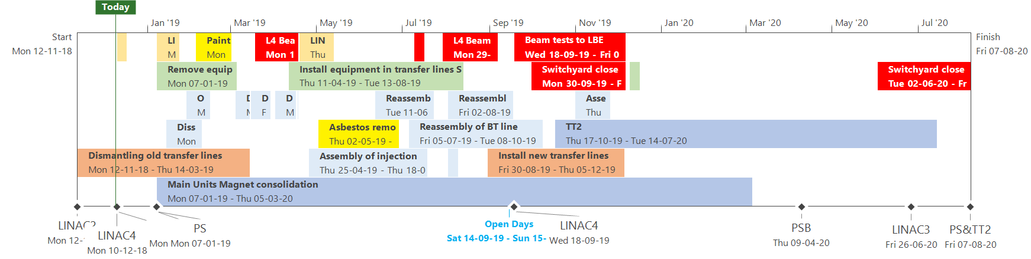
Thank you !

