Slide 1
Week 1 (49/2018)
LHC experimental areas
On behalf of BVO Josef Sestak
2nd VSC LS2 Overview of activities

Slide 2
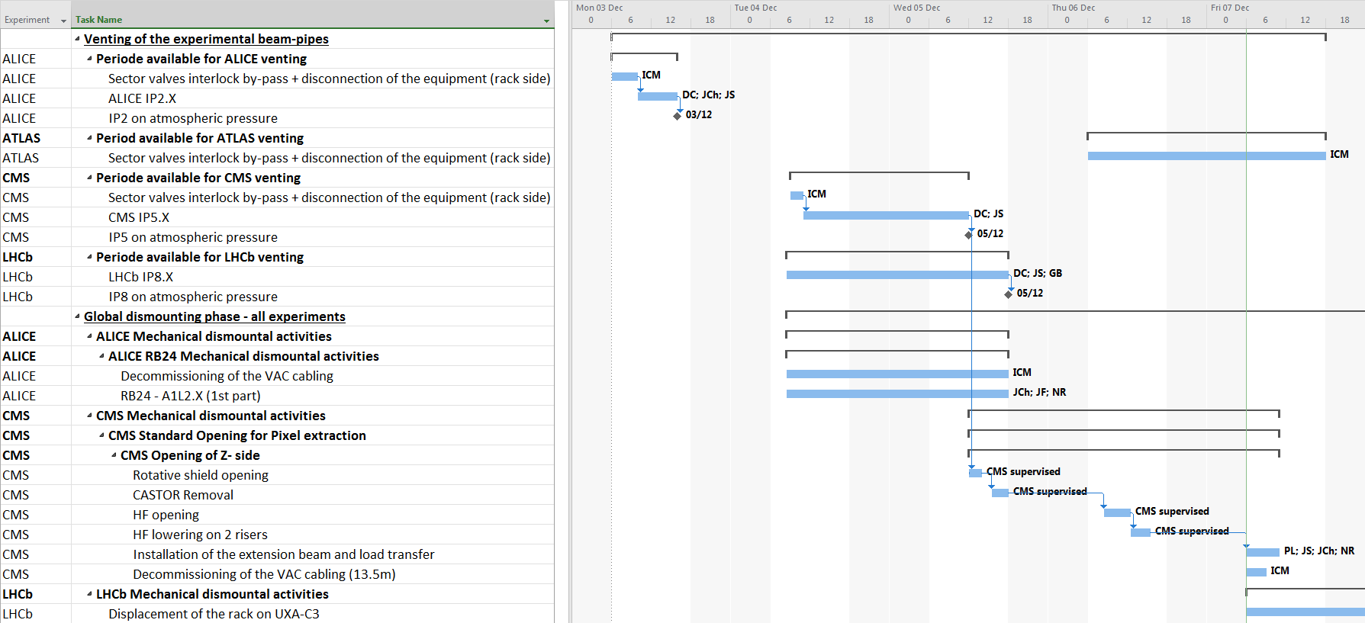
Performed activities during last week

Slide 3
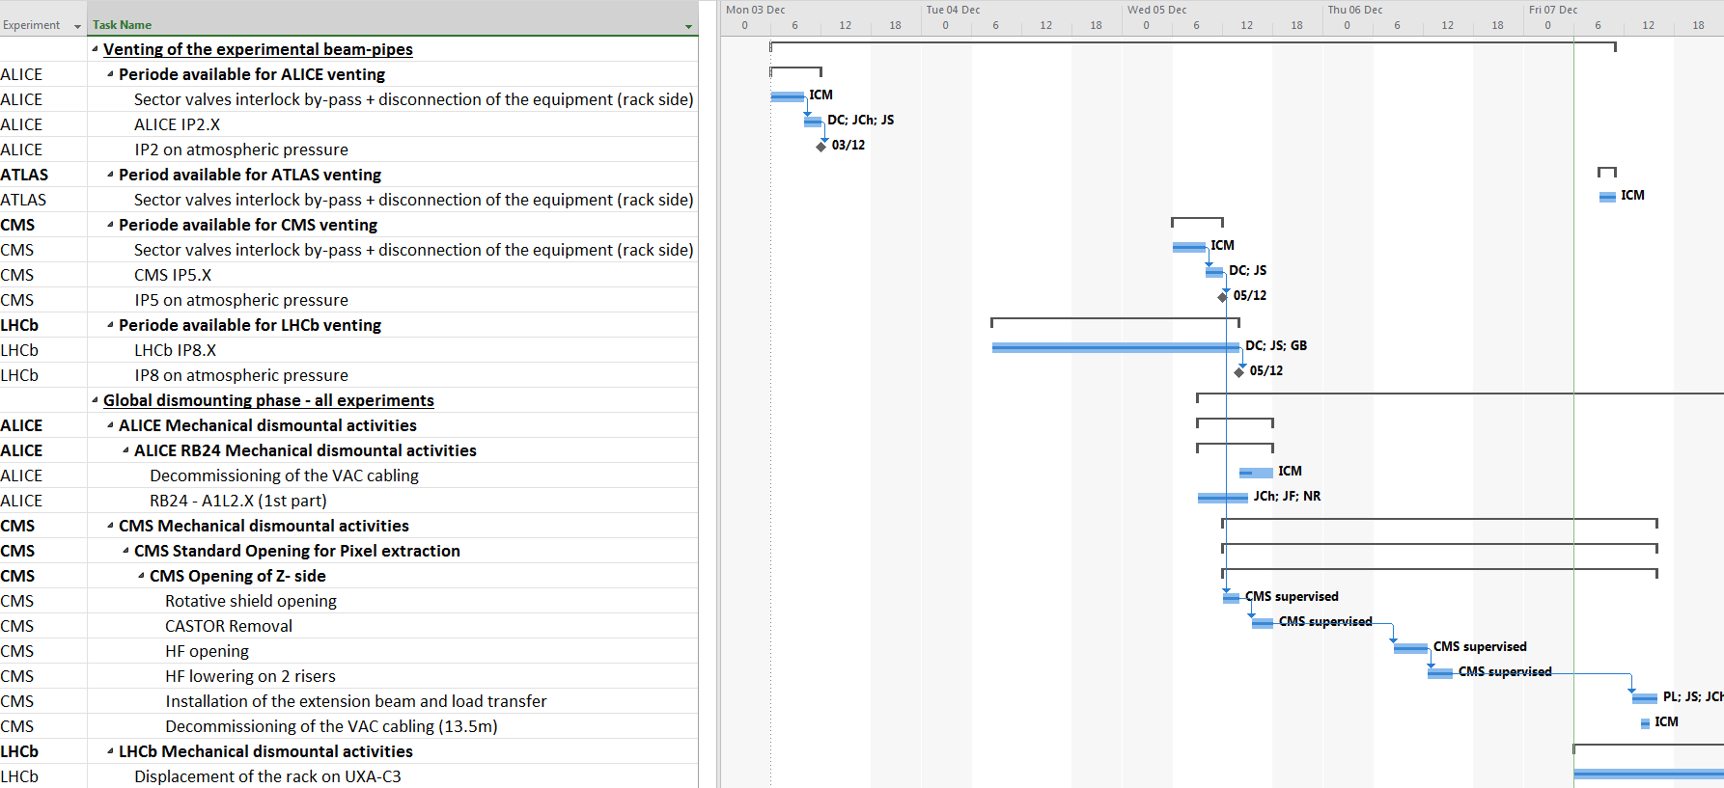
Performed activities during last week

Slide 4
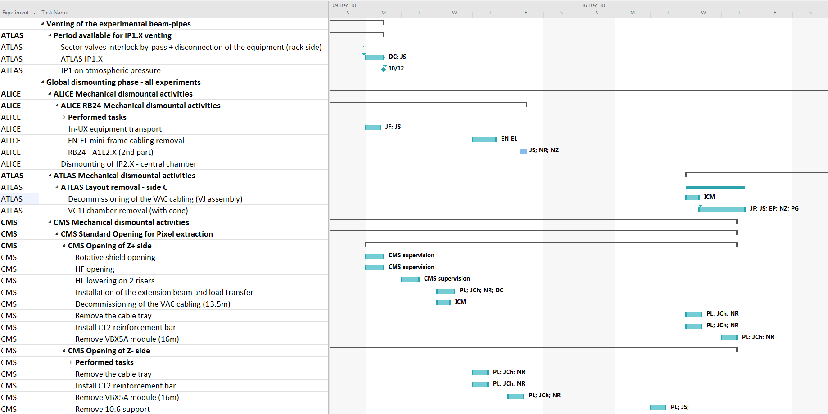
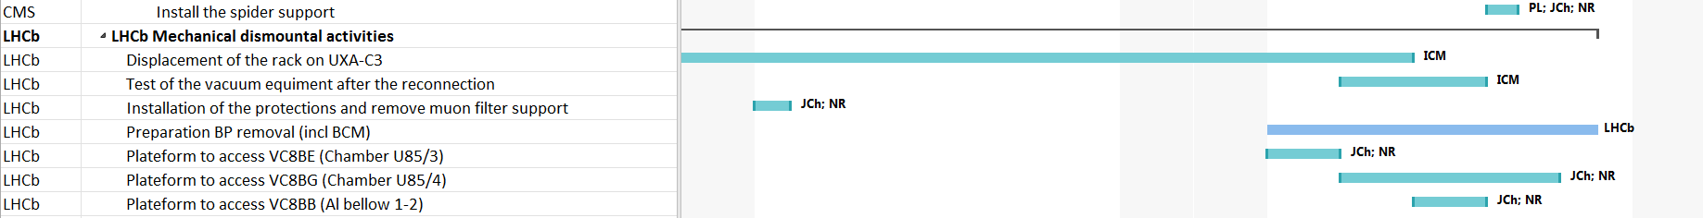
Planned activities for next 2 weeks

Slide 5
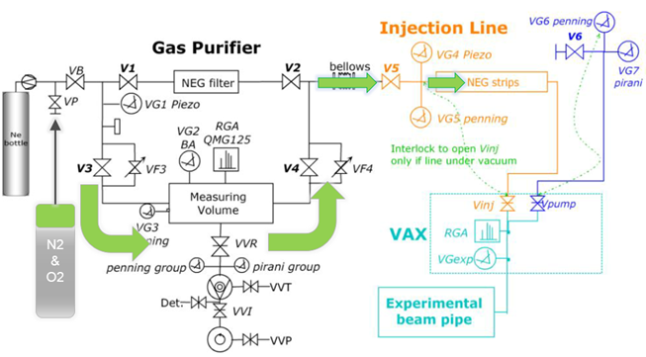
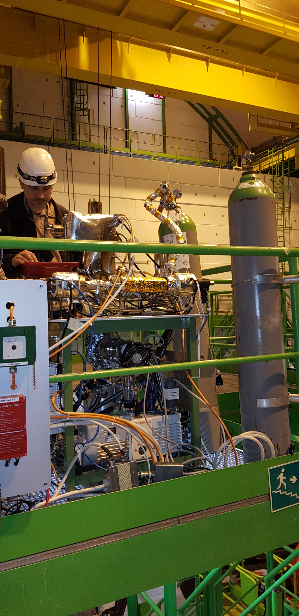
Venting interventions
Venting gas N₂ (60) – O₂ (55) 80-20;
ALICE & CMS injected bypassing the NEG filter;

Slide 6
Venting interventions challenges
ALICE
  VVGSW.A1R2.X interlocked by IT2L – solved by ICM;
CMS
  PLC and GIS table status due to the power-cut;
  PLC restarted but without respond of primary pump;
  GIS primary pump state reset on site;
LHCb
  VELO beam volume & detector volume opened to the atmospheric pressure;
  Bypass valve connecting both volumes removed (no balancing mode);
Detailed intervention reports will be published in EDMS

Slide 7
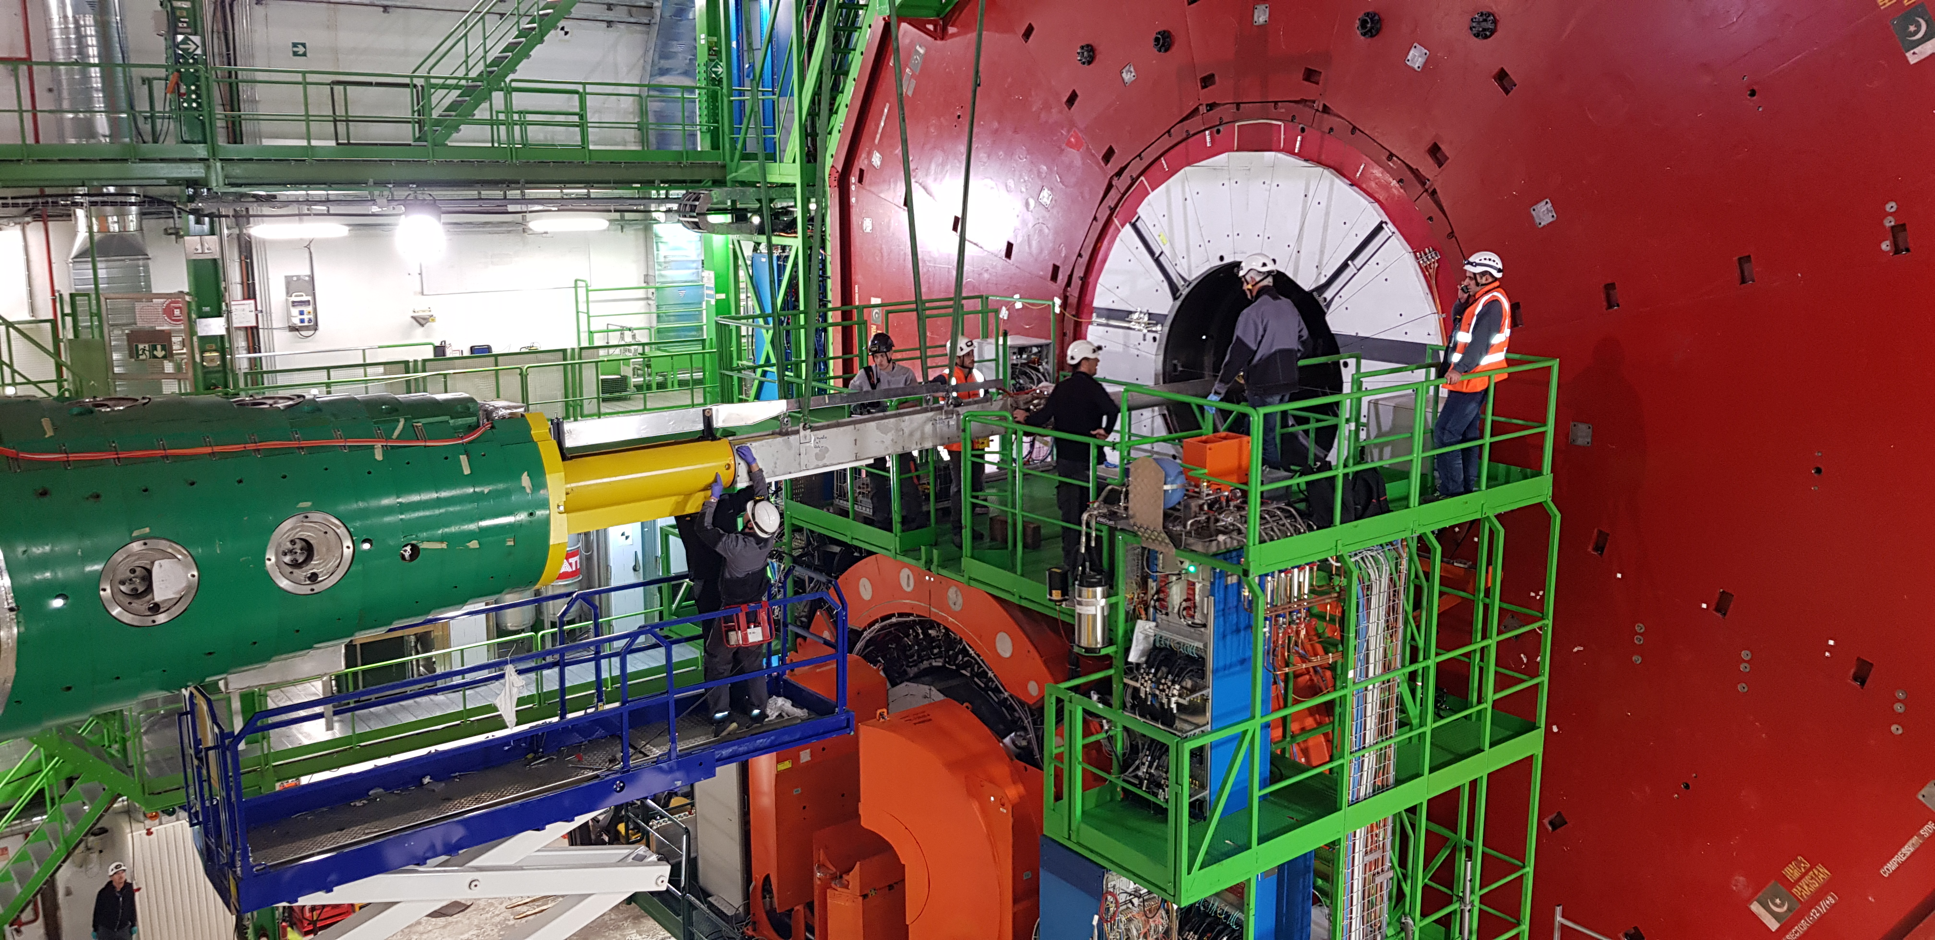
Mechanical interventions

Slide 8
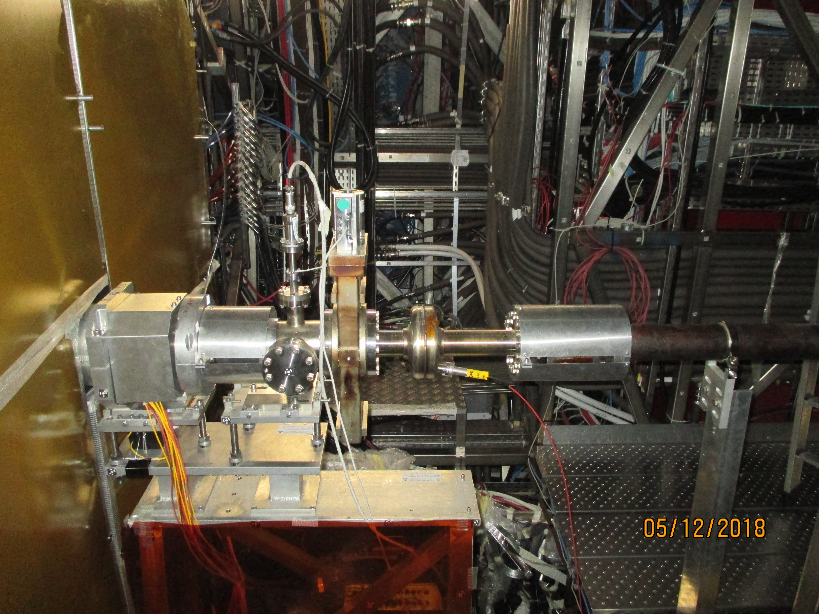
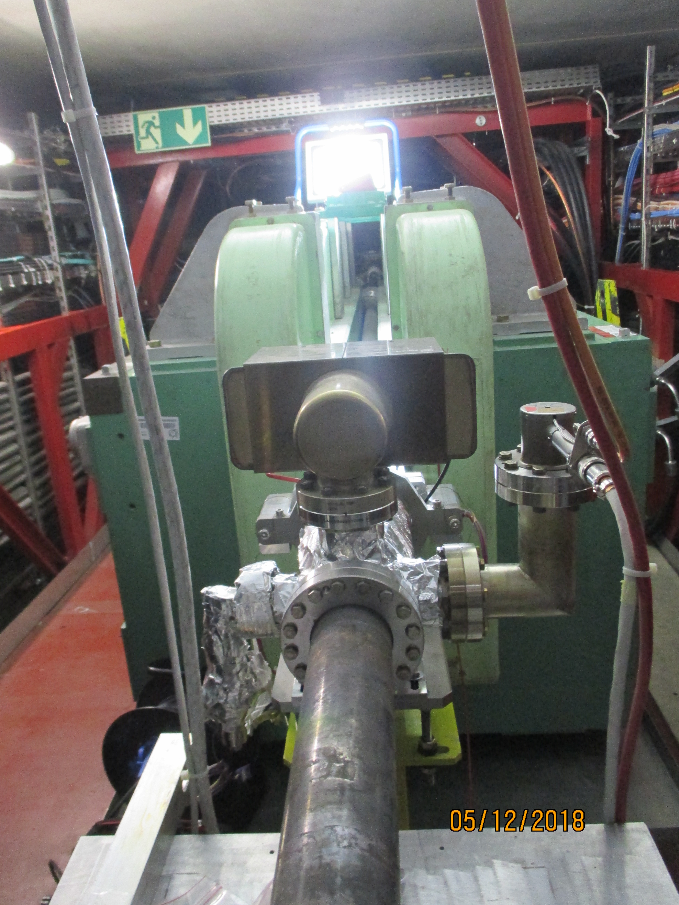
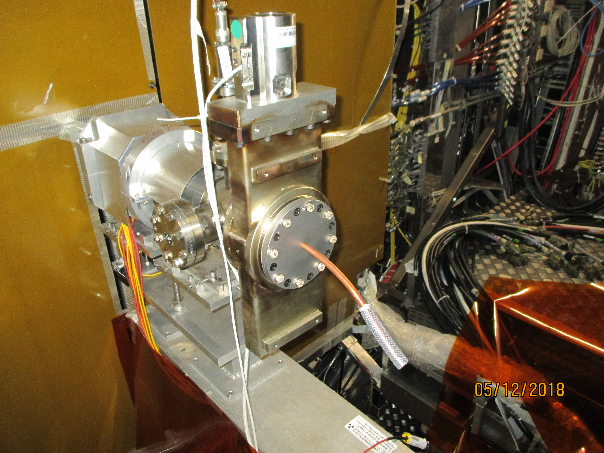
Mechanical interventions

Slide 9
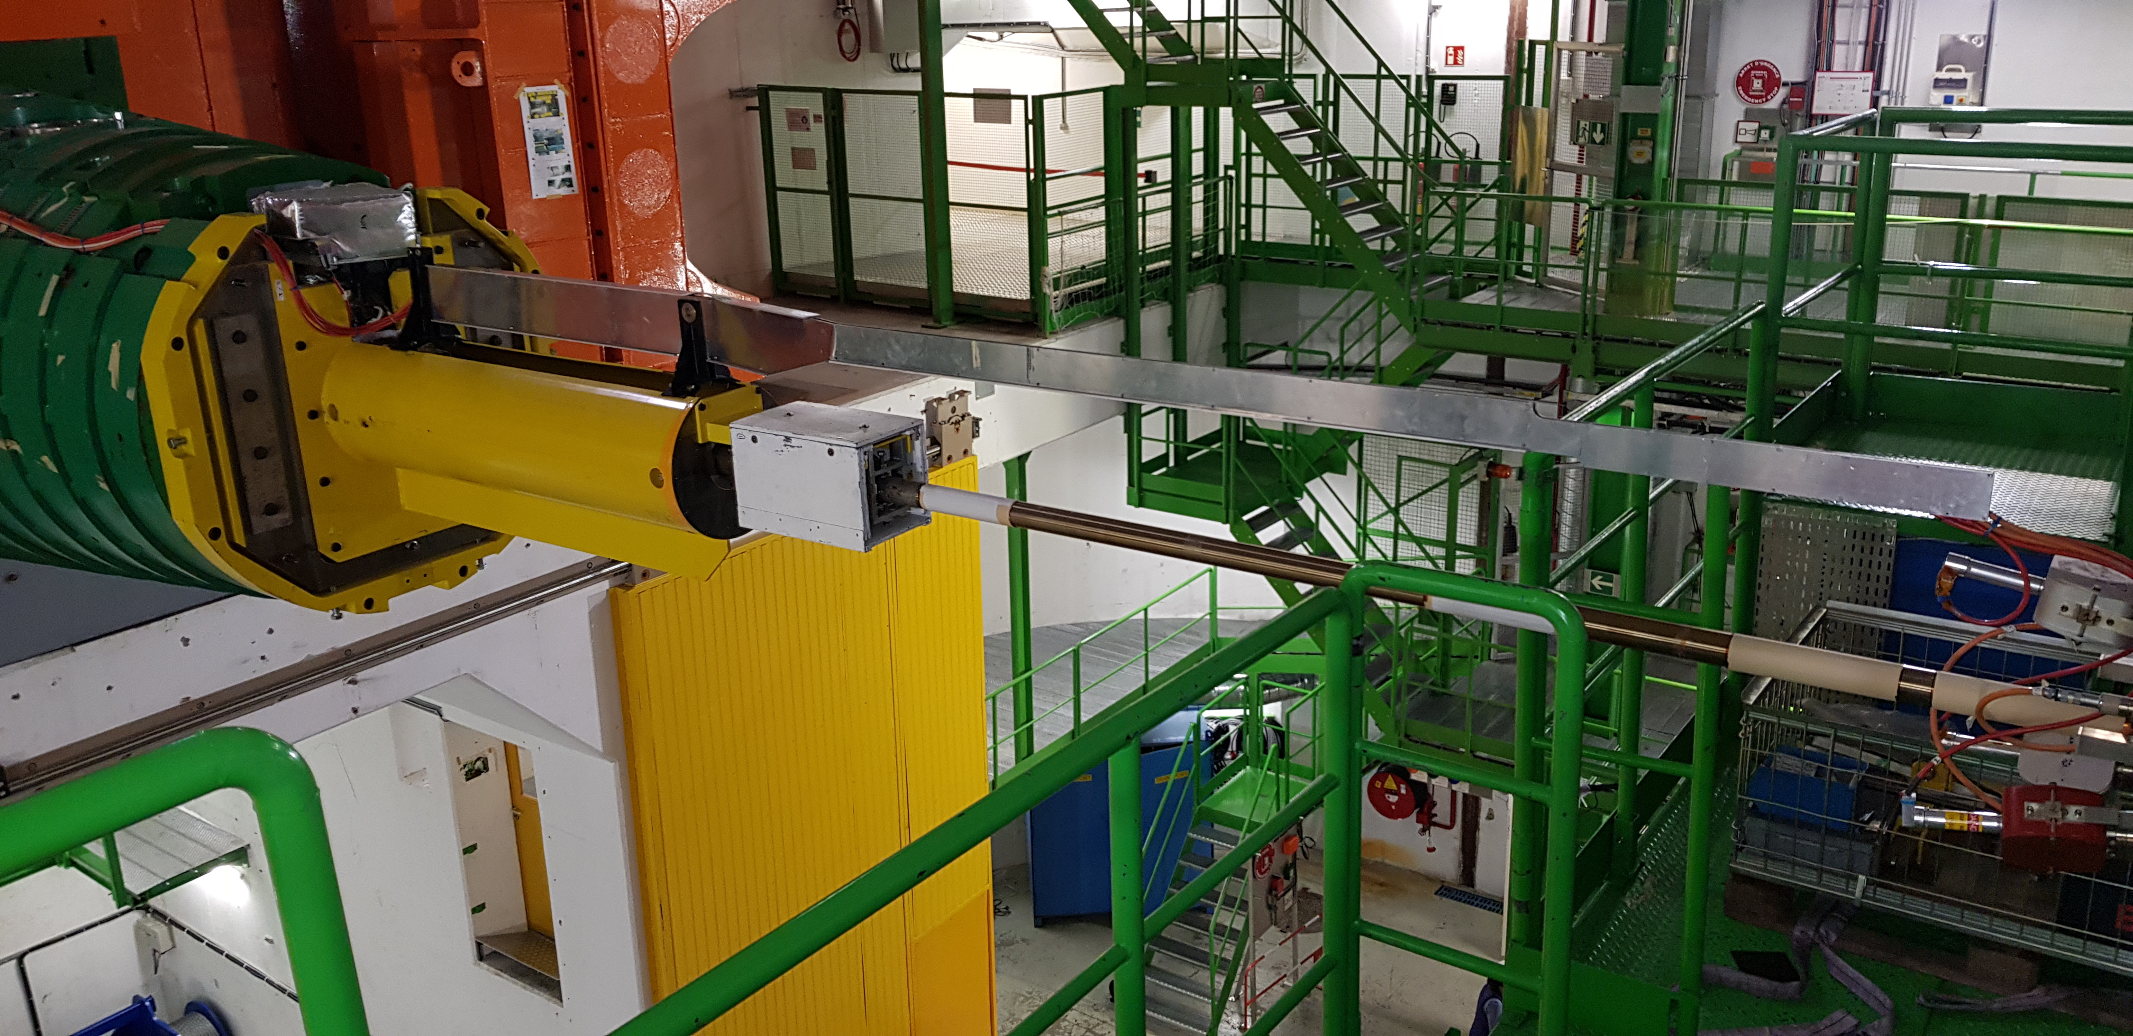
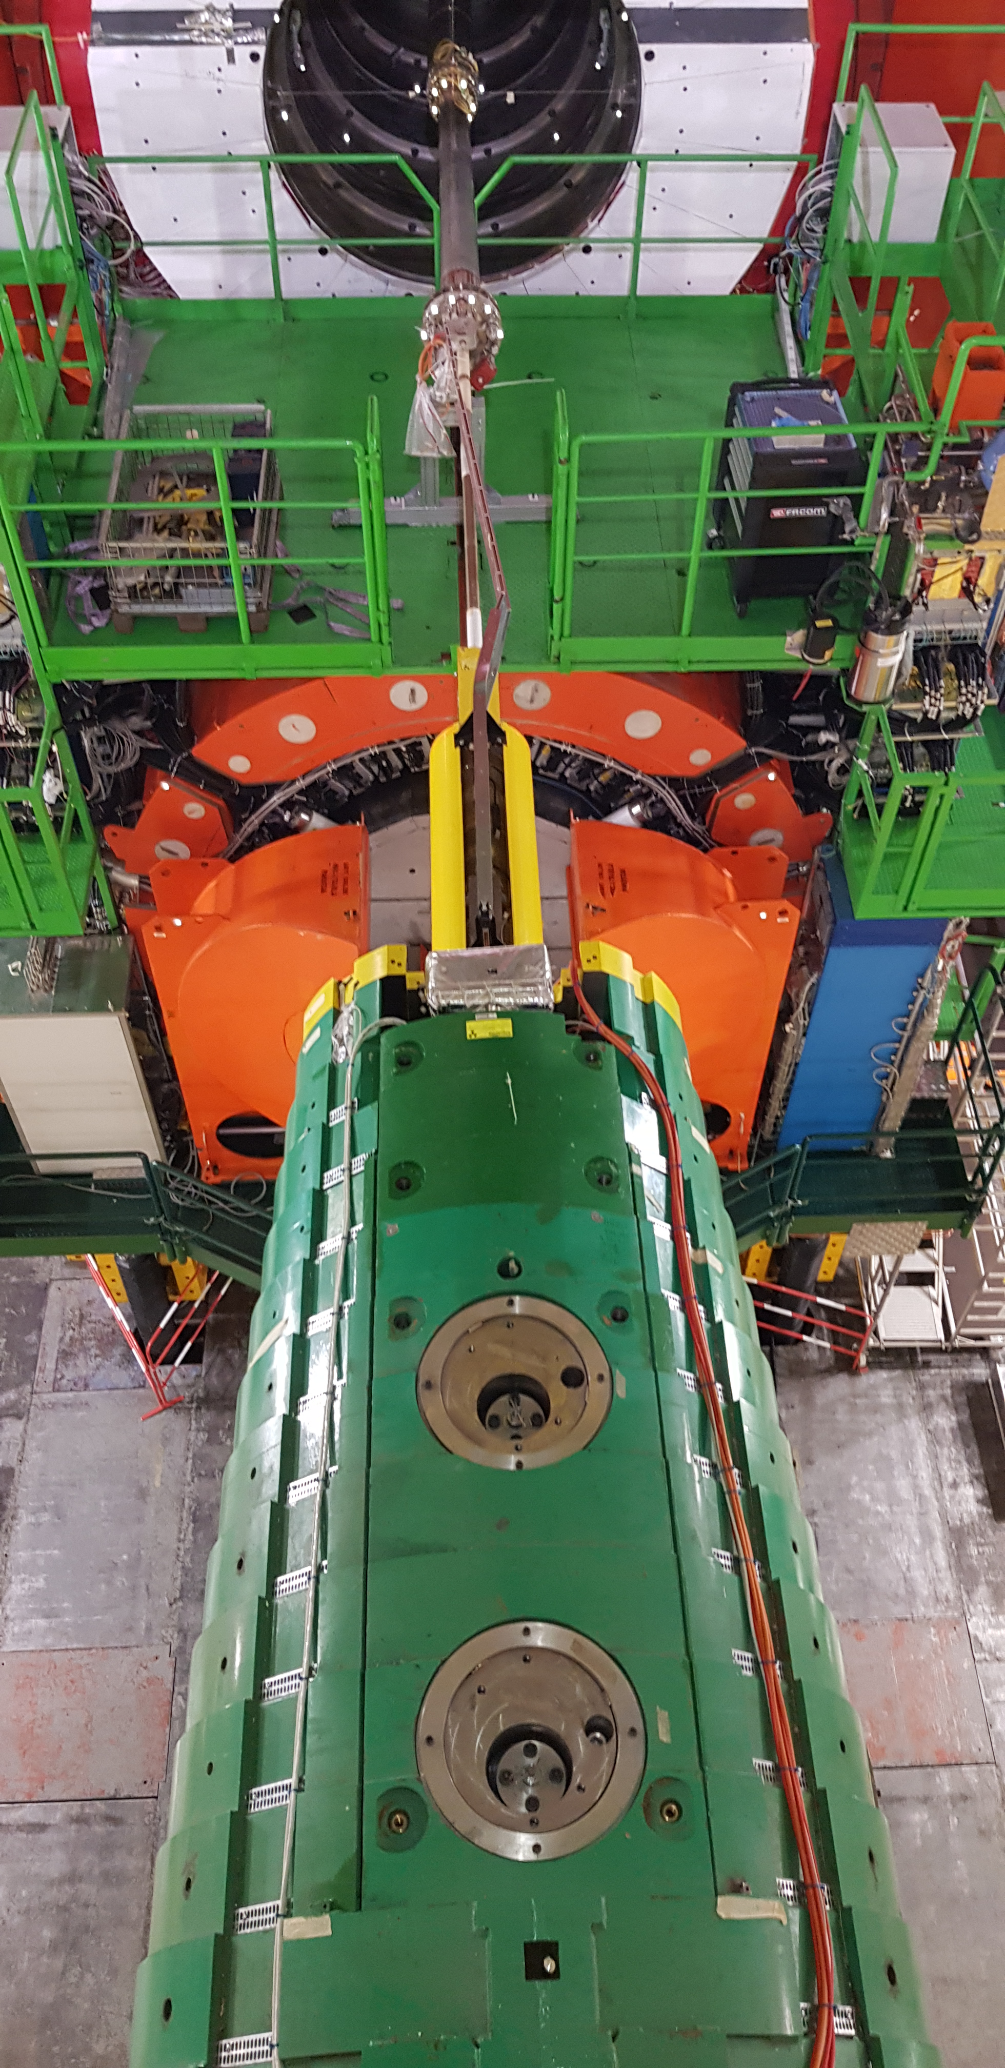
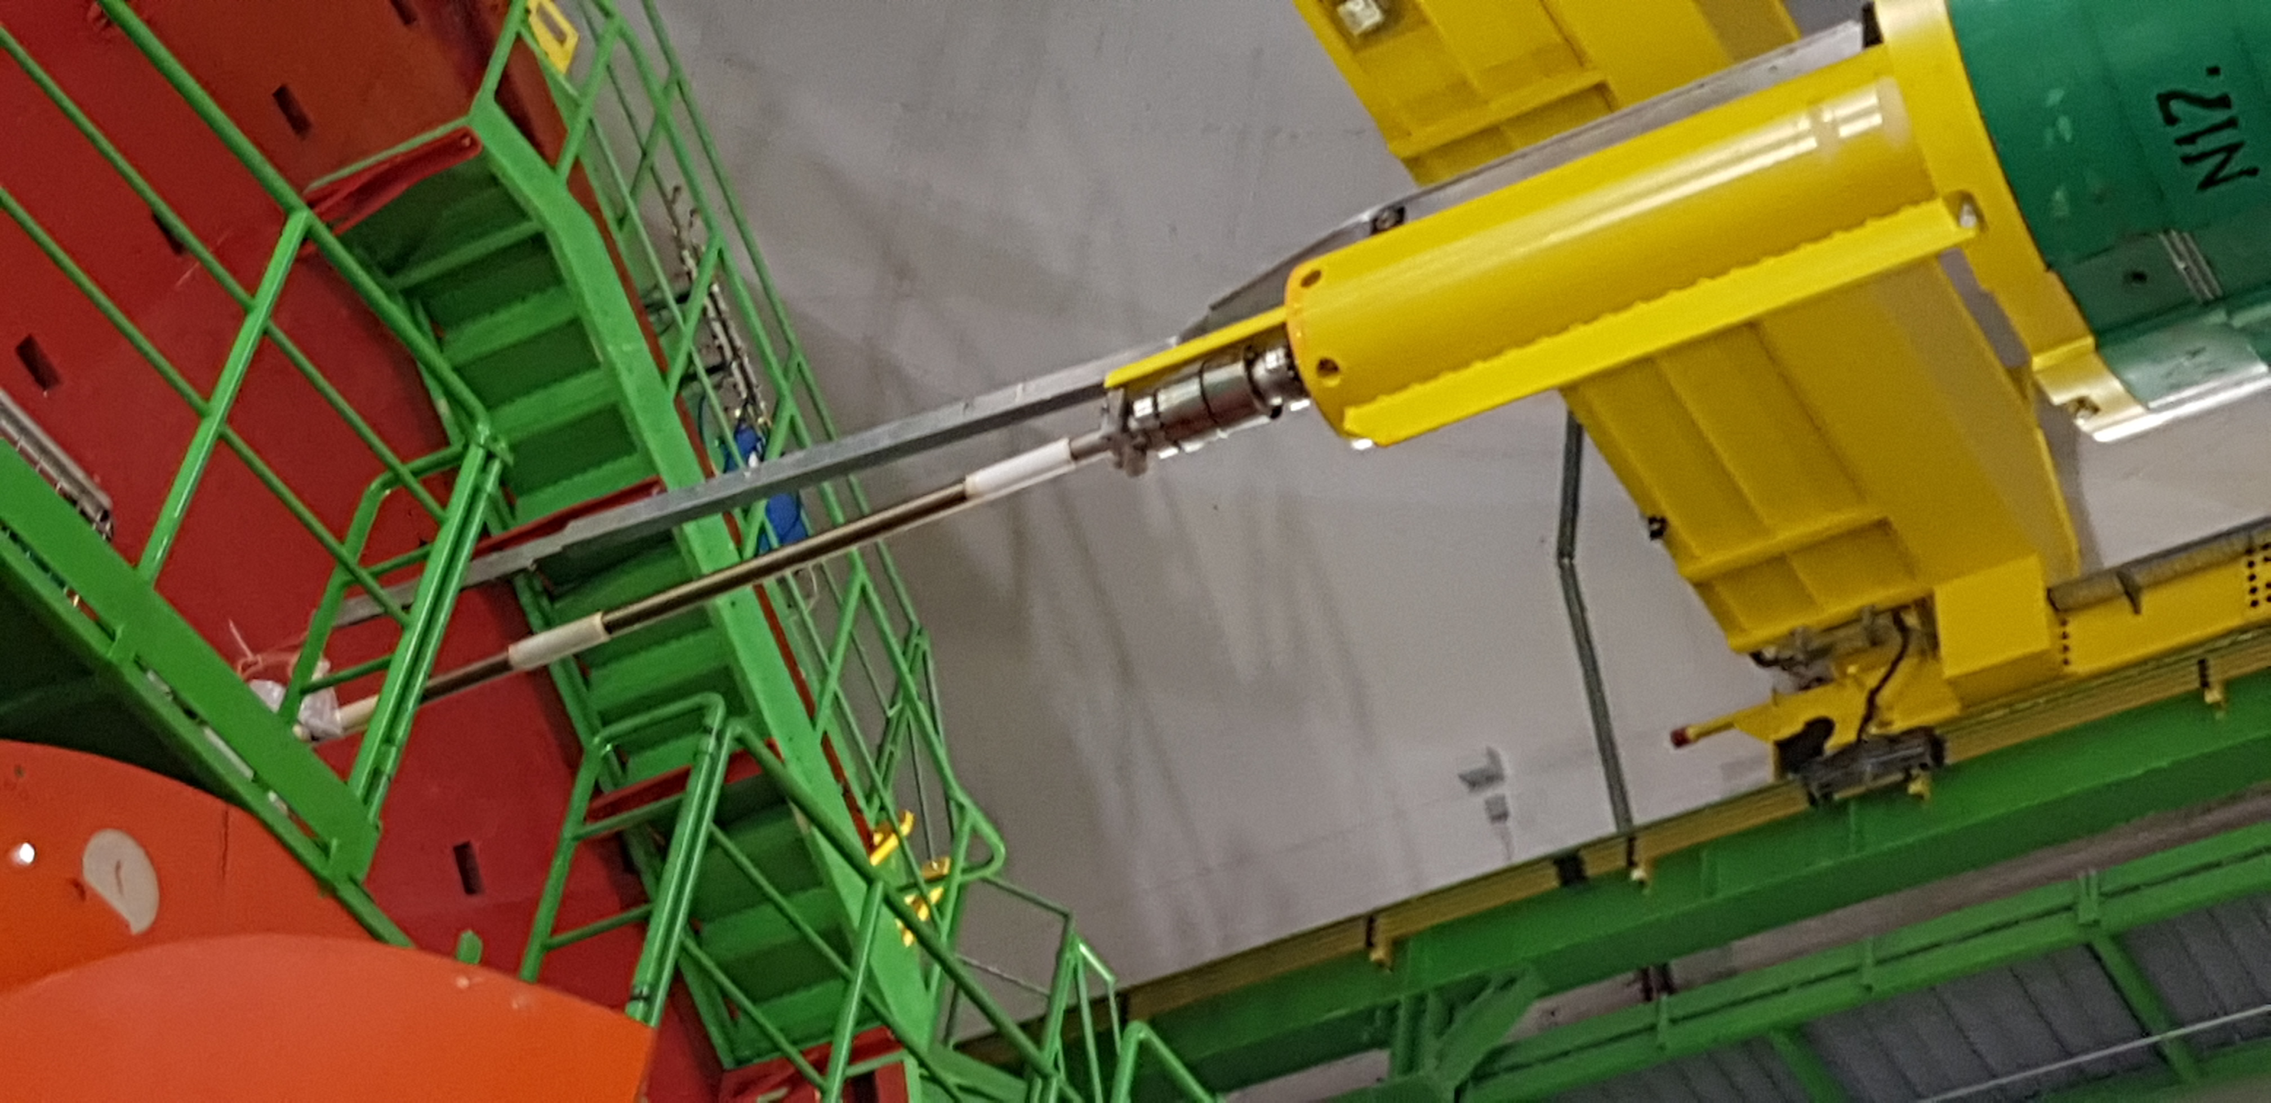
Technical problems – CMS opening conflict

Slide 10
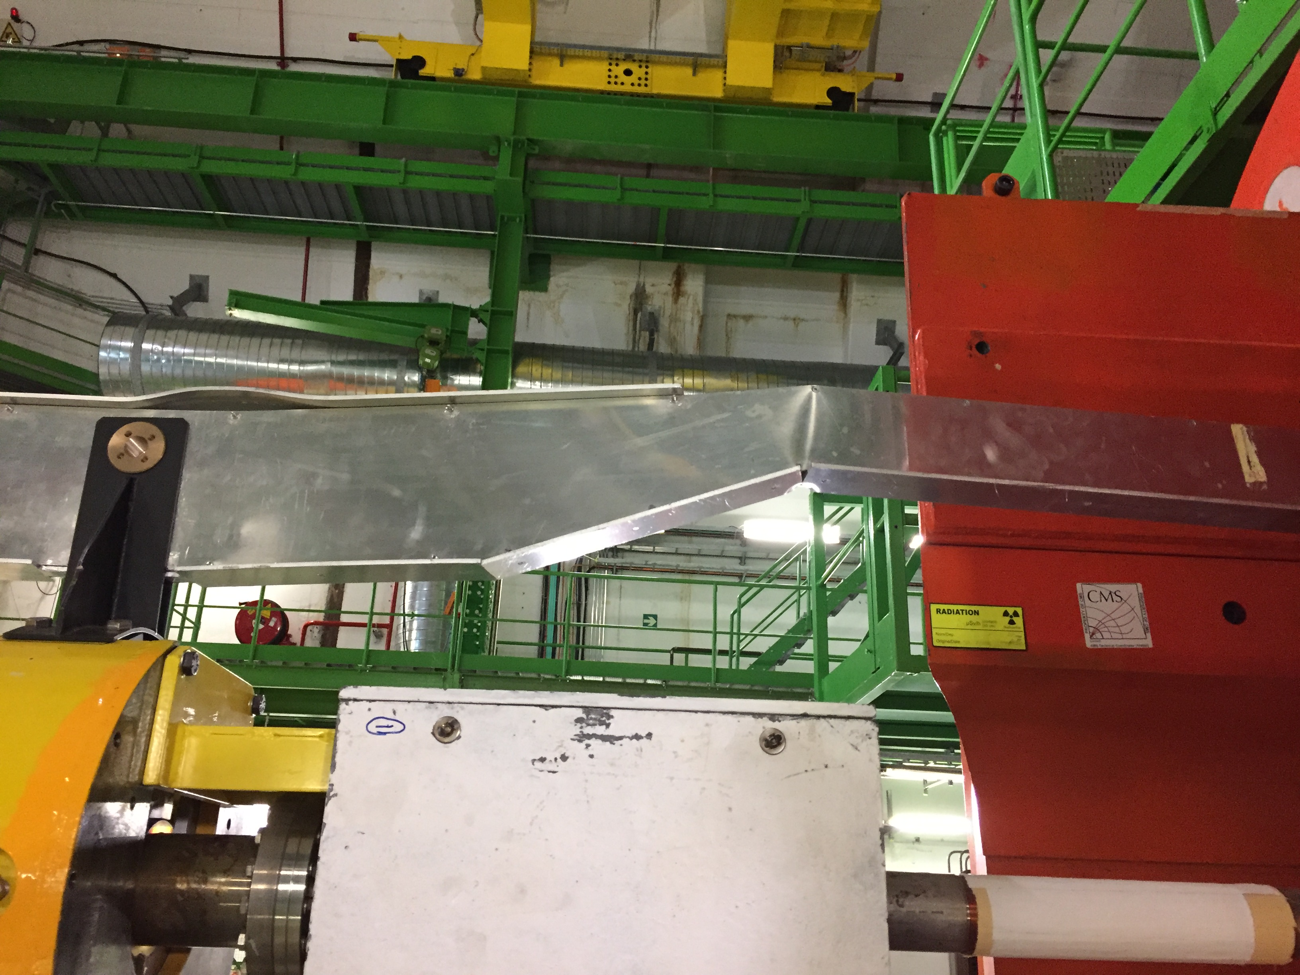
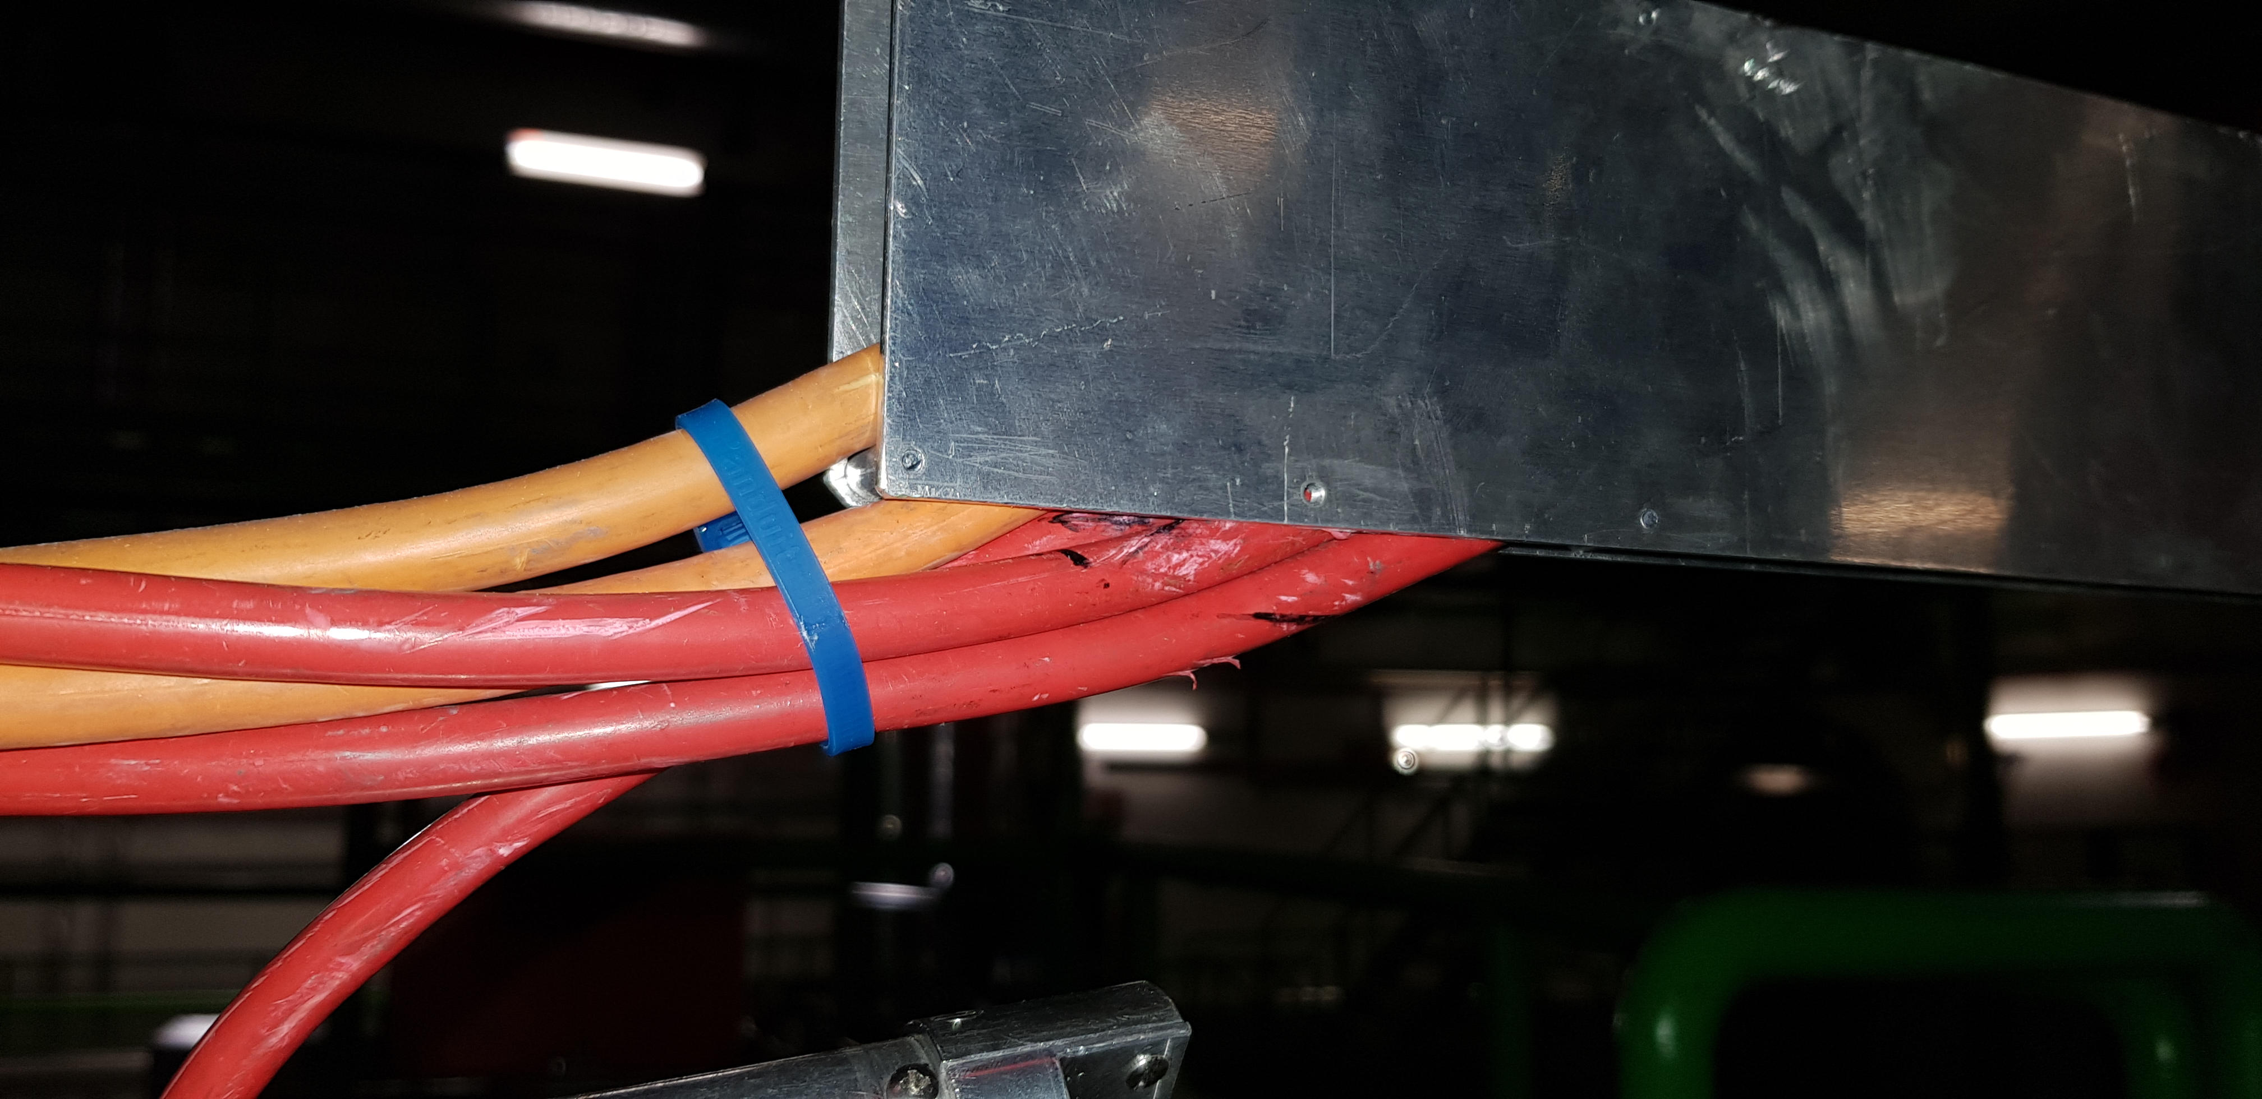
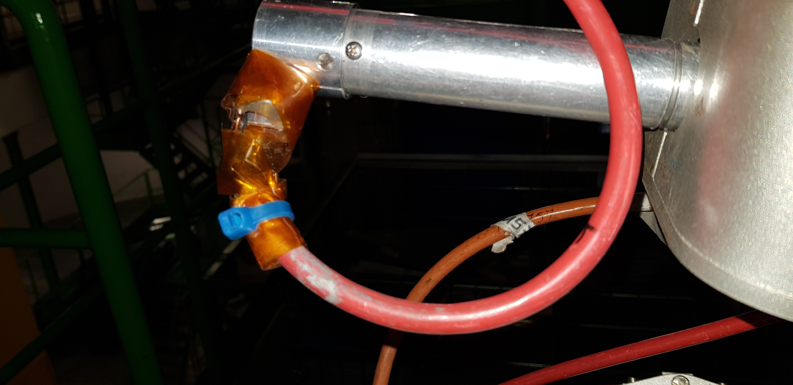
Technical problems – CMS opening conflict
Cable tray broken during the HF opening – cabling & connectors damaged.
Leak detection of the CT2 chamber to be performed (on the surface)

Slide 11
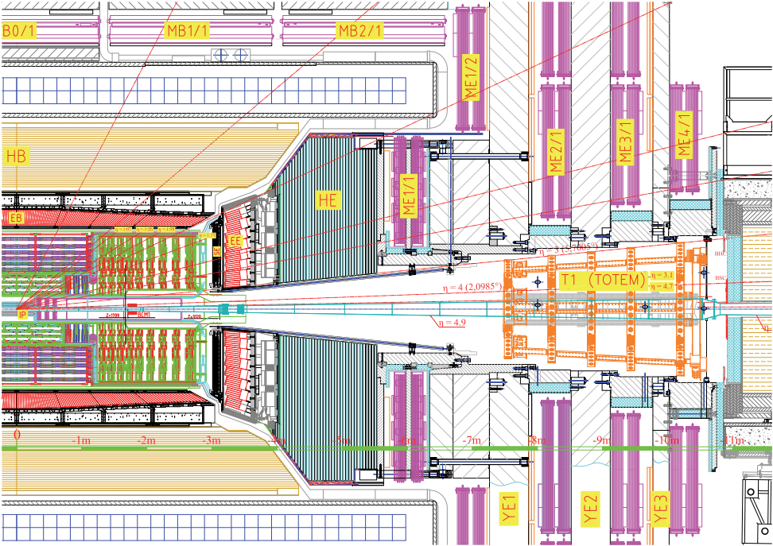
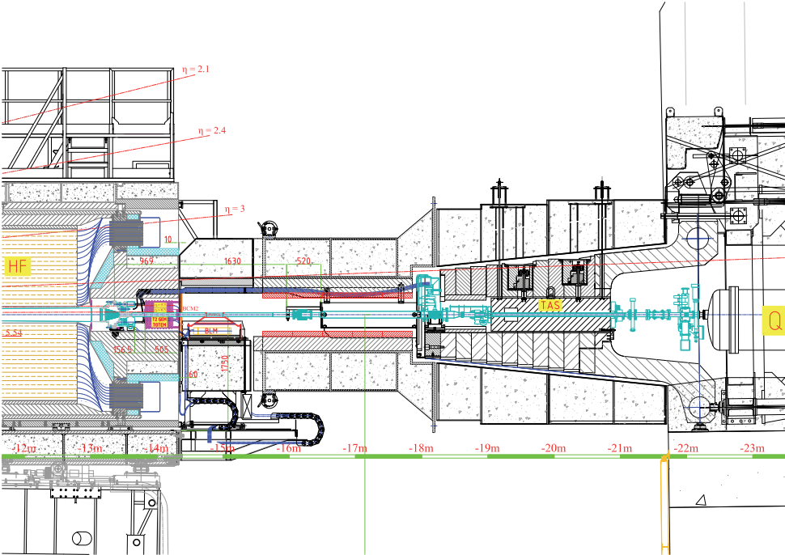
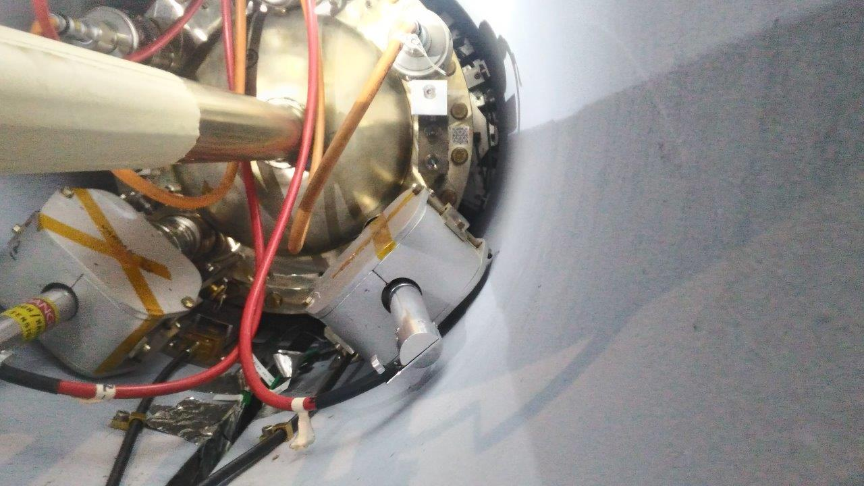
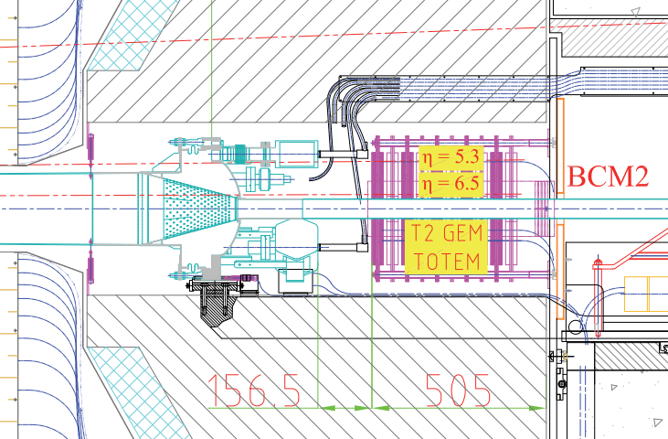
Technical problems – CMS opening conflict
Conflict occurred during the opening phase of HF detector
HF small movement by 10mm out of IP;
HF radial opening to increase the clearance around the beam-pipe;
HF movement out of IP (tens of centimetres);

Slide 12
Thank you !

Slide 13
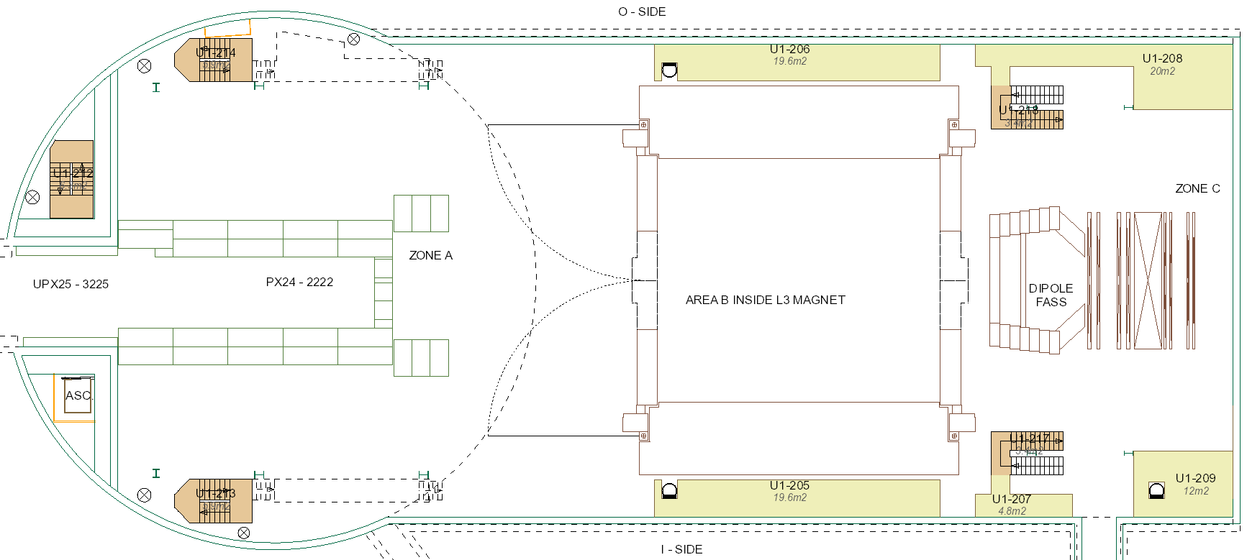
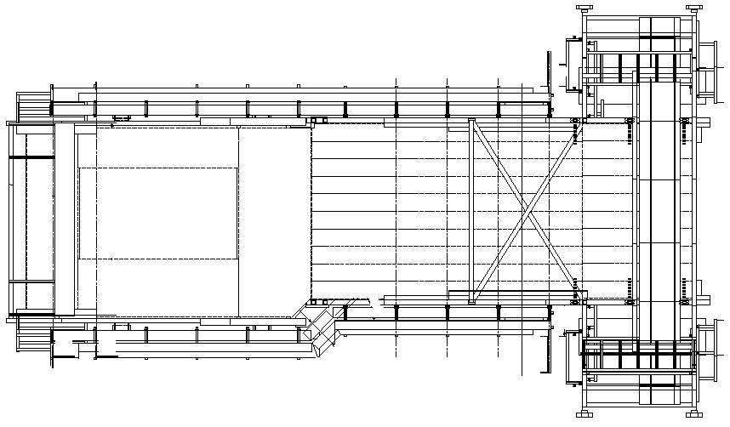
Cabling routing in RB24
Cabling for vacuum equipment (1x VVGMT; 2x VGRB; 2x VPI; 1x VGI) to be re-routed (ALICE request – Mini-frame removal);
14m up to UX25 wall
Cabling from Run1 layout still in place (additional VGPB cabling).
EN – EL intervention on Thursday

Slide 14
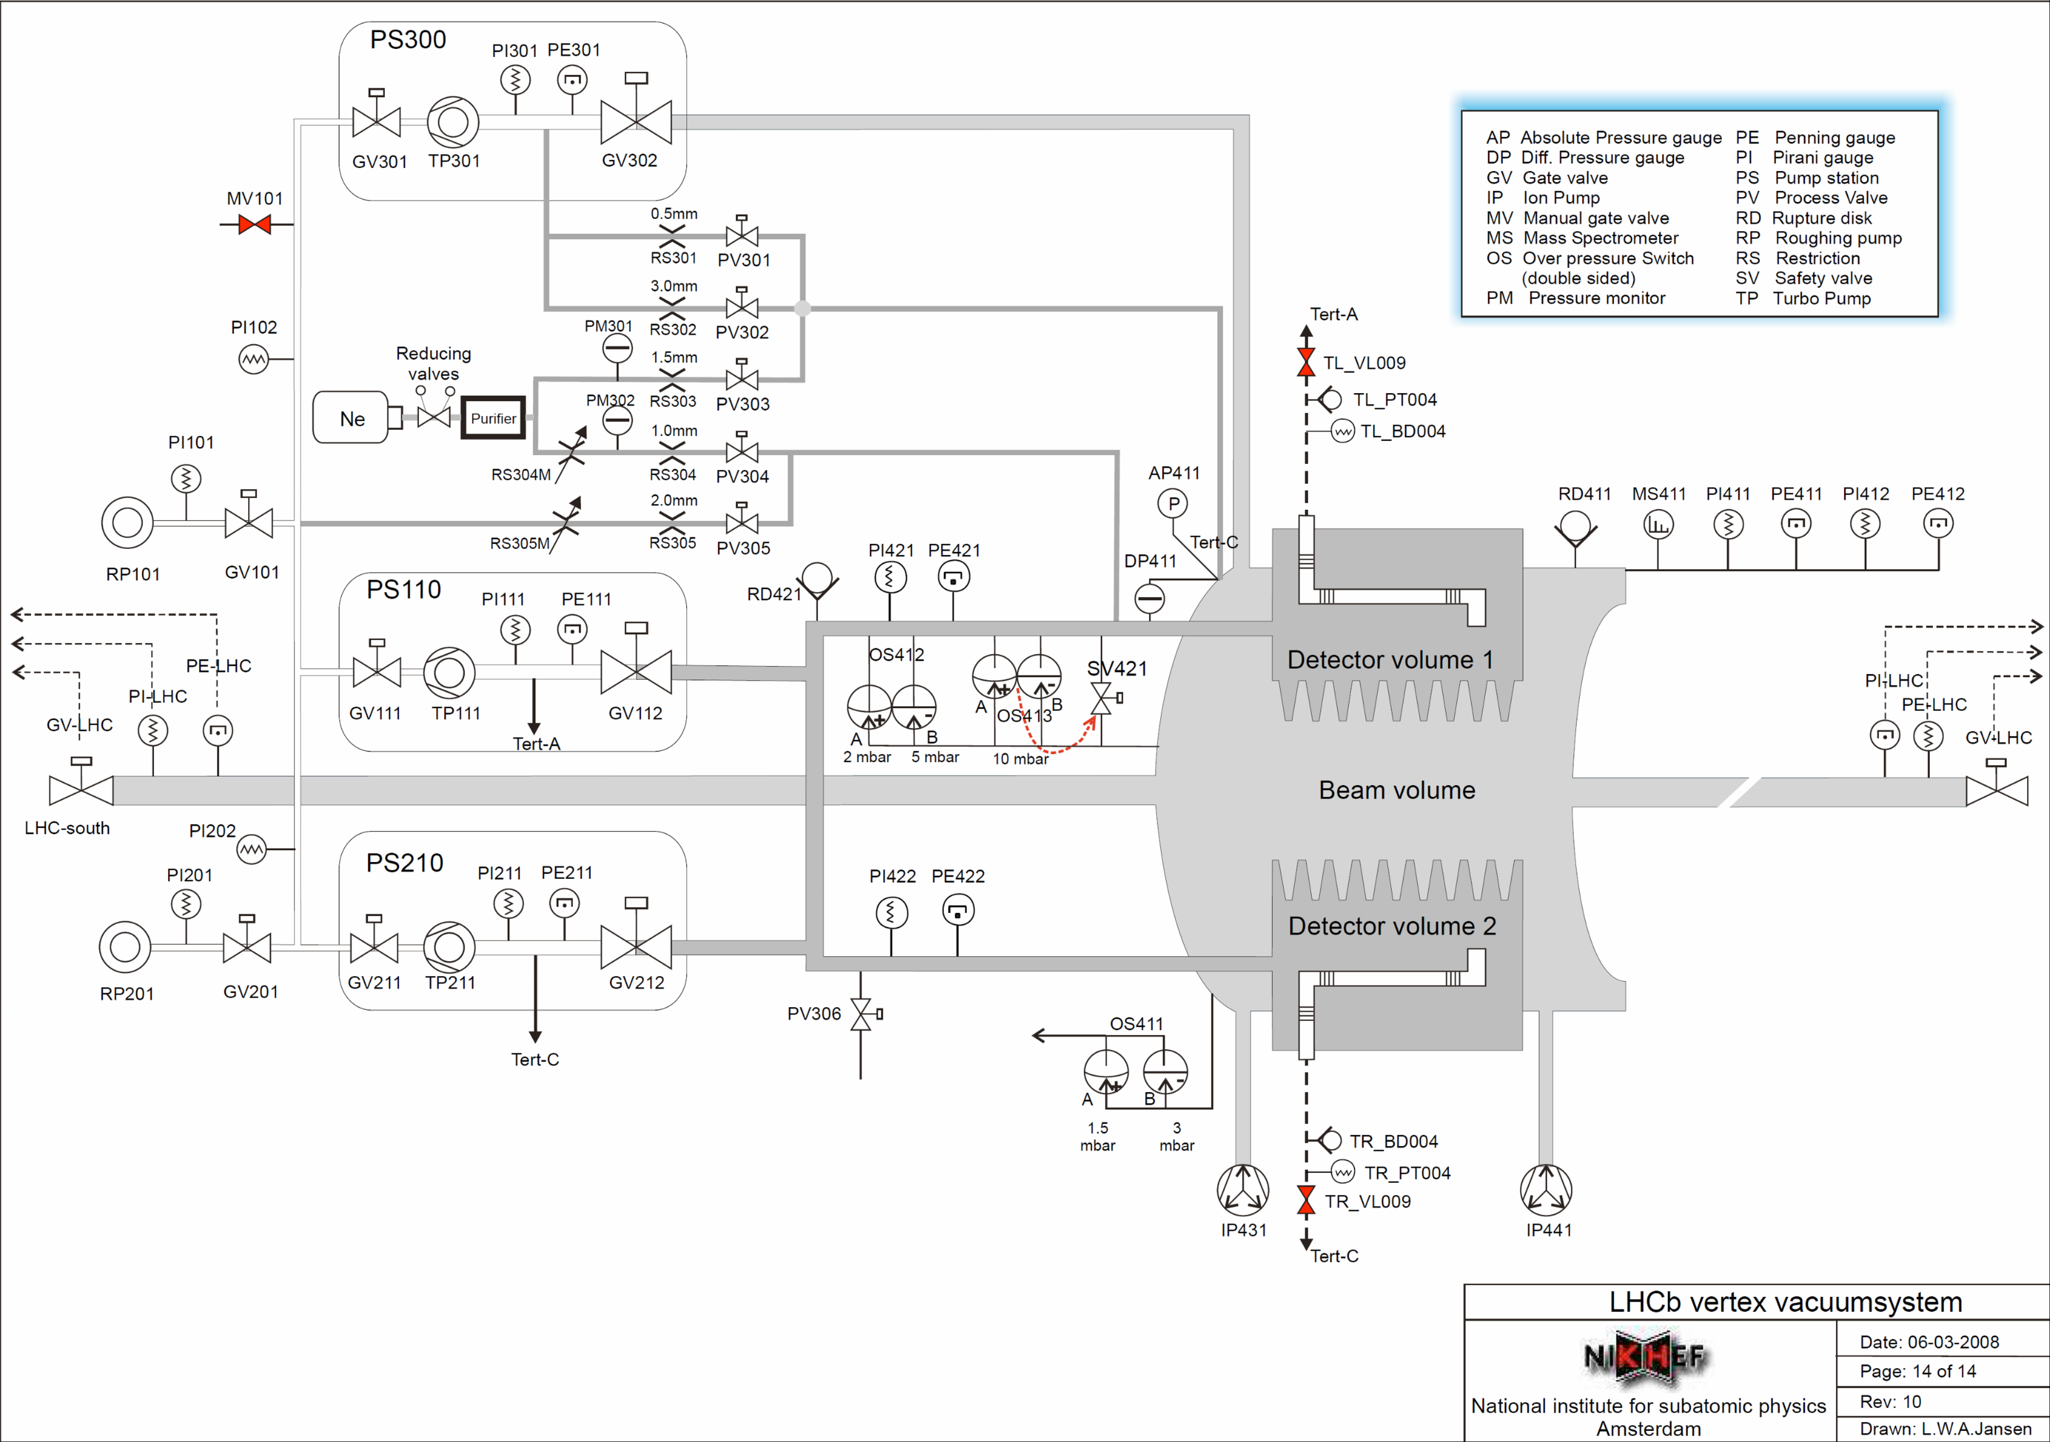
LHCb VELO – venting to atm pressure

