Slide 1

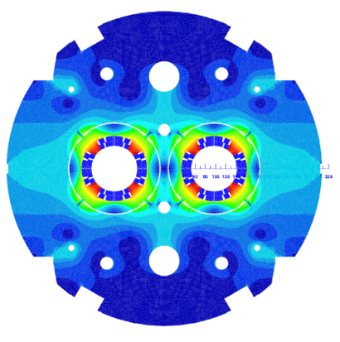
WP3 - MQYYM magnet for HL-LHC
H. Felice for the MQYY team
CEA: H. Felice, D. Simon, S. Perraud, M. Segreti, J. M. Rifflet, R. Correia-Machado, S. Somson, R. Godon, D. Bouziat, J. M. Gheller, H. Allain, P. Graffin, G. Minier, H. Neyrial
CERN: A. Foussat, J. C. Perez, N. Bourcey, L. Fiscarelli, O. Dunkel, G. Kirby, J. Fleiter, E. Todesco, M. Guinchard, P. Gros-Claude, P. Viret

Slide 2
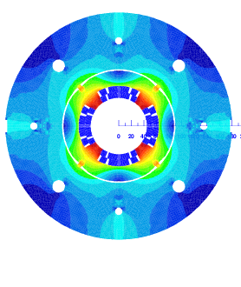
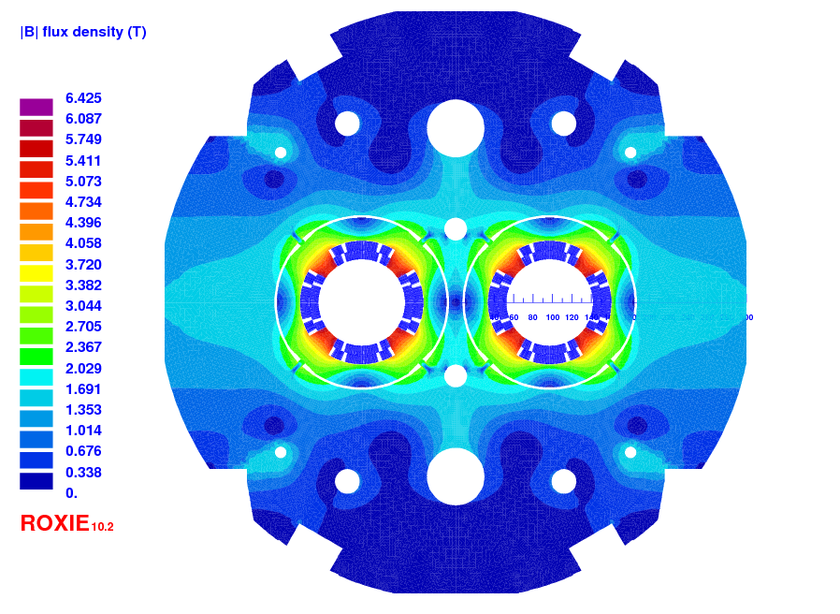
Overview of MQYY activity
MQYYM: MQYY short model
MQYY prototypes (MQYYP) within QUACO
Based on a design study carried out at CEA
(M. Segreti)
Physical length | 1350 mm
Magnetic length at 1.9 K | 1204 mm
Outer diameter | 360 mm
Bare cable width | 8.8 mm
Bare cable thickness | 0.77/0.91 mm
Insulation thickness at nominal | 0.080 mm
Short sample current | 5980 A
Operating Gradient | 120 T/m
Operating current | 4550 A
Bpeak at operation | 6.42 T
Selection of 4 companies to design and manufacture MQYY prototypes(competitive process 4/3/2 in conceptual/engineering/manufacturing phase)
Starting point:
  CEA magnetic design
  Mechanical design is NOT provided
Phase 3: first of a kind manufacturing => ongoing

Slide 3
D3.1: 10 MQYYM cured coils
 | Conformity | Electrical tests | Non-conformity | Possible repair | Risk | Shipped to CERN
Coil 0 | No | Not conform | Practice coil, vtap practicing | No |  | Y
Coil 1 | No | OK | Damaged insulation and 1st set of end spacers | No |  | Y
Coil 2 | Yes | OK |  |  |  | Y
Coil 3 | Yes | OK |  |  |  | Y
Coil 4 | No | OK | Ends with low compaction |  |  | Y
Coil 5 | No | OK | Damaged interlayer insulation in the straight section | Filling in the area where the insulation has been torn | High
Coil 6 | No | OK | Mispositionned Layer jump Layer 2: unwound and rewound | No | Medium | Y
Coil 7 | No | Not tested | Damaged insulation and possible overcompression of a turn due to tooling failure | No - Unwound after decision to make 2 more coils.
Coil 7 mock up | No IL only wound to validate the repair of the tool
Coil 8 | Yes | OK |  |  |  | Y
Coil 9 | Yes | OK |  |  |  | Y
MQYYM: coils 2,3,8 and 9
Coils 4 and 6 are possible spares

Slide 4
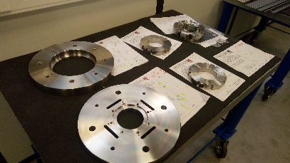
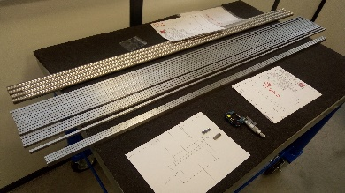
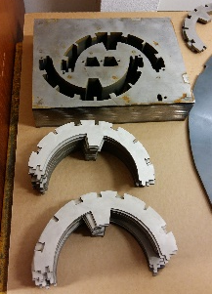
D3.2 MQYYM assembled magneT
Components | Status
End parts | Procured for 10 coils (2 + 6)
Cu wedges | Procured for 10 coils
Interlayer insulation | Procured for 10 coils
Collar | Procured / at CERN
Yoke | Procured / at CERN
End flanges | Procured / at CERN
Keys, tie rods… | Procured / at CERN
Connection box + G11 components | Procured / at CERN
Collaring shoe and protection sheets | Procured / at CERN
Traces | Procured / at CERN

Slide 5
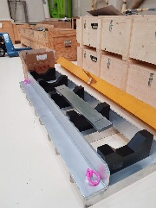
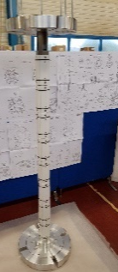
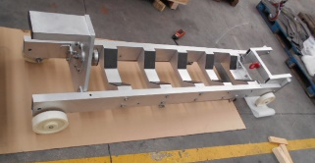
D3.2 MQYYM assembled magnet
STATUS
Components | Status
End parts | Procured for 10 coils (2 + 6)
Cu wedges | Procured for 10 coils
Interlayer insulation | Procured for 10 coils
Collar | Procured / at CERN
Yoke | Procured / at CERN
End flanges | Procured / at CERN
Keys, tie rods… | Procured / at CERN
Connection box + G11 components | Procured / at CERN
Collaring shoe and protection sheets | Procured / at CERN
Traces | Procured / at CERN
Tooling | Status
Coil fabrication tooling | Completed in 02/2017
Magnet assembly tooling | Delivered at CERN early 03/2018
GPI forming tooling | At CERN and in use
Coil rigidity measurement tooling | Procured/at CERN, in use
Splicing tooling | Procured/at CERN
Coil Transport tooling | Procured/at CERN
Tilting support during assembly (adaptation) | Procured/at CERN
Magnet transportation tooling | Procured/at CERN
Magnet tilting tooling
Assembly sequence and schedule are being discussed with Juan Carlos Perez

Slide 6
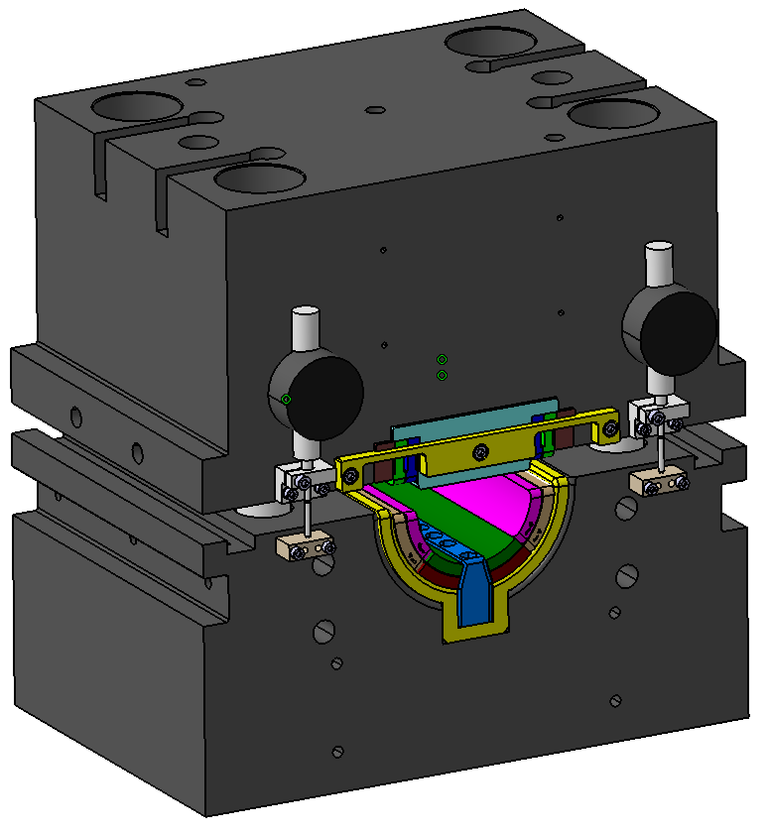
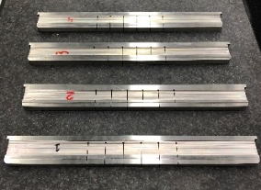
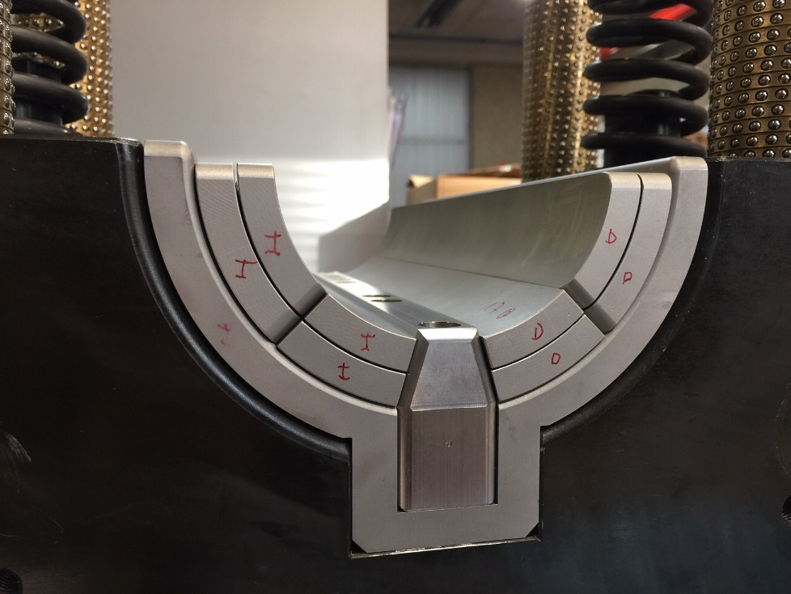
Focus on the critical path
Critical path related to the coil rigidity measurement tooling
Initial delay due to lack of anticipation
Order placed on Dec 7th 2017 with FMI, Netherlands
FMI broke the contract at the end of January 2018
New order with DMP placed on May 7th 2018 after successful prototyping phase
Kick-off meeting held on June 5th 2018 (CEA team + J.C. Perez)
Parts delivered at CERN:
  Measuring bars: mid-october 2018
  Rest of the components: end of november 2018

Slide 7
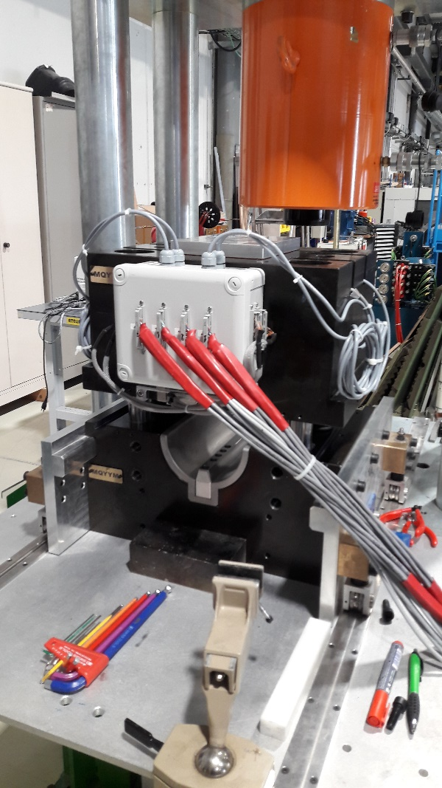
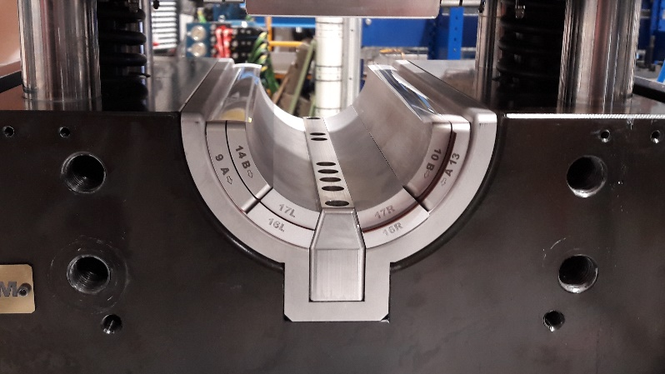
Status on coil measurement tooling
Tooling set up in 927 mid December
Set up is ongoing
thanks to Michael Guinchard, Sorhab Emani Naini, Salvador Ferradas Troitino, Juan Carlos Perez
Goal: measurements of MQYYM coils by the end of January 2019. Schedule under discussion

Slide 8
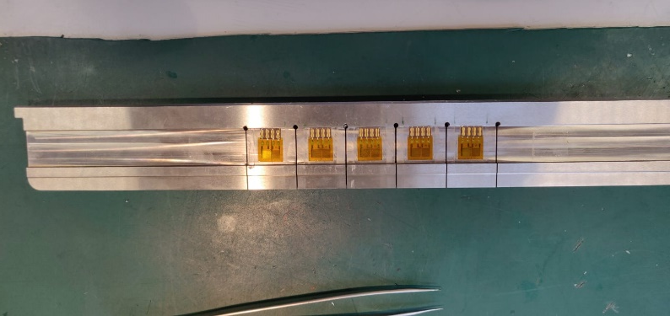
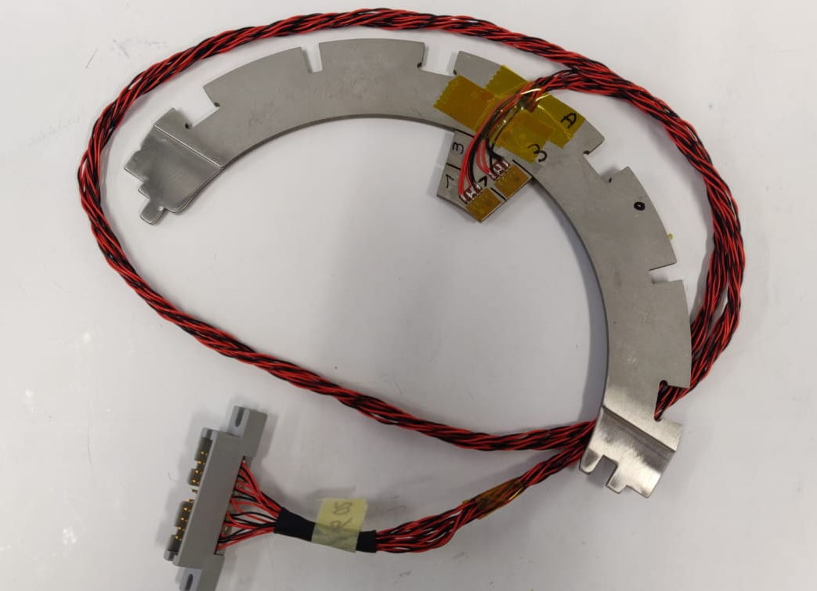
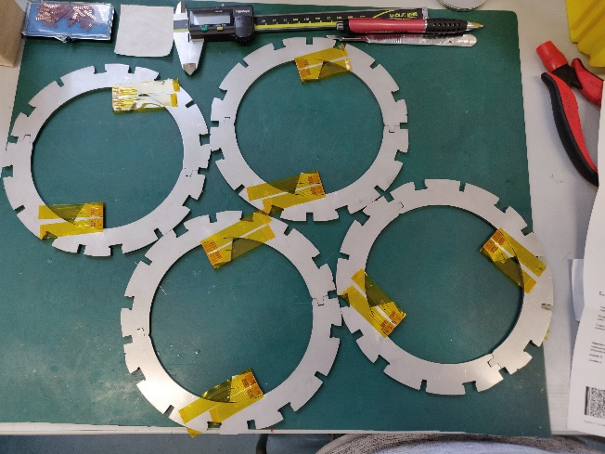
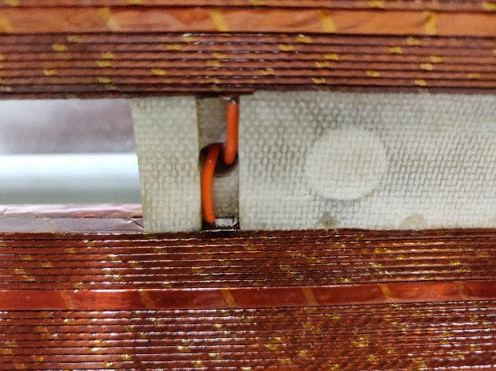
Instrumentation
Instrumentation of the measuring bars
At CERN by Michael Guinchard’s team
Collar Instrumentation
At CERN by Ricardo Correia Machado with MG supervision
Coil instrumentation

Slide 9
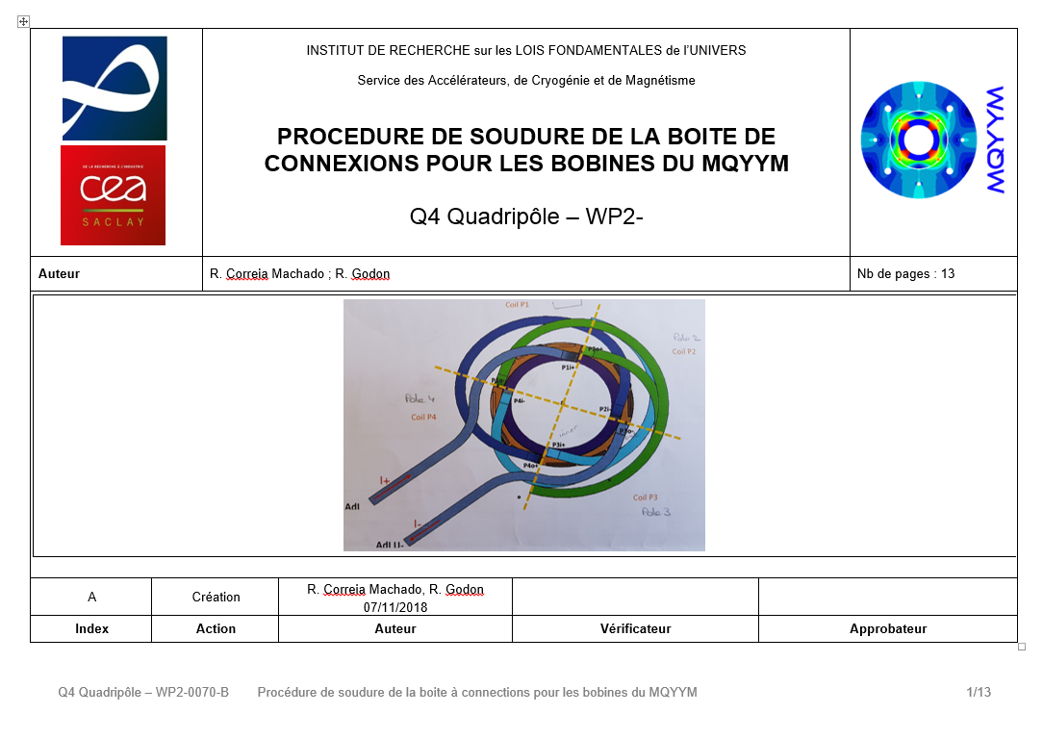
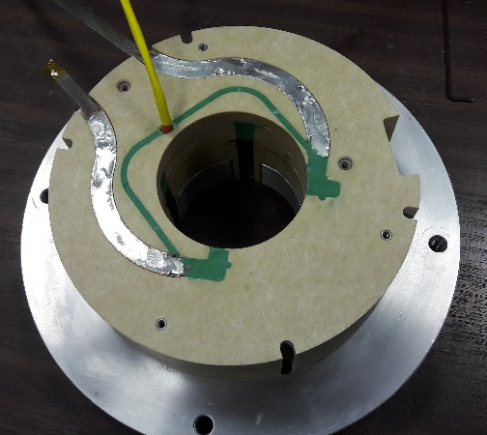
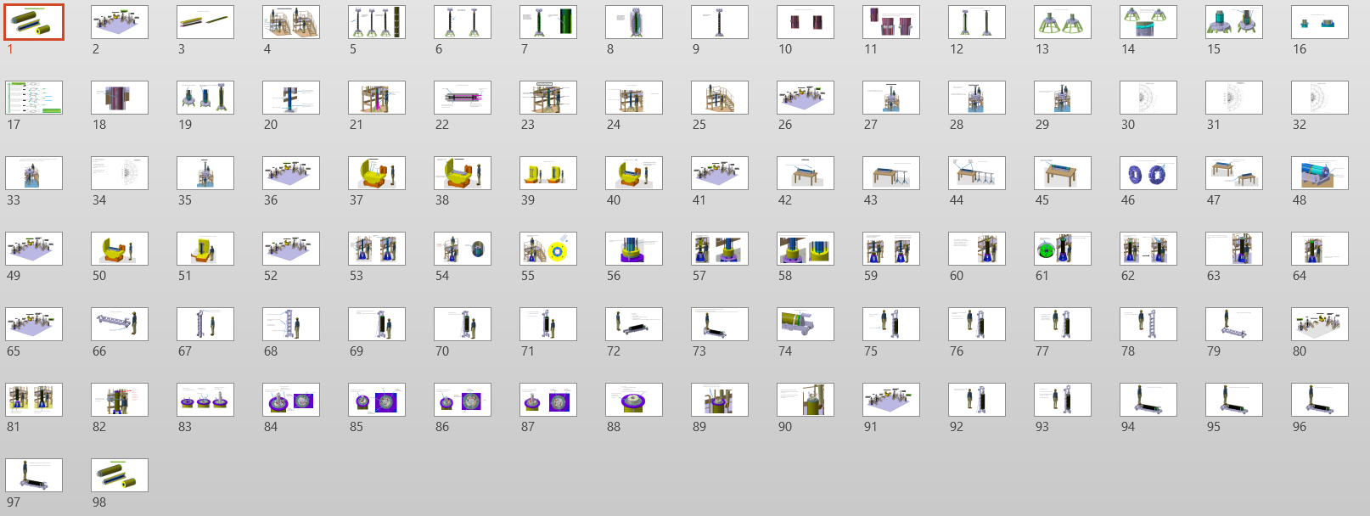
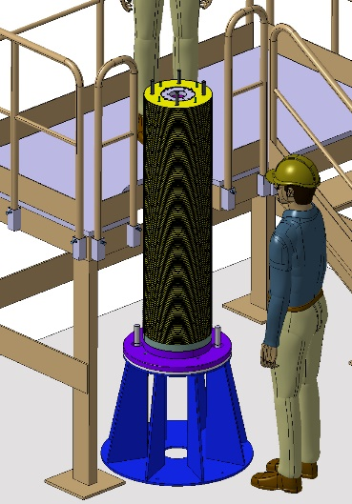
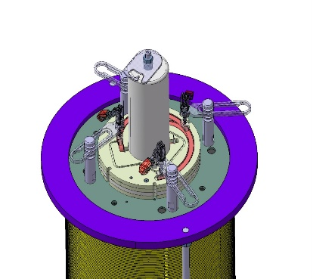
Assembly preparation
Connection box
Practice connection box and procedure definition
(R. Correia Machado, R. Godon)
Assembly steps
Validated with N. Bourcey and J.C. Perez

Slide 10
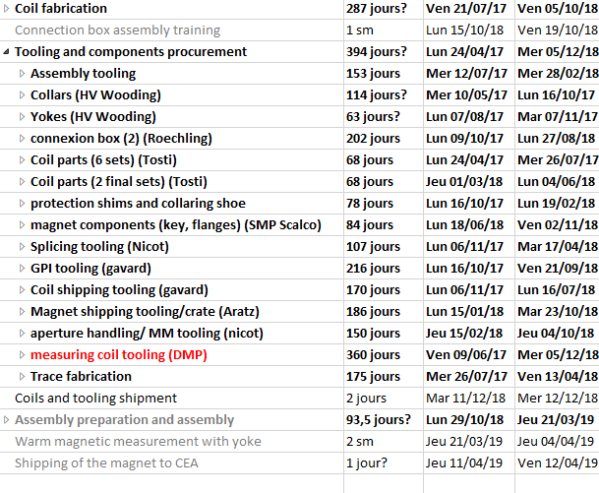
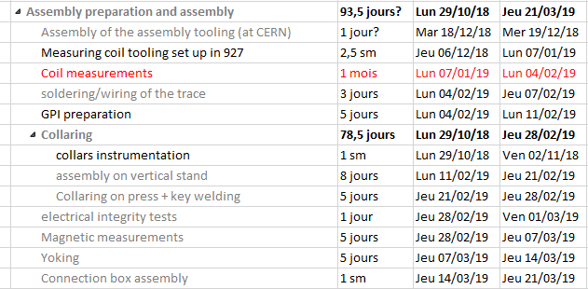
D3.2 MQYYM assembled magnet
Pending actions and completion date
All coils are manufactured
All the components are procured

Slide 11
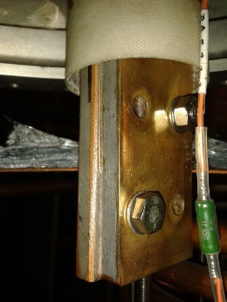
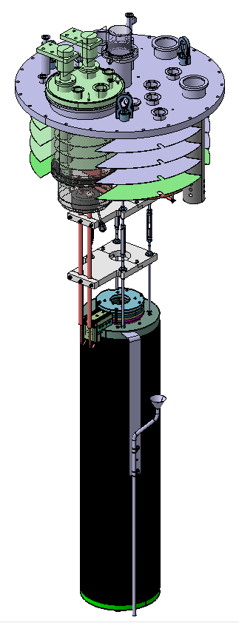
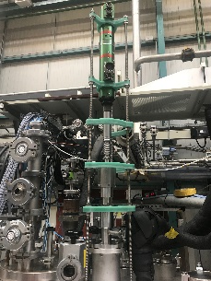
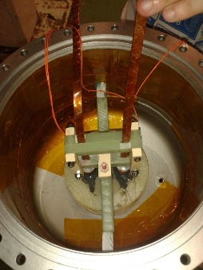
D3.3 Cold test of MQYYM
Cryogenic facility
Effort carried out by J.M Gheller
CEA 8 m vertical cryostat equipped with a 3 m long « sock » (tank)
Adaptation of an existing top plate
Cryogenics preparation is ongoing
Saturated LHe bath at 1.9 K 23 mbar => some concern about Paschen discharge
  Some tests are being performed
  Full scale test early February
Data acquisition and magnet protection
Effort carried out by Denis Bouziat + another IRFU Department (DIS)
Resources shared with other projects
Magnetic measurements
  Agreement on a probe: 47 mm in diameter, 5 modules of 222 mm in length
  Cold Probe (LHe, no anticryostat), rotating unit and measuring system will be provided by CERN => mechanical set up has been tested

Slide 12
In Summary
All coils are completed
All the magnet components and tooling are procured and shipped to CERN
Coil mechanical measurements foreseen by the end of jan 2019
Assembly expected in Feb-March 2019
Major causes of delay
Unavailability of draftmen due to strong hiring constraints and unexpected turnover => Close team work at CEA between magnet group and design office
Underestimation of the effort related to tooling development => lessons learned
Some non conformity in the coils
Contractor failure
Updated Critical path: test facility (assuming uneventful magnet assembly)

Slide 13
Back-up slides

Slide 14
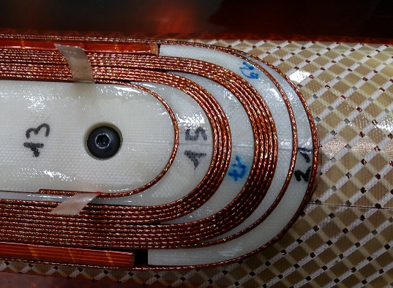
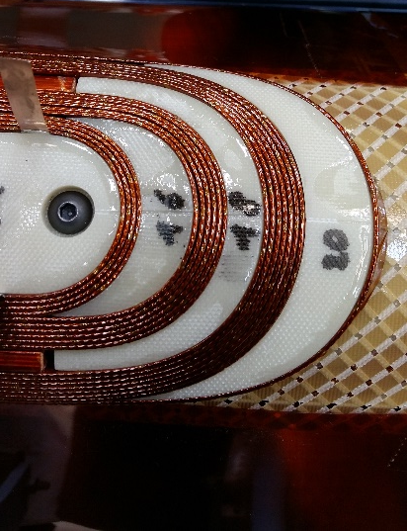
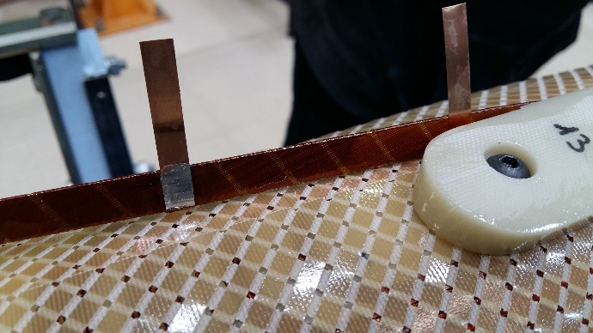
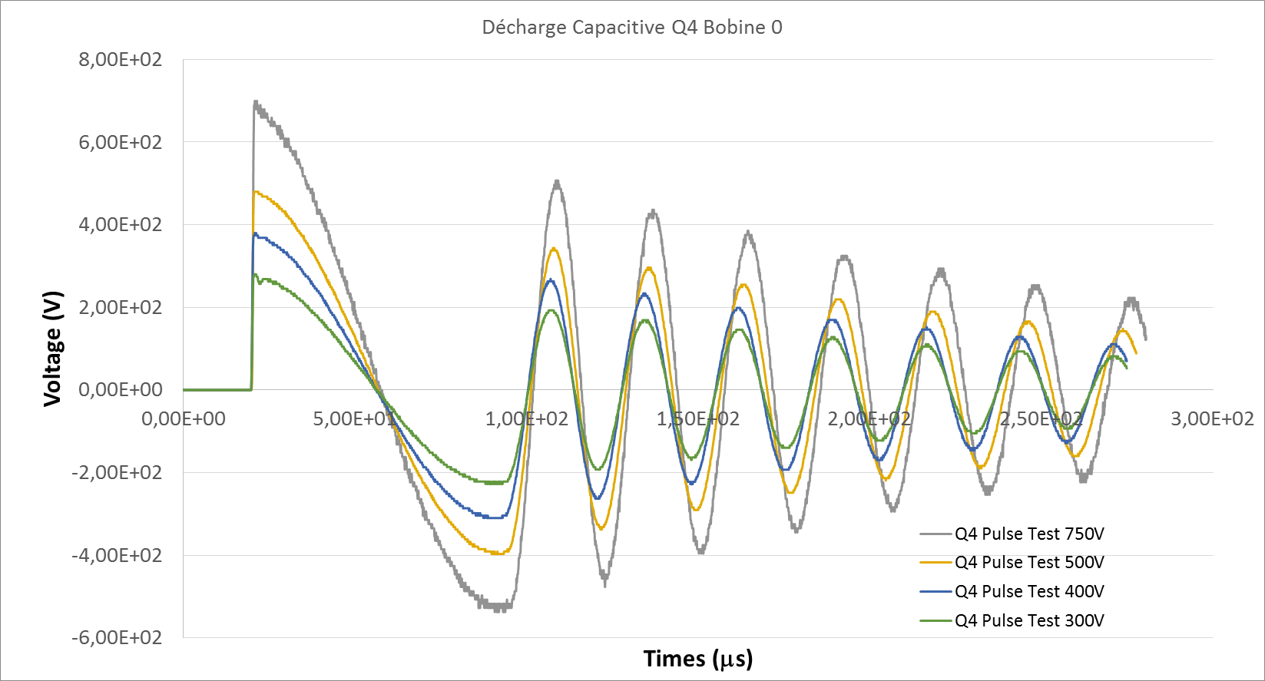
Fabrication: coil 0
Good matching of the coil parts with the winding
CuBe Broken flags after polymerization
=> Require smoothing of the sharp edges to avoid damaging the flags
Impulse test showing change of frequency as V increases
=> Turn to turn weakness?
likely due to the weld of the vtaps using Tin Indium solder (fusion T < polymerization T!)
Layer 2 winding
Soldered vtaps

Slide 15
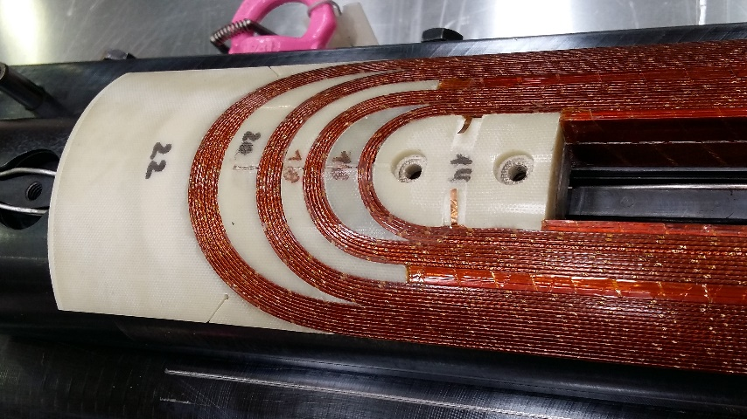
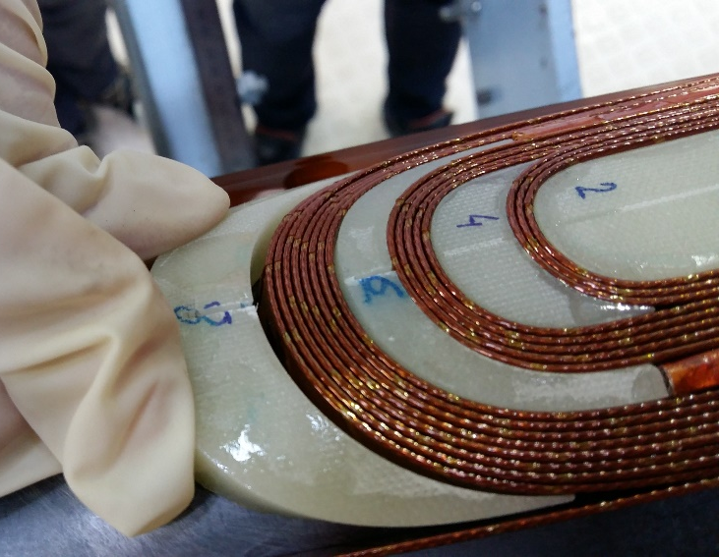
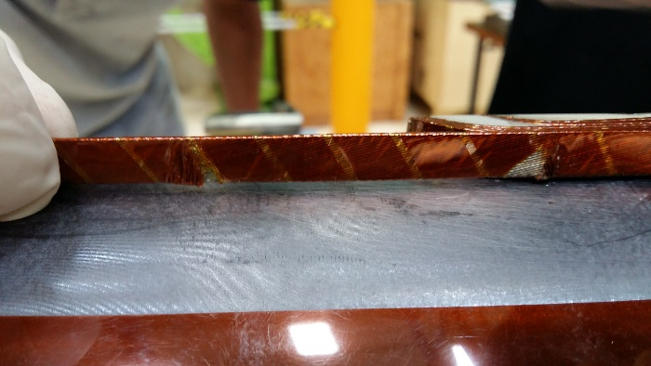
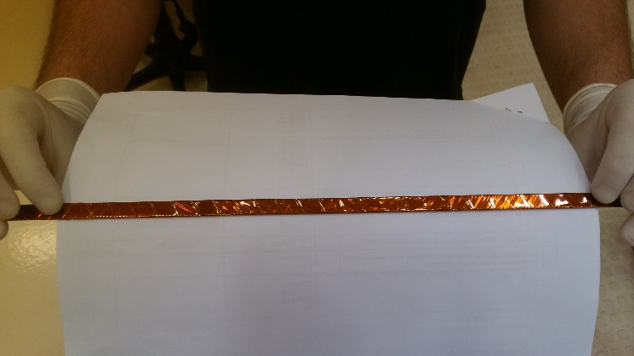
Coil 1
Vtaps:
  narrower CuSn₆ flags and SnAg solder
  Grooves added in the end part
Slit in some of the spacers, filled with G10 pieces before polymerization
Finalization of procedures for insulation of angular wedges
Coil 1
Coil 1

Slide 16
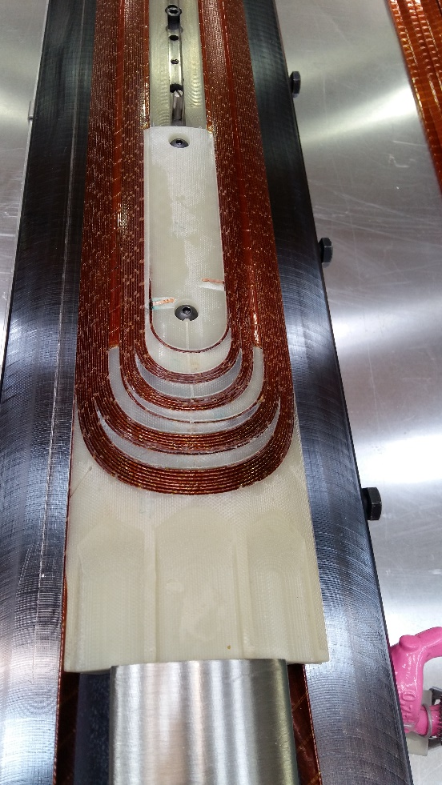
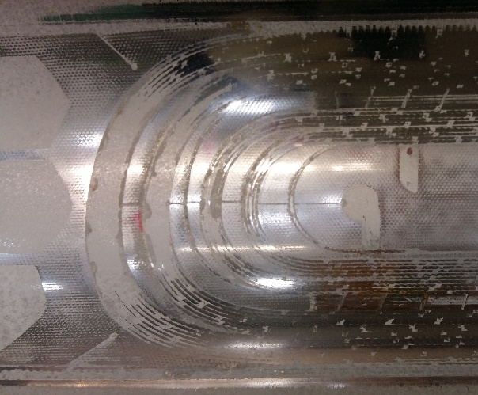
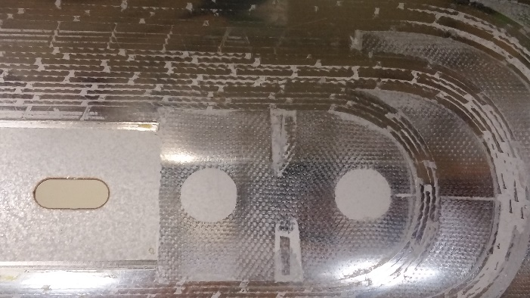
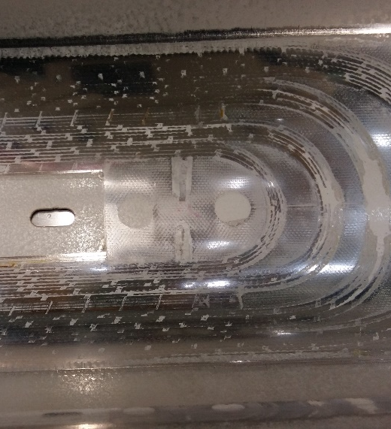
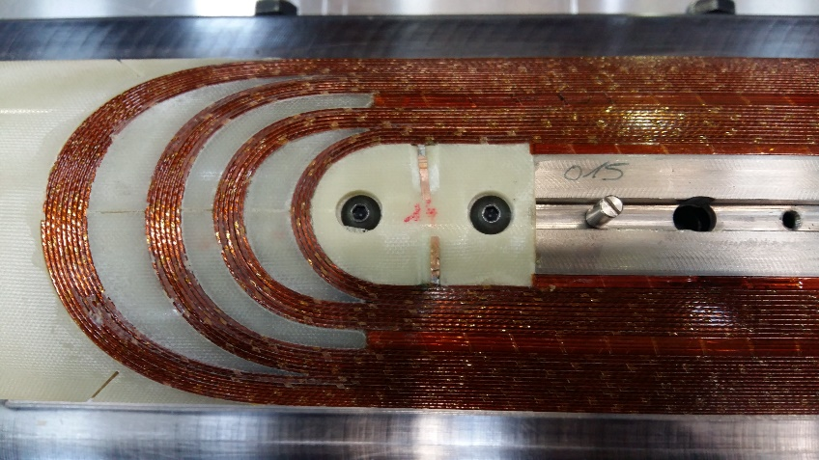
Coil 2 to 3
=> MQYYM
Coil 2
No major issue during coil fabrication of coil 2 and 3
Concern on vtap flags: grooves are not deep enough => some compression of the taps
Coil 2
Coil 3
OK
Coil 3
Coil 3
NOT OK

Slide 17
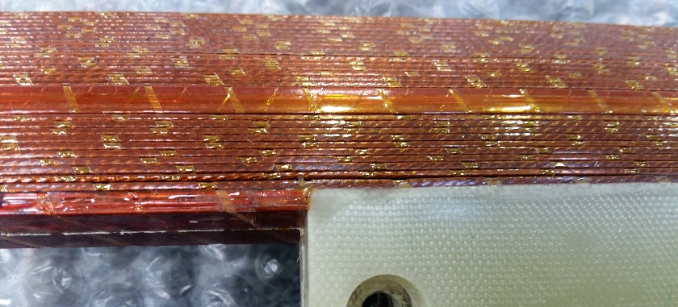
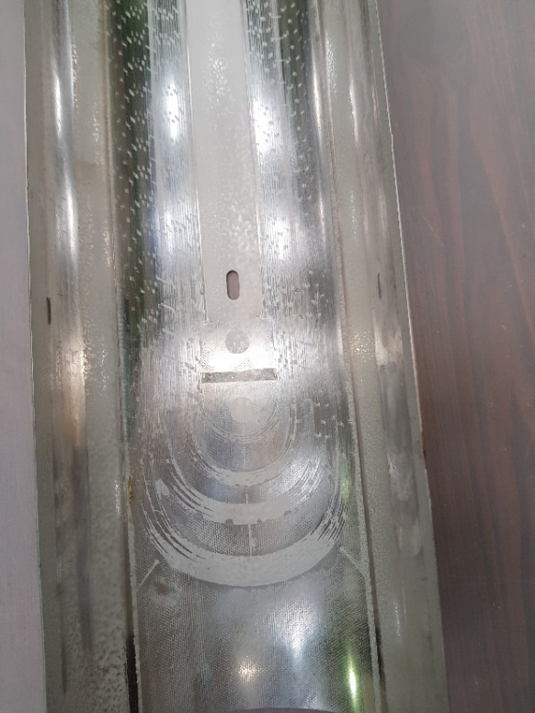
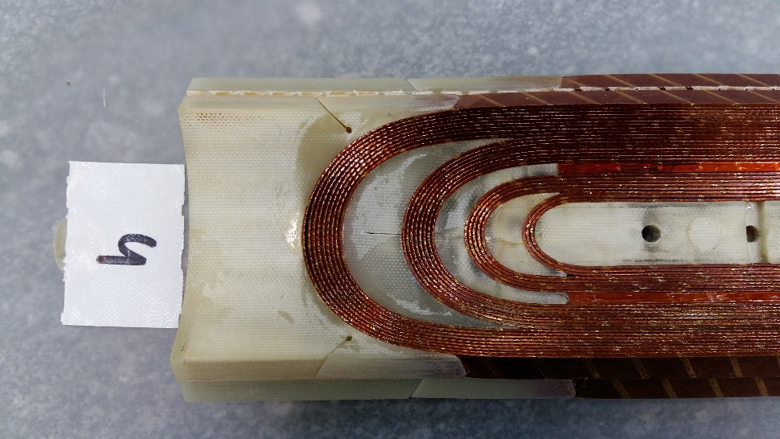

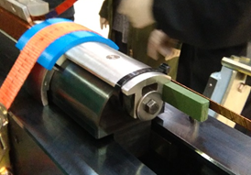
Coil 4
Vtaps/endpart groove problem solved
But :
Unglued turn on the outer layer => adhesive missing? Unexpected cleaning?
Gap in the last but one turn in the RE IL
Repair: Filling the area with resin is considered but of concern
Change of process: Release of the end pusher after press top plate positionning and before mandrel release
OK

Slide 18
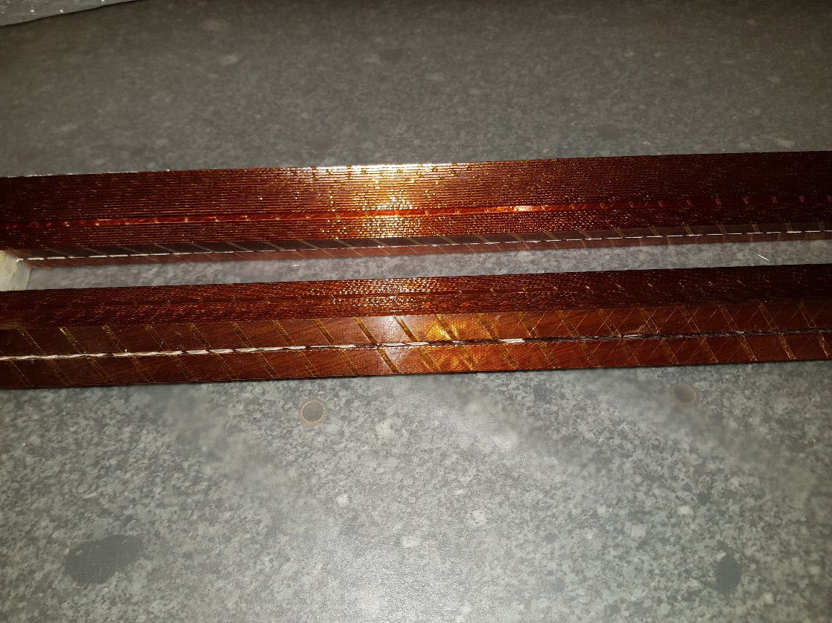
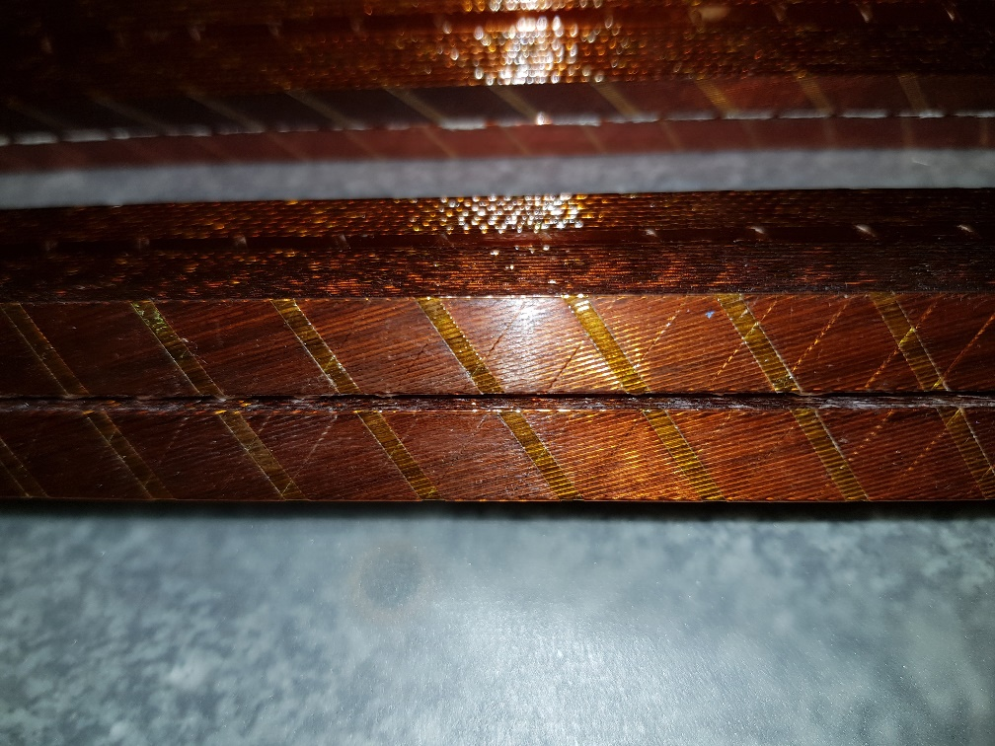
Coil 5
Issue encountered after the curing of the external layer
Uneventful winding
But damage of the interlayer insulation after fabrication during the cuting of the insulation

Slide 19
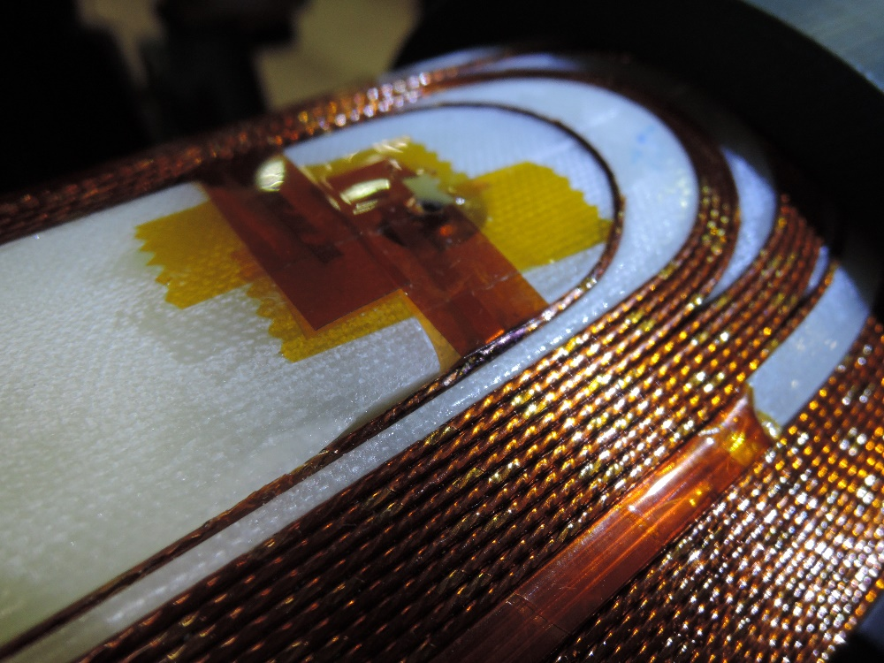
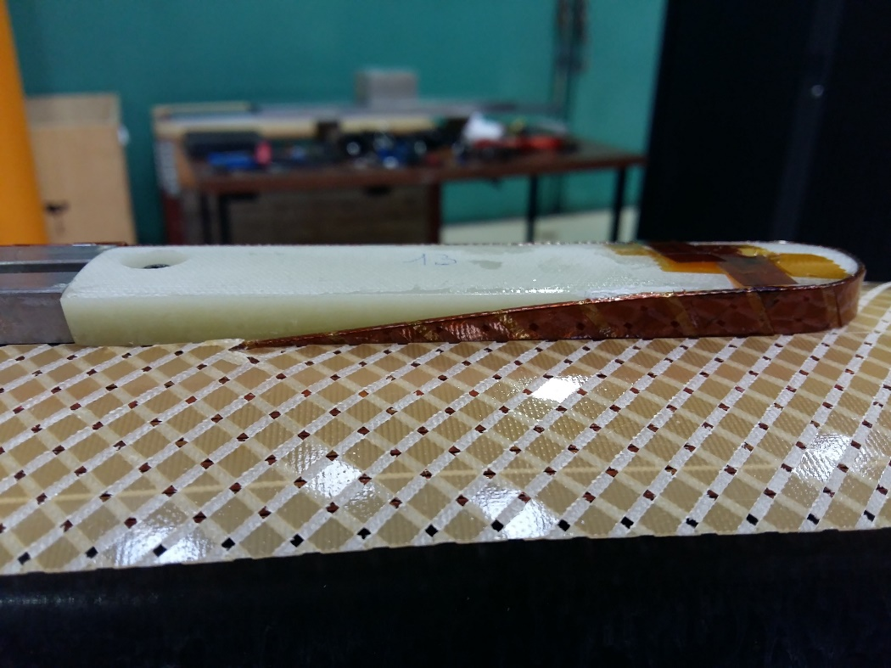


Coil 6
Issue encountered before curing of the external layer
Unwinding
Filing of the pole piece
Top part and groove to match the already formed layer jump
Damaged insulation
Layer jump is mispositionned
G11 seems weakened locally
At QA step: notice an issue with the layer jump
Decision to unwind layer 2
Damaged insulation repaired and layer rewound
Curing ongoing

Slide 20



Coil 7
Issue encountered after the IL curing sheet removal:
Weld failure and pinched kapton
Imprint of the block on the coil end part and on the wedge
Missing Kapton matching the weld failure
Imprint also seen in
Coil 1 and subsequent coils
without insulation damage

Slide 21


Slide 22


