Slide 1

Test results MCBXFBP1
First cold test of prototype with single dipole
G. Willering
M. Bajko, V. Desbiolles, K. Pepitone
F. Toral, J.C. Perez
Mechanical measurements reported separately: J. C. Perez, M. Guinchard and S. Emami Naini
Magnetic measurement results reported separately: L. Fiscarelli
TE-MSC-TF SM18 magnet test facility

Slide 2
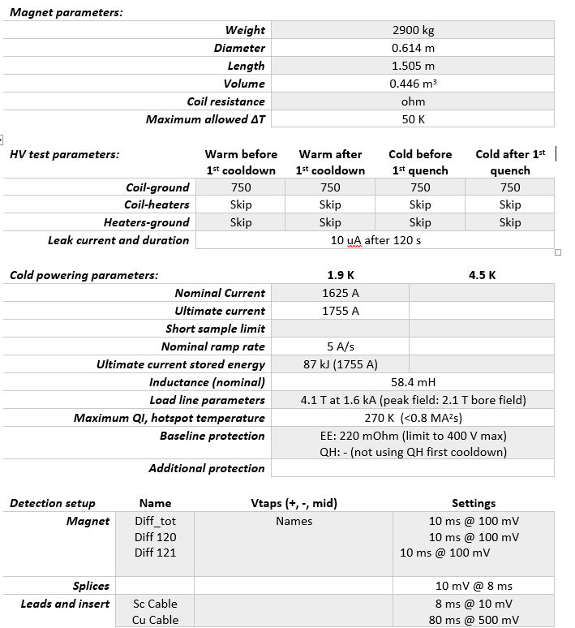
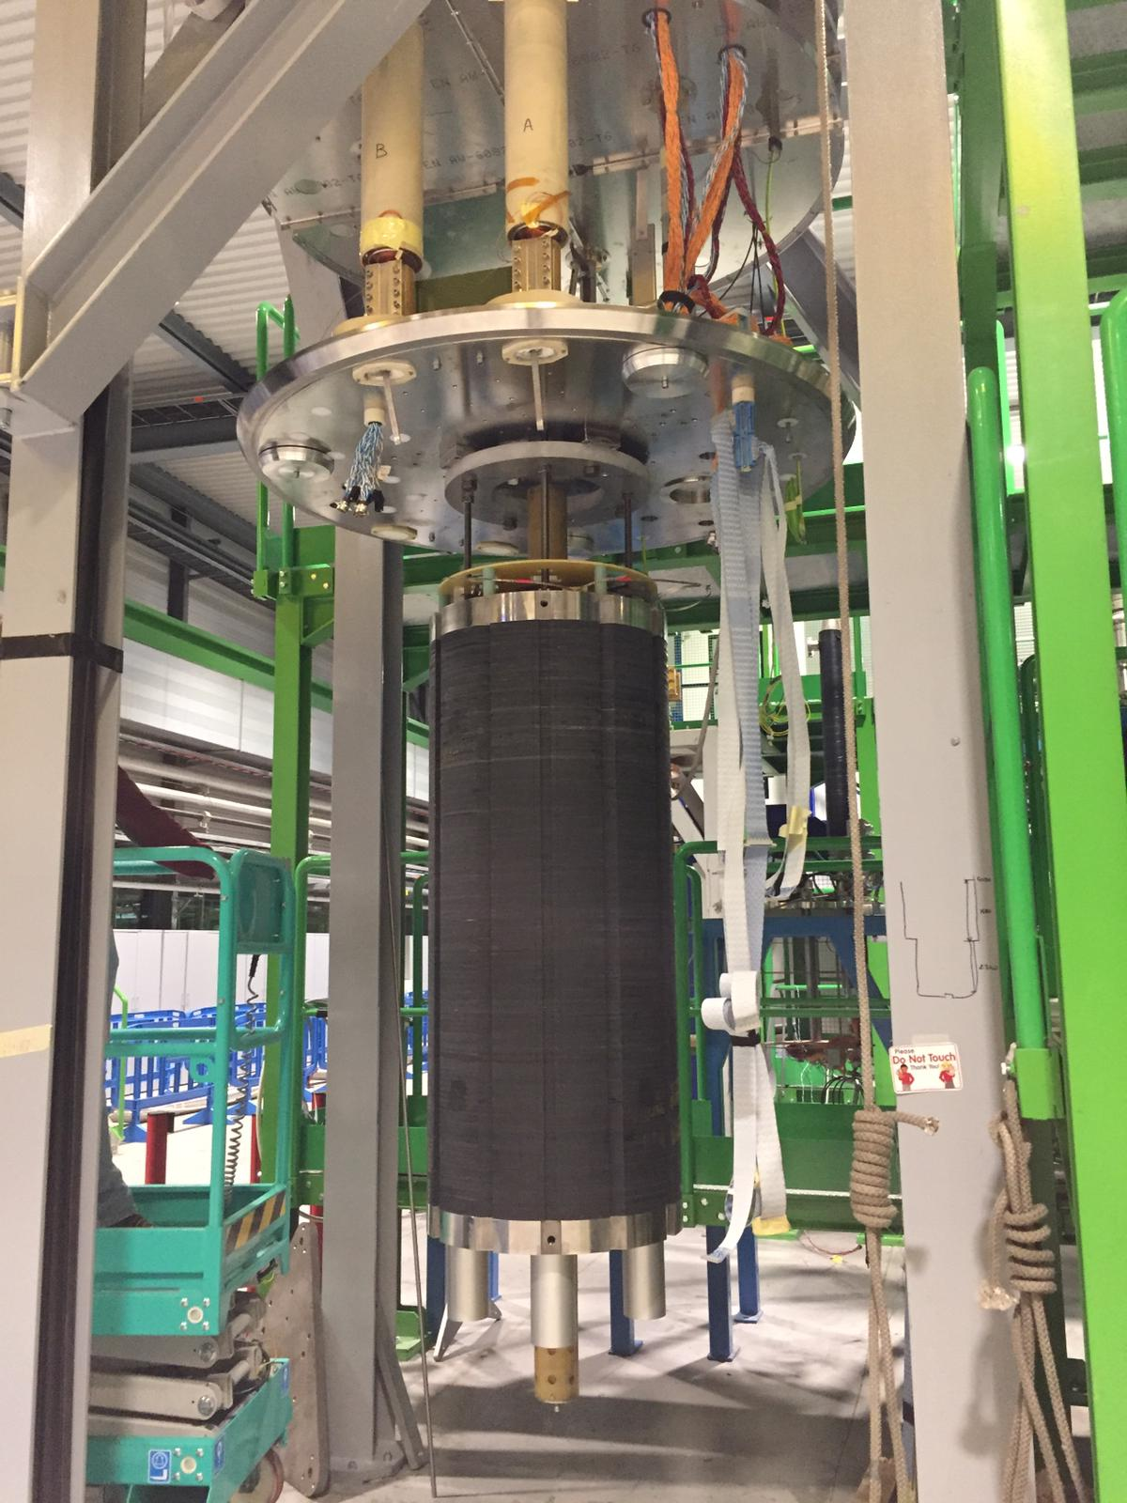
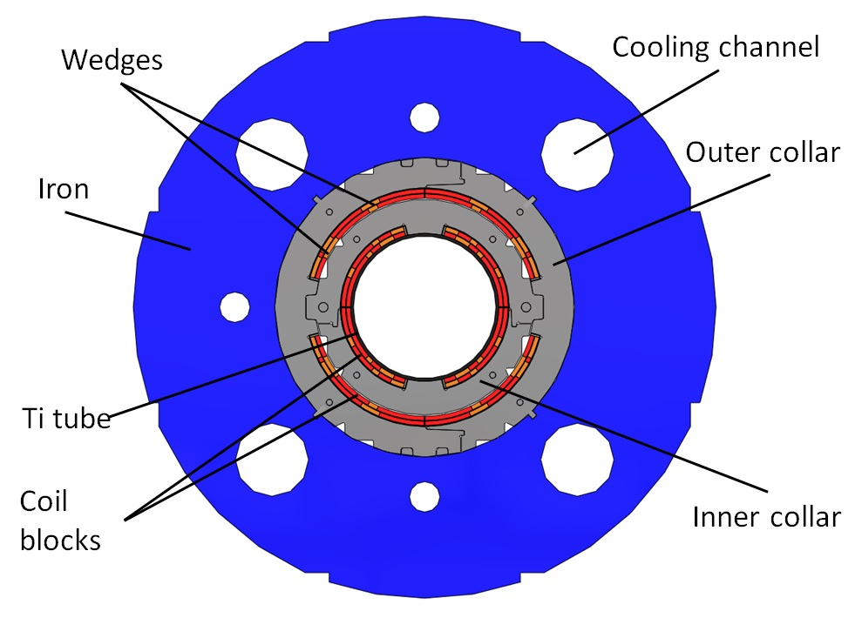
Test program and parameters
Test program outlined in EDMS 2058288
Only the inner dipole exists for this prototype. Outer dipole will be placed in second phase.

Slide 3
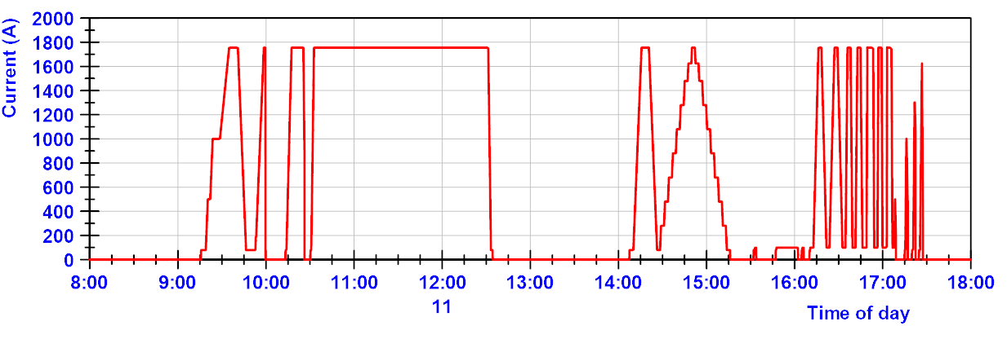
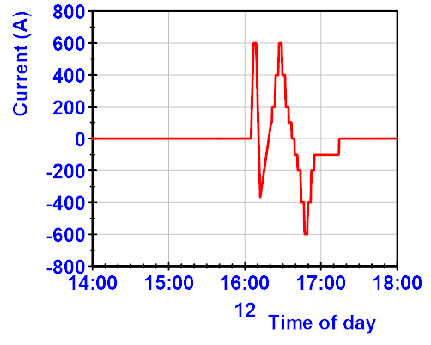
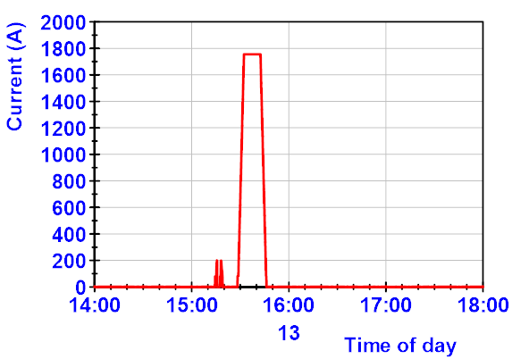
Test overview
Day 1 at 1.9 K
AC loss up to 100 A/s
No quench
EE
2 hour endurance at 1755 A
Magnetic measurements+ splice
EE at 1 kA, 1.3 kA and 1.625 kA
Stepwise powering
Day 2 at 1.9 K
Day 3 at 4.5 K
Magnetic measurements -600 A to + 600 A
Ramp to nominal current, staying for 10 minutes.

Slide 4
Powering results overview
0 quench were recorded throughout the tests: Very good result
Ramp rates:
At 1.9 K to 1755 A no quench at 2 A/s to 100 A/s (8 A/s gives similar ramp time at for the current MCBX in the LHC)
Endurance test
At 1.9 K at 1755 A for 2 hours, no quench
At 4.5 K (1.9 K is nominal):
Ramp at 8 A/s to 1755 A, stay for 10 minutes, no quench.

Slide 5
HV insulation test
All tests were performed to maximum 750 V and only between coil and ground.
Before cooldown in air OK
At 1.9 K in superfluid helium before powering tests OK
At 4.5 K after the powering tests OK

Slide 6
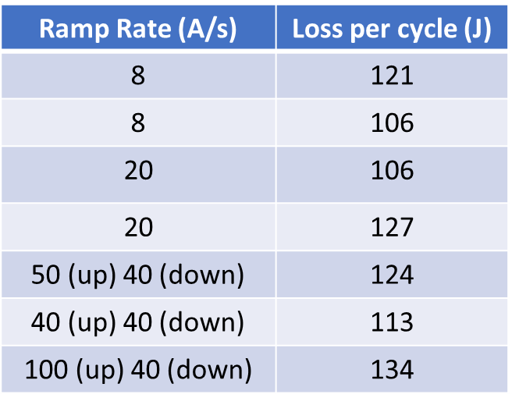
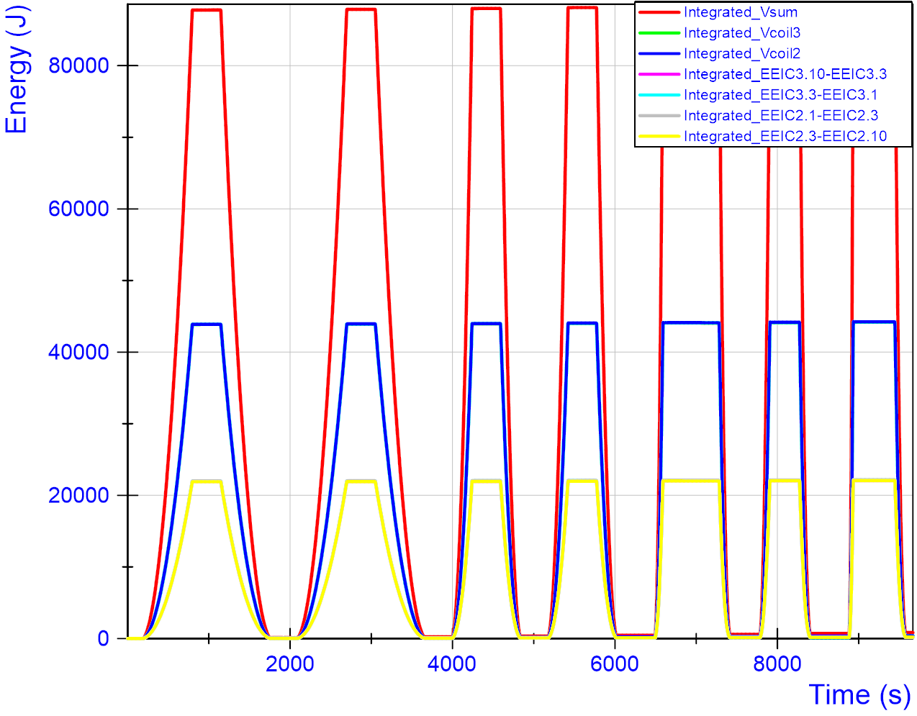
AC loss
AC loss cycles from 100 A to 1755 A.
Loss per cycle between 100 and 134 J in the full aperture.

Slide 7
Quench Heaters
Quench heaters are placed on the coil, but they have not been powered. They were also excluded from HV insulation test this cool down.

Slide 8
Splices
Only for the inter coil splice the resistance could be measured: 1.4 nΩ.
Other segments with spices included the coil, adding too much noise for a clear measurement. We can only quantify: splice resistances do not exceed 10 nΩ.
Also all splices were stable during the 2 hour continuous current powering.

Slide 9
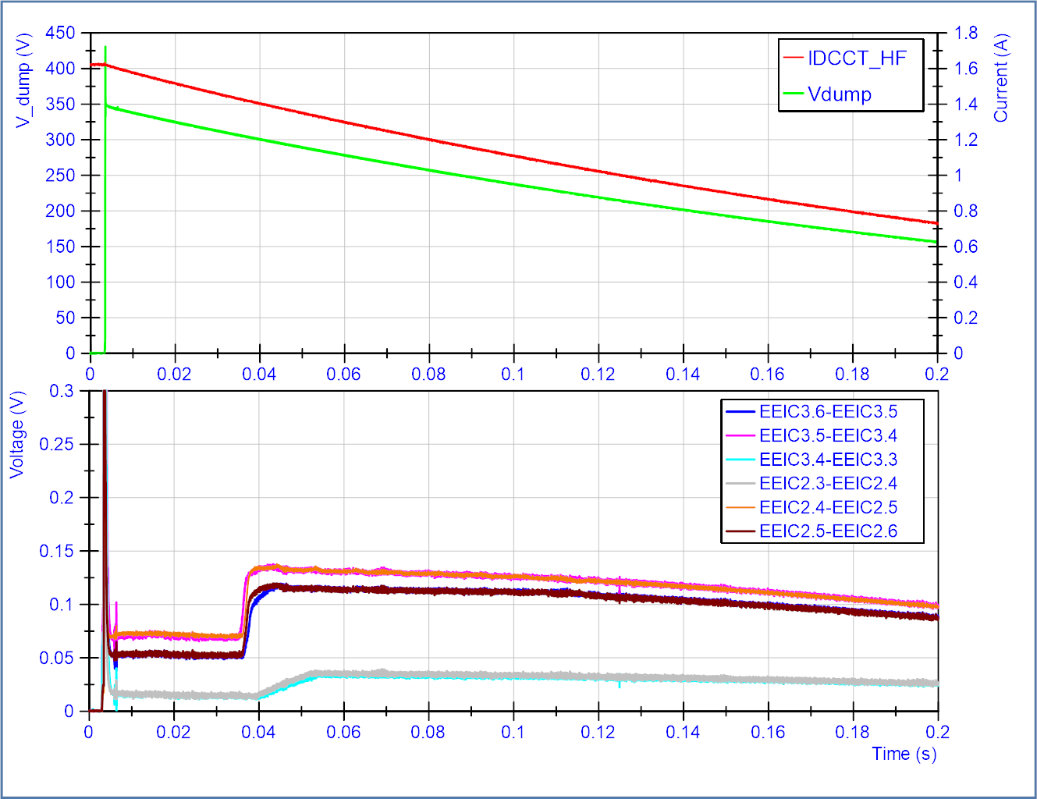
Quench back start
Following energy extraction (220 mOhm), quench back occurs.
Usefull for loss calculation validations.
The time for quench back start between the different short voltage segments is rather consistent and symmetric between coil 2 and 3.
Quench back
start time
These data are taken to provide input for possible calculations. Quench back is not in the required specifications for protection of the magnet.

Slide 10
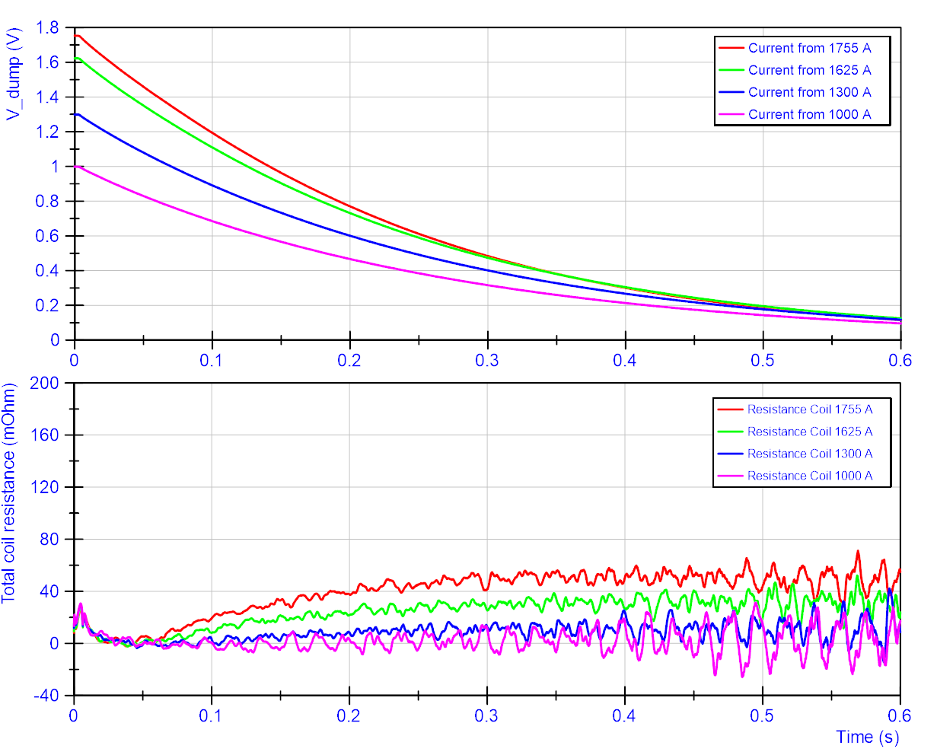
Resistance growth in coil due to quench back
In this configuration, the total resistance in the coil due to quench back is reaching about 50 mOhm during a discharge from 1755 A with an energy extraction resistance of 220 mOhm at 1.9 K.
At 1 kA no resistance is built up (consistent with the lack of quench back shown in the previous slide)
These data are taken to provide input for possible calculations. Quench back is not in the required specifications for protection of the magnet.

Slide 11
Conclusion
Magnet reached ultimate current without quench
  At both 1.9 K as at 4.5 K
  At high ramp rates up to 100 A/s
  Stable operation for 2 hours at ultimate current proven
Other aspects:
  Splices OK
  QH not verified
  Insulation test coil-ground OK (still at 750 V)
The magnet has not seen thermal gradients due to quench
Some data on AC loss and quench back is gathered for feedback
To be reported later
Mechanical measurements structural analysis
Magnetic measurement results

